Slide 1

SMART INDIA HACKATHON 2026
FleetMesh
Local coordination for
warehouse robot fleets
Problem Statement ID: 26123
Edge-AI Based Distributed Fleet Coordination for
Autonomous Mobile Robots (AMRs) in Smart Warehouses
Theme: Smart Automation
PS Category: Software
Team ID: [Enter registered ID]
Team Name: [Enter registered team name]
Notes:
FleetMesh 1.3.0. Replace the registered Team ID and Team Name before submission. The project name is FleetMesh and must not be confused with the team's registered name. Opening (25 seconds): Warehouse robots share narrow routes. FleetMesh gives each robot its own planner and a peer permission protocol. We have built a complete local software simulation with an operator console, live disturbances, recorded replay and inspectable results. Today we will show actual robot processes and what happens when the route or communication changes. The prototype runs on laptops. It is not yet a physical warehouse deployment. Source: supplied SIH 2026 PS 26123 screenshots and official presentation template.
Cloud validation, 15 September 2026: Render https://fleetmesh-api.onrender.com/app uses Neon production branch br-purple-pine-b3gbko9x. Vercel deployment was submitted but its returned URLs require provider authentication; public Vercel flow remains unverified. Browser run 4613e511f5b74c5482b80be6165d8d55 completed seven missions at 198.3 simulated seconds with zero detected collisions. Screenshot shows this actual run. Results apply only to finite simulation checks. The supervisor supplies ideal localization, clock, physics, proximity sensing and job announcements. Hardware deployment remains future work. Retained 160-run benchmark is historical, not a new hosted benchmark. Team name and registered ID still require completion.

Slide 2
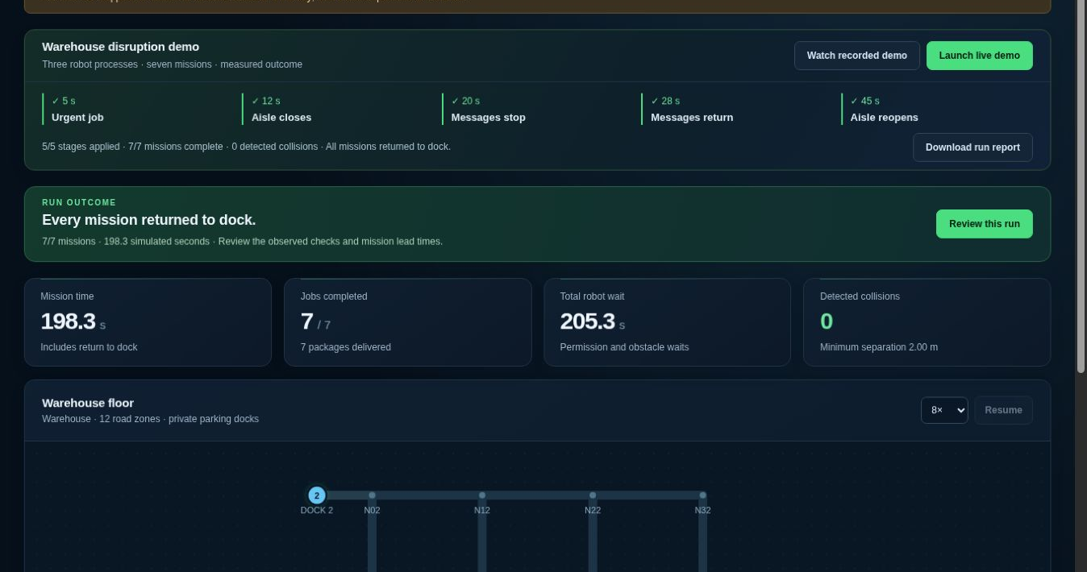
FLEETMESH
[Team
name]
Proposed Solution
Robots agree before shared routes overlap
Hosted result: three independent robot processes
Detailed explanation of the proposed solution
Each robot owns its planner.
Peers share intent and grant routes.
How it addresses the problem
Release cleared zones early.
Replan or wait at blocked aisles.
Innovation and uniqueness of the solution
7/7 missions in 198.3 s. Zero detected collisions.
Inspect decisions. Replay and review.
Notes:
Solution (35 seconds): Robots negotiate mission ownership, share intent and obtain peer permissions before entering shared road zones. As a robot clears its final use of a zone, it releases it. If an aisle blocks its route, it replans through an owned retreat when possible or waits for reopening. This is not a claim of first-ever decentralized coordination. Our product contribution is an inspectable implementation with fault injection, saved evidence and a complete operator workflow. The editable floor schematic shows actual ProcessRuntime state at 20.0 simulated seconds, warehouse map, seed 200, three workers and six jobs with the fixed rule. R1 and R2 wait for permissions; R3 moves toward pickup. This is recorded simulator data, not a screenshot or proof of simultaneous movement. Source: evidence/pitch_snapshot.json.
Cloud validation, 15 September 2026: Render https://fleetmesh-api.onrender.com/app uses Neon production branch br-purple-pine-b3gbko9x. Vercel deployment was submitted but its returned URLs require provider authentication; public Vercel flow remains unverified. Browser run 4613e511f5b74c5482b80be6165d8d55 completed seven missions at 198.3 simulated seconds with zero detected collisions. Screenshot shows this actual run. Results apply only to finite simulation checks. The supervisor supplies ideal localization, clock, physics, proximity sensing and job announcements. Hardware deployment remains future work. Retained 160-run benchmark is historical, not a new hosted benchmark. Team name and registered ID still require completion.

Slide 3
TECHNICAL APPROACH
[Team
name]
Methodology and process for implementation
Each robot plans locally. Peers agree on access.
Direct peer
messages
Technologies to be used
Robot 1
Planner + gate
Robot 2
Planner + gate
Render: Python/UDP + Neon history
Vercel: frontend access pending
Position, intent, grants
01
Bid for jobs
Robot 3
Planner + gate
Agree on pickup ownership.
02
Plan the route
Local regression or fixed route costs.
03
Reserve and move
Shared simulator: clock, pose and physics.
Three workers on one Render instance.
Peer grants, then release clear zones.
Notes:
Technical approach (40 seconds): Three to six independent operating-system processes exchange HMAC-authenticated UDP messages over loopback. Every process owns its planner, mission ledger and permission gate. Per-job auctions allocate unpicked work. Transfers freeze pickup until all peers acknowledge a new owner; picked cargo retains its owner. The supervisor supplies ideal simulated physics, a common clock, local observations and job announcements, but does not plan routes or grant access. The dashboard records state in SQLite. A small local ridge-regression model predicts waiting costs. The fixed rule stays the default because it performs better in most of our current benchmark means. These are laptop processes, not separate edge boards. Source: agent.py, transport.py, simulation.py and model.json. Foundation: Ricart and Agrawala, https://doi.org/10.1145/358527.358537 .
Cloud validation, 15 September 2026: Render https://fleetmesh-api.onrender.com/app uses Neon production branch br-purple-pine-b3gbko9x. Vercel deployment was submitted but its returned URLs require provider authentication; public Vercel flow remains unverified. Browser run 4613e511f5b74c5482b80be6165d8d55 completed seven missions at 198.3 simulated seconds with zero detected collisions. Screenshot shows this actual run. Results apply only to finite simulation checks. The supervisor supplies ideal localization, clock, physics, proximity sensing and job announcements. Hardware deployment remains future work. Retained 160-run benchmark is historical, not a new hosted benchmark. Team name and registered ID still require completion.

Slide 4
FEASIBILITY AND VIABILITY
[Team
name]
Analysis of the feasibility of the idea
3–6
160
0
independent robot processes
historical benchmark runs
detected collisions in those runs
Potential challenges and risks | Strategies for overcoming these challenges
Failed peer can halt progress | Now: retain owned zones. Next: verified restart recovery.
Idealized sensing and motion | Next: edge-board tests, braking trials and noisy sensing.
Predictor trails the fixed rule | Now: fixed rule by default. Next: independent AI tests.
51 system tests pass. Hosted runs save to Neon. Physical AMR validation remains future work.
Notes:
Feasibility (35 seconds): The unchanged development benchmark has 160 completed runs and zero detected collisions. The 1.3 system suite passes 26 tests and the HTTP/UI harness passes 34 checks. Six additional 1.2 process audit cases completed 81 jobs across three, four and six workers without detected collisions. Keep these three kinds of evidence separate. The UI harness uses minimal DOM/canvas stubs with a real HTTP backend, not full browser visual testing. The robot protocol is unchanged from the previous audit. A failed peer retains held zones and can halt progress. We do not expire occupied space on a timer. Next work: safe restart membership, three edge boards, braking/localization trials and an independently defined performance workload. Sources: evidence/tests.txt, ui_http_checks.json, runtime_audit.json, summary.json. No hardware or real Wi-Fi validation has been performed.
Cloud validation, 15 September 2026: Render https://fleetmesh-api.onrender.com/app uses Neon production branch br-purple-pine-b3gbko9x. Vercel deployment was submitted but its returned URLs require provider authentication; public Vercel flow remains unverified. Browser run 4613e511f5b74c5482b80be6165d8d55 completed seven missions at 198.3 simulated seconds with zero detected collisions. Screenshot shows this actual run. Results apply only to finite simulation checks. The supervisor supplies ideal localization, clock, physics, proximity sensing and job announcements. Hardware deployment remains future work. Retained 160-run benchmark is historical, not a new hosted benchmark. Team name and registered ID still require completion.

Slide 5
IMPACT AND BENEFITS
[Team
name]
Potential impact on the target audience
For AMR manufacturers and warehouse integrators
Pilot offer: one warehouse map, then three AMRs. Revenue: integration + support.
Benefits of the solution
25.2%
Fixed rule (default)
Learned delay
less time in extended congestion
26.0%
less time with loss and delay
Both vs the included sequential baseline. 8 runs per bar. Return to dock included.
20% target met in 2 of 5 means. The fixed rule is faster in 4 of 5 scenario averages.
Notes:
Impact (40 seconds): The proposed first customer is an AMR manufacturer or warehouse integrator. Begin with a partner-defined map and workload, then a supervised three-AMR pilot. Integration and support are proposed revenue sources, not measured demand or existing sales. Chart: fixed-rule and learned-delay percentage reductions against the same included sequential baseline, eight paired development seeds in each of five cohorts. Fixed-rule benefits round to 25.2% in extended congestion and 26.0% under injected loss/delay. The predictor's corresponding values are 24.3% and 26.1%. Both reach the 20% target in only two of five cohort means. The fixed rule is faster in four of five. Baseline-to-enhanced differences combine coordination and routing changes; they do not isolate the AI contribution. Mission time includes return to dock. Maps are synthetic, localization ideal, and the baseline conservative. We do not claim superiority over MiR, OTTO or Open-RMF. Sources: evidence/benchmark.csv and summary.json, https://mobile-industrial-robots.com/products/software/mir-fleet , https://ottomotors.com/autonomy/ .
Cloud validation, 15 September 2026: Render https://fleetmesh-api.onrender.com/app uses Neon production branch br-purple-pine-b3gbko9x. Vercel deployment was submitted but its returned URLs require provider authentication; public Vercel flow remains unverified. Browser run 4613e511f5b74c5482b80be6165d8d55 completed seven missions at 198.3 simulated seconds with zero detected collisions. Screenshot shows this actual run. Results apply only to finite simulation checks. The supervisor supplies ideal localization, clock, physics, proximity sensing and job announcements. Hardware deployment remains future work. Retained 160-run benchmark is historical, not a new hosted benchmark. Team name and registered ID still require completion.

Slide 6
RESEARCH AND REFERENCES
[Team
name]
Details / Links of the reference and research work
01 Problem statement
04 Existing fleet products
SIH 2026, PS 26123
Requirements from the supplied screenshots.
MiR Fleet and OTTO
Fleet coordination already exists commercially.
02 Coordination method
05 Open coordination research
Ricart–Agrawala (1981)
Peer mutual exclusion as the foundation.
Open-RMF traffic management (2026)
A relevant open-source comparison.
03 Safety context
06 Our evidence package
Nav2 Collision Monitor
Physical safety needs hardware validation.
160 historical runs + 51 system tests
Hosted replay and scoped Neon history.
Demo sequence
Urgent job. Closed aisle. Message outage. Recorded recovery.
Notes:
Closing and demo (30 seconds before live walkthrough): The product connects robot decisions with evidence. Launch live demo, select a robot to inspect its reason and route, then use Present. At t=5 an urgent job arrives, t=12 a clear aisle closes, t=20 messages stop, t=28 return, and t=45 the aisle reopens. Outcomes come from the agents. After completion open Run review and the report. For backup select Watch recorded demo, which is clearly labelled and uses an included v1.1 capture: seven completed missions, 198.4 simulated seconds, two route recoveries and one ownership transfer. It is a known demonstration, not a new benchmark. P toggles presentation view and Escape exits it. Ask for support to validate on three edge-controlled AMRs. Research context: https://docs.ros.org/en/ros2_packages/jazzy/api/nav2_collision_monitor/__README.html ; https://discourse.openrobotics.org/t/next-gen-open-rmf-traffic-management/57646 . Winner lessons: MathWorks-verified Solar Masters pairs simulation, hardware and monitoring in https://drive.google.com/file/d/1j2UZkoPTj_1MH4cUCnO_BDQAO8DpbKCn/view ; officially listed SIH 2023 Team Vizion shares its workflow and submission in https://github.com/uzibytes/KnitKraft . These informed demonstration clarity and evidence, not a guarantee of selection. Full linked research is bundled in FleetMesh_SIH_Winner_Research.pdf.
Cloud validation, 15 September 2026: Render https://fleetmesh-api.onrender.com/app uses Neon production branch br-purple-pine-b3gbko9x. Vercel deployment was submitted but its returned URLs require provider authentication; public Vercel flow remains unverified. Browser run 4613e511f5b74c5482b80be6165d8d55 completed seven missions at 198.3 simulated seconds with zero detected collisions. Screenshot shows this actual run. Results apply only to finite simulation checks. The supervisor supplies ideal localization, clock, physics, proximity sensing and job announcements. Hardware deployment remains future work. Retained 160-run benchmark is historical, not a new hosted benchmark. Team name and registered ID still require completion.

