Slide 1
Books Gallery
and
Career Site
A.GANESH-180030038
P.PRAVALLIKA SAI-180030041
(Batch No - 310)

Slide 2
Nowadays everyone is being educated, but the main problem is not getting proper resources to educate and choose their path, behind that there are many websites which include paid resources even though they get paid, they are taking credentials from the users. So, by making open source every educator can access all items in an efficient way they can build their career by transforming this into an open source idea.

Slide 3
ContenTs:
INTRODUCTION
PROBLEM STATEMENT
ANALYSIS OF EXISTING WORK
IMPLEMENTATION
EXPERIMENTAL RESULTS
CONCLUSION

Slide 4
Introduction

Slide 5
As technology gets increasing day by day, there is no difference in ages using the network beyond the limits. But coming to villages they are using some website platforms just as a way of usage and using the requirements without getting total information regarding platforms. To avoid that usage a thought which is to get all the resources for free without aiming for any information from the user

Slide 6
Problem Statement

Slide 7
A Design going to be made by using tool figma that the design must be very clear, while delivered to the user with a web application. where users can access & use it freely without any much more thinking on it, where they can freely download all pdfs standard which they belong to.

Slide 8
Analysis Of Existing Work

Slide 9
Nowadays as developers and creators are more they are developing themselves design, code and delivering the application in the market with paid subscription. No One is providing freely with proper content in it. The main problem in paid subscription is they are not updating the requirements on change always using regular content and converting into money. People are not looking into it what inside happening before they taken paid subscription

Slide 10
Implementation

Slide 11
The overall design will be in the form of an Web application which can easily be accessed over internet users after the delivery of an application. It is going to state each & every operation while usage of an application will be in clear format without any disturbance in usage of an application.

Slide 12
Experimental Results

Slide 13
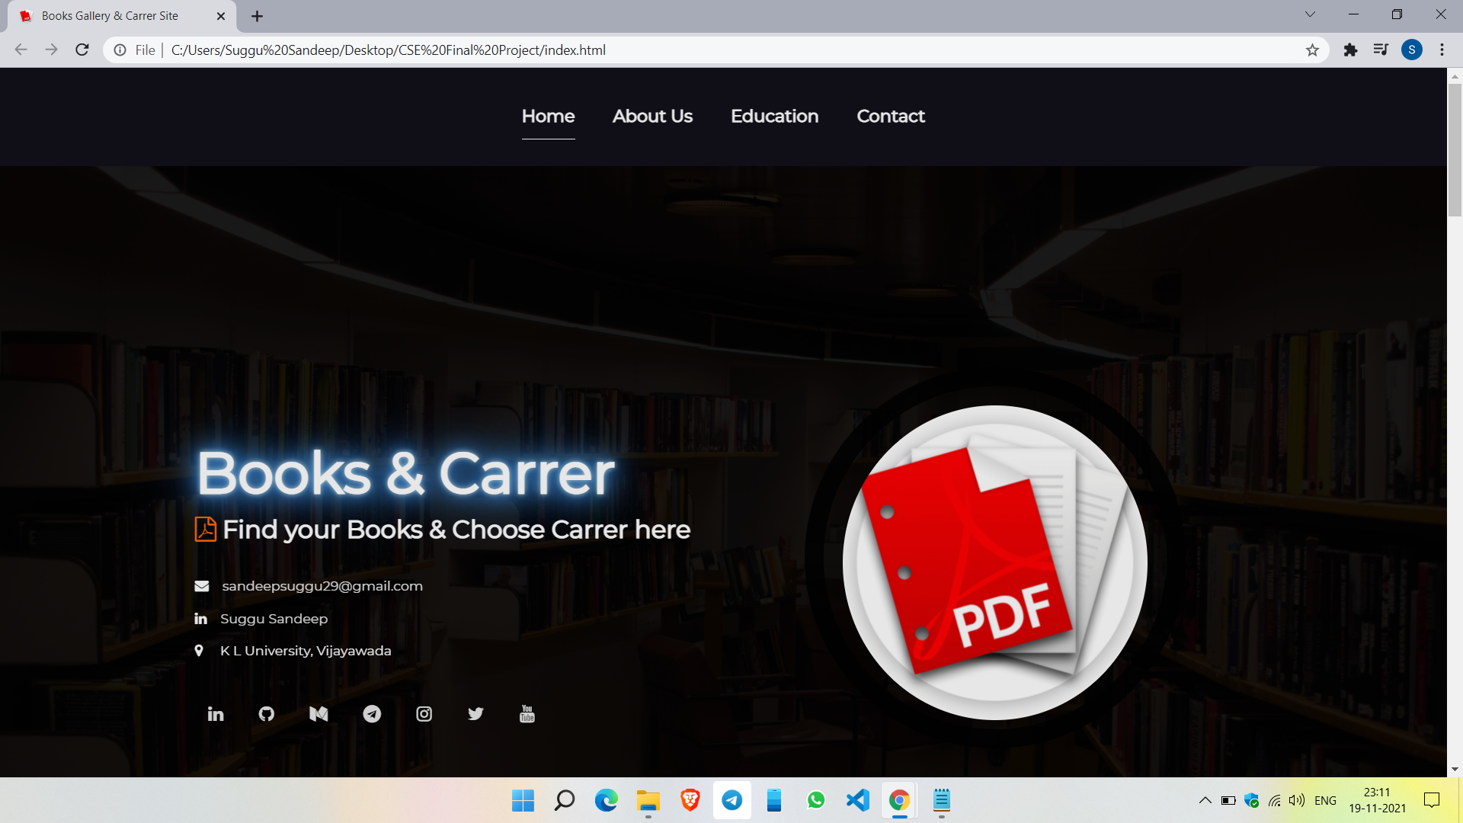

Slide 14
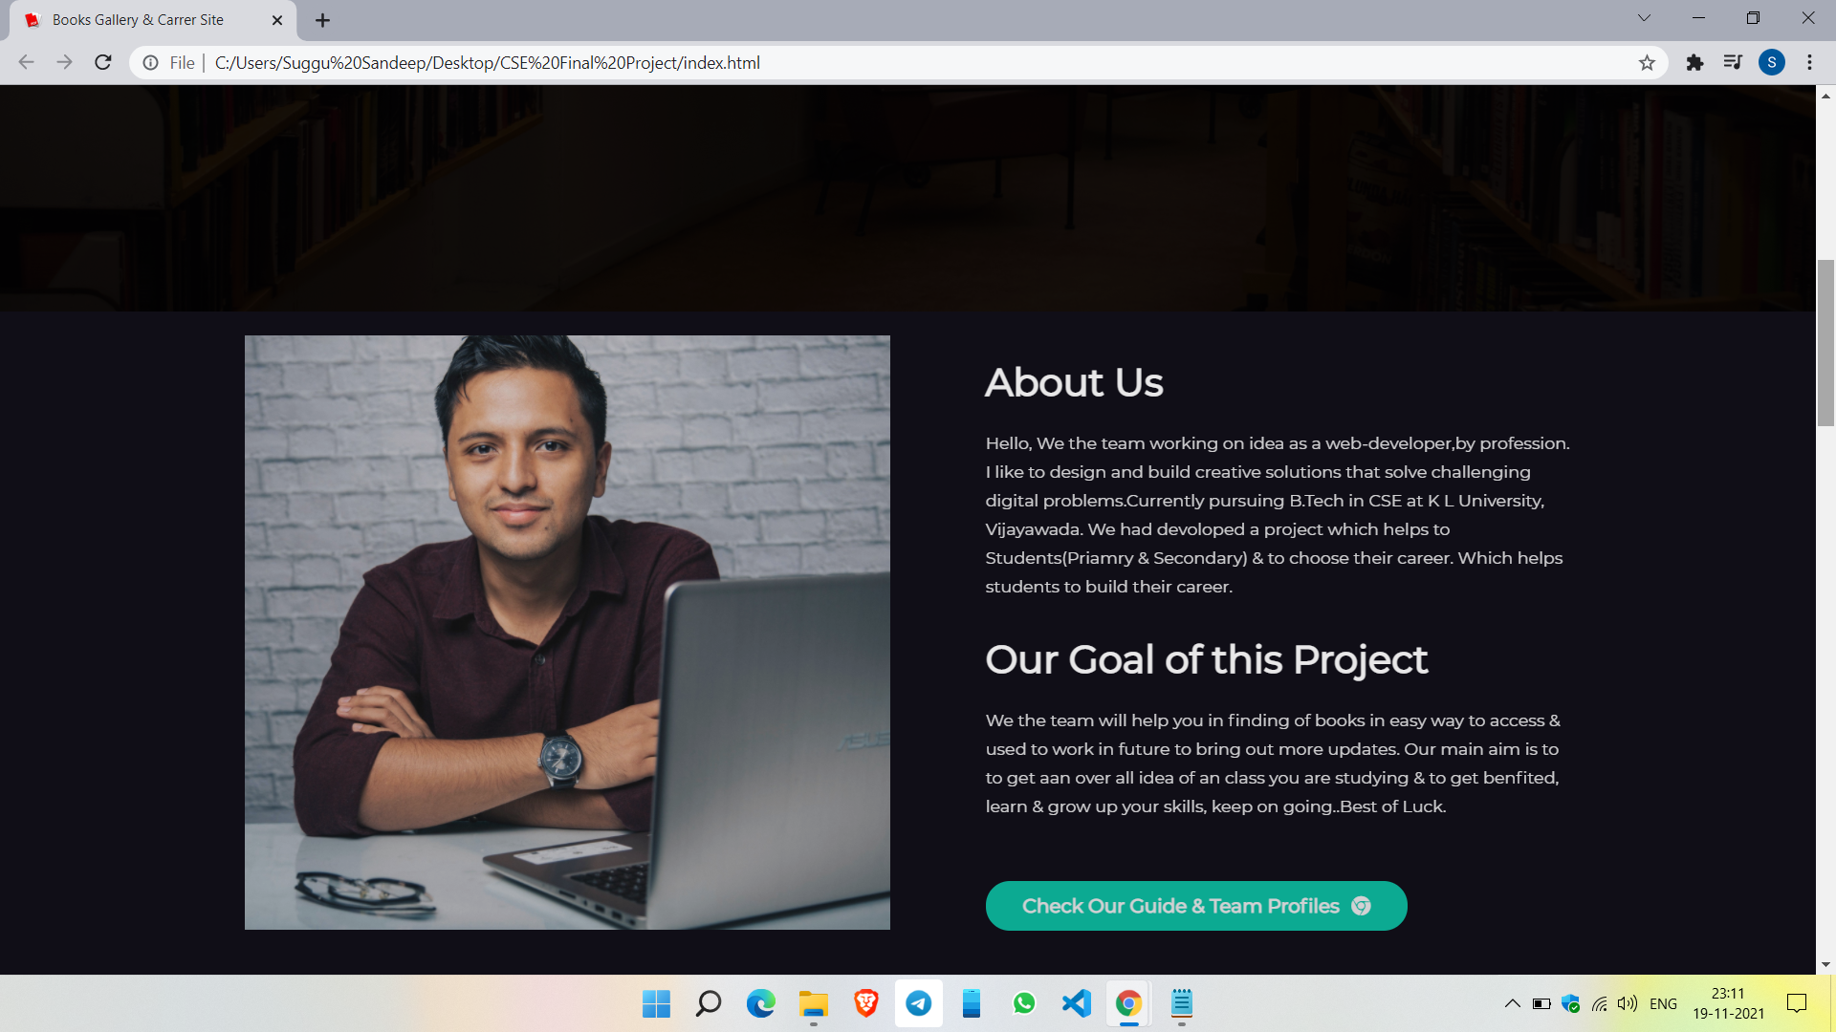

Slide 15
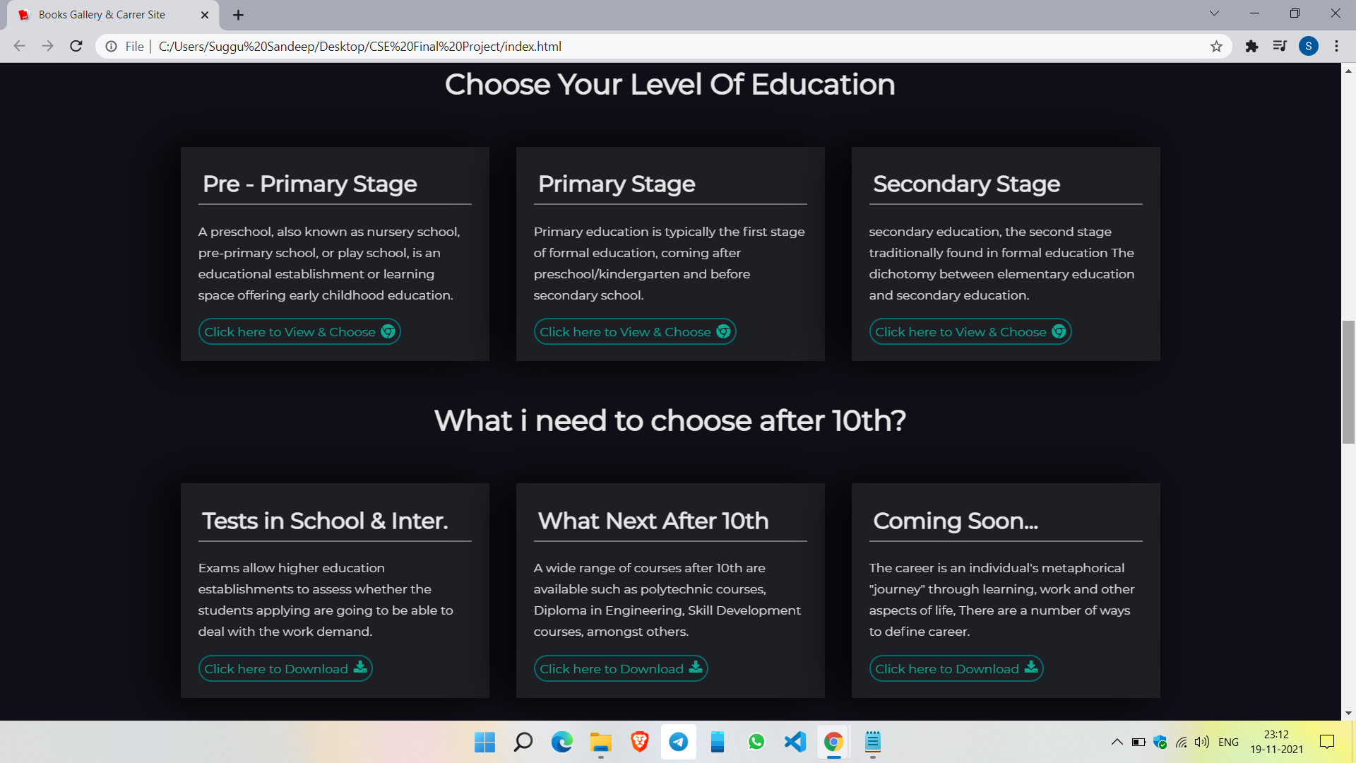

Slide 16
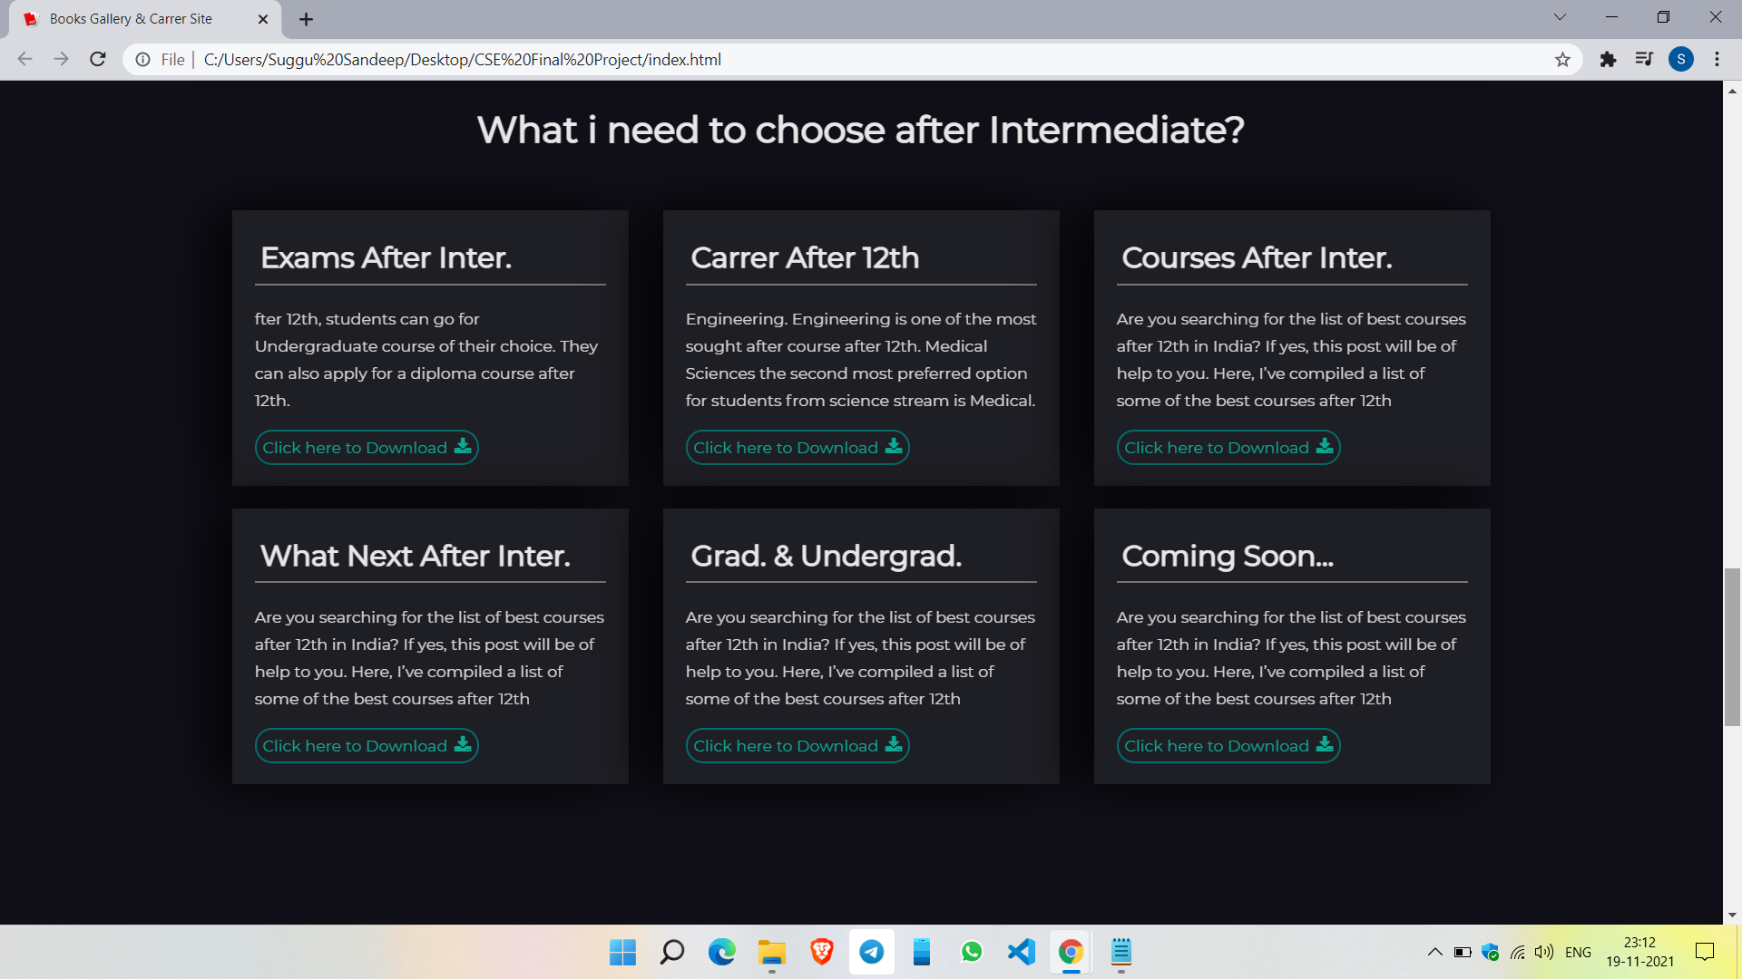

Slide 17
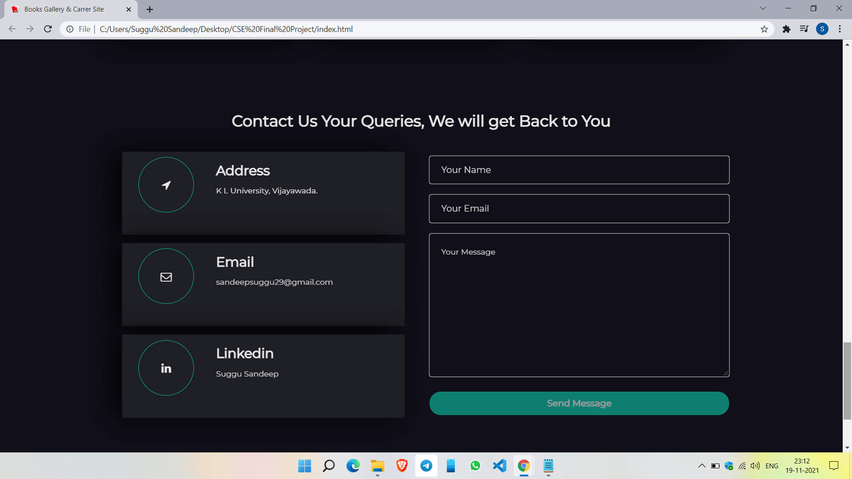

Slide 18
Big concept
Bring the attention of audience over a key concept

Slide 19
Conclusion

Slide 20
The idea of the design is going to perform any operations to the user while usage of an application. Design which facilitates the ideal way of thinking for the user. It going to give output needed for the user without any disturbance while in usage of application. No authentication is needed, everything is free and open source.

Slide 21
They can download the books which they want at free cost. The Design which is especially made with different variations in colors that enables the user to look and feel strikes his mind. More Over so many users(Educators) will get benefited from this Books Gallery Application, that is the best thing which includes more knowledge will be gained by the educators.

Slide 22
it's important to focus on your career aspirations,
plan for the future and consider any suggestions
that can help propel
your advancement in your chosen field.
Doing this can help you better prepare and ensure
you're ready for any professional opportunities.

Slide 23
Thank You

