Slide 1

Pet-Factor
180030472 – J. Navya sree bhavani
180030861 - M. Sai Valli lakshmi seershika

Slide 2
CONTENTS
ABSTRACT
INTRODUCTION
TOOLS
PERSONA
CUSTOMER JOURNEY MAP
EMPATHY MAP
USER FLOW DIAGRAM
WIREFRAME

Slide 3
CONTENTS
PROTOTYPE
FUTURE COURSE OF ACTION
CONCLUSION
REFERENCES

Slide 4
ABSTRACT
Pet-Factor
Pet care system
UIUX
Persona
CJM
Empathy Map
User flow diagram
Low-Fidelity
High- Fidelity

Slide 5
INTRODUCTION
User Interface: The user interface is a visible group of instructions which makes user interact thoroughly with the app or website that designer has developed for particular work that has to be done.
User Experience: The process by which we determine what that experience will be.

Slide 6
TOOLS
UXPRESSIA
PERSONA
CUSTOMER JOURNEY MAP
EMPATHY MAP
WHIMSICAL
USER FLOW DIAGRAM
WIREFRAME
FIGMA
PROTOTYPE

Slide 7
PERSONA
GOAL DIRECTED PERSONA
ROLE-BASED PERSONA
ENGAGING PERSONA
FICTIONAL PERSONA

Slide 8
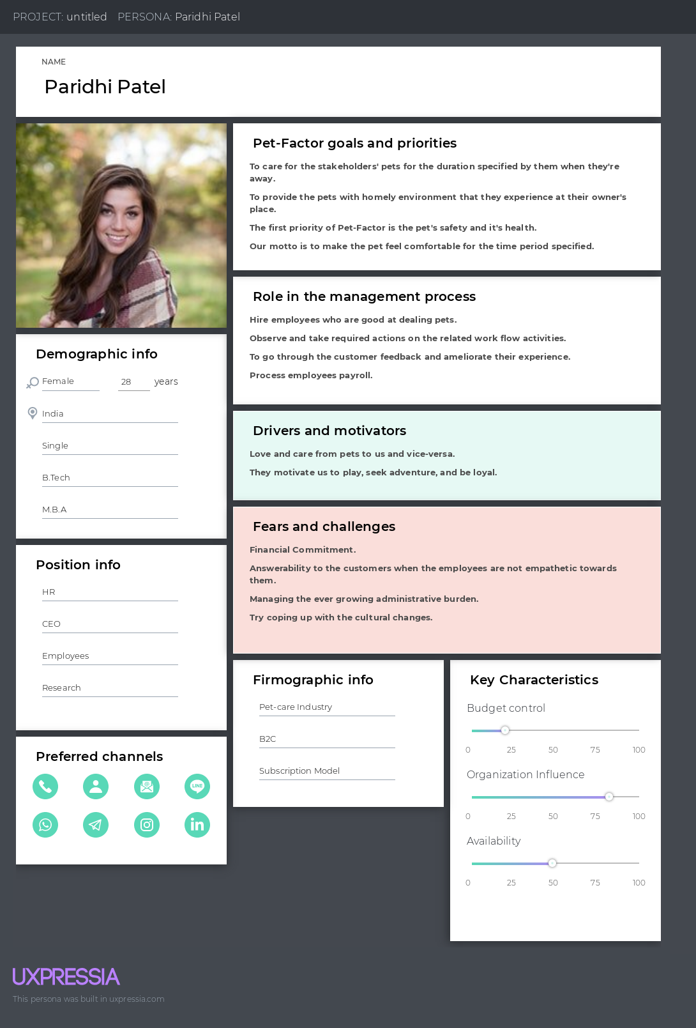
PERSONA

Slide 9
CUSTOMER JOURNEY MAP
1.Nail down your buyer's persona
2. Understand buyer's goals
3. Figure out buyers' touchpoints
4. dentify customers' hassles
5. Prioritize and fix roadblocks 6. Update the information and enhance.

Slide 10
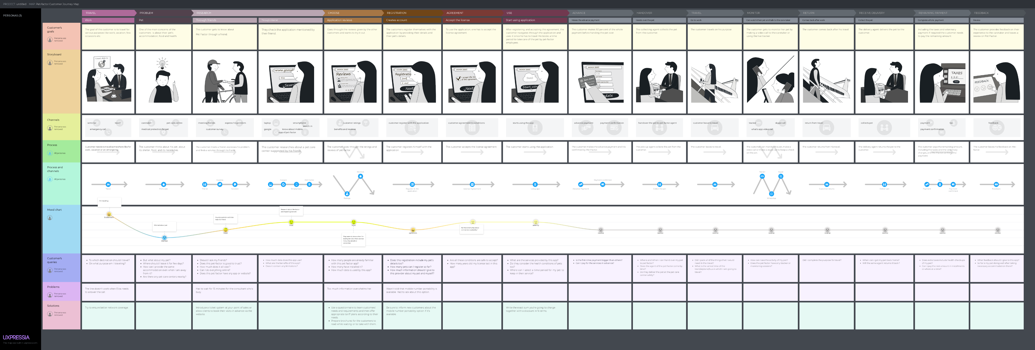
CUSTOMER JOURNEY MAP

Slide 11
EMPATHY MAP
EMPATHIZE WITH CUSTOMERS
EMPATHY
LISTENING SKILLS
OBSERVATION SKILLS

Slide 12
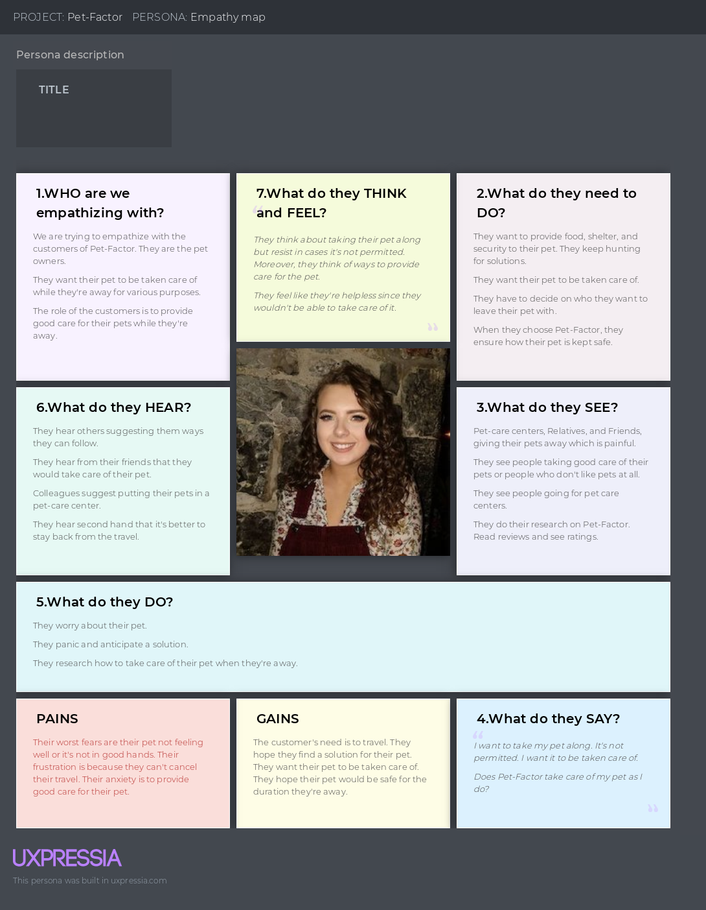
EMPATHY MAP

Slide 13
USER FLOW DIAGRAM
APPLICATION FLOW
SHAPES
WHIMSICAL
WHITEBOARD SKETCHES

Slide 14
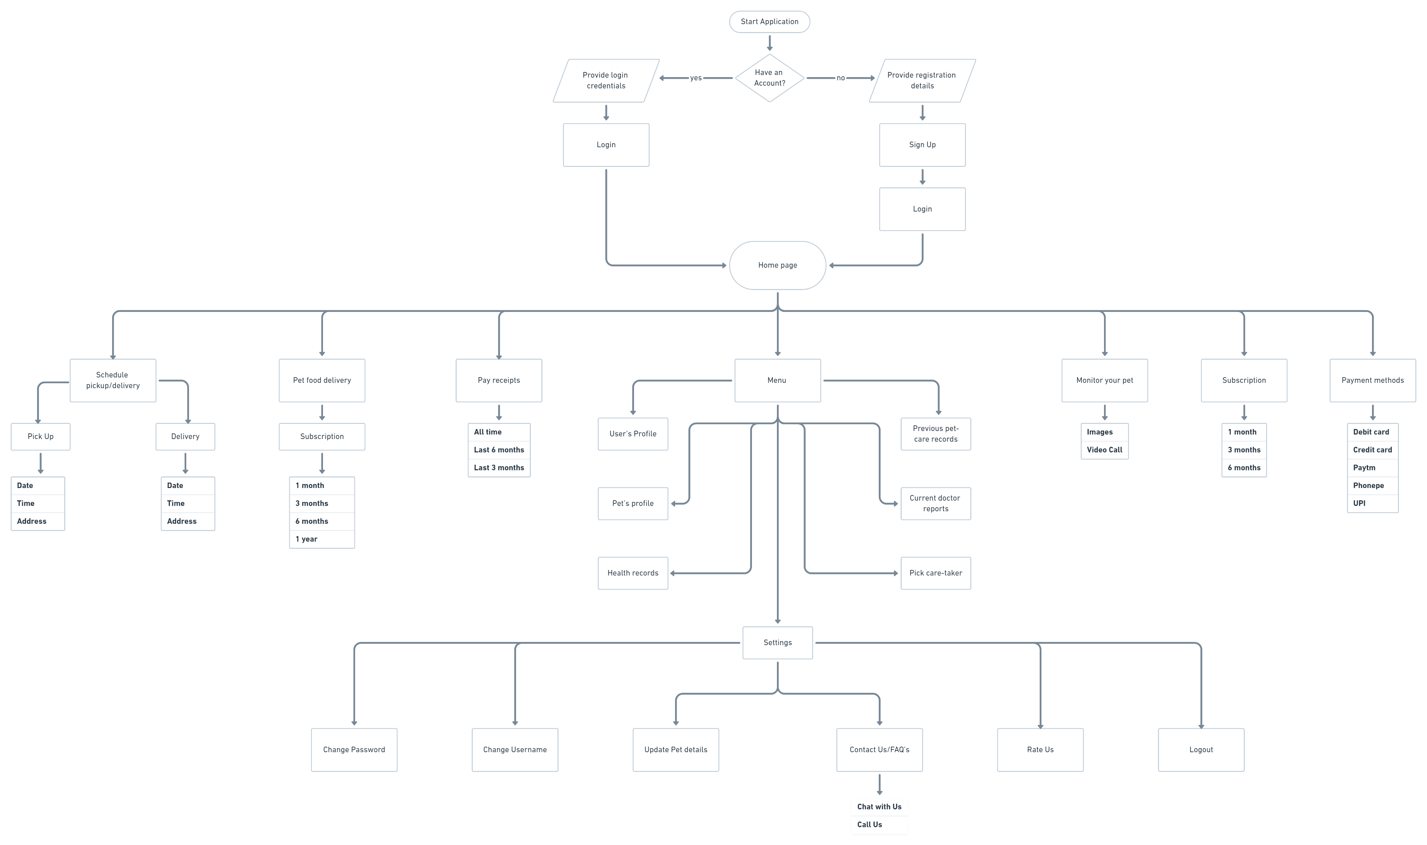
USER FLOW DIAGRAM

Slide 15
WIREFRAME
STRUCTURAL REPRESENTATION
WEBSITE BLUEPRINT
TYPES
LOW-FIDELTY
HIGH-FIDELITY

Slide 16
PROTOTYPE
FINAL PHASE
FIGMA
VECTOR GRAPHICS
WIREFRAMES
PROTOTYPE
PLUGINS
BLEND

Slide 17
FUTURE COURSE OF ACTION
UI/UX design has a great scope in the future as it deals with the design process and the rules of the design which makes the interface easily accessible for the users.
UPI Payment methods and authentication processes
Unique identification number that to be generated for the pet.
Unique identification number generation for each of the complaints raised by the customer.

Slide 18
CONCLUSION
The phases of UIUX methodology have been applied to the Pet-Factor to design the application interface for a pet care center.
The UX rules have been implemented and verified in order make the User Interface easier for the users to access.
The user journey with the application has been figured out using the customer journey mapping and the user has also been empathized with and his flow while using the application has been figured out using user flow diagram.
Finally, the design has been made in the stages of low-fidelity and high-fidelity.

Slide 19
REFERENCES
[1] B. Laurel, “Design Research: Methods and Perspectives”, MA: MIT Press, Cambridge, 2003..
[2] R. Unger, C. Chandler, “A Project Guide to UX Design: For User Experience Designers in the Field or in the Making”, CA: New Riders, Berkeley, 2012.
[3] Seong-Hwan Cho, Seung- Hee Kim, “Suggestion for Collaboration- Based UI/UX Development Model through Risk Analysis” Journal of Information Processing Systems ISSN: 2092-805X Volume 16, No 6 (2020), pp. 1372 - 1390
[4] P. Kashfi, R. Feldt, A. Nilsson, "Integrating UX principles and practices into software development organizations: a case study of influencing events," Journal of Systems and Software, vol. 154, pp. 37-58, 2019.
[5] Hernández-Ramírez, R.: “On the origins and basic aspects of user-centered design and user experience”. In: Ayanoğlu, H., Duarte, E. (eds.) “Emotional Design in Human-Robot Interaction”. HIS, pp. 71–92. Springer, Cham (2019).
[6] Marcus, A.: Color my UX readable. Interactions, 15 March 2013

