Slide 1

Pet-Factor
180030861 - M. Sai Valli lakshmi seershika
180030472 – J. Navya sree bhavani

Slide 2
CONTENTS
ABSTRACT
INTRODUCTION
PERSONA SCREENSHOT
CUSTOMER JOURNEY MAP SCREENSHOT
EMPATHY MAP SCREENSHOT
FUTURE IMPLEMENTATION
CONCLUSION

Slide 3
ABSTRACT
Pet-Factor
Pet care system
UIUX
Persona
CJM
Empathy Map
User flow diagram
Low-Fidelity
High- Fidelity

Slide 4
INTRODUCTION
User Interface: The user interface is a visible group of instructions which makes user interact thoroughly with the app or website that designer has developed for particular work that has to be done.
User Experience: The process by which we determine what that experience will be.

Slide 5
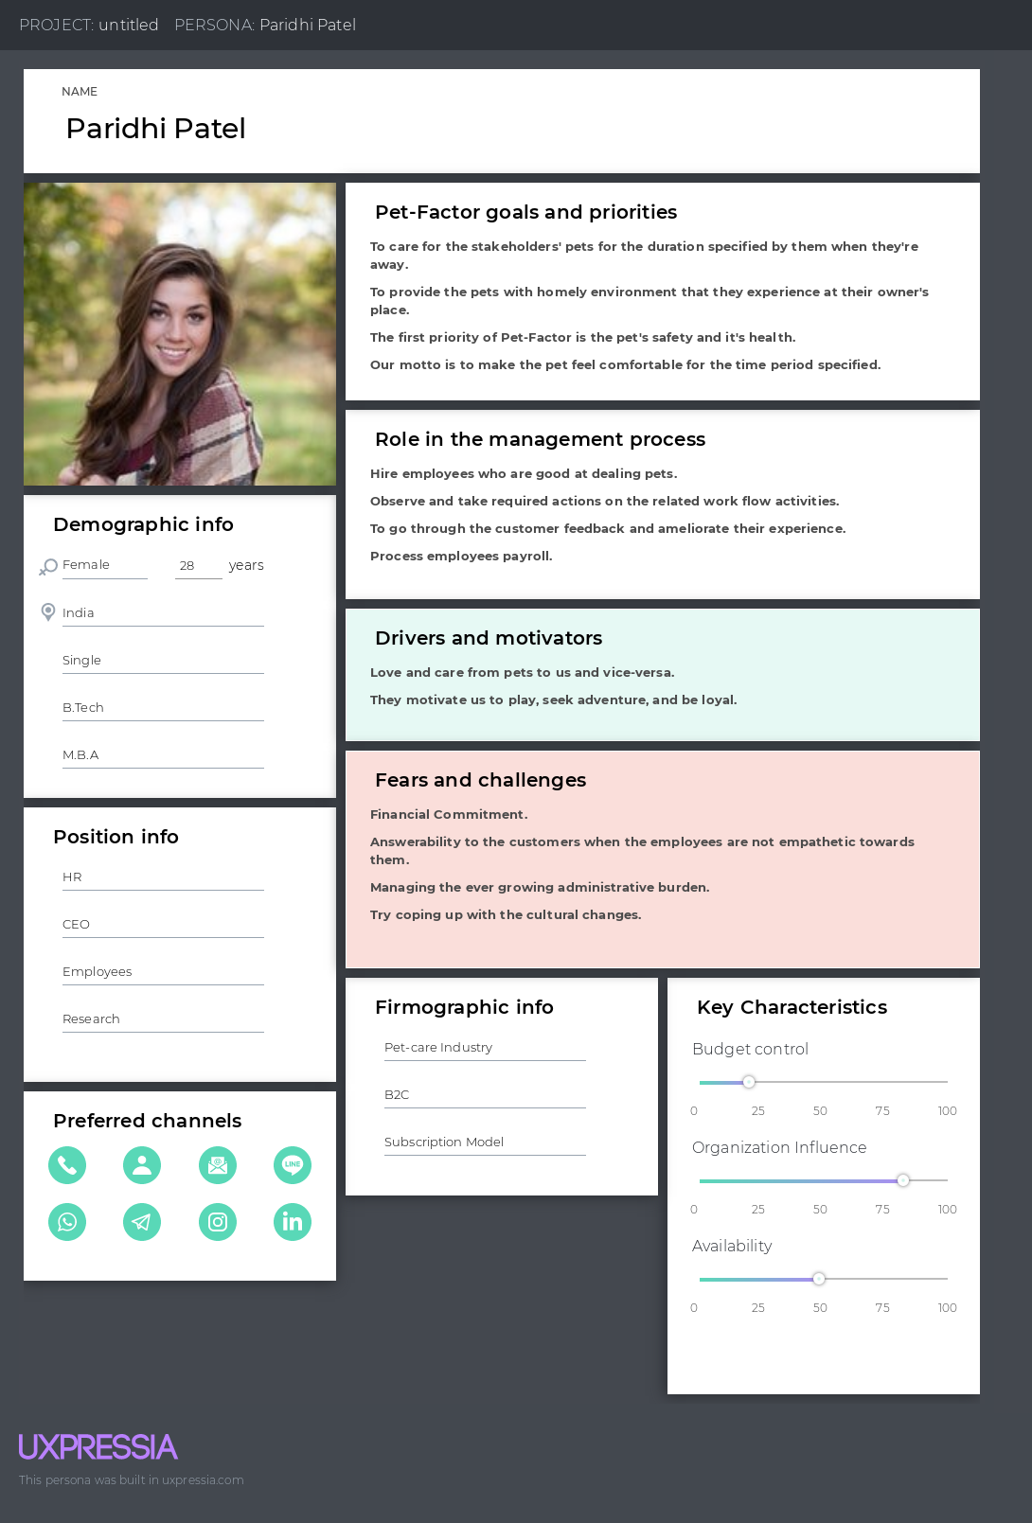
PERSONA

Slide 6
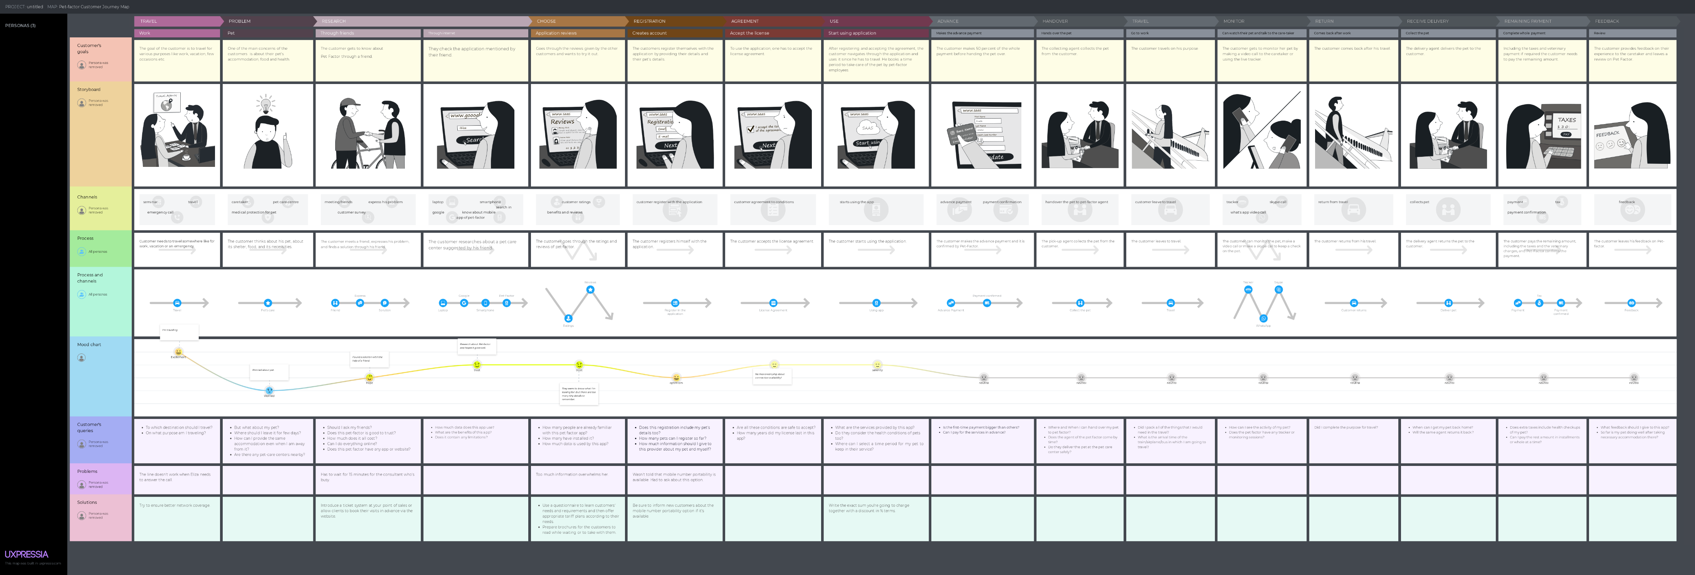
CUSTOMER JOURNEY MAP

Slide 7
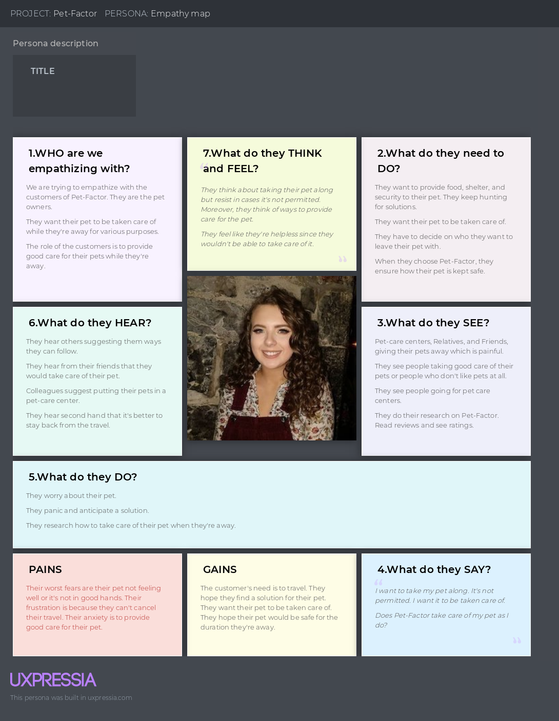
EMPATHY MAP

Slide 8
FUTURE COURSE OF ACTION
UI/UX design has a great scope in the future as it deals with the design process and the rules of the design which makes the interface easily accessible for the users.
Pet-Factor does not consist of any feature to continuously monitor the pet. This can be resolved in the future implementation of the design. It is yet to be made into a mobile application and that has to be included in the future implementation as well.

Slide 9
CONCLUSION
The phases of UIUX methodology have been applied to the Pet-Factor to design the application interface for a pet care center.
The UX rules have been implemented and verified in order make the User Interface easier for the users to access.
The user journey with the application has been figured out using the customer journey mapping and the user has also been empathized with and his flow while using the application has been figured out using user flow diagram.
Finally, the design has been made in the stages of low-fidelity and high-fidelity.

