Slide 1
Origins: The evolution of Modern Languages
With a focus on the spread of the Indo-European language family
Notes:
For my non-technical topic I wanted to discuss one of my favorite subjects: languages, and more specifically, or not so specific, the evolution of language. This is a huge topic, but I’ll try to just give a general overview with some examples to demonstrate my point.

Slide 2
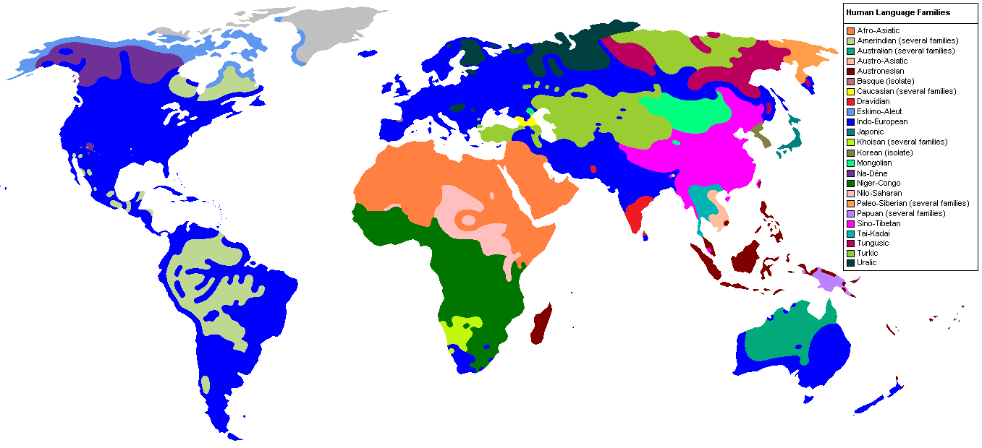
The Language Families
Image taken from http://library--of--babel.blogspot.com/2013/05/historical-linguistics.html
Notes:
This is a map of major language families, or at least generalized groupings of what are thought to be related languages. Of course, some linguists debate over whether some of these families can be combined or if the current families should actually be broken apart.

Slide 3
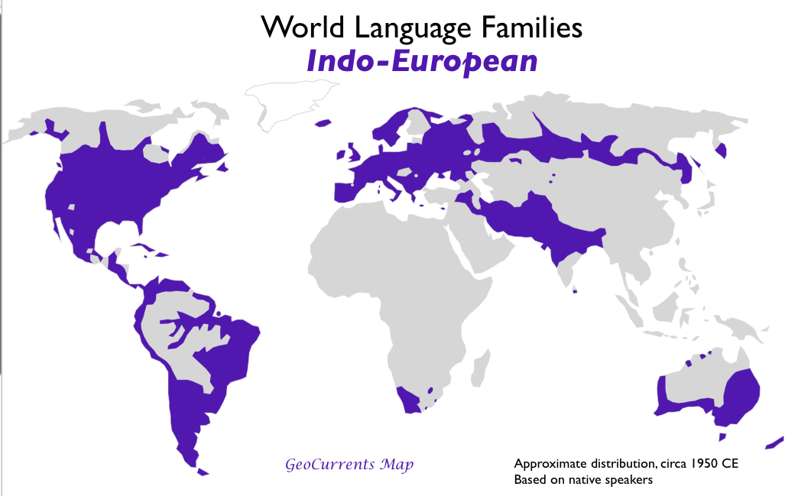
RANGE OF Indo-European Languages today
Image taken from https://abagond.files.wordpress.com/2015/03/indo-european-language-family-map.png
Notes:
I’m only going to focus on the Indo-European language family, for time’s sake, and because I know more specific details about the connections between Indo-European languages. But a lot of other language families have similar connections to the ones I’ll discuss here.

Slide 4
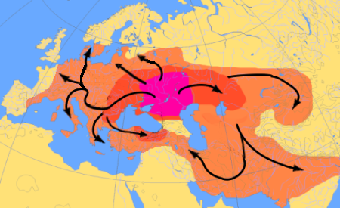
The Expansion of Indo-European
https://en.wikipedia.org/wiki/Indo-European_migrations
Notes:
Many linguists, archaeologists, anthropologists and geneticists have uncovered evidence that Indo-European language spread from the area in red or thereabouts, out to Europe and also through Central Asia to modern day Iran and India. This expansion might have occurred around 4000 BC but some say earlier, and this was made possible when people figured out how to domesticate and ride horses.

Slide 5
How do we know English, Russian, Hindi, FARSI, Latin, (AND OTHERS) are IE Languages?
English | Latin | Norwegian | Russian | Hindi | Farsi
Brother | Frater | Bror | Brat | Bhaee | Baradur
Mother | Mater | Mor | Mat’ | Mata | Madar
Hundred | Centum | Hundre | Sto | Sau | Sad
Year | Anno | År | God | Sal | Sal
One | Unus | En | Odin | Ek | Yek
Two | Duo | To | Dva | Do | Do
Three | Tres | Tre | Tri | Teen | Se
Four | Quattor | Fire | Chetyre | Chaar | Chahar
Five | Quinque | Fem | Pyat’ | Panj | Panj
Thou | Tu | Du | Ty | To | To
Notes:
How do we know these languages are related? Well we can’t look at the originator of what we call Indo-European languages, but we can look for patterns. If we compare words from different languages with the same or similar meanings, and we see that they have a similar root, or similar consonant patterns, and related sounds within those consonant patterns, we could demonstrate how the sounds shifted while the basic original proto-Indo-European root remains the same.
Here are six languages from different (and fairly distant) branches of the Indo-European language family, We can’t see patterns or a common root across all words for all these languages, but we do see overlap between the word for “brother” in almost all of the languages here, as well as the words for “two” and the archaic English “thou”

Slide 6
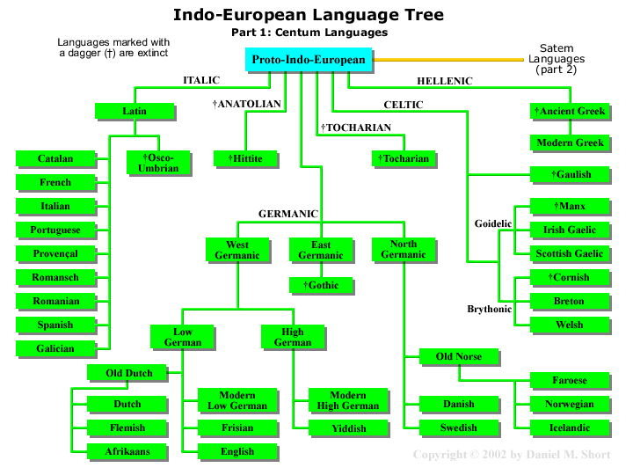
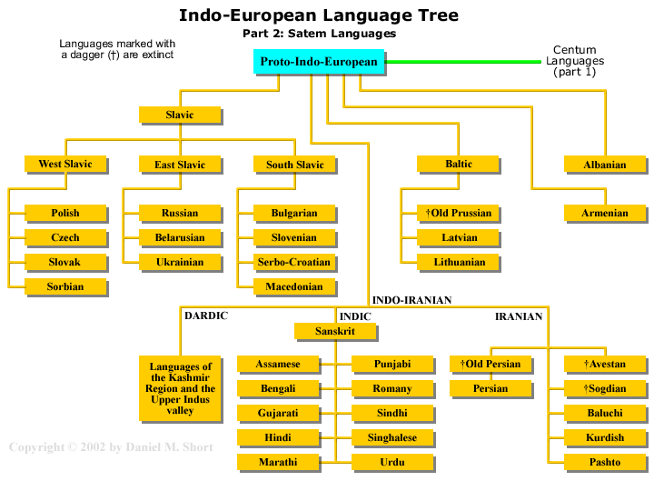
The Indo-European Language Family – Centum and Satem Branches
Images taken from http://web.cn.edu/
Notes:
Indo-European languages classified into Satem and Centum branches. The Satem and Centrum divide doesn’t apply for all Indo-European languages. I think there are some extinct Indo-European languages that did not fall into these categories.

Slide 7
Sound Connections and Patterns of Change
Centum vs Satem – Words for hundred
Latin – “centum” (pronounced “kentum”),Greek “ekato”
Russian “sto” and Farsi “sad”
Latin – “cor” - Russian “serdtse”
Related – The shift from k to h sounds:
Latin “centum” - English “hundred”
Latin – curro “I run” and English – hurry (to move quickly)
Latin “cor” and English “heart”
Other sound Relationships - P and F,
Latin “pisces” and English “fish”
Latin “pater”, Farsi “padar” - English “father”
Notes:
Slide 6
Centum and satem are words for hundred, but they illustrates a possible sound divergence between K and S, as we see a pattern of K or S at the beginning of different words with the same or similar meaning between languages.
And just to show these aren’t coincidences, we have more evidence.
We also see a more localized shift from k -> h
This is present in English and Latin, but very noticeable between Swedish and Norwegian. Swedish kva vs Norwegian hva.

Slide 8
Helpful Resources
The Wikipedia article on Indo-European Languages at https://en.wikipedia.org/wiki/Indo-European_languages
A pretty thorough and entertaining video on the subject by LangFocus on YouTube https://www.youtube.com/watch?v=SqK7XXvfiXs

