Slide 1
Origins: The evolution of Modern Languages
With a focus on the spread of the Indo-European language family

Slide 2
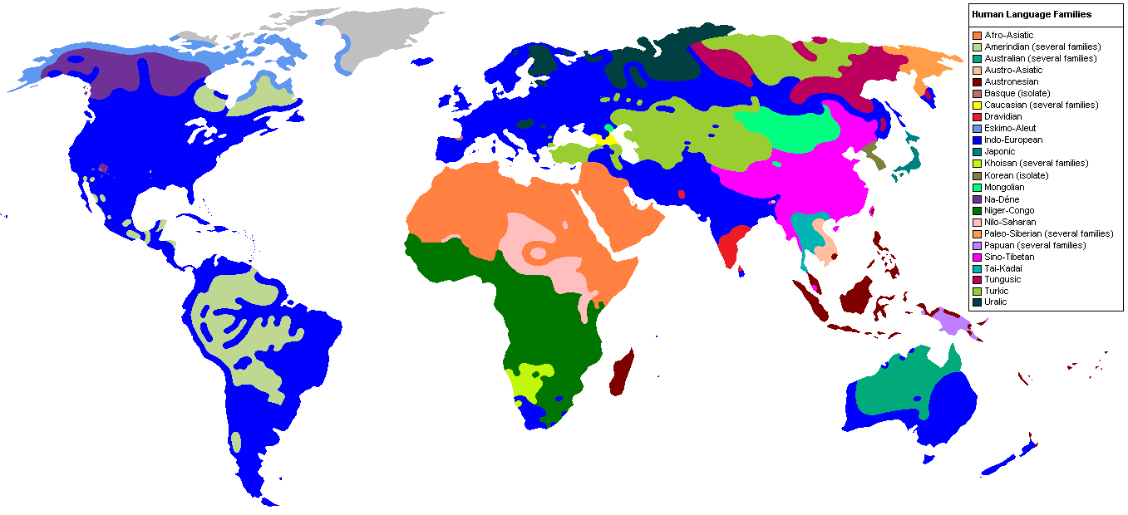
The Language Families
Image taken from http://library--of--babel.blogspot.com/2013/05/historical-linguistics.html
Notes:
This is a map of major language families, or at least generalized groupings of what are thought to be related languages. Of course, some linguists debate over whether some of these families can be combined or if the current families should actually be broken apart.

Slide 3
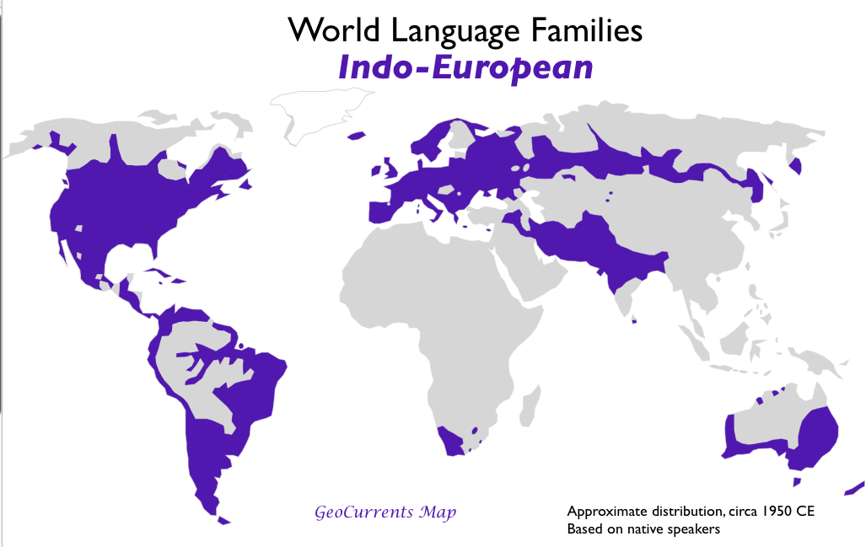
RANGE OF Indo-European Languages today
Image taken from https://abagond.files.wordpress.com/2015/03/indo-european-language-family-map.png
Notes:
I’m only going to focus on the Indo-European language family, for time’s sake. But a lot of other language families have similar connections to the ones I’ll discuss here.

Slide 4
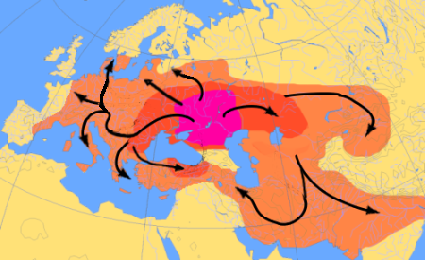
The Expansion of Indo-European
https://en.wikipedia.org/wiki/Indo-European_migrations
Notes:
Many linguists, archaeologists, anthropologists and geneticists agree that Indo-European have uncovered evidence that Indo-European language spread with Indo-European peoples from the area in red, out to Europe and through Central Asia to modern day Iran and India. This expansion likely occurred around 4000 BC, and was made possible when people figured out how to domesticate and ride horses.

Slide 5
How do we know English, Polish, Hindi, and Farsi are all IE Languages?
English | Latin | Norwegian | Polish | Hindi | Farsi
Brother | Frater | Bror | Brat | Bhaee | Baradur
Mother | Mater | Mor | Mac | Mata | Madar
Hundred | Centum | Hundre | Sto | Sau | Sad
Year | Anno | År | Rok | Sal | Sal
One | Unus | En | Jeden | Ek | Yek
Two | Duo | To | Dwa | Do | Do
Three | Tres | Tre | Trzy | Teen | Se
Four | Quattor | Fire | Cztery | Chaar | Chahar
Five | Quinque | Fem | Pięć | Panj | Panj
Thou | Tu | Du | Ty | To | To
Notes:
How do we know these languages are related? Well we can’t look at the originator of what we call Indo-European languages, but we can look for patterns. If we compare words with the same or similar meanings in different languages, and we see that they have a similar root, or similar consonant patterns, and related sounds within those consonant patterns, we could demonstrate how the sounds shifted while the basic original proto-Indo-European root remained the same.
Here are six languages from different (and fairly distant) branches of the Indo-European language family, We can’t see patterns or a common root across all words for all languages, but we do see overlap between the word for “brother” in almost all of the languages here, as well as the words for “two” and the archaic English “thou”

Slide 6
Sound connections and Patterns of change
Centum vs Satem – Words for hundred
“Western” branches (Germanic, Italic, Celtic) are considered Centum languages, while “Eastern” branches are considered Satem languages
Latin – “centum” vs Russian “sto”, Latin – “cor” vs Russian “serdtse”
Related – The shift from k to h sounds:
Ex. Latin “centum” to English “hundred”, Latin – curro “I run” and English – hurry (to move quickly), or Latin “cor” and English “heart”
Other sound Relationships
P and F,
Ex. Latin “pisces” and English “fish”, Latin “pater” and Farsi “padar” to English “father”, Latin “ferro” - I carry and English –”bear”, Russian “beru” – I take,
K and H
Related words (Some derived and some are cognates)
Ex. Most words and grammatical structures of Romance languages are derived from Latin, as most Indic languages are derived from Sanskrit. Likewise, there are many examples of cognates between languages of the major branches of Indo European.
Notes:
Here is some more evidence and examples of these sound patterns: Centum vs Satem
Illustrates possible sound divergence between K and S, as we see a pattern of K or S at the beginning of different words with the same or similar meaning between languages.
Shift from k -> h
This is present in English and Latin, but very noticeable between Swedish and Norwegian. Swedish kva vs Norwegian hva.

Slide 7
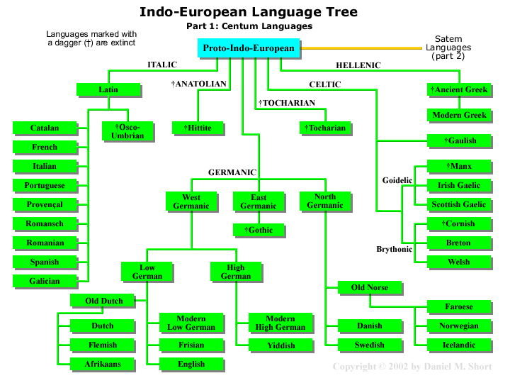
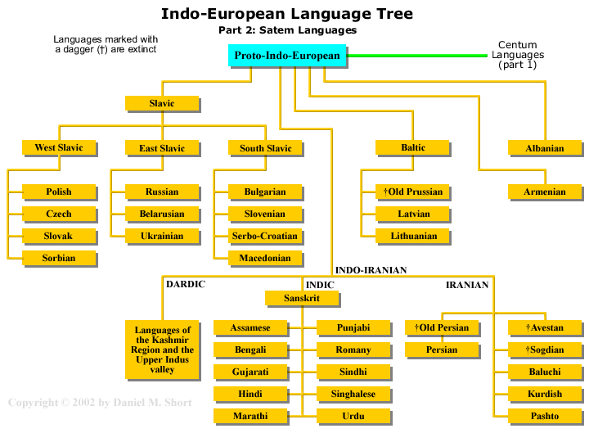
The Indo-European Language Family – Centum and Satem Branches
Images taken from http://web.cn.edu/

Slide 8
Helpful Resources
The Wikipedia article on Indo-European Languages at https://en.wikipedia.org/wiki/Indo-European_languages
A pretty thorough and entertaining video on the subject by LangFocus on YouTube https://www.youtube.com/watch?v=SqK7XXvfiXs

