Slide 1
IT VEDANT - CHENNAI
Duck Hunt Game Project
Presented by
Logesh Kumar.N

Slide 2
ABSTRACT
A simple Duck Hunt game with an objective of shooting moving targets on the screen

Slide 3
OBJECTIVE
To understand and develop the skills in designing a game using HTML along with an External Style Sheet (CSS) and JavaScript called in Python.

Slide 4
System Requirements
Hardware
Processor - Intel core duo or higher
RAM - 4GB minimum
Disk - 500 GB
Monitor - 15” color with VGI card
Speed - Min 500MHz
Software
OS - Windows-10 for emulator
Editor - Visual Studio Community
IDLE - Python IDLE
Languages - Python , HTML, CSS and JavaScript

Slide 5
Functional Description
A title screen is created in HTML with an external CSS with two images, one for title screen audio which is auto loaded at the time of loading the page.
Another part of this title screen has an hyper reference attribute to navigate to another screen with an animated dog’s page. In that page also, one screen for background music and another screen for hyper reference attribute to navigate to a dog’s hide and jump page. Hover effect is used for hide and jump page. Next page will be the actual Game page.
A JavaScript is used in the game page to play the background sounds at the time when the moving objects get shot.
An aimer is used to shoot the object. This is a .png file.
Some images are of type png and some others are of Jpg.
All audio files are of type mp3.
All the pages and script files are called in python using codecs.

Slide 6
Functional Description
In CSS, key frames are used for animations. It gives us more control over the animation we want to perform.
The animation is created by gradually changing from one style to another. We can change the CSS styles as many times as we want.

Slide 7
Functional Description
The animated object’s labels are positioned absolutely and located outside, on the right side of the main div within the game area.
Each object has its own styles with a unique flying animation.
The key frame percentages relate to the animation duration. For example: with a 10 second animation, 10% is the 1 second mark, 50% the 5 second mark, and 100% the 10 second mark.

Slide 8
Functional Description
The key frames of the object at the beginning of the style sheet designates the the location of the object with respect to time.
For example, if the Nth animated object’s time is declared as 5 seconds, then the 0% is going to be the initial status before the object starts its animation and the coordinates are defined as left and top with some defined % value which denotes the relative position of the object in that time duration.
:nth-last-of-type(N)
:nth-last-of-type takes an argument N
The :nth-last-of-type selector allows you select one or more elements based on their source order. In this project it is the index of the object, ie. Object’s precedence.

Slide 9
Functional Description
For each object, its animation behaviors are separately defined by way of its associated attribute values such as “Transform”, “Rotate” along with their attribute values in percentage. Negative percentages shows the movement in the reverse direction.
The z-index property specifies the stack order of an element (which element should be placed in front of, or behind, the others).
Higher the value of z index (eg. z-index:5 for object-1 and z-index:3 for object-2) means, object-1 will be stacked in front and object-2 will be stacked at the back.

Slide 10
Functional Description
For each object, its animation behaviors are separately defined by way of its associated attribute values such as “Transform”, “Rotate” along with their attribute values in percentage. Negative percentages shows the movement in the reverse direction.
Various type of animations available are:
animation-direction: normal
animation-direction: reverse
animation-direction: alternate
animation-direction: alternate-reverse

Slide 11
Functional Description
animation-direction: normal
The animation plays forwards each cycle. In other words, each time the animation cycles, the animation will reset to the beginning state and start over again. This is the default value.
animation-direction: reverse
The animation plays backwards each cycle. In other words, each time the animation cycles, the animation will reset to the end state and start over again. Animation steps are performed backwards, and timing functions are also reversed.
animation-direction: alternate
The animation reverses direction each cycle, with the first iteration being played forwards.
animation-direction: alternate-reverse
The animation reverses direction each cycle, with the first iteration being played backwards. The count to determine if a cycle is even or odd starts at one.

Slide 12
Functional Description
The z-index property specifies the stack order of an element (which element should be placed in front of, or behind, the others).
Higher the value of z index (eg. z-index:5 for object-1 and z-index:3 for object-2) means, object-1 will be stacked in front and object-2 will be stacked at the back.
Score count gets incremented when the object is shot by using the counter function with the ‘score’ as the parameter passed to the function.
This is accomplished in the CSS file as
.Score::after{content: counter(score)};

Slide 13
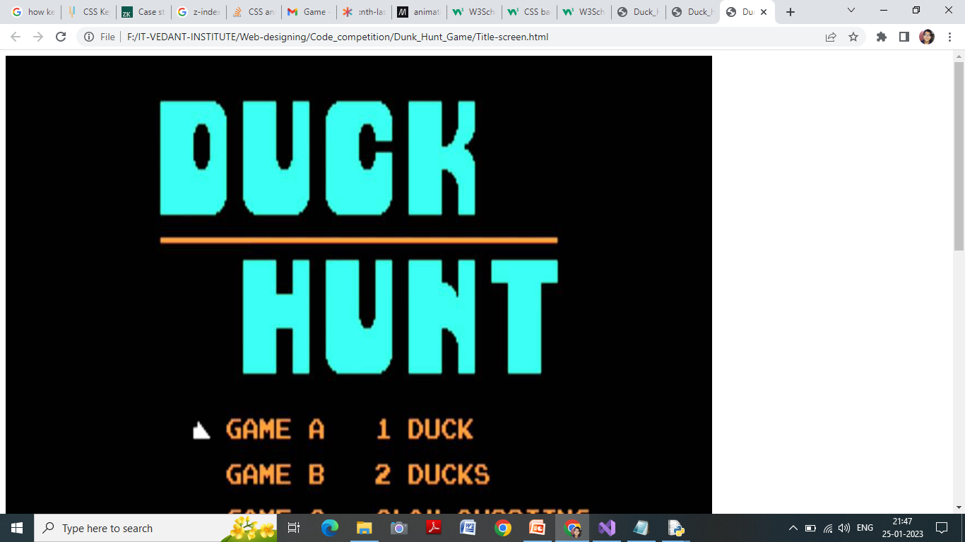
Outputs:
The above screen is for Title screen audio, when clicked, it plays an audio in the background in auto play loop mode till the next page is clicked.

Slide 14
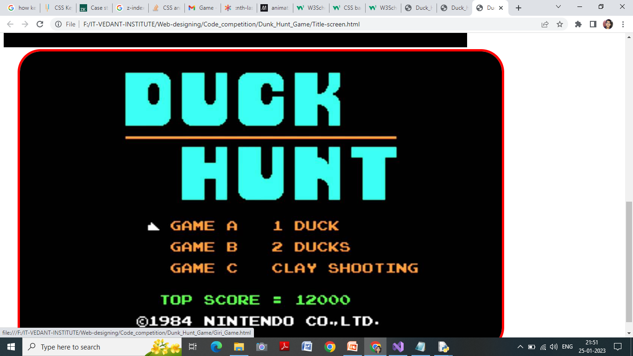
Outputs:
The above screen, when the mouse is brought to the image, an hover effect is used to enlarge the image. When clicked, it takes us to another two screens where one is for audio and another is a href page for navigation.

Slide 15
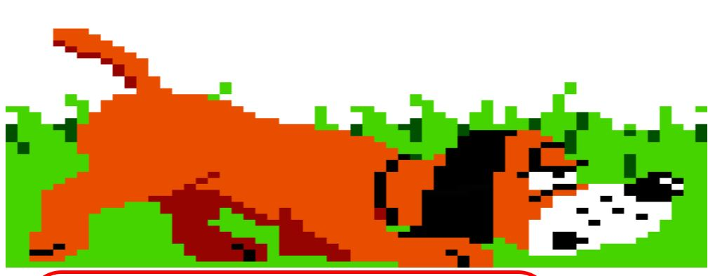

Slide 16
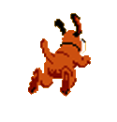

Slide 17
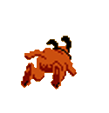
Clicking on this image will take us to the actual game page.

Slide 18
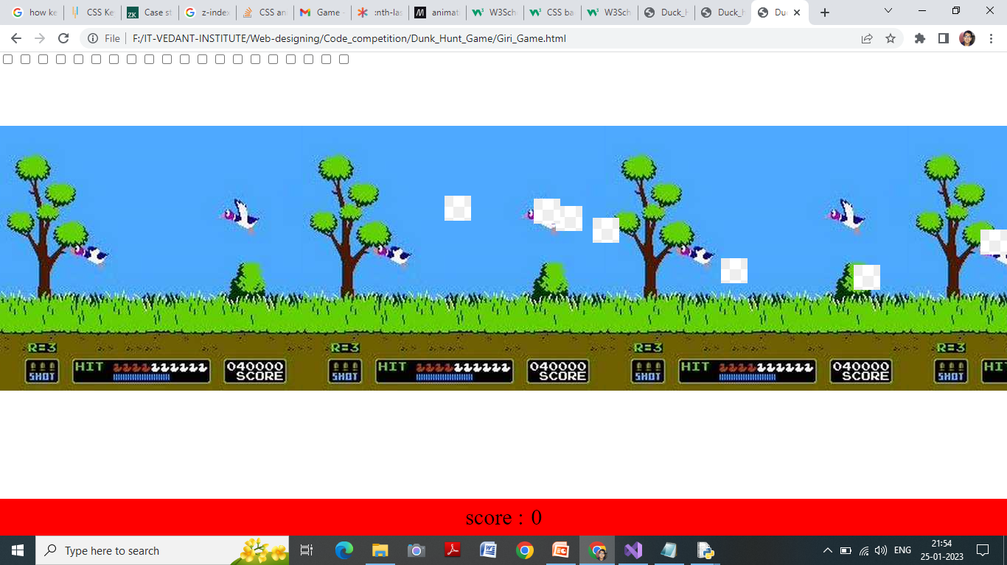
Outputs:
In the above screen, white colored square shaped image is the flying object. .

Slide 19
Thank You

