Slide 1
Inertial navigation system: Localization
Sandipan Das
Notes:
<number>

Slide 2
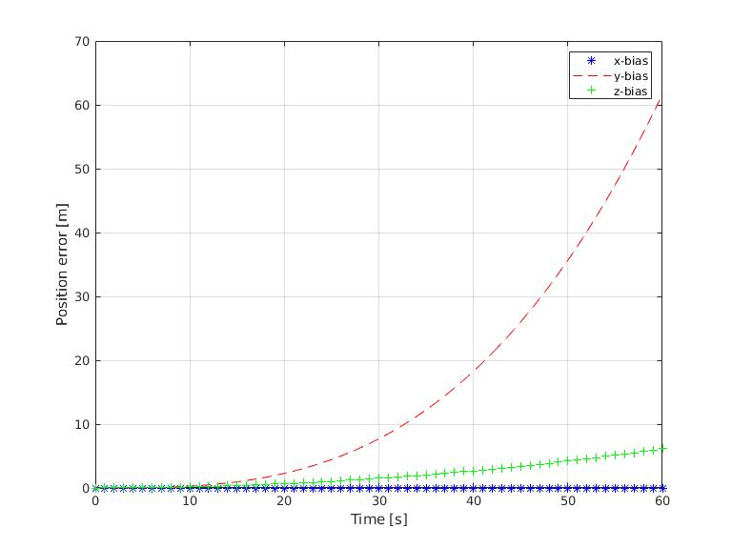
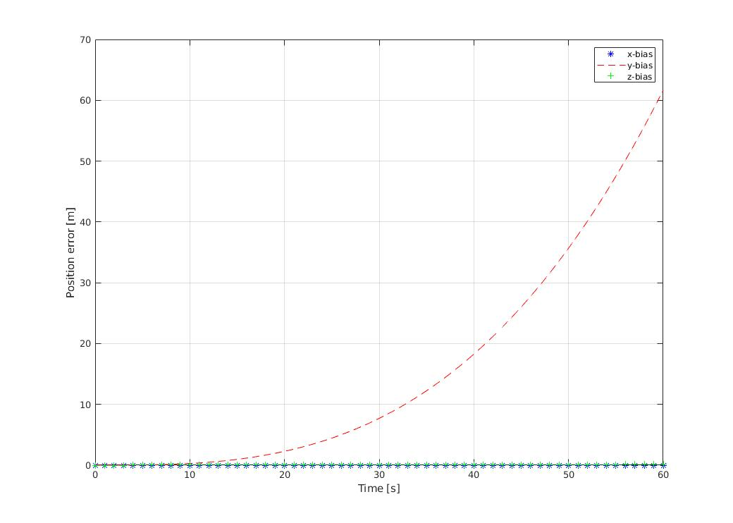
Task 1: Position error growth with time for Gyro-bias
Position error for Gyro-bias: [0.01*pi/180; 0; 0]
Lund – Latitude 55 deg N
Stockholm – Latitude 59 deg N
03/22/2020
<number>

Slide 3
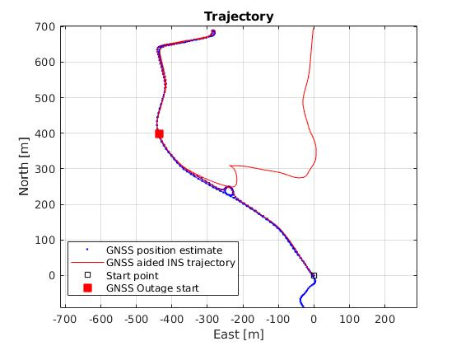
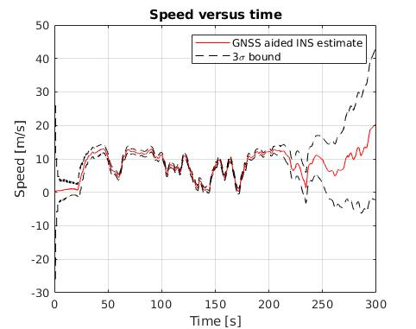
Task 2: GNSS-receiver outage simulation
Trajectory with simulated GNSS outage at 200s
Speed estimate with simulated GNSS outage at 200s
03/22/2020
<number>

Slide 4
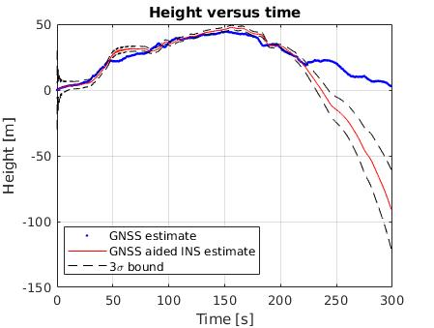
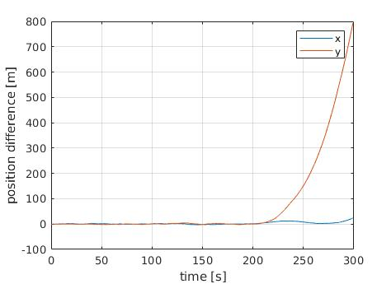
Task 2: GNSS-receiver outage simulation
Height profile with GNSS outage simulationat 200s
X, Y difference with GNSS outage simulationat 200s
03/22/2020
<number>

Slide 5
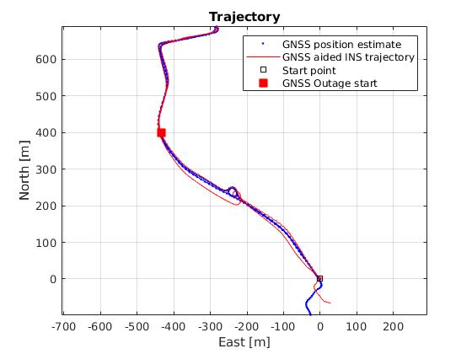
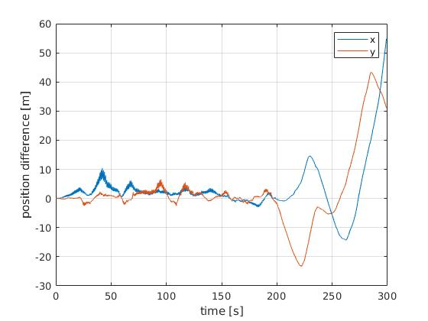
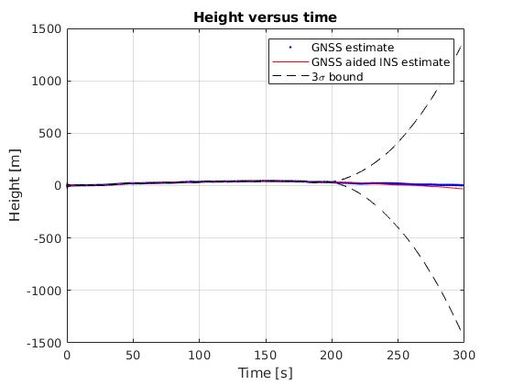
Task 2: Improved trajectory with updated process and measurement noise
Trajectory with GNSS outage simulationat 200s
X, Y difference and H with GNSS outage simulation
03/22/2020
<number>

Slide 6
Task 2: Improved trajectory with updated process and measurement noise
The overall position error RMS with process and measurement = 16.3333
% Process noise covariance (Q)
sigma_acc = 4;
sigma_gyro = 0.025*pi/180;
sigma_acc_bias = 0.1;
sigma_gyro_bias = 0.001*pi/180;
% GNSS position measurement noise covariance (R)
factp(1) = 10;
factp(2) = 5; factp(3:5) = (pi/180*[1 1 20]');
factp(6) = 0.005;
factp(7) = (0.01*pi/180);
In general, the acc std. deviation is increased and gyro std. deviation is decreased
03/22/2020
<number>

Slide 7
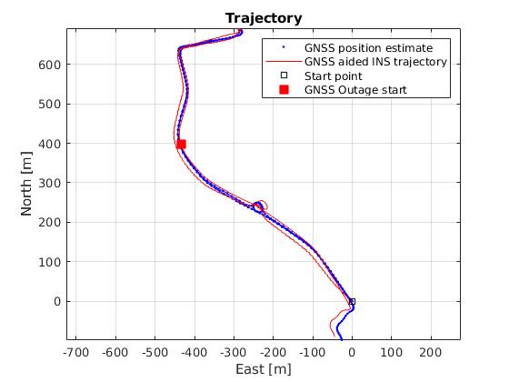
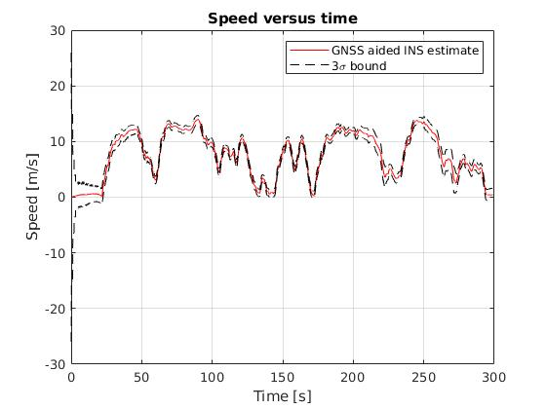
Task 3: GNSS-receiver outage simulation with non-holonomic constraints
% sigma_non_holonomic = 3 %[m/s]
Position error RMS = 9.7721
03/22/2020
<number>

Slide 8
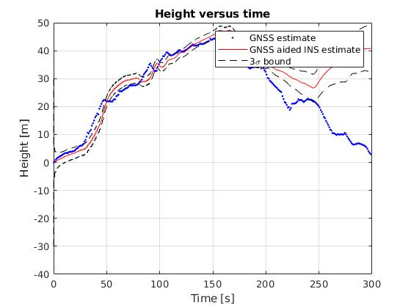
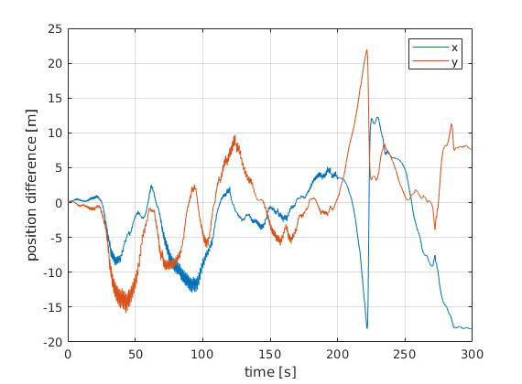
Task 3: GNSS-receiver outage simulation with non-holonomic constraints
% sigma_non_holonomic = 3 %[m/s]
03/22/2020
<number>

Slide 9
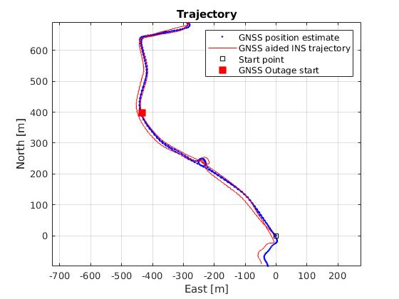
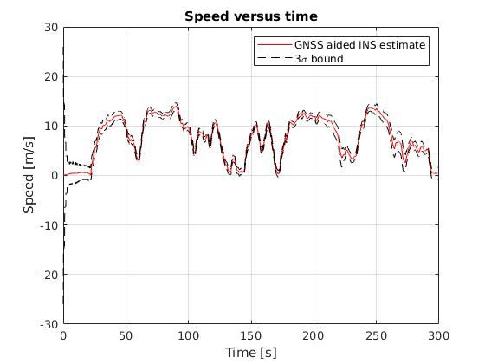
Task 4: GNSS-receiver outage simulation with non-holonomic constraints and speed-aiding
% sigma_speed = 30 %[m/s]
Position error RMS = 10.0474
03/22/2020
<number>

Slide 10
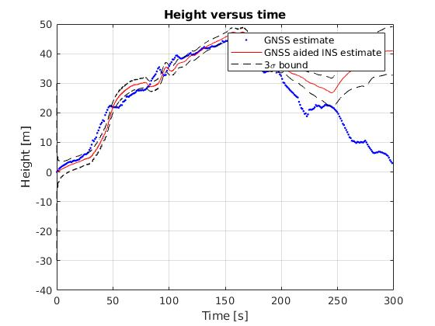
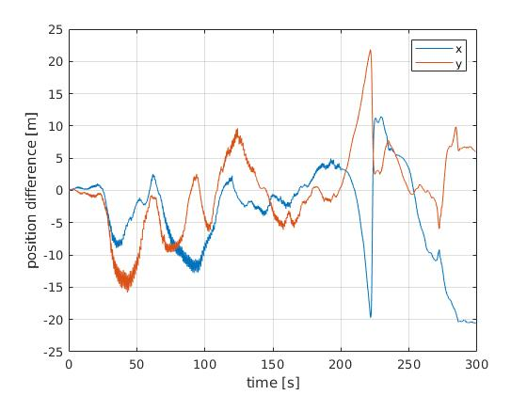
Task 4: GNSS-receiver outage simulation with non-holonomic constraints and speed-aiding
% sigma_speed = 30 %[m/s]
03/22/2020
<number>

Slide 11
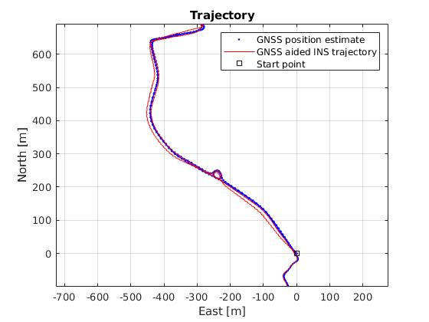
Extra: No GNSS outage but with non-holonomic constraints and speed-aiding
Position error RMS = 6.3166
03/22/2020
<number>

Slide 12
Thank you
03/22/2020
<number>

