Slide 1
Basic Auth & OAUTH2

Slide 2
Basic auth
Access to restricted pages
Provided by HTTP
Have to send username and password for each request

Slide 3
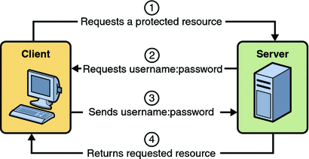
OAUTH

Slide 4
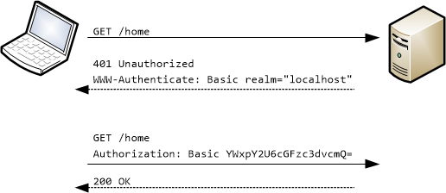
Basic auth

Slide 5
OAUTH2

Slide 6
Resource owner
An entity capable of granting access to a protected resource.
When the resource owner is a person, it is referred to as an end-user.

Slide 7
Resource server
The server hosting the protected resources, capable of accepting and responding to protected resource requests using access tokens.

Slide 8
Client
An application making protected resource requests on behalf of the resource owner and with its authorization

Slide 9
The server issuing access tokens to the client after successfully authenticating the resource owner and obtaining authorization

Slide 10
