Slide 1
FAKE NEWS DETECTION USING AI
University BDT College of Engineering , Davangere.
Department of Master of Computer Applications.
Submitted By,
MOHAN N J
Guided By,
Dr. HARISH B G
CHETAN KUMAR G S

Slide 2
contents
What is Machine Learning?
What is AI?
Introduction
Objective
Tools and Technologies
Hardware and Software
Existing and Proposed
Applications
Conclusion
Future Enhancement

Slide 3
What is Machine Learning?
ML is an application of AI.
It’s the process of using mathematical models of data to help a computer learn without direct instruction.
This enables a computer system to continue learning and improving on its own, based on experience.

Slide 4
What is AI?
AI is the science of making machines that can think like humans.
AI technology can process large amounts of data in ways, unlike humans.
The goal for AI is to be able to do things such as recognize patterns, make decisions, and judge like humans.

Slide 5
INTRODUCTION
Natural language processing (NLP)-based fake news identification is a critical field for study and technology development targeted at halting the spread of misleading information.
In digital age, fake news, or fraudulent information portrayed as true news, has grown to be a serious problem. Through social media sites and other online means, false information can spread quickly, potentially having negative social and political repercussions.

Slide 6
Data collection is the initial steps , which entails gathering a sizable and varied dataset of news stories from a variety of sources both reliable and imporvable.
The dataset provides the basis the NLP model’s testing and training.
Text processing is done on the data before it is fed into NLP model.
Feature Extraction to present the content in a numerical manner appropriate regarding machine learning algorithms.

Slide 7
OBJECTIVES
Identify and Mitigate Disinformation.
Enhance Information Credibility.
Reduce Harmful Consequences.
Enhance Fact-Checking.
Continuous Improvement.

Slide 8
Tools and technologies
Python Programming Language.
Machine Learning.
NLP Libraries.
Data Visualisation Tool .
Virtual Environment.

Slide 9
HARDWARE AND SOFTWARE
Hardware Requirements:
Processing Power : Intel Core i3 or higher.
Memory(RAM) : 8 GB to 32GB or more.
Storage : Necessary storage capacity.

Slide 10
Software Requirements:
Front end : Bootstrap framework.
Back end : Python.
Operating system : Window 7 or any compatible.
IDE : PyCharm, Visual studio , Anaconda, Jupyter Notebook.
Web framework : Flask.
Libraries : Pandas, Matplotlib,Sklearn,Numpy.

Slide 11
Existing and Praposed System
Existing System :
Fact-Checking and Verification.
Source Reputation.
Praposed System :
Data Gathering and Preprocessing.
Feature Extraction.
Machine Learning Model.

Slide 12
Applications
Media and Journalism.
Social Media and Online Platform.
Public Awareness.
Cyber Security.
Financial Markets.
Healthcare.
Academic Research.
Education.

Slide 13
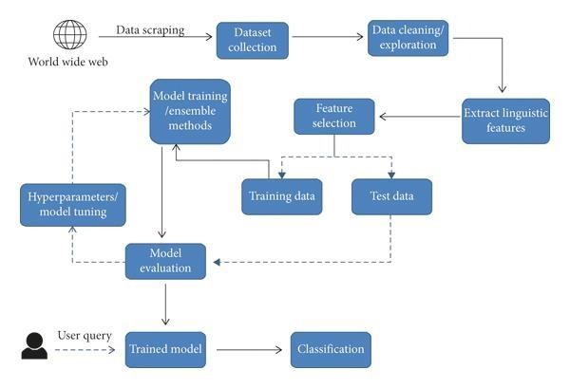
CONTEXT DIAGRAM
Before being utilized as an input for training the models, the that was retrieved from the corpus World Wide Web is subjected to some form of processing. Before being utilized as an input for training the models, the that was retrieved from the corpus World Wide Web is subjected to some form of processing.

Slide 14
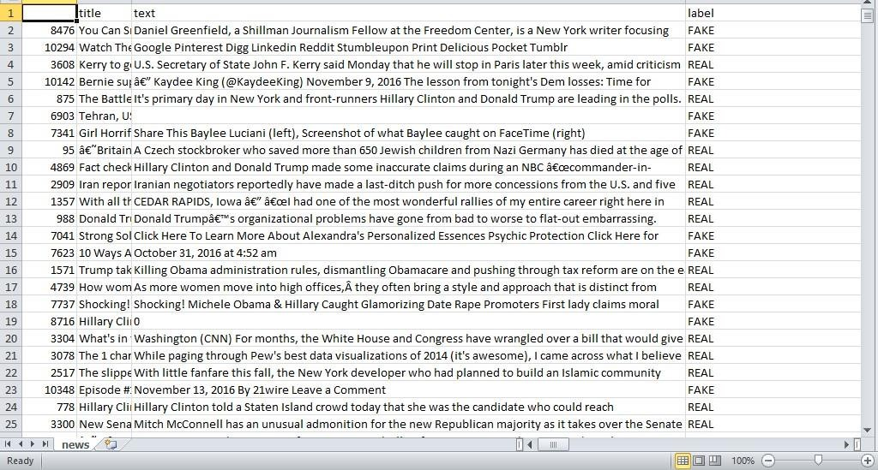
Screenshot
Dataset being Used.

Slide 15
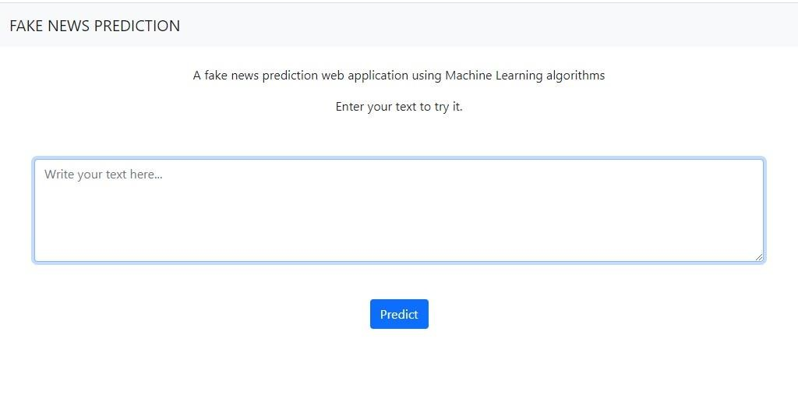
Input form
Screen showing input form.

Slide 16
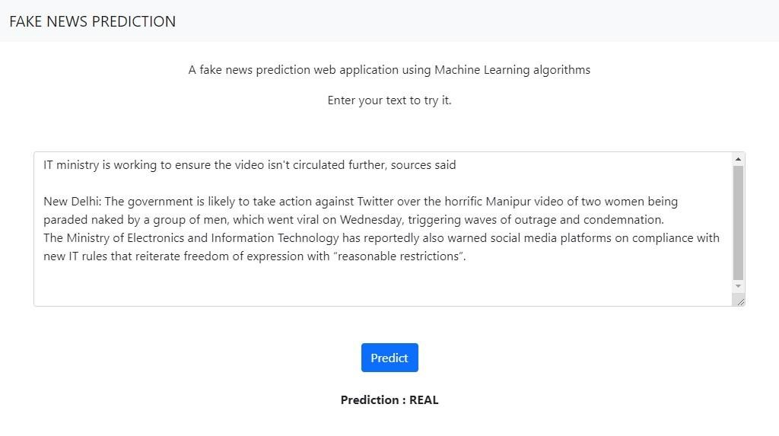
real CLASSIFICATION OF RESULT

Slide 17
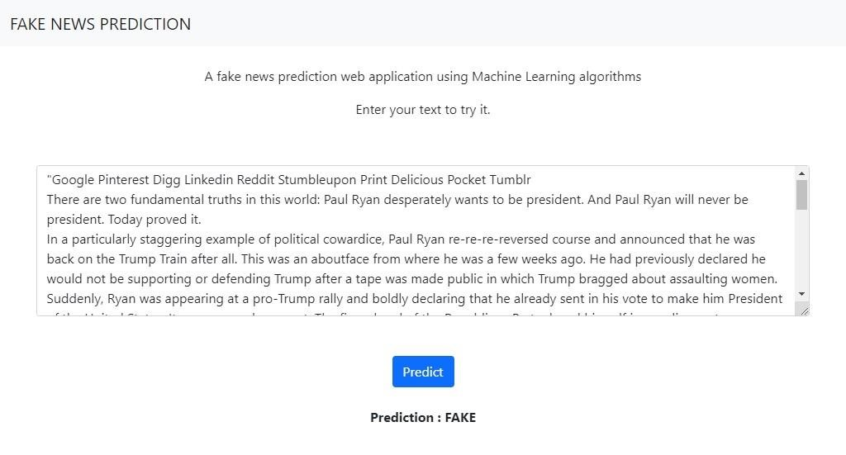
FAKE CLASSIFICATION OF RESULT

Slide 18
Conclusion
NLP-based fake news identification has become an essential tool for stopping the spread of false information and ensuring that accurate information is shared.
Combining NLP techniques the use of machine learning models produced promising results in identifying real news articles from false ones.
As we navigate the digital age , AI-powered solutions offer hope in the fight against fake news . stay informed and skeptical!

Slide 19
Future enhancement
Improving Accuracy and Effectiveness.
Impact on Media Literacy and Democracy.

