Slide 1
Transformers

Slide 2
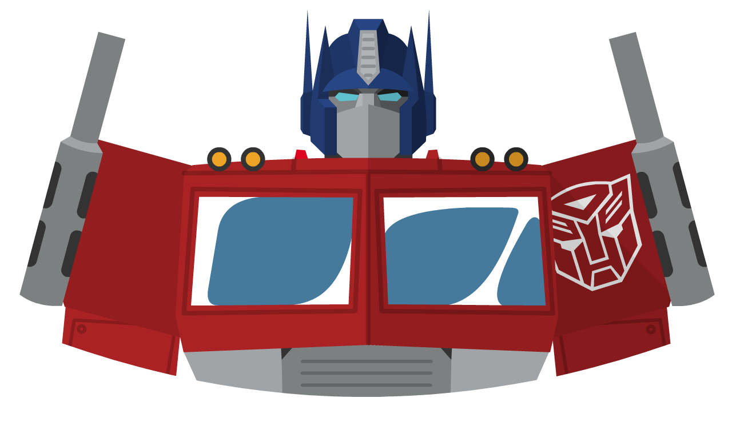
En
ZH
How are you?
transformer
你好吗？
Sequence
-to-
Sequence
model

Slide 3


ZH
你
好
吃
饱
吗
$$⋯$$
？
<end>
你
好
吃
饱
$$⋯$$
？
<end>
Encoders
Decoders
transformer
En
How are you?
<start>

Slide 4
ZH
你
好
吃
饱
吗
$$⋯$$
？
<end>
好
吃
饱
$$⋯$$
？
<end>
Encoders
Decoders
transformer
En
How are you?
<start>
你

Slide 5
ZH
吗
你
好
吃
饱
吗
$$⋯$$
？
<end>
好
吃
饱
$$⋯$$
？
<end>
Encoders
Decoders
transformer
En
How are you?
<start>
你

Slide 6
ZH
吗
你
好
吃
饱
吗
$$⋯$$
？
<end>
吃
饱
$$⋯$$
？
<end>
Encoders
Decoders
transformer
En
How are you?
<start>
你
好

Slide 7
ZH
你
好
吃
饱
吗
$$⋯$$
？
<end>
吃
饱
$$⋯$$
？
<end>
Encoders
Decoders
transformer
En
How are you?
<start>
你
好

Slide 8


ZH
你
好
吃
饱
吗
$$⋯$$
？
<end>
吃
饱
$$⋯$$
？
<end>
Encoders
Decoders
transformer
En
How are you?
<start>
你
好
吗

Slide 9
ZH
你
好
吃
饱
吗
$$⋯$$
？
吃
饱
$$⋯$$
？
<end>
<end>
Encoders
Decoders
transformer
En
How are you?
<start>
你
好
吗

Slide 10
ZH
你
好
吃
饱
吗
$$⋯$$
？
<end>
饱
$$⋯$$
<end>
Encoders
Decoders
transformer
En
How are you?
<start>
你
好
吗
？

Slide 11
ZH
你
好
吃
饱
吗
$$⋯$$
？
<end>
吃
饱
$$⋯$$
<end>
Encoders
Decoders
transformer
En
How are you?
<start>
你
好
吗
？

Slide 12
AuTo-regressive
ZH
你
好
吃
饱
吗
$$⋯$$
？
吃
饱
$$⋯$$
<end>
Encoders
Decoders
transformer
En
How are you?
<start>
<end>
你
好
吗
？

Slide 13
Encoders
How are you?

Slide 14

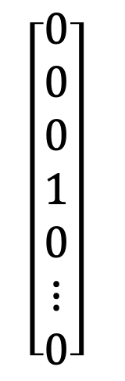
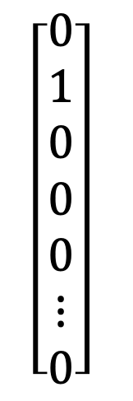
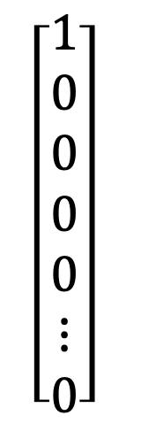

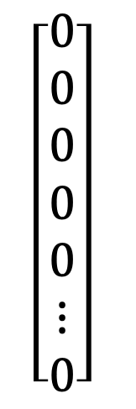
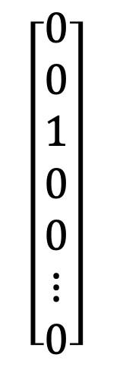
Encoders
Tokenization
8607
4339
2472
311
832
4037
11
719
1063
1541
956
25
3687
23936
13
cat
dog
bear
cow
indiv
$$\left[\begin{aligned}1 \\ 0 \\ 0 \\ 0 \\ 0 \\ ⋮ \\ 0\end{aligned}\right]$$
$$\left[\begin{aligned}0 \\ 1 \\ 0 \\ 0 \\ 0 \\ ⋮ \\ 0\end{aligned}\right]$$
$$\left[\begin{aligned}0 \\ 0 \\ 1 \\ 0 \\ 0 \\ ⋮ \\ 0\end{aligned}\right]$$
$$\left[\begin{aligned}0 \\ 0 \\ 0 \\ 1 \\ 0 \\ ⋮ \\ 0\end{aligned}\right]$$
$$\left[\begin{aligned}0 \\ 0 \\ 0 \\ 0 \\ 0 \\ ⋮ \\ 0\end{aligned}\right]$$
One-hot encoding
Value 1 at 3687th entry
$\#$ tokens

Slide 15




Encoders
TOKEN EMBEDDING
One-hot encoding
cat
dog
bear
cow
indiv
$$\left[\begin{aligned}1 \\ 0 \\ 0 \\ 0 \\ 0 \\ ⋮ \\ 0\end{aligned}\right]$$
$$\left[\begin{aligned}0 \\ 1 \\ 0 \\ 0 \\ 0 \\ ⋮ \\ 0\end{aligned}\right]$$
$$\left[\begin{aligned}0 \\ 0 \\ 1 \\ 0 \\ 0 \\ ⋮ \\ 0\end{aligned}\right]$$
$$\left[\begin{aligned}0 \\ 0 \\ 0 \\ 1 \\ 0 \\ ⋮ \\ 0\end{aligned}\right]$$
$$\left[\begin{aligned}0 \\ 0 \\ 0 \\ 0 \\ 0 \\ ⋮ \\ 0\end{aligned}\right]$$
Value 1 at 3687th entry

Slide 16
Encoders
TOKEN EMBEDDING
cat
dog
bear
cow
indiv
$$\left[\begin{aligned}1 \\ 0 \\ 0 \\ 0 \\ 0 \\ ⋮ \\ 0\end{aligned}\right]$$
$$\left[\begin{aligned}0 \\ 1 \\ 0 \\ 0 \\ 0 \\ ⋮ \\ 0\end{aligned}\right]$$
$$\left[\begin{aligned}0 \\ 0 \\ 1 \\ 0 \\ 0 \\ ⋮ \\ 0\end{aligned}\right]$$
$$\left[\begin{aligned}0 \\ 0 \\ 0 \\ 1 \\ 0 \\ ⋮ \\ 0\end{aligned}\right]$$
$$\left[\begin{aligned}0 \\ 0 \\ 0 \\ 0 \\ 0 \\ ⋮ \\ 0\end{aligned}\right]$$
Value 1 at 3687th entry
Embedding Space

Slide 17
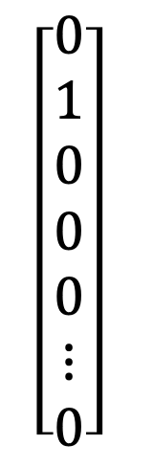


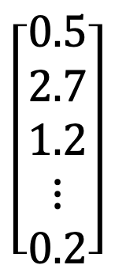




Encoders
TOKEN EMBEDDING
dog
$$\left[\begin{aligned}0 \\ 1 \\ 0 \\ 0 \\ 0 \\ ⋮ \\ 0\end{aligned}\right]$$
$\#$ tokens
$$\left[\begin{aligned}0.5 \\ 2.7 \\ 1.2 \\ ⋮ \\ 0.2\end{aligned}\right]$$
$$\left[\begin{aligned}0 \\ 0 \\ 0 \\ 0 \\ 0\end{aligned} \right]$$
$W_{E}$
$$d$$
$$=$$
$$d$$
Embedding Space
Embedded token
Embedding Matrix

Slide 18


Encoder
TOKEN EMBEDDING
dog
$$\left[\begin{aligned}0 \\ 1 \\ 0 \\ 0 \\ 0 \\ ⋮ \\ 0\end{aligned}\right]$$
$\#$ tokens
$$\left[\begin{aligned}0.5 \\ 2.7 \\ 1.2 \\ ⋮ \\ 0.2\end{aligned}\right]$$
$$\left[\begin{aligned}0 \\ 0 \\ 0 \\ 0 \\ 0\end{aligned} \right]$$
$W_{E}$
$$d$$
$$=$$
$$d$$
$$⋯$$
Embedding Space
Embedded token
Embedding Matrix

Slide 19

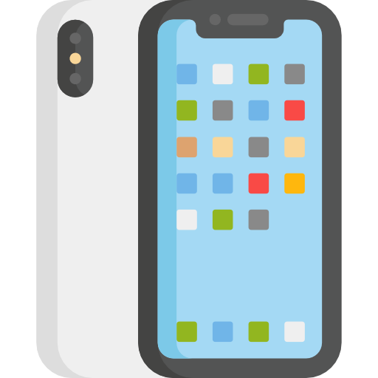




Encoder
TOKEN EMBEDDING
Apple
dog
$$\left[\begin{aligned}0 \\ 1 \\ 0 \\ 0 \\ 0 \\ ⋮ \\ 0\end{aligned}\right]$$
$\#$ tokens
$$\left[\begin{aligned}0.5 \\ 2.7 \\ 1.2 \\ ⋮ \\ 0.2\end{aligned}\right]$$
$$\left[\begin{aligned}0 \\ 0 \\ 0 \\ 0 \\ 0\end{aligned} \right]$$
$W_{E}$
$$d$$
$$=$$
$$d$$
$$⋯$$
Embedding Space
Embedded token
Embedding Matrix

Slide 20
Encoder
TOKEN EMBEDDING
I bought an apple and an orange.
Apple
I bought an apple watch.
dog
$$\left[\begin{aligned}0 \\ 1 \\ 0 \\ 0 \\ 0 \\ ⋮ \\ 0\end{aligned}\right]$$
$\#$ tokens
$$\left[\begin{aligned}0.5 \\ 2.7 \\ 1.2 \\ ⋮ \\ 0.2\end{aligned}\right]$$
$$\left[\begin{aligned}0 \\ 0 \\ 0 \\ 0 \\ 0\end{aligned} \right]$$
$W_{E}$
$$d$$
$$=$$
$$d$$
$$⋯$$
Embedding Space
Embedded token
Embedding Matrix

Slide 21







Encoder
Embedded
Tokens
Token Embedding
$$W_{E}$$
$$W_{E}$$
$$W_{E}$$
$$W_{E}$$
$$W_{E}$$
$$W_{E}$$
$$W_{E}$$
Tokens
I
bought
an
apple
and
an
orange

Slide 22
Feed Forward
Feed Forward
Feed Forward
Feed Forward
Feed Forward
Feed Forward
Feed Forward
Embedded
Tokens
Token Embedding
$$W_{E}$$
$$W_{E}$$
$$W_{E}$$
$$W_{E}$$
$$W_{E}$$
$$W_{E}$$
$$W_{E}$$
Tokens
I
bought
an
apple
and
an
orange

Slide 23
Feed Forward
Feed Forward
Feed Forward
Feed Forward
Feed Forward
Feed Forward
Feed Forward
Self-Attention
Embedded
Tokens
Token Embedding
$$W_{E}$$
$$W_{E}$$
$$W_{E}$$
$$W_{E}$$
$$W_{E}$$
$$W_{E}$$
$$W_{E}$$
Tokens
I
bought
an
apple
and
an
orange

Slide 24
Self-Attention
apple
Embedding Space
Embedded
Tokens
Tokens
I
bought
an
apple
and
an
orange

Slide 25
Self-Attention
apple
Embedding Space
Embedded
Tokens
Tokens
I
bought
an
apple
and
an
orange

Slide 26
Self-Attention
apple
Embedding Space
Embedded
Tokens
Tokens
I
bought
an
apple
watch

Slide 27
Self-Attention
apple
Embedding Space
Embedded
Tokens
Tokens
I
bought
an
apple
watch

Slide 28
Self-Attention
Embedding Space
Embedded
Tokens
Tokens
I
bought
an
apple
watch

Slide 29
Self-Attention
Embedding Space
Embedded
Tokens
Tokens
I
bought
an
apple
watch

Slide 30




































$$α_{4,1}^{′}$$
$$α_{4,2}^{′}$$
$$α_{4,3}^{′}$$
$$α_{4,4}^{′}$$
$$α_{4,5}^{′}$$
Softmax
$$α_{4,1}=x_{4}^{⊤}x_{1}$$
$$α_{4,2}=x_{4}^{⊤}x_{2}$$
$$α_{4,3}=x_{4}^{⊤}x_{3}$$
$$α_{4,4}=x_{4}^{⊤}x_{4}$$
$$α_{4,5}=x_{4}^{⊤}x_{5}$$
$$=k_{1}^{⊤}q_{4}$$
$$=k_{2}^{⊤}q_{4}$$
$$=k_{3}^{⊤}q_{4}$$
$$=k_{4}^{⊤}q_{4}$$
$$=k_{5}^{⊤}q_{4}$$
$$W^{Q}$$
$$∈R^{d_{k}×d}$$
$$W^{K}$$
$$∈R^{d_{k}×d}$$
$$k_{1}$$
$$k_{2}$$
$$k_{3}$$
$$q_{4}$$
$$k_{4}$$
$$k_{5}$$
$${ W}^{K}$$
$${ W}^{K}$$
$${ W}^{K}$$
$$W^{Q}$$
$${ W}^{K}$$
$${ W}^{K}$$
Embedded
Tokens
$$x_{1}$$
$$x_{2}$$
$$x_{3}$$
$$x_{4}$$
$$x_{5}$$
Tokens
I
bought
an
apple
watch

Slide 31












$$α_{4,3}^{′}$$
$$α_{4,3}^{′}$$
$$α_{4,5}^{′}$$
$$α_{4,2}^{′}$$
$$α_{4,5}^{′}$$
$$α_{4,2}^{′}$$
$$α_{4,4}^{′}$$
$$α_{4,1}^{′}$$
$$α_{4,4}^{′}$$
$$α_{4,1}^{′}$$
Softmax
$$α_{4,1}=x_{4}^{⊤}x_{1}$$
$$α_{4,2}=x_{4}^{⊤}x_{2}$$
$$α_{4,3}=x_{4}^{⊤}x_{3}$$
$$α_{4,4}=x_{4}^{⊤}x_{4}$$
$$α_{4,5}=x_{4}^{⊤}x_{5}$$
$$=k_{1}^{⊤}q_{4}$$
$$=k_{2}^{⊤}q_{4}$$
$$=k_{3}^{⊤}q_{4}$$
$$=k_{4}^{⊤}q_{4}$$
$$=k_{5}^{⊤}q_{4}$$
$$W^{Q}$$
$$∈R^{d_{k}×d}$$
$$W^{K}$$
$$∈R^{d_{k}×d}$$
$$k_{1}$$
$$v_{1}$$
$$v_{2}$$
$$v_{3}$$
$$v_{4}$$
$$v_{5}$$
$$v_{1}$$
$$k_{2}$$
$$v_{2}$$
$$k_{3}$$
$$v_{3}$$
$$q_{4}$$
$$k_{4}$$
$$v_{4}$$
$$k_{5}$$
$$v_{5}$$
$$W^{V}$$
$$∈R^{d_{v}×d}$$
$${ W}^{K}$$
$${ W}^{V}$$
$${ W}^{K}$$
$${ W}^{V}$$
$${ W}^{K}$$
$${ W}^{V}$$
$$W^{Q}$$
$${ W}^{K}$$
$${ W}^{V}$$
$${ W}^{K}$$
$${ W}^{V}$$
Embedded
Tokens
$$x_{1}$$
$$x_{2}$$
$$x_{3}$$
$$x_{4}$$
$$x_{5}$$
Tokens
I
bought
an
apple
watch

Slide 32















Updated feature
$$x_{4}^{′}$$
$$=$$
$$α_{4,1}^{′}$$
$$v_{1}$$
$$+$$
$$α_{4,2}^{′}$$
$$v_{2}$$
$$+$$
$$α_{4,3}^{′}$$
$$v_{3}$$
$$+$$
$$α_{4,4}^{′}$$
$$v_{4}$$
$$+$$
$$α_{4,5}^{′}$$
$$v_{5}$$
$$α_{4,1}^{′}$$
$$α_{4,2}^{′}$$
$$α_{4,3}^{′}$$
$$α_{4,4}^{′}$$
$$α_{4,5}^{′}$$
Softmax
$$α_{4,1}=x_{4}^{⊤}x_{1}$$
$$α_{4,2}=x_{4}^{⊤}x_{2}$$
$$α_{4,3}=x_{4}^{⊤}x_{3}$$
$$α_{4,4}=x_{4}^{⊤}x_{4}$$
$$α_{4,5}=x_{4}^{⊤}x_{5}$$
$$=k_{1}^{⊤}q_{4}$$
$$=k_{2}^{⊤}q_{4}$$
$$=k_{3}^{⊤}q_{4}$$
$$=k_{4}^{⊤}q_{4}$$
$$=k_{5}^{⊤}q_{4}$$
$$W^{Q}$$
$$∈R^{d_{k}×d}$$
$$W^{K}$$
$$∈R^{d_{k}×d}$$
$$k_{1}$$
$$v_{1}$$
$$k_{2}$$
$$v_{2}$$
$$k_{3}$$
$$v_{3}$$
$$q_{4}$$
$$k_{4}$$
$$v_{4}$$
$$k_{5}$$
$$v_{5}$$
$$W^{V}$$
$$∈R^{d_{v}×d}$$
$${ W}^{K}$$
$${ W}^{V}$$
$${ W}^{K}$$
$${ W}^{V}$$
$${ W}^{K}$$
$${ W}^{V}$$
$$W^{Q}$$
$${ W}^{K}$$
$${ W}^{V}$$
$${ W}^{K}$$
$${ W}^{V}$$
Embedded
Tokens
$$x_{1}$$
$$x_{2}$$
$$x_{3}$$
$$x_{4}$$
$$x_{5}$$
Tokens
I
bought
an
apple
watch

Slide 33

















$$α_{2,1}^{′}$$
$$α_{2,2}^{′}$$
$$α_{2,3}^{′}$$
$$α_{2,4}^{′}$$
$$α_{2,5}^{′}$$
Softmax
$$α_{2,1}=x_{4}^{⊤}x_{2}$$
$$α_{2,2}=x_{4}^{⊤}x_{2}$$
$$α_{2,3}=x_{4}^{⊤}x_{3}$$
$$α_{2,4}=x_{4}^{⊤}x_{4}$$
$$α_{2,5}=x_{4}^{⊤}x_{5}$$
$$=k_{1}^{⊤}q_{2}$$
$$=k_{2}^{⊤}q_{2}$$
$$=k_{3}^{⊤}q_{2}$$
$$=k_{4}^{⊤}q_{2}$$
$$=k_{5}^{⊤}q_{2}$$
$$W^{Q}$$
$$∈R^{d_{k}×d}$$
$$W^{K}$$
$$∈R^{d_{k}×d}$$
$$k_{1}$$
$$v_{1}$$
$$q_{2}$$
$$k_{2}$$
$$v_{2}$$
$$k_{3}$$
$$v_{3}$$
$$k_{4}$$
$$v_{4}$$
$$k_{5}$$
$$v_{5}$$
$$W^{V}$$
$$∈R^{d_{v}×d}$$
$${ W}^{K}$$
$${ W}^{V}$$
$$W^{Q}$$
$${ W}^{K}$$
$${ W}^{V}$$
$${ W}^{K}$$
$${ W}^{V}$$
$${ W}^{K}$$
$${ W}^{V}$$
$${ W}^{K}$$
$${ W}^{V}$$
Embedded
Tokens
$$x_{1}$$
$$x_{2}$$
$$x_{3}$$
$$x_{4}$$
$$x_{5}$$
Tokens
I
bought
an
apple
watch

Slide 34










$$α_{2,3}^{′}$$
$$α_{2,2}^{′}$$
$$α_{2,3}^{′}$$
$$α_{2,5}^{′}$$
$$α_{2,1}^{′}$$
$$α_{2,2}^{′}$$
$$α_{2,4}^{′}$$
$$α_{2,5}^{′}$$
$$α_{2,1}^{′}$$
$$α_{2,4}^{′}$$
Softmax
$$α_{2,1}=x_{4}^{⊤}x_{2}$$
$$α_{2,2}=x_{4}^{⊤}x_{2}$$
$$α_{2,3}=x_{4}^{⊤}x_{3}$$
$$α_{2,4}=x_{4}^{⊤}x_{4}$$
$$α_{2,5}=x_{4}^{⊤}x_{5}$$
$$=k_{1}^{⊤}q_{2}$$
$$=k_{2}^{⊤}q_{2}$$
$$=k_{3}^{⊤}q_{2}$$
$$=k_{4}^{⊤}q_{2}$$
$$=k_{5}^{⊤}q_{2}$$
$$W^{Q}$$
$$∈R^{d_{k}×d}$$
$$W^{K}$$
$$∈R^{d_{k}×d}$$
$$v_{1}$$
$$q_{2}$$
$$v_{2}$$
$$v_{3}$$
$$v_{4}$$
$$v_{5}$$
$$k_{1}$$
$$v_{1}$$
$$k_{2}$$
$$v_{2}$$
$$k_{3}$$
$$v_{3}$$
$$k_{4}$$
$$v_{4}$$
$$k_{5}$$
$$v_{5}$$
$$W^{V}$$
$$∈R^{d_{v}×d}$$
$${ W}^{K}$$
$${ W}^{V}$$
$$W^{Q}$$
$${ W}^{K}$$
$${ W}^{V}$$
$${ W}^{K}$$
$${ W}^{V}$$
$${ W}^{K}$$
$${ W}^{V}$$
$${ W}^{K}$$
$${ W}^{V}$$
Embedded
Tokens
$$x_{1}$$
$$x_{2}$$
$$x_{3}$$
$$x_{4}$$
$$x_{5}$$
Tokens
I
bought
an
apple
watch

Slide 35
















Updated feature
$$x_{2}^{′}$$
$$=$$
$$α_{2,1}^{′}$$
$$v_{1}$$
$$+$$
$$α_{2,2}^{′}$$
$$v_{2}$$
$$+$$
$$α_{2,3}^{′}$$
$$v_{3}$$
$$+$$
$$α_{2,4}^{′}$$
$$v_{4}$$
$$+$$
$$α_{2,5}^{′}$$
$$v_{5}$$
$$α_{2,1}^{′}$$
$$α_{2,2}^{′}$$
$$α_{2,3}^{′}$$
$$α_{2,4}^{′}$$
$$α_{2,5}^{′}$$
Softmax
$$α_{2,1}=x_{4}^{⊤}x_{2}$$
$$α_{2,2}=x_{4}^{⊤}x_{2}$$
$$α_{2,3}=x_{4}^{⊤}x_{3}$$
$$α_{2,4}=x_{4}^{⊤}x_{4}$$
$$α_{2,5}=x_{4}^{⊤}x_{5}$$
$$=k_{1}^{⊤}q_{2}$$
$$=k_{2}^{⊤}q_{2}$$
$$=k_{3}^{⊤}q_{2}$$
$$=k_{4}^{⊤}q_{2}$$
$$=k_{5}^{⊤}q_{2}$$
$$W^{Q}$$
$$∈R^{d_{k}×d}$$
$$W^{K}$$
$$∈R^{d_{k}×d}$$
$$k_{1}$$
$$v_{1}$$
$$q_{2}$$
$$k_{2}$$
$$v_{2}$$
$$k_{3}$$
$$v_{3}$$
$$k_{4}$$
$$v_{4}$$
$$k_{5}$$
$$v_{5}$$
$$W^{V}$$
$$∈R^{d_{v}×d}$$
$${ W}^{K}$$
$${ W}^{V}$$
$$W^{Q}$$
$${ W}^{K}$$
$${ W}^{V}$$
$${ W}^{K}$$
$${ W}^{V}$$
$${ W}^{K}$$
$${ W}^{V}$$
$${ W}^{K}$$
$${ W}^{V}$$
Embedded
Tokens
$$x_{1}$$
$$x_{2}$$
$$x_{3}$$
$$x_{4}$$
$$x_{5}$$
Tokens
I
bought
an
apple
watch

Slide 36


























$$α_{1,1}$$
$$k_{1}^{⊤}$$
$$q_{1}$$
$$=$$
$$α_{1,2}$$
$$k_{2}^{⊤}$$
$$q_{1}$$
$$=$$
$$α_{1,3}$$
$$k_{3}^{⊤}$$
$$q_{1}$$
$$=$$
$$α_{1,4}$$
$$k_{4}^{⊤}$$
$$q_{1}$$
$$=$$
$$α_{1,5}$$
$$k_{5}^{⊤}$$
$$q_{1}$$
$$=$$
$$q_{1}$$
$$k_{1}$$
$$v_{1}$$
$$q_{2}$$
$$k_{2}$$
$$v_{2}$$
$$q_{3}$$
$$k_{3}$$
$$v_{3}$$
$$q_{4}$$
$$k_{4}$$
$$v_{4}$$
$$q_{5}$$
$$k_{5}$$
$$v_{5}$$
$$W^{Q}$$
$${ W}^{K}$$
$${ W}^{V}$$
$$W^{Q}$$
$${ W}^{K}$$
$${ W}^{V}$$
$$W^{Q}$$
$${ W}^{K}$$
$${ W}^{V}$$
$$W^{Q}$$
$${ W}^{K}$$
$${ W}^{V}$$
$$W^{Q}$$
$${ W}^{K}$$
$${ W}^{V}$$
Embedded
Tokens
$$x_{1}$$
$$x_{2}$$
$$x_{3}$$
$$x_{4}$$
$$x_{5}$$
Tokens
I
bought
an
apple
watch

Slide 37


















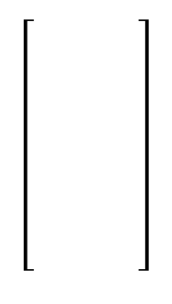




















$$\left[\begin{aligned}1 \\ 1 \\ 1 \\ 1 \\ 1 \\ 1 \\ 1 \end{aligned}\right]$$
$$α_{1,1}$$
$$α_{2,1}$$
$$α_{3,1}$$
$$α_{4,1}$$
$$α_{5,1}$$
$$k_{1}^{⊤}$$
$$α_{1,2}$$
$$α_{2,2}$$
$$α_{3,2}$$
$$α_{4,2}$$
$$α_{5,2}$$
$$k_{2}^{⊤}$$
$$q_{1}$$
$$q_{1}$$
$$q_{2}$$
$$q_{1}$$
$$q_{1}$$
$$q_{3}$$
$$q_{4}$$
$$q_{5}$$
$$α_{1,3}$$
$$α_{2,3}$$
$$α_{3,3}$$
$$α_{4,3}$$
$$α_{5,3}$$
$$=$$
$$k_{3}^{⊤}$$
$$q_{1}$$
$$α_{1,4}$$
$$α_{2,4}$$
$$α_{3,4}$$
$$α_{4,4}$$
$$α_{5,4}$$
$$k_{4}^{⊤}$$
$$α_{1,5}$$
$$α_{2,5}$$
$$α_{3,5}$$
$$α_{4,5}$$
$$α_{5,5}$$
$$k_{5}^{⊤}$$
$$q_{1}$$
$$k_{1}$$
$$v_{1}$$
$$q_{2}$$
$$k_{2}$$
$$v_{2}$$
$$q_{3}$$
$$k_{3}$$
$$v_{3}$$
$$q_{4}$$
$$k_{4}$$
$$v_{4}$$
$$q_{5}$$
$$k_{5}$$
$$v_{5}$$
$$W^{Q}$$
$${ W}^{K}$$
$${ W}^{V}$$
$$W^{Q}$$
$${ W}^{K}$$
$${ W}^{V}$$
$$W^{Q}$$
$${ W}^{K}$$
$${ W}^{V}$$
$$W^{Q}$$
$${ W}^{K}$$
$${ W}^{V}$$
$$W^{Q}$$
$${ W}^{K}$$
$${ W}^{V}$$
Embedded
Tokens
$$x_{1}$$
$$x_{2}$$
$$x_{3}$$
$$x_{4}$$
$$x_{5}$$
Tokens
I
bought
an
apple
watch

Slide 38


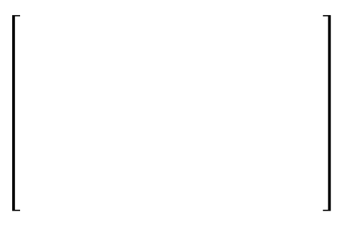















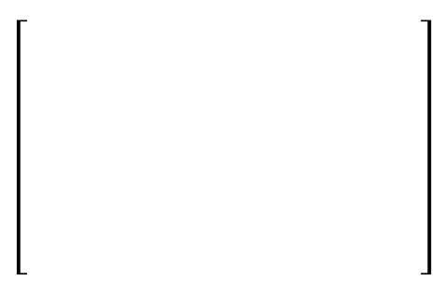






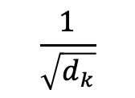


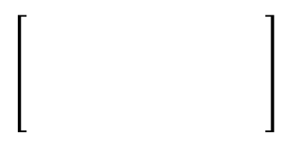
$$\frac{1}{\sqrt{d_{k}}}$$
$$\left[\begin{aligned}1 \\ 1 \\ 1 \\ 1 \\ 1 \\ 1 \\ 1 \end{aligned}\right]$$
$$\left[\begin{aligned}1 \\ 1 \\ 1 \\ 1 \\ 1 \\ 1 \\ 1 \end{aligned}\right]$$
$$α_{1,1}$$
$$α_{2,1}$$
$$α_{3,1}$$
$$α_{4,1}$$
$$α_{5,1}$$
$$k_{1}^{⊤}$$
$$α_{1,2}$$
$$α_{2,2}$$
$$α_{3,2}$$
$$α_{4,2}$$
$$α_{5,2}$$
$$k_{2}^{⊤}$$
$\left[\begin{aligned}= \\ 1 \\ 1 \\ 1 \end{aligned} \right]$
$$q_{1}$$
$$q_{1}$$
$$q_{2}$$
$$q_{1}$$
$$q_{1}$$
$$q_{3}$$
$$q_{4}$$
$$q_{5}$$
$$α_{1,3}$$
$$α_{2,3}$$
$$α_{3,3}$$
$$α_{4,3}$$
$$α_{5,3}$$
$$=$$
$$k_{3}^{⊤}$$
$$q_{1}$$
$$α_{1,4}$$
$$α_{2,4}$$
$$α_{3,4}$$
$$α_{4,4}$$
$$α_{5,4}$$
$$k_{4}^{⊤}$$
$$α_{1,5}$$
$$α_{2,5}$$
$$α_{3,5}$$
$$α_{4,5}$$
$$α_{5,5}$$
$$k_{5}^{⊤}$$
Softmax
$$\left[\begin{aligned}1 \\ 1 \\ 1 \\ 1 \\ 1 \\ 1 \\ 1 \end{aligned}\right]$$
$$α_{1,1}^{′}$$
$$α_{2,1}^{′}$$
$$α_{3,1}^{′}$$
$$α_{4,1}^{′}$$
$$α_{5,1}^{′}$$
$$α_{1,2}^{′}$$
$$α_{2,2}^{′}$$
$$α_{3,2}^{′}$$
$$α_{4,2}^{′}$$
$$α_{5,2}^{′}$$
$$α_{1,3}^{′}$$
$$α_{2,3}^{′}$$
$$α_{3,3}^{′}$$
$$α_{4,3}^{′}$$
$$α_{5,3}^{′}$$
$$α_{1,4}^{′}$$
$$α_{2,4}^{′}$$
$$α_{3,4}^{′}$$
$$α_{4,4}^{′}$$
$$α_{5,4}^{′}$$
$$α_{1,5}^{′}$$
$$α_{2,5}^{′}$$
$$α_{3,5}^{′}$$
$$α_{4,5}^{′}$$
$$α_{5,5}^{′}$$
$$q_{1}$$
$$k_{1}$$
$$v_{1}$$
$$q_{2}$$
$$k_{2}$$
$$v_{2}$$
$$q_{3}$$
$$k_{3}$$
$$v_{3}$$
$$q_{4}$$
$$k_{4}$$
$$v_{4}$$
$$q_{5}$$
$$k_{5}$$
$$v_{5}$$
$$W^{Q}$$
$${ W}^{K}$$
$${ W}^{V}$$
$$W^{Q}$$
$${ W}^{K}$$
$${ W}^{V}$$
$$W^{Q}$$
$${ W}^{K}$$
$${ W}^{V}$$
$$W^{Q}$$
$${ W}^{K}$$
$${ W}^{V}$$
$$W^{Q}$$
$${ W}^{K}$$
$${ W}^{V}$$
Embedded
Tokens
$$x_{1}$$
$$x_{2}$$
$$x_{3}$$
$$x_{4}$$
$$x_{5}$$
Tokens
I
bought
an
apple
watch

Slide 39


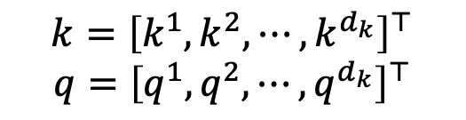

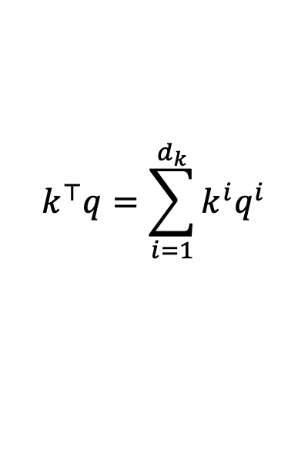
$$\frac{1}{\sqrt{d_{k}}}$$
$$\left[\begin{aligned}1 \\ 1 \\ 1 \\ 1 \\ 1 \\ 1 \\ 1 \end{aligned}\right]$$
$$\left[\begin{aligned}1 \\ 1 \\ 1 \\ 1 \\ 1 \\ 1 \\ 1 \end{aligned}\right]$$
$$α_{1,1}$$
$$α_{2,1}$$
$$α_{3,1}$$
$$α_{4,1}$$
$$α_{5,1}$$
$$k_{1}^{⊤}$$
$$α_{1,2}$$
$$α_{2,2}$$
$$α_{3,2}$$
$$α_{4,2}$$
$$α_{5,2}$$
$$k_{2}^{⊤}$$
$\left[\begin{aligned}= \\ 1 \\ 1 \\ 1 \end{aligned} \right]$
$$q_{1}$$
$$q_{1}$$
$$q_{2}$$
$$q_{1}$$
$$q_{1}$$
$$q_{3}$$
$$q_{4}$$
$$q_{5}$$
$$α_{1,3}$$
$$α_{2,3}$$
$$α_{3,3}$$
$$α_{4,3}$$
$$α_{5,3}$$
$$=$$
$$k_{3}^{⊤}$$
$$q_{1}$$
$$α_{1,4}$$
$$α_{2,4}$$
$$α_{3,4}$$
$$α_{4,4}$$
$$α_{5,4}$$
$$k_{4}^{⊤}$$
$$α_{1,5}$$
$$α_{2,5}$$
$$α_{3,5}$$
$$α_{4,5}$$
$$α_{5,5}$$
$$k_{5}^{⊤}$$
Softmax
$$k={\left[k^{1},k^{2},⋯,k^{d_{k}}\right]}^{⊤}$$
$$q={\left[q^{1},q^{2},⋯,q^{d_{k}}\right]}^{⊤}$$
$$E\left[k^{i}\right]=E\left[q^{i}\right]=0$$
$$\left[\begin{aligned}1 \\ 1 \\ 1 \\ 1 \\ 1 \\ 1 \\ 1 \end{aligned}\right]$$
$$α_{1,1}^{′}$$
$$α_{2,1}^{′}$$
$$α_{3,1}^{′}$$
$$α_{4,1}^{′}$$
$$α_{5,1}^{′}$$
$$α_{1,2}^{′}$$
$$α_{2,2}^{′}$$
$$α_{3,2}^{′}$$
$$α_{4,2}^{′}$$
$$α_{5,2}^{′}$$
$$Var\left[k^{i}\right]=Var\left[q^{i}\right]=1$$
$$α_{1,3}^{′}$$
$$α_{2,3}^{′}$$
$$α_{3,3}^{′}$$
$$α_{4,3}^{′}$$
$$α_{5,3}^{′}$$
$$k^{⊤}q=\sum_{i=1}^{d_{k}}{k^{i}q^{i}}$$
$$α_{1,4}^{′}$$
$$α_{2,4}^{′}$$
$$α_{3,4}^{′}$$
$$α_{4,4}^{′}$$
$$α_{5,4}^{′}$$
$$α_{1,5}^{′}$$
$$α_{2,5}^{′}$$
$$α_{3,5}^{′}$$
$$α_{4,5}^{′}$$
$$α_{5,5}^{′}$$
$$Var\left[k^{⊤}q\right]=d_{k}$$
$$q_{1}$$
$$k_{1}$$
$$v_{1}$$
$$q_{2}$$
$$k_{2}$$
$$v_{2}$$
$$q_{3}$$
$$k_{3}$$
$$v_{3}$$
$$q_{4}$$
$$k_{4}$$
$$v_{4}$$
$$q_{5}$$
$$k_{5}$$
$$v_{5}$$
$$W^{Q}$$
$${ W}^{K}$$
$${ W}^{V}$$
$$W^{Q}$$
$${ W}^{K}$$
$${ W}^{V}$$
$$W^{Q}$$
$${ W}^{K}$$
$${ W}^{V}$$
$$W^{Q}$$
$${ W}^{K}$$
$${ W}^{V}$$
$$W^{Q}$$
$${ W}^{K}$$
$${ W}^{V}$$
Embedded
Tokens
$$x_{1}$$
$$x_{2}$$
$$x_{3}$$
$$x_{4}$$
$$x_{5}$$
Tokens
I
bought
an
apple
watch

Slide 40

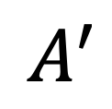


$$\frac{1}{\sqrt{d_{k}}}$$
$$\left[\begin{aligned}1 \\ 1 \\ 1 \\ 1 \\ 1 \\ 1 \\ 1 \end{aligned}\right]$$
$$\left[\begin{aligned}1 \\ 1 \\ 1 \\ 1 \\ 1 \\ 1 \\ 1 \end{aligned}\right]$$
$$α_{1,1}$$
$$α_{2,1}$$
$$α_{3,1}$$
$$α_{4,1}$$
$$α_{5,1}$$
$$k_{1}^{⊤}$$
$$α_{1,2}$$
$$α_{2,2}$$
$$α_{3,2}$$
$$α_{4,2}$$
$$α_{5,2}$$
$$k_{2}^{⊤}$$
$\left[\begin{aligned}= \\ 1 \\ 1 \\ 1 \end{aligned} \right]$
$$A$$
$$K^{⊤}$$
$$Q$$
$$q_{1}$$
$$q_{1}$$
$$q_{2}$$
$$q_{1}$$
$$q_{1}$$
$$q_{3}$$
$$q_{4}$$
$$q_{5}$$
$$α_{1,3}$$
$$α_{2,3}$$
$$α_{3,3}$$
$$α_{4,3}$$
$$α_{5,3}$$
$$=$$
$$k_{3}^{⊤}$$
$$q_{1}$$
$$α_{1,4}$$
$$α_{2,4}$$
$$α_{3,4}$$
$$α_{4,4}$$
$$α_{5,4}$$
$$k_{4}^{⊤}$$
$$α_{1,5}$$
$$α_{2,5}$$
$$α_{3,5}$$
$$α_{4,5}$$
$$α_{5,5}$$
$$k_{5}^{⊤}$$
Softmax
$$\left[\begin{aligned}1 \\ 1 \\ 1 \\ 1 \\ 1 \\ 1 \\ 1 \end{aligned}\right]$$
$$α_{1,1}^{′}$$
$$α_{2,1}^{′}$$
$$α_{3,1}^{′}$$
$$α_{4,1}^{′}$$
$$α_{5,1}^{′}$$
$$α_{1,2}^{′}$$
$$α_{2,2}^{′}$$
$$α_{3,2}^{′}$$
$$α_{4,2}^{′}$$
$$α_{5,2}^{′}$$
$$A^{′}$$
$$α_{1,3}^{′}$$
$$α_{2,3}^{′}$$
$$α_{3,3}^{′}$$
$$α_{4,3}^{′}$$
$$α_{5,3}^{′}$$
$$α_{1,4}^{′}$$
$$α_{2,4}^{′}$$
$$α_{3,4}^{′}$$
$$α_{4,4}^{′}$$
$$α_{5,4}^{′}$$
$$α_{1,5}^{′}$$
$$α_{2,5}^{′}$$
$$α_{3,5}^{′}$$
$$α_{4,5}^{′}$$
$$α_{5,5}^{′}$$
$$q_{1}$$
$$k_{1}$$
$$v_{1}$$
$$q_{2}$$
$$k_{2}$$
$$v_{2}$$
$$q_{3}$$
$$k_{3}$$
$$v_{3}$$
$$q_{4}$$
$$k_{4}$$
$$v_{4}$$
$$q_{5}$$
$$k_{5}$$
$$v_{5}$$
$$W^{Q}$$
$${ W}^{K}$$
$${ W}^{V}$$
$$W^{Q}$$
$${ W}^{K}$$
$${ W}^{V}$$
$$W^{Q}$$
$${ W}^{K}$$
$${ W}^{V}$$
$$W^{Q}$$
$${ W}^{K}$$
$${ W}^{V}$$
$$W^{Q}$$
$${ W}^{K}$$
$${ W}^{V}$$
Embedded
Tokens
$$x_{1}$$
$$x_{2}$$
$$x_{3}$$
$$x_{4}$$
$$x_{5}$$
Tokens
I
bought
an
apple
watch

Slide 41






































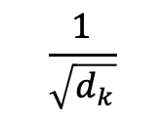













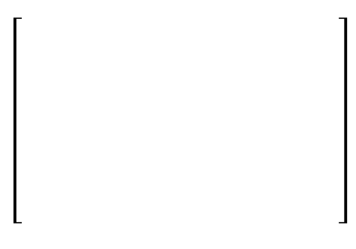


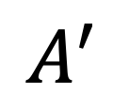













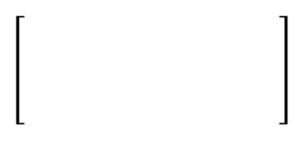









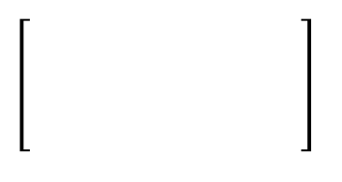
















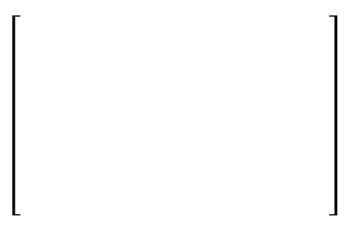




$$\frac{1}{\sqrt{d_{k}}}$$
$$\left[\begin{aligned}1 \\ 1 \\ 1 \\ 1 \\ 1 \\ 1 \\ 1 \end{aligned}\right]$$
$$\left[\begin{aligned}1 \\ 1 \\ 1 \\ 1 \\ 1 \\ 1 \\ 1 \end{aligned}\right]$$
$$α_{1,1}$$
$$α_{2,1}$$
$$α_{3,1}$$
$$α_{4,1}$$
$$α_{5,1}$$
$$k_{1}^{⊤}$$
$$α_{1,2}$$
$$α_{2,2}$$
$$α_{3,2}$$
$$α_{4,2}$$
$$α_{5,2}$$
$$k_{2}^{⊤}$$
$\left[\begin{aligned}= \\ 1 \\ 1 \\ 1 \end{aligned} \right]$
$$A$$
$$K^{⊤}$$
$$Q$$
$$q_{1}$$
$$q_{1}$$
$$q_{2}$$
$$q_{1}$$
$$q_{1}$$
$$q_{3}$$
$$q_{4}$$
$$q_{5}$$
$$α_{1,3}$$
$$α_{2,3}$$
$$α_{3,3}$$
$$α_{4,3}$$
$$α_{5,3}$$
$$=$$
$$k_{3}^{⊤}$$
$$q_{1}$$
$$α_{1,4}$$
$$α_{2,4}$$
$$α_{3,4}$$
$$α_{4,4}$$
$$α_{5,4}$$
$$k_{4}^{⊤}$$
$$α_{1,5}$$
$$α_{2,5}$$
$$α_{3,5}$$
$$α_{4,5}$$
$$α_{5,5}$$
$$k_{5}^{⊤}$$
Softmax
$$\left[\begin{aligned}1 \\ 1 \\ 1 \\ 1 \\ 1 \\ 1 \\ 1 \end{aligned}\right]$$
$$\left[\begin{aligned}1 \\ 1 \\ 1 \\ 1 \\ 1 \\ 1 \\ 1 \end{aligned}\right]$$
$$α_{1,1}^{′}$$
$$α_{2,1}^{′}$$
$$α_{3,1}^{′}$$
$$α_{4,1}^{′}$$
$$α_{5,1}^{′}$$
$$α_{1,1}^{′}$$
$$α_{2,1}^{′}$$
$$α_{3,1}^{′}$$
$$α_{4,1}^{′}$$
$$α_{5,1}^{′}$$
$$α_{1,2}^{′}$$
$$α_{2,2}^{′}$$
$$α_{3,2}^{′}$$
$$α_{4,2}^{′}$$
$$α_{5,2}^{′}$$
$\left[\begin{aligned}= \\ 1 \\ 1 \\ 1. \end{aligned} \right]$
$\left[\begin{aligned}= \\ 1 \\ 1 \\ 1 \end{aligned} \right]$
$$α_{1,2}^{′}$$
$$α_{2,2}^{′}$$
$$α_{3,2}^{′}$$
$$α_{4,2}^{′}$$
$$α_{5,2}^{′}$$
$$A^{′}$$
$$A^{′}$$
$$q_{1}$$
$$v_{1}$$
$$v_{2}$$
$$q_{1}$$
$$q_{1}$$
$$v_{3}$$
$$v_{4}$$
$$v_{5}$$
$$α_{1,3}^{′}$$
$$α_{2,3}^{′}$$
$$α_{3,3}^{′}$$
$$α_{4,3}^{′}$$
$$α_{5,3}^{′}$$
$$x_{1}^{′}$$
$$x_{2}^{′}$$
$$x_{3}^{′}$$
$$x_{4}^{′}$$
$$x_{5}^{′}$$
$$=$$
$$q_{1}$$
$$α_{1,3}^{′}$$
$$α_{2,3}^{′}$$
$$α_{3,3}^{′}$$
$$α_{4,3}^{′}$$
$$α_{5,3}^{′}$$
$$α_{1,4}^{′}$$
$$α_{2,4}^{′}$$
$$α_{3,4}^{′}$$
$$α_{4,4}^{′}$$
$$α_{5,4}^{′}$$
$$α_{1,4}^{′}$$
$$α_{2,4}^{′}$$
$$α_{3,4}^{′}$$
$$α_{4,4}^{′}$$
$$α_{5,4}^{′}$$
$$α_{1,5}^{′}$$
$$α_{2,5}^{′}$$
$$α_{3,5}^{′}$$
$$α_{4,5}^{′}$$
$$α_{5,5}^{′}$$
Output features
$$α_{1,5}^{′}$$
$$α_{2,5}^{′}$$
$$α_{3,5}^{′}$$
$$α_{4,5}^{′}$$
$$α_{5,5}^{′}$$
$$q_{1}$$
$$k_{1}$$
$$v_{1}$$
$$q_{2}$$
$$k_{2}$$
$$v_{2}$$
$$q_{3}$$
$$k_{3}$$
$$v_{3}$$
$$q_{4}$$
$$k_{4}$$
$$v_{4}$$
$$q_{5}$$
$$k_{5}$$
$$v_{5}$$
$$W^{Q}$$
$${ W}^{K}$$
$${ W}^{V}$$
$$W^{Q}$$
$${ W}^{K}$$
$${ W}^{V}$$
$$W^{Q}$$
$${ W}^{K}$$
$${ W}^{V}$$
$$W^{Q}$$
$${ W}^{K}$$
$${ W}^{V}$$
$$W^{Q}$$
$${ W}^{K}$$
$${ W}^{V}$$
Embedded
Tokens
$$x_{1}$$
$$x_{2}$$
$$x_{3}$$
$$x_{4}$$
$$x_{5}$$
Tokens
I
bought
an
apple
watch
$$V$$

Slide 42











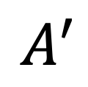














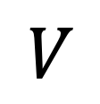


$$\frac{1}{\sqrt{d_{k}}}$$
$$\left[\begin{aligned}1 \\ 1 \\ 1 \\ 1 \\ 1 \\ 1 \\ 1 \end{aligned}\right]$$
$$\left[\begin{aligned}1 \\ 1 \\ 1 \\ 1 \\ 1 \\ 1 \\ 1 \end{aligned}\right]$$
$$Q$$
$$=$$
$$α_{1,1}$$
$$α_{2,1}$$
$$α_{3,1}$$
$$α_{4,1}$$
$$α_{5,1}$$
$$k_{1}^{⊤}$$
$$W^{Q}$$
$$x_{1}$$
$$x_{2}$$
$$x_{3}$$
$$x_{4}$$
$$x_{5}$$
$$α_{1,2}$$
$$α_{2,2}$$
$$α_{3,2}$$
$$α_{4,2}$$
$$α_{5,2}$$
$$k_{2}^{⊤}$$
$\left[\begin{aligned}= \\ 1 \\ 1 \\ 1 \end{aligned} \right]$
$$K$$
$$A$$
$$K^{⊤}$$
$$Q$$
$$=$$
$${ W}^{K}$$
$$q_{1}$$
$$q_{1}$$
$$q_{2}$$
$$q_{1}$$
$$q_{1}$$
$$q_{3}$$
$$q_{4}$$
$$q_{5}$$
$$α_{1,3}$$
$$α_{2,3}$$
$$α_{3,3}$$
$$α_{4,3}$$
$$α_{5,3}$$
$$=$$
$$k_{3}^{⊤}$$
$$q_{1}$$
$$x_{1}$$
$$x_{2}$$
$$x_{3}$$
$$x_{4}$$
$$x_{5}$$
$$α_{1,4}$$
$$α_{2,4}$$
$$α_{3,4}$$
$$α_{4,4}$$
$$α_{5,4}$$
$$k_{4}^{⊤}$$
$$α_{1,5}$$
$$α_{2,5}$$
$$α_{3,5}$$
$$α_{4,5}$$
$$α_{5,5}$$
$$V$$
$$=$$
$${ W}^{V}$$
$$k_{5}^{⊤}$$
$$x_{1}$$
$$x_{2}$$
$$x_{3}$$
$$x_{4}$$
$$x_{5}$$
Softmax
$$\left[\begin{aligned}1 \\ 1 \\ 1 \\ 1 \\ 1 \\ 1 \\ 1 \end{aligned}\right]$$
$$\left[\begin{aligned}1 \\ 1 \\ 1 \\ 1 \\ 1 \\ 1 \\ 1 \end{aligned}\right]$$
$$α_{1,1}^{′}$$
$$α_{2,1}^{′}$$
$$α_{3,1}^{′}$$
$$α_{4,1}^{′}$$
$$α_{5,1}^{′}$$
$$α_{1,1}^{′}$$
$$α_{2,1}^{′}$$
$$α_{3,1}^{′}$$
$$α_{4,1}^{′}$$
$$α_{5,1}^{′}$$
$$α_{1,2}^{′}$$
$$α_{2,2}^{′}$$
$$α_{3,2}^{′}$$
$$α_{4,2}^{′}$$
$$α_{5,2}^{′}$$
$\left[\begin{aligned}= \\ 1 \\ 1 \\ 1. \end{aligned} \right]$
$\left[\begin{aligned}= \\ 1 \\ 1 \\ 1 \end{aligned} \right]$
$$α_{1,2}^{′}$$
$$α_{2,2}^{′}$$
$$α_{3,2}^{′}$$
$$α_{4,2}^{′}$$
$$α_{5,2}^{′}$$
$$A^{′}$$
$$V$$
$$A^{′}$$
$$q_{1}$$
$$v_{1}$$
$$v_{2}$$
$$q_{1}$$
$$q_{1}$$
$$v_{3}$$
$$v_{4}$$
$$v_{5}$$
$$α_{1,3}^{′}$$
$$α_{2,3}^{′}$$
$$α_{3,3}^{′}$$
$$α_{4,3}^{′}$$
$$α_{5,3}^{′}$$
$$x_{1}^{′}$$
$$x_{2}^{′}$$
$$x_{3}^{′}$$
$$x_{4}^{′}$$
$$x_{5}^{′}$$
$$=$$
$$q_{1}$$
$$α_{1,3}^{′}$$
$$α_{2,3}^{′}$$
$$α_{3,3}^{′}$$
$$α_{4,3}^{′}$$
$$α_{5,3}^{′}$$
$$α_{1,4}^{′}$$
$$α_{2,4}^{′}$$
$$α_{3,4}^{′}$$
$$α_{4,4}^{′}$$
$$α_{5,4}^{′}$$
$$α_{1,4}^{′}$$
$$α_{2,4}^{′}$$
$$α_{3,4}^{′}$$
$$α_{4,4}^{′}$$
$$α_{5,4}^{′}$$
$$α_{1,5}^{′}$$
$$α_{2,5}^{′}$$
$$α_{3,5}^{′}$$
$$α_{4,5}^{′}$$
$$α_{5,5}^{′}$$
Output features
$$α_{1,5}^{′}$$
$$α_{2,5}^{′}$$
$$α_{3,5}^{′}$$
$$α_{4,5}^{′}$$
$$α_{5,5}^{′}$$
$$q_{1}$$
$$k_{1}$$
$$v_{1}$$
$$q_{2}$$
$$k_{2}$$
$$v_{2}$$
$$q_{3}$$
$$k_{3}$$
$$v_{3}$$
$$q_{4}$$
$$k_{4}$$
$$v_{4}$$
$$q_{5}$$
$$k_{5}$$
$$v_{5}$$
$$W^{Q}$$
$${ W}^{K}$$
$${ W}^{V}$$
$$W^{Q}$$
$${ W}^{K}$$
$${ W}^{V}$$
$$W^{Q}$$
$${ W}^{K}$$
$${ W}^{V}$$
$$W^{Q}$$
$${ W}^{K}$$
$${ W}^{V}$$
$$W^{Q}$$
$${ W}^{K}$$
$${ W}^{V}$$
Embedded
Tokens
$$x_{1}$$
$$x_{2}$$
$$x_{3}$$
$$x_{4}$$
$$x_{5}$$
Tokens
I
bought
an
apple
watch
$$V$$

Slide 43

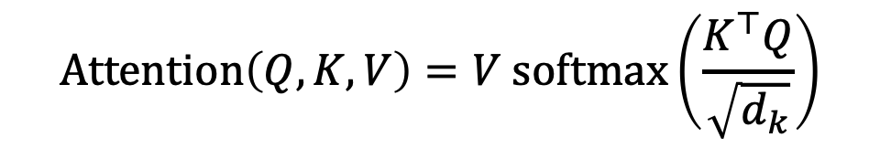
$$Q$$
$$=$$
$$W^{Q}$$
Single-head attention
$$x_{1}$$
$$x_{2}$$
$$x_{3}$$
$$x_{4}$$
$$x_{5}$$
$$Attention\left(Q, K, V\right)=V softmax\left(\frac{K^{⊤}Q}{\sqrt{d_{k}}}\right)$$
$$K$$
$$=$$
$${ W}^{K}$$
$$x_{1}$$
$$x_{2}$$
$$x_{3}$$
$$x_{4}$$
$$x_{5}$$
$$V$$
$$=$$
$${ W}^{V}$$
$$x_{1}$$
$$x_{2}$$
$$x_{3}$$
$$x_{4}$$
$$x_{5}$$
$$q_{1}$$
$$k_{1}$$
$$v_{1}$$
$$q_{2}$$
$$k_{2}$$
$$v_{2}$$
$$q_{3}$$
$$k_{3}$$
$$v_{3}$$
$$q_{4}$$
$$k_{4}$$
$$v_{4}$$
$$q_{5}$$
$$k_{5}$$
$$v_{5}$$
$$W^{Q}$$
$${ W}^{K}$$
$${ W}^{V}$$
$$W^{Q}$$
$${ W}^{K}$$
$${ W}^{V}$$
$$W^{Q}$$
$${ W}^{K}$$
$${ W}^{V}$$
$$W^{Q}$$
$${ W}^{K}$$
$${ W}^{V}$$
$$W^{Q}$$
$${ W}^{K}$$
$${ W}^{V}$$
Embedded
Tokens
$$x_{1}$$
$$x_{2}$$
$$x_{3}$$
$$x_{4}$$
$$x_{5}$$
Tokens
I
bought
an
apple
watch

Slide 44










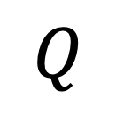








$$Q$$
$$Q$$
$$Q$$
$$Q$$
$$=$$
$$W^{Q}$$
Single-head attention
$$x_{1}$$
$$x_{2}$$
$$x_{3}$$
$$x_{4}$$
$$x_{5}$$
$$K$$
$$K$$
$$K$$
$$Attention\left(Q, K, V\right)=V softmax\left(\frac{K^{⊤}Q}{\sqrt{d_{k}}}\right)$$
$$K$$
$$=$$
$${ W}^{K}$$
$$x_{1}$$
$$x_{2}$$
$$x_{3}$$
$$x_{4}$$
$$x_{5}$$
$$V$$
$$V$$
$$V$$
$$V$$
$$=$$
$${ W}^{V}$$
$$x_{1}$$
$$x_{2}$$
$$x_{3}$$
$$x_{4}$$
$$x_{5}$$
$$W_{0}^{Q}$$
$$W_{0}^{Q}$$
$$W_{0}^{K}$$
$$W_{0}^{K}$$
$$W_{0}^{V}$$
$$W_{0}^{V}$$
$$W_{1}^{Q}$$
$$W_{1}^{Q}$$
$$W_{1}^{K}$$
$$W_{1}^{K}$$
$$W_{1}^{V}$$
$$W_{1}^{V}$$
$$W_{h−1}^{Q}$$
$$W_{h−1}^{Q}$$
$$W_{h−1}^{K}$$
$$W_{h−1}^{K}$$
$$W_{h−1}^{V}$$
$$⋯$$
$$W_{h−1}^{V}$$
$$W_{i}^{Q}$$
$$∈R^{d_{k}×d}$$
$$W_{i}^{K}$$
$$∈R^{d_{k}×d}$$
$$W_{i}^{V}$$
$$∈R^{d_{v}×d}$$

Slide 45









$$Q$$
$$Q$$
$$Q$$
$$=$$
$$W^{Q}$$
Single-head attention
$$x_{1}$$
$$x_{2}$$
$$x_{3}$$
$$x_{4}$$
$$x_{5}$$
$$K$$
$$K$$
$$Attention\left(Q, K, V\right)=V softmax\left(\frac{K^{⊤}Q}{\sqrt{d_{k}}}\right)$$
$$K$$
$$=$$
$${ W}^{K}$$
$$x_{1}$$
$$x_{2}$$
$$x_{3}$$
$$x_{4}$$
$$x_{5}$$
$$V$$
$$V$$
$$V$$
$$=$$
$${ W}^{V}$$
$$x_{1}$$
$$x_{2}$$
$$x_{3}$$
$$x_{4}$$
$$x_{5}$$
$$W_{0}^{Q}$$
$$W_{0}^{K}$$
$$W_{0}^{V}$$
$$W_{1}^{Q}$$
$$W_{1}^{Q}$$
$$W_{1}^{K}$$
$$W_{1}^{K}$$
$$W_{1}^{V}$$
$$W_{1}^{V}$$
$$W_{h−1}^{Q}$$
$$W_{h−1}^{Q}$$
$$W_{h−1}^{K}$$
$$W_{h−1}^{K}$$
$$W_{h−1}^{V}$$
$$⋯$$
$$W_{h−1}^{V}$$
$$W_{i}^{Q}$$
$$∈R^{d_{k}×d}$$
$$W_{0}^{Q}$$
$$Q$$
$$W_{0}^{K}$$
$$K$$
$$W_{0}^{V}$$
$$V$$
$$W_{i}^{K}$$
$$∈R^{d_{k}×d}$$
$$Attention$$
$$W_{i}^{V}$$
$$∈R^{d_{v}×d}$$
$${Head}_{0}$$
$$∈R^{d_{v}×n}$$

Slide 46












$$Q$$
$$Q$$
$$=$$
$$W^{Q}$$
Single-head attention
$$x_{1}$$
$$x_{2}$$
$$x_{3}$$
$$x_{4}$$
$$x_{5}$$
$$K$$
$$Attention\left(Q, K, V\right)=V softmax\left(\frac{K^{⊤}Q}{\sqrt{d_{k}}}\right)$$
$$K$$
$$=$$
$${ W}^{K}$$
$$x_{1}$$
$$x_{2}$$
$$x_{3}$$
$$x_{4}$$
$$x_{5}$$
$$V$$
$$V$$
$$=$$
$${ W}^{V}$$
$$x_{1}$$
$$x_{2}$$
$$x_{3}$$
$$x_{4}$$
$$x_{5}$$
$$W_{0}^{Q}$$
$$W_{0}^{K}$$
$$W_{0}^{V}$$
$$W_{1}^{Q}$$
$$W_{1}^{K}$$
$$W_{1}^{V}$$
$$W_{h−1}^{Q}$$
$$W_{h−1}^{Q}$$
$$W_{h−1}^{K}$$
$$W_{h−1}^{K}$$
$$W_{h−1}^{V}$$
$$⋯$$
$$W_{h−1}^{V}$$
$$W_{i}^{Q}$$
$$∈R^{d_{k}×d}$$
$$W_{0}^{Q}$$
$$Q$$
$$W_{0}^{K}$$
$$K$$
$$W_{0}^{V}$$
$$V$$
$$W_{1}^{Q}$$
$$Q$$
$$W_{1}^{K}$$
$$K$$
$$W_{1}^{V}$$
$$V$$
$$W_{i}^{K}$$
$$∈R^{d_{k}×d}$$
$$Attention$$
$$Attention$$
$$W_{i}^{V}$$
$${Head}_{0}$$
$$∈R^{d_{v}×n}$$
$${Head}_{1}$$
$$∈R^{d_{v}×n}$$
$$⋯$$
$${Head}_{h−1}$$
$$∈R^{d_{v}×n}$$
$$∈R^{d_{v}×d}$$

Slide 47
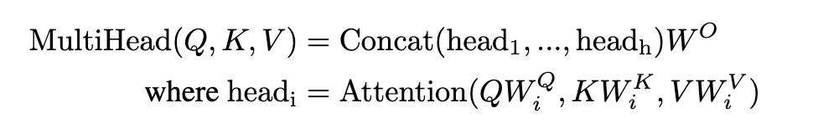



$$Q$$
$$Q$$
$$=$$
$$W^{Q}$$
Single-head attention
$$x_{1}$$
$$x_{2}$$
$$x_{3}$$
$$x_{4}$$
$$x_{5}$$
$$K$$
$$Attention\left(Q, K, V\right)=V softmax\left(\frac{K^{⊤}Q}{\sqrt{d_{k}}}\right)$$
$$K$$
$$=$$
$${ W}^{K}$$
$$x_{1}$$
$$x_{2}$$
$$x_{3}$$
$$x_{4}$$
$$x_{5}$$
$$V$$
$$V$$
$$=$$
$${ W}^{V}$$
$$x_{1}$$
$$x_{2}$$
$$x_{3}$$
$$x_{4}$$
$$x_{5}$$
$$W_{0}^{Q}$$
$$W_{0}^{K}$$
$$W_{0}^{V}$$
$$W_{1}^{Q}$$
$$W_{1}^{K}$$
$$W_{1}^{V}$$
$$W_{h−1}^{Q}$$
$$W_{h−1}^{Q}$$
$$W_{h−1}^{K}$$
$$W_{h−1}^{K}$$
$$W_{h−1}^{V}$$
$$⋯$$
$$W_{h−1}^{V}$$
$$W_{i}^{Q}$$
$$∈R^{d_{k}×d}$$
$$W_{0}^{Q}$$
$$Q$$
$$W_{0}^{K}$$
$$K$$
$$W_{0}^{V}$$
$$V$$
$$W_{1}^{Q}$$
$$Q$$
$$W_{1}^{K}$$
$$K$$
$$W_{1}^{V}$$
$$V$$
$$W_{i}^{K}$$
$$∈R^{d_{k}×d}$$
$$Attention$$
$$Attention$$
$${Head}_{0}$$
$$∈R^{d_{v}×n}$$
$$∈R^{d_{v}×n}$$
$$⋯$$
$${Head}_{h−1}$$
$$∈R^{d_{v}×n}$$
$${Head}_{0}$$
$${Head}_{1}$$
$${Head}_{h−1}$$
$$W_{i}^{V}$$
$$∈R^{d_{v}×d}$$
$${Head}_{1}$$

Slide 48




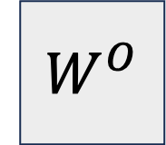
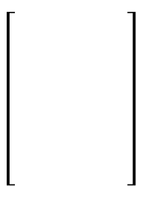




$$Q$$
$$Q$$
$$=$$
$$W^{Q}$$
Single-head attention
$$x_{1}$$
$$x_{2}$$
$$x_{3}$$
$$x_{4}$$
$$x_{5}$$
$$K$$
$$Attention\left(Q, K, V\right)=V softmax\left(\frac{K^{⊤}Q}{\sqrt{d_{k}}}\right)$$
$$K$$
$$=$$
$${ W}^{K}$$
$$x_{1}$$
$$x_{2}$$
$$x_{3}$$
$$x_{4}$$
$$x_{5}$$
$$V$$
$$V$$
$$=$$
$${ W}^{V}$$
Multi-head attention
$$x_{1}$$
$$x_{2}$$
$$x_{3}$$
$$x_{4}$$
$$x_{5}$$
$$W_{0}^{Q}$$
$$W_{0}^{K}$$
$$W_{0}^{V}$$
$$W_{1}^{Q}$$
$$W_{1}^{K}$$
$$W_{1}^{V}$$
$$W_{h−1}^{Q}$$
$$W_{h−1}^{Q}$$
$$W_{h−1}^{K}$$
$$W_{h−1}^{K}$$
$$W_{h−1}^{V}$$
$$W^{O}$$
$$∈R^{d×hd_{v}}$$
$$⋯$$
$$W_{h−1}^{V}$$
$$W_{i}^{Q}$$
$$∈R^{d_{k}×d}$$
$$W_{0}^{Q}$$
$$Q$$
$$W_{0}^{K}$$
$$K$$
$$W_{0}^{V}$$
$$V$$
$$W_{1}^{Q}$$
$$Q$$
$$W_{1}^{K}$$
$$K$$
$$W_{1}^{V}$$
$$V$$
$$W_{i}^{K}$$
$$∈R^{d_{k}×d}$$
$$Attention$$
$$Attention$$
$$W_{i}^{V}$$
$${Head}_{0}$$
$$∈R^{d_{v}×n}$$
$${Head}_{1}$$
$$∈R^{d_{v}×n}$$
$$⋯$$
$${Head}_{h−1}$$
$$∈R^{d_{v}×n}$$
$$∈R^{d_{v}×d}$$
$${Head}_{0}$$
$$W^{O}$$
$${Head}_{1}$$
$$MultiHeadedAttention\left(Q, K, V\right)$$
$$=$$
$$⋮$$
$${Head}_{h−1}$$

Slide 49
Feed Forward Network (FFN)
$$FFN\left(x\right)=W_{2}ReLU\left(W_{1}x+b_{1}\right)+b_{2}$$
Feed Forward
Feed Forward
Feed Forward
Feed Forward
Feed Forward
Encoder #1
Multi-head Self-Attention
Embedded
Tokens
$$x_{1}$$
$$x_{2}$$
$$x_{3}$$
$$x_{4}$$
$$x_{5}$$
Tokens
I
bought
an
apple
watch

Slide 50
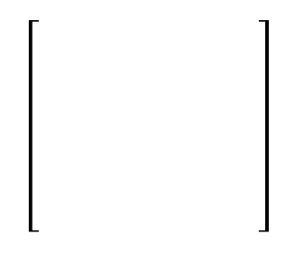





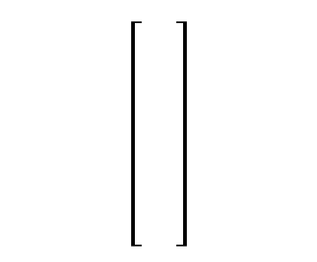

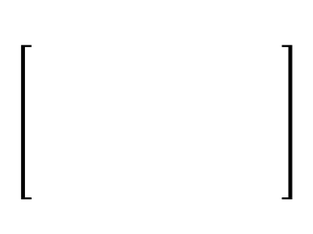
Feed Forward Network (FFN)
$$FFN\left(x\right)=W_{2}ReLU\left(W_{1}x+b_{1}\right)+b_{2}$$
$$⋮$$
$$ReLU$$
$$⋮$$
$$W_{2}$$
$$W_{1}$$
$$x$$
Feed Forward
Feed Forward
Feed Forward
Feed Forward
Feed Forward
Encoder #1
Multi-head Self-Attention
Embedded
Tokens
$$x_{1}$$
$$x_{2}$$
$$x_{3}$$
$$x_{4}$$
$$x_{5}$$
Tokens
I
bought
an
apple
watch

Slide 51
Feed Forward
Feed Forward
Feed Forward
Feed Forward
Feed Forward
Encoder #1
Multi-head Self-Attention
Embedded
Tokens
$$x_{1}$$
$$x_{2}$$
$$x_{3}$$
$$x_{4}$$
$$x_{5}$$
Tokens
I
bought
an
apple
watch

Slide 52





Feed Forward
Feed Forward
Feed Forward
Feed Forward
Feed Forward
Encoder #1
Multi-head Self-Attention
Embedded
Tokens
$$x_{5}$$
$$x_{3}$$
$$x_{4}$$
$$x_{1}$$
$$x_{2}$$
Tokens
watch
an
apple
I
bought

Slide 53
Positional encoding
Feed Forward
Feed Forward
Feed Forward
Feed Forward
Feed Forward
Encoder #1
Multi-head Self-Attention
Embedded
Tokens
$$x_{1}$$
$$x_{2}$$
$$x_{3}$$
$$x_{4}$$
$$x_{5}$$
Tokens
I
bought
an
apple
watch

Slide 54
Embedded
Tokens
$$x_{1}$$
$$x_{2}$$
$$x_{3}$$
$$x_{4}$$
$$x_{5}$$
Tokens
I
bought
an
apple
watch

Slide 55





Feed Forward
Feed Forward
Feed Forward
Feed Forward
Feed Forward
Encoder #1
Multi-head Self-Attention
Embedded
Tokens
$$x_{1}$$
$$x_{2}$$
$$x_{3}$$
$$x_{4}$$
$$x_{5}$$
Tokens
I
bought
an
apple
watch

Slide 56





Feed Forward
Feed Forward
Feed Forward
Feed Forward
Feed Forward
Encoder #1
Multi-head Self-Attention
Embedded
Tokens
$$x_{1}$$
$$x_{2}$$
$$x_{3}$$
$$x_{4}$$
$$x_{5}$$
Tokens
I
bought
an
apple
watch
Position
$$m=1$$
$$m=2$$
$$m=3$$
$$m=4$$
$$m=5$$

Slide 57
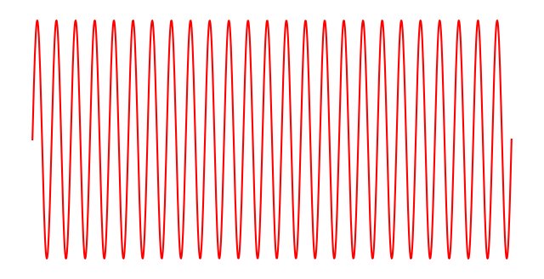
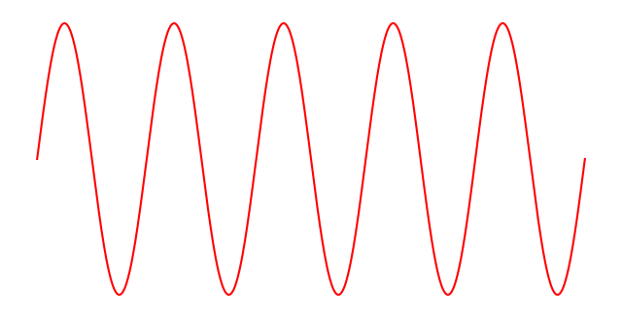
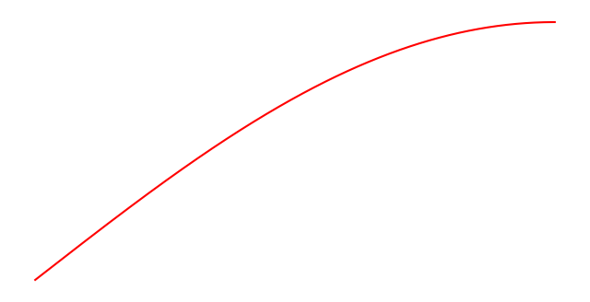

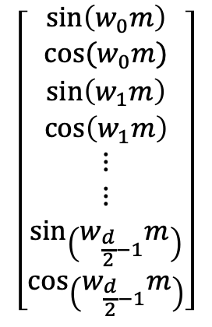



Feed Forward
Feed Forward
Feed Forward
Feed Forward
Feed Forward
Encoder #1
Multi-head Self-Attention
Embedded
Tokens
$$x_{1}$$
$$x_{2}$$
$$x_{3}$$
$$x_{4}$$
$$x_{5}$$
Tokens
I
bought
an
apple
watch
Position
$$m=1$$
$$m=2$$
$$m=3$$
$$m=4$$
$$m=5$$
Position $k$
$$\left[\begin{aligned}\sin\left(w_{0}m\right) \\ cos⁡(w_{0}m) \\ \sin\left(w_{1}m\right) \\ \cos\left(w_{1}m\right) \\ ⋮ \\ ⋮ \\ \sin\left(w_{\frac{d}{2}−1}m\right) \\ \cos\left(w_{\frac{d}{2}−1}m\right)\end{aligned}\right]$$
Fast oscillating
Angular frequency
$$w_{i}=N^{−2i/d}$$
$$d$$
Slow oscillating
$$N=100,000$$

Slide 58
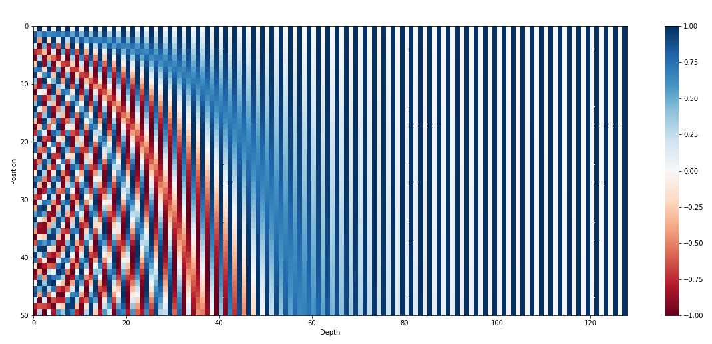

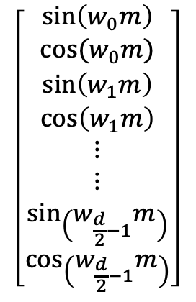
Feed Forward
Feed Forward
Feed Forward
Feed Forward
Feed Forward
Encoder #1
Multi-head Self-Attention
Embedded
Tokens
$$x_{1}$$
$$x_{2}$$
$$x_{3}$$
$$x_{4}$$
$$x_{5}$$
Tokens
I
bought
an
apple
watch
Position
$$m=1$$
$$m=2$$
$$m=3$$
$$m=4$$
$$m=5$$
$$\left[\begin{aligned}\sin\left(w_{0}m\right) \\ cos⁡(w_{0}m) \\ \sin\left(w_{1}m\right) \\ \cos\left(w_{1}m\right) \\ ⋮ \\ ⋮ \\ \sin\left(w_{\frac{d}{2}−1}m\right) \\ \cos\left(w_{\frac{d}{2}−1}m\right)\end{aligned}\right]$$
$$d$$

Slide 59
Feed Forward
Feed Forward
Feed Forward
Feed Forward
Feed Forward
Encoder #1
Multi-head Self-Attention
Embedded
Tokens
$$x_{1}$$
$$x_{2}$$
$$x_{3}$$
$$x_{4}$$
$$x_{5}$$
Tokens
I
bought
an
apple
watch
Position
$$m=1$$
$$m=2$$
$$m=3$$
$$m=4$$
$$m=5$$
$$\left[\begin{aligned}\sin\left(w_{0}m\right) \\ cos⁡(w_{0}m) \\ \sin\left(w_{1}m\right) \\ \cos\left(w_{1}m\right) \\ ⋮ \\ ⋮ \\ \sin\left(w_{\frac{d}{2}−1}m\right) \\ \cos\left(w_{\frac{d}{2}−1}m\right)\end{aligned}\right]$$
$$d$$

Slide 60
Feed Forward
Feed Forward
Feed Forward
Feed Forward
Feed Forward
Encoder #1
Multi-head Self-Attention
Embedded
Tokens
$$x_{1}$$
$$x_{2}$$
$$x_{3}$$
$$x_{4}$$
$$x_{5}$$
Tokens
I
bought
an
apple
watch
Position
$$m=1$$
$$m=2$$
$$m=3$$
$$m=4$$
$$m=5$$
$$\left[\begin{aligned}\sin\left(w_{0}m\right) \\ cos⁡(w_{0}m) \\ \sin\left(w_{1}m\right) \\ \cos\left(w_{1}m\right) \\ ⋮ \\ ⋮ \\ \sin\left(w_{\frac{d}{2}−1}m\right) \\ \cos\left(w_{\frac{d}{2}−1}m\right)\end{aligned}\right]$$
$$d$$

Slide 61







Positional encoding
Positional embedding
$$P_{1}$$
$$P_{2}$$
$$P_{3}$$
$$P_{4}$$
$$P_{5}$$
$$d$$
Embedded
Tokens
$$x_{1}$$
$$x_{2}$$
$$x_{3}$$
$$x_{4}$$
$$x_{5}$$
$$d$$
Tokens
I
bought
an
apple
watch

Slide 62





Feed Forward
Feed Forward
Feed Forward
Feed Forward
Feed Forward
Encoder #1
Multi-head Self-Attention
Embedded
Tokens
$$x_{1}$$
$$P_{1}$$
$$x_{2}$$
$$P_{2}$$
$$x_{3}$$
$$P_{3}$$
$$x_{4}$$
$$P_{4}$$
$$x_{5}$$
$$P_{5}$$
$$d$$
Tokens
I
bought
an
apple
watch

Slide 63
Feed Forward
Feed Forward
Feed Forward
Feed Forward
Feed Forward
Encoder #2
Multi-head Self-Attention
Feed Forward
Feed Forward
Feed Forward
Feed Forward
Feed Forward
Encoder #1
Multi-head Self-Attention
Embedded
Tokens
$$x_{1}$$
$$P_{1}$$
$$x_{2}$$
$$P_{2}$$
$$x_{3}$$
$$P_{3}$$
$$x_{4}$$
$$P_{4}$$
$$x_{5}$$
$$P_{5}$$
$$d$$
Tokens
I
bought
an
apple
watch

Slide 64
Feed Forward
Feed Forward
Feed Forward
Feed Forward
Feed Forward
Encoder #2
Multi-head Self-Attention
Feed Forward
Feed Forward
Feed Forward
Feed Forward
Feed Forward
Encoder #1
Multi-head Self-Attention
Embedded
Tokens
$$x_{1}$$
$$P_{1}$$
$$x_{2}$$
$$P_{2}$$
$$x_{3}$$
$$P_{3}$$
$$x_{4}$$
$$P_{4}$$
$$x_{5}$$
$$P_{5}$$
$$d$$
Tokens
I
bought
an
apple
watch

Slide 65
Residual connection
Feed Forward
Feed Forward
Feed Forward
Feed Forward
Feed Forward
Multi-head Self-Attention
Embedded
Tokens
$$x_{1}$$
$$P_{1}$$
$$x_{2}$$
$$P_{2}$$
$$x_{3}$$
$$P_{3}$$
$$x_{4}$$
$$P_{4}$$
$$x_{5}$$
$$P_{5}$$
$$d$$
Tokens
I
bought
an
apple
watch

Slide 66
Residual connection
Feed Forward
Feed Forward
Feed Forward
Feed Forward
Feed Forward
Multi-head Self-Attention
Embedded
Tokens
$$x_{1}$$
$$P_{1}$$
$$x_{2}$$
$$P_{2}$$
$$x_{3}$$
$$P_{3}$$
$$x_{4}$$
$$P_{4}$$
$$x_{5}$$
$$P_{5}$$
$$d$$
Tokens
I
bought
an
apple
watch

Slide 67
Residual connection
Layer normalization
LayerNorm
LayerNorm
LayerNorm
LayerNorm
LayerNorm
Feed Forward
Feed Forward
Feed Forward
Feed Forward
Feed Forward
LayerNorm
LayerNorm
LayerNorm
LayerNorm
LayerNorm
Multi-head Self-Attention
Embedded
Tokens
$$x_{1}$$
$$P_{1}$$
$$x_{2}$$
$$P_{2}$$
$$x_{3}$$
$$P_{3}$$
$$x_{4}$$
$$P_{4}$$
$$x_{5}$$
$$P_{5}$$
$$d$$
Tokens
I
bought
an
apple
watch

Slide 68


Residual connection
Layer normalization
LayerNorm
LayerNorm
LayerNorm
LayerNorm
LayerNorm
$$LayerNorm\left(x\right)=$$
$$γ\left(\frac{x−mean\left(x\right)}{\sqrt{Variance\left(x\right)+ε}}\right)+β$$
Feed Forward
Feed Forward
Feed Forward
Feed Forward
Feed Forward
LayerNorm
LayerNorm
LayerNorm
LayerNorm
LayerNorm
Multi-head Self-Attention
$$γ, β∈R$$
Learnable parameters
Embedded
Tokens
$$x_{1}$$
$$P_{1}$$
$$x_{2}$$
$$P_{2}$$
$$x_{3}$$
$$P_{3}$$
$$x_{4}$$
$$P_{4}$$
$$x_{5}$$
$$P_{5}$$
$$d$$
Tokens
I
bought
an
apple
watch

Slide 69
Residual connection
Layer normalization
$$LayerNorm\left(x\right)=$$
$$γ\left(\frac{x−mean\left(x\right)}{\sqrt{Variance\left(x\right)+ε}}\right)+β$$
Feed Forward
Feed Forward
Feed Forward
Feed Forward
Feed Forward
LayerNorm
LayerNorm
LayerNorm
LayerNorm
LayerNorm
Multi-head Self-Attention
$$γ, β∈R$$
Learnable parameters
LayerNorm
LayerNorm
LayerNorm
LayerNorm
LayerNorm
Embedded
Tokens
$$x_{1}$$
$$P_{1}$$
$$x_{2}$$
$$P_{2}$$
$$x_{3}$$
$$P_{3}$$
$$x_{4}$$
$$P_{4}$$
$$x_{5}$$
$$P_{5}$$
$$d$$
Tokens
I
bought
an
apple
watch
[Xiong et al. 2020] On Layer Normalization in the Transformer Architecture

Slide 70







Feed Forward
Feed Forward
Feed Forward
Feed Forward
Feed Forward
LayerNorm
LayerNorm
LayerNorm
LayerNorm
LayerNorm
Multi-head Self-Attention
LayerNorm
LayerNorm
LayerNorm
LayerNorm
LayerNorm
Embedded
Tokens
$$x_{1}$$
$$P_{1}$$
$$x_{2}$$
$$P_{2}$$
$$x_{3}$$
$$P_{3}$$
$$x_{4}$$
$$P_{4}$$
$$x_{5}$$
$$P_{5}$$
$$d$$
Tokens
I
bought
an
apple
watch

Slide 71
Encoder #6
Encoder #5
Encoder #4
Encoder #3
Encoder #2
Encoder #1
Embedded
Tokens
$$x_{1}$$
$$P_{1}$$
$$x_{2}$$
$$P_{2}$$
$$x_{3}$$
$$P_{3}$$
$$x_{4}$$
$$P_{4}$$
$$x_{5}$$
$$P_{5}$$
$$d$$
Tokens
I
bought
an
apple
watch

Slide 72
Encoder #6
Encoder #5
Encoder #4
Encoder #3
Encoder #2
Encoder #1
Embedded
Tokens
$$x_{1}$$
$$P_{1}$$
$$x_{2}$$
$$P_{2}$$
$$x_{3}$$
$$P_{3}$$
$$x_{4}$$
$$P_{4}$$
$$d$$
Tokens
How
are
you
?

Slide 73

Encoder #6
$$⋮$$
Encoder #1
Embedded
Tokens
$$x_{1}$$
$$P_{1}$$
$$x_{2}$$
$$P_{2}$$
$$x_{3}$$
$$P_{3}$$
$$x_{4}$$
$$P_{4}$$
$$d$$
Tokens
How
are
you
?

Slide 74
















吗
你
好
吃
饱
吗
$$⋯$$
？
<end>
你
好
吃
饱
$$⋯$$
？
Softmax
$$e_{1}$$
$$e_{2}$$
$$e_{3}$$
$$e_{4}$$
Linear
Encoder #$L$
Decoder #$L$
$$⋮$$
$$⋮$$
$$⋮$$
Encoder #1
Decoder #1
$$d$$
$$x_{1}$$
$$P_{1}$$
$$x_{2}$$
$$P_{2}$$
$$x_{3}$$
$$P_{3}$$
$$x_{4}$$
$$P_{4}$$
$$d$$
$$z_{1}$$
$$P_{1}$$
How
are
you
?
<start>

Slide 75


吗
你
好
吃
饱
吗
$$⋯$$
？
<end>
好
吃
饱
$$⋯$$
？
Softmax
$$e_{1}$$
$$e_{2}$$
$$e_{3}$$
$$e_{4}$$
Linear
Encoder #$L$
Decoder #$L$
$$⋮$$
$$⋮$$
$$⋮$$
Encoder #1
Decoder #1
$$d$$
$$x_{1}$$
$$P_{1}$$
$$x_{2}$$
$$P_{2}$$
$$x_{3}$$
$$P_{3}$$
$$x_{4}$$
$$P_{4}$$
$$d$$
$$z_{1}$$
$$P_{1}$$
$$z_{2}$$
$$P_{2}$$
How
are
you
?
<start>
你

Slide 76





你
好
吃
饱
吗
$$⋯$$
？
<end>
好
吃
饱
$$⋯$$
？
<end>
Softmax
$$z_{1}$$
$$z_{2}$$
$$z_{3}$$
$$z_{4}$$
Linear
Encoder #$L$
Decoder #$L$
$$⋮$$
$$⋮$$
$$⋮$$
Encoder #1
Decoder #1
$$d$$
$$x_{1}$$
$$P_{1}$$
$$x_{2}$$
$$P_{2}$$
$$x_{3}$$
$$P_{3}$$
$$x_{4}$$
$$P_{4}$$
$$d$$
$$z_{1}$$
$$P_{1}$$
$$z_{2}$$
$$P_{2}$$
How
are
you
?
<start>
你

Slide 77

你
好
吃
饱
吗
$$⋯$$
？
<end>
吃
饱
$$⋯$$
？
<end>
Softmax
$$e_{1}$$
$$e_{2}$$
$$e_{3}$$
$$e_{4}$$
Linear
Encoder #$L$
Decoder #$L$
$$⋮$$
$$⋮$$
$$⋮$$
Encoder #1
Decoder #1
$$d$$
$$x_{1}$$
$$P_{1}$$
$$x_{2}$$
$$P_{2}$$
$$x_{3}$$
$$P_{3}$$
$$x_{4}$$
$$P_{4}$$
$$d$$
$$z_{1}$$
$$P_{1}$$
$$z_{2}$$
$$P_{2}$$
$$z_{3}$$
$$P_{3}$$
How
are
you
?
<start>
你
好

Slide 78

你
好
吃
饱
吗
$$⋯$$
？
<end>
吃
饱
吗
$$⋯$$
？
Softmax
$$e_{1}$$
$$e_{2}$$
$$e_{3}$$
$$e_{4}$$
Linear
Encoder #$L$
Decoder #$L$
$$⋮$$
$$⋮$$
$$⋮$$
Encoder #1
Decoder #1
$$d$$
$$x_{1}$$
$$P_{1}$$
$$x_{2}$$
$$P_{2}$$
$$x_{3}$$
$$P_{3}$$
$$x_{4}$$
$$P_{4}$$
$$d$$
$$z_{1}$$
$$P_{1}$$
$$z_{2}$$
$$P_{2}$$
$$z_{3}$$
$$P_{3}$$
How
are
you
?
<start>
你
好

Slide 79

你
好
吃
饱
吗
$$⋯$$
？
<end>
吃
饱
$$⋯$$
？
Softmax
$$e_{1}$$
$$e_{2}$$
$$e_{3}$$
$$e_{4}$$
Linear
Encoder #$L$
Decoder #$L$
$$⋮$$
$$⋮$$
$$⋮$$
Encoder #1
Decoder #1
$$d$$
$$x_{1}$$
$$P_{1}$$
$$x_{2}$$
$$P_{2}$$
$$x_{3}$$
$$P_{3}$$
$$x_{4}$$
$$P_{4}$$
$$d$$
$$z_{1}$$
$$P_{1}$$
$$z_{2}$$
$$P_{2}$$
$$z_{3}$$
$$P_{3}$$
$$z_{4}$$
$$P_{4}$$
How
are
you
?
<start>
你
好
吗
？
<end>

Slide 80
$$e_{1}$$
$$e_{2}$$
$$e_{3}$$
$$e_{4}$$
Encoder #$L$
$$⋮$$
Encoder #1
Decoder #1
$$d$$
$$x_{1}$$
$$P_{1}$$
$$x_{2}$$
$$P_{2}$$
$$x_{3}$$
$$P_{3}$$
$$x_{4}$$
$$P_{4}$$
$$d$$
$$z_{1}$$
$$P_{1}$$
$$z_{2}$$
$$P_{2}$$
$$z_{3}$$
$$P_{3}$$
$$z_{4}$$
$$P_{4}$$
How
are
you
?
<start>
你
好
吗
？
<end>

Slide 81
$$e_{1}$$
$$e_{2}$$
$$e_{3}$$
$$e_{4}$$
Encoder #$L$
$$⋮$$
Encoder #1
Multi-head Self-Attention
Decoder #1
$$d$$
$$x_{1}$$
$$P_{1}$$
$$x_{2}$$
$$P_{2}$$
$$x_{3}$$
$$P_{3}$$
$$x_{4}$$
$$P_{4}$$
$$d$$
$$z_{1}$$
$$P_{1}$$
$$z_{2}$$
$$P_{2}$$
$$z_{3}$$
$$P_{3}$$
$$z_{4}$$
$$P_{4}$$
How
are
you
?
<start>
你
好
吗

Slide 82
$$e_{1}$$
$$e_{2}$$
$$e_{3}$$
$$e_{4}$$
Encoder #$L$
$$⋮$$
Encoder #1
Multi-head Self-Attention
Decoder #1
$$d$$
$$x_{1}$$
$$P_{1}$$
$$x_{2}$$
$$P_{2}$$
$$x_{3}$$
$$P_{3}$$
$$x_{4}$$
$$P_{4}$$
$$d$$
$$z_{1}$$
$$P_{1}$$
$$z_{2}$$
$$P_{2}$$
$$z_{3}$$
$$P_{3}$$
$$z_{4}$$
$$P_{4}$$
How
are
you
?
<start>
你
好
吗

Slide 83
$$e_{1}$$
$$e_{2}$$
$$e_{3}$$
$$e_{4}$$
Encoder #$L$
$$⋮$$
Encoder #1
Multi-head Self-Attention
Decoder #1
$$d$$
$$x_{1}$$
$$P_{1}$$
$$x_{2}$$
$$P_{2}$$
$$x_{3}$$
$$P_{3}$$
$$x_{4}$$
$$P_{4}$$
$$d$$
$$z_{1}$$
$$P_{1}$$
$$z_{2}$$
$$P_{2}$$
$$z_{3}$$
$$P_{3}$$
$$z_{4}$$
$$P_{4}$$
How
are
you
?
<start>
你
好
吗

Slide 84




$$e_{1}$$
$$e_{2}$$
$$e_{3}$$
$$e_{4}$$
$$Attention\left(Q, K, V\right)=V softmax\left(\frac{K^{⊤}Q}{\sqrt{d_{k}}}\right)$$
Encoder #$L$
$$⋮$$
$$MaskedAttention\left(Q, K, V\right)=V softmax\left(\frac{K^{⊤}Q}{\sqrt{d_{k}}}+M\right)$$
Encoder #1
Multi-head Self-Attention
$$0$$ | $$0$$ | $$0$$ | $$0$$ | $$0$$
$$−∞$$ | $$0$$ | $$0$$ | $$0$$ | $$0$$
$$−∞$$ | $$−∞$$ | $$0$$ | $$0$$ | $$0$$
$$−∞$$ | $$−∞$$ | $$−∞$$ | $$0$$ | $$0$$
$$−∞$$ | $$−∞$$ | $$−∞$$ | $$−∞$$ | $$0$$
Decoder #1
$$x_{1}$$
$$x_{2}$$
$$x_{3}$$
$$x_{4}$$
$$z_{1}$$
$$z_{2}$$
$$z_{3}$$
$$z_{4}$$
$$M=$$
$$d$$
$$P_{1}$$
$$P_{2}$$
$$P_{3}$$
$$P_{4}$$
$$d$$
$$P_{1}$$
$$P_{2}$$
$$P_{3}$$
$$P_{4}$$
How
are
you
?
<start>
你
好
吗

Slide 85
$$e_{1}$$
$$e_{2}$$
$$e_{3}$$
$$e_{4}$$
$$Attention\left(Q, K, V\right)=V softmax\left(\frac{K^{⊤}Q}{\sqrt{d_{k}}}\right)$$
Encoder #$L$
$$⋮$$
$$MaskedAttention\left(Q, K, V\right)=V softmax\left(\frac{K^{⊤}Q}{\sqrt{d_{k}}}+M\right)$$
Encoder #1
Masked
Multi-head Self-Attention
$$0$$ | $$0$$ | $$0$$ | $$0$$ | $$0$$
$$−∞$$ | $$0$$ | $$0$$ | $$0$$ | $$0$$
$$−∞$$ | $$−∞$$ | $$0$$ | $$0$$ | $$0$$
$$−∞$$ | $$−∞$$ | $$−∞$$ | $$0$$ | $$0$$
$$−∞$$ | $$−∞$$ | $$−∞$$ | $$−∞$$ | $$0$$
Decoder #1
$$x_{1}$$
$$x_{2}$$
$$x_{3}$$
$$x_{4}$$
$$z_{1}$$
$$z_{2}$$
$$z_{3}$$
$$z_{4}$$
$$M=$$
$$d$$
$$P_{1}$$
$$P_{2}$$
$$P_{3}$$
$$P_{4}$$
$$d$$
$$P_{1}$$
$$P_{2}$$
$$P_{3}$$
$$P_{4}$$
How
are
you
?
<start>
你
好
吗

Slide 86
$$e_{1}$$
$$e_{2}$$
$$e_{3}$$
$$e_{4}$$
你
你
好
Training examples
Masked
Multi-head Self-Attention
Decoder #1
你
好
吗
$$d$$
$$z_{1}$$
$$P_{1}$$
$$z_{2}$$
$$P_{2}$$
$$z_{3}$$
$$P_{3}$$
$$z_{4}$$
$$P_{4}$$
你
好
吗
?
<start>
你
好
吗

Slide 87

LayerNorm
LayerNorm
LayerNorm
LayerNorm
Feed Forward
Feed Forward
Feed Forward
Feed Forward
$$K_{encoder}$$
$$V_{encoder}$$
LayerNorm
LayerNorm
LayerNorm
LayerNorm
$$e_{1}$$
$$e_{2}$$
$$e_{3}$$
$$e_{4}$$
Encoder-decoder Attention
Encoder #$L$
LayerNorm
LayerNorm
LayerNorm
LayerNorm
$$⋮$$
Encoder #1
Masked
Multi-head Self-Attention
Decoder #1
$$d$$
$$x_{1}$$
$$P_{1}$$
$$x_{2}$$
$$P_{2}$$
$$x_{3}$$
$$P_{3}$$
$$x_{4}$$
$$P_{4}$$
$$d$$
$$z_{1}$$
$$P_{1}$$
$$z_{2}$$
$$P_{2}$$
$$z_{3}$$
$$P_{3}$$
$$z_{4}$$
$$P_{4}$$
How
are
you
?
<start>
你
好
吗

Slide 88





































$$α_{2,1}^{′}$$
$$α_{2,2}^{′}$$
$$α_{2,3}^{′}$$
$$α_{2,4}^{′}$$
$$α_{2,1}^{′}$$
$$α_{2,2}^{′}$$
$$α_{2,3}^{′}$$
$$α_{2,4}^{′}$$
Softmax
$$k_{1}q_{2}$$
$$k_{2}^{⊤}q_{2}$$
$$k_{3}^{⊤}q_{2}$$
$$k_{4}^{⊤}q_{2}$$
$$q_{2}$$
$$W^{Q}$$
$$k_{2}$$
$$v_{2}$$
LayerNorm
LayerNorm
$$v_{2}$$
$$k_{3}$$
$$v_{3}$$
$$k_{1}$$
$$v_{1}$$
$$v_{3}$$
$$v_{1}$$
$$k_{4}$$
$$v_{4}$$
$$v_{4}$$
$${ W}^{K}$$
$${ W}^{V}$$
$${ W}^{K}$$
$${ W}^{V}$$
$${ W}^{K}$$
$${ W}^{V}$$
$${ W}^{K}$$
$${ W}^{V}$$
Masked
Multi-head Self-Attention
$$e_{1}$$
$$e_{2}$$
$$e_{3}$$
$$e_{4}$$
Decoder #1
Encoder #$L$
$$d$$
$$z_{1}$$
$$P_{1}$$
$$z_{2}$$
$$P_{2}$$
$$⋮$$
<start>
你

Slide 89






















$$α_{2,1}^{′}$$
$$α_{2,2}^{′}$$
$$α_{2,3}^{′}$$
$$α_{2,4}^{′}$$
$$z_{2}^{′}$$
$$=$$
$$W^{O}$$
$$α_{2,1}^{′}$$
$$v_{1}$$
$$+$$
$$α_{2,2}^{′}$$
$$v_{2}$$
$$+$$
$$α_{2,3}^{′}$$
$$v_{3}$$
$$+$$
$$α_{2,4}^{′}$$
$$v_{4}$$
Softmax
$$k_{1}q_{2}$$
$$k_{2}^{⊤}q_{2}$$
$$k_{3}^{⊤}q_{2}$$
$$k_{4}^{⊤}q_{2}$$
Cross-attention
Encoder-decoder attention
$$q_{2}$$
$$W^{Q}$$
$$k_{1}$$
$$v_{1}$$
$$k_{1}$$
$$v_{2}$$
$$k_{1}$$
$$v_{3}$$
$$k_{1}$$
$$v_{4}$$
LayerNorm
LayerNorm
$${ W}^{K}$$
$${ W}^{V}$$
$${ W}^{K}$$
$${ W}^{V}$$
$${ W}^{K}$$
$${ W}^{V}$$
$${ W}^{K}$$
$${ W}^{V}$$
Masked
Multi-head Self-Attention
$$e_{1}$$
$$e_{2}$$
$$e_{3}$$
$$e_{4}$$
Decoder #1
Encoder #$L$
$$d$$
$$z_{1}$$
$$P_{1}$$
$$z_{2}$$
$$P_{2}$$
$$⋮$$
<start>
你
(ignore the scaling $1/\sqrt{d_{k}}$ here for simplicity)

Slide 90
LayerNorm
LayerNorm
LayerNorm
LayerNorm
Feed Forward
Feed Forward
Feed Forward
Feed Forward
$$K_{encoder}$$
$$V_{encoder}$$
LayerNorm
LayerNorm
LayerNorm
LayerNorm
$$e_{1}$$
$$e_{2}$$
$$e_{3}$$
$$e_{4}$$
Encoder-decoder Attention
Encoder #$L$
LayerNorm
LayerNorm
LayerNorm
LayerNorm
$$⋮$$
Encoder #1
Masked
Multi-head Self-Attention
Decoder #1
$$d$$
$$x_{1}$$
$$P_{1}$$
$$x_{2}$$
$$P_{2}$$
$$x_{3}$$
$$P_{3}$$
$$x_{4}$$
$$P_{4}$$
$$d$$
$$z_{1}$$
$$P_{1}$$
$$z_{2}$$
$$P_{2}$$
$$z_{3}$$
$$P_{3}$$
$$z_{4}$$
$$P_{4}$$
How
are
you
?
<start>
你
好
吗

Slide 91
$$K_{encoder}$$
$$V_{encoder}$$
$$e_{1}$$
$$e_{2}$$
$$e_{3}$$
$$e_{4}$$
Encoder #$L$
$$⋮$$
Encoder #1
Decoder #1
$$d$$
$$x_{1}$$
$$P_{1}$$
$$x_{2}$$
$$P_{2}$$
$$x_{3}$$
$$P_{3}$$
$$x_{4}$$
$$P_{4}$$
$$d$$
$$z_{1}$$
$$P_{1}$$
$$z_{2}$$
$$P_{2}$$
$$z_{3}$$
$$P_{3}$$
$$z_{4}$$
$$P_{4}$$
How
are
you
?
<start>
你
好
吗

Slide 92
$$K_{encoder}$$
$$V_{encoder}$$
Softmax
$$e_{1}$$
$$e_{2}$$
$$e_{3}$$
$$e_{4}$$
Linear
Encoder #$L$
Decoder #$L$
$$⋮$$
$$⋮$$
$$⋮$$
Encoder #1
Decoder #1
$$d$$
$$x_{1}$$
$$P_{1}$$
$$x_{2}$$
$$P_{2}$$
$$x_{3}$$
$$P_{3}$$
$$x_{4}$$
$$P_{4}$$
$$d$$
$$z_{1}$$
$$P_{1}$$
$$z_{2}$$
$$P_{2}$$
$$z_{3}$$
$$P_{3}$$
$$z_{4}$$
$$P_{4}$$
How
are
you
?
<start>
你
好
吗

Slide 93










Examples:
Encoder-Decoder Transformer
Attention is all you need, T5, BART.
Good for:
Machine translation, summarization. QA (when input/target are sufficiently different)
$$K_{encoder}$$
$$V_{encoder}$$
Softmax
$$e_{1}$$
$$e_{2}$$
$$e_{3}$$
$$e_{4}$$
Linear
Encoder #$L$
Decoder #$L$
$$⋮$$
$$⋮$$
$$⋮$$
Encoder #1
Decoder #1

Slide 94
Examples:
Encoder-Decoder Transformer
Attention is all you need, T5
Good for:
Machine translation, summarization. QA (when input/target are sufficiently different)
$$e_{1}$$
$$e_{2}$$
$$e_{3}$$
$$e_{4}$$
Encoder #$L$
$$⋮$$
Encoder #1

Slide 95


Examples:
Encoder-only Transformer
BERT
Good for:
Classification, sequence tagging, sentiment analysis (Understand text, but not generate them)
$$e_{1}$$
Encoder #$L$
$$⋮$$
Encoder #1

Slide 96

Examples:
Decoder-only Transformer
GPT
Good for:
Text generation, multi-round conversation
Softmax
Linear
Decoder #$L$
$$⋮$$
Decoder #1

Slide 97











Encoder-Decoder Transformer
Decoder-only Transformer
Softmax
Softmax
$$e_{1}$$
$$e_{2}$$
$$e_{3}$$
$$e_{4}$$
Linear
Linear
Encoder #$L$
Decoder #$L$
Decoder #$L$
$$⋮$$
$$⋮$$
$$⋮$$
$$⋮$$
Encoder #1
Decoder #1
Decoder #1
<Input>
<Target>
<Input>
<Target>
<Input>
$$⋯$$
Prompting, in-context examples
Different parameters for encoder/decoder
Shared parameters

