Slide 1
Deep Recurrent Survival Analysis
Kan Ren, Jiarui Qin, Lei Zheng, Zhengyu Yang,
Weinan Zhang, Lin Qiu, Yong Yu

Slide 2
Table of Contents
Background
Deep Recurrent Model
Loss Functions
Experiments

Slide 3
Background
Time-to-event data analysis
The probability of the event over time.
May have different meanings in different areas.
Area | Time | Event | Event Probability
Medicine Research | Survival time | Disease | Survival rate
Information System | Duration time | Next visit | Visiting rate
Second-price Auction | Bid price | Winning the auction | Losing rate

Slide 4
Survival Analysis (SA)
Survival Analysis
To analyze the expected duration of time until one or more events happen.

Slide 5
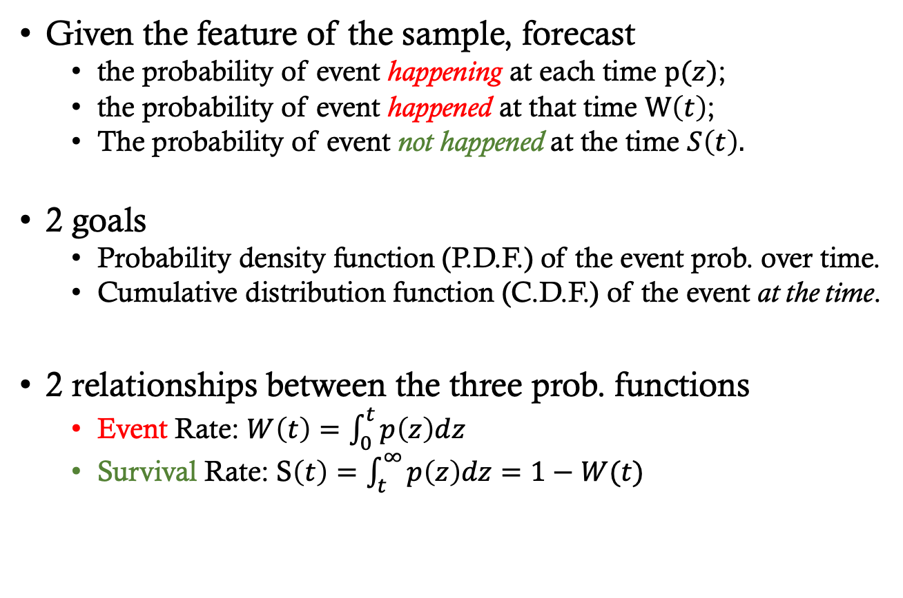
Task of SA
Given the feature of the sample, forecast
the probability of event happening at each time $p(z)$;
the probability of event happened at that time $W\left(t\right)$;
The probability of event not happened at the time $S\left(t\right).$
2 goals
Probability density function (P.D.F.) of the event prob. over time.
Cumulative distribution function (C.D.F.) of the event at the time.
2 relationships between the three prob. functions
Event Rate: $W\left(t\right)=\int_{0}^{t}{p\left(z\right)dz}$
Survival Rate: S$\left(t\right)=\int_{t}^{∞}{p\left(z\right)dz}=1−W(t)$

Slide 6
Challenges in SA
No ground truth
For the form of the event probability distribution
For the value of the event probability
Sparsity
Event is sparse, rare to happen
Censorship
Some clues are censored (without the true event time)

Slide 7
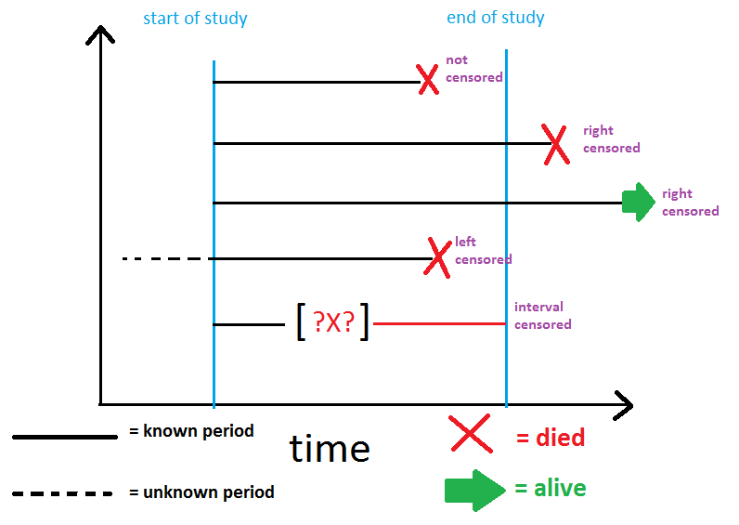
Censorship
http://www.karlin.mff.cuni.cz/~pesta/NMFM404/survival.html

Slide 8
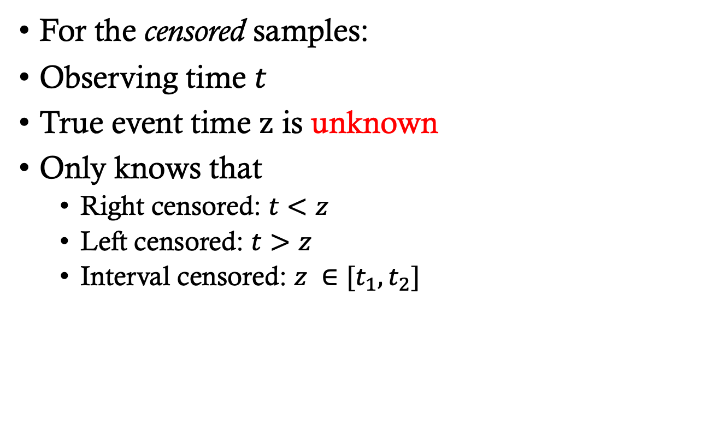
Censorship (cont.)
For the censored samples:
Observing time $t$
True event time $z$ is unknown
Only knows that
Right censored: $t<z$
Left censored: $t>z$
Interval censored: $z ∈[t_{1}, t_{2}]$

Slide 9
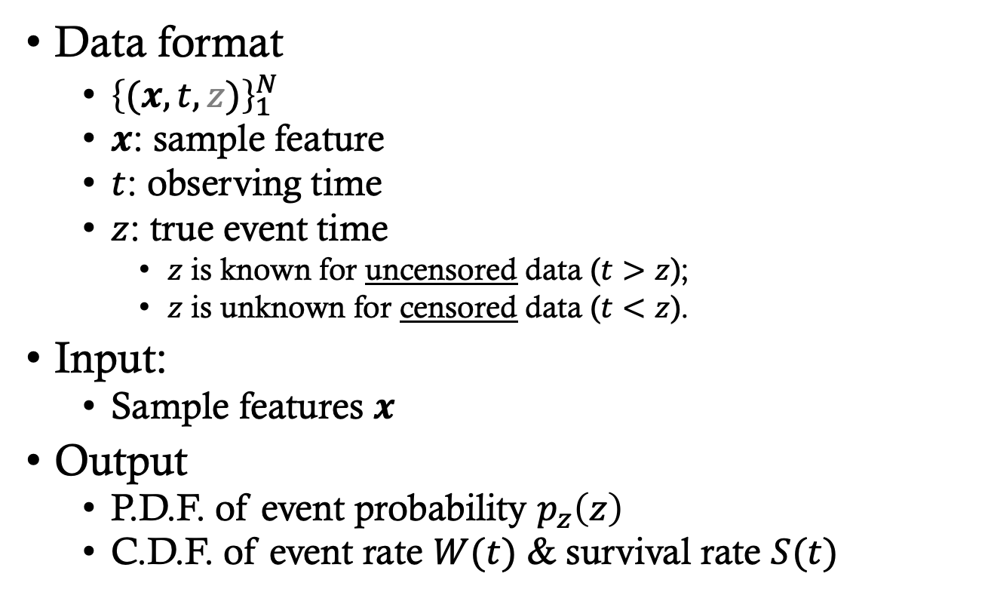
Task Formulation
Data format
${\left\{(x, t, z)\right\}}_{1}^{N}$
$x$: sample feature
$t$: observing time
$z$: true event time
$z$ is known for uncensored data ($t>z$);
$z$ is unknown for censored data ($t<z$).
Input:
Sample features $x$
Output
P.D.F. of event probability $p_{z}\left(z\right)$
C.D.F. of event rate $W(t)$ & survival rate $S(t)$

Slide 10
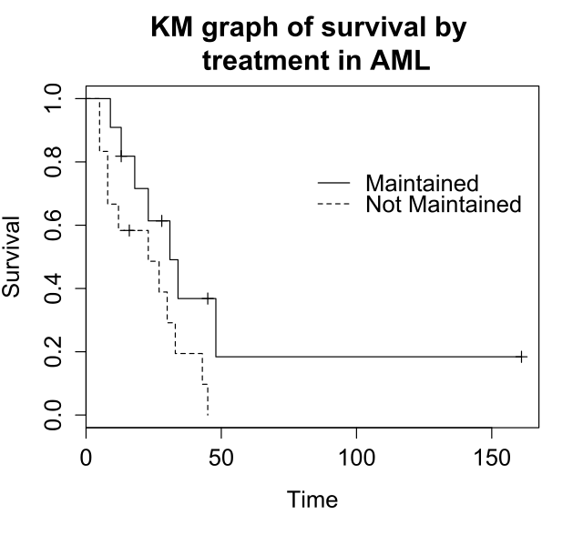
Existing Methods
Statistical methods
Kaplan-Meier method
Coarse-grained, counting-based, low generalization
﻿Kaplan and Meier 1958.

Slide 11
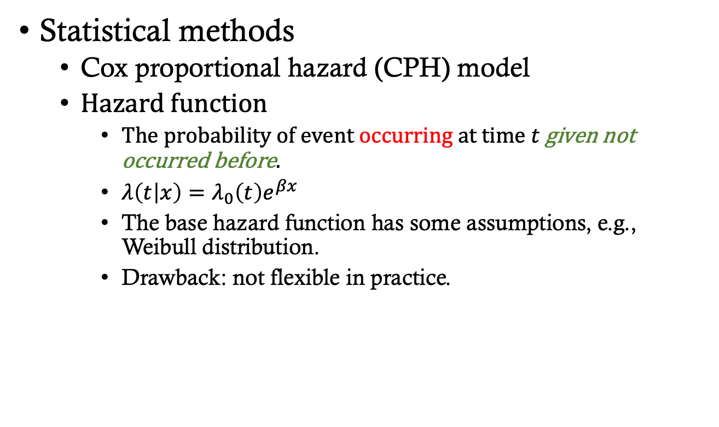
Existing Methods (cont.)
Statistical methods
Cox proportional hazard (CPH) model
Hazard function
The probability of event occurring at time $t$ given not occurred before.
$λ\left(t | x\right)=λ_{0}\left(t\right)e^{βx}$
The base hazard function has some assumptions, e.g., Weibull distribution.
Drawback: not flexible in practice.
﻿Cox 1992; ﻿Zhang and Lu 2007.

Slide 12
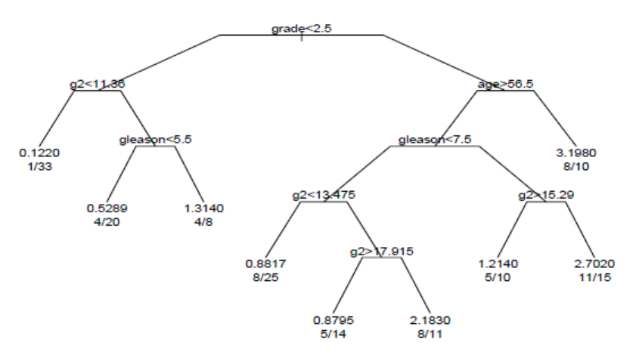
Existing Methods (cont.)
Machine learning methods
Survival tree model
Drawback:
based on segmented data
coarse-grained
﻿Wang et al. 2016.

Slide 13
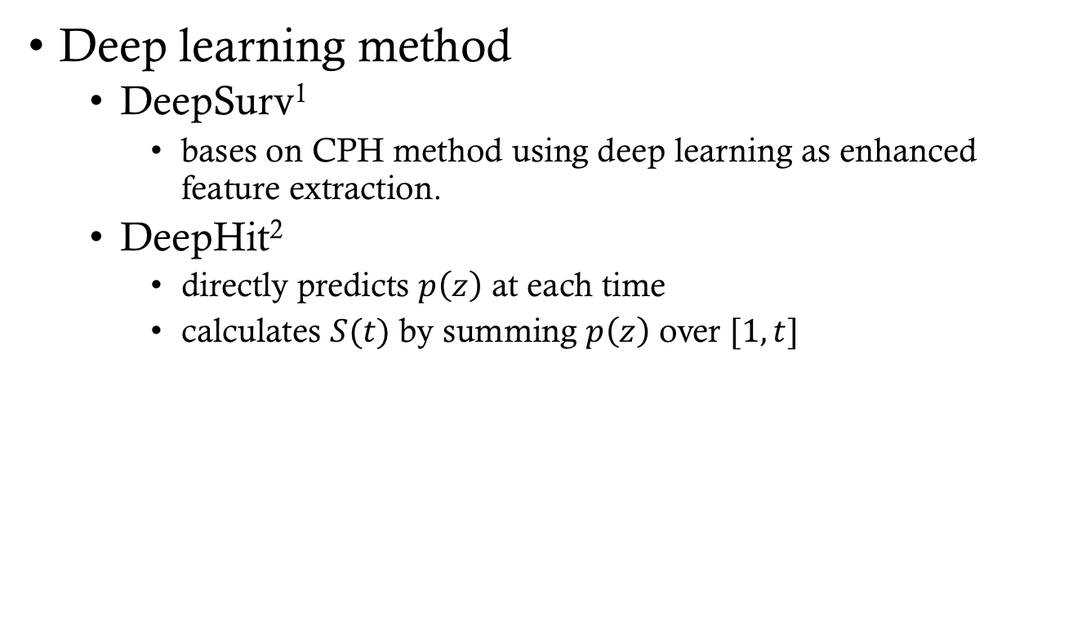
Existing Methods (cont.)
Deep learning method
DeepSurv¹
bases on CPH method using deep learning as enhanced feature extraction.
DeepHit²
directly predicts $p\left(z\right)$ at each time
calculates $S(t)$ by summing $p\left(z\right)$ over $[1,t]$
1. Katzman et al. 2018; 2. Lee et al. 2018.

Slide 14
Cons of the Existing Methods
Statistical methods
Counting-based statistics, loss of generality
Kaplan-Meier
Specific form of the probability distribution
CPH, Lasso-cox
Machine learning methods
Based on segmented data, too coarse-grained
Survival Trees
Assumption of the specific form of distribution
DeepSurv
No consideration about sequential patterns over time!

Slide 15
Deep Recurrent Survival Analysis (DRSA)
No assumption about distributional forms
Captures sequential patterns in the feature-time space
First work ever, utilizes auto-regressive model for SA
Handling censorship with unbiased learning
Significant improvement against both stat. methods and ML methods

Slide 16

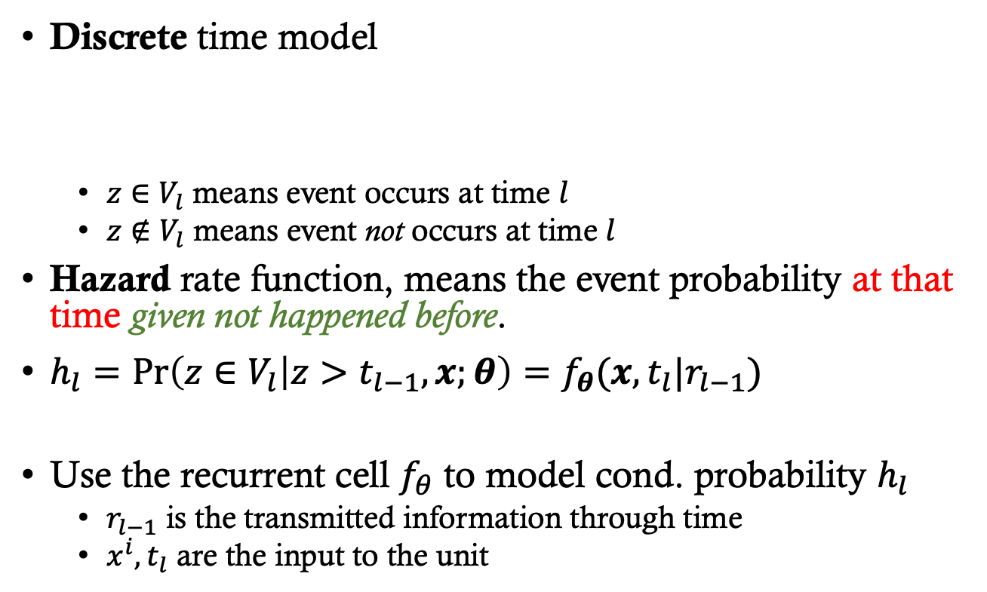







Our method
Discrete time model
$z∈V_{l}$ means event occurs at time $l$
$z∉V_{l}$ means event not occurs at time $l$
Hazard rate function, means the event probability at that time given not happened before.
$h_{l}=\operatorname{Pr}\left(z∈V_{l} | z>t_{l−1},x;θ\right)=f_{θ}(x,t_{l}|r_{l−1})$
Use the recurrent cell $f_{θ}$ to model cond. probability $h_{l}$
$r_{l−1}$ is the transmitted information through time
$x^{i}, t_{l}$ are the input to the unit
$$V_{l}$$
…
$$t_{1}$$
$$t_{2}$$
$$t_{l−2}$$
$$t_{l−1}$$
$$t_{l}$$
$$t_{l+1}$$
$$t_{l+2}$$
Notes:
$V_{l}$ is the $l$-th time interval with $[t_{l−1}, t_{l}]$

Slide 17
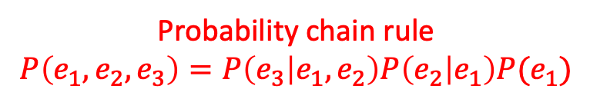
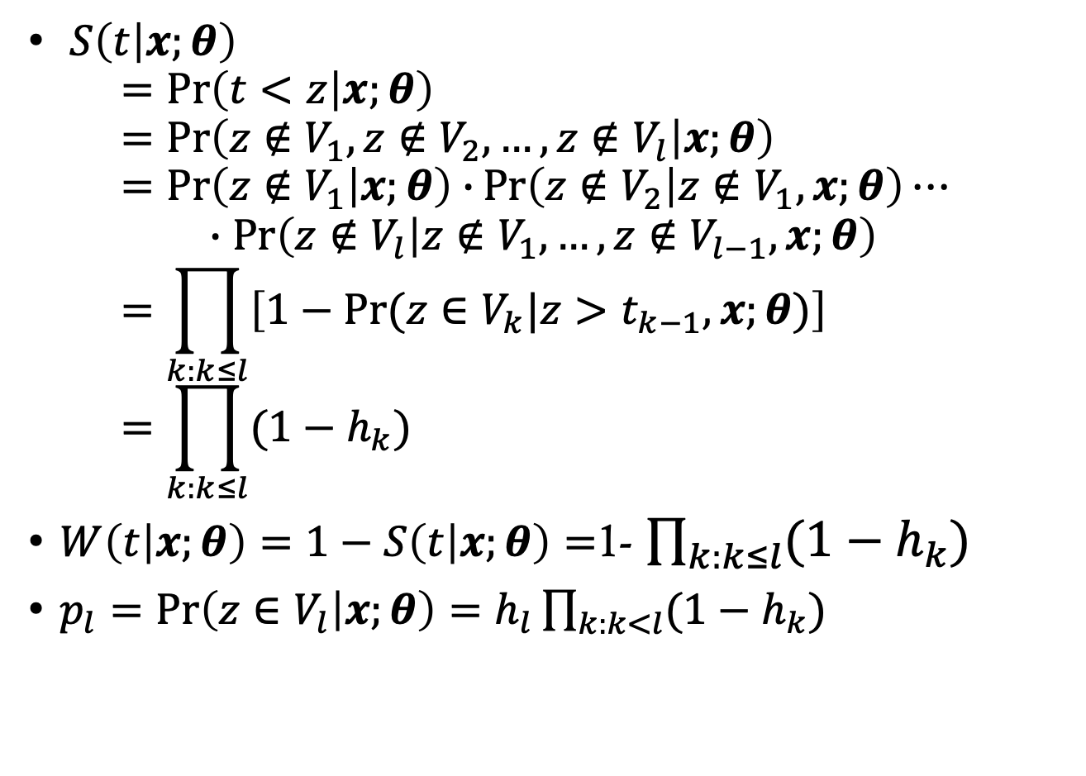
Relationships among Probability Functions
$S\left(t | x;θ\right)$ $=\operatorname{Pr}\left(t<z | x;θ\right)$ $=Pr\left(z∉V_{1},z∉V_{2},…,z∉V_{l} | x;θ\right)$ $=\operatorname{Pr}\left(z∉V_{1} | x;θ\right)∙\operatorname{Pr}\left(z∉V_{2} | z∉V_{1},x;θ\right)⋯$ $∙\operatorname{Pr}\left(z∉V_{l} | z∉V_{1},…,z∉V_{l−1},x;θ\right)$ $=\prod_{k:k≤l}{\left[1−Pr⁡(z∈V_{k}|z>t_{k−1},x;θ)\right]}$ $=\prod_{k:k≤l}{(1−h_{k})}$
$W\left(t | x;θ\right)=1−S\left(t | x;θ\right)=$1- $\prod_{k:k≤l}{(1−h_{k})}$
$p_{l}=\operatorname{Pr}\left(z∈V_{l} | x;θ\right)=h_{l}\prod_{k:k<l}{(1−h_{k})}$
Probability chain rule
$$P\left(e_{1}, e_{2}, e_{3}\right)=P\left(e_{3} | e_{1},e_{2}\right)P\left(e_{2} | e_{1}\right)P(e_{1})$$

Slide 18
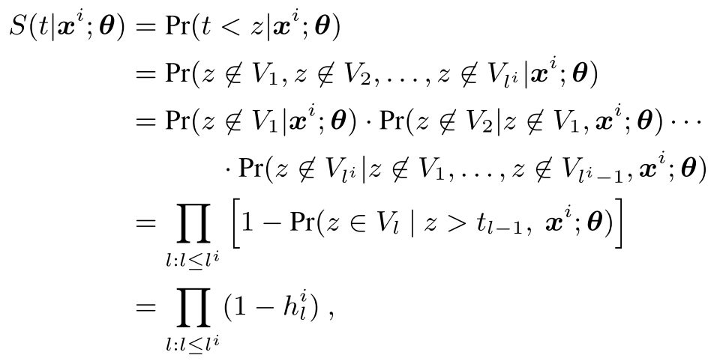
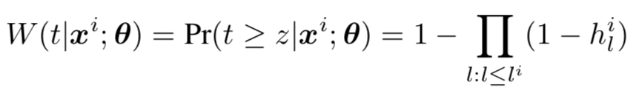
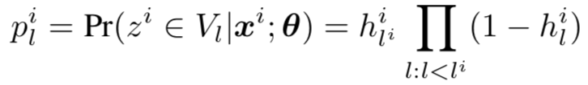
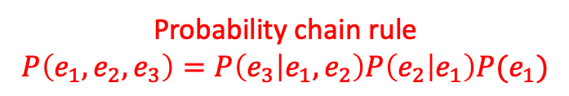
Relationships among Probability Functions
Probability chain rule
$$P\left(e_{1}, e_{2}, e_{3}\right)=P\left(e_{3} | e_{1},e_{2}\right)P\left(e_{2} | e_{1}\right)P(e_{1})$$

Slide 19
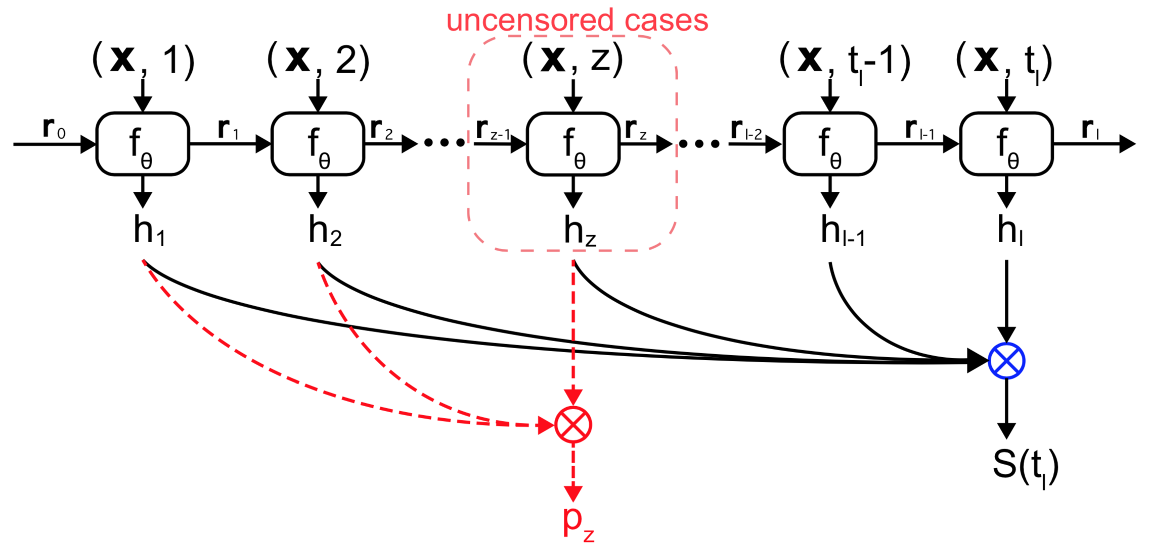
The Recurrent Model

Slide 20
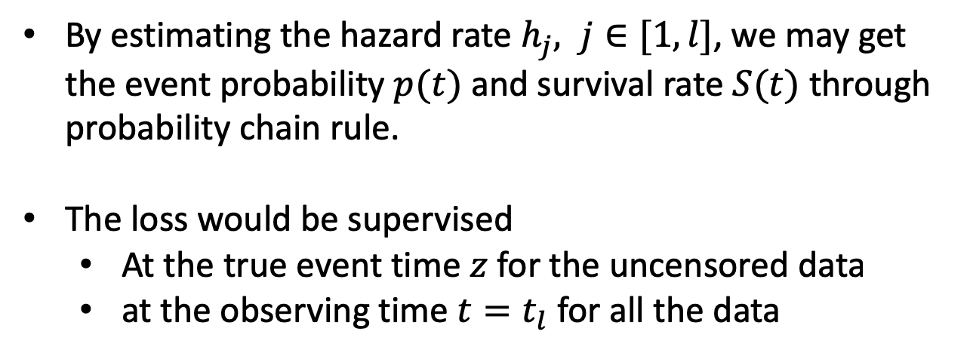
Details of Inference
By estimating the hazard rate $h_{j}, j∈[1,l]$, we may get the event probability $p(t)$ and survival rate $S(t)$ through probability chain rule.
The loss would be supervised
At the true event time $z$ for the uncensored data
at the observing time $t=t_{l}$ for all the data

Slide 21
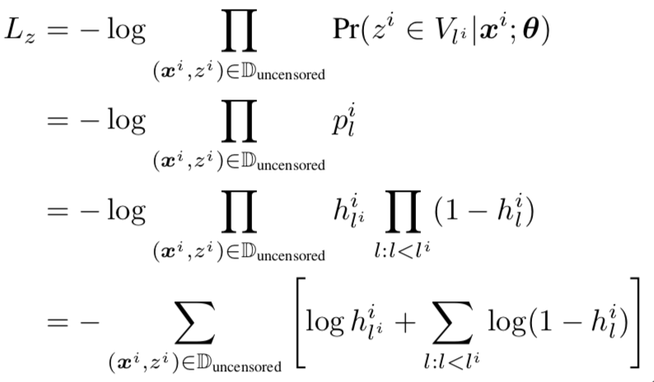

Loss Functions (1/3)
Uncensored data
P.D.F. loss on the true event time $z$
Maximize the log likelihood

Slide 22
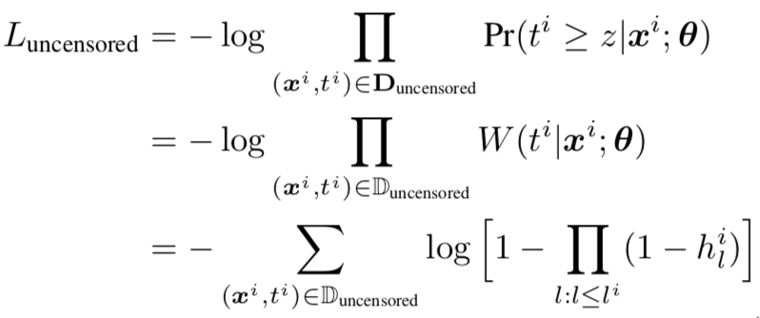

Loss Functions (2/3)
Uncensored data ($z<t$)
C.D.F. loss on the observing time $t$
Maximize the log partial likelihood

Slide 23
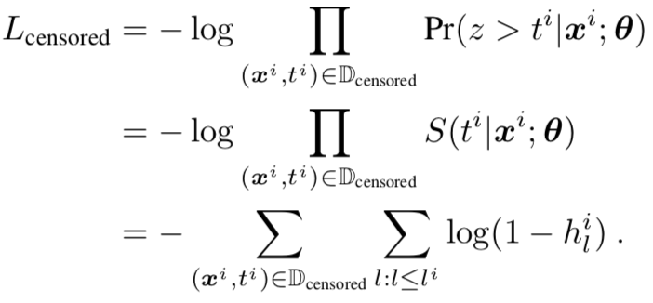

Loss Functions (3/3)
Censored data ($z$ is unknown since $z>t$)
C.D.F. loss on the observing time $t$
Maximize the log partial likelihood
Unbiased learning

Slide 24
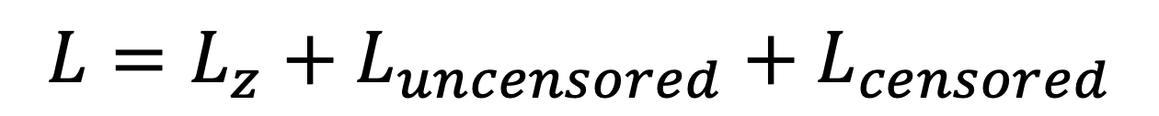
Loss Functions (cont.)
Three losses
Uncensored Data
Censored Data
$$L=L_{z}+L_{uncensored}+L_{censored}$$
P.D.F. Loss
C.D.F. Loss

Slide 25
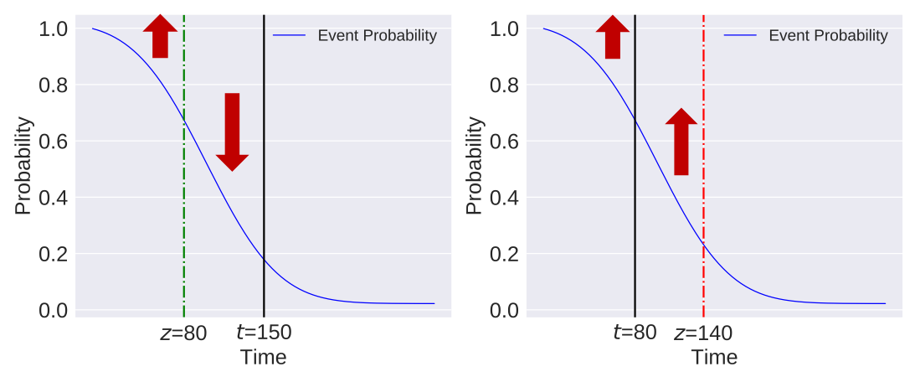
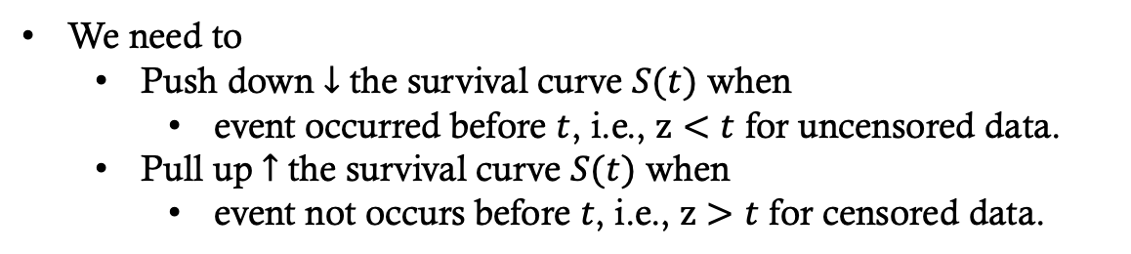
Intuition behind C.D.F. Losses
Uncensored Case
(z has been known)
Censored Case
(z is unknown)
We need to
Push down $↓$ the survival curve $S(t)$ when
event occurred before $t$, i.e., $z<t$ for uncensored data.
Pull up $↑$ the survival curve $S(t)$ when
event not occurs before $t$, i.e., $z>t$ for censored data.

Slide 26
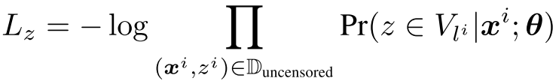
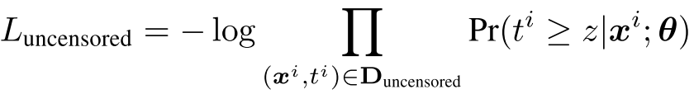
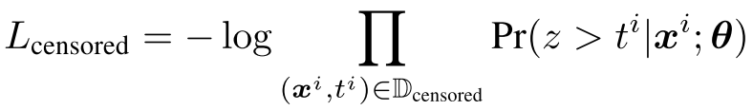


Why need $L_{uncensored}$?
Traditional methods (DeepSurv, DeepHit) use $L_{z}$ and $L_{censored}$, without $L_{uncensored}$.

Slide 27
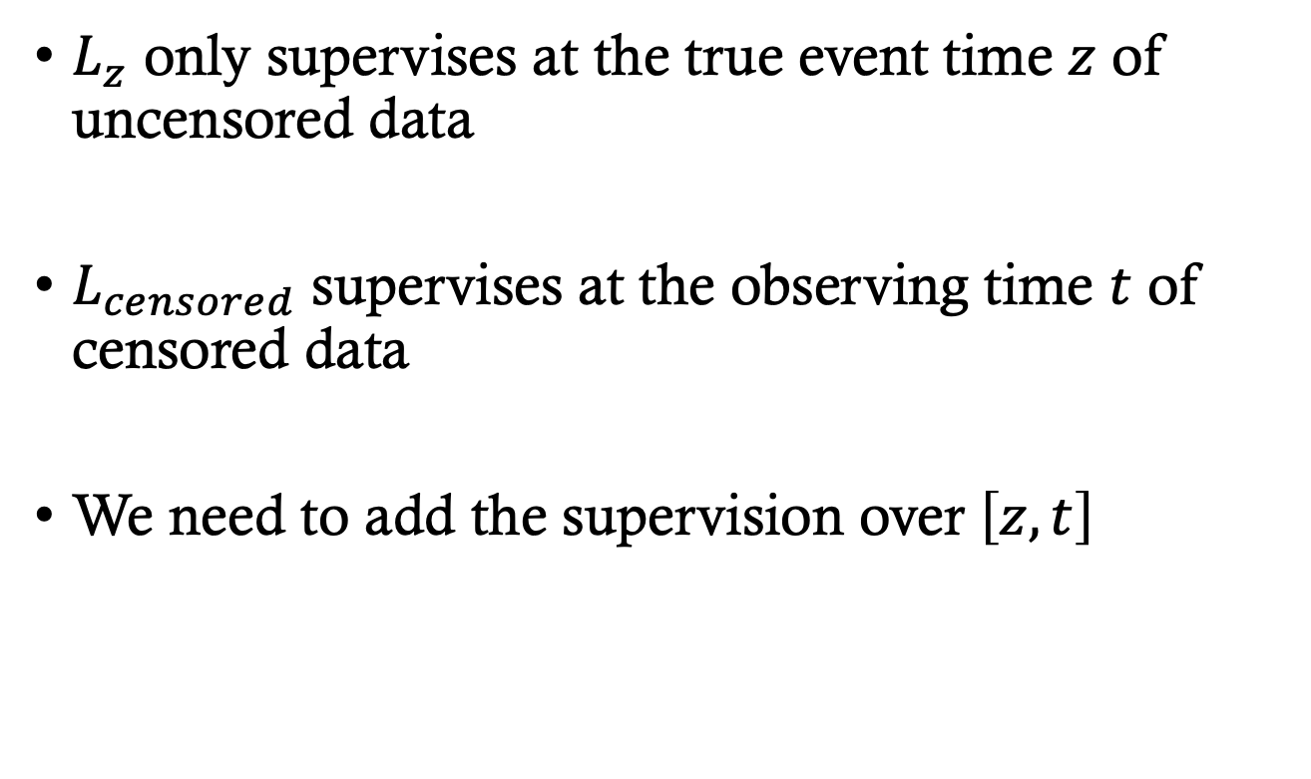
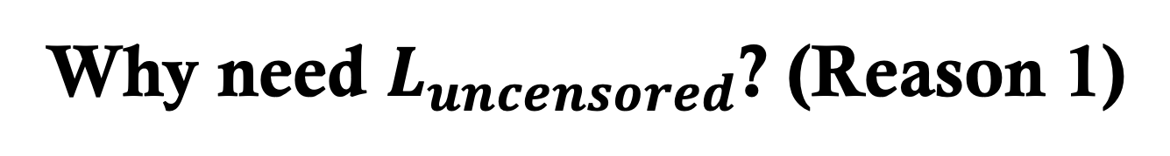
Why need $L_{uncensored}$? (Reason 1)
$L_{z}$ only supervises at the true event time $z$ of uncensored data
$L_{censored}$ supervises at the observing time $t$ of censored data
We need to add the supervision over $\left[z, t\right]$

Slide 28
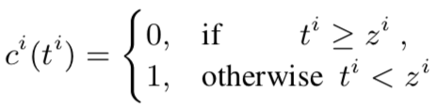
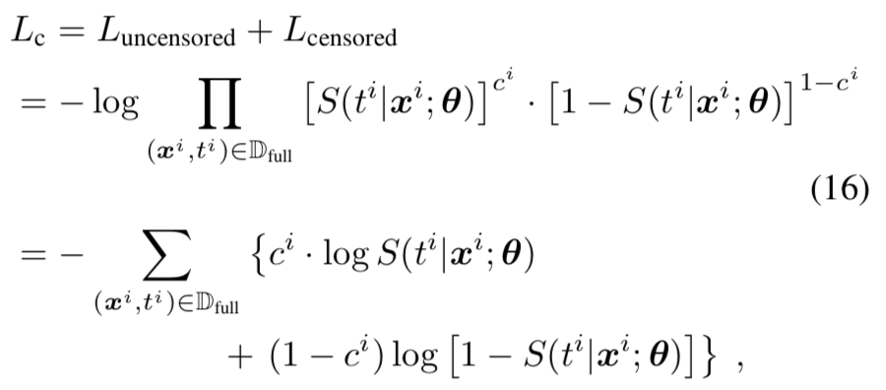

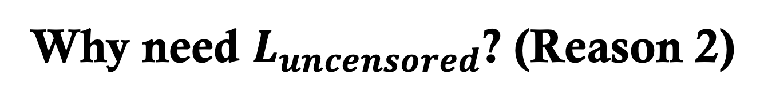
Why need $L_{uncensored}$? (Reason 2)
Combine $L_{uncensored}$ and $L_{censored}$ and get
A binary classification loss of censorship for the observed sample $\left(x^{i},t^{i}\right)$
To judge whether $z^{i}≤t^{i}$ or $z^{i}>t^{i}$.

Slide 29

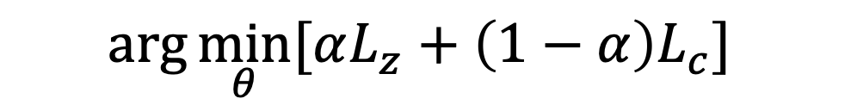
The Final Loss
$$\arg{\min_{θ}{[αL_{z}+\left(1−α\right)L_{c}]}}$$
MLE Loss
Classification Loss

Slide 30
Experiments
3 real-world large-scale datasets
2 evaluation metrics
6 compared baseline models

Slide 31
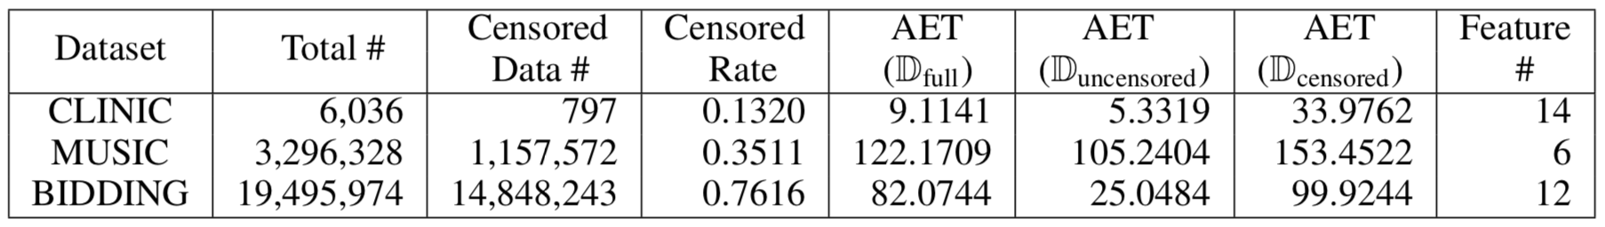
Datasets
3 real-world large-scale datasets
Download link of the processed data:
https://goo.gl/nUFND4.
CLINIC from medicine research
MUSIC from information systems
BIDDING from economics

Slide 32
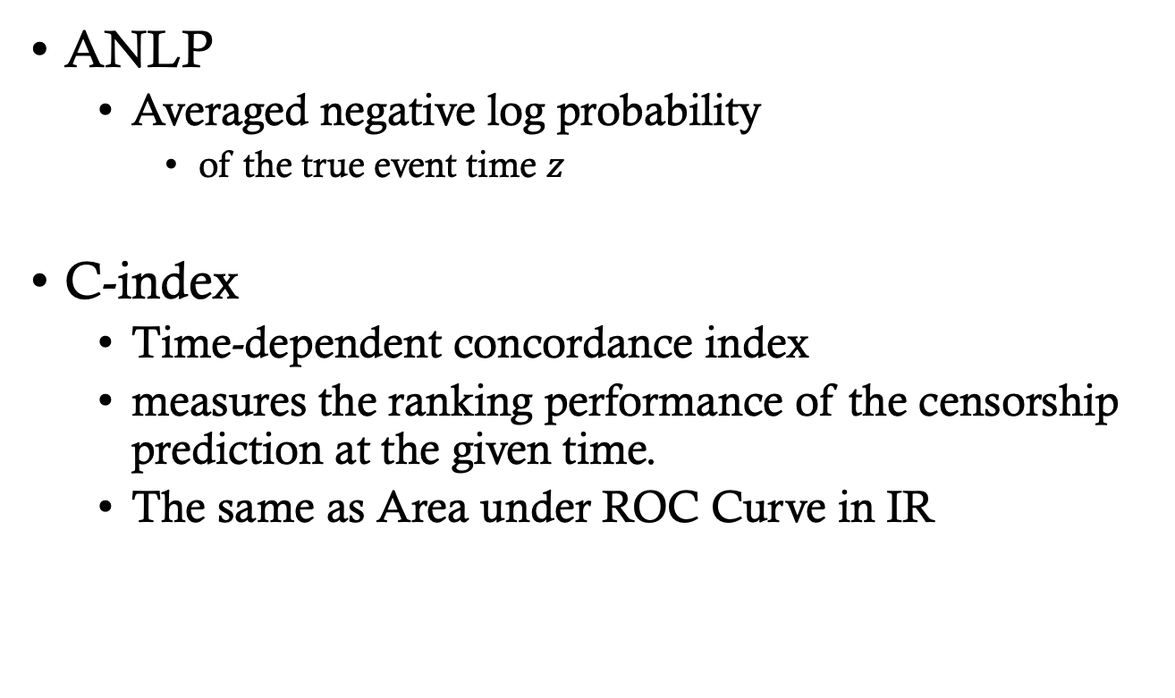
Evaluation Metrics
ANLP
Averaged negative log probability
of the true event time $z$
C-index
Time-dependent concordance index
measures the ranking performance of the censorship prediction at the given time.
The same as Area under ROC Curve in IR

Slide 33
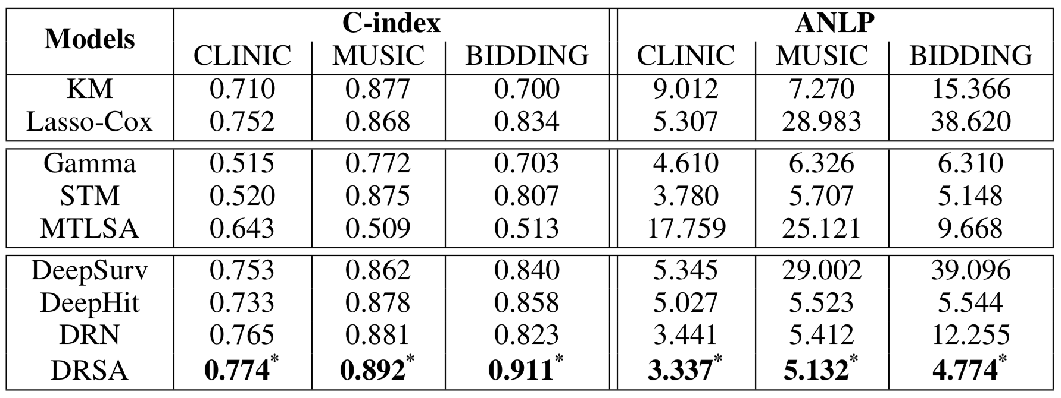
Experiment Results
Performance comparison on C-index (the higher, the better) and ANLP (the lower, the better). (* indicates p- value < 10−6 in significance test)

Slide 34
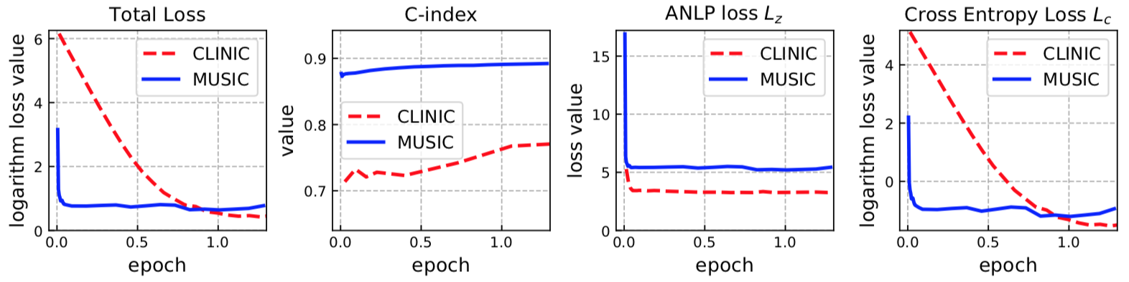
Learning Curves

Slide 35
Survival Curves

Slide 36
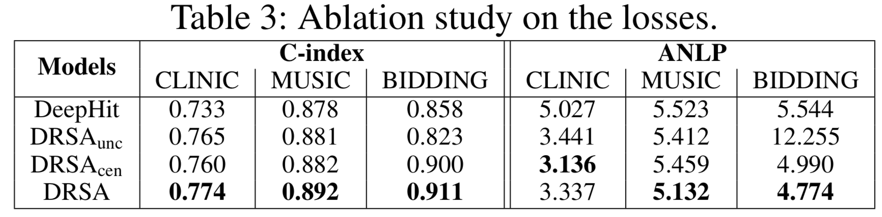
Ablation Study

Slide 37

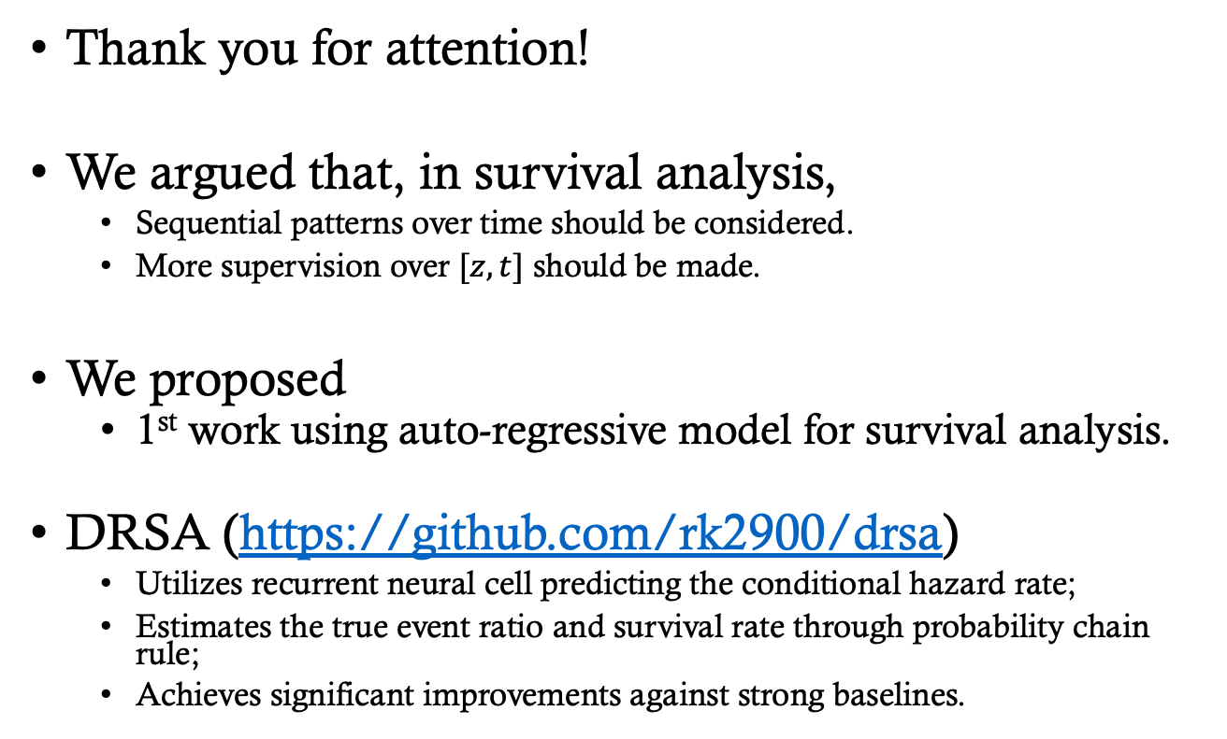
Conclusion
Thank you for attention!
We argued that, in survival analysis,
Sequential patterns over time should be considered.
More supervision over $[z, t]$ should be made.
We proposed
1st work using auto-regressive model for survival analysis.
DRSA (https://github.com/rk2900/drsa)
Utilizes recurrent neural cell predicting the conditional hazard rate;
Estimates the true event ratio and survival rate through probability chain rule;
Achieves significant improvements against strong baselines.

