Slide 1



Reinforcement learning
Bonus I
Intrinsic motivation in RL

Slide 2
Summary of RL course so far...

Slide 3
Yes we can!
Can solve RL for
    Finite/Infinite MDP
    Full or partial observability
    Large or continuous state space
    Small OR structured OR continuous action space (later)
Given
    Frequent rewards
    Short delay between reward and its cause
    Efficient exploration

Slide 4
Real world
Can solve RL for
    Finite/Infinite MDP
    Full or partial observability
    Large or continuous state space
    Small OR structured OR continuous action space (later)
Given
    Frequent rewards
    Short delay
    Efficient exploration
You're graded once in weeks
… for stuff you did months ago
because we suck at
checking up your homeworks

Slide 5

Exploration Vs Exploitation
Balance between using what you learned and trying to find something even better
How did we do that before?

Slide 6
Exploration strategies
Strategies:
    ε-greedy
        With probability ε take a uniformly random action;
        Otherwise take optimal action.
    Boltzman
        Pick action proportionally to transformed Qvalues
    Policy based: add entropy
    Bandits or finite MDP: UCB-1

Slide 7
Voila! We've solved the reinforcement learning!
Or have we?
  What happens if we apply it to real world problems?

Slide 8
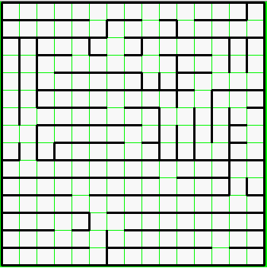
How many random actions does it take
to exit this maze?
(you only get reward at the end)
`

Slide 9
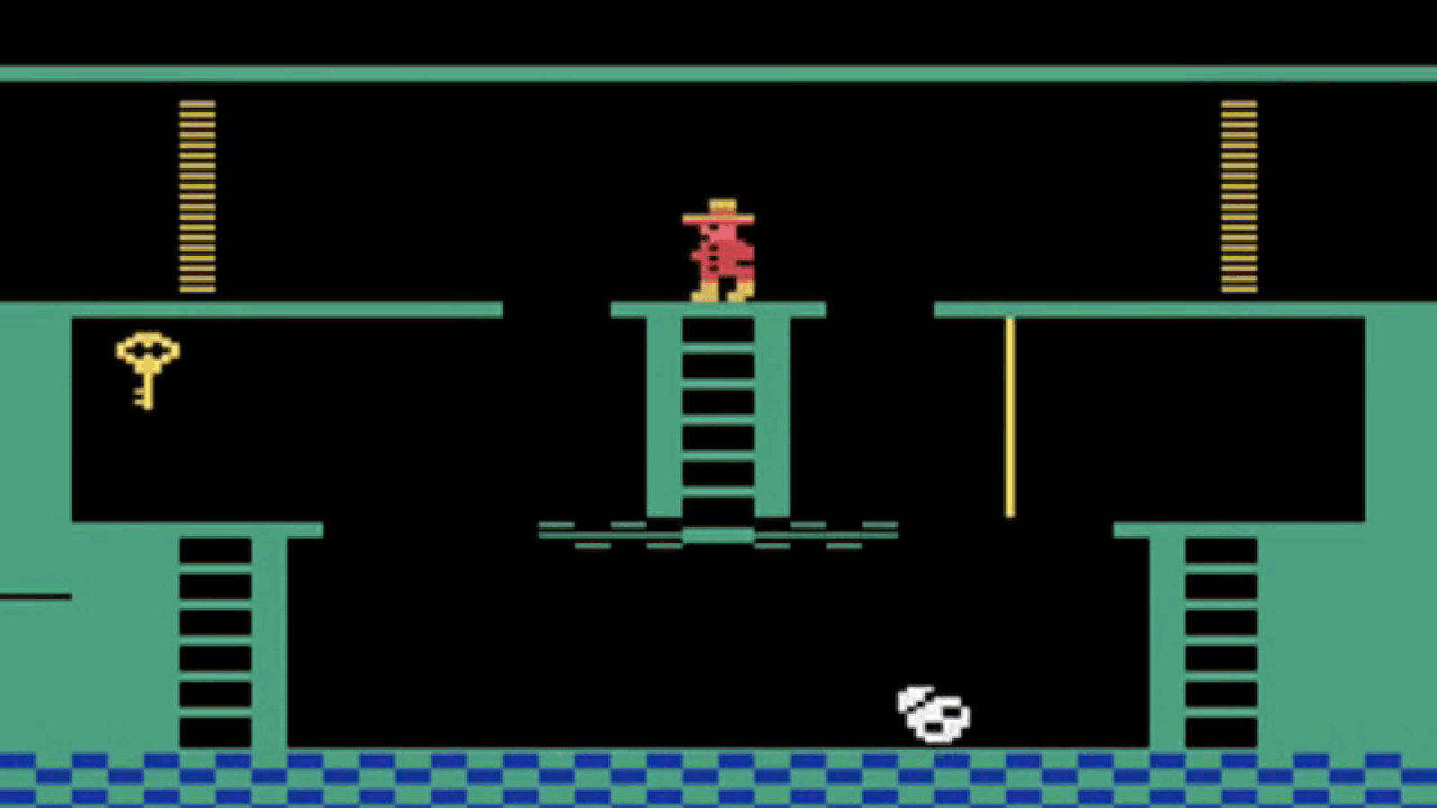
Less than it takes to discover that
this game is solved by using the key

Slide 10

Less than it takes to learn how to
          Apply medical treatment
          Control robots
          Invent efficient VAE training
    Except humans can learn these in less than a lifetime

Slide 11
Less than it takes to learn how to
          Apply medical treatment
          Control robots
          Invent efficient VAE training
We humans explore not with e-greedy policy!

Slide 12
BTW how humans explore?
  Whether some new particles violate physics
  Vs
  Whether you still can't fly by pulling your hair up

Slide 13

I got it!
It's all about funding!

Slide 14
I got it!
It's all about funding!
(Just kidding)

Slide 15
Reward augmentation
Let's “pay” agent for exploration!

Slide 16
Reward augmentation
Let's “pay” agent for exploration!
Extrinsic
reward
Intrinsic
reward

Slide 17
In Real Life
Extrinsic reward
  Not dying is good
Curiosity
  Discovering new things feels good
Social stuff
  Helping others feels good
  Being praised feels good
...

Slide 18
In Real Life
Extrinsic reward
  Not dying is good
Curiosity
  Discovering new things feels good
Social stuff
  Helping others feels good
  Being praised feels good
...
Disclaimer: I am NOT an expert
neurologist/psychologist :)

Slide 19
Reward augmentation
Let's “pay” agent for exploration!
Trivia: Any suggestions on intrinsic r for atari/doom?

Slide 20
UNREAL main idea
Auxilary objectives:
  Pixel control: maximize pixel change in NxN grid over image
  Feature control: maximize activation of some neuron deep inside neural network
  Reward prediction: predict future rewards given history
  article: arxiv.org/abs/1611.05397
  blog post: bit.ly/2g9Yv2A

Slide 21
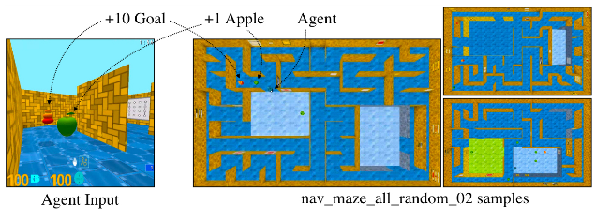
Environment: Labyrinth
Maze with rewards
Partially observable
  Used a2c + LSTM + experience replay

Slide 22
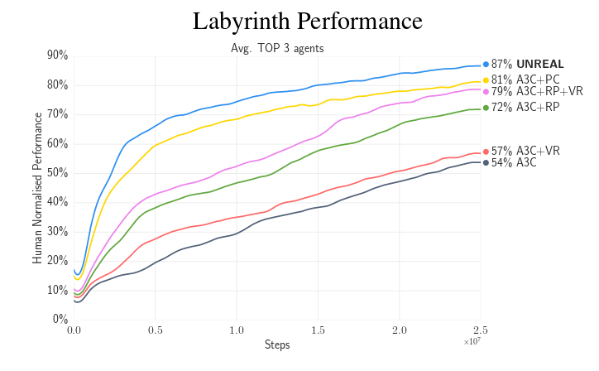
Results: labyrinth

Slide 23
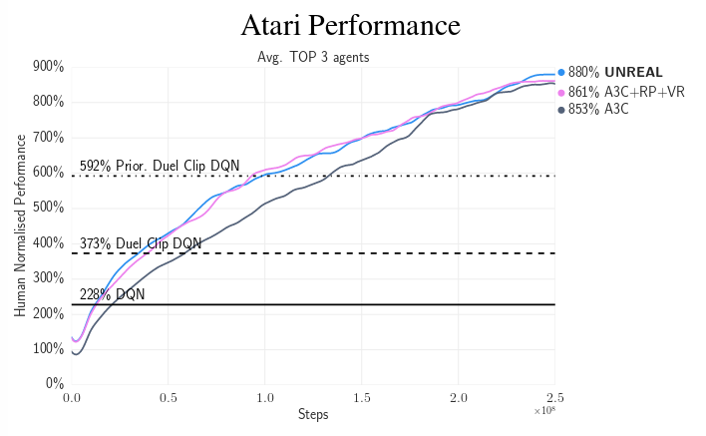
Results: Atari

Slide 24
Count-based exploration
UCB-1 for bandits
  Idea:
    Prioritize actions with uncertain outcomes!
    Less times visited = more uncertain.
    Math: add upper confidence bond to reward.

Slide 25
Count-based exploration
UCB-1 for bandits
  Take actions in in proportion to
  number of time-steps so far
  times action a is taken
Upper bound
For bernoilli r

Slide 26
Count-based exploration
UCB-1 for bandits
  Take actions in in proportion to
  number of time-steps so far
  times action a is taken

Slide 27
Count-based exploration
UCB generalized for multiple states
where
  visits to state s
  times action a is taken from state s

Slide 28
Count-based models
TL;DR article
Use approximate density model, p(s)
Encourage visiting rare states
Article: arxiv.org/abs/1606.01868

Slide 29
Vime motivation
Curiosity
  Taking actions that increase your knowledge about the world (a.k.a. the environment)
Knowledge about the world
  Whatever allows you to predict how world works depending on your behavious

Slide 30
Vime main idea
Add curiosity to the reward
Curiosity definition

Slide 31
Vime main idea
Environment model
Session
Surrogate reward
curiosity
need proof for that last line?

Slide 32
Naive objective
where

Slide 33
Naive objective
Sample
From MDP
Sample
Somehow...
Model
Prior
dunno
Better avoid computing P(theta|z) directly!

Slide 34

BAYES

Slide 35
We want a model that
- predicts P(s'|z,a,theta)
- allows to estimate P(theta|D)
- we can sample from it

Slide 36
BNNs
X
tanh
0.3
-0.1
P(y|x)
Regular
NN
-0.25
tanh
1.3

Slide 37
BNNs
X
tanh
P(y|x)
Bayesian
NN
tanh
X
tanh
0.3
-0.1
P(y|x)
Regular
NN
-0.25
tanh
1.3

Slide 38
BNNs
X
tanh
Idea:
No explicit weights
  Maintain parametric distribution on them instead!
    Practical: fully-factorized normal or similar
P(y|x)
tanh

Slide 39
BNNs
Idea:
No explicit weights
  Maintain parametric distribution on them instead!
    Practical: fully-factorized normal or similar
Learn parameters of that distribution (reparameterization trick)
  Less variance: local reparameterization trick.
wanna explicit formulae?

Slide 40
Lower bound

Slide 41
Lower bound
Trivia: what can you say about each of the summands?

Slide 42
Lower bound
loglikelihood
-distance to prior
+const

Slide 43
Lower bound
Can we perform gradient ascent directly?

Slide 44
Reparameterization trick
Use reparameterization trick
Using BNN
Better: local reparameterization trick (google it)

Slide 45
Vime objective
BNN
sample
from env
sample
from BNN
BNN
last tick

Slide 46
Algorithm
Forever:
  Interact with environment, get <s,a,r,s'>
  Compute curiosity reward
  train_agent(s,a,r,s') //with any RL algorithm
  train_BNN(s,a,s') //maximize lower bound
  ~

Slide 47
Dirty hacks
Use batches of many <s,a,r,s'>
  for CPU/GPU efficiency
  greatly improves RL stability
Simple formula for KL
  Assuming fully-factorized normal distribution
  Even simpler: second order Taylor approximation
Divide KL by its running average over past iterations

Slide 48
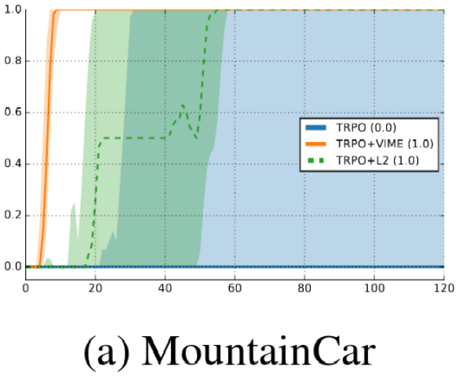
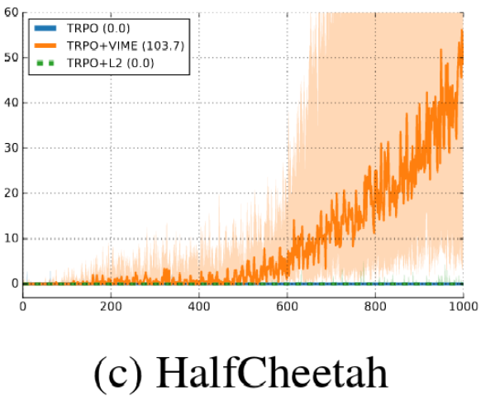
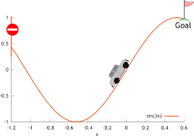
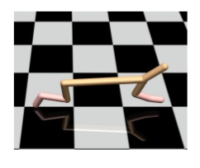
Results
Session reward
Session reward
epoch
epoch

Slide 49
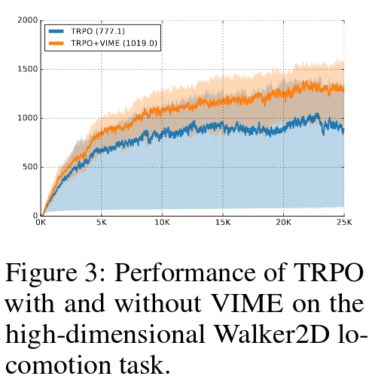
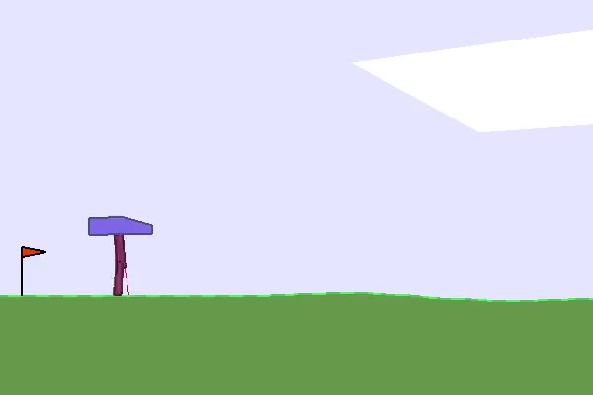
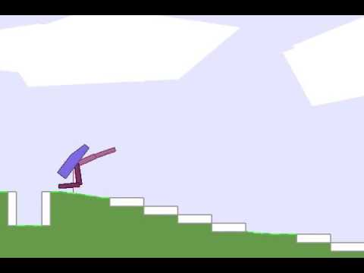
Results
Session reward
epoch

Slide 50
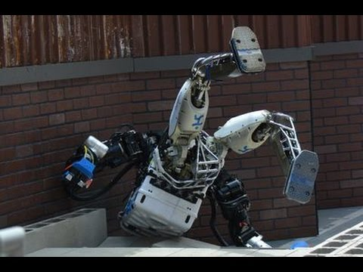
Pitfalls
It's curious about irrelevant things
Predicting (210x160x3) images is hard
We don't observe full states (POMDP)

Slide 51
State = hidden NN activation
Qvalues
Q(s,a)
More layers
Some layers
Raw observation
S

Slide 52
State = hidden NN activation
Qvalues
qvalues, (~n actions)
More layers
After DNN, (~256)
Only policy-relevant
Some layers
Raw observation
Pixels (210x160x3)
All information

Slide 53
State = hidden NN activation
Qvalues
More layers
This is our new state
Predict it with BNN
Some layers
Raw observation
We don't care

Slide 54
A case for POMDP
Qvalues
More layers
This is our new state
Predict it with BNN
RNN
RNN
RNN
RNN
O
t-3
O
t-2
O
t-1
O
t
We don't care

Slide 55
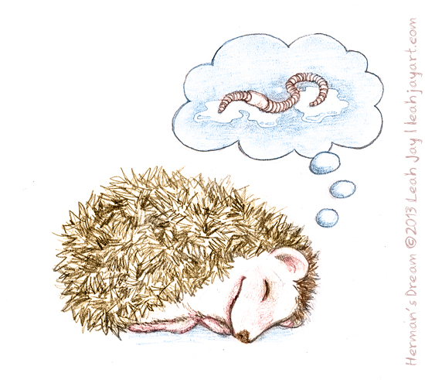
links
https://arxiv.org/pdf/1605.09674v3.pdf
http://mybinder.org/repo/justheuristic/vime
  Will add pacman once it converges :P

Slide 56
Special thanks to
Arseniy Ashukha – for reviewing (and covering my arse at HSE DL this very moment)
Maxim Kochurov (ferrine@github) – for simple BNN @lasagne

