Slide 1



Reinforcement learning
Episode 1
Black box optimization

Slide 2

Recap: reinforcement learning
Agent
observation
action
Environment

Slide 3

Recap: MDP
Classic MDP(Markov Decision Process)
Agent interacts with environment
  Environment states:
  Agent actions:
  State transition:

Slide 4
Recap: reinforcement learning
Agent
observation
action
Environment

Slide 5

Feedback (Monte-Carlo)
Naive objective:
Deterministic policy:
  Find policy with highest
  expected reward

Slide 6
Feedback (Monte-Carlo)
Whole session
Naive objective:
Deterministic policy:
  Find policy with highest
  expected reward

Slide 7
Black box optimization setup
Agent

Slide 8
Black box optimization setup
Agent
Policy
params
R

Slide 9
Black box optimization setup
black
box
Agent
Policy
params
R

Slide 10
Today's menu
Evolution strategies
  A general black box optimization
  Easy to implement & scale
Crossentropy method
  A general method with special case for RL
  Works remarkably well in practice

Slide 11
Evolution Strategies
  Introduce distribution over weights
  Maximize expected reward

Slide 12
Evolution Strategies
  Introduce distribution over weights
  Maximize expected reward
other P(θ) will
work as well

Slide 13
Evolution Strategies
  Introduce distribution over weights
  Maximize expected reward

Slide 14
Evolution Strategies
  Expected reward (using math. Expectation)
Q: How can we estimate J in practice?
for large/infinite state space

Slide 15
Evolution Strategies
  Expected reward (using math. Expectation)
  Approximate with sampling
Sample Θ from

Slide 16
Evolution Strategies
  Expected reward (using math. Expectation)
  Approximate with sampling
reward for
session
Sample Θ from

Slide 17
Evolution Strategies
  Expected reward (using math. expectation)
  What we need

Slide 18
Evolution Strategies
  Expected reward (using math. expectation)
  What we need
Q: Can we estimate ∇J with samples?

Slide 19
Evolution Strategies
  Expected reward (using math. expectation)
  What we need
Not a valid expectation
∇ N (Θ|μ,σ) is not a distribution

Slide 20
Logderivative trick
Simple math
(try chain rule)

Slide 21
Logderivative trick
Simple math

Slide 22
Logderivative trick
Analytical inference

Slide 23
Evolution Strategies
Analytical inference
Q: How can we estimate ∇J in now?

Slide 24
Evolution Strategies
Analytical inference
Sampled estimate
Sample Θ from

Slide 25
Evolution strategies
Algorithm
1. Initialize
2. Forever:

Slide 26
Evolution strategies
Features
  A general black box optimization
  Needs a lot of samples
  Easy to implement & scale

Slide 27
Evolution strategies
Features
  A general black box optimization
  Easy to implement & scale
Q: You have 1000 CPUs.
Optimize this formula!

Slide 28
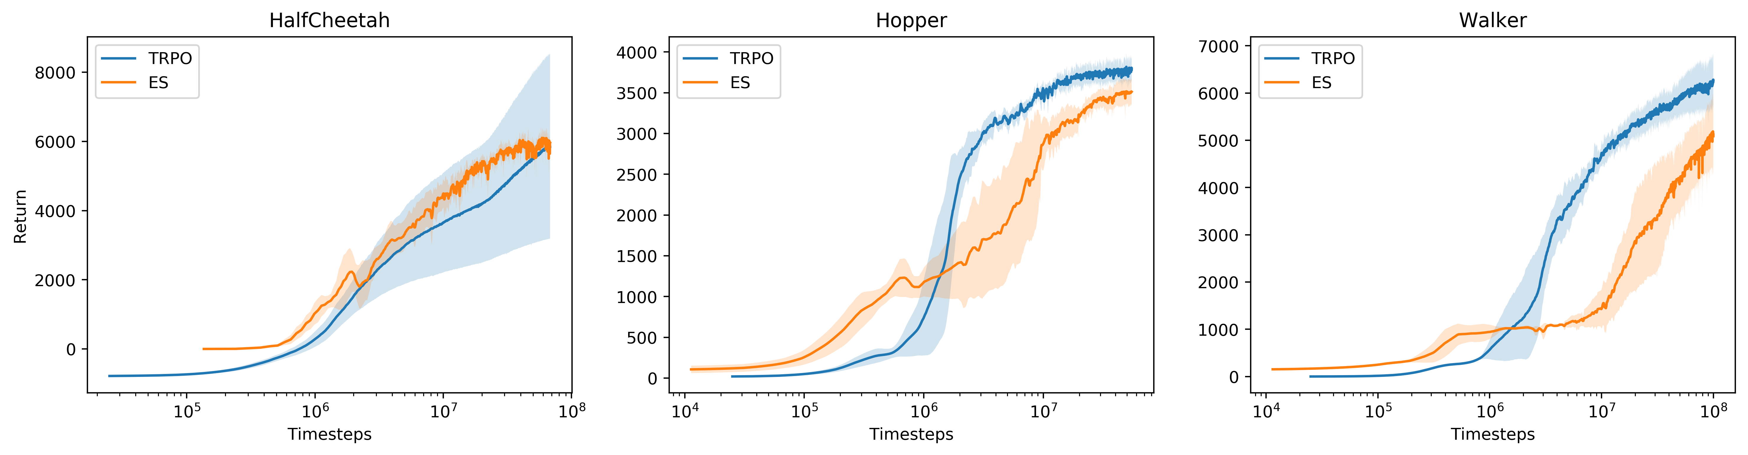
Evolution strategies
Features
  A general black box optimization
  Some results on gym
https://blog.openai.com/evolution-strategies/

Slide 29
Today's menu
Evolution strategies
  A general black box optimization
  Requires a lot of sampling
Crossentropy method
  A general method with special case for RL
  Works remarkably well in practice

Slide 30
Estimation problem
You want to estimate

Slide 31
Estimation is not a problem
You want to estimate
So what? You just compute it!

Slide 32
Estimation problem
You want to estimate
So what? You just compute it!
  x may be 1000-dimensional
  H(x) may be costly to compute
Ideas?

Slide 33
Estimation in the wild
You want to estimate
So what? You just compute it!
  x may be 1000-dimensional
  H(x) may be costly to compute

Slide 34
Estimation in the wild
You want to estimate profits!
x – user of your online game (age, gender, ...)
p(x) – probability of such user
H(x) – try to guess :)

Slide 35
Estimation in the wild
You want to estimate profits!
x – user of your online game (age, gender, ...)
p(x) – probability of such user
H(x) – money donated by such user

Slide 36
Estimation in the wild
Sampling = asking users to pass survey
Usually costs money!
Guess H(median russian gamer)?

Slide 37
Estimation in the wild
Sampling = asking users to pass survey
Usually costs money!
H(median russian gamer) ~ 0
It's H(hard-core donators) that matters!

Slide 38
Estimation in the wild
Sampling = asking users to pass survey
Usually costs money!
Most H(x) are small, few are very large

Slide 39
Estimation in the wild
Sampling = asking users to pass survey
Usually costs money!
99% of H(x)=0, 1% H(x)=$1000 (whale)
You make a survey of N=50 people
How accurate are we?

Slide 40
Estimation in the wild
Sampling = asking users to pass survey
Usually costs money!
99% of H(x)=0, 1% H(x)=$1000 (whale)
You make a survey of N=50 people
0 whales: H=0, 1 whale: H= 5x true

Slide 41
Importance sampling
Idea: we know that most whales are
  30-40 year old
  single
  wage >100k
Sample 50% in that group, 50% rest
Adjust for difference in distributions

Slide 42
Importance sampling
Math:

Slide 43
Importance sampling
Math:
=
=

Slide 44
Importance sampling
Math:
=
=

Slide 45
Importance sampling
TL;DR:

Slide 46
Importance sampling
TL;DR:

Slide 47
Importance sampling
TL;DR:
If p(x)>0, then q(x)>0
original distribution
other distribution

Slide 48
Importance sampling
Idea: we may know that all whales are
  30-40 year old
  single
  wage >100k
Sample q(x): 50% that group, 50% rest
Adjust for difference in distributions

Slide 49
Importance sampling
Idea: we may know that all whales are
  30-40 year old
  single
  wage >100k
Sample from different q(x)
Adjust for difference in distributions
Which q(x) is best?

Slide 50

Crossentropy method
Pick
What's q(x)?
H(x)
p(x)

Slide 51
Crossentropy method
Pick
q(x)
H(x)
p(x)

Slide 52
Crossentropy method
Minimize difference between and
How to measure that difference? Ideas?

Slide 53
Crossentropy method
Minimize difference between and
Kullback-Leibler divergence

Slide 54
Crossentropy method
Minimize difference between and
Kullback-Leibler divergence
=
=
what?
what?

Slide 55
Crossentropy method
Minimize difference between and
Kullback-Leibler divergence
=
const( p2(x) )
=
entropy
crossentropy

Slide 56
Crossentropy method
Minimize difference between and
Minimize Kullback-Leibler divergence
entropy
crossentropy

Slide 57
Crossentropy method
Pick q(x) to minimize crossentropy
Exact solution in many cases (e.g. gaussian)
Otherwise use numeric optimization
  e.g. when q(x) is a neural network

Slide 58
Iterative approach
Pick q(x) to minimize crossentropy
Start with
Iteration

Slide 59
Finally, reinforcement learning
Objective: H(x) = [R > threshold]
p(x) = uniform
Threshold = M'th (e.g. 50th) percentile of R

Slide 60
Finally, reinforcement learning
Objective: H(x) = [R > threshold]
p(x) = uniform
Threshold = M'th (e.g. 50th) percentile of R
Something wrong with the formula!

Slide 61
Finally, reinforcement learning
Objective: H(x) = [R > threshold]
p(x) = uniform
Threshold = M'th (e.g. 50th) percentile of R
No p(x)/q(x) term as it's okay to expect over pi(a|s)

Slide 62
TL;DR, simplified
Sample N=100 sessions
Take M=25 best
Fit policy to behave as in M best sessions
Repeat until satisfied
Policy will gradually get better.

Slide 63
Tabular crossentropy method
Policy is a matrix
Sample N games with that policy
Get M best games (highest reward)
Contatenate, K state-action pairs total

Slide 64
Tabular crossentropy method
Policy is a matrix
Sample N games with that policy
Take M best (highest reward)
Aggregate by states

Slide 65
Tabular crossentropy method
Policy is a matrix
Sample N games with that policy
Take M best (highest reward)
Aggregate by states
In M best
games

Slide 66
Smoothing
If you were in some state only once, you only take this action now.
Apply smoothing
Alternative idea: smooth updates
In M best
games

Slide 67
Stochastic MDPs
If there's randomness in environment, algorithm will prefer “lucky” sessions.
Training on lucky sessions is no good
Solution: sample action for each state and run several simulations with these state-action pairs. Average the results.

Slide 68
Approximate (deep) version
Policy is approximated
  Neural network predicts given s
  Linear model / Random Forest / ...
Can't set explicitly
All state-action pairs from M best sessions

Slide 69
Approximate (deep) version
Neural network predicts given s
All state-action pairs from M best sessions
Maximize likelihood of actions in “best” games

Slide 70
Approximate (deep) version
Neural network predicts given s
All state-action pairs from M best sessions
Maximize likelihood of actions in “best” games
conveniently,
nn.fit(elite_states,elite_actions)

Slide 71

Approximate (deep) version

Slide 72
Approximate (deep) version
Initialize NN weights
Loop:
  Sample N sessions
  elite = take M best sessions and concatenate

Slide 73
Approximate (deep) version
Initialize NN weights
Loop:
  Sample N sessions
  elite = take M best sessions and concatenate
model = MLPClassifier()
model.fit(elite_states,elite_actions)

Slide 74
Continuous action spaces
Continuous state space
Model
  Mu(s) is neural network output
  Sigma is a parameter or yet another network output
Loop:
  Sample N sessions
  elite = take M best sessions and concatenate
What changed?

Slide 75
Continuous action spaces
Continuous state space
Model
  Mu(s) is neural network output
  Sigma is a parameter or yet another network output
Loop:
  Sample N sessions
  elite = take M best sessions and concatenate
Nothing!
model = MLPRegressor()
model.fit(elite_states,
elite_actions)

Slide 76

Tricks
Remember sessions from 3-5 past iterations
  Threshold and use all of them when training
  May converge slower if env is easy to solve.
Regularize with entropy
  to prevent premature convergence.
Parallelize sampling
Use RNNs if partially-observable

Slide 77

Monte-carlo: upsides
Great for short episodic problems
Very modest assumptions
  Easy to extend to continuous actions, partial observations and more

Slide 78
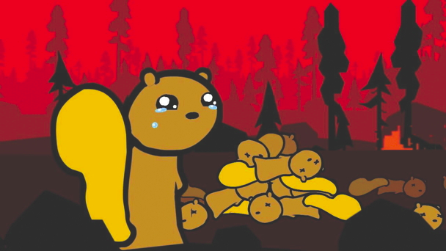
Monte-carlo: downsides
Need full session to start learning
Require a lot of interaction
  A lot of crashed robots / simulations

Slide 79

Gonna fix that next lecture!
Need full session to start learning
Require a lot of interaction
  A lot of crashed robots / simulations

Slide 80

Seminar

