Slide 1



Reinforcement learning
Episode that was long overdue...
Planning

Slide 2
Learning Vs planning
Learning
    Black box environment
    Explore through trial and error
    Minimize regret
Planning
    Got environment model
    Search for optimal behavior
    Then act optimally

Slide 3

Model-based setup
What we know
State transitions
or
Rewards

Slide 4
Model-based setup
What we know
State transitions
or
Rewards
Weaker version: we can only
sample from P(s'|s,a)

Slide 5
Planning: pathfinding
Further limitations:
Deterministic
Pay c(s1,s2) for
moving s1->s2
Find shortest route
from state A to state B
Trivia: how do we do that?

Slide 6
Planning: pathfinding
Further limitations:
Deterministic
Pay c(s1,s2) for
moving s1->s2
Find shortest route
from state A to state B
Consider c(s1,s2) as a negative reward
-r(s1,go_to_s2)
Trivia: how do we do that?

Slide 7
Dynamic programming
Compute following function

Slide 8
Dijkstra's algorithm
Computes the same function
Maintains a queue of candidate nodes
Expands the node with minimal distance to start

Slide 9
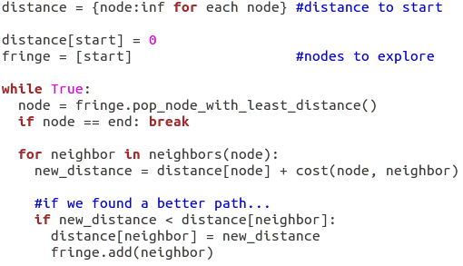
Pseudo-code

Slide 10
Pseudo-code
Trivia: how do we get path(start,end)?

Slide 11
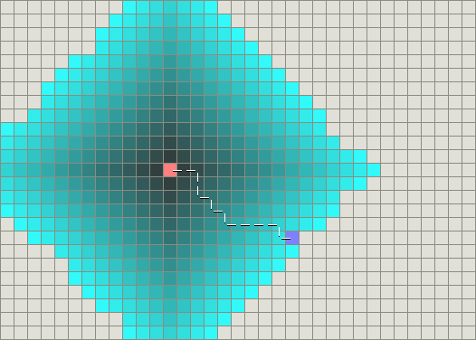
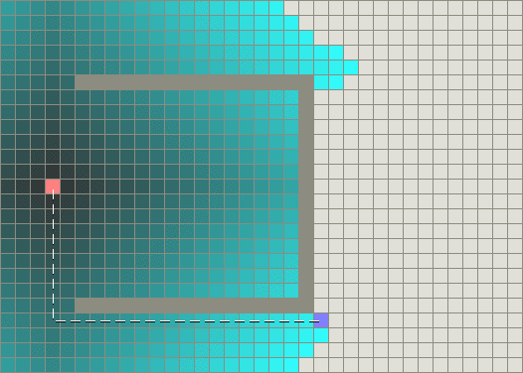
Examples
Blue: viewed nodes, red/violet = start/end, dark-grey = obstacle

Slide 12
A*, informed search
Heuristic estimate of distance
Optimistic path estimate
Pick nodes with least estimate(node)!

Slide 13
A*, informed search
Heuristic estimate of distance
Optimistic path estimate
Pick nodes with least estimate(node)!
e.g. euclidian distance

Slide 14
A*, “informed” search
Heuristic estimate of distance
pop_node_with_least_estimate()

Slide 15

A* example
Blue: fringe, red/green= distance, dark-grey = obstacle

Slide 16
Adversarial setup
Same as deterministic case, but there's a second agent...
And he's playing against us!
We want highest expected reward.
Examples:
- Any board game: chess, checkers, go
- Pong :)

Slide 17
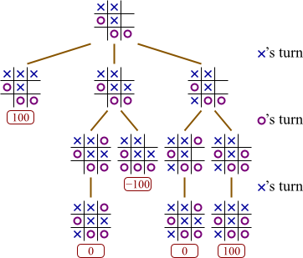
Adversarial search trees

Slide 18
Stochastic setup
Stochastic environment,
We want highest expected reward
or least expected cost

Slide 19
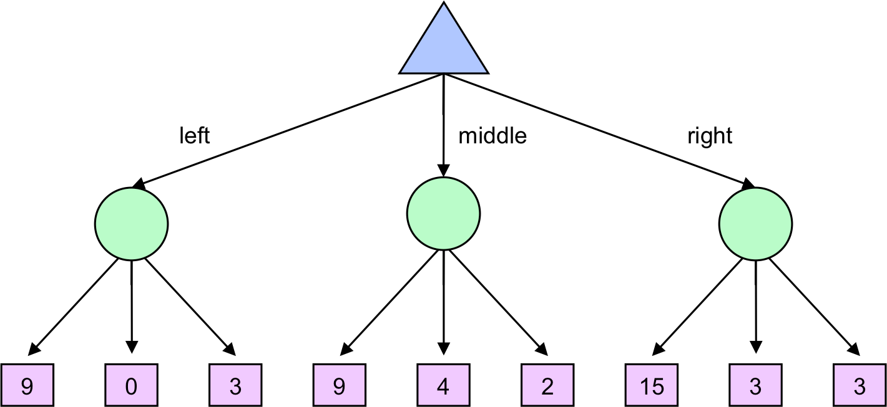
Stochastic search trees
How to evaluate action value?

Slide 20
Large/continuous state space
We can't explore all the nodes.
Need to pick most interesting ones!
Examples:
~any practical use case :)
Atari

Slide 21
Count-based exploration
UCB-1 for bandits
  Idea:
    Prioritize actions with uncertain outcomes!
    Less times visited = more uncertain.
    Math: add upper confidence bond to reward.

Slide 22
Count-based exploration
UCB-1 for bandits
  Take actions in in proportion to
  number of time-steps so far
  times action a is taken
Upper conf. bound
for r in [0,1]

Slide 23
Count-based exploration
UCB-1 for bandits
  Take actions in in proportion to
  number of time-steps so far
  times action a is taken

Slide 24
Count-based exploration
UCB generalized for multiple states
where
  visits to state s
  times action a is taken from state s

Slide 25
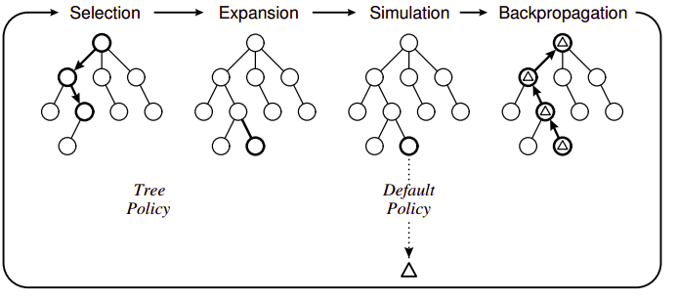
MCTS

Slide 26
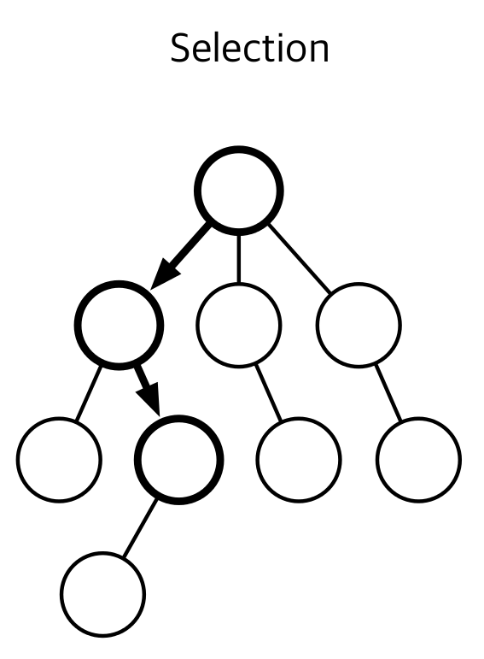
MCTS: selection
Starting from the root,
recursively select node
with highest ucb-1 score

Slide 27
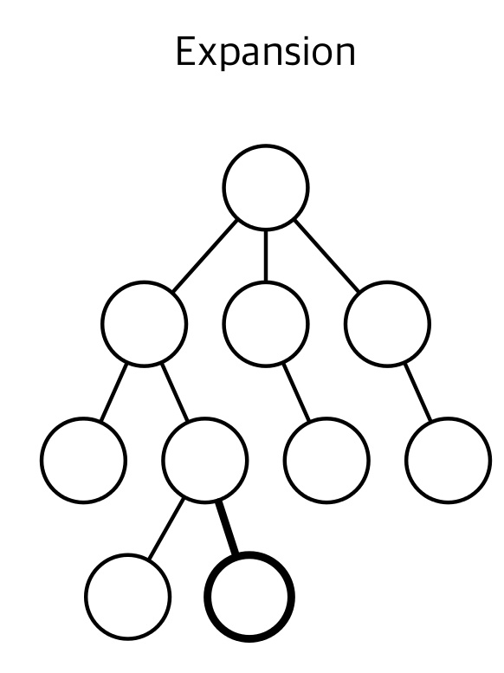
MCTS: Expansion
Add one or more children
from the chosen node.
Each child is a one-step simulation s → s', a, r
Simple case: add one
node per action.

Slide 28
MCTS: Expansion
Add one or more children
from the chosen node.
Each child is a one-step simulation s → s', a, r
Simple case: add one
node per action.
Any ideas when this is won't work?

Slide 29
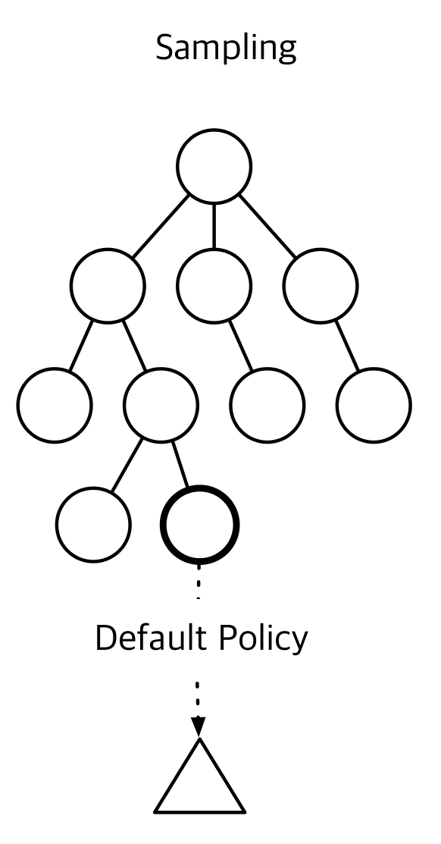
MCTS: Rollout (sampling)
Estimate node value by playing game from that state
till the end with simple policy.
e.g. random actions
Remember total reward.
rollout
policy
end

Slide 30
MCTS: Rollout (sampling)
Estimate node value by playing game from that state
till the end with simple policy.
e.g. random actions
Remember total reward.
Can we do better
than random?
rollout
policy
end

Slide 31
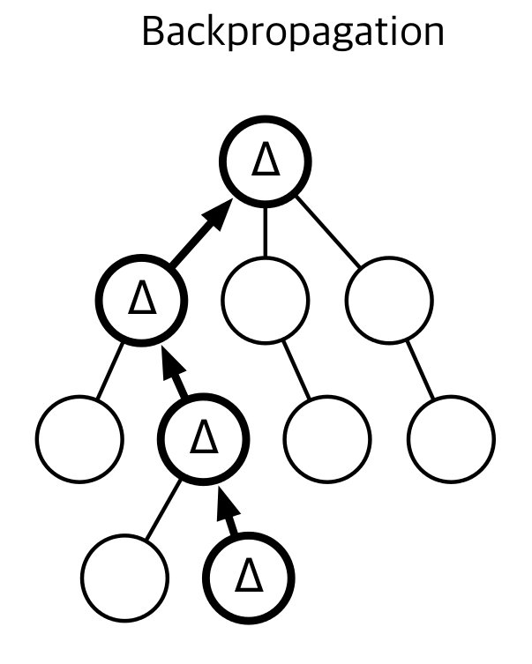
MCTS: Backprop
Given rollout reward,
update value of leaf and
all it's parents.
Also increment visit counts
(N and n_a for ucb-1)

Slide 32
MCTS
How do we pick action from root?

Slide 33

Brace yourselves
And now goes the part with actual cool stuff...

