Slide 1



Reinforcement learning
Episode -1
Miscellaneous cool stuff

Slide 2

Part 1: Continuous action spaces
Regular MDP
Which methods can we use?

Slide 3
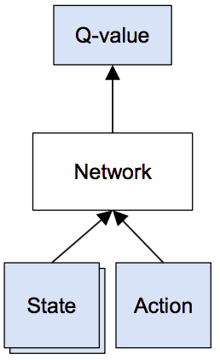
Continuous action spaces
We can learn critic easily
The problem is finding
Worst case: optimize over neural net!

Slide 4
Normalized advantage functions
Idea 1: restrict Q(s,a) so that optimization
becomes trivial
For example, parabola (for 1d action space)
How to find optimal a?

Slide 5
Normalized advantage functions
Idea 1: restrict Q(s,a) so that optimization
becomes trivial
For example, parabola (for 1d action space)
How to find optimal a? - a_opt = mu(s)

Slide 6
Normalized advantage functions
Idea 1: restrict Q(s,a) so that optimization
becomes trivial
For example, parabola (for 1d action space)
How does it generalize for n-dimensional a?

Slide 7
Normalized advantage functions
Idea 1: restrict Q(s,a) so that optimization
becomes trivial
For example, parabola (for 1d action space)
Where L(s) is a lower-triangular matrix

Slide 8
Normalized advantage functions
Network:
(trains end-to-end)
V(s)
(scalar)
μ(s)
(vector)
L(s)
(lower-tri)
model
state
https://arxiv.org/pdf/1603.00748.pdf

Slide 9

Deterministic policy gradient
Idea2: learn a separate network to find a_opt
Train critic
Train actor

Slide 10
Deterministic policy gradient
Idea2: learn a separate network to find a_opt
Train critic
Train actor
How do we get V(s')?

Slide 11
Deterministic policy gradient
Idea2: learn a separate network to find a_opt
Train critic
Train actor

Slide 12
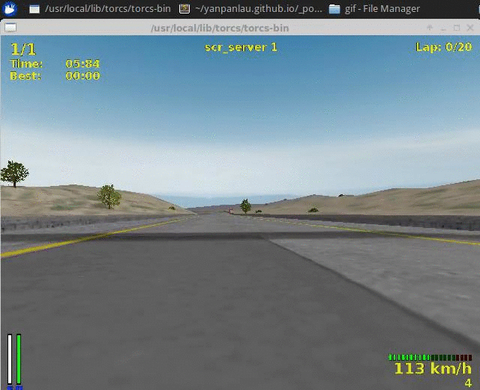
Deterministic policy gradient
Demo with torcs http://bit.ly/2pXwdKa

Slide 13

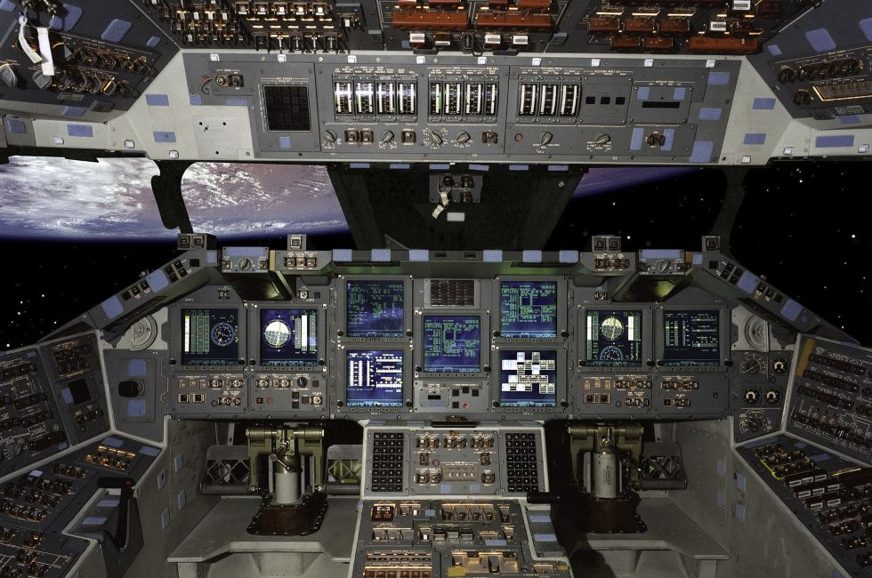
Ugly action spaces
Keyboard
Aircraft control
~Any strategy game

Slide 14
Exploiting action space structure
Imagine a large discrete action space, 10^90

Slide 15

Exploiting action space structure
Imagine a large discrete action space, 10^90
Like, way over 9000

Slide 16
Exploiting action space structure
Imagine a large discrete action space, 10^90
  We worked with such spaces before!
Does it remind you of anything?

Slide 17
Exploiting action space structure
Imagine a large discrete action space, 10^90
  We worked with such spaces before!
a_i is a single letter, a is full translation
How did we deal with 10^90 actions?

Slide 18
Structured action space: sequential
Action space
Straightforward
Sequential

Slide 19
Structured action space: sequential
Action space
Straightforward
Sequential
How did we approximate this distribution?

Slide 20
Structured action space: sequential
Action space
Straightforward
Sequential
How did we approximate this distribution?
With RNNs/HMMs!

Slide 21
Recommender systems
Typical bandit
One action per item, 10^5 items (still over 9000)
Even worse: new items arrive over time!
Similar items have similar audiences

Slide 22
Recommender systems
Typical bandit
One action per item, 10^5 items (still over 9000)
Even worse: new items arrive over time!
Similar items have similar audiences

Slide 23
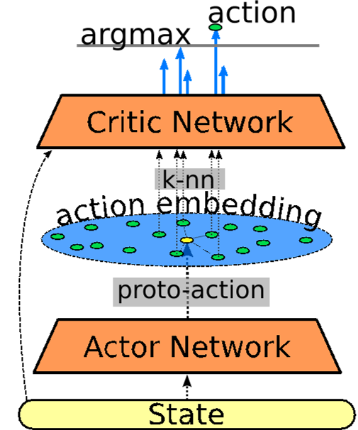
Action embedding
Map actions into some
continuous space
How to do that for films?

Slide 24
Action embedding
Map actions into some
continuous space
(hand-crafted / tsne / emb)
Predict continuous “action”
  (aka proto-action)
Pick closest discrete action
  e.g. with (LSH)
(locally sensitive hashes)
https://arxiv.org/abs/1512.07679

Slide 25

Let's figure it out!
http://universe.openai.com

Slide 26


Let's figure it out!
Emulate human PC user
  Actions: keyboard and mouse
How do we define ?

Slide 27
Part 2: hierarchical RL
Problem: Rewards are usually sparse (temporally rare) and delayed.
It takes exponentially more random exploration to learn optimal policy in case of rare rewards.

Slide 28
Humans:
Don't seem to follow epsilon-greedy exploration policy
(see lecture 9)
Think in several layers of abstraction
  “Contract leg muscles”
  “Push gas pedal (while driving)”
  “Take left turn in 15 meters”
  “Drive to school”,
  “Give my children education”

Slide 29
Humans:
Don't seem to follow epsilon-greedy exploration policy
(see lecture 9)
Think in several layers of abstraction
  “Contract leg muscles”
  “Push gas pedal (while driving)”
  “Take left turn in 15 meters”
  “Drive to school”,
  “Give my children education”
We want hierarchical decision-making!

Slide 30
So what is hierarchy, again?
Suggestions?

Slide 31
So what is hierarchy, again?
I know, I know! It's about operating in term of more abstract states!
No! It's about acting on a longer time scale!
No! it's about decomposing reward into short-term and long-term

Slide 32

Hierarchical MDP
“Boss”
Goal
observation
Agent
action

Slide 33

Feudal RL
Idea:
  At the bottom, there's regular agent that operates on raw states and takes actual actions. He also receives goals from above.
  Above him, there's a 'manager' agent that operates on more abstract states and issues goals to bottom agent. He also may receive higher-order goals from above him.
  Manager doesn't care whether his goal is actually beneficial to his super.
  Neither he does care about what orders does his sub-manager issue.

Slide 34
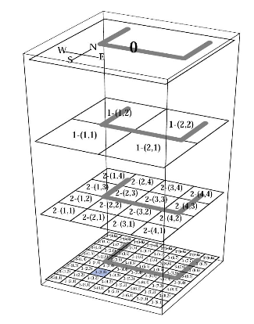
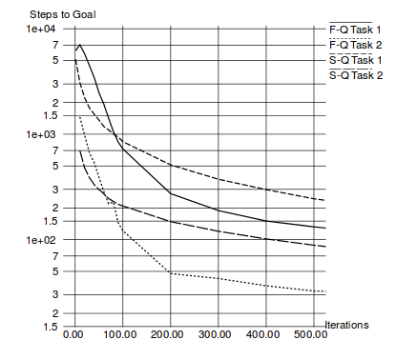
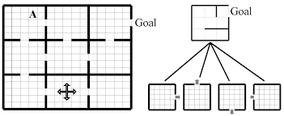
Feudal RL
Idea:

Slide 35
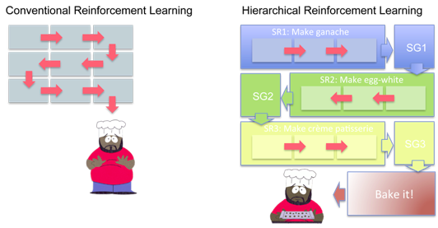
Temporal abstraction RL
The “option" method by Sutton, Precup, and Singh 1998

Slide 36
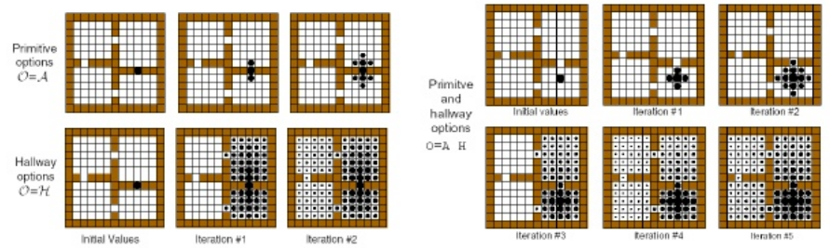
Temporal abstraction RL
The “option" method by Sutton, Precup, and Singh 1998

Slide 37
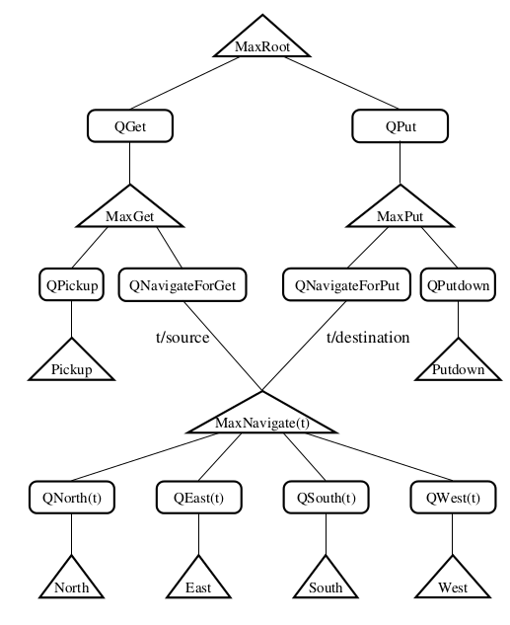
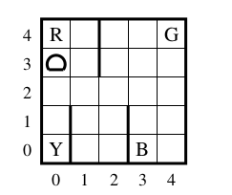
MDP decomposition

Slide 38
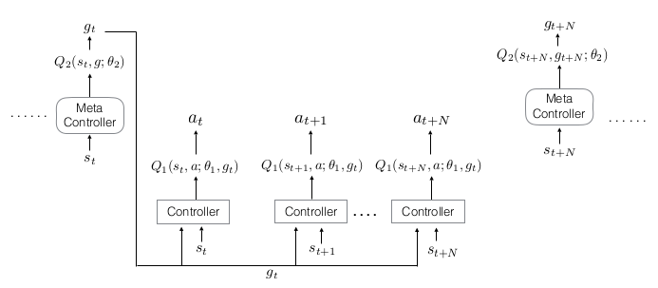
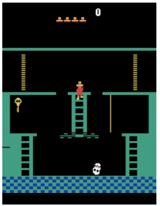
Hierarchical deep RL
Tenenbaum et al. https://arxiv.org/abs/1604.06057v1

Slide 39
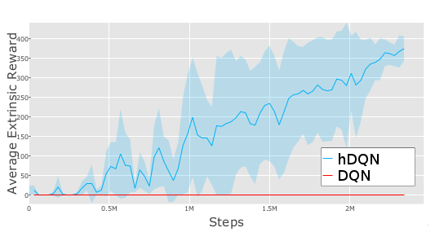
Hierarchical deep RL
Tenenbaum et al. https://arxiv.org/abs/1604.06057v1

Slide 40
Hierarchical RL
A1
A1 memory
A1
goal
goal
g
g
g
g
g
A0
m0
A0
m0
A0
m0
A0
m0
A0
m0
o
o
o
o
o
a
a
a
a
a
Environment
time

Slide 41
Model-free hierarchical RL
  Upper-level agent actions (goals for lower-level) are just arbitrary numbers without any model knowledge
  Lower-level agent uses goal embedding as a part of his state vector

Slide 42
Model-free hierarchical RL
  Upper-level agent actions (goals for lower-level) are just arbitrary numbers without any model knowledge
  Lower-level agent uses goal embedding as a part of his state vector

Slide 43
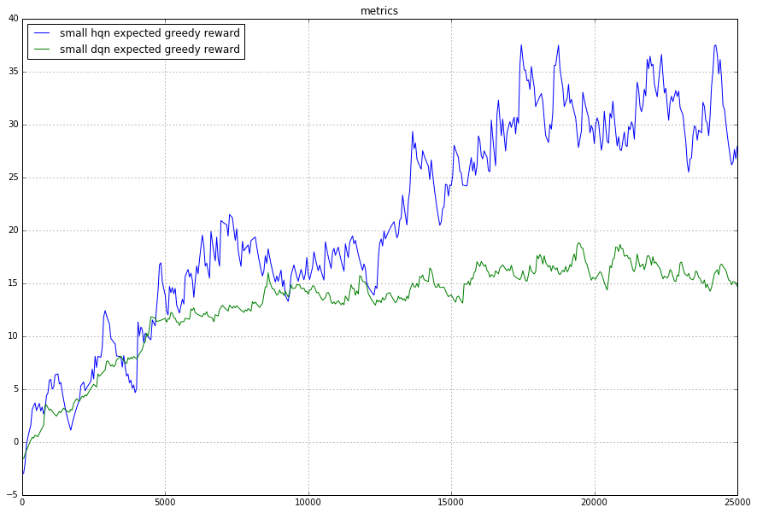
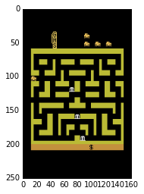
Learning curves

Slide 44
What's left behind
Learning from human experience
Inverse RL – learn r given near-optimal policy
Model-based methods
Whatever new stuff comes out '17

Slide 45
Course outro
This is almost the end...
Probably not too late to send homeworks.
Gonna be binge-checking on 19-20
Please tell us how to improve the course
http://bit.ly/2qwZSwN

Slide 46
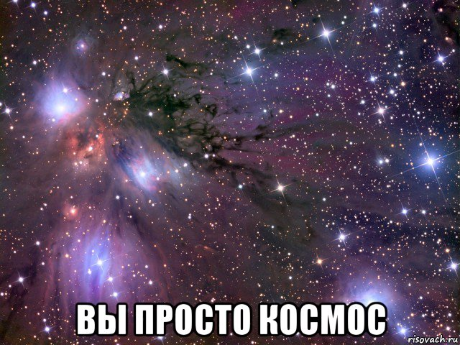
Course outro

