Slide 1



Reinforcement learning
Episode -1, part -1
Hierarchical RL 101
Slides by Pavel Shvechikov

Slide 2
RL agents vs humans:
Model-free: trial & error (mostly error)
Model-based: planning & execution

Slide 3
RL agents vs humans:
Model-free: trial & error (mostly error)
Model-based: planning & execution
Action values: understanding consequences of actions
Exploration: curiosity

Slide 4
RL agents vs humans:
Model-free: trial & error (mostly error)
Model-based: planning & execution
Action values: understanding consequences of actions
Exploration: curiosity
POMDP: learning to remember past events
Inverse RL: understanding others’ motives
Imitation learning: learning by imitation (cpt. obvious)
Multi-agent RL: accounting for others’ interests
???
???
???
???

Slide 5
RL agents vs humans:
Model-free: trial & error (mostly error)
Model-based: planning & execution
Action values: understanding consequences of actions
Exploration: curiosity
POMDP: learning to remember past events
Inverse RL: understanding others’ motives
Imitation learning: learning by imitation (cpt. obvious)
Multi-agent RL: accounting for others’ interests

Slide 6
How humans work:
Don't seem to follow epsilon-greedy exploration policy
(see exploration lecture)
Think in several layers of abstraction
  “Contract leg muscles”
  “Push gas pedal (while driving)”
  “Take left turn in 15 meters”
  “Drive to school”,
  “Give my children education”

Slide 7
Problem: Rewards are usually sparse (rare) and/or delayed in time.
It takes exponentially more random exploration to learn optimal policy in case of rare rewards.

Slide 8
Humans:
Don't seem to follow epsilon-greedy exploration policy
(see exploration lecture)
Think in several layers of abstraction
  “Contract leg muscles”
  “Push gas pedal (while driving)”
  “Take left turn in 15 meters”
  “Drive to school”,
  “Give my children education”
We want hierarchical decision-making!

Slide 9
So what is hierarchy, again?
Suggestions?

Slide 10
So what is hierarchy, again?
I know, I know! It's about operating in term of more abstract states!
No! It's about acting on a longer time scale!
No! it's about decomposing reward into short-term and long-term

Slide 11

Normal MDP
Agent
action

Slide 12
Hierarchical MDP
“Boss”
Goal
observation
Agent
action

Slide 13
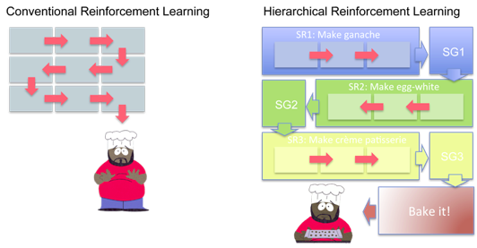
Options
The “option" method by Sutton, Precup, and Singh 1998

Slide 14
Naive Hierarchical RL
A1
A1 memory
A1
goal
goal
g
g
g
g
g
A0
m0
A0
m0
A0
m0
A0
m0
A0
m0
o
o
o
o
o
a
a
a
a
a
Environment
time

Slide 15
Naive Hierarchical RL
  Model-based
    Manual measurable goals
    e.g. arxiv: 1604.06057
  Model-free
    Agent needs to “learn” useful goals
    Naive: no better than standard rl

Slide 16
FeUdal Networks
  Sketch:
    Goal = direction
    in state space
    Differentiable
    End-to-end
“Boss”
Goal
observation
Agent
action
Arxiv: 1703.01161

Slide 17
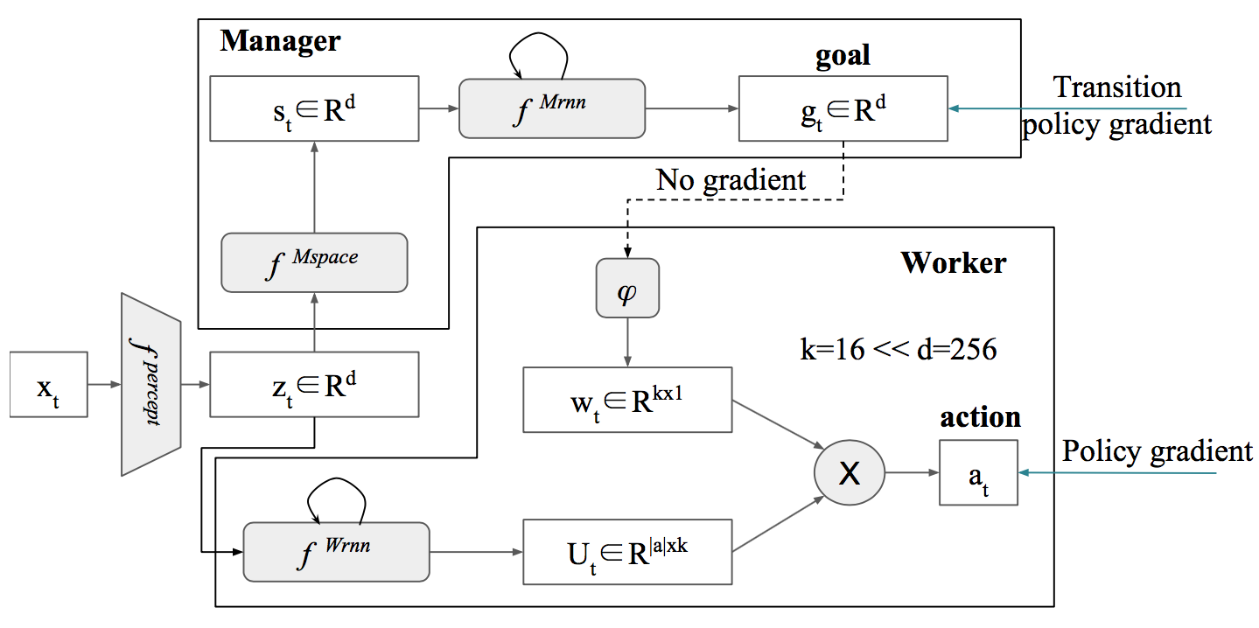
FeUdal Networks
goal

Slide 18
FeUdal Networks

Slide 19
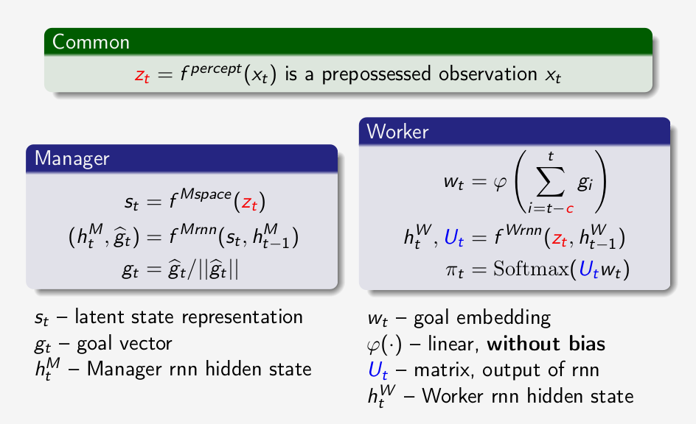

Slide 21
Update rules: manager
  Boss’ objective
  - agent’s path in state space (embedding)
  - cosine similarity
  - advantage
  Q: Reminds you of something?

Slide 22
Update rules: manager
  Boss’ objective
  - agent’s path in state space (embedding)
  - cosine similarity
  - advantage
  Policy gradient for von Mises-Fisher distribution

Slide 23
Update rules: worker
  Intrinsic reward
  Worker updates:

Slide 24
That scheme again

Slide 25
More on FeUdal nets
More hacks:
  Dilated LSTM for manager (as Mrnn)
  stack of r = 10 states
  Only one group is updated per time-step
  Read more: arxiv.org/abs/1703.01161 , section 4.1
  Similar idea: arxiv.org/abs/1402.3511

Slide 26
More on FeUdal nets
More hacks:
  Dilated LSTM for manager (as Mrnn)
  stack of r = 10 states
  Only one group is updated per time-step

Slide 27
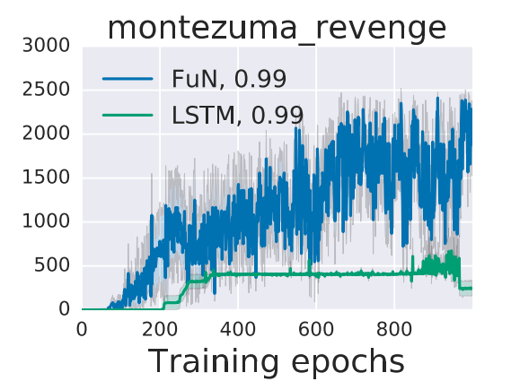
Some results

Slide 28
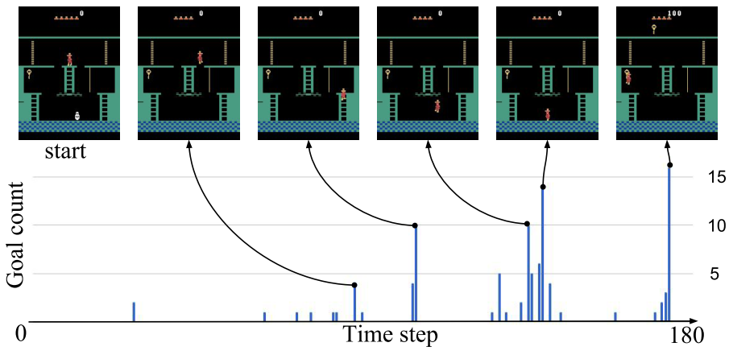
Some results

Slide 29
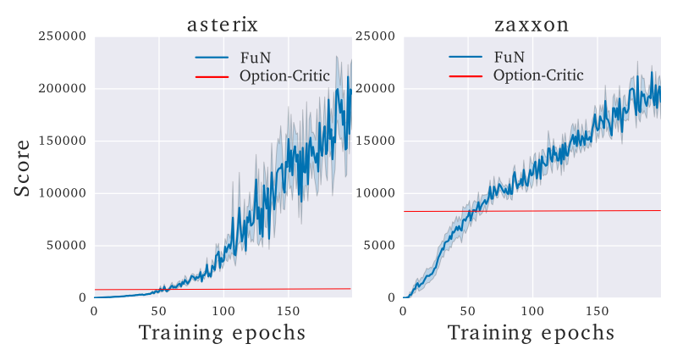
More results

Slide 30
Course outro
the end...
Not too late to send homeworks.
Gonna be binge-checking on 19-20
Please tell us how to improve the course
http://bit.ly/2qwZSwN

Slide 31
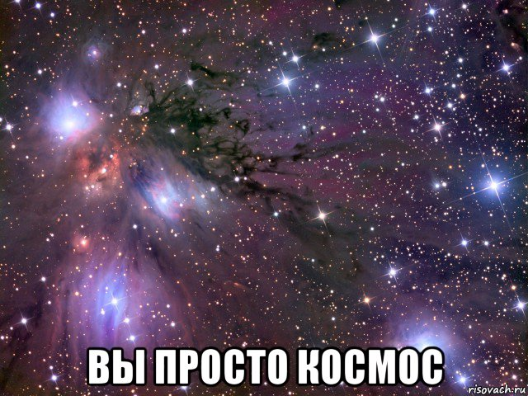
Course outro
Tons of bug-fixes
Awesome research
Useful feedback
Please tell us how to improve the course
http://bit.ly/2qwZSwN

