Slide 1



Practical RL
@spring ‘18
Intro to Reinforcement Learning
Why should you care

Slide 2
Terms
Ask!
  Even if the question feels stupid.
  Chances are, half of the group is just like you.
  If it's necessary, interrupt the speaker.
Contribute!
  Found an error? Got useful link? Ported the seminar to py3 from py2? Answered peer's question in the chat?
  You're awesome!

Slide 3
<a convenient slide for public survey>

Slide 4
Supervised learning
Given:
    objects and answers
    algorithm family
    loss function
Find:

Slide 5
Supervised learning
Given:
    objects and answers
    algorithm family
    loss function
Find:
[banner,page], ctr
linear / tree / NN
MSE, crossentropy

Slide 6
Supervised learning
Great... except if we have no reference answers

Slide 7


Online Ads
Great... except if we have no reference answers
We have:
  YouTube at your disposal
  Live data stream
  (banner & video features, #clicked)
  (insert your favorite ML toolkit)
We want:
  Learn to pick relevant ads
Ideas?

Slide 8


Duct tape approach
Common idea:
  Initialize with naïve solution
  Get data by trial and error and error and error and error
  Learn (situation) → (optimal action)
  Repeat

Slide 9

Giant Death Robot (GDR)
Great... except if we have no reference answers
We have:
  Evil humanoid robot
  A lot of spare parts
    to repair it :)
We want:
  Enslave humanity
  Learn to walk forward
Ideas?

Slide 10
Duct tape approach (again)
Common idea:
  Initialize with naïve solution
  Get data by trial and error and error and error and error
  Learn (situation) → (optimal action)
  Repeat

Slide 11


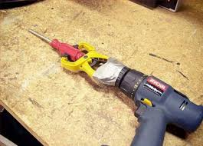
Duct tape approach

Slide 12
Problems
Problem 1:
  What exactly does the “optimal action” mean?
  Extract as much
  money as you can right now
  VS
Make user happy
so that he would visit you again

Slide 13
Problems
Problem 2:
  If you always follow the “current optimal” strategy, you may never discover something better.
  If you show the same banner to 100% users, you will never learn how other ads affect them.
  Ideas?

Slide 14
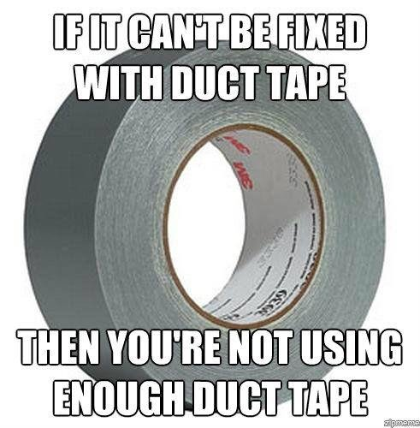
Duct tape approach

Slide 15

Reinforcement learning

Slide 16

What-what learning?
      Supervised learning
  Learning to approximate reference answers
  Needs correct answers
  Model does not affect the input data
      Reinforcement learning
  Learning optimal strategy
by trial and error
  Needs feedback on agent's own actions
  Agent can affect it's own observations

Slide 17
What-what learning?
      Unsupervised learning
  Learning underlying
  data structure
  No feedback required
  Model does not affect the input data
      Reinforcement learning
  Learning optimal strategy
by trial and error
  Needs feedback on agent's own actions
  Agent can affect it's own observations

Slide 18

What is: bandit
observation
Agent
action
Feedback
Examples:
  banner ads (RTB)
  recommendations
  medical treatment

Slide 19

What is: bandit
observation
Agent
action
Feedback
Examples:
  banner ads (RTB)
  recommendations
  medical treatment

Slide 20
What is: bandit
observation
Agent
action
Feedback
Examples:
  banner ads (RTB)
  recommendations
  medical treatment
Q: what's observation, action and feedback in the banner ads problem?

Slide 21
What is: bandit
observation
Agent
action
Feedback
user features
time of year
trends
show
banner
click,
money
Examples:
  banner ads (RTB)
  recommendations
  medical treatment

Slide 22

What is: bandit
observation
Agent
action
Feedback
user features
time of year
trends
show
banner
click,
money
Q: You're Yandex/Google/Youtube.
There's a kind of banners that would have great click rates: the “clickbait”.
Is it a good idea to show clickbait?

Slide 23
What is: bandit
observation
Agent
action
Feedback
Q: You're Yandex/Google/Youtube.
There's a kind of banners that would have great click rates: the “clickbait”.
Is it a good idea to show clickbait?
No, no one will trust you after that!

Slide 24
What is: decision process
Agent
observation
action
Environment

Slide 25
What is: decision process
Agent
Can do anything
observation
action
Can't even see
(worst case)
Environment

Slide 26

Reality check: web
Cases:
  Pick ads to maximize profit
  Design landing page to maximize user retention
  Recommend movies to users
  Find pages relevant to queries
Example
  Observation – user features
  Action – show banner #i
  Feedback – did user click?

Slide 27




Reality check: dynamic systems

Slide 28

Reality check: dynamic systems
Cases:
    Robots
    Self-driving vehicles
    Pilot assistant
    More robots!
Example
  Observation: sensor feed
  Action: voltage sent to motors
  Feedback: how far did it move
    forward before falling

Slide 29




Reality check: videogames
  Q: What are observations, actions and feedback?

Slide 30
Reality check: videogames
  Q: What are observations, actions and feedback?

Slide 31


Other use cases
Personalized medical treatment
Even more games (Go, chess, etc)
  Q: What are observations, actions and feedback?

Slide 32


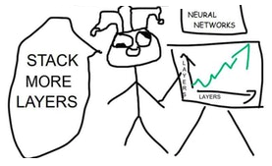
Other use cases
Conversation systems
  learning to make user happy
Quantitative finance
  portfolio management
Deep learning
  optimizing non-differentiable loss
  finding optimal architecture

Slide 33

The MDP formalism
Markov Decision Process
  Environment states:
  Agent actions:
  Rewards
  Dynamics:

Slide 34
The MDP formalism
Markov Decision Process
  Markov assumption

Slide 35
The MDP formalism
Markov Decision Process
  Markov assumption

Slide 36

Total reward
Total reward for session:
Agent's policy:
Problem: find policy with
highest reward:

Slide 37
Objective
The easy way:
is an expected sum of rewards
that agent with policy earns per session
The hard way:

Slide 38
Objective
The easy way:
is an expected sum of rewards
that agent with policy earns per session
The hard way:

Slide 39
How do we solve it?
General idea:
  Play a few sessions
  Update your policy
  Repeat

Slide 40
Crossentropy method
Intialize policy
Repeat:
  Sample N[100] sessions
  Pick M[25] best sessions, called elite sessions
  Change policy so that it prioritizes
  actions from elite sessions

Slide 41
Step-by-step view

Slide 42
Step-by-step view
elites

Slide 43
Step-by-step view

Slide 44
Step-by-step view

Slide 45
Step-by-step view

Slide 46
Step-by-step view

Slide 47
Step-by-step view

Slide 48
Step-by-step view

Slide 49
Step-by-step view

Slide 50
Step-by-step view

Slide 51
Step-by-step view

Slide 52
Tabular crossentropy method
Policy is a matrix
Sample N games with that policy
Get M best sessions (elites)

Slide 53
Tabular crossentropy method
Policy is a matrix
Sample N games with that policy
Take M best sessions (elites)
Aggregate by states

Slide 54
Tabular crossentropy method
Policy is a matrix
Sample N games with that policy
Take M best sessions (elite)
Aggregate by states
In M best
games

Slide 55
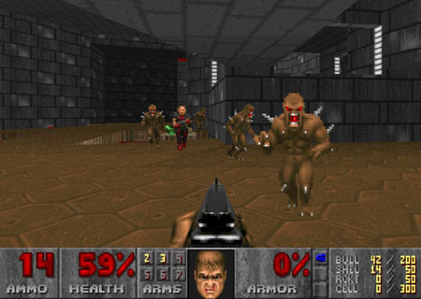
Grim reality
If your environment has infinite/large state space

Slide 56
Approximate crossentropy method
Policy is approximated
  Neural network predicts given s
  Linear model / Random Forest / ...
Can't set explicitly
All state-action pairs from M best sessions

Slide 57
Approximate crossentropy method
Neural network predicts given s
All state-action pairs from M best sessions
Maximize likelihood of actions in “best” games

Slide 58
Approximate crossentropy method
Initialize NN weights
Loop:
  Sample N sessions

Slide 59
Approximate crossentropy method
nn = MLPClassifier(...)
Initialize NN weights
Loop:
  Sample N sessions
  nn.fit(elite_states,elite_actions)

Slide 60
Continuous action spaces
Continuous state space
Model
  Mu(s) is neural network output
  Sigma is a parameter or yet another network output
Loop:
  Sample N sessions
  elite = take M best sessions and concatenate
What changed?

Slide 61
Approximate crossentropy method
nn = MLPRegressor(...)
Initialize NN weights
Loop:
  Sample N sessions
  nn.fit(elite_states,elite_actions)
Almost nothing!

Slide 62

Tricks
Remember sessions from 3-5 past iterations
  Threshold and use all of them when training
  May converge slower if env is easy to solve.
Regularize with entropy
  to prevent premature convergence.
Parallelize sampling
Use RNNs if partially-observable (later)

