Slide 1



Reinforcement learning
Episode 2
Temporal Difference

Slide 2

Recap: reinforcement learning
Agent
Can do anything
observation
action
Can't even see
(worst case)
Environment

Slide 3
Recap: reinforcement learning
Agent
Can do anything
observation
action
Can't even see
(worst case)
Q: How did we solve it?
Environment

Slide 4
Black box methods
Metaheuristics (simulated annealing)
Evolution strategies
Crossentropy method
…

Slide 5

Black box drawbacks
Both need a full session to start learning
Requires a lot of interaction
  A lot of crashed robots / simulations

Slide 6
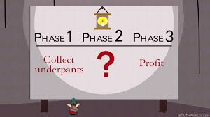
Today: value-based methods
Core idea:
  1. You are at state s
  2. Compute expected reward for session if you take
    each possible action (a1,a2,a3,...)
  Then what? (e.g. chess)
    You can compute expected win rate for each move.
    What do you do?

Slide 7
Today: value-based methods
Core idea:
  1. You are at state s
  2. Compute expected reward for session if you take
    each possible action (a1,a2,a3,...)
  3. Take action with highest expected reward!

Slide 8

MDP formalism: reward on each tick
Classic MDP(Markov Decision Process)
Agent interacts with environment
  Environment states:
  Agent actions:
  State transition:
  Reward:

Slide 9
Model-based setup
What we know
State transitions
or
Rewards

Slide 10
Model-based setup
What we know
State transitions
or
Rewards
Weaker version: we can only
sample from P(s'|s,a)

Slide 11

Discounted reward MDP
Objective:
  Discounted return G
γ ~ patience
Cake tomorrow is γ as good as now

Slide 12
Discounted reward MDP
Objective:
  Discounted return G
γ ~ patience
Cake tomorrow is γ as good as now
Q1: which γ corresponds to
“only current reward matters”?
Q2: with which γ G is just a sum of rewards?

Slide 13
Discounted reward MDP
Objective:
  Discounted return G
Reinforcement learning:
  Find policy that maximizes
    the expected reward

Slide 14
Discounted reward MDP
Objective:
  Discounted return G
Reinforcement learning:
  Find policy that maximizes
    the expected reward
Does not maximize sum of rewards
Unless γ = 1

Slide 15

Dealing with G
=
We rewrite G with sheer power of math!

Slide 16
Dealing with G
=
=
=
We rewrite G with sheer power of math!

Slide 17
Dealing with G
=
=
=
=
We rewrite G with sheer power of math!

Slide 18

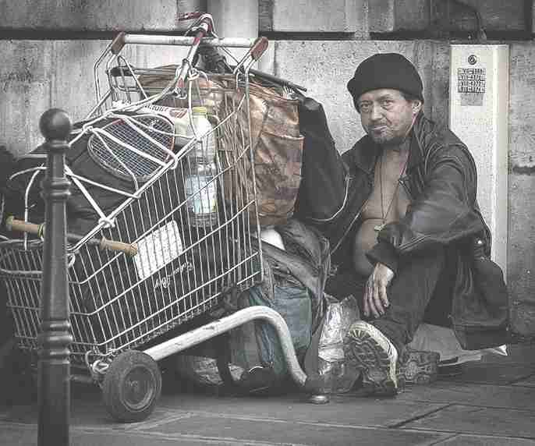
More new letters!
  Definition: Vπ(s) – expected total reward G that can be obtained starting from state s and following policy π.
large potential rewards
small potential rewards
vs

Slide 19
More new letters!
  Definition: Vπ(s) – expected total reward G that can be obtained starting from state s and following policy π.
…

Slide 20
State value
  Definition: Vπ(s) – expected total reward G that can be obtained starting from state s and following policy π.
…

Slide 21
State value
  Definition: Vπ(s) – expected total reward G that can be obtained starting from state s and following policy π.
…

Slide 22
State value
  Definition: Vπ(s) – expected total reward G that can be obtained starting from state s and following policy π.

Slide 23
State value
  Definition: Vπ(s) – expected total reward G that can be obtained starting from state s and following policy π.
trajectory τ = (s,a,r,s',a',r',...)

Slide 24
Bellman equation
  Definition: Vπ(s) – expected total reward R that can be obtained starting from state s and following policy π.

Slide 25
Bellman equation
  Definition: Vπ(s) – expected total reward R that can be obtained starting from state s and following policy π.
how I like s = what r I can get right now + γ * how I like s'

Slide 26
Optimal policy
Imagine we know exact value of any Vπ(s).
(also P(s',r|s,a))
Q: how do we pick optimal action?
s1
V(s1) = 4.5
r=+1
s0
a1
s2
a2
r=+2
V(s2) = 3.9
a3
r=+3
s3
V(s2) = 3.2

Slide 27
Optimal policy
Imagine we know exact value of any Vπ(s).
(also P(s',r|s,a))
Q: how do we pick optimal action?
s1
V(s1) = 4.5
r=+1
s0
a1
s2
a2
r=+2
V(s2) = 3.9
a3
r=+3
s3
V(s2) = 3.2

Slide 28
V*(s) and π*(a|s)

Slide 29
Value iteration (TD)
Idea:
  Iterative updates

Slide 30

Value iteration (TD)
Idea:
  Iterative updates
0
0
0
0
0
0
0
0
0
0

Slide 31
Value iteration (TD)
Idea:
  Iterative updates
0
0
γ
0
0
0
0
0
0
1

Slide 32
Value iteration (TD)
Idea:
  Iterative updates
0
γ²
γ
0
γ²
0
0
0
0
2

Slide 33
Value iteration (TD)
Idea:
  Iterative updates
γ³
γ²
γ
0
γ²
0
0
γ³
0
3

Slide 34
Value iteration (TD)
Idea:
  Iterative updates
γ³
γ²
γ
γ⁴
γ²
γ⁵
γ⁴
γ³
γ⁴
5

Slide 35

Value iteration (TD)
Idea:
  Iterative updates

Slide 36
At scale
Q: What to do if we have large/continuous state space?
We can no longer explore all states!

Slide 37
At scale
Q: What to do if we have large/continuous state space?
We can no longer explore all states!
Idea: we can only search some neighboring states!

Slide 38
Adversarial setup
Your agent plays a deterministic game with another agent in it.
And he's playing against us!
We want highest expected reward.
He wants to minimize our expected reward.
Examples:
- Any board game: chess, checkers, go
- Pong :)

Slide 39
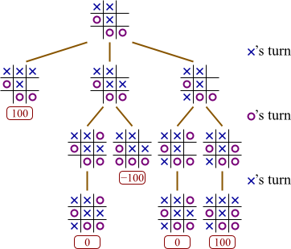
Adversarial search trees

Slide 40
Adversarial search trees
What's optimal action
from top state?

Slide 41
Adversarial search trees
V = 100
V = 0
V = -100

Slide 42
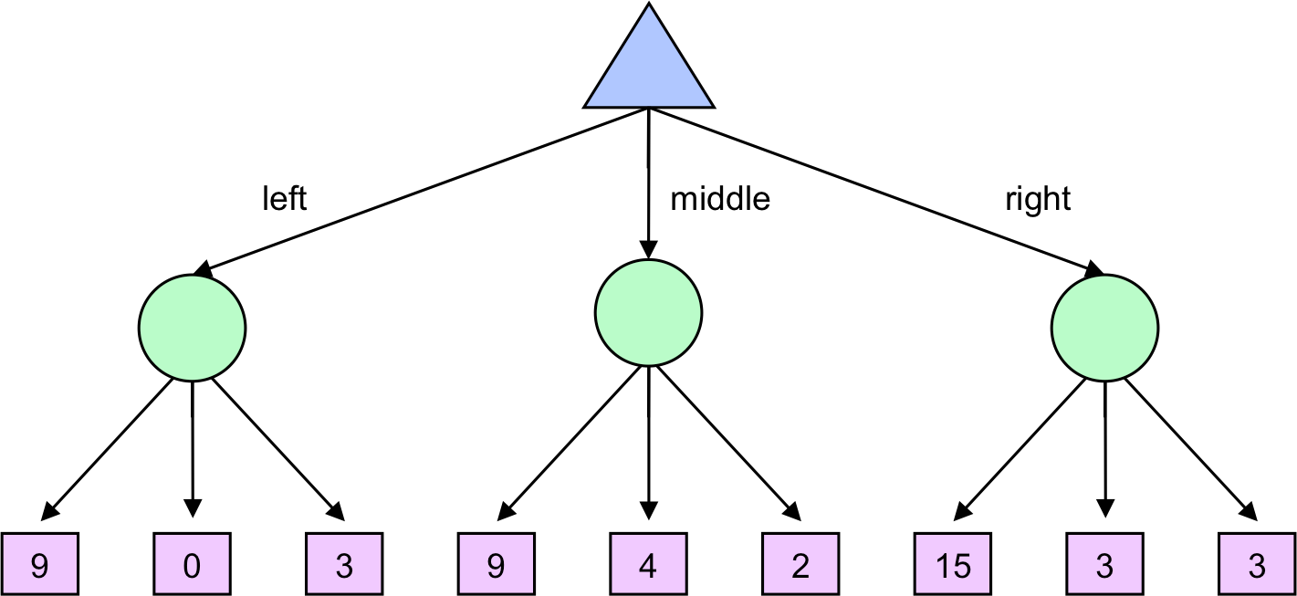
Stochastic search trees
current
state
s0
How to evaluate action value?
action
a1
a2
a3
r+V(s')

Slide 43
Large/continuous state space
We can't explore all the nodes.
Need to pick most interesting ones!
Examples:
~any practical use case :)
Atari

Slide 44
Count-based exploration
UCB-1 for bandits
  Idea:
    Prioritize actions with uncertain outcomes!
    Less times visited = more uncertain.
    Math: add upper confidence bond to reward.

Slide 45
Count-based exploration
UCB-1 for bandits
  Take actions in in proportion to
  number of time-steps so far
  times action a is taken
Upper conf. bound
for r in [0,1]

Slide 46
Count-based exploration
UCB-1 for bandits
  Take actions in in proportion to
  number of time-steps so far
  times action a is taken

Slide 47
Count-based exploration
UCB generalized for multiple states
where
  visits to state s
  times action a is taken from state s

Slide 48
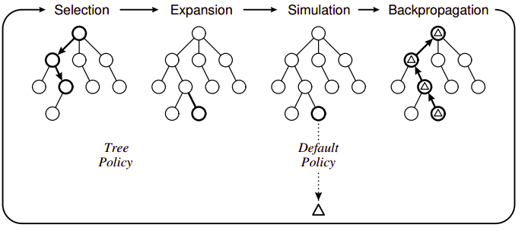
MCTS

Slide 49
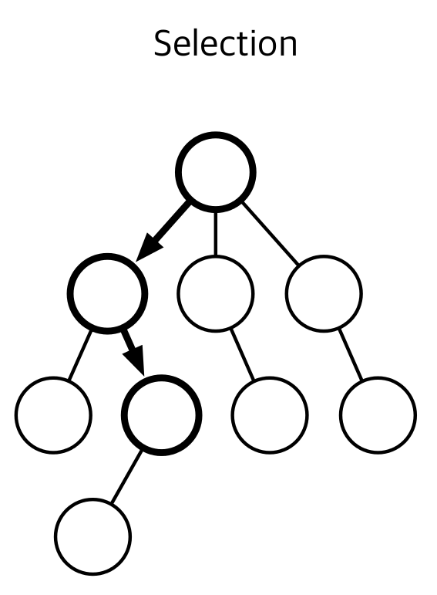
MCTS: selection
Starting from the root,
recursively select node
with highest ucb-1 score

Slide 50
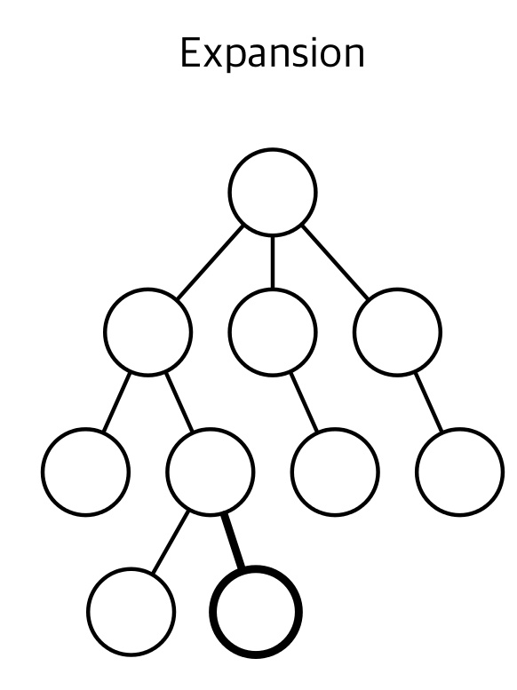
MCTS: Expansion
Add one or more children
from the chosen node.
Each child is a one-step simulation s → s', a, r
Simple case: add one
node per action.

Slide 51
MCTS: Expansion
Add one or more children
from the chosen node.
Each child is a one-step simulation s → s', a, r
Simple case: add one
node per action.
Any ideas when this is won't work?

Slide 52
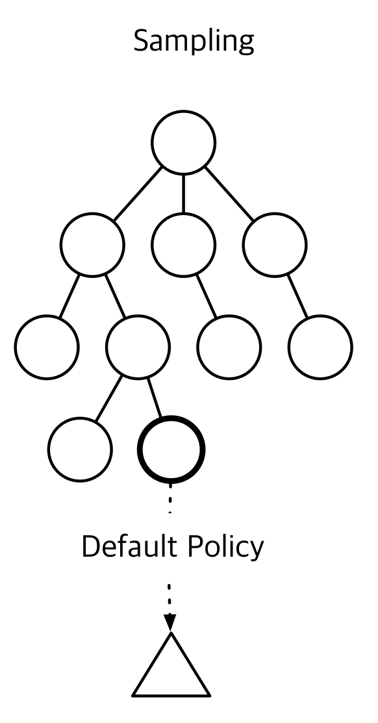
MCTS: Rollout (sampling)
Estimate node value by playing game from that state
till the end with simple policy.
e.g. random actions
Remember total reward.
rollout
policy
end

Slide 53
MCTS: Rollout (sampling)
Estimate node value by playing game from that state
till the end with simple policy.
e.g. random actions
Remember total reward.
Can we do better
than random?
rollout
policy
end

Slide 54
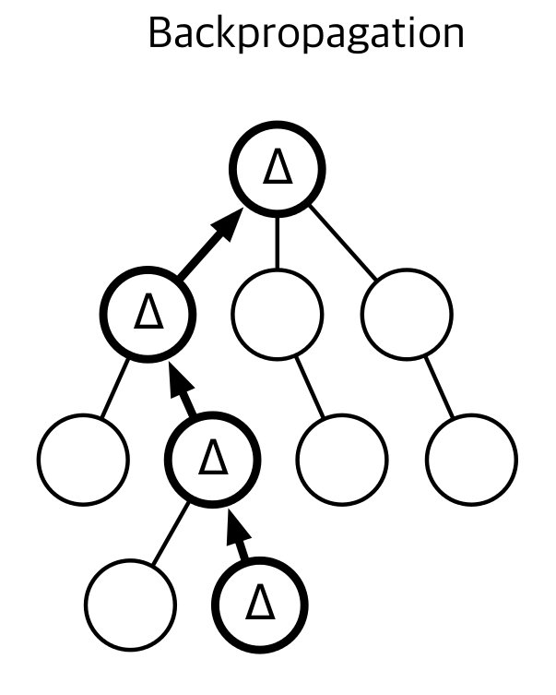
MCTS: Backprop
Given rollout reward,
update value of leaf and
all it's parents.
Also increment visit counts
(N and n_a for ucb-1)

Slide 55
MCTS
How do we pick action from root?

Slide 56
MCTS
Pick action to maximize expected reward!

Slide 57
Recap
What did we learn?

Slide 58
Recap
What did we learn?
    Discounted rewards, G
    State values,V(s) V*(s)
    Value iteration
    Planning trees, MCTS

Slide 59
Voila! We've solved the reinforcement learning!
Or have we?
  What happens if we apply it to real world problems?

Slide 60



Reality check: web
Cases:
    Pick ads to maximize profit
    Design landing page to maximize user retention
    Recommend items to users
Common traits:
    Independent states
    Large action space

Slide 61




Reality check: dynamic systems

Slide 62

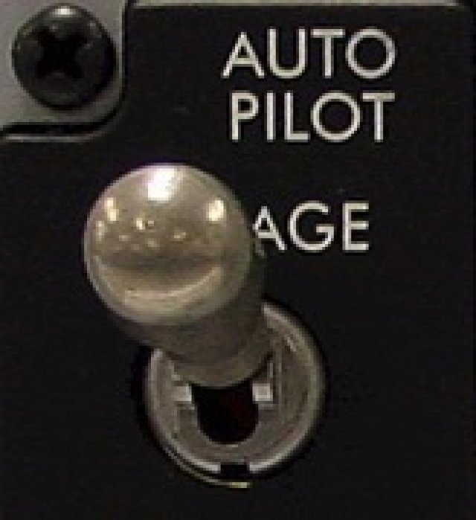
Reality check: MOAR
Cases:
    Robots
    Self-driving vehicles
    Pilot assistant
    More robots!
Common traits:
  Continuous state space
  Continuous action space
  Partially-observable environment
  LONG sessions

Slide 63
Real world
observe
Agent
apply
action
Large?
Conti-nuous?
Partial?
~Infinite?
Observation
action
?!
We never know exactly
how it works

Slide 64
Next on practical_rl
How to deal with unknown P(s'|s,a)?
How to learn from sampled trajectories?
How to learn from other agent's experience?

Slide 65
Remember discounted rewards?

Slide 66
Discounted reward fails #1
s0
Trivial example:
r=1
s1
s2
terminal state
s3
...
What path will agent choose?
    γ=0.9
    arrows = actions
    game ends at s1 or s100
r=10
s100
terminal state

Slide 67
Discounted reward fails #1
s0
Trivial example:
r=1
s1
s2
terminal state
s3
...
What path will agent choose?
    γ=0.9
    arrows = actions
    game ends at s1 or s100
    left action has higher R!
r=10
s100
terminal state

Slide 68

Discounted reward fails #2
Deephack'17 qualification round, Atari Skiing
You steer the red guy
Session lasts ~5k steps
You get -3~-7 reward each tick
(faster game = better score)
At the end of session, you get up to r=-30k
(based on passing gates, etc.)
Q-learning with gamma=0.99 fails
it doesn't learn to pass gates
What's the problem?
http://rl.deephack.me/

Slide 69
Discounted reward fails #2
Deephack'17 qualification round, Atari Skiing
You steer the red guy
Session lasts ~5k steps
You get -3~-7 reward each tick
(faster game = better score)
At the end of session, you get up to r=-30k
(based on passing gates, etc.)
  Q-learning with gamma=0.99 fails
http://rl.deephack.me/

Slide 70

Discounted reward fails #3
CoastRunner7 experiment (openAI)
You control the boat
Rewards for getting to checkpoints
Rewards for collecting bonuses
What could possibly go wrong?
“Optimal” policy video:
https://www.youtube.com/watch?v=tlOIHko8ySg
https://openai.com/blog/faulty-reward-functions/

Slide 71

Nuts and bolts: MC vs TD
Monte-carlo
Ignores intermediate rewards
  doesn't need γ (discount)
Needs full episode to learn
Infinite MDP are a problem
Doesn't use Markov property
  Works with non-markov envs
Temporal Difference
Uses intermediate rewards
  trains faster under right γ
Learns from incomplete episode
  Works with infinite MDP
Requires markov property
  Non-markov env is a problem

Slide 72
Nuts and bolts: discount
Effective horizon
Heuristic: your agent stops giving a damn in this many turns.
Typical values:
  γ=0.9, 10 turns
  γ=0.95, 20 turns
  γ=0.99, 100 turns
  γ=1, infinitely long
Higher γ = less stable algorithm.
γ=1 only works for episodic MDP (finite amount of turns).

Slide 73
Nuts and bolts: discount
Effective horizon
Heuristic: your agent stops giving a damn in this many turns.
Atari Skiing, reward was
delayed by in 5k steps
γ=0.99 is not enough
γ=1 and a few hacks
works better
Or use a better
reward function

Slide 74
Let's write some code!

