Slide 1




Practical Reinforcement Learning
Episode 3.5
Deep Learning 101

Slide 2
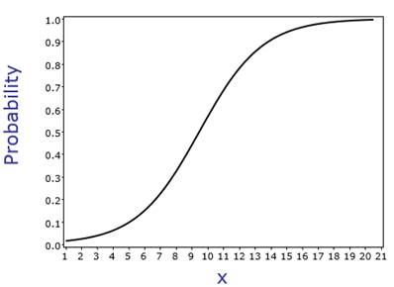
Recap: logistic regression
X
Wx +b
P(y)

Slide 3
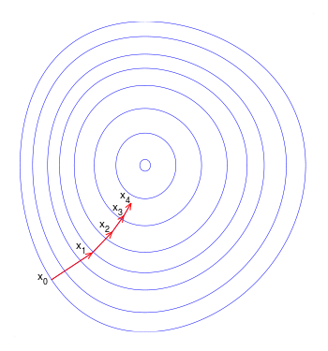
Recap: Gradient descent
Repeat until convergence
Ɵ~{W,b}

Slide 4
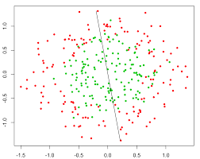
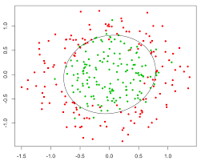
Problem: Nonlinear dependencies
What we have What we want
Trivia: how do we solve that with logistic regression?

Slide 5
Feature extraction
Loss, for example:
Model:
Feature
Extractor
(manual)
Classifier
Ɵ1~{W,b}
X
Prediction
Training:

Slide 6
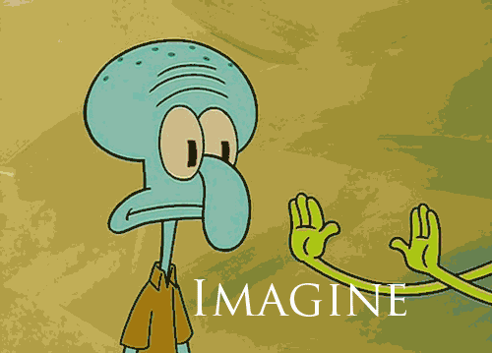
Features would tune to your problem automatically!

Slide 7
What do we want, exactly?
Loss, for example:
Model:
Feature
Extractor
Ɵ2
Classifier
Ɵ1~{W,b}
X
Prediction
?
Training:

Slide 8
What do we want, exactly?
Loss, for example:
Model:
Feature
Extractor
Ɵ2 ~ {?!}
Classifier
Ɵ1~{W,b}
X
Prediction
Gradients:

Slide 9
Try linear
Model:
Linear
model
Logistic
Regres-
sion
X
Prediction

Slide 10
Try linear
Model:
Linear
model
Logistic
Regres-
sion
X
Prediction
Output:
Is it any better than logistic regression?

Slide 11
Try linear

Slide 12
Try linear
Model:
Linear
model
Logistic
Regres-
sion
X
Prediction
Output:
Is it any better than logistic regression?

Slide 13
Nonlinearity
Model:
Linear
model
σ(h)
Logistic
Regres-
sion
X
Prediction

Slide 14
Nonlinearity
Model:
Linear
model
σ(h)
Logistic
Regres-
sion
X
Prediction
Output:

Slide 15
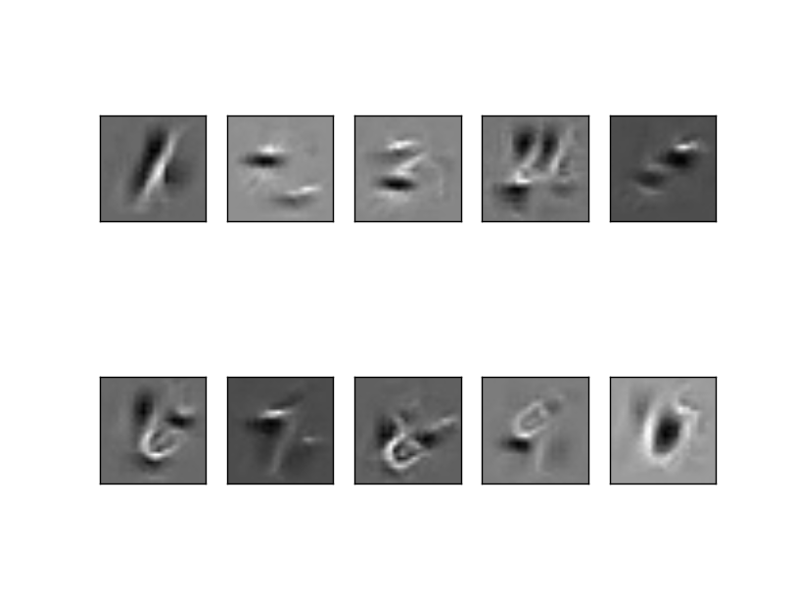
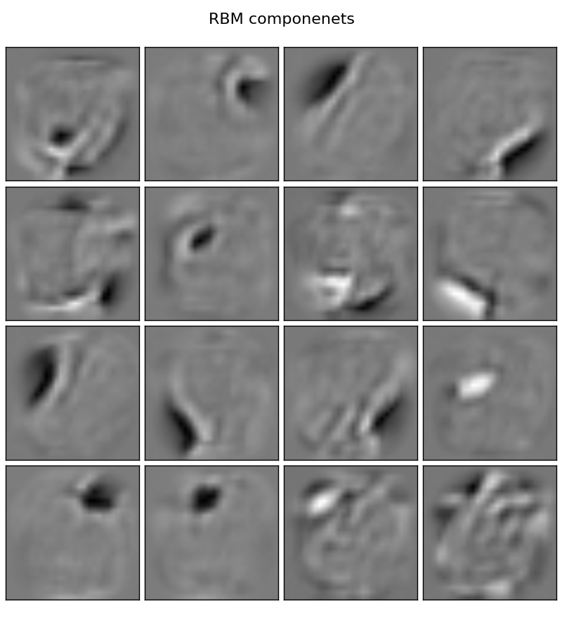
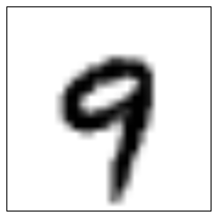
Nonlinearity
Model:
Linear
model
σ(h)
Logistic
Regres-
sion
X
Prediction
P(“1”)
P(“2”)
...
P(“9”)

Slide 16
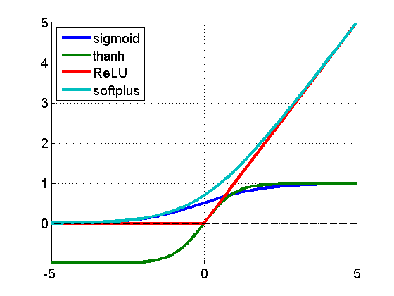
Nonlinearity
f(a) = 1/(1+e^a)
f(a) = tanh(a)
f(a) = max(0,a)
f(a) = log(1+e^a)
f(a)
a

Slide 17
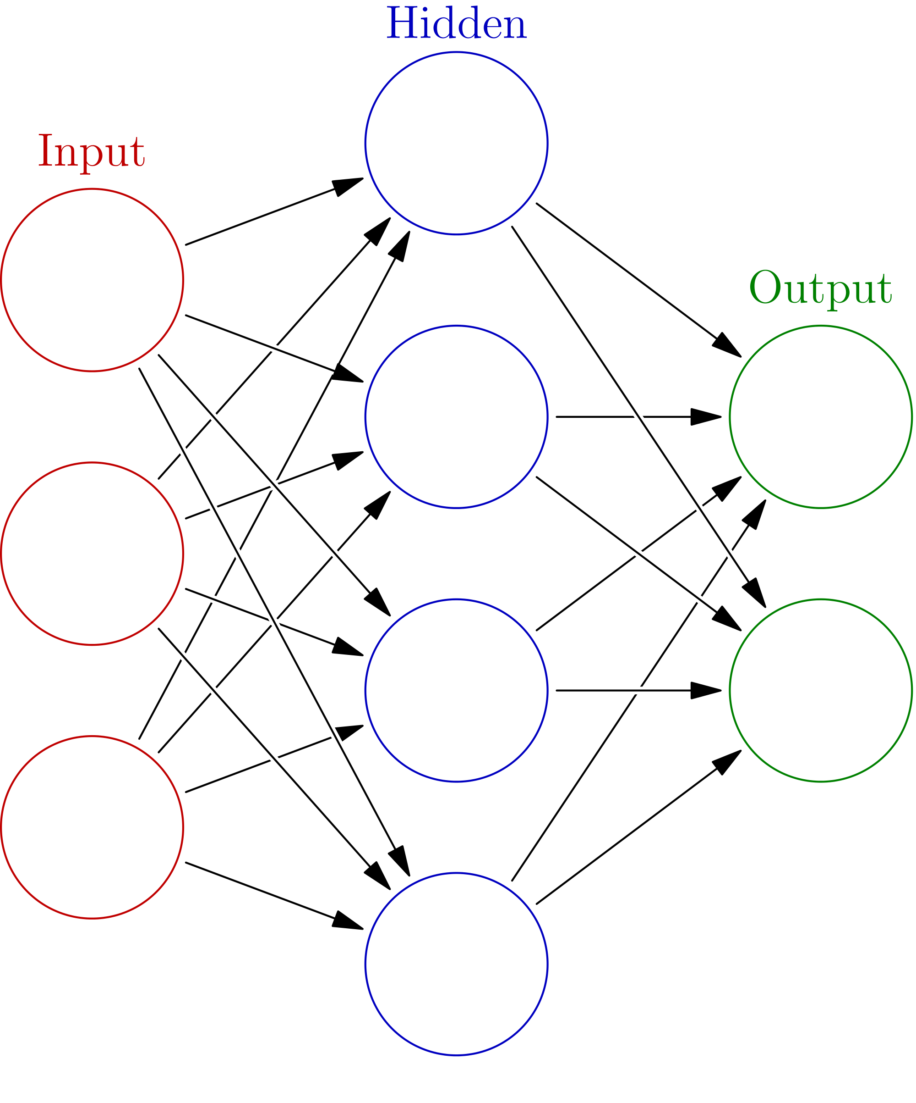
Initialization, symmetry problem
h0
Initialize with zeros
W ← 0
What will the first step look like?
x0
h1
y0
x1
h2
y1
h2
x2
h3

Slide 18
Initialization, symmetry problem
h0
Break the symmetry!
Initialize with random numbers!
W ← N(0,0.01)?
W ← U(0,0.1)?
Can get a bit better for deep NNs
x0
h1
y0
x1
h2
y1
h2
x2
h3

Slide 19
Connectionist phrasebook
Layer – a building block for NNs :
    “Dense layer”: f(x) = Wx+b
    “Nonlinearity layer”: f(x) = σ(x)
    Input layer, output layer
    A few more we gonna cover later
Activation – layer output
    i.e. some intermediate signal in the NN
Backpropagation – a fancy word for “chain rule”

Slide 20
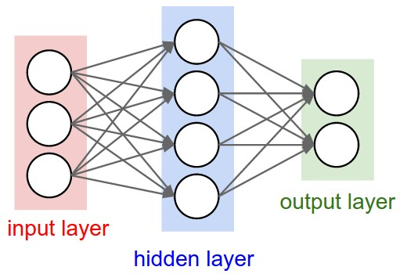
Connectionist phrasebook
Dense layer
with a nonlinearity
“Train it via backprop!”

Slide 21

Connectionist phrasebook
How do we train it?

Slide 22
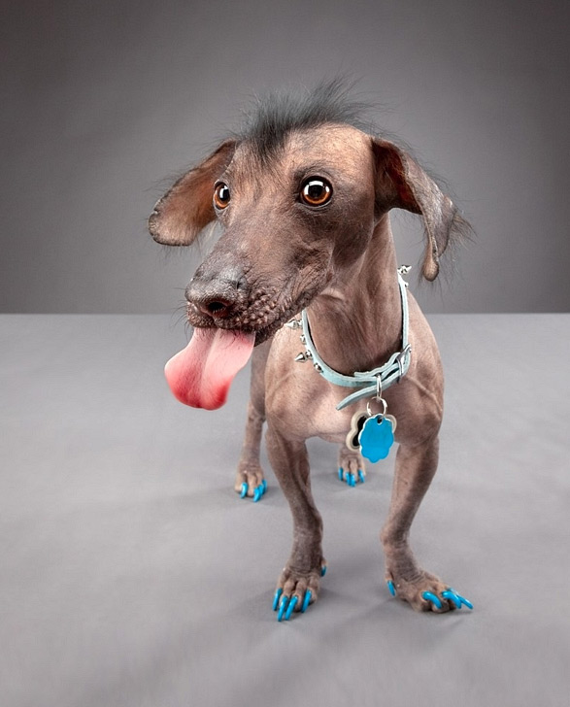
Image recognition
“Dog”

Slide 23
Image recognition
“Gray wall”
“Dog tongue”
“Dog”
<a particular kind of dog>
“Animal sadism”

Slide 24
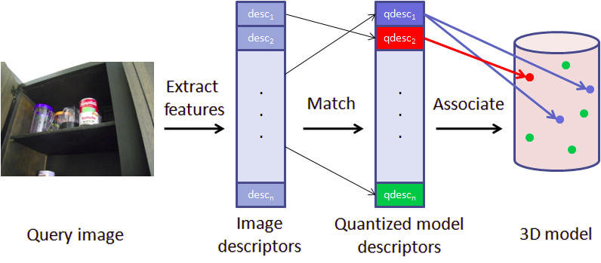
Classical approach
“Dog”

Slide 25
NN approach
P(Dog)
  What features could NN learn this way?

Slide 26


Slide 27
Problem
Should we require, say, “Dog ear” feature
      Linear combination can only select dog ear at a one (or a few) positions.
      Need to learn independent features for each position
      Next layer needs to react on “dog ear 0,0 or dog ear 0,1 or … or dog ear 255,255”
      Introduce a lot of parameters and risk overfitting.
  Idea: force all these “dog ear” features to use exactly same weights, shifting weight matrix each time.

Slide 28
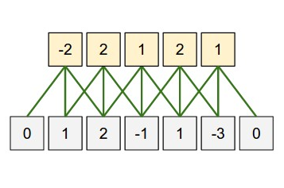

Convolution
Apply same weights to all patches
output
weights
image

Slide 29
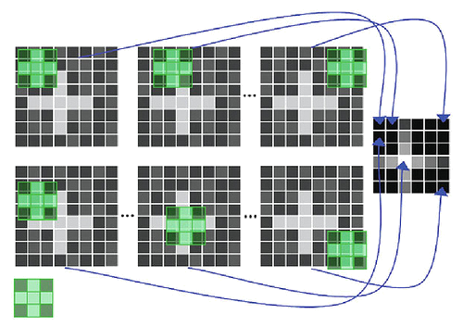
Convolution
apply same filter to all patches

Slide 30

Convolution
5x5
3x3 (5-3+1)
Intuition: how cat-like is this square?

Slide 31
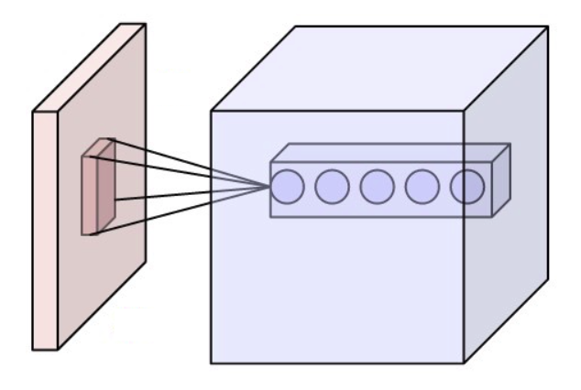
Convolution
Intuition: how cat-like is this square?

Slide 32
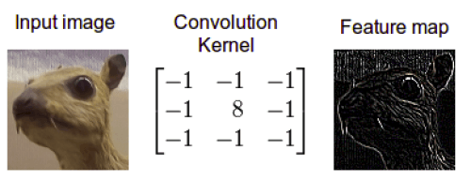
Convolution
Intuition: how edge-like is this square?

Slide 33
Convolution
?!
Filters: 100x(3x5x5)
Image : 3 (RGB) x 100 px x 100 px

Slide 34
Convolution
100x96x96
~10^6
Filters: 100x(3x5x5)
Image : 3 (RGB) x 100 px x 100 px
Somewhat too many!

Slide 35
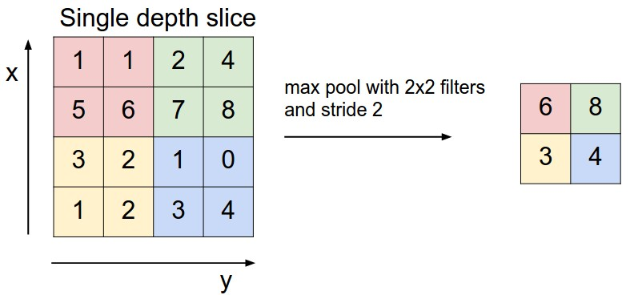
Pooling
Intuition: What is the max cat-likelihood over this area?

Slide 36
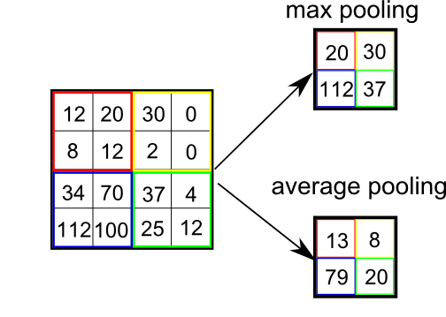
Pooling
Motivation:
Reduce layer size by a factor
Make NN less sensitive to small image shifts
Popular types:
Max
Mean(average)

Slide 38
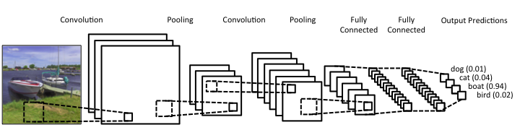
Convolutional NNs

Slide 39
Convolutional NNs
32 filters 5x5
3x3
3x3
64 filters 5x5
512
512
4
3x100x100
Quiz:
1) What is the blob size after second pooling

Slide 40
Convolutional NNs
32 filters 5x5
3x3
3x3
64 filters 5x5
512
512
4
3x100x100
Quiz:
2) How many image pixels does one cell after second convolution depend on?

Slide 41
Convolutional NNs
32 filters 5x5
3x3
3x3
64 filters 5x5
512
512
4
3x100x100
Quiz:
3) Which layer is hardest to compute?
4) Which layer has most independent parameters?

Slide 42
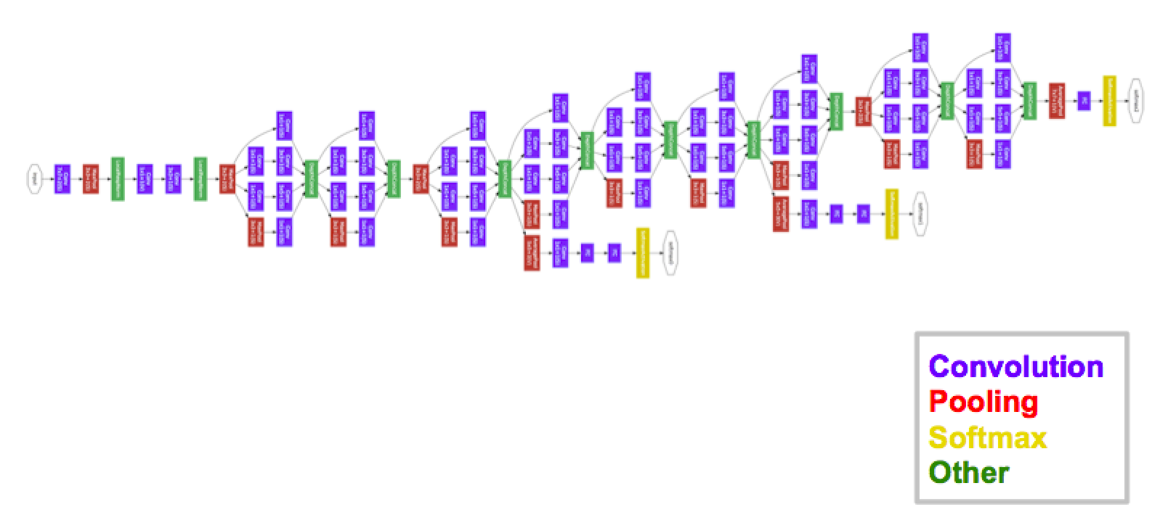
Inception-GoogleNet
[moar, inception]
It is not a moon. It is a space station (c)

Slide 43
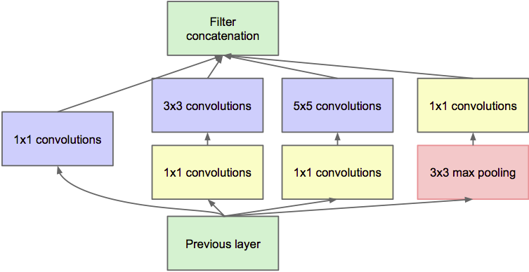
Inception-GoogleNet
[moar, inception]

Slide 44
Potential caveats?
Hardcore overfitting
No “golden standard” for architecture
Computationally heavy

Slide 45
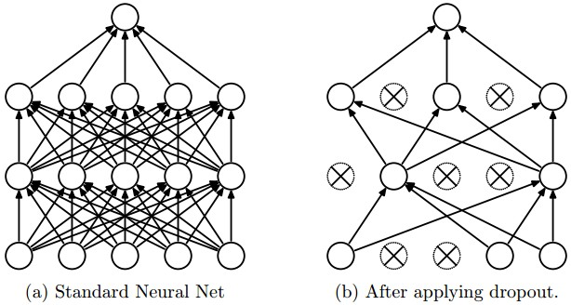
Regularization
L1, L2, as usual
Dropout

Slide 46
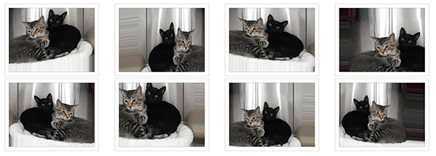
Data augmentation
Idea: we can get N times more data by tweaking images.
If you rotate cat image by 15°, it's still a cat
Rotate, crop, zoom, flip horizontally, add noise, etc.
Sound data: add background noise

Slide 47
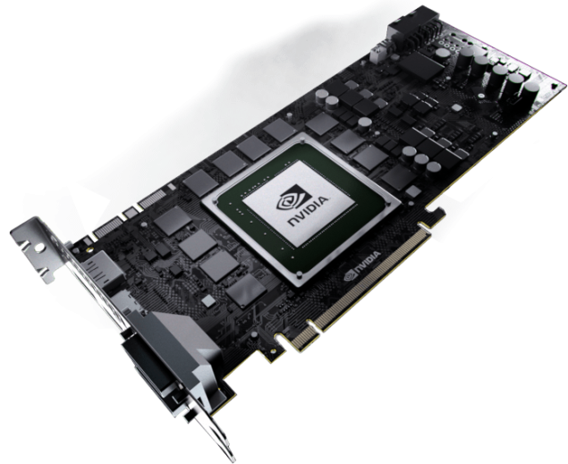
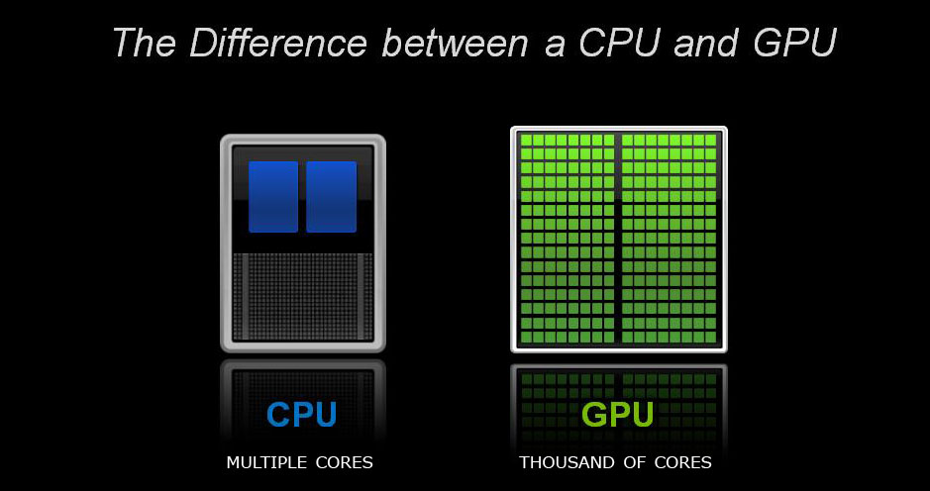
Computation

Slide 48
Batch normalization
Problem:
  Consider a neuron in any layer beyond first
  At each iteration we tune it's weights towards better loss function
  But we also tune it's inputs. Some of them become larger, some – smaller
  Now the neuron needs to be re-tuned for it's new inputs

Slide 49
Batch normalization
TL;DR:
  It's usually a good idea to normalize linear model inputs
      (c) Every machine learning lecturer, ever

Slide 50
Batch normalization
Idea:
  We normalize activation of a hidden layer
    (zero mean unit variance)
  Update with moving average while training

Slide 51
Batch normalization
Idea:
  We normalize activation of a hidden layer
    (zero mean unit variance)
  Update with moving average while training
i stands for i-th neuron

Slide 52

Batch normalization
Linear
model
σ(h)
Batch
norm
Linear
model
Batch
norm
σ(h)

Slide 53
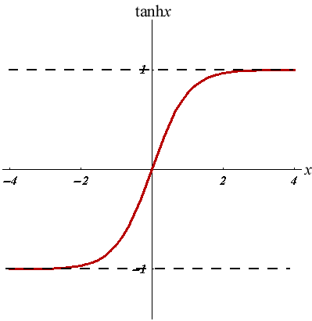
Batch normalization
Good side effect #1:
  Vanishing gradient less a problem for sigmoid-like nonlinearities
Good side effect #2:
  We no longer need to train bias (+b term in Wx+b)

Slide 54
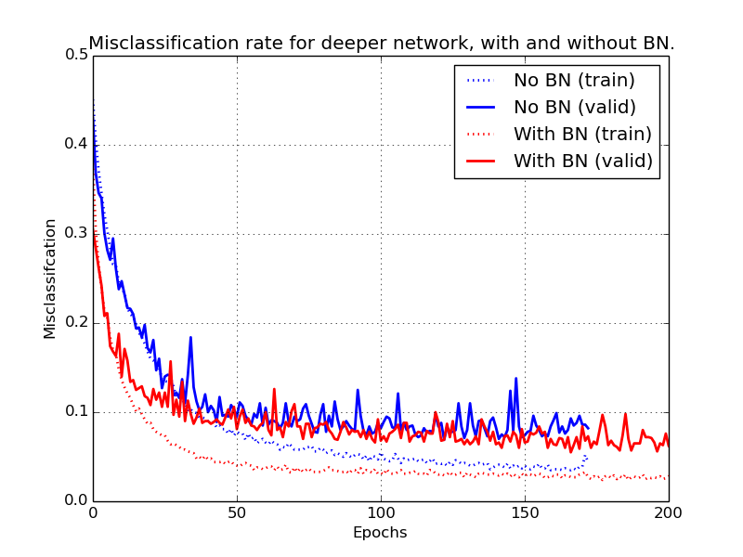
Batch Normalization

Slide 55
More
Regularization:
  dropconnect, variational dropout, ...
Normalization:
  weight normalization,
  normalization propagation,
  layer normalization,
Initlialization:
  data-aware initialization, pre-training, ...

Slide 56
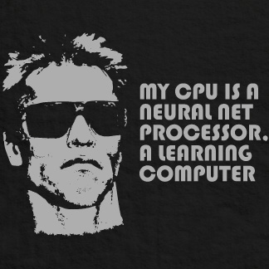
Nuff
Let's code some neural networks!

