Slide 1



Reinforcement learning
Episode 3
Value-based methods

Slide 2

Recap: Discounted reward MDP
Classic MDP(Markov Decision Process)
Agent interacts with environment
  Environment states:
  Agent actions:
  State transition:
  Reward:

Slide 3

Recap: Discounted reward MDP
Objective:
  Total action value
γ ~ patience
Cake tomorrow is γ as good as now
Reinforcement learning:
  Find policy that maximizes
    the expected reward

Slide 4

Recap: Optimal policy
=
=
=
=
We rewrite R with sheer power of math!

Slide 5
Recap: Q-learning
One approach:
action Q-values
Action value Q(s,a) is the expected total reward R agent gets from state s by taking action a and following policy π from next state.
Trivia: how do we get policy π(a|s) given Q(s,a)?

Slide 6
Recap: Q-learning
One approach:
action Q-values
Action value Q(s,a) is the expected total reward R agent gets from state s by taking action a and following policy π from next state.

Slide 7
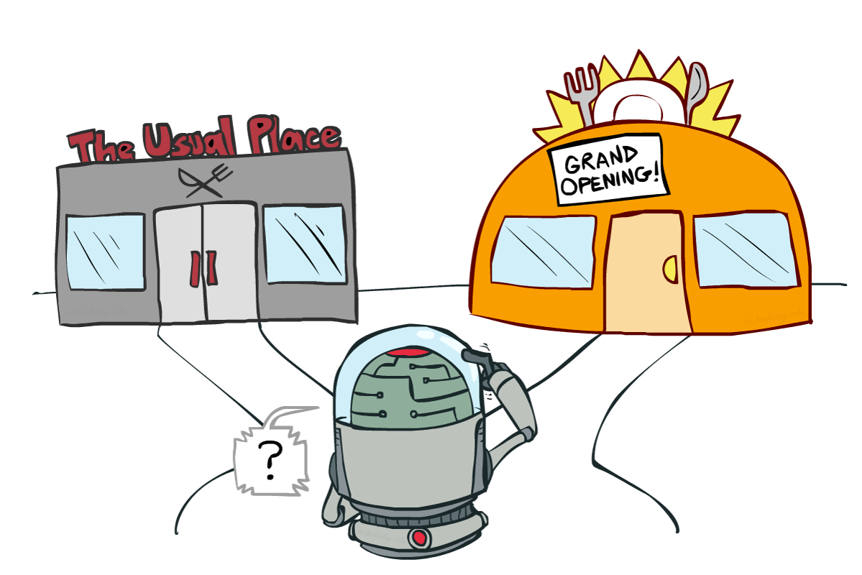
Recap: Exploration Vs Exploitation
Balance between using what you learned and trying to find something even better
    ε-greedy
      With probability ε
      take random action;
      Otherwise take optimal action.
Trivia: how to define now?

Slide 8
Exploration Vs Exploitation
Balance between using what you learned and trying to find something even better
    ε-greedy
      With probability ε
      take random action;
      Otherwise take optimal action.

Slide 9
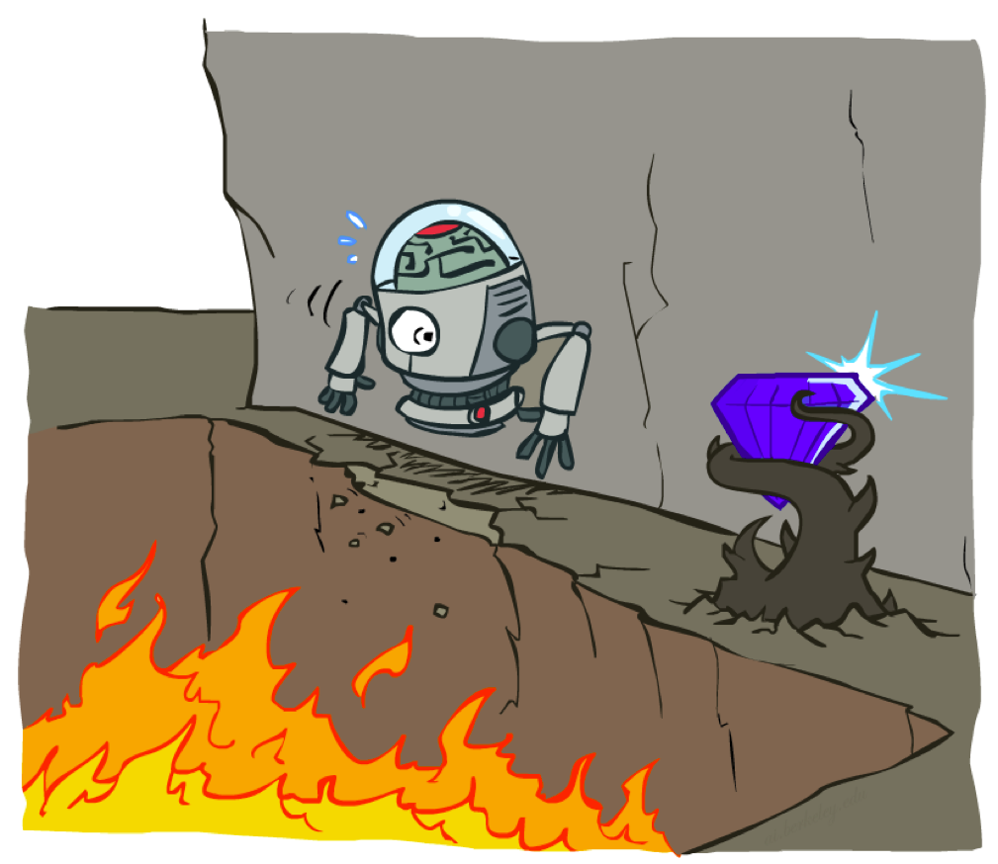
Cliff world
Picture from Berkeley CS188x

Slide 10
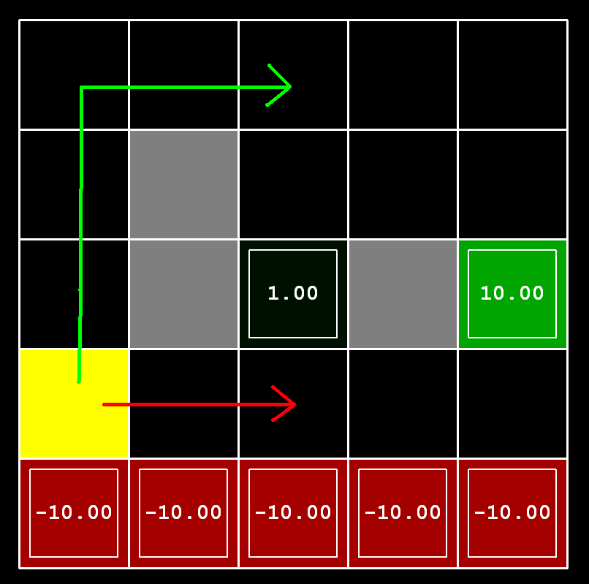
Cliff world
Conditions
      Q-learning
      no slipping
Trivia:
What will q-learning learn?

Slide 11
Cliff world
Conditions
      Q-learning
      no slipping
Trivia:
What will q-learning learn?
Will it maximize reward?
follow the short path

Slide 12
Cliff world
Conditions
      Q-learning
      no slipping
Trivia:
What will q-learning learn?
Will it maximize reward?
follow the short path
no, robot will fall due to
epsilon-greedy “exploration”

Slide 13
Cliff world
Conditions
      Q-learning
      no slipping
Decisions must account
for actual policy!
e.g. ε-greedy policy

Slide 14
Generalized value iteration
Update rule (from Bellman eq.)
“better Q(s,a)”

Slide 15
Q-learning VS SARSA
Update rule (from Bellman eq.)
Q-learning
“better Q(s,a)”

Slide 16
Q-learning VS SARSA
Update rule (from Bellman eq.)
Q-learning
SARSA
“better Q(s,a)”

Slide 17
Q-learning VS SARSA
Update rule (from Bellman eq.)
Q-learning
SARSA
“better Q(s,a)”
Expected from
s' ~ P(s'|s,a)

Slide 18
MDP trajectory
  r
prev s
s'
s
a'
a
s''
prev a
a''
  r'
sample sequence of
  states (s)
  actions (a)
  rewards (r)
Can be infinite, we can't wait that long

Slide 19
Recap: Q-learning
  r
possible
actions
prev s
s'
s
a'
a
s''
prev a
a''
  r'
Loop:
  Sample <s,a,r,s'> from env
  Compute
  Update

Slide 20
SARSA
  r
prev s
s'
s
a'
a
s''
prev a
a''
  r'
Loop:
  Sample <s,a,r,s',a'> from env
  Compute
  Update

Slide 21
SARSA
  r
prev s
s'
s
a'
a
s''
prev a
a''
  r'
Loop:
  Sample <s,a,r,s',a'> from env
  Compute
  Update
hence “SARSA”
next action
(not max)

Slide 22
Expected value SARSA
  r
possible
actions
prev s
s'
s
a'
a
s''
prev a
a''
  r'
Loop:
  Sample <s,a,r,s'> from env
  Compute
  Update

Slide 23
Expected value SARSA
  r
possible
actions
prev s
s'
s
a'
a
s''
prev a
a''
  r'
Loop:
  Sample <s,a,r,s'> from env
  Compute
  Update
Expected value

Slide 24
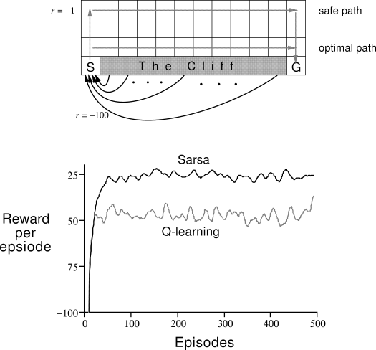
Difference
SARSA converges
to optimal policy
Q-learning policy
would be optimal
without exploration

Slide 25
On-policy vs Off-policy
Two problem setups
on-policy
Agent can pick actions
  Most obvious setup :)
  Agent always follows his
  own policy
off-policy
Agent can't pick actions
  Learning with exploration,
  playing without exploration
  Learning from expert
    (expert is imperfect)
  Learning from sessions
    (recorded data)

Slide 26
On-policy vs Off-policy
Two problem setups
on-policy
Agent can pick actions
  On-policy algorithms can't learn off-policy
  (but they be faster/better)
off-policy
Agent can't pick actions
  Off-policy algorithms can
  learn on-policy
  learn optimal policy even if agent takes random actions
Trivia: which of Q-learning, SARSA and exp. val. SARSA
will only work on-policy?

Slide 27
On-policy vs Off-policy
Two problem setups
on-policy
Agent can pick actions
  On-policy algorithms can't learn off-policy
  SARSA
  more coming soon
off-policy
Agent can't pick actions
  Off-policy algorithms can
  learn on-policy
  Q-learning
  Expected Value SARSA
Trivia: will Crossentropy Method converge if it learns off-policy
from agent that takes random actions?

Slide 28
On-policy vs Off-policy
Two problem setups
on-policy
Agent can pick actions
  On-policy algorithms can't learn off-policy
  SARSA
  more coming soon
off-policy
Agent can't pick actions
  Off-policy algorithms can
  learn on-policy
  Q-learning
  Expected Value SARSA
Trivia: will Crossentropy Method converge if it learns off-policy
from agent that takes random actions?
Well, no :)

Slide 29
N-step algorithms
Recall R?
=
=
=
=
=
=

Slide 30
N-step SARSA
General formula

Slide 31
N-step SARSA
General formula
1-step SARSA
2-step SARSA
3-step SARSA
???

Slide 32
N-step SARSA
General formula
1-step SARSA
2-step SARSA
3-step SARSA

Slide 33
N-step SARSA
General formula
1-step SARSA
N-step SARSA

Slide 34
N-step algorithms
General formula
N-step SARSA
N-step Q-learning
Trivia: which of these methods work off-policy?

Slide 35
N-step algorithms
General formula
N-step SARSA
N-step Q-learning
Trivia: which of these methods work off-policy?
None of them!

Slide 36
1-step Vs n-step
  +1
Simple example
How many games does it take for SARSA to learn the optimal policy?
Cake!

Slide 37
1-step Vs n-step
  +1
Simple example
SARSA needs 5 steps, n-step SARSA needs 1
Nuts and bolts
  Nonlinear approximations learn much faster!
  Play for N steps, than learn (batched)
Cake!

Slide 38
n → inf
  +1
Finite MDP,
Sample many trajectories (or tree search)
Compute expected
minimal assumptions, unbiased, large variance
Cake!

Slide 39
Long road ahead
value-based
V-iteration
MCES
UCT
n step
q-learning
sarsa
e.v. sarsa
MCTS
TD(λ)
monte
carlo
temporal
difference
PGQ
SVG
heuristics (GA)
DPG
NPO
Adv. actor-critic
CEM
SCST
TRPO
PPO
policy-based
REINFORCE
(policy gradient MC)

Slide 40
Let's write some code!

