Slide 1



Model-free reinforcement learning

Slide 2
Previously...
V(s) and V*(s,a)
know V* and P(s'|s,a) → know optimal policy
We can learn V* with dynamic programming

Slide 3

Decision process in the wild
Agent
Can do anything
observation
action
Can't even see
(worst case)
Environment

Slide 4



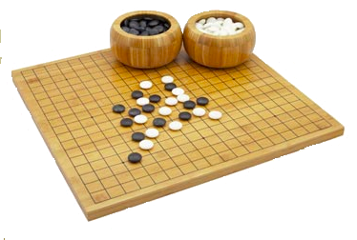
Decision process in the wild
Agent
Can do anything
observation
action
Can't even see
(worst case)
Environment

Slide 5
Model-free setting:
We don't know actual
P(s',r|s,a)
Whachagonnado?

Slide 6
Model-free setting:
We don't know actual
P(s',r|s,a)
Learn it?
Get rid of it?

Slide 7
More new letters
Vπ(s) – expected G from state s if you follow π
V*(s) – expected G from state s if you follow π*

Slide 8
More new letters
Vπ(s) – expected G from state s if you follow π
V*(s) – expected G from state s if you follow π*
Qπ(s,a) – expected G from state s
  if you start by taking action a
  and follow π from next state on
Q*(s,a) – guess what it is :)

Slide 9
More new letters
Vπ(s) – expected G from state s if you follow π
V*(s) – expected G from state s if you follow π*
Qπ(s,a) – expected G from state s
  if you start by taking action a
  and follow π from next state on
Q*(s,a) – same as Qπ(s,a) where π = π*

Slide 10
Trivia
Assuming you know Q*(s,a),
  how do you compute π*
  how do you compute V*(s)?
Assuming you know V(s)
  how do you compute Q(s,a)?

Slide 11

To sum up
Image: cs188x
Action value Qπ(s,a) is the expected total reward G agent gets from state s by taking action a and following policy π from next state.

Slide 12
Learning from trajectories
Model-based: you know P(s'|s,a)
- can apply dynamic programming
- can plan ahead
Model-free: you can sample trajectories
- can try stuff out
- insurance not included
  r
prev s
s'
s
a'
a
s''
prev a
a''
  r'

Slide 13
MDP trajectory
  r
prev s
s'
s
a'
a
s''
prev a
a''
  r'
Trajectory is a sequence of
  states (s)
  actions (a)
  rewards (r)
We can only sample trajectories

Slide 14
MDP trajectory
  r
prev s
s'
s
a'
a
s''
prev a
a''
  r'
Trajectory is a sequence of
  states (s)
  actions (a)
  rewards (r)
We can only sample trajectories
Q: What to learn?
V(s) or Q(s,a)

Slide 15
MDP trajectory
  r
prev s
s'
s
a'
a
s''
prev a
a''
  r'
Trajectory is a sequence of
  states (s)
  actions (a)
  rewards (r)
We can only sample trajectories
Q: What to learn?
V(s) or Q(s,a)
V(s) is useless
without P(s'|s,a)

Slide 16
Idea 1: monte-carlo
Get all trajectories containing particular (s,a)
Estimate G(s,a) for each trajectory
Average them to get expectation
  +1
Cake!

Slide 17

Idea 1: monte-carlo
Get all trajectories containing particular (s,a)
Estimate G(s,a) for each trajectory
Average them to get expectation
takes a lot of sessions
Image: super meat boy

Slide 18
Idea 2: temporal difference
Remember we can improve Q(s,a) iteratively!

Slide 19
Idea 2: temporal difference
Remember we can improve Q(s,a) iteratively!
That's Q*(s,a)
That's value for π*
aka optimal policy

Slide 20
Idea 2: temporal difference
Remember we can improve Q(s,a) iteratively!
That's Q*(s,a)
That's value for π*
aka optimal policy
That's something
we don't have
What do we do?

Slide 21
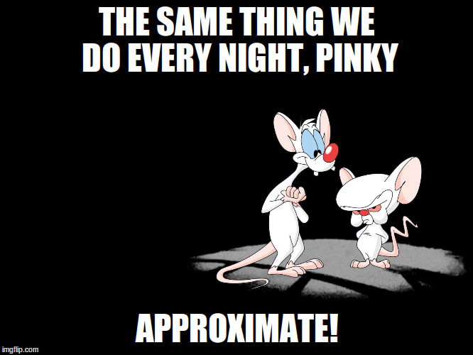
Idea 2: temporal difference

Slide 22
Idea 2: temporal difference
Replace expectation with sampling

Slide 23
Idea 2: temporal difference
Replace expectation with sampling
Use moving average with just one sample!

Slide 24
Q-learning
  r
prev s
s'
s
a'
a
s''
prev a
a''
  r'
Works on a sequence of
  states (s)
  actions (a)
  rewards (r)

Slide 25
Q-learning
  r
prev s
s'
s
a'
a
s''
prev a
a''
  r'
Initialize Q(s,a) with zeros
Loop:
  Sample <s,a,r,s'> from env

Slide 26
Q-learning
  r
possible
actions
prev s
s'
s
a'
a
s''
prev a
a''
  r'
Initialize Q(s,a) with zeros
Loop:
  Sample <s,a,r,s'> from env
  Compute

Slide 27
Q-learning
  r
possible
actions
prev s
s'
s
a'
a
s''
prev a
a''
  r'
Initialize Q(s,a) with zeros
Loop:
  Sample <s,a,r,s'> from env
  Compute
  Update

Slide 28
Recap
Monte-carlo
Averages Q over sampled paths
Temporal Difference
Uses recurrent formula for Q
  r
possible
actions
  +1
s'
s
Cake!
a

Slide 29

Nuts and bolts: MC vs TD
Monte-carlo
Averages Q over sampled paths
Needs full trajectory to learn
Less reliant on markov property
Temporal Difference
Uses recurrent formula for Q
Learns from partial trajectory
Works with infinite MDP
Needs less experience to learn

Slide 30

What could possibly go wrong?
Our mobile robot learns to walk.
Initial Q(s,a) are zeros
robot uses argmax Q(s,a)
He has just learned to crawl with positive reward!

Slide 31
What could possibly go wrong?
Our mobile robot learns to walk.
Initial Q(s,a) are zeros
robot uses argmax Q(s,a)
Too bad, now he will never learn to walk upright =(

Slide 32
What could possibly go wrong?
New problem:
If our agent always takes “best” actions
from his current point of view,
How will he ever learn that other actions
may be better than his current best one?
Ideas?

Slide 33

Exploration Vs Exploitation
Balance between using what you learned and trying to find something even better

Slide 34
Exploration Vs Exploitation
Strategies:
    ε-greedy
        With probability ε take random action; otherwise take optimal action.

Slide 35
Exploration Vs Exploitation
Strategies:
    ε-greedy
        With probability ε take random action; otherwise take optimal action.
    Softmax
        Pick action proportional to softmax of shifted normalized Q-values.
    More cool stuff coming later

Slide 36
Exploration over time
Idea:
If you want to converge to optimal policy,
you need to gradually reduce exploration
Example:
Initialize ε-greedy ε = 0.5, then gradually reduce it
    If ε → 0, it's greedy in the limit
    Be careful with non-stationary environments

Slide 37
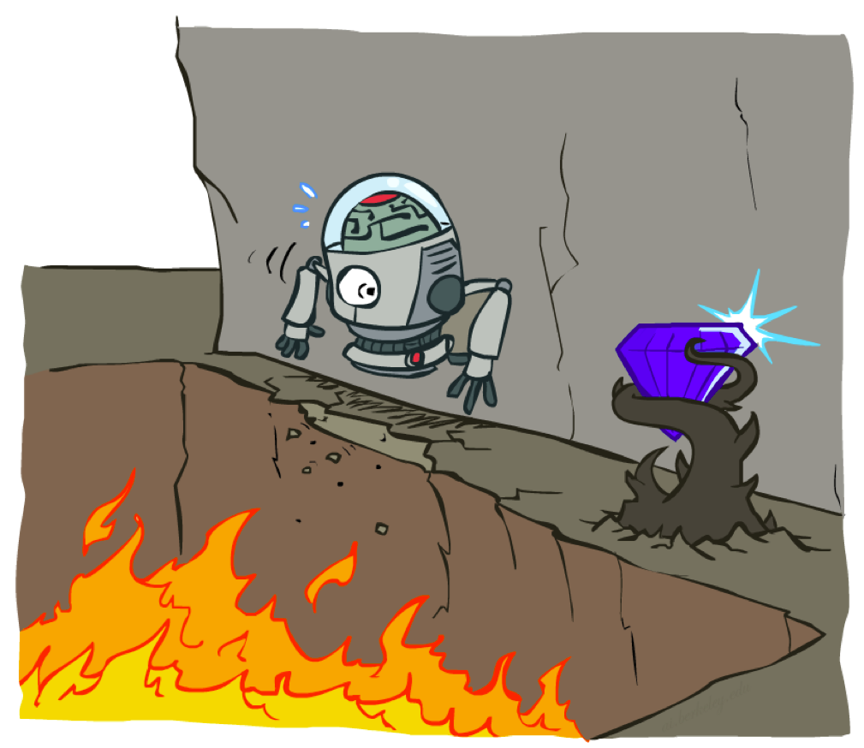
Cliff world
Picture from Berkeley CS188x

Slide 38
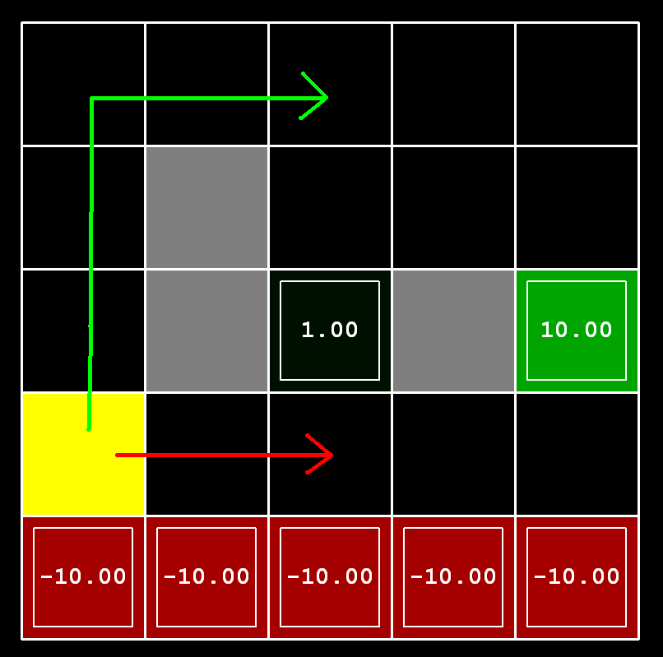
Cliff world
Conditions
      Q-learning
      no slipping
Trivia:
What will q-learning learn?

Slide 39
Cliff world
Conditions
      Q-learning
      no slipping
Trivia:
What will q-learning learn?
Will it maximize reward?
follow the short path

Slide 40
Cliff world
Conditions
      Q-learning
      no slipping
Trivia:
What will q-learning learn?
Will it maximize reward?
follow the short path
no, robot will fall due to
epsilon-greedy “exploration”

Slide 41
Cliff world
Conditions
      Q-learning
      no slipping
Decisions must account
for actual policy!
e.g. ε-greedy policy

Slide 42
Generalized update rule
Update rule (from Bellman eq.)
“better Q(s,a)”

Slide 43
Q-learning VS SARSA
Update rule (from Bellman eq.)
Q-learning
“better Q(s,a)”

Slide 44
Q-learning VS SARSA
Update rule (from Bellman eq.)
Q-learning
SARSA
“better Q(s,a)”

Slide 45
Recap: Q-learning
  r
possible
actions
prev s
s'
s
a'
a
s''
prev a
a''
  r'
Loop:
  Sample <s,a,r,s'> from env
  Compute
  Update

Slide 46
SARSA
  r
prev s
s'
s
a'
a
s''
prev a
a''
  r'
Loop:
  Sample <s,a,r,s',a'> from env
  Compute
  Update

Slide 47
SARSA
  r
prev s
s'
s
a'
a
s''
prev a
a''
  r'
Loop:
  Sample <s,a,r,s',a'> from env
  Compute
  Update
hence “SARSA”
next action
(not max)

Slide 48
Expected value SARSA
  r
possible
actions
prev s
s'
s
a'
a
s''
prev a
a''
  r'
Loop:
  Sample <s,a,r,s'> from env
  Compute
  Update

Slide 49
Expected value SARSA
  r
possible
actions
prev s
s'
s
a'
a
s''
prev a
a''
  r'
Loop:
  Sample <s,a,r,s'> from env
  Compute
  Update
Expected value

Slide 50
Difference
SARSA gets optimal
rewards under current
policy
Q-learning policy
would be optimal
under
Q-learning
SARSA

Slide 51
On-policy vs Off-policy
Two problem setups
on-policy
Agent can pick actions
  Most obvious setup :)
  Agent always follows his
  own policy
off-policy
Agent can't pick actions
  Learning with exploration,
  playing without exploration
  Learning from expert
    (expert is imperfect)
  Learning from sessions
    (recorded data)

Slide 52
On-policy vs Off-policy
Two problem setups
on-policy
Agent can pick actions
  On-policy algorithms can't learn off-policy
off-policy
Agent can't pick actions
  Off-policy algorithms can
  learn on-policy
  learn optimal policy even if agent takes random actions
Q: which of Q-learning, SARSA and exp. val. SARSA
will only work on-policy?

Slide 53
On-policy vs Off-policy
Two problem setups
on-policy
Agent can pick actions
  On-policy algorithms can't learn off-policy
  SARSA
  more later
off-policy
Agent can't pick actions
  Off-policy algorithms can
  learn on-policy
  Q-learning
  Expected Value SARSA

Slide 54
On-policy vs Off-policy
Two problem setups
on-policy
Agent can pick actions
  On-policy algorithms can't learn off-policy
  SARSA
  more coming soon
off-policy
Agent can't pick actions
  Off-policy algorithms can
  learn on-policy
  Q-learning
  Expected Value SARSA

Slide 55
On-policy vs Off-policy
Two problem setups
on-policy
Agent can pick actions
  On-policy algorithms can't learn off-policy
  SARSA
  more coming soon
off-policy
Agent can't pick actions
  Off-policy algorithms can
  learn on-policy
  Q-learning
  Expected Value SARSA

Slide 56
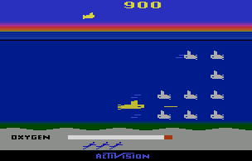
Experience replay
Interaction
Idea: store several past interactions
<s,a,r,s'>
Train on random subsamples
Agent
training
<s,a,r,s'>
<s,a,r,s'>
<s,a,r,s'>
<s,a,r,s'>
<s,a,r,s'>
<s,a,r,s'>
<s,a,r,s'>
~
training
batches
Replay
buffer

Slide 57
Experience replay
Interaction
Idea: store several past interactions
<s,a,r,s'>
Train on random subsamples
Training curriculum:
- play 1 step and record it
- pick N random transitions to train
Profit: you don't need to re-visit same (s,a) many times to learn it.
Only works with
off-policy algorithms!
Agent
training
<s,a,r,s'>
<s,a,r,s'>
<s,a,r,s'>
<s,a,r,s'>
<s,a,r,s'>
<s,a,r,s'>
<s,a,r,s'>
~
training
batches
Btw, why
only them?
Replay
buffer

Slide 58
Experience replay
</chapter>
Interaction
Idea: store several past interactions
<s,a,r,s'>
Train on random subsamples
Training curriculum:
- play 1 step and record it
- pick N random transitions to train
Profit: you don't need to re-visit same (s,a) many times to learn it.
Only works with
off-policy algorithms!
Agent
training
<s,a,r,s'>
<s,a,r,s'>
<s,a,r,s'>
<s,a,r,s'>
<s,a,r,s'>
<s,a,r,s'>
<s,a,r,s'>
~
training
batches
Old (s,a,r,s) are
from older/weaker
version of policy!
Replay
buffer

Slide 59
New stuff we learned
Anything?

Slide 60
New stuff we learned
Q(s,a),Q*(s,a)
Q-learning, SARSA
  We can learn from trajectories (model-free)
Exploration vs exploitation (basics)
Learning On-policy vs Off-policy
  Using experience replay

Slide 61

Coming next...
What if state space is large/continuous
Deep reinforcement learning

