Slide 1



Reinforcement learning
Episode 4
Approximate reinforcement learning

Slide 2
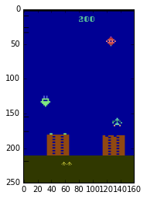

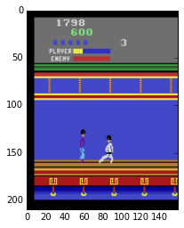
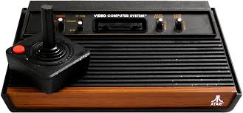
Reality check: videogames
  Trivia: What are the states and actions?

Slide 3

Recap: Q-learning
One approach:
action Q-values
Action value Q(s,a) is the expected total reward R agent gets from state s by taking action a and following policy π from next state.

Slide 4
Recap: Q-learning
One approach:
action Q-values
We can replace
P(s' | s,a)
with sampling

Slide 5
Q-learning as MSE minimization
Given <s,a,r,s'> minimize
How to optimize?

Slide 6
Q-learning as MSE minimization
Given <s,a,r,s'> minimize
For tabular Q(s,a)

Slide 7
Q-learning as MSE minimization
Given <s,a,r,s'> minimize
For tabular Q(s,a)
Something's sooo wrong!

Slide 8
Q-learning as MSE minimization
Given <s,a,r,s'> minimize
const
const
For tabular Q(s,a)

Slide 9
Q-learning as MSE minimization
For tabular Q(s,a)
Gradient descent step:

Slide 10
Q-learning as MSE minimization
For tabular Q(s,a)
Gradient descent step:

Slide 11
Q-learning as MSE minimization
For tabular Q(s,a)
Gradient descent step:
= moving average formula
(define alpha' = 2*alpha)

Slide 12
Real world
observe
Agent
apply
action
Observation
action
?!
We never know exactly
how it works

Slide 13
Problem:
State space is usually large,
sometimes continuous.
              And so is action space;
However, states do have a structure, similar states have similar action outcomes.

Slide 14
Problem:
State space is usually large,
sometimes continuous.
              And so is action space;
Two solutions:
  Binarize state space
  Approximate agent with a function
Which one would you prefer for atari?

Slide 15
Problem:
State space is usually large,
sometimes continuous.
              And so is action space;
Two solutions:
  Binarize state space
  Approximate agent with a function
Too many bins or handcrafted features
Let's pick this one

Slide 16
From tables to approximations
Before:
  For all states, for all actions, remember Q(s,a)
Now:
  Approximate Q(s,a) with some function
  e.g. linear model over state features
  Trivia: should we use classification or regression model?
  (e.g. logistic regression Vs linear regression)

Slide 17
From tables to approximations
Before:
  For all states, for all actions, remember Q(s,a)
Now:
  Approximate Q(s,a) with some function
  e.g. linear model over state features
Solve it as a regression problem!

Slide 18

MDP again
Agent
observe
apply
action
Observation
action
Environment

Slide 19
Approximate Q-learning
Q-values:
Q(s,a0),
Q(s,a1),
Q(s,a2)
model
W = params
Objective:
Gradient step:
image

Slide 20
Approximate Q-learning
Q-values:
Q(s,a0),
Q(s,a1),
Q(s,a2)
model
W = params
Objective:
consider const
Gradient step:
image

Slide 21
Approximate SARSA
Objective:
Q(s,a0),
Q(s,a1),
Q(s,a2)
consider const
Q-learning:
model
W = params
SARSA:
Expected Value SARSA:
???
image

Slide 22
Approximate SARSA
Objective:
Q(s,a0),
Q(s,a1),
Q(s,a2)
consider const
Q-learning:
model
W = params
SARSA:
Expected Value SARSA:
image

Slide 23
Approximate n-step methods
Objective:
Q(s,a0),
Q(s,a1),
Q(s,a2)
consider const
Q-learning:
model
W = params
Q-learning n-step:
image

Slide 24
Approximate Q-learning
action
Qvalues
apply
action
Qvalues is a dense layer with no nonlinearity
Dense
ϵ-greedy rule
(tune ϵ or use probabilistic rule)
Dense
Dense
Whatever you found in your favorite
deep learning
toolkit
Obser-
vation

Slide 25

Architectures
Given (s,a)
Predict Q(s,a)
Given s predict all q-values
Q(s,a0), Q(s,a1), Q(s,a2)

Slide 26
Architectures
Given (s,a)
Predict Q(s,a)
Given s predict all q-values
Q(s,a0), Q(s,a1), Q(s,a2)
Trivia: in which situation does left model work better?
And right?

Slide 27
Architectures
Needs one forward pass
for each action
Works if action space is large / continuous
Needs one forward pass
for all actions
(faster)

Slide 28
What kind of network digests images well?

Slide 29

Deep learning approach: DQN

Slide 30
DQN
ϵ-greedy rule
(tune ϵ or use probabilistic rule)
action
apply
action
Qvalues is a dense layer with no nonlinearity
Qvalues
Dense
Change axis order to fit in with lasagne convolutions
Any neural network you can think of.
conv
pool
dense
dropout
batchnorm
...
Conv1
image
(i,w,h,3)
Dimshuffle
(i,3,w,h)
Conv0

Slide 31
DQN
ϵ-greedy rule
(tune ϵ or use probabilistic rule)
action
apply
action
Qvalues is a dense layer with no nonlinearity
Qvalues
Dense
Change axis order to fit in with lasagne convolutions
Any neural network you can think of.
conv
pool
dense
dropout
batchnorm
...
Conv1
image
(i,w,h,3)
Dimshuffle
(i,3,w,h)
Conv0
Those two are
a bit tricky (later)

Slide 32

TSNE makes every slide 40% better
  Embedding of pre-last layer activations
  Color = V(s) = max_a Q(s,a)

Slide 33


Slide 34
How bad it is if agent spends
next 1000 ticks under the left rock?
(while training)

Slide 35

Problem
  Training samples are not “i.i.d”,
  Model forgets parts of environment it hasn't
  visited for some time
  Drops on learning curve
  Any ideas?

Slide 36

Multiple agent trick
parameter
server
W
Idea: Throw in several agents with shared W.
agent0
agent1
agent2
env0
env1
env2

Slide 37
Multiple agent trick
parameter
server
W
Idea: Throw in several agents with shared W.
  Chances are, they will be exploring different parts of the environment,
  More stable training,
  Requires a lot of interaction
  Trivia: your agent is a real robot car. Any problems?
agent0
agent1
agent2
env0
env1
env2

Slide 38

Experience replay
Interaction
Idea: store several past interactions
<s,a,r,s'>
Train on random subsamples
Any +/- ?
Agent
training
<s,a,r,s'>
<s,a,r,s'>
<s,a,r,s'>
<s,a,r,s'>
<s,a,r,s'>
<s,a,r,s'>
<s,a,r,s'>
~
training
batches
Replay
buffer

Slide 39
Experience replay
Interaction
Idea: store several past interactions
<s,a,r,s'>
Train on random subsamples
  Atari DQN: >10^5 interactions
  Closer to i.i.d
  pool contains several sessions
  Older interactions were obtained under weaker policy
  Better versions coming next week
Agent
training
<s,a,r,s'>
<s,a,r,s'>
<s,a,r,s'>
<s,a,r,s'>
<s,a,r,s'>
<s,a,r,s'>
<s,a,r,s'>
~
training
batches
Replay
buffer

Slide 40
Summary so far
to make data closer to i.i.d.
Use one or several of
  experience replay
  multiple agents
  Infinitely small learning rate :)
  better tricks coming next week

Slide 41
An important question
You approximate Q(s,a) with a neural network
You use experience replay when training
Trivia: which of those algorithms will fail?
  Q-learning
  SARSA
  15-step q-learning
  Expected Value SARSA

Slide 42
An important question
You approximate Q(s,a) with a neural network
You use experience replay when training
Trivia: which of those algorithms will fail?
  Q-learning
  SARSA
  Agent trains off-policy on an older version of him
  Off-policy methods work, On-policy is super-slow (fail)
  15-step q-learning
  Expected Value SARSA

Slide 43
When training with on-policy methods,
  use no (or small) experience replay
  compensate with parallel game sessions

Slide 44
Deep learning meets MDP
  Dropout, noize
    Used in experience replay only: like the usual dropout
    Used when interacting: a special kind of exploration
    You may want to decrease p over time.
  Batchnorm
    Faster training but may break moving average
    Experience replay: may break down if buffer is too small
    Parallel agents: may break down under too few agents
    <same problem of being non i.i.d.>

Slide 45

Final problem
Left or right?

Slide 46
Problem:
Most practical cases are partially observable:
Agent observation does not hold all information about process state (e.g. human field of view).
Any ideas?

Slide 47
Problem:
Most practical cases are partially observable:
Agent observation does not hold all information about process state (e.g. human field of view).
However, we can try to infer hidden states from sequences of observations.
Intuitively that's agent memory state.

Slide 48
Partially observable MDP
observe
Agent
apply
action
Observation
action
Hidden state
(Markov assumption holds)
[but no one cares]

Slide 49

N-gram heuristic
Idea:
  e.g. ball movement in breakout
  One frame
  Several frames

Slide 50
4-frame DQN
ϵ-greedy rule
(tune ϵ or use probabilistic rule)
action
apply
action
Qvalues is a dense layer with no nonlinearity
Qvalues
Dense
Any neural network you can think of.
conv
pool
dense
dropout
batchnorm
...
push image
Conv1
stack
image t
image t-1
image t-2
image t-3
image
(i,w,h,3)
4 images
Conv0
delete last frame

Slide 51
N-gram heuristic
Idea:
  e.g. ball movement in breakout
  One frame
  Several frames

Slide 52
Alternatives
Ngrams:
    Nth-order markov assumption
    Works for velocity/timers
    Fails for anything longer that N frames
    Impractical for large N
Alternative approach:
    Infer hidden variables given observation sequence
    Kalman Filters, Recurrent Neural Networks
    More on that in a few lectures

Slide 53
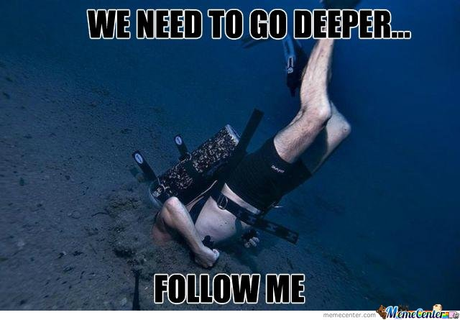
Seminar

Slide 54
Autocorrelation
  Reference is based on predictions
  Any error in Q approximation is propagated to neighbors
  If some Q(s,a) is mistakenly over-exaggerated,
  neighboring qvalues will also be increased in a cascade
  Worst case: divergence
  Any ideas?

Slide 55
Target networks
Idea: use older network snapshot
to compute reference
  Update Q old periodically
    Slows down training

Slide 56
Target networks
Idea: use older network snapshot
to compute reference
  Update Q old periodically
    Slows down training
  Smooth version:
    use moving average
    Θ = weights

