Slide 1



Reinforcement learning
Week 5
Bandits, exploration, production hacks

Slide 2
Previously
Value-based methods
  We know Q(s,a) → we know π*(a|s)
Model-free setting: learn from trajectories
  Q-learning, SARSA, expected value SARSA
Too many states: approximate RL
  deep q-learning, duct tape, more duct tape

Slide 3
Today: exploration
how to pick actions to learn π*(a|s) faster?

Slide 4

Multi-armed bandits
A simplified MDP with only one step
observation
Agent
action
Feedback
Why: it's simpler to explain exploration methods,
Formulae are shorter
(we can generalize to MDP if you wish)

Slide 5
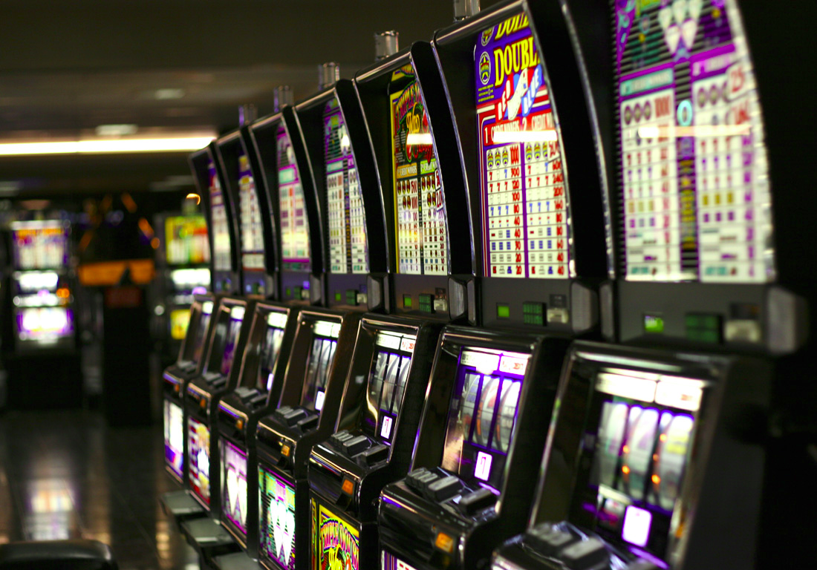
Multi-armed bandits

Slide 6
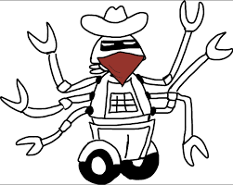
Multi-armed bandits

Slide 7
What is: contextual bandit
state
Agent
action
r(s,a)
Feedback
Examples:
  banner ads (RTB)
  recommendations
  medical treatment
Basicaly it's 1-step MDP where
  G(s,a) = r(s,a)
  Q(s,a) = E r(s,a)
  All formulae are 50% shorter

Slide 8
How to measure exploration
You own a website that sells banner ads.
There are two ways to learn optimal ad placement:
“method A” vs “method B”
Both are black boxes
How do you choose one?

Slide 9
How to measure exploration
Bad idea: by the sound of their name
Good idea: with $$$ it brought/lost you

Slide 10
How to measure exploration
Bad idea: by the sound of their name
Good idea: with $$$ it brought/lost you
Regret of policy π(a|s):
Consider an optimal policy, π*(a|s)
Regret per tick = optimal – yours
Finite horizon: t < max_t Infinite horizon: t → inf

Slide 11
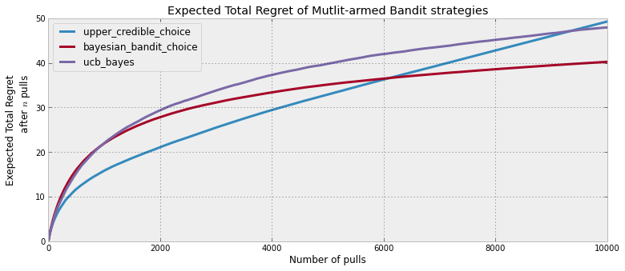
How to measure exploration
Bad idea: by the sound of their name
Good idea: with $$$ it brought/lost you
Regret of policy π(a|s):
Regret per tick = optimal – yours

Slide 12
Quiz time
Strategies:
    ε-greedy
        With probability ε take a uniformly random action;
        Otherwise take optimal action.
    Boltzman
        Pick action proportionally to transformed Qvalues
    Policy based: add entropy

Slide 13
Quiz time
Your agent uses ε-greedy strategy with ε=0.1
What about his regret?

Slide 14
Quiz time
Your agent uses ε-greedy strategy with ε=0.1
What about his regret?
It grows linearly with time!
We never reach optimal policy cuz of ε
Q: How do we fix it?

Slide 15
Greedy in the limit
If exploration is asymptotically zero,
we will reach π* in the limit
Practical: multiply by 0.99 every K steps :)

Slide 16

How many lucky random actions it takes to
          Apply medical treatment
          Control robots
          Invent efficient VAE training
    Except humans can learn these in less than a lifetime

Slide 17
How many lucky random actions it takes to
          Apply medical treatment
          Control robots
          Invent efficient VAE training
We humans explore not with e-greedy policy!

Slide 18
BTW how humans explore?
  Whether some new particles violate physics
  Vs
  Whether you still can't fly by pulling your hair up

Slide 19
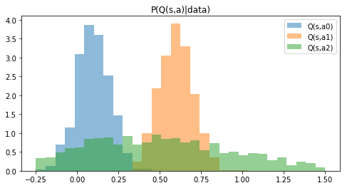
Uncertainty in returns
We want to try actions if we believe there's a chance they turn out optimal.
Idea: let's model how certain we are that Q(s,a) is what we predicted
Q(s,a)

Slide 20
Thompson sampling
Policy:
  sample once from each Q distribution
  take argmax over samples
  which actions will be taken?
Q(s,a)

Slide 21
Thompson sampling
Policy:
  sample once from each Q distribution
  take argmax over samples
  which actions will be taken?
Takes a1 with p ~ 0.65, a2 with p ~ 0.35, a0 ~ never
Q(s,a)

Slide 22
Optimism in face of uncertainty
  Idea:
    Prioritize actions with uncertain outcomes!
    More uncertain = better.
    Greater expected value = better
    Math: try until upper confidence bound is small enough.

Slide 23
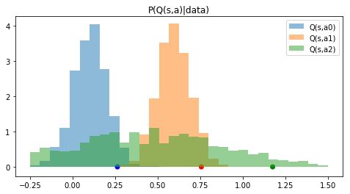
Optimism in face of uncertainty
Policy:
  Compute 95% upper confidence bound for each a
  Take action with highest confidence bound
  What can we tune here to explore more/less?
Q(s,a)

Slide 24
Optimism in face of uncertainty
Policy:
  Compute 95% upper confidence bound for each a
  Take action with highest confidence bound
  Adjust: change 95% to more/less
points = 95% percentiles
Q(s,a)

Slide 25
Frequentist approach
There's a number of inequalities that bound
P(x>t) < something
E.g. Hoeffding inequality (arbitrary x in [0,1])
Remember any others?

Slide 26
Frequentist approach
There's a number of inequalities that bound
P(x>t) < something
E.g. Hoeffding inequality (arbitrary x in [0,1])
Remember any others?
(Chernoff, Chebyshev, over9000)

Slide 27
Count-based exploration
UCB-1 for bandits
  Take actions in in proportion to
  number of time-steps so far
  times action a is taken

Slide 28
Count-based exploration
UCB-1 for bandits
  Take actions in in proportion to
  number of time-steps so far
  times action a is taken
Upper conf. bound
for r in [0,1]
If not?

Slide 29
Count-based exploration
UCB-1 for bandits
  Take actions in in proportion to
  number of time-steps so far
  times action a is taken
Upper conf. bound
for r in [0,1]
If not – divide
by r_max

Slide 30
Count-based exploration
UCB generalized for multiple states
where
  visits to state s
  times action a is taken from state s

Slide 31
Bayesian UCB
The usual way:
  Start from prior P(Q)
  Learn posterior P(Q|data)
  Take q-th percentile
What models can learn that?

Slide 32
Bayesian UCB
The usual way:
  Start from prior P(Q)
  Learn posterior P(Q|data)
  Take q-th percentile
Approach 1: learn parametric P(Q), e.g. normal
Approach 2: use bayesian neural networks

Slide 33
Parametric
X
tanh
0.3
-0.1
Regular
NN
y
-0.25
tanh
1.3

Slide 34
Parametric
X
tanh
-0.1
μ
0.3
1.3
Predict
x~N(μ,σ)
P(y|x)
0.2
σ
-0.25
tanh
Normal distribution
0.05
X
tanh
0.3
-0.1
Regular
NN
y
-0.25
tanh
1.3

Slide 35
BNNs
Disclaimer: this is a hacker's guide to BNNs!
It does not cover all the philosophy and general cases.
X
tanh
0.3
-0.1
y
Regular
NN
-0.25
tanh
1.3

Slide 36
BNNs
X
tanh
P(y|x)
Bayesian
NN
tanh
X
tanh
0.3
-0.1
y
Regular
NN
-0.25
tanh
1.3

Slide 37
BNNs
X
tanh
Idea:
No explicit weights
  Maintain parametric distribution on them instead!
    Practical: fully-factorized normal or similar
P(y|x)
tanh

Slide 38
BNNs
X
tanh
Idea:
No explicit weights
  Maintain parametric distribution on them instead!
    Practical: fully-factorized normal or similar
P(y|x)
tanh

Slide 39
BNNs
X
tanh
Idea:
No explicit weights
Inference: sample from weight distributions, predict 1 point
To get distribution, aggregate K samples (e.g. with histogram)
  Yes, it means running network multiple times per one X
P(y|x)
tanh

Slide 40
BNNs
Idea:
No explicit weights
  Maintain parametric distribution on them instead!
    Practical: fully-factorized normal or similar
Learn parameters of that distribution (reparameterization trick)
  Less variance: local reparameterization trick.
wanna explicit formulae? d = dataset

Slide 41
Lower bound
d = dataset
loglikelihood
-distance to prior
+const

Slide 42
Lower bound
Can we perform gradient ascent directly?

Slide 43
Reparameterization trick
Use reparameterization trick
simple formula
(for normal q)
What does this log P(d|...) mean?
BNN likelihood
Better: local reparameterization trick (google it)

Slide 44
Reparameterization trick
In other words,
Σx,y~d log p(y|x,µ+σψ)
BNN likelihood
Better: local reparameterization trick (google it)

Slide 45
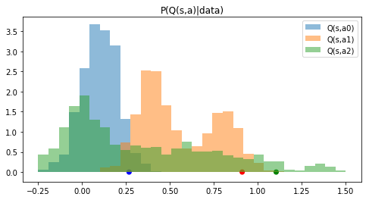
Using BNNs
If you sample from BNNs
  Can learn ~arbitrary distribution (e.g. multimodal)
  But it takes running network many times
  Use empirical percentiles for exploration priority
    Again, 3 points on horizontal axis are percentiles

Slide 46
Using BNNs
If you sample from BNNs
  Can learn ~arbitrary distribution (e.g. multimodal)
  But it takes running network many times
  Use empirical percentiles for exploration priority
    Again, 3 points on horizontal axis are percentiles

Slide 47

Practical stuff
Approximate exploration policy
  with something cheaper
Bayesian UCB:
  Prior can make or break it
  Sometimes parametric guys win
  (vs bnn)
Of course, neural nets aren't
  always the best model

Slide 48
What we learned?
What new stuff did we learn today?
Note to self: I should stay silent.

Slide 49
What we learned?
Regret: money agent lost while learning optimal policy
  Less regret = better exploration
  ε-greedy and boltzmann can be really bad!
Using uncertainty:
  Thompson, UCB, bayes-UCB
Scaling things up: bayesian neural networks

