Slide 1



Practical RL
week 5, spring’18
Bandits, exploration, production hacks

Slide 2
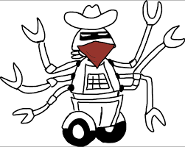
Multi-armed bandits

Slide 3
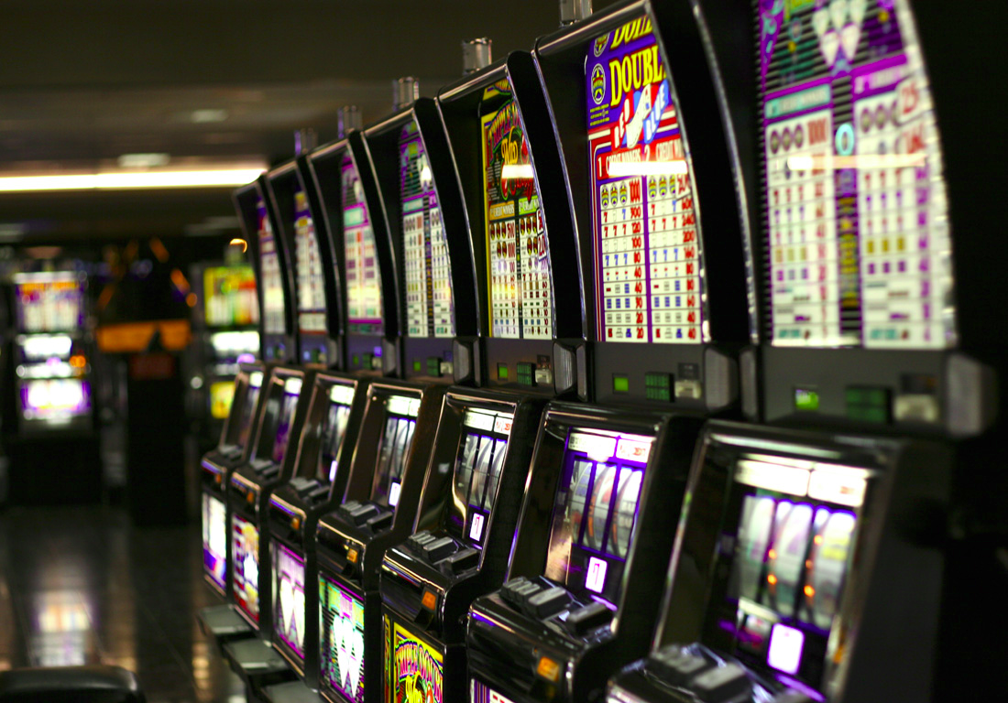
Multi-armed bandits

Slide 4

Multi-armed bandits: simplest
Simple case: no different “states”, just N actions
same state
each time
Agent
action
Feedback
Exploration: figure out which action is best overall;
take as few bad actions as you can

Slide 5
Multi-armed bandits: contextual
A simplified MDP with only one step
observation
Agent
action
Feedback
Why bandits: it's simpler to explain math here,
Formulae are, like, 50% shorter
(we will generalize to MDP in the second half)

Slide 6
What is: contextual bandit
state
Agent
action
r(s,a)
Feedback
Examples:
  banner ads (RTB)
  recommendations
  medical treatment
Basicaly it's 1-step MDP where
  G(s,a) = r(s,a)
  Q(s,a) = E r(s,a)
  All formulae are 50% shorter

Slide 7
How to measure exploration
Ideas?

Slide 8
How to measure exploration
Bad idea: by the sound of the name
Good idea: by $$$ it brought/lost you
Regret of policy π(a|s):
Consider an optimal policy, π*(a|s)
Regret = sum over training time [ optimal – yours ]
Finite horizon: t < max_t Infinite horizon: t → inf

Slide 9
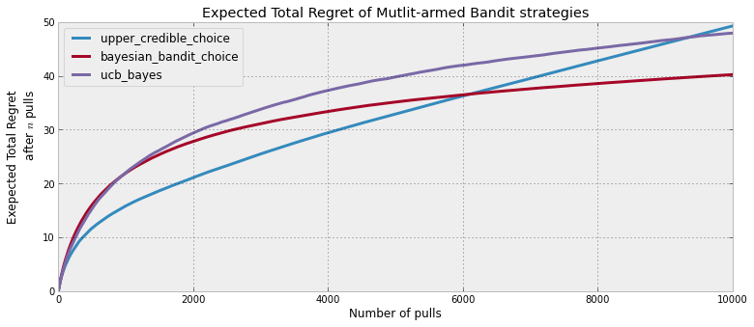
How to measure exploration
Bad idea: by the sound of the name
Good idea: by $$$ it brought/lost you
Regret of policy π(a|s):
Regret per tick = optimal – yours

Slide 10

Exploration Vs Exploitation
What exploration strategies
did we use before?

Slide 11
Exploration strategies so far...
Strategies:
    ε-greedy
        With probability ε take a uniformly random action;
        Otherwise take optimal action.
    Boltzman
        Pick action proportionally to transformed Qvalues
    Optimistic initialization
        start from high initial Q(s,a) for all states/actions
        good for tabular algorithms, hard to approximate

Slide 12
Exploration strategies so far...
Strategies:
    ε-greedy
        With probability ε take a uniformly random action;
        Otherwise take optimal action.
    Say, we use ε-greedy with const ε = 0.25
    on top of q-learning to play a videogame.
    What can you say about regret?

Slide 13
Exploration strategies so far...
Strategies:
    ε-greedy
        With probability ε take a uniformly random action;
        Otherwise take optimal action.
    Say, we use ε-greedy with const ε = 0.25
    on top of q-learning to play a videogame.
    Regret grows linearly over time!
    Agent always acts suboptimally due to ε

Slide 14
Exploration over time
Idea:
If you want to converge to optimal policy,
you need to gradually reduce exploration
Example:
Initialize ε-greedy ε = 0.5, then gradually reduce it
    If ε → 0, it's greedy in the limit
    Be careful with non-stationary environments

Slide 15

How many lucky random actions it takes to
          Apply medical treatment
          Control robots
          Invent efficient VAE training
    Except humans can learn these in less than a lifetime

Slide 16
How many lucky random actions it takes to
          Apply medical treatment
          Control robots
          Invent efficient VAE training
We humans explore not with e-greedy policy!

Slide 17
BTW how humans explore?
  Whether some new particles violate physics
  Vs
  Whether you still can't fly by pulling your hair up

Slide 18
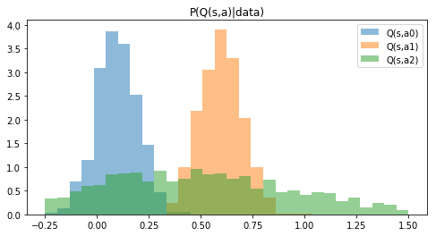
Uncertainty in returns
We want to try actions if we believe there's a chance they turn out optimal.
Idea: let's model how certain we are that Q(s,a) is what we predicted
Q(s,a)

Slide 19
Thompson sampling
Policy:
  sample once from each Q distribution
  take argmax over samples
  which actions will be taken?
Q(s,a)

Slide 20
Thompson sampling
Policy:
  sample once from each Q distribution
  take argmax over samples
  which actions will be taken?
Takes a1 with p ~ 0.65, a2 with p ~ 0.35, a0 ~ never
Q(s,a)

Slide 21
Optimism in face of uncertainty
  Idea:
    Prioritize actions with uncertain outcomes!
    More uncertain = better.
    Greater expected value = better
    Math: try until upper confidence bound is small enough.

Slide 22
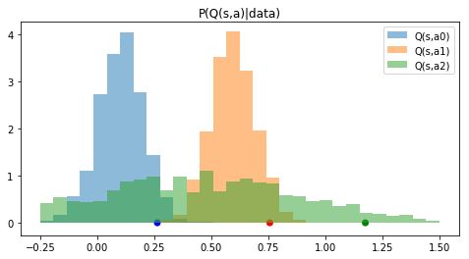
Optimism in face of uncertainty
Policy:
  Compute 95% upper confidence bound for each a
  Take action with highest confidence bound
  What can we tune here to explore more/less?
Q(s,a)

Slide 23
Optimism in face of uncertainty
Policy:
  Compute 95% upper confidence bound for each a
  Take action with highest confidence bound
  Adjust: change 95% to more/less
points = 95% percentiles
Q(s,a)

Slide 24
Frequentist approach
There's a number of inequalities that bound
P(x>t) < something
E.g. Hoeffding inequality (arbitrary x in [0,1])
Remember any others?

Slide 25
Frequentist approach
There's a number of inequalities that bound
P(x>t) < something
E.g. Hoeffding inequality (arbitrary x in [0,1])
Remember any others?
(Chernoff, Chebyshev, over9000)

Slide 26
Count-based exploration
UCB-1 for bandits
  Take actions in in proportion to
  number of time-steps so far
  times action a is taken

Slide 27
Count-based exploration
UCB-1 for bandits
  Take actions in in proportion to
  number of time-steps so far
  times action a is taken
Upper conf. bound
for r in [0,1]
If not?

Slide 28
Count-based exploration
UCB-1 for bandits
  Take actions in in proportion to
  number of time-steps so far
  times action a is taken
Upper conf. bound
for r in [0,1]
If not – divide
by r_max

Slide 29
Count-based exploration
UCB generalized for multiple states
where
  visits to state s
  times action a is taken from state s

Slide 30
Bayesian UCB
The usual way:
  Start from prior P(Q)
  Learn posterior P(Q|data)
  Take q-th percentile
What models can learn that?

Slide 31
Bayesian UCB
The usual way:
  Start from prior P(Q)
  Learn posterior P(Q|data)
  Take q-th percentile
Approach 1: learn parametric P(Q), e.g. normal
Approach 2: use bayesian neural networks

Slide 32
Parametric
X
tanh
0.3
-0.1
Regular
NN
y
-0.25
tanh
1.3

Slide 33
Parametric
X
tanh
-0.1
μ
0.3
1.3
Predict
x~N(μ,σ)
P(y|x)
0.2
σ
-0.25
tanh
Normal distribution
0.05
X
tanh
0.3
-0.1
Regular
NN
y
-0.25
tanh
1.3

Slide 34
BNNs
Disclaimer: this is a hacker's guide to BNNs!
It does not cover all the philosophy and general cases.
X
tanh
0.3
-0.1
y
Regular
NN
-0.25
tanh
1.3

Slide 35
BNNs
X
tanh
P(y|x)
Bayesian
NN
tanh
X
tanh
0.3
-0.1
y
Regular
NN
-0.25
tanh
1.3

Slide 36
BNNs
X
tanh
Idea:
No explicit weights
  Maintain parametric distribution on them instead!
    Practical: fully-factorized normal or similar
P(y|x)
tanh

Slide 37
BNNs
X
tanh
Idea:
No explicit weights
  Maintain parametric distribution on them instead!
    Practical: fully-factorized normal or similar
P(y|x)
tanh

Slide 38
BNNs
X
tanh
Idea:
No explicit weights
Inference: sample from weight distributions, predict 1 point
To get distribution, aggregate K samples (e.g. with histogram)
  Yes, it means running network multiple times per one X
P(y|x)
tanh

Slide 39
BNNs
Idea:
No explicit weights
  Maintain parametric distribution on them instead!
    Practical: fully-factorized normal or similar
Learn parameters of that distribution (reparameterization trick)
  Less variance: local reparameterization trick.
wanna explicit formulae? d = dataset

Slide 40
Lower bound
d = dataset
loglikelihood
-distance to prior
+const

Slide 41
Lower bound
Can we perform gradient ascent directly?

Slide 42
Reparameterization trick
Use reparameterization trick
simple formula
(for normal q)
What does this log P(d|...) mean?
BNN likelihood
Better: local reparameterization trick (google it)

Slide 43
Reparameterization trick
In other words,
Σx,y~d log p(y|x,µ+σψ)
BNN likelihood
Better: local reparameterization trick (google it)

Slide 44
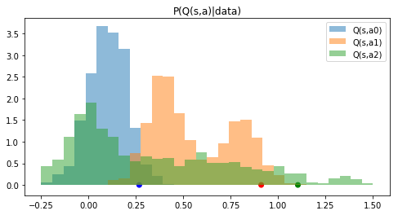
Using BNNs
If you sample from BNNs
  Can learn ~arbitrary distribution (e.g. multimodal)
  But it takes running network many times
  Use empirical percentiles for exploration priority
    Again, 3 points on horizontal axis are percentiles

Slide 45
Using BNNs
If you sample from BNNs
  Can learn ~arbitrary distribution (e.g. multimodal)
  But it takes running network many times
  Use empirical percentiles for exploration priority
    Again, 3 points on horizontal axis are percentiles

Slide 46

Practical stuff
Approximate exploration policy
  with something cheaper
Bayesian UCB:
  Prior can make or break it
  Sometimes parametric guys win
  (vs bnn)
Of course, neural nets aren't
  always the best model

Slide 47
Markov Decision Processes
Naive approach:
  Infer posterior distribution on Q(s,a)
  Do UCB or Thompson Sampling on those Q-values
  Anything wrong with this?

Slide 48
Markov Decision Processes
Naive approach:
  Infer posterior distribution on Q(s,a)
  Do UCB or Thompson Sampling on those Q-values
  Agent is “greedy” w.r.t. exploration
    It would prefer taking one uncertain action now than
    make several steps to end up in unexplored regions

Slide 49
Markov Decision Processes
Naive approach:
  Infer posterior distribution on Q(s,a)
  Do UCB or Thompson Sampling on those Q-values
  Agent is “greedy” w.r.t. exploration
Reward augmentation
  Devise a surrogate “reward” for exploration
    We “pay” our agent for exploring
  Maximize this reward with a (separate) RL agent

Slide 50

I got it!
It's all about funding!
(Just kidding)

Slide 51
Reward augmentation
Let's “pay” agent for exploration!

Slide 52
Reward augmentation
Let's “pay” agent for exploration!
Q: Any suggestions on
surrogate r for atari?

Slide 53
UNREAL main idea
Auxilary objectives:
  Pixel control: maximize pixel change in NxN grid over image
  Feature control: maximize activation of some neuron deep inside neural network
  Reward prediction: predict future rewards given history
  article: arxiv.org/abs/1611.05397
  blog post: bit.ly/2g9Yv2A

Slide 54
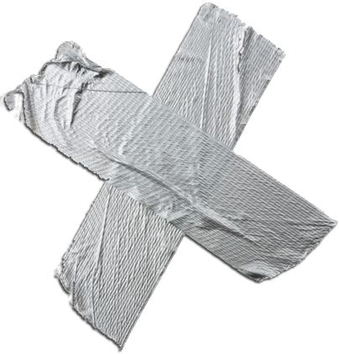
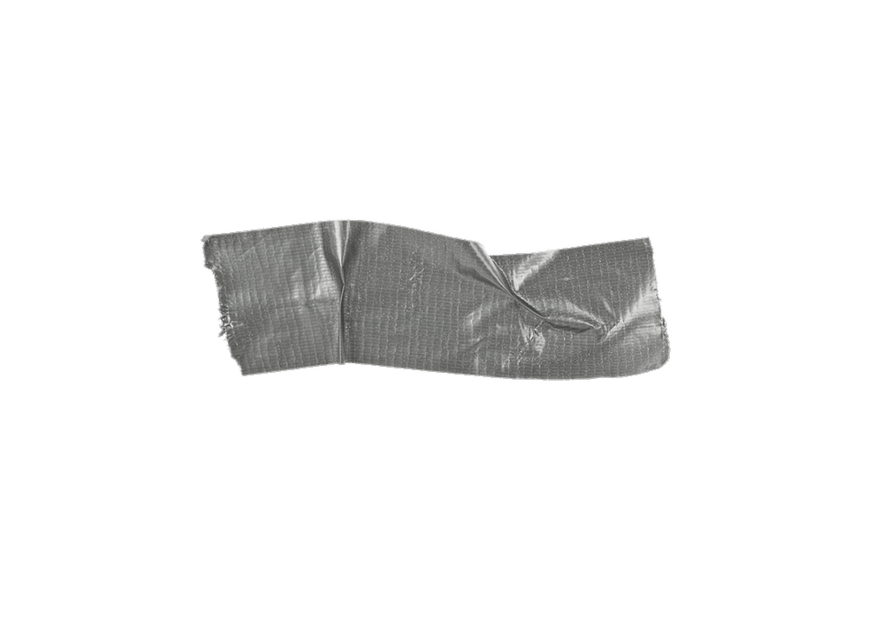
UNREAL main idea
Auxilary objectives:
  Pixel control: maximize pixel change in NxN grid over image
  Feature control: maximize activation of some neuron deep inside neural network
  Reward prediction: predict future rewards given history
  article: arxiv.org/abs/1611.05397
  blog post: bit.ly/2g9Yv2A
Keep calm!
we’ll get more theoretically
sound models in a few slides

Slide 55
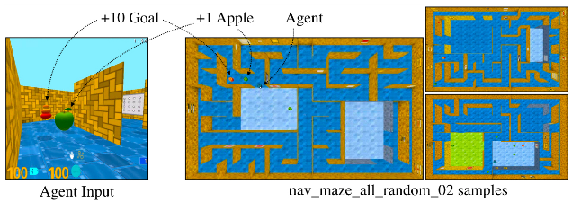
Environment: Labyrinth
Maze with rewards
Partially observable
  Used a2c + LSTM + experience replay

Slide 56
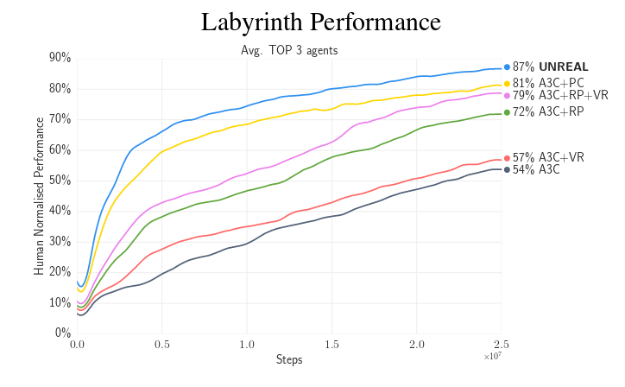
Results: labyrinth

Slide 57
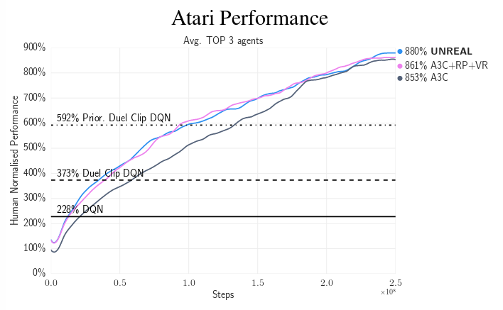
Results: Atari

Slide 58
Count-based models
TL;DR encourage visiting underexplored states
Use approximate density model, N(s)
N(s) ~ how many times agent
visited s over training time

Slide 59
Count-based models
TL;DR encourage visiting underexplored states
Use approximate density model, N(s)
N(s) ~ how many times agent
visited s over training time
Reward for visiting low-N states, e.g. N(s)^-0.5
  Examples: arxiv:1606.01868, arxiv:1703.01310

Slide 60
Count-based models
On-policy: start training with surrogate rewards,
  gradually reduce their weight over time
Off-policy: train a separate agent to maximize
exploration via surrogate rewards, learn Q(s,a)
for original reward from that with off-policy algo

Slide 61
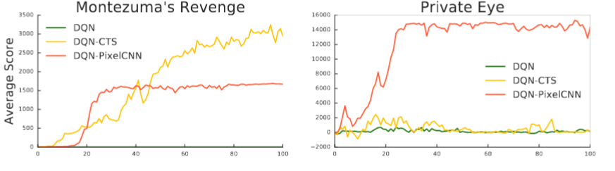
Estimating counts
We need some way to estimate N(s)
Task-specific: e.g. image density models
Generic: e.g. VAE / alphaGAN, expected log p(x|z)
Density ratio: estimate p(s) / q(s) for baseline q

Slide 62
Density ratio trick
We need some way to estimate N(s)
count = state density (probability)
up to a coefficient of n_steps

Slide 63
Density ratio trick
We need some way to estimate N(s)
count = state density (probability)
up to a coefficient of n_steps
To estimate d(s), we introduce any
known distribution q(s), e.g. uniform

Slide 64
Density ratio trick
We need some way to estimate N(s)
count = state density (probability)
up to a coefficient of n_steps
To estimate d(s), we introduce any
known distribution q(s), e.g. uniform
Train another model to discriminate between and
Q: What is P(s ∈ d(s) ) under optimal model?

Slide 65
Density ratio trick
Train another model to discriminate between and
Perfect discriminator:

Slide 66
Density ratio trick
Train another model to discriminate between and
Perfect discriminator:
Q: Can you express in terms of ?

Slide 67
Density ratio trick
Train another model to discriminate between and
Perfect discriminator:

Slide 68
Density ratio trick
Train another model to discriminate between and
Perfect discriminator:

Slide 69
Density ratio trick
We need some way to estimate N(s)
count = state density (probability)
up to a coefficient of n_steps
Train neural network to discriminate between
visited states and arbitrary known
Uniform q(s) = simple math, high variance d(s),
Task-specific q(s) = possibly smaller variance

Slide 70
Variational Information-Maximizing Exploration
I hope I don’t have enough time for this…
arxiv:1605.09674

Slide 71
Variational Information-Maximizing Exploration
Curiosity
  Taking actions that increase your knowledge about the world (a.k.a. the environment)
Knowledge about the world
  Whatever allows you to predict how world works depending on your behavious
arxiv:1605.09674

Slide 72
Vime main idea
Add curiosity to the reward
Curiosity definition

Slide 73
Vime main idea
Environment model
Session
Surrogate reward
curiosity
need proof for that last line?

Slide 74
Naive objective
where

Slide 75
Naive objective
Sample
From MDP
Sample
Somehow...
Model
Prior
dunno
Better avoid computing P(theta|tau) directly!

Slide 76

BAYES

Slide 77
We want a model that
- predicts P(s'|s,a,s,…,a, theta)
- we can estimate P(theta | D)
- we can sample from P(theta | D)

Slide 78
We want a model that
- predicts P(s'|s,a,s,…,a, theta)
- we can estimate P(theta | D)
- we can sample from P(theta | D)
- Bayesian Neural Networks!

Slide 79
Vime objective
BNN
sample
from env
sample
from BNN
BNN
last tick

Slide 80
Algorithm
Forever:
  Interact with environment, get <s,a,r,s'>
  Compute curiosity reward
  train_agent(s,a,r,s') //with any RL algorithm
  train_BNN(s,a,s') //maximize lower bound
  ~

Slide 81
Dirty hacks
Use batches of many <s,a,r,s'>
  for CPU/GPU efficiency
  greatly improves RL stability
Simple formula for KL
  Assuming fully-factorized normal distribution
  Even simpler: second order Taylor approximation
Divide KL by its running average over past iterations

Slide 82
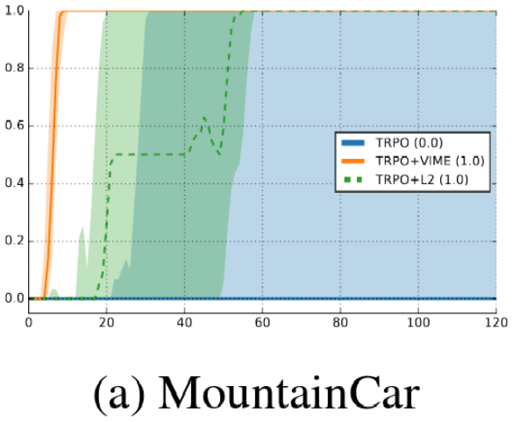
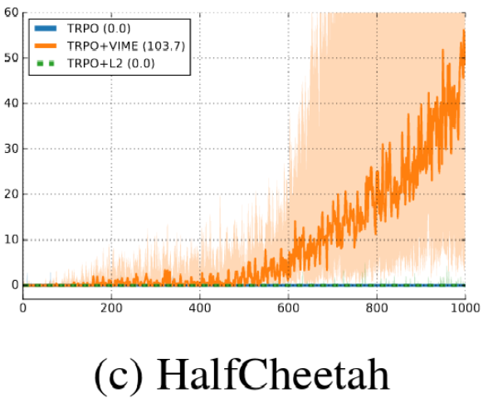
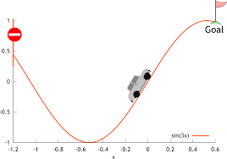
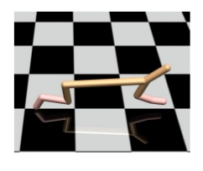
Results
Session reward
Session reward
epoch
epoch

Slide 83
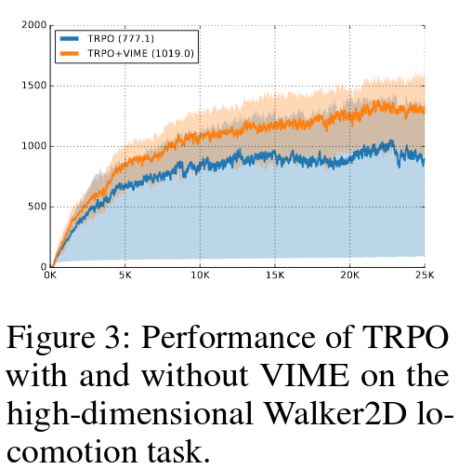
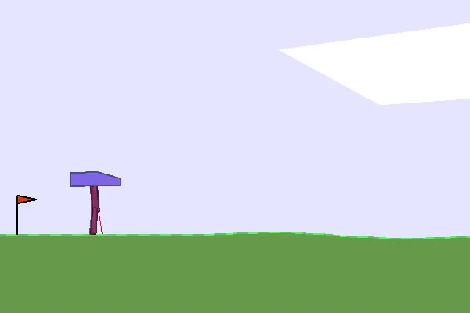
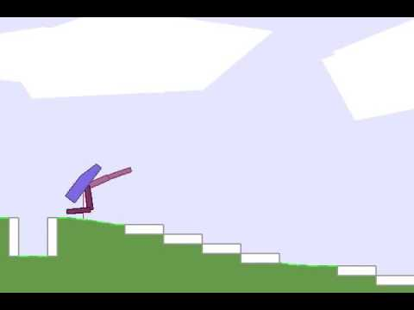
Results
Session reward
epoch

Slide 84
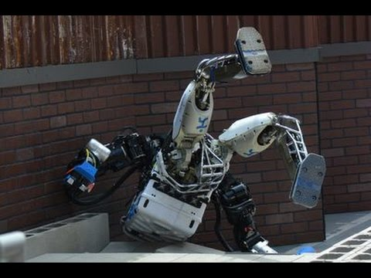
Pitfalls
It's curious about irrelevant things
Predicting (210x160x3) images is hard
We don't observe full states (POMDP)

Slide 85
State = hidden NN activation
Qvalues
Q(s,a)
More layers
Some layers
Raw observation
S

Slide 86
State = hidden NN activation
Qvalues
qvalues, (~n actions)
More layers
After DNN, (~256)
Only policy-relevant
Some layers
Raw observation
Pixels (210x160x3)
All information

Slide 87
State = hidden NN activation
Qvalues
More layers
This is our new state
Predict it with BNN
Some layers
Raw observation
We don't care

Slide 88
A case for POMDP
Qvalues
More layers
This is our new state
Predict it with BNN
RNN
RNN
RNN
RNN
O
t-3
O
t-2
O
t-1
O
t
We don't care

