Slide 1




Practical Reinforcement Learning
Episode 6 ¾, spring 2018
Recurrent neural networks deep learning recap 2

Slide 2
Previously on reinforcement learning...

Slide 3
Recap: MDP
Agent
observe
pick
action
State
S
Action
a
Environment

Slide 4
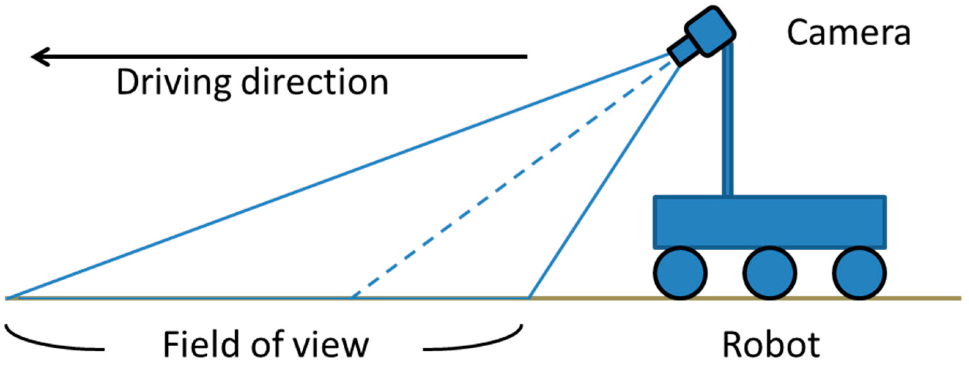
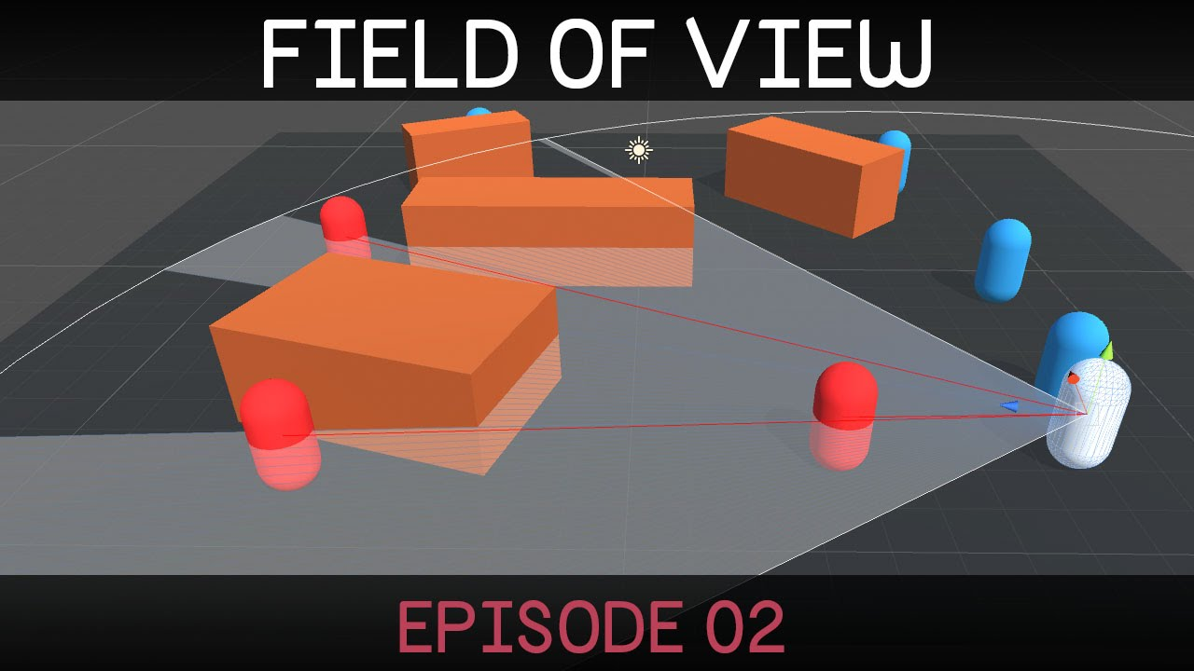
Partially Observable MDP

Slide 5
Partially Observable MDP
Agent
observe
pick
action
Observation
o(s)
Action
a
Hidden State
s

Slide 6
Partially Observable MDP
Agent
observe
pick
action
Observation
o(s)
Action
a
Hidden State
s
Markovness w.r.t. s
(but nobody cares)

Slide 7
Partially Observable MDP
How do we train an agent
in such process?

Slide 8
Partially observable MDP
memory
state
h
observe
pick
action
Observation
policy
action
Hidden state
(Markov assumption holds)
[but no one cares]

Slide 9

N-gram heuristic
Idea:
  e.g. ball movement in breakout
  One frame
  Several frames

Slide 10
4-frame DQN
ϵ
-greedy
rule
(tune
ϵ
or use
apply
probabilistic rule)
action
action
Qvalues is a
Qvalues
dense layer with
no nonlinearity
Dense
Any neural
push image
network you
can think of.
Conv1
●
conv
●
pool
●
dense
stack
●
dropout
image
image t
4 images
●
batchnorm
(i,w,h,3)
image t-1
Conv0
...
image t-2
image t-3
delete last frame

Slide 11
Can we do better?
There's a hidden process
You only see some part of it
You want to learn hidden states
<Yes, recurrent neural networks>

Slide 12
Sequential data
Time series
  Financial data analysis
  Demand prediction
  Predict vehicle breakdown
    using sensor data
  Medical sensors
    e.g. sugar level

Slide 13

Sequential data
Time series
  Financial data analysis
  Demand prediction
  Predict vehicle breakdown
    using sensor data
  Medical sensors
    e.g. sugar level
Sound
  Speech recognition
  Text to speech
  Music generation
  Music recommendation
  …
Text
  Generating tweets, poetry
  Sentiment analysis
  See last lecture :)
Spatio-temporal
  Video
  Precipitation maps
  Ultrasonography
  Robot camera frames
  Could go on all day

Slide 14

Time series @finance
Data:
  Stock indices
  Commodities
  Forex
Objectives:
  Portfolio management
  Volatility targeting
  Estimating true value
  ...

Slide 15
Time series @finance
Data:
  Stock indices
  Commodities
  Forex
Objectives:
  Portfolio management
  Volatility targeting
  Estimating true value
  ~ trading stuff
  ~ evaluating risk
  ...

Slide 16
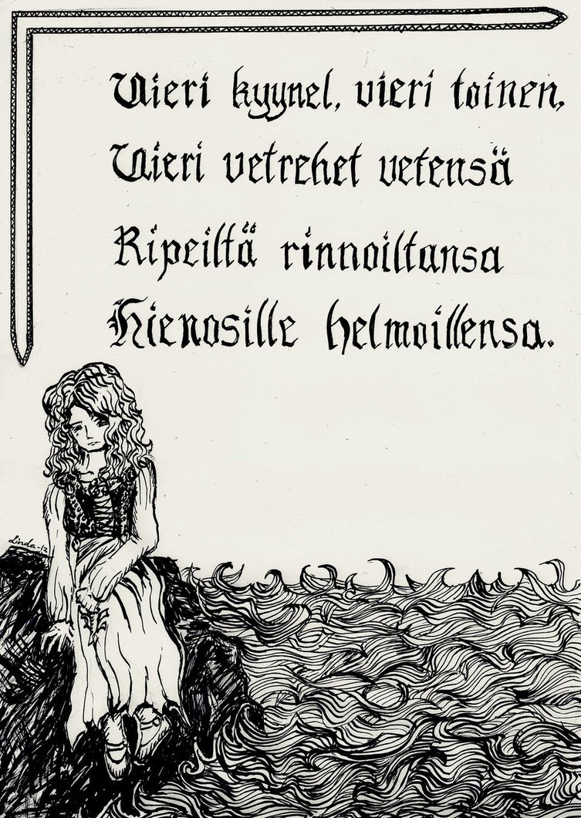
Natural language as time series
Data:
  Literature
  Conversation
  Tweets
  Book scans
  Speech

Slide 17
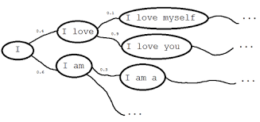
Language model
Objective:
    Learn P(text)

Slide 18
Language model
Why learning it?
    Detect languages as P(text|language)
    Sentiment analysis P(text|happy)
    Any text analysis you can imagine
    Generate texts!
      Cool article http://bit.ly/1K610Ie
      Generating clickbait: http://bit.ly/21cZM70

Slide 19
Language model
    Actual distribution
    Bag of words assumption (independent words)
    Anything better?

Slide 20
Language model
    Actual distribution
    Bag of words assumption (independent words)
    Markov assumption
      also 3-gram, 5-gram, 100-gram

Slide 21
Can we learn* arbitrarily long dependencies?
* without infinitely many parameters

Slide 22
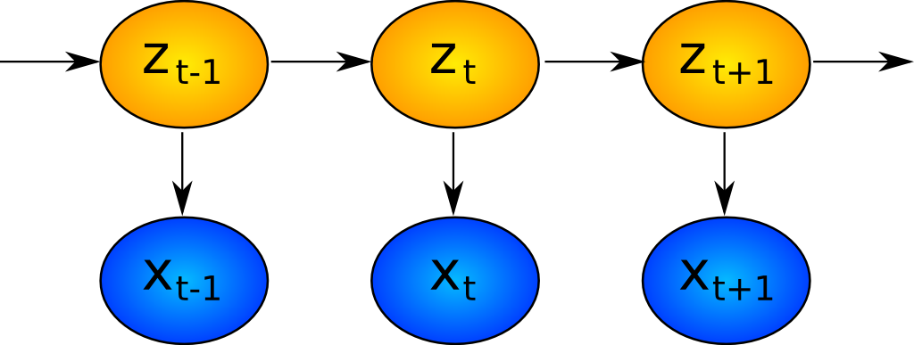
Hidden Markov Models: what's hidden
Hidden
Observed

Slide 23
Hidden Markov Models: what is hidden
Author's brain state
Hidden
Observed
Words

Slide 24
Recurrent neural network: one step
output
concat
Wx+b
H units
Last
State
sigmoid
New
state
z_t
time
Input at
This tick
x_t

Slide 25
Recurrent neural network: one step
output
Elementwise
Wx+b
h x h
matrix
+
sigmoid
Last
State
h units
New
state
Wx+b
i x h matrix
time
Input at
This tick

Slide 26
Recurrent neural network
Zoom-out
of previous slide

Slide 27
Recurrent neural network
old state
new state
Input x0

Slide 28
Recurrent neural network
old state
new state
even newer state
Input x0
Input x1

Slide 29
Recurrent neural network
old state
new state
even newer state
Input x0
Input x1
We use same weight matrices for all steps

Slide 30
Recurrent neural network
P(next)
x0=”the”
x1=”cat”
x2=”sat”
x3=”on”

Slide 31
Recurrent neural network
P(next)
x0=”the”
x1=”cat”
x2=”sat”
x3=”on”
How can we represent words?

Slide 32
Recurrent neural network
P(next)
h0
h1
h1
h2
h3
embed
embed
embed
embed
x0=”the”
x1=”cat”
x2=”sat”
x3=”on”

Slide 33
Recurrent neural network
P(next)
h0
h1
h1
h2
h3
embed
embed
embed
embed
x0=”the”
x1=”cat”
x2=”sat”
x3=”on”

Slide 34
Recurrent neural network
P(next)
h0
h1
h1
h2
h3
embed
embed
embed
embed
x0=”the”
x1=”cat”
x2=”sat”
x3=”on”

Slide 35
Recurrent neural network
P(next)
embed
embed
embed
embed
x0=”the”
x1=”cat”
x2=”sat”
x3=”on”

Slide 36
Recurrent neural network
Loss
P(next)
...
embed
embed
embed
embed
x0=”the”
x1=”cat”
x2=”sat”
x3=”on”

Slide 37
Recurrent neural network
Loss
How do we train it?
P(next)
...
embed
embed
embed
embed
x0=”the”
x1=”cat”
x2=”sat”
x3=”on”

Slide 38


Slide 39

Backpropagation through time
Loss
Chain rule
unroll
P(next)
...
embed
embed
embed
embed
x0=”the”
x1=”cat”
x2=”sat”
x3=”on”

Slide 40

Truncated BPTT
Reality: roll for T steps, then truncate
(T=10? 20? 1000?)
Loss
Chain rule
unroll
P(next)
...
embed
embed
embed
embed
x0=”the”
x1=”cat”
x2=”sat”
x3=”on”

Slide 41
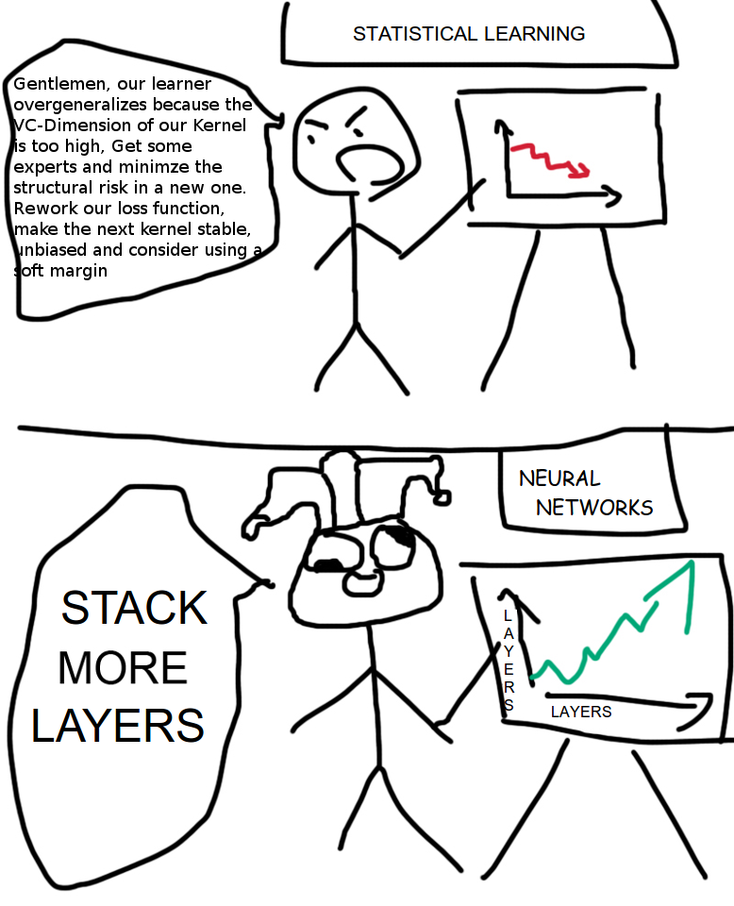

Slide 42
What is layer, again?
x1
x2
x3
x4
embed
embed
embed
embed
x0=”the”
x1=”cat”
x2=”sat”
x3=”on”

Slide 43
Layers
Where to stick more layers?
Dense
(softmax)
x1
x2
x3
x4
RNN
embed
embed
embed
embed
Embedding
Input
x0=”the”
x1=”cat”
x2=”sat”
x3=”on”

Slide 44
More layers
Dense
(softmax)
x1
x2
x3
x4
RNN 2
RNN 1
embed
embed
embed
embed
Embedding
Input
x0=”the”
x1=”cat”
x2=”sat”
x3=”on”

Slide 45

Too f**king complicated
Dense
(softmax)
x1
x2
x3
x4
RNN 2
RNN 1
embed
embed
embed
embed
Embedding
Input
x0=”the”
x1=”cat”
x2=”sat”
x3=”on”

Slide 46
2-layer RNN
Dense
(softmax)
x1
x2
x3
x4
RNN 2
RNN 1
embed
embed
embed
embed
Embedding
Input
x0=”the”
x1=”cat”
x2=”sat”
x3=”on”

Slide 47
BPTT again
Dense
(softmax)
x1
x2
x3
x4
RNN 2
RNN 1
embed
embed
embed
embed
Embedding
Chain rule
unroll
Input
x0=”the”
x1=”cat”
x2=”sat”
x3=”on”

Slide 48
BPTT Again
Loss
?!
P(next)
Chain rule
unroll
embed
embed
embed
embed
x0=”the”
x1=”cat”
x2=”sat”
x3=”on”

Slide 49
BPTT Again
Loss
P(next)
Chain rule
unroll
embed
embed
embed
embed
x0=”the”
x1=”cat”
x2=”sat”
x3=”on”

Slide 50
BPTT Again
consider h2 constant
Loss
P(next)
Chain rule
unroll
embed
embed
embed
embed
x0=”the”
x1=”cat”
x2=”sat”
x3=”on”

Slide 51
BPTT Again
Loss
P(next)
Chain rule
unroll
embed
embed
embed
embed
x0=”the”
x1=”cat”
x2=”sat”
x3=”on”

Slide 52
BPTT Again
Loss
Your guess?
P(next)
Chain rule
unroll
embed
embed
embed
embed
x0=”the”
x1=”cat”
x2=”sat”
x3=”on”

Slide 53
BPTT Again
Loss
P(next)
Chain rule
unroll
embed
embed
embed
embed
x0=”the”
x1=”cat”
x2=”sat”
x3=”on”

Slide 54
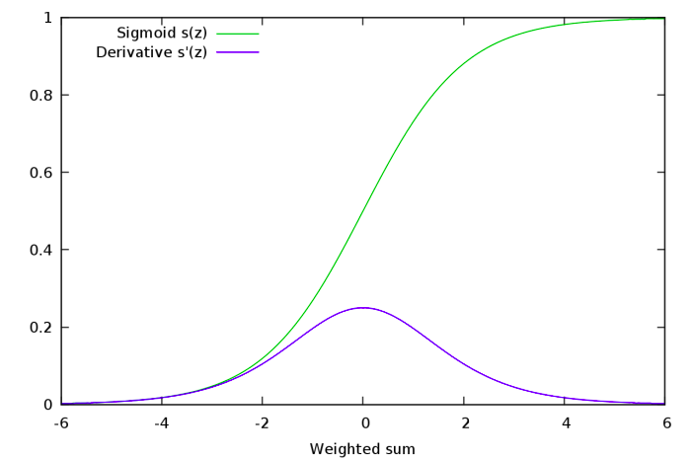
Gradient explosion and vanishing
Many sigmoids near 0 or 1
  Gradients → 0
  Not training for long-term dependencies
Many nonzero values
  Derivative stacks to >1
  Gradients → inf
  Weights → shit

Slide 55
RNN step
Elementwise
Wx+b
H units
+
Nonline-
arity
Last
State
New
state
Wx+b
H units
time
Input at
This tick

Slide 56
RNN step
Elementwise
Wx+b
H units
+
Tanh
Last
State
New
state
Wx+b
H units
time
Input at
This tick

Slide 57
Residual RNN step
Elementwise
+
New
state
Last
State
Elementwise
Wx+b
H units
+
Tanh
Wx+b
H units
time
Input at
This tick

Slide 58
Residual RNN step
Elementwise
+
New
state
Last
State
Elementwise
Wx+b
H units
+
Tanh
Difference:
Preserving information through time is now effortless.
Gradients do not vanish.
Much harder to get rid of something (reset cell to zero) when you need to do so.
Wx+b
H units
Chain rule
unroll
time
Input at
This tick

Slide 59
Residual RNN step
Elementwise
+
New
state
Last
State
Elementwise
Wx+b
H units
+
Tanh
Wx+b
H units
Update
time
Input at
This tick

Slide 60
Residual RNN step
Elementwise
+
New
state
Last
State
Update
time
Input at
This tick

Slide 61
Residual RNN step
Elementwise
+
New
state
Last
State
Update
time
Input at
This tick

Slide 62
Residual RNN step
Elementwise
mul
Elementwise
+
New
state
Last
State
sigm
Wx+b
Update
Trivia:
What should the new Wx+b be equivalent to previous slide RNN?
How can it fully erase the memory?
time
Input at
This tick

Slide 63
Residual RNN step
Elementwise
mul
Elementwise
+
New
state
Last
State
sigm
forget
gate
Wx+b
Update
Note: If at some tick we killed h while we needed them later, the gradient will cause forgetgate to “open”
time
Input at
This tick

Slide 64
What we drew
*
h
prev
sigm
+
h
new
Wx+b
forget
gate
Update
xi

Slide 65
What we drew
*
h
prev
sigm
+
h
new
Wx+b
forget
gate
Update
xi

Slide 66
What we drew
*
+
How to compute
h_new?
h
prev
sigm
forget
gate
h
new
Wx+b
Update
xi

Slide 67
What we drew

Slide 68
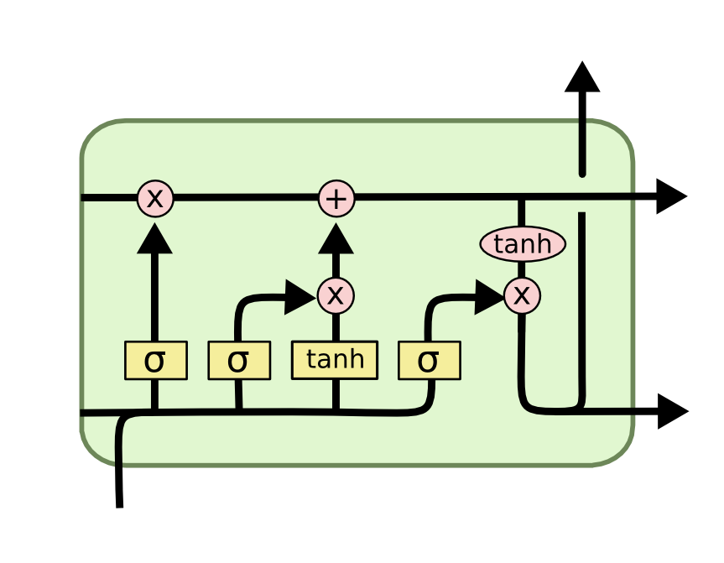
LSTM
2 hidden states:
Cell (“private” state)
Output (“public” state)
4 blocks:
Update
Forget gate
Input gate
Output gate

Slide 69
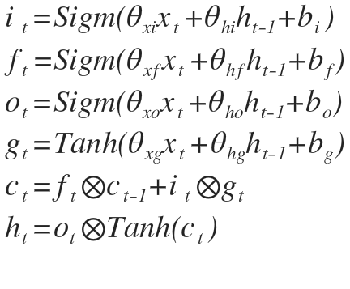
LSTM
h new
(output)
c
prev
c
new
h
prev
h
new
x
Where are the gates?

Slide 70
LSTM
h new
(output)
c
prev
c
new
i
f
g
h
prev
o
h
new
x

Slide 71
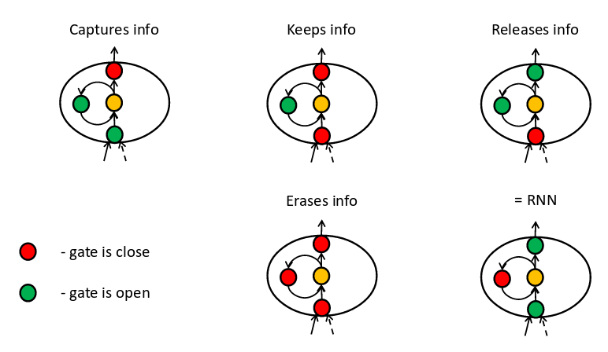
LSTM: not a monster
o
f
i
g
[Pictures: E Lobacheva, D Vetrov ]

Slide 72
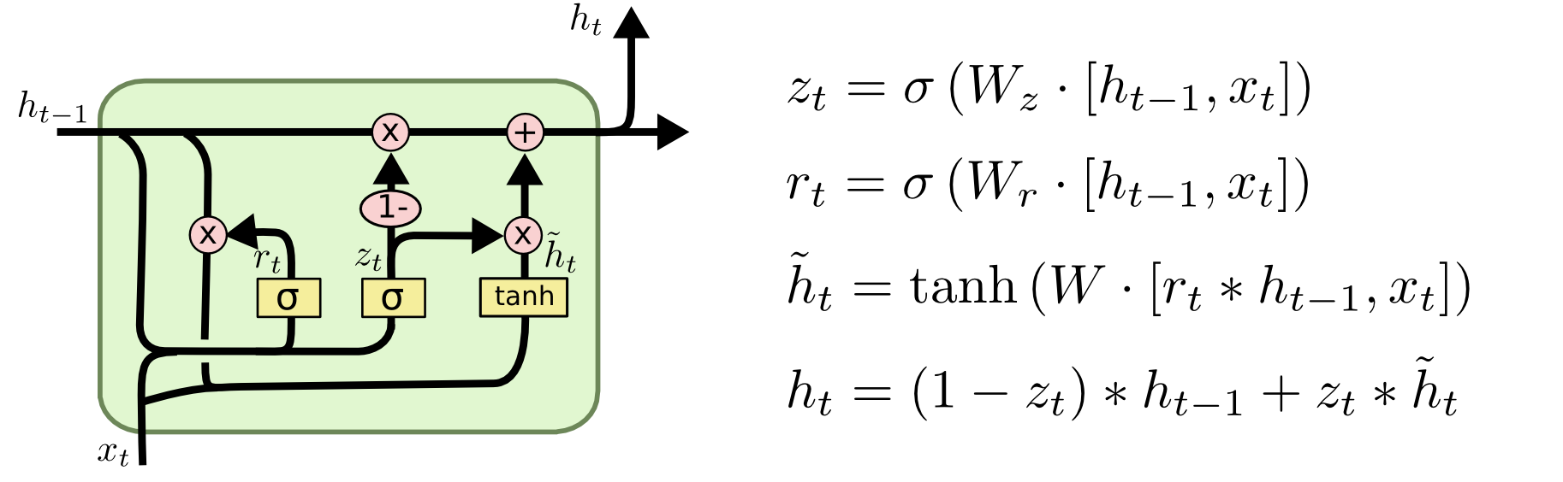
GRU

Slide 73
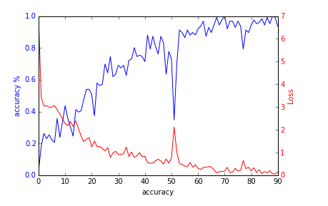
Okay, the gradients no longer vanish
except they still do, if only slower
But how do we deal with exploding grads?
Ideas?

Slide 74
Gradient clipping
At each time tick,
  check if grad abs value is more than … 5?
  If so, clip it
      large positive is now 5,
      large negative is now -5
  How large is too large?
    Reduce clipping threshold until explosions disappear

Slide 75
Gradient clipping
Where do I clip?
  Clip each element of
  Clip each element of
  Clip whole by norm
    If , scale

Slide 76
Generating stuff
Easy:
  Names, small phrases
  Orthographically correct delirium
Medium:
  Grammatically coherent text
  Resembling particular author
Hard:
  C/C++ source code
  Music
  Organic molecules
  LaTex articles
  Your course projects

Slide 77
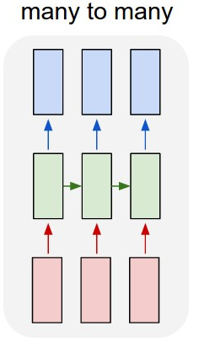
Recurrent Architectures: regular
  Read sequence
  Predict sequence of answers at each tick
Tasks:
  Language model
  POS Tagging
How to implement?
  See last week

Slide 78
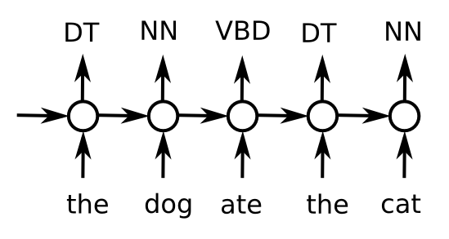
Recurrent Architectures: regular
  Read sequence
  Predict sequence of answers at each tick
POS tagging
Why RNN?

Slide 79
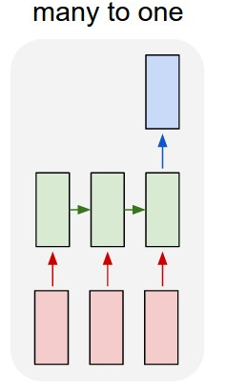
Recurrent Architectures: Encoder
Encoder
  Read sequence
  Predict once
Tasks:
  ?!
How to implement?
  ?!

Slide 80
Recurrent Architectures: Encoder
Encoder
  Read sequence
  Predict once
Tasks:
  Sentiment analysis
  Detect age by status
  Filter bad content
  Any text analysis
How to implement?
  Take last/max/mean over time

Slide 81
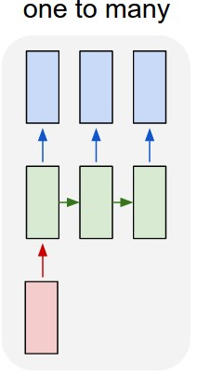
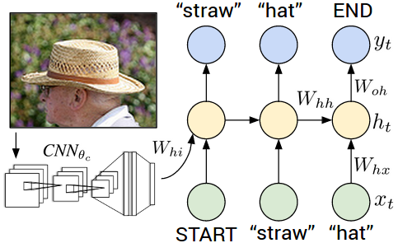
Recurrent Architectures: Decoder
Decoder
  Take one state
  Generate sequence
Tasks:
  Image captioning
How to implement?
  ?!

Slide 82
Recurrent Architectures: Decoder
Decoder
  Take one state
  Generate sequence
Tasks:
  Image captioning
How to implement?
  First state init (instead of zeros)
  Input at each tick

Slide 83
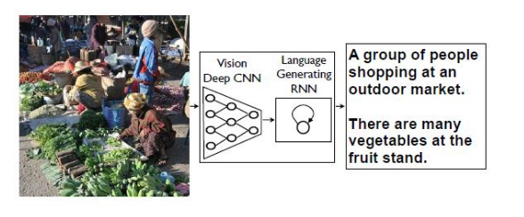
Image captioning
Demo - http://stanford.io/2esMxOq
Upload your image - http://bit.ly/2eAoueP

Slide 84
Seq2seq
How do we convert sequence to sequence of different kind/without time synchronization?
Example: Machine translation

Slide 85
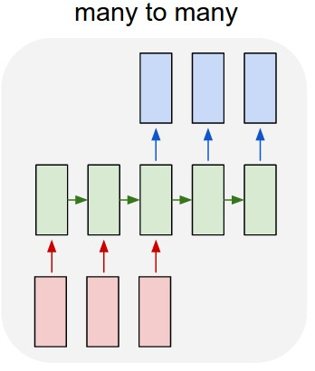
Seq2seq
Idea:
  first read (encode) the sequence
  then generate new one out of the encoded vector
How to implement that?

Slide 86

Seq2seq: encoder-decoder

Slide 87
Seq2seq: Conversation model
Exactly the same

Slide 88
Seq2seq: Machine translation
translation
Je
suis
étudiant
I
am
a
student
source

Slide 89
Meanwhile in reinforcement learning

Slide 90
RNN for RL
old state
new state
even newer state
o(s0)
o(s1)

Slide 91
RNN for RL
Or pi(a|s)
Q(s,a)
o(s0)
o(s1)
o(s1)
o(s1)

Slide 92
Deep Recurrent Q-network
const
Loss
Loss for SGD:
Q(s,a)
...
o(s0)
o(s1)
o(s1)
o(s1)

Slide 93
To be continued...

Slide 94

Nuff
Coding time!

