Slide 1
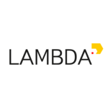


Reinforcement learning
episode 8, spring ‘18
RL outside games
Sequence learning

Slide 2
General formalism
Maximize over π

Slide 3
General formalism
Maximize over π
R(s,a) or G(s,a) is a black box
  Special case: G(s,a) = r(s,a) + γG(s',a')

Slide 4
General formalism
Maximize over π
R(s,a) or R(session) is a black box
  Special case: R(s,a) = r(s,a) + γR(s',a')
Markov property: P(s'|s,a,*) = P(s'|s,a)
Special case: obs(s) = s , fully observable

Slide 5
General approaches
Idea 1: evolution strategies
  pertrubate π, take ones with higher J
Idea 2: value-based methods
  estimate J as a function of a, pick best a
Idea 3: policy gradient
  ascend J over π(a|s) using ∇J

Slide 6
General approaches
Idea 4: Bayesian optimization
  build a model of J, pick π that is most informative
  to finding maximal J
  e.g. Gaussian processes (low-dimensional only)
Idea 5: simulated annealing
Idea 6: crossentropy method
...

Slide 7
Application domains
Videogames
Online ads
Recommender systems
Conversation systems
Robot control / dynamic system control
Parameter tuning
Financial tasks
Medicine
...

Slide 8
Domains so far
Videogames
Online ads
Recommender systems
Conversation systems
Robot control / dynamic system control
Parameter tuning
Financial tasks
Medicine
...
toy problems
videogames
toy problems
videogames
toy problems
guess what?

Slide 9

Encoder-decoder architectures
Read input data (sequence / arbitrary)
Generate output sequence
Trivia: what problems match this formulation?

Slide 10
Encoder-decoder tasks
Machine translation
Image to caption
Word to transcript
Conversation system
Image to latex
Code to docstring

Slide 11
Machine translation
Problem:
Read sentence in Chinese
Generate sentence in English
Sentences must mean the same thing
Solution?

Slide 12
Machine translation
Problem:
Read sentence in Chinese
Generate sentence in English
Sentences must mean the same thing
Solution:
Take large dataset of (source,translation) pairs
Maximize log P(translation|source)

Slide 13
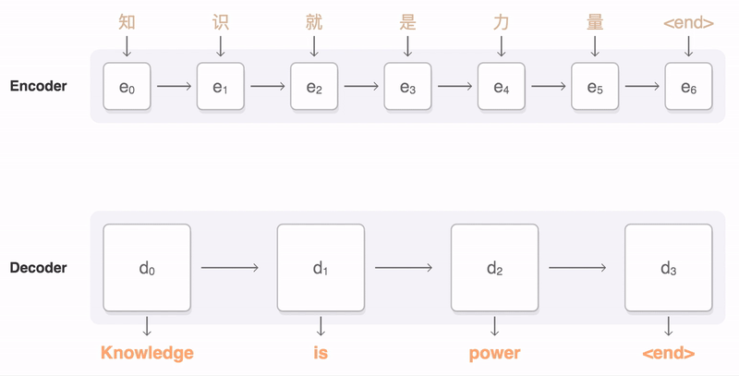
Digression: attentive translation
Let decoder choose where to look on each tick
image: https://github.com/google/seq2seq

Slide 14
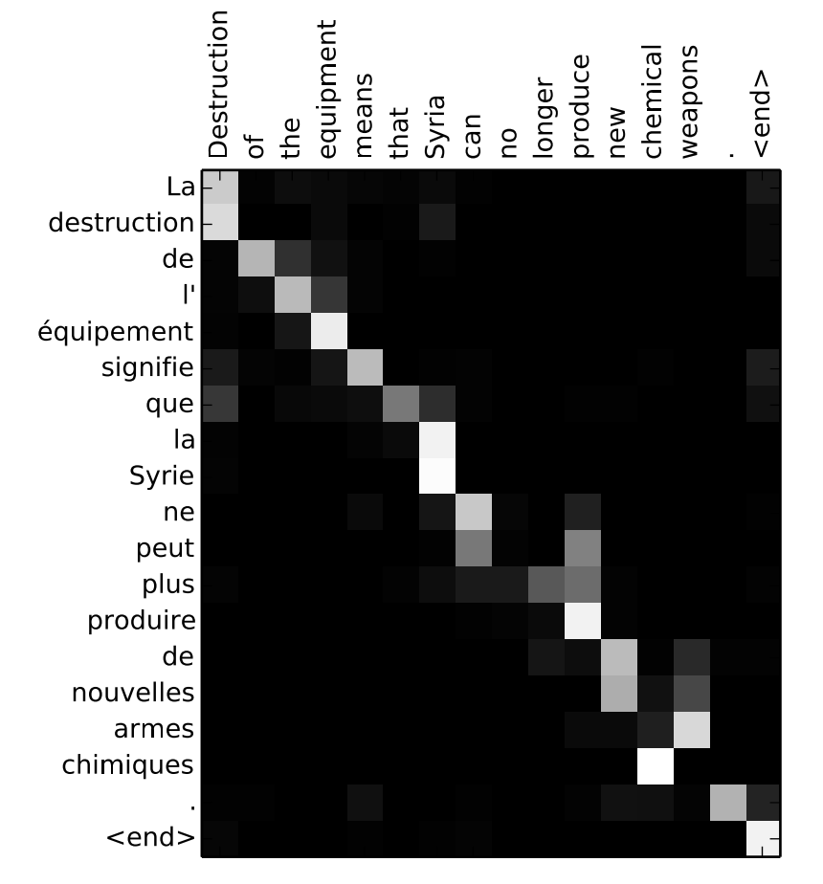
Digression: attentive translation
Simultaneously learns
  Word alignment
  Word translation
Differentiable attention:

Slide 15
Digression: attentive translation
Simultaneously learns
  Word alignment
  Word translation
Differentiable attention:

Slide 16
Machine translation, again
Problem:
Read sentence in Chinese
Generate sentence in English
Sentences must mean the same thing (e.g. BLEU)
Solution:
Take large dataset of (source,translation) pairs
Maximize log P(translation|source)

Slide 17
Conversation systems
Problem:
Read sentence from user
Generate response sentence
System must be able to support conversation
Solution:
Take large dataset of (phrase,response) pairs
Maximize log P(response|phrase)

Slide 18
Grapheme to phoneme
Problem:
Read word (characters): “hedgehog”
Generate transcript (phonemes): “hɛǰhag”
Transcript must read like real word (Levenshtein)
Solution:
Take large dataset of (word,transcript) pairs
Maximize log P(transcript|word)

Slide 19
Yet another problem
Problem:
Read x~X
Produce answer y~Y
Answer should be argmax R(x,y)
Solution:
Take large dataset of (x,y) pairs with good R(x,y)
Maximize log P(y|x) over those pairs

Slide 20
Summary
Works great as long as you have good data!
good = abundant + near-optimal R(x,y)
What could possibly go wrong?

Slide 21
Distribution shift
Supervised seq2seq learning:
Inference
???

Slide 22
Distribution shift
Supervised seq2seq learning:
Inference

Slide 23
Distribution shift
Supervised seq2seq learning:
Inference
If model ever makes something that isn't in data,
It gets volatile from next time-step!

Slide 24
Summary
Works great as long as you have good data!
good = abundant + near-optimal R(x,y)
… and a perfect network ...

Slide 25
Summary
Works great as long as you have good data!
good = abundant + near-optimal R(x,y)
… and a perfect network ...
Spoiler: most of the time we don't. Too bad.

Slide 26

Summary
Works great as long as you have good data!
good = abundant + near-optimal R(x,y)
Spoiler: most of the time we don't. Too bad.

Slide 27
Machine translation issues
There's more then one correct translation.
Source: 在 找 给 家里 人 的 礼物.
Versions:
i 'm searching for some gifts for my family.
i want to find something for my family as presents.
i 'm about to buy some presents for my family.
i 'd like to buy my family something as a gift.
i 'm looking for a present for my family.
...
( Sample from IWSLT 2009 Ch-En, http://bit.ly/2o404Tz )

Slide 28
Machine translation issues
There's more then one correct translation.
You don't need to learn all of them.
Source: 在 找 给 家里 人 的 礼物.
Versions:
i 'm searching for some gifts for my family.
i want to find something for my family as presents.
i 'm about to buy some presents for my family.
i 'd like to buy my family something as a gift.
i 'm looking for a present for my family.
...
( Sample from IWSLT 2009 Ch-En, http://bit.ly/2o404Tz )

Slide 29
Machine translation issues
There's more then one correct translation.
You don't need to learn all of them.
Source: 在 找 给 家里 人 的 礼物.
Model 1 Model 2
Versions: p(y|x) p(y|x)
(version 1) 1e-2 0.99
(version 2) 2e-2 1e-100
(version 3) 1e-2 1e-100
(all rubbish) 0.96 0.01

Slide 30
Machine translation issues
There's more then one correct translation.
You don't need to learn all of them.
Source: 在 找 给 家里 人 的 礼物.
Model 1 Model 2
Versions: p(y|x) p(y|x)
(version 1) 1e-2 0.99
(version 2) 2e-2 1e-100
(version 3) 1e-2 1e-100
(all rubbish) 0.96 0.01
Trivia: which model has better
Mean log p(y|x) ?
not in data

Slide 31
Machine translation issues
There's more then one correct translation.
You don't need to learn all of them.
Source: 在 找 给 家里 人 的 礼物.
Model 1 Model 2
Versions: p(y|x) p(y|x)
(version 1) 1e-2 0.99
(version 2) 2e-2 1e-100
(version 3) 1e-2 1e-100
(all rubbish) 0.96 0.01
better llh worse llh
96% rubbish 1% rubbish
not in data

Slide 32
Conversation system issues
Two kinds of datasets:
  Large raw data
    twitter, open subtitles, books, bulk logs
    10^6-8 samples, http://bit.ly/2nJHmA7
  Small clean data
    moderated logs, assessor-written conversations
    10^2~4 samples

Slide 33
Conversation system issues
Two kinds of datasets:
  Large raw data
    twitter, open subtitles, books, bulk logs
    10^6-8 samples, http://bit.ly/2nJHmA7
  Small clean data
    moderated logs, assessor-written conversations
    10^2~4 samples
Big enough, but suboptimal R(x,y)
Near-optimal R(x,y), but too small

Slide 34
Motivational example
So you want to train a Q&A bot for a bank.

Slide 35
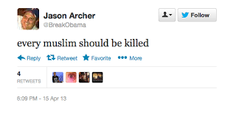

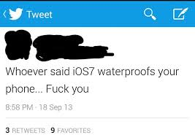

Motivational example
So you want to train a Q&A bot for a bank.
Let's scrape some data from social media!

Slide 36

Motivational example
So you want to train a Q&A bot for a bank.
Let's scrape some data from social media!

Slide 37
Seq2seq as a POMDP
a0
a1
a2
a3
Je
suis
étudiant
h0
h1
h2
h3
I
am
a
student
r
Hidden state s = translation/conversation state
Initial state s = encoder output
Observation o = previous words
Action a = write next word
Reward r = domain-specific reward (e.g. BLEU)

Slide 38
Supervised learning Vs policy gradient
Supervised learning:
Policy gradient:

Slide 39
Supervised learning Vs policy gradient
Supervised learning:
Policy gradient:

Slide 40
Supervised learning Vs policy gradient
Supervised learning:
Policy gradient:
Trivia: what's different? (apart from Q(s,a))

Slide 41
Supervised learning Vs policy gradient
Supervised learning:
Policy gradient:
reference
generated

Slide 42
Supervised learning Vs policy gradient
Supervised learning:
  Need (near-)optimal dataset
  Trains on reference sessions
Policy gradient:
  Need ~some data and reward function
  Trains on it's own output

Slide 43

SL VS RL
Train on references
Need good reference (y_opt)
If model is imperfect [and it is],
  training:
  P(y_next|x,y_prev_ideal)
  prediction:
  P(y_next|x,y_prev_predicted)
Reinforcement learning
Need reward function
Model learns to improve current policy. If policy is pure random, local improvements are unlikely to produce good translation.

Slide 44
SL VS RL
Supervised learning
Rather simple
Small variance
Need good reference (y_opt)
Distribution shift
  different h distribution
  when training vs generating
Reinforcement learning
Cold start problem
Large variance (so far)
Only needs x and r(s,a)
No distribution shift

Slide 45
SL VS RL
Supervised learning
Trains from scratch
Small variance
Need good reference (y_opt)
Distribution shift
  different h distribution
  when training vs generating
Reinforcement learning
Cold start problem
Large variance (so far)
Only needs x and r
No distribution shift
pre-training
post-training

Slide 46
SL VS RL
Supervised learning
Trains from scratch
Small variance
Need good reference (y_opt)
Distribution shift
  different h distribution
  when training vs generating
Reinforcement learning
Cold start problem
Large variance (so far)
Only needs x and r
No distribution shift
pre-training
post-training
Trivia: How do we make policy gradient less noisy?

Slide 47
Introducing baselines

Slide 48
Introducing baselines
Trivia: How do we estimate A(s,a) in practice?

Slide 49
Advantage actor-critic
Problem: need to train both π and V!
Can we get V for free?

Slide 50
Training Vs inference
Recap: encoder-decoder rnn
...
h
...
x0
x1
x2
x3
“start”
Input sequence
e.g. source language
Input sequence
e.g. source language

Slide 51
Training Vs inference
Recap: encoder-decoder rnn
sample
...
h
...
x0
x1
x2
x3
“start”
Input sequence
e.g. source language
Input sequence
e.g. source language

Slide 52
Training Vs inference
Recap: encoder-decoder rnn
output sequence
...
h
h
h
...
x0
x1
x2
x3
“start”
Input sequence
e.g. source language
Input sequence
e.g. source language

Slide 53
Training Vs Inference
Training is different from inference!
Encoder
same behavior for
training and inference
sample
sample
sample
...
h
h
h
...
x0
x1
x2
x3
“start”
Input sequence
e.g. source language
Input sequence
e.g. source language
Trivia: how does decoder
change during inference?

Slide 54
Training Vs Inference
Inference mode
Encoder
same behavior for
training and inference
max
max
max
...
h
h
h
...
x0
x1
x2
x3
“start”
Decoder:
Takes best action
instead of sampling
Input sequence
e.g. source language
Input sequence
e.g. source language

Slide 55
Training Vs inference
Simplified scheme
...
Encoder
same behavior for
training and inference
Decoder
mode = inference
h
h
h
...
x0
x1
x2
x3
“start”
Input sequence
e.g. source language
Input sequence
e.g. source language

Slide 56
Self-critical sequence training
Idea: use inference mode as a baseline!
Decoder
mode = inference
greedy
reward
Encoder
same behavior for
training and inference
Input sequence
e.g. source language
Decoder
mode = sampling
sampled
reward

Slide 57
Self-critical sequence training
Idea: use inference mode as a baseline!
Decoder
mode = inference
greedy
reward
Encoder
same behavior for
training and inference
baseline
~ V(s)
~ R(s,a)
Input sequence
e.g. source language
Decoder
mode = sampling
sampled
reward

Slide 58
Self-critical sequence training

Slide 59
Self-critical sequence training
sampling
mode
greedy
mode
(inference)

Slide 60
Self-critical sequence training
Non-trivia: why don't we use sampling mode for baseline?

Slide 61
Self-critical sequence training
Non-trivia: why don't we use sampling mode for baseline?
Sampling mode is more noisy due to... sampling
Also it isn't what we'll use in production

Slide 62
Image captioning with SCST
Problem:
Process image
Generate caption
Caption must describe image (CIDEr)
Dataset: MSCOCO, http://mscoco.org
What do we do?

Slide 63
Image captioning with SCST
Problem:
Process image
Generate caption
Caption must describe image (CIDEr)
Dataset: MSCOCO, http://mscoco.org
Pre-training: maximize log P(caption|image)
Fine-tuning: maximize expected CIDEr
  Used self-critical baseline to reduce variance

Slide 64
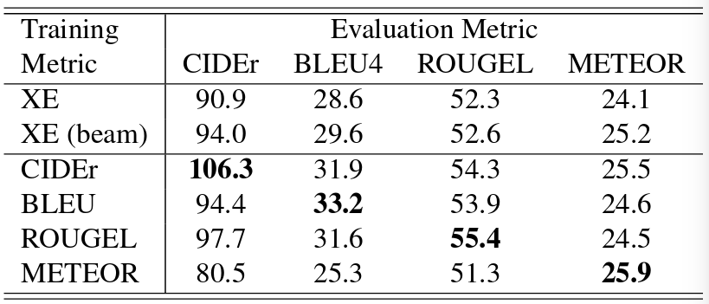
SCST: results
Table: validation score on 4 metrics (columns) for models that optimize crossentropy (supervised) or one of those 4 metrics (scst).
Taken from https://arxiv.org/pdf/1612.00563.pdf

Slide 65
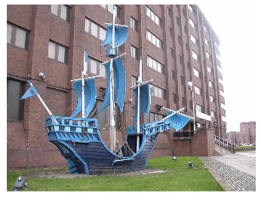
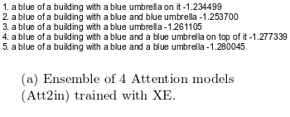
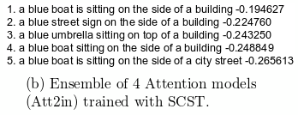
MSCOCO: objects out of context
Taken from https://arxiv.org/pdf/1612.00563.pdf

Slide 66
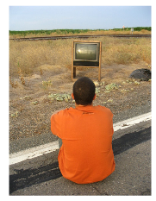
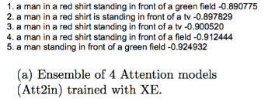
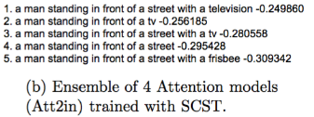
MSCOCO: objects out of context
Taken from https://arxiv.org/pdf/1612.00563.pdf

Slide 67
Common pitfalls
What can go wrong
Make sure agent didn't cheat R(s,a)
  https://openai.com/blog/faulty-reward-functions/
Unlike games, agent can overfit data
  Check validation performance

Slide 68
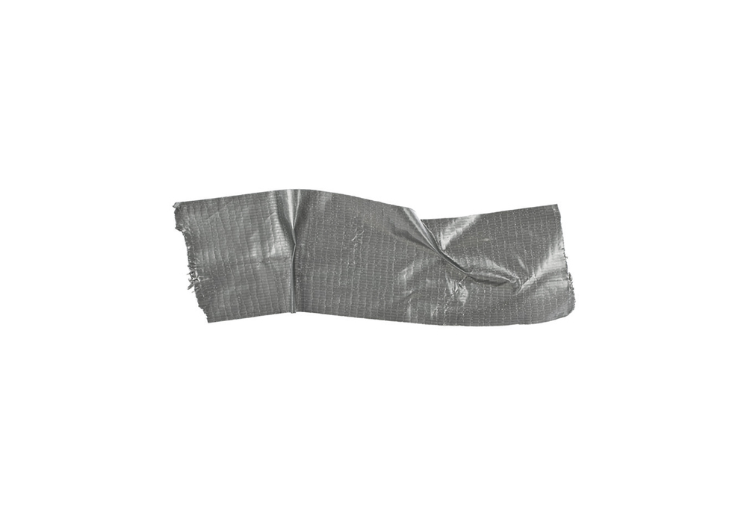
Duct tape zone
Pre-train agent in supervised mode
  RL takes longer to train from scratch
All policy-based tricks apply
  Regularize with entropy / L2 logits
  Better sampling techniques (tree, vine, etc.)
Most seq2seq tricks apply
  Use bottleneck If vocabulary is large
  Some (but not all) softmax improvements

Slide 69
Bonus: exploration for seq2seq
Idea: the main reason we learn are rare actions (sequences) that are better than current baseline
Focus on those under-appreciated actions

Slide 70
Bonus: exploration for seq2seq
Consider “optimal policy”:
Our new objective:

Slide 71
Bonus: exploration for seq2seq
Consider “optimal policy”:
Our new objective:
policy gradient
exploration

Slide 72
Bonus: exploration for seq2seq
Consider “optimal policy”:
Our new objective:
policy gradient
exploration

Slide 73
Bonus: exploration for seq2seq
Ёж, если ты читаешь это, то ты продолбал слайды
arxiv.org/abs/1611.09321

Slide 74
Bonus: discrete GANs
Generalized GAN scheme
noise,
inputs
Generator
G(z)
fake
data
Discriminator
D(x)
P(real)
real
data

Slide 75
Bonus: discrete GANs
Generalized GAN scheme
noise,
inputs
Generator
G(z)
fake
data
dL/dw
dL/dw
Discriminator
D(x)
P(real)
real
data

Slide 76
Bonus: discrete GANs
Standard scheme fails if G(z) is discrete
generating text
generatng music notes
generating molecules
binary image masks
noise,
inputs
Generator
G(z)
fake
data
dL/dw
dL/dw
Discriminator
D(x)
P(real)
real
data

Slide 77
Bonus: discrete GANs
We can train generator with reinforcement learning!

Slide 78
Takeaway
We can fit discrete things with policy gradient:
Notes:
It’s less computation-efficient than backprop
Use SCST and other tricks where possible
There are alternatives (e.g. gumbel-softmax)
  “hard” attention
  discrete loss functions
binary networks
rnn augmentations

Slide 79
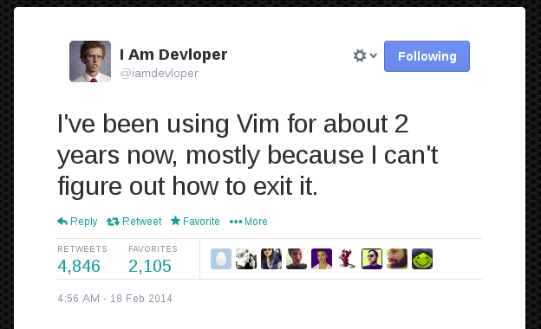
Let's code!

