Slide 1



Reinforcement learning
Episode 9 ¾, 2018
More policy gradients

Slide 2

Continuous action spaces
Regular MDP
Which methods can we use?

Slide 3
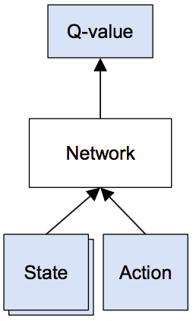
Continuous action spaces
We can learn critic easily
The problem is finding
Worst case: optimize over neural net!

Slide 4
Normalized advantage functions
Idea 1: restrict Q(s,a) so that optimization
becomes trivial
For example, parabola (for 1d action space)
How to find optimal a?

Slide 5
Normalized advantage functions
Idea 1: restrict Q(s,a) so that optimization
becomes trivial
For example, parabola (for 1d action space)
How to find optimal a? - a_opt = mu(s)

Slide 6
Normalized advantage functions
Idea 1: restrict Q(s,a) so that optimization
becomes trivial
For example, parabola (for 1d action space)
Q: How does it generalize for n-dimensional a?

Slide 7
Normalized advantage functions
Idea 1: restrict Q(s,a) so that optimization
becomes trivial
For example, parabola (for 1d action space)
Where L(s) is a lower-triangular matrix

Slide 8
Normalized advantage functions
Network:
(trains end-to-end)
V(s)
(scalar)
μ(s)
(vector)
L(s)
(lower-tri)
model
state
https://arxiv.org/pdf/1603.00748.pdf

Slide 9

Deterministic policy gradient
Idea2: learn a separate network to find a_opt
Train critic
Train actor

Slide 10
Deterministic policy gradient
Idea2: learn a separate network to find a_opt
Train critic
Train actor
How do we get V(s')?

Slide 11
Deterministic policy gradient
Idea2: learn a separate network to find a_opt
Train critic
Train actor

Slide 12
Deterministic policy gradient
actual returns

Slide 13
Deterministic policy gradient
Gradient approximation:
actual returns
critic (approx)

Slide 14
Deterministic policy gradient
Gradient approximation:
actual returns
critic (approx)
sgd updates
init

Slide 15
Going neural
actor
s
a
a
critic
Q(s,a)
s

Slide 16
Duct tape zone
In general
  “Natural” for continuous action spaces
    Discrete: use gumbel-softmax, bit.ly/2v0Xfpz
  Approximation is best around current policy
  Weak critic can introduce bias
vs. REINFORCE
  Better off-policy
  Less variance if reward is smooth
  (subjectively) harder to tune

Slide 17
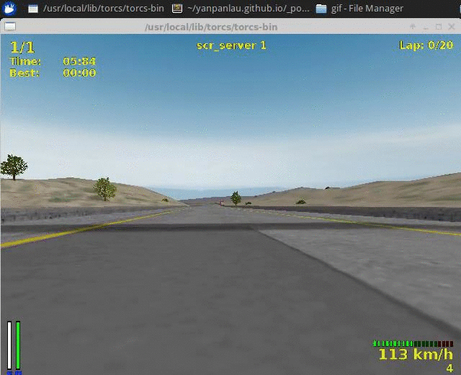
Deterministic policy gradient
Demo with torcs http://bit.ly/2pXwdKa

