Slide 1

UNIT 1
Life is a learning curve

Slide 2
Unit 1 Life is a learning curve
Learning objectives
Opening up
Listening to the world
Speaking for communication
Further practice in listening
Wrapping up
Fun time

Slide 3

Learning objectives
1
talk about learning experiences
2
listen for signal words for listing
3
give and respond to advice
4
talk about learning / teaching methods

Slide 4
Opening up
Read the following quotes about learning. Do you agree with them? Why or why not?
We learn by doing.
— Aristotle
I partly agree with the quote because it is not the only way of learning:
We gain first-hand experience by interacting with the environment ;
We gain second-hand experience by reading books

Slide 5
Opening up
Read the following quotes about learning. Do you agree with them? Why or why not?
A little knowledge is a dangerous thing.
— Albert Einstein
Yes. It is dangerous for a person who knows a little about something thinks he knows it all.

Slide 6
Opening up
Read the following quotes about learning. Do you agree with them? Why or why not?
The best way to learn is to teach.
— Anonymous
Yes. Going through the process of trying to explain something to others will help you understand, absorb and consolidate what you have learned.

Slide 7
Listening to the world
Sharing
Listening
Viewing

Slide 8
Listening to the world
Sharing
1
Watch a podcast for its general idea.
The podcast is mainly about the things people are learning at the moment and the most difficult thing they have ever learned.
2
Watch Part 1 and fill in the blanks.
new things
At the moment
quite difficult

Slide 9
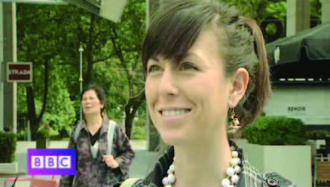
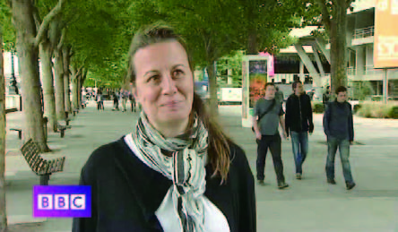

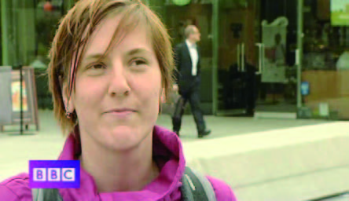
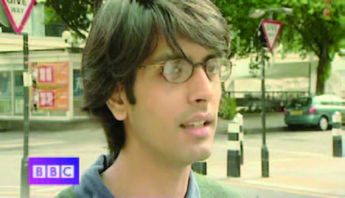
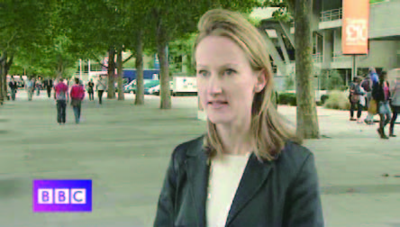
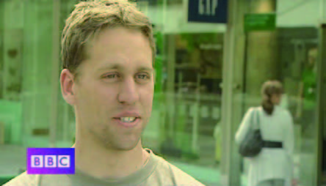
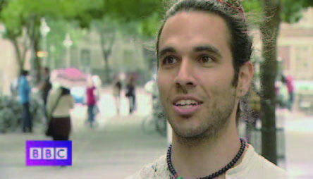
Listening to the world
Sharing
3
Watch Part 2 and check the true statements.
1
√
2
√
A
B
3
4
C
D
5
6
E
F
√
√
8
7
G
H

Slide 10
Listening to the world
Sharing
4
Watch Part 3 and fill in the blanks.
A
B
A：The most difficult thing 1) _________________is Mandarin Chinese. I did it in evening classes a few years ago and I 2) ______ it really, really difficult.
I have ever learned
found
B：Probably capoeira, which is a Brazilian dance, martial art, fight thing. It’s 3) _____________of all these things. And yes, that was very difficult because there were lots of unusual 4)__________________ to learn.
a combination
body movements

Slide 11
Listening to the world
Sharing
4
Watch Part 3 and fill in the blanks.
C
D
Learning to drive
C: 5) ________________was the most difficult thing.
D: Well, I learned some Sanskrit, and that’s got um, 6)________________ two more than Latin. It’s quite difficult 7)__________________.
nine cases
by most standards

Slide 12
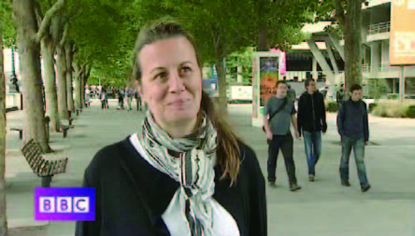
Listening to the world
Sharing
3
Watch Part 3 and fill in the blanks.
E
F
French
I think I found 8)___________ very hard at school.
Um, I learned to play the trumpet at school. That was pretty difficult. Er … and maybe learning to drive. I 9)___________ learning to drive.
hated

Slide 13
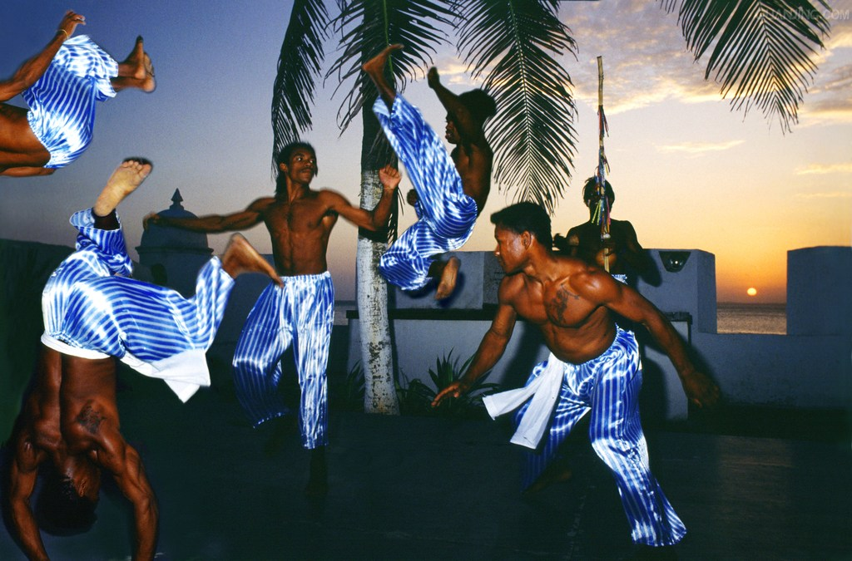
Listening to the world
Sharing
3
Watch Part 3 and fill in the blanks.
Additional Notes
capoeira A Brazilian folk dance created by descendants of slaves from Angola. It combines elements of dance, music, and martial arts, known for quick and complex moves using power, speed, and leverage for leg sweeps.

Slide 14

Listening to the world
Additional Notes
Sanskrit one of the oldest, and also the most famous and culturally important Indic languages. It was used by the refined and cultured members of ancient Indian society, and continues to be used today in religion and certain types of high discourse. Sanskrit is of tremendous importance for Hindus because many Hindu religious texts are written in it.

Slide 15
Listening to the world
Sharing
5
Work in pairs and discuss the question.
1 What are you learning at the moment? Do you enjoy learning it? Why?
I am learning yoga at the moment. I enjoy it because it helps improve my flexibility, strength and balance.
2 What’s the most difficult thing you’ve ever learned? Why?
The most difficult thing for me is learning to drive, because I was overwhelmed with all the things I was asked to do at the same time.

Slide 16

Listening to the world
Sharing
5
Work in pairs and discuss the question.
3 What do you enjoy learning most? Why?
I enjoy learning how to use new technology, because new technology makes my life convenient and comfortable.

Slide 17
Listening to the world
Sharing
Listening
Viewing

Slide 18
Listening to the world
Listening
BEFORE you listen
1
Discuss the questions.
1 What difficulties have you encountered while learning English?
First of all, I had a limited vocabulary.
Secondly, I had difficulty understanding authentic listening materials.

Slide 19
Listening to the world
Listening
BEFORE you listen
1
Discuss the questions.
2 What advice did you receive as to how to deal with these difficulties?
I was advised to carry around a notebook.
I was also advised to watch English movies with English subtitles.

Slide 20
Listening to the world
Listening
BEFORE you listen
1
Discuss the questions.
3 How did you finally overcome these difficulties?
I read a lot of English newspapers and magazines.
I tried to listen to the news, listen to podcasts, and watch English television and movies as much as possible.

Slide 21
Listening to the world
Listening
Listening skills
Additional Tips
Listening for signal words for listing Listen for the total number of items at the beginning Listen for words and expressions that signal the beginning, following and end of the listing e.g. the last, the final, lastly, and finally Listing items with equal value e.g. to begin with, to start with, furthermore, moreover, in addition, besides, what’s more, the last but not the least, lastly, finally

Slide 22
Listening to the world
Listening
Listening skills
Additional Tips
Listening for signal words for listing Words and expressions indicating importance expressions: above all, the most important / obvious / noteworthy Adjectives: main, vital, significant, chief, central, principal, primary, major, distinctive, and the –est forms of adjectives

Slide 23

Listening to the world
Listening
WHILE you listen
2
Listen to a radio program and rearrange the following expressions.
e-c-a-g-d-h-b-f

Slide 24
Listening to the world
Listening
WHILE you listen
3
Listen to the radio program again and complete the table.
1) speak
2) saying the wrong thing
3) practice speaking / talking to himself
4) making mistakes
5) native speakers
6) pronunciation
7) listening skills
8) listening and reading

Slide 25
Listening to the world
Listening
WHILE you listen
4
Fill in the blanks.
1 Embarrassed; hear
2 anything you like; going for the weekend
3 Voice; pronunciation
4 how it sounds; the news; English television
5 on the internet
6 sound like; native speaker

Slide 26
Listening to the world
Listening
After you listen
5
Read the website message below and think of three things Tomasz can do to improve his English.
chatting with native speakers of English
watching English movies with English subtitles
visiting English websites to read the news

Slide 27
Listening to the world
Listening
After you listen
6
Read the replies and discuss. Which items have you thought of? Which ideas do you think are the most useful ones?
I’ve thought of and even tried all of them. I think reading news websites, watching English movies and talking to someone who speaks English are the most useful ideas.
Visiting English websites is a good way to improve my reading skills.
Watching English movies helps me improve listening skills.
Chatting with people helps improve my spoken English greatly.

Slide 28
Listening to the world
Sharing
Listening
Viewing

Slide 29
Listening to the world
Viewing
BEFORE your view
1
Read the program information below and check the true statements.
Every 11-year-old
1 In 1932, all adults in Scotland did an intelligence test.
2 Many of the same people do the test again nearly 70 years later
3 The program can tell us how to live longer.
√
About the type of people who live the longest

Slide 30
Listening to the world
Viewing
WHILE your view
2
Read the statements. Then watch the video clip and underline the correct alternative.
1 The results of the 1932 test were
2 the same as they were in 1932
3 the exam they have done
4 well

Slide 31

Listening to the world
Viewing
WHILE your view
3
Read the statements and the answer choices. Then watch the video clip again and choose the best answers.
1 D
2 A
3 B
4 A
5 D

Slide 32
Listening to the world
Viewing
AFTER your view
4
Discuss the questions.
1 What do you think of the view “Intelligence must be bred, not trained”?
I think the view is biased
Now research has shown that both nature and nurture play a role in intelligence.
This view states that intelligence is determined by a person’s genes and psychological attributes.
The nurture view states that intelligence is formed from personal experience and developed through education and exposure to the world.

Slide 33
Listening to the world
Viewing
AFTER your view
4
Discuss the questions.
2 In your opinion, what factors affect intelligence?
I think intelligence is determined by genes and environmental factors such as nutrition, education, family background, living standards, parenting style, etc.

Slide 34
Listening to the world
Viewing
AFTER your view
4
Discuss the questions.
3 How does your intelligence change as you get older? Why?
I think my intelligence grows progressively as I get older by interacting with the natural environment and various kinds of people around us.

Slide 35
Speaking for communication
Role-play
1
Read the statements. Then listen to a conversation and check the true statements..
1 Both of the speakers agree that studying with friends is more motivating.
2 The woman thinks that talking to someone while reading notes helps her concentrate.
3 Eating a lot before an exam always makes the speakers feel sleepy in the exam.
4 The woman always try to sleep for eight hours the night before an exam.
√
√

Slide 36

Speaking for communication
Role-play
2
Read the table. Then listen to the conversation and write G for giving advice and R for responding to advice in the right column.
1 G
2 R
3 G
4 R
5 G
6 R
7 R

Slide 37
Speaking for communication
Role-play
Speaking skills
Additional Tips
Giving and responding to advice Giving and responding to advice in an appropriate way are useful and important speaking skills.
Expressions for giving advice
Why don’t you…? My( main/personal) recommendation/suggestion/ is/would be… If that happened to me/ If I were in your place/ if I were you/ In that case, I’d recommend… Do you think it is a good idea…? The sooner you…the better. …might work/ would probably work/is worth a try. If you ask me/ The way I see it, it probably would have been better(not) to have…

Slide 38
Speaking for communication
Role-play
Speaking skills
Additional Tips
Expressions for responding to advice
• Thank you, I’ll take that into consideration. • Thanks. That sounds good/interesting. I hadn’t thought of that before. Thank you so much for offering that advice. Thank you for the advice. I’ll try… Maybe you’re right. Thanks for saying that.

Slide 39
Speaking for communication
Role-play
3
Look at the pictures and read the conversations below. Then fill in the blanks using the words in brackets.
1 you should eat; a good
2 should not spend; You’re
3 Why don’t; am not sure that’s
4 it’s a good; suppose to

Slide 40
Speaking for communication
Role-play
5
Role-play the situations.
Situation 1
What should I do about my son?
B: How was your weekend?
A: I spent the whole weekend… tired
B: Why don’t you ask your son to give you a hand?
A: He needs to study …
B: I think you should let him do some housework.
A: You are right. But … misses lessons…
B: I think you should have a talk with him.
A: I agree with you. He went out …
B: If I were you, I’d talk with him as soon as possible.
A: You are right.

Slide 41
Speaking for communication
Role-play
4
Role-play the situations.
Situation 2
My flatmate is driving me crazy!
B: Many expensive clothes … Has she got lots of money?
A: She borrowed money from me …
B: Has she paid you back?
A: No …
B: I think you really need to have it back?
A: I think so, but how …?
B: Have you tried asking her to sell the clothes she never wears?
A: That’s a good idea.

Slide 42
Speaking for communication
Role-play
4
Role-play the situations.
Situation 3
Should I help my friend find a girlfriend?
A: Bob is getting even fatter...
B: I think he should go to the gym…
A: Right. Also, Bob buys takeaway meals.
B: Then perhaps he should try to change his diet.
A: Good idea. Bob likes watching TV.
B: I really think he should change his way of living.
A: Exactly. I think he probably should change his job.
B: That’s a good idea.

Slide 43



Speaking for communication
Group discussion
Get ideas
1
Read Passages for information.
Learning by listening
Starting young
Homeschooling

Slide 44
Speaking for communication
Group discussion
Discuss and organize ideas
2
Take notes in the table
Methods | Differences | Likes | Dislikes
Learning by listening
• No textbooks, tests, exams.
• Learn by music.
• Learn gardening and how to concentrate.
• Don’t have to learn to read and write at an early age.
• No tests or exams.
• Learn by music.
• Don’t have to learn to read and write at an early age.
• Have to go to special music and body movement classes to learn to concentrate.

Slide 45
Speaking for communication
Group discussion
Discuss and organize ideas
2
Take notes in the table
Methods | Differences | Likes | Dislikes
Starting young
• begin to learn music as young as possible.
• Even two-year-olds can play difficult music.
• practice for hours every day and give a performance every week.
•Even two-year-olds can play difficult music.
•practice for hours every day and give a performance every week.

Slide 46
Speaking for communication
Group discussion
Discuss and organize ideas
2
Take notes in the table
Methods | Differences | Likes | Dislikes
Home schooling
• Don’t have to go to school or follow school rules.
• Choose subjects they like.
• Choose when to work.
• Choose subjects they like.
• Choose when to work.
• Don’t have to go to school, so have little chance to socialize with peers.

Slide 47
Speaking for communication
Group discussion
Discuss and organize ideas
3
Decide together the best and worst methods.
Best | Worst
Method: homeschooling
Reason:
freedom of choosing subjects they want to study;
freedom of choosing to work when they feel like it;
beneficial for their physical and mental development
Method: starting young
Reason:
too much for small children;
practice for hours every day;
give a performance once a week;
a stressful life in a competitive environment;
have potential harmful effects

Slide 48
Speaking for communication
Group discussion
Present ideas
4
Present your ideas to the class.
The method we enjoy most is homeschooling because children enjoy the freedom of choosing which subjects they want to study and choosing to work when they feel like it. And we believe a relaxing and intellectually-stimulating environment is beneficial for the physical and mental development of children.
The method we dislike most is starting young because the children have to practice for hours every day and give a performance once a week. We think children at such a young age should not be forced to experience such a stressful life in a competitive environment, which may have potential harmful effects on their future development.

Slide 49
Further practice in listening
Short conversations
1 Q: What can we learn from the conversation?
B The woman should seek help from the writing center.
2 Q: Why does the woman choose to learn French?
D She thinks speaking French is a must for cultured people.
3 Q: What did the man do last night?
D He attended a speech.
4 Q: What made Melissa unhappy?
C That she lost her chance to enter the contest.
5 Q: What does the man think of the woman’s opinion?
A It is one-sided.

Slide 50
Further practice in listening
Long conversation
1 Q: How is the woman doing in the man’s class?
C She often fails to turn in her homework on time.
2 Q: What does the woman think of learning Spanish?
D It presents difficulty for her.
3 Q: What do we know from this conversation about the man?
A He has a good personal relationship with the woman.
4 Q: What is the woman most likely to do after talking with the man?
C Work harder in her Spanish class.

Slide 51
Further practice in listening
Passage 1
1 Q: What do you know about the speaker’s Spanish learning experience in high school?
D She showed dissatisfaction with the slow pace of her class.
2 Q: What made the speaker feel more frustrated while learning Spanish in high school?
A She had to learn the material that she already knew.
3 Q: What did the speaker say about her study of Spanish literature in college?
C It proved to be an unbalanced way to learn the language.
4 Q: Which experience benefited the speaker most in terms of her use of Spanish?
D She taught Spanish speakers how to speak English.

Slide 52

Further practice in listening
Passage 2
1) alternative
2) numerous
3) traditional
4) academic
5) countryside
6) athletes
7) take advantage of
8) Secondary
9) in a collective effort
10) serve as

Slide 53
Wrapping up
Use the following self-assessment checklist to check what you have learned in this unit.
Skills | OK | Needs work
I can talk about my learning experiences.
I can listen for signal words for listing.
I can give and respond to advice.
I can discuss learning / teaching methods.

Slide 54
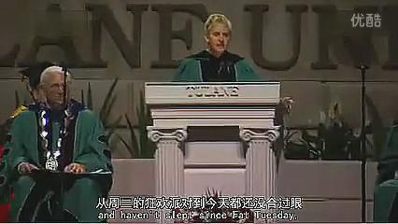
Fun time
Enjoy Ellen DeGeneres’ Commencement Speech at Tulane University .

