Slide 1
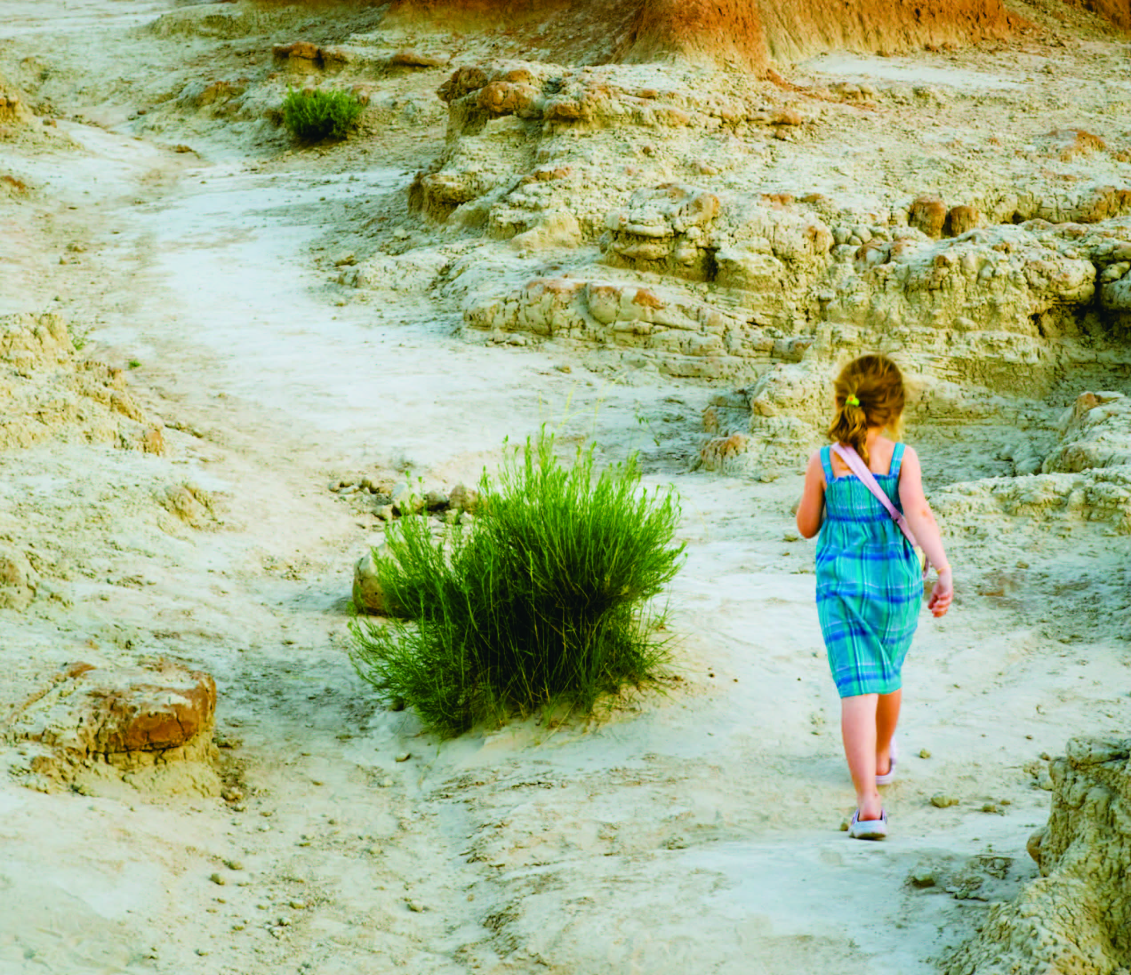
UNIT 2
Journey into the unknown

Slide 2
Unit 1 Traces of the past
Learning objectives
Opening up
Listening to the world
Speaking for communication
Further practice in listening
Wrapping up
Fun time

Slide 3

Learning objectives
1
talk about your own traveling experiences
2
understand the problem-solution pattern
3
ask for and give directions
4
make a plan for a dream journey

Slide 4
Opening up
What does each of the following quotes mean? Do you agree with them? Why or why not?
The real voyage of discovery consists not in seeking new landscapes, but in having new eyes.
— Marcel Proust
It means that real discovery doesn’t necessarily come from seeking new things; it lies in seeing things from new perspectives.
Yes. If we pay more attention to the details of our surroundings, we may discover something “new” from our daily routine.

Slide 5
Opening up
Read the following quotes about learning. Do you agree with them? Why or why not?
When you travel, if you reject the food, ignore the customs, fear the religion and avoid the people, you might better stay home.
— James Albert Michener
It means that a mature traveler should be ready to become part of the local culture.
Yes. Being an open-minded traveler will help us gain a multicultural perspective.

Slide 6
Opening up
Read the following quotes about learning. Do you agree with them? Why or why not?
The world is a book, and those who do not travel read only one page.
—St. Augustine
It means that if we never go traveling, we’ll have a very limited view of the world.
No. With the development of modern technology, traveling is no longer the only means for us to broaden our mind.

Slide 7
Listening to the world
Sharing
Listening
Viewing

Slide 8
Listening to the world
Sharing
1
Watch a podcast for its general idea.
The podcast is mainly about people’s traveling experiences and what they like and don’t like about traveling.
2
Watch Part 1 and fill in the blanks.
different countries
home
new places
new cultures

Slide 9
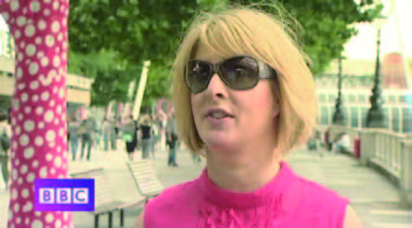
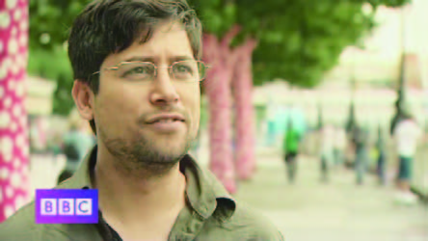
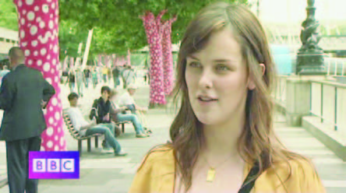
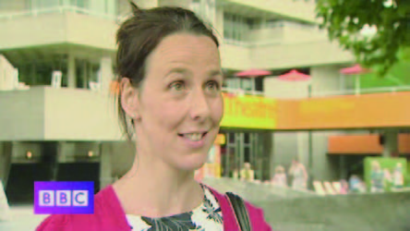
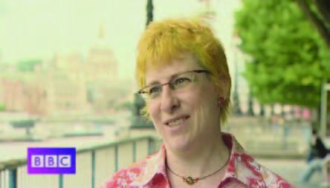
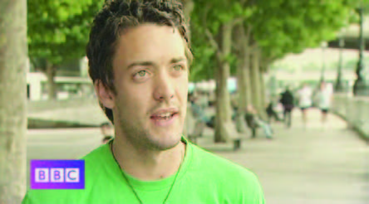
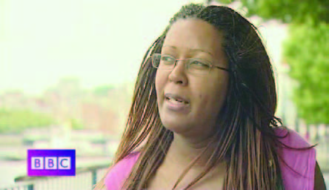
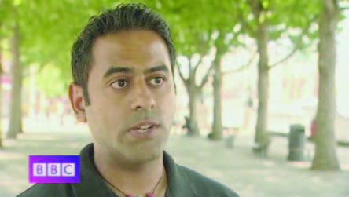
Listening to the world
Sharing
3
Watch Part 2 and check the true statements.
1
2
√
A
B
3
√
4
C
D
√
6
5
E
F
7
8
G
H

Slide 10
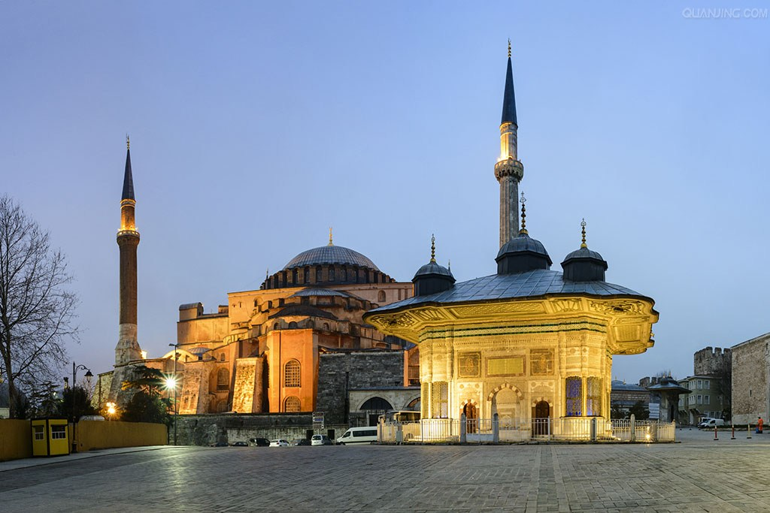
Listening to the world
Sharing
4
Watch Part 2 and check the true statements.
Additional Notes
Istanbul the largest city in Turkey, constituting the country’s economic, cultural and historical heart. Famous tourist attractions include Byzantine churches, Ottoman palaces, Aya Sofya, the Blue Mosque, the Basilica Cistern, and the Grand Bazaar.

Slide 11
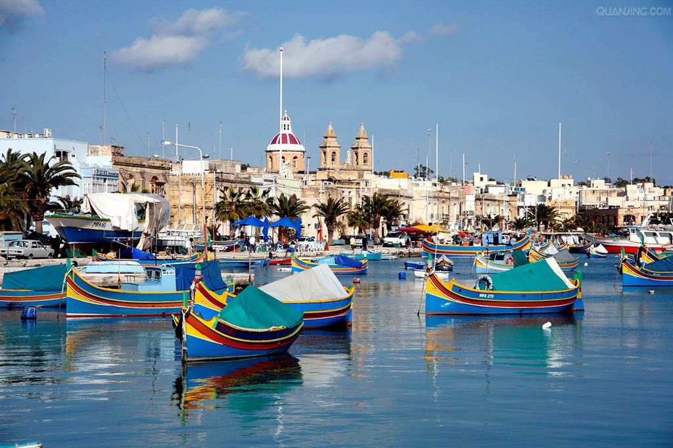
Listening to the world
Additional Notes
Malta a Southern European country situated in the center of the Mediterranean. Renowned for its Blue Lagoon, the island’s baroque towns and prehistoric ruins also deserve a visit. The Maltese capital, Valletta, is a historical time capsule. It is thick with Italianate churches and golden limestone buildings.
Marsaxlokk Bay is the best place to see Luzzus, brightly colored traditional Maltese fishing boats, with their mythical eye painted on the prows. The Sunday fish market offers a glimpse of traditional island life and the harbor side restaurants serve excellent fish dishes.

Slide 12
Listening to the world
Sharing
4
Watch Part 3 and fill in the blanks.
mature
airport
theater
scenery
culture
language

Slide 13
Listening to the world
Sharing
5
Watch Part 4 and match the statement 1-6 to the people A-F.
1 B
2 A
3 E
4 C
5 F
6 D

Slide 14
Listening to the world
Sharing
6
Work in pairs and discuss the question.
1 Do you like traveling? Why or why not?
• I like traveling a lot.
It is a good experience since it helps people escape from the pressure of city life and the boredom of daily routine.
What’s more, the contact with different cultures helps broaden the mind and probably change our way of living and thinking.
• I don’t like traveling. I like the stability and the secure, warm feeling of home, which make me feel comfortable.

Slide 15
Listening to the world
Sharing
6
Work in pairs and discuss the question.
2 Have you traveled much? Where have you been? What did you like most?
I haven’t traveled much so far, but the backpacking trip I had in Yunnan is an unforgettable experience.
What I liked most was to drift along the river on a bamboo raft. It seemed to me that the river had a life of its own with the current either drifting in leisure or raging forward with force.

Slide 16
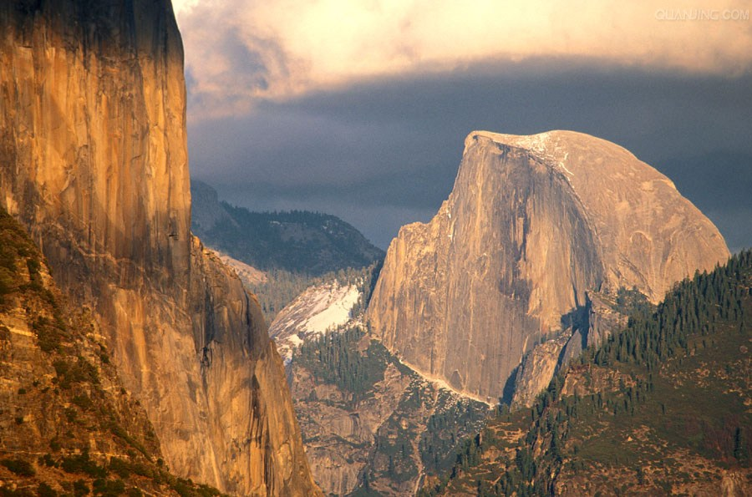
Listening to the world
Sharing
5
Work in pairs and discuss the question.
2 If you can afford the money and time, which place(s) would you love to go? Why?
I would choose to go to the American West, to visit the deserts, the canyons, and the mountains, and to totally get immersed into the wilderness.
Probably only by going deep into nature can we truly find our true self, our real value, and our relation with others and the world.

Slide 17
Listening to the world
Sharing
Listening
Viewing

Slide 18
Listening to the world
Listening
BEFORE you listen
1
Discuss the questions.
1 What do you know about Venice?
Venice is a great tourist destination in Italy, which is famous for its architecture and its artworks.
It is a city built on small islands separated by canals and linked by bridges. That is why it is the only city which has no cars, and people use gondolas to travel around.

Slide 19
Listening to the world
Listening
BEFORE you listen
1
Discuss the questions.
2 Venice is a city in danger. What do you think the major problem might be?
As far as I know, Venice has been sinking slowly and is still sinking slowly. That is a major problem threatening Venice right now.

Slide 20
Listening to the world
Listening
Listening skills
Additional Tips
Understanding the problem-solution pattern The pattern consists of four sections: 1) Situation: the background information about the problem; 2) Problem: the problem, dilemma, puzzle, and obstacle the speaker is going to address; 3) Solution: the proposed, attempted, or actual solution to the problem; 4) Evaluation: the positive or negative evaluation of the solution.

Slide 21
Listening to the world
Listening
WHILE you listen
2
Listen and answer the questions.
1 What problem is Venice facing now?
The city is slowly sinking.
2 How serious is the problem?
Venice is sinking at a rate of two and a half inches every decade.
3 What measure is being adopted to save the city?
Barriers are being put in to try and stop the water getting too high.

Slide 22
Listening to the world
Listening
WHILE you listen
2
Listen and answer the questions.
4 How does the speaker think of the measure?
It is a temporary measure.
5 What advice does the speaker give in order to save the city?
Put pressure on the government to spend the money it needs to find a permanent solution to the problem.

Slide 23
Listening to the world
Listening
WHILE you listen
3
Listen and check the true statements.
14th
1 Ever since the 15th century.
2 There are as many as 40 floods in Venice between May and September every year.
3 What measure is being adopted to save the city?
4 What does the speaker think of the measure?
5 What advice does the speaker give in order to save the city?
March
√
√
√

Slide 24
Listening to the world
Listening
AFTER you listen
4
Discuss the questions.
1 Can you think of any other problems threatening tourist cities around the world?
One problem facing the UNESCO world heritage sites is the pressure of mass tourism. Places that didn’t see a lot of tourists are now struggling to accommodate the surge in tourists after getting the world heritage status.

Slide 25
Listening to the world
Listening
AFTER you listen
4
Discuss the questions.
2 In your opinion, what measures should be taken to tackle the above problems?
I think limiting the number of visitors to these world heritage sites will be an effective solution. For example, the Mogao Caves in remote Northwestern China set a limit on the number of visitors that are allowed into the place per day.

Slide 26
Listening to the world
Sharing
Listening
Viewing

Slide 27
Listening to the world
Viewing
BEFORE you view
1
Read the program information below and answer the questions.
1 What do you know about the five places mentioned in the following program information?
Bangkok, Cape Town, the Grand Canyon, the Masai Mara, and Paris.

Slide 28
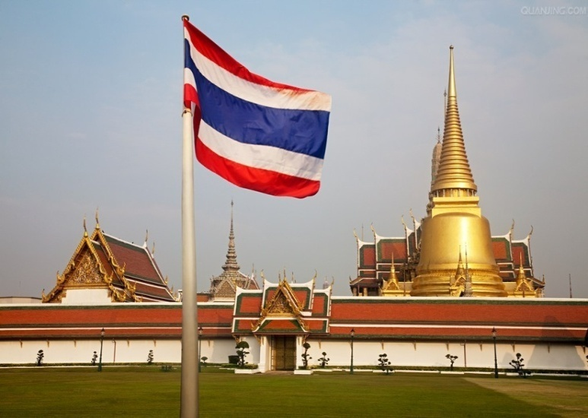
Listening to the world
Viewing
BEFORE you view
1
Read the program information below and answer the questions.
Bangkok
Bangkok is the capital and the largest city of Thailand. It is a popular tourist destination with high-rise buildings, lots of temples, intense heat, and vibrant nightlife.

Slide 29
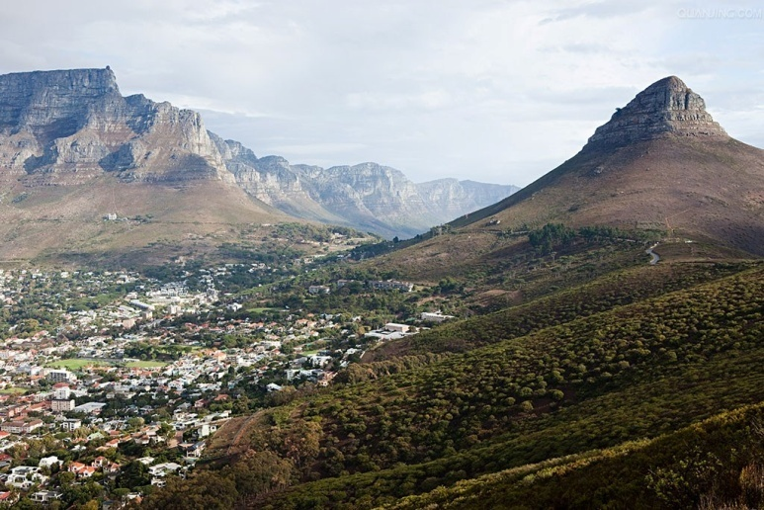
Listening to the world
Viewing
BEFORE you view
1
Read the program information below and answer the questions.
Cape Town
Cape Town is the most southern city in Africa, and one of Africa’s most popular tourist destinations.

Slide 30
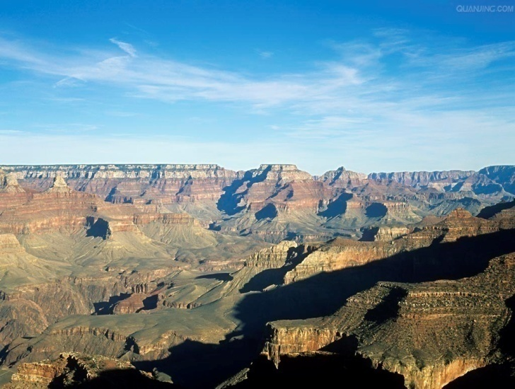
Listening to the world
Viewing
BEFORE you view
1
Read the program information below and answer the questions.
The Grand Canyon
The Grand Canyon is a magnificent canyon in the state of Arizona, America. It is one of the Seven Natural Wonders of the World.

Slide 31
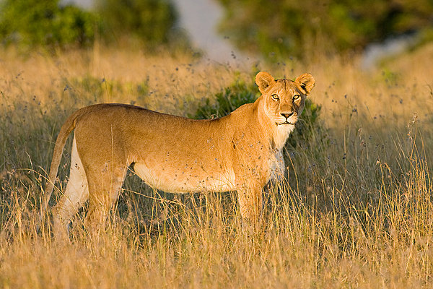
Listening to the world
Viewing
BEFORE you view
1
Read the program information below and answer the questions.
The Masai Mara
The Masai Mara is a reserve for a vast variety of wild animals in Africa.

Slide 32
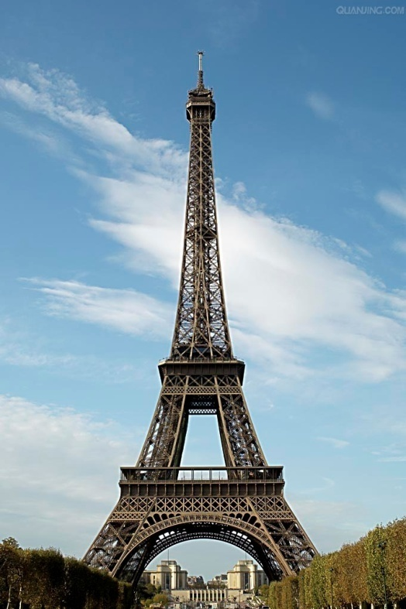
Listening to the world
Viewing
BEFORE you view
1
Read the program information below and answer the questions.
Paris
Paris is the capital of France, with the reputation of being the most beautiful and romantic of all cities. It is a popular tourist destination and the Capital of Fashion, attracting the finest and most luxurious fashion designers around the world.

Slide 33
Listening to the world
Viewing
BEFORE you view
1
Read the program information below and answer the questions.
1 What place do you think is the number one place to see?
I think Paris is the number one place I want to see.
I want to see those famous tourist sites such as the Eiffel Tower, the Arc de Triomphe, the Notre-Dame de Paris, the Louvre Museum, etc.
I also want to try delicious French food and go shopping in the Capital of Fashion.

Slide 34
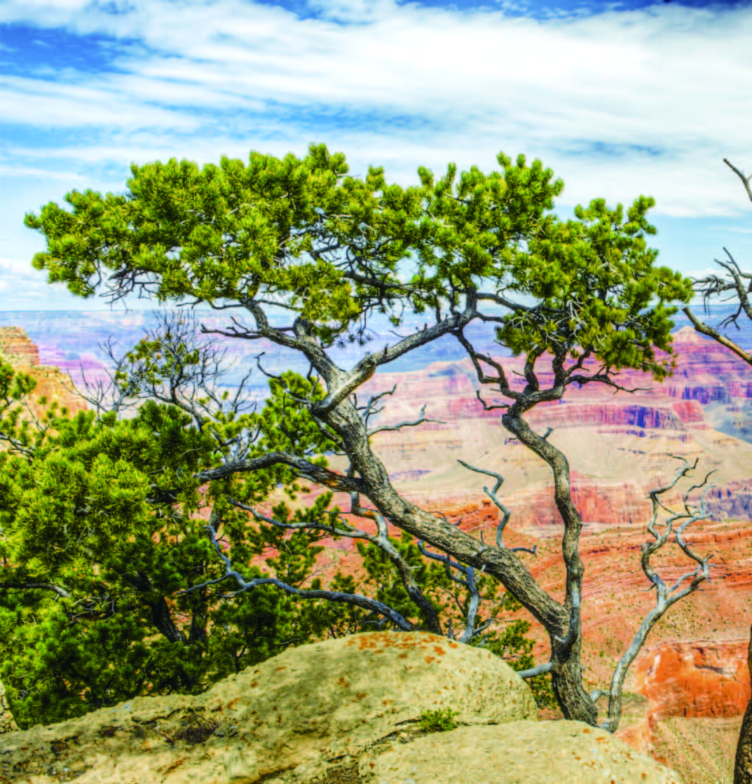
Listening to the world
Viewing
WHILE you view
2
Read the statements. Then watch the video clip and choose the best answers.
1 D
2 B
3 B
4 C
5 D

Slide 35
Listening to the world
Viewing
WHILE you view
3
Watch the video clip again and fill in the blanks.
1 busy; shopping
2 bars; need
3 spaces; friendliness
4 elegant; expensive
5 views
6 beaches; cheap
7 changing; sunset
8 cried

Slide 36
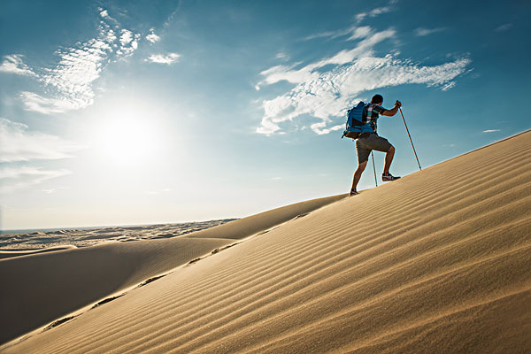
Listening to the world
Viewing
AFTER you view
4
Discuss the questions.
1 Which places in the world would you like to visit? Make a list of three places and give your reasons.
The three places we would like to visit are Bali Island, Sydney and Niagara Falls.

Slide 37
Listening to the world
Viewing
AFTER you view
4
Discuss the questions.
1 Which places in the world would you like to visit? Make a list of three places and give your reasons.
Bali Island
It has varied landscape of hills and mountains, rugged coastlines, long sandy beaches, warm blue water, lush rice terraces, dense tropical jungle, barren volcanic hillsides;
It has world-class surfing and diving, and a large number of cultural, historical and archaeological attractions

Slide 38
Listening to the world
Viewing
AFTER you view
4
Discuss the questions.
1 Which places in the world would you like to visit? Make a list of three places and give your reasons.
Sydney
Sydney is a dynamic city and we love its verve and vibrancy, its beautiful harbor, its iconic Sydney Harbor Bridge and Sydney Opera House, and myriad waterways.
It is also an adventure playground with a wide variety of activities, such as the Bondi surf, sailing under the Harbor Bridge on a yacht, jogging along the Coogee cliff tops or rampaging through Centennial Park on horseback.

Slide 39
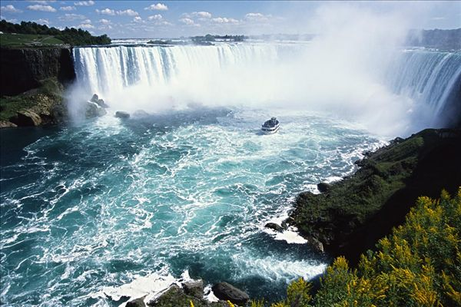
Listening to the world
Viewing
AFTER you view
4
Discuss the questions.
1 Which places in the world would you like to visit? Make a list of three places and give your reasons.
Niagara Falls
Niagara Falls is one of the world’s natural wonders, with millions of gallons of water rocketing over the falls every minute.

Slide 40
Listening to the world
Viewing
AFTER you view
4
Discuss the questions.
2 Which attracts you more: a natural or a cultural landscape? Why?
I prefer a natural landscape. Getting in touch with Mother Nature can take my worries away, and make me come back refreshed and energized with a renewed sense of being and purpose.
I prefer a cultural landscape to a natural landscape. Cultural landscape represents the combined works of nature and man, displaying the harmony between humankind and the environment.

Slide 41
Listening to the world
Viewing
AFTER you view
4
Discuss the questions.
3 How does your intelligence change as you get older? Why?
I think my intelligence grows progressively as I get older by interacting with the natural environment and various kinds of people around us.

Slide 42
Speaking for communication
Role-play
1
Listen to three conversations and check the true statements.
Doesn’t need
1 The inquirer in Conversation 1 needs to take a bus to go to the carnival.
2 The inquirer in Conversation 2 learns that the cinema is just beside the Plaza Hotel.
3 The inquirer in Conversation 3 will see a restaurant before arriving at the Grand Motel
Is not
√

Slide 43

Speaking for communication
Role-play
2
Read the table. Then listen to the conversation and complete the table.
1) trying to get to
2) takes about 10 minutes
3) looking for
4) right way
5) take the first left
6) until you reach
7) want to get to
8) Is it far
9) Go left
10) on the left

Slide 44
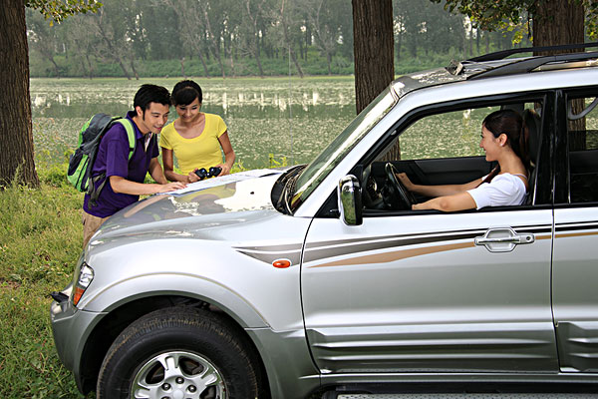
Speaking for communication
Role-play
Speaking skills
Additional Tips
Asking for and giving directions Asking for directions is a useful speaking skill in our daily life, especially for those people who are new to a place.
Asking for directions
Note: You should start your questions with Excuse me, Could you help me … ? Or Please … when you ask questions. Otherwise people may think you are rude.

Slide 45
Speaking for communication
Role-play
Speaking skills
Additional Tips
Asking for and giving directions
Giving directions
Useful expressions for giving directions to drivers: Make a U-turn on the one-way street at the next junction. Take the freeway south and turn off at the fourth exit. Drive south on Highway No. 9 and leave the highway at the third exit. Drive straight along the road, through the roundabout. Then follow the signs at the traffic lights. | Useful words for giving directions to drivers: Roads: highway, freeway, walkway, boulevard, avenue Signs: traffic lights, junction, roundabout, U-turn, one way sign, turn, stop

Slide 46
Speaking for communication
Role-play
5
Role-play the situations.
Situation 1
I can’t find my way!
1 A: Excuse me, how can I get to a nightclub called Risky Business? B: Go along London Road, past a crossing till you reach Madrid Street on your right. Keep going on Madrid Street, and you will find Risky Business on your left.
2 A: Excuse me, would you please show me the way to a restaurant called The Waterfall?
B: The Waterfall is on the corner of London Road and Dublin Street. Go along London Road till you reach the crossing. Take a left turn and the restaurant is on the right.

Slide 47
Speaking for communication
Role-play
5
Role-play the situations.
Situation 1
I can’t find my way!
3 A: Excuse me, I’m looking for the Screen by the Pond cinema. Would you help me? B: Sure. Go down on London Road till you reach Lima Avenue. Take the left turn, go past the Florist, and you will see the cinema on your left. You won’t miss it!
4 A: Excuse me, would you please give me the directions to the Museum of Fashion and Design?
B: No problem. Take the second turning on the left. Go along Paris Walk, and you will find the museum on your left.

Slide 48
Speaking for communication
Role-play
5
Role-play the situations.
Situation 2
Can you show me the direction
1 A: Excuse me, would you please show me the way to The Ferry Theater? B: Go along London Road, and turn right at the crossing. Keep going for about 10 minutes, and you will find the theater on your left.
2 A: Excuse me, would you please tell me how to go to the Concert Hall?
B: Um … the Concert Hall. Yes, take the second turning on the left. Keep going on Paris Walk, go past a building, cross a bridge and you will see the Concert Hall on your left.

Slide 49
Speaking for communication
Role-play
5
Role-play the situations.
Situation 2
Can you show me the direction
3 A: Excuse me, can you help me? I’m looking for a bar called The Consultants’ Rescue. B: Go straight on London Road till you see the Florist on your left. Go past the Florist and take a left turn on to Lima Avenue. Keep going and you will find the bar on your right.
4 A: Excuse me, would you please give me the directions to the Museum of Fashion and Design?
B: No problem. Take the second turning on the left. Go along Paris Walk, and you will find the museum on your left.

Slide 50
Speaking for communication
Group discussion
Get ideas
1
Listen and fill in the blanks.
Isolated
far
plane
three months
Culture
way of life
speak to
find out
history
dreams

Slide 51
Speaking for communication
Group discussion
Discuss and organize ideas
2
Discuss and fill in the table
When
Where
How
How long
Who
What
Why
This winter
New Zealand
By air
my family and friends
Two weeks
enjoy beautiful landscapes; eat fresh food; meet friendly people; and talk with kiwi natives and fellow travelers
a wonderful destination; a self-drive tour; a video about the life and people in New Zealand

Slide 52
Speaking for communication
Group discussion
Present ideas
4
Present your ideas to the class.
I would like to go to New Zealand with my family and some friends this winter. New Zealand is one of those countries with the greatest and most spectacular natural landscapes in the world. It’s our dream destination. We are going to travel there by plane and the trip is going to take two weeks. We will fly to Auckland first and then fly to Christchurch. Once we get there, we will rent a car and drive to different places. On the way we hope to enjoy varied and beautiful landscapes, eat fresh food, meet friendly people, and if possible, talk with kiwi natives to find out about their customs and traditions. We will also try to talk with fellow travelers from all over the world to see what they think of the culture and life in New Zealand. When we finish the whole journey, we will drive back to Christchurch, and fly to Auckland and then back to China.

Slide 53
Speaking for communication
Group discussion
Present ideas
4
Present your ideas to the class.
We have every reason to believe that we will win the award. First, we choose a wonderful destination which will impress visitors with its various and breathtaking views and its unique culture. Second, we choose a self-drive tour over a package tour, which means that we don’t have to be shunted along with lots of other people to tourist attractions. We have the freedom and flexibility to get to places off the track, and then spend as much time as we want there. Third, during the journey, we will film the wonderful natural landscapes as well as our talks with local people and foreign visitors. We are sure this video will not only record those beautiful and memorable moments in our dream journey, but also help us gain insight into the customs and lifestyle of people in New Zealand.

Slide 54
Further practice in listening
Short conversations
1 Q: What does the woman say about a whole package tour?
A It costs less money.
2 Q: What are the two speakers planning to do?
D Have their daughter get to know such a life.
3 Q: What will the woman do?
B Follow the Indian culture and cutoms.
4 Q: What does the woman feel uncertain about?
C Whether it is possible to travel with her kid.
5 Q: What are the two speakers talking about?
D The popularity of time travel stories.

Slide 55
Further practice in listening
Long conversation
1 Q: What does Emily say about the plants in the Amazon rainforest?
A There are so many plants that it is hard to see the sky.
2 Q: What does Emily say about the local people?
D They are separated from the world outside of the jungle .
3 Q: Why was the old woman in the village so excited?
C Because Emily gave her an empty bottle.
4 Q: What is the woman most likely to do after talking with the man?
A Small and common things should also be valued.

Slide 56
Further practice in listening
Passage 1
1 Q: What may happen to children after watching nature programs on TV?
D They may be more distant from the actual nature.
2 Q: How should children get close to nature according to the speaker?
A By experiencing it with the five senses.
3 Q: What impression might the Discovery Channel leave on children?
B Nature seems very far away from them.
4 Q: What is the main idea of this passage?
D Real nature experiences com from physical contact with nature.

Slide 57
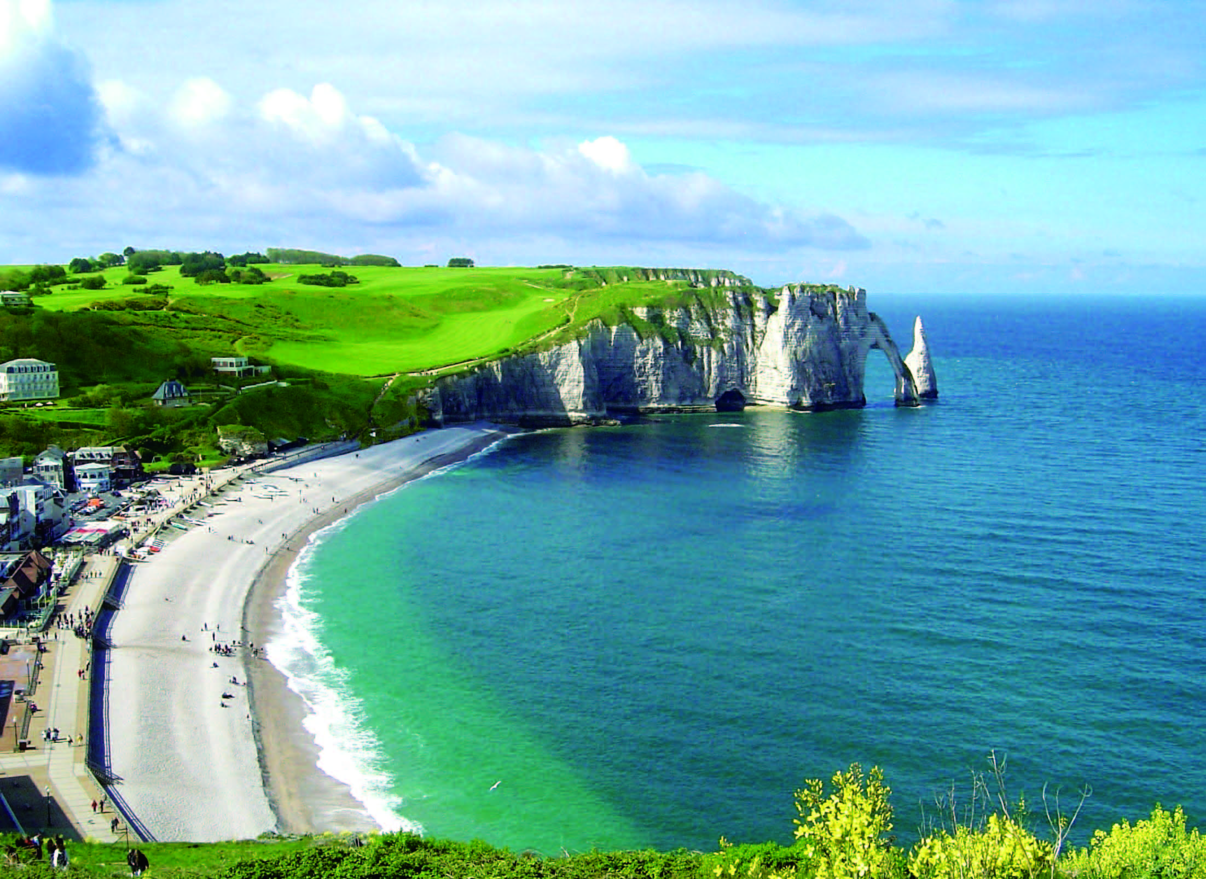
Further practice in listening
Passage 2
1) scared
2) perceive
3) negative
4) result in
5) lose faith in
6) goes down
7) depressed
8) preferably
9) adapt

Slide 58
Wrapping up
Use the following self-assessment checklist to check what you have learned in this unit.
Skills | OK | Needs work
I can talk about my learning experiences.
I can listen for signal words for listing.
I can give and respond to advice.
I can discuss learning / teaching methods.

Slide 59
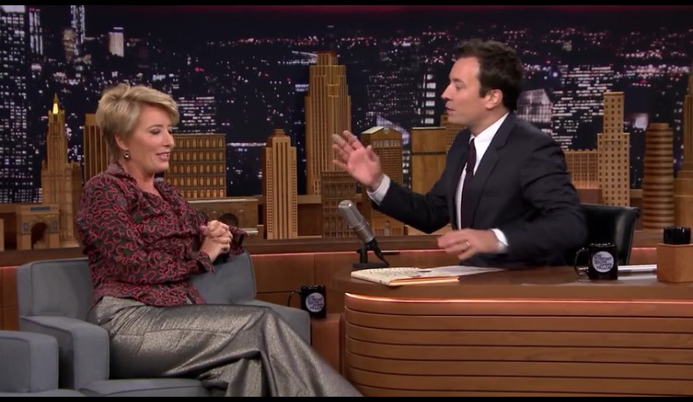
Fun time
Enjoy the video clip from Jimmy Fallon’s The Tonight Show with guest Emma Thompson.

