Slide 1
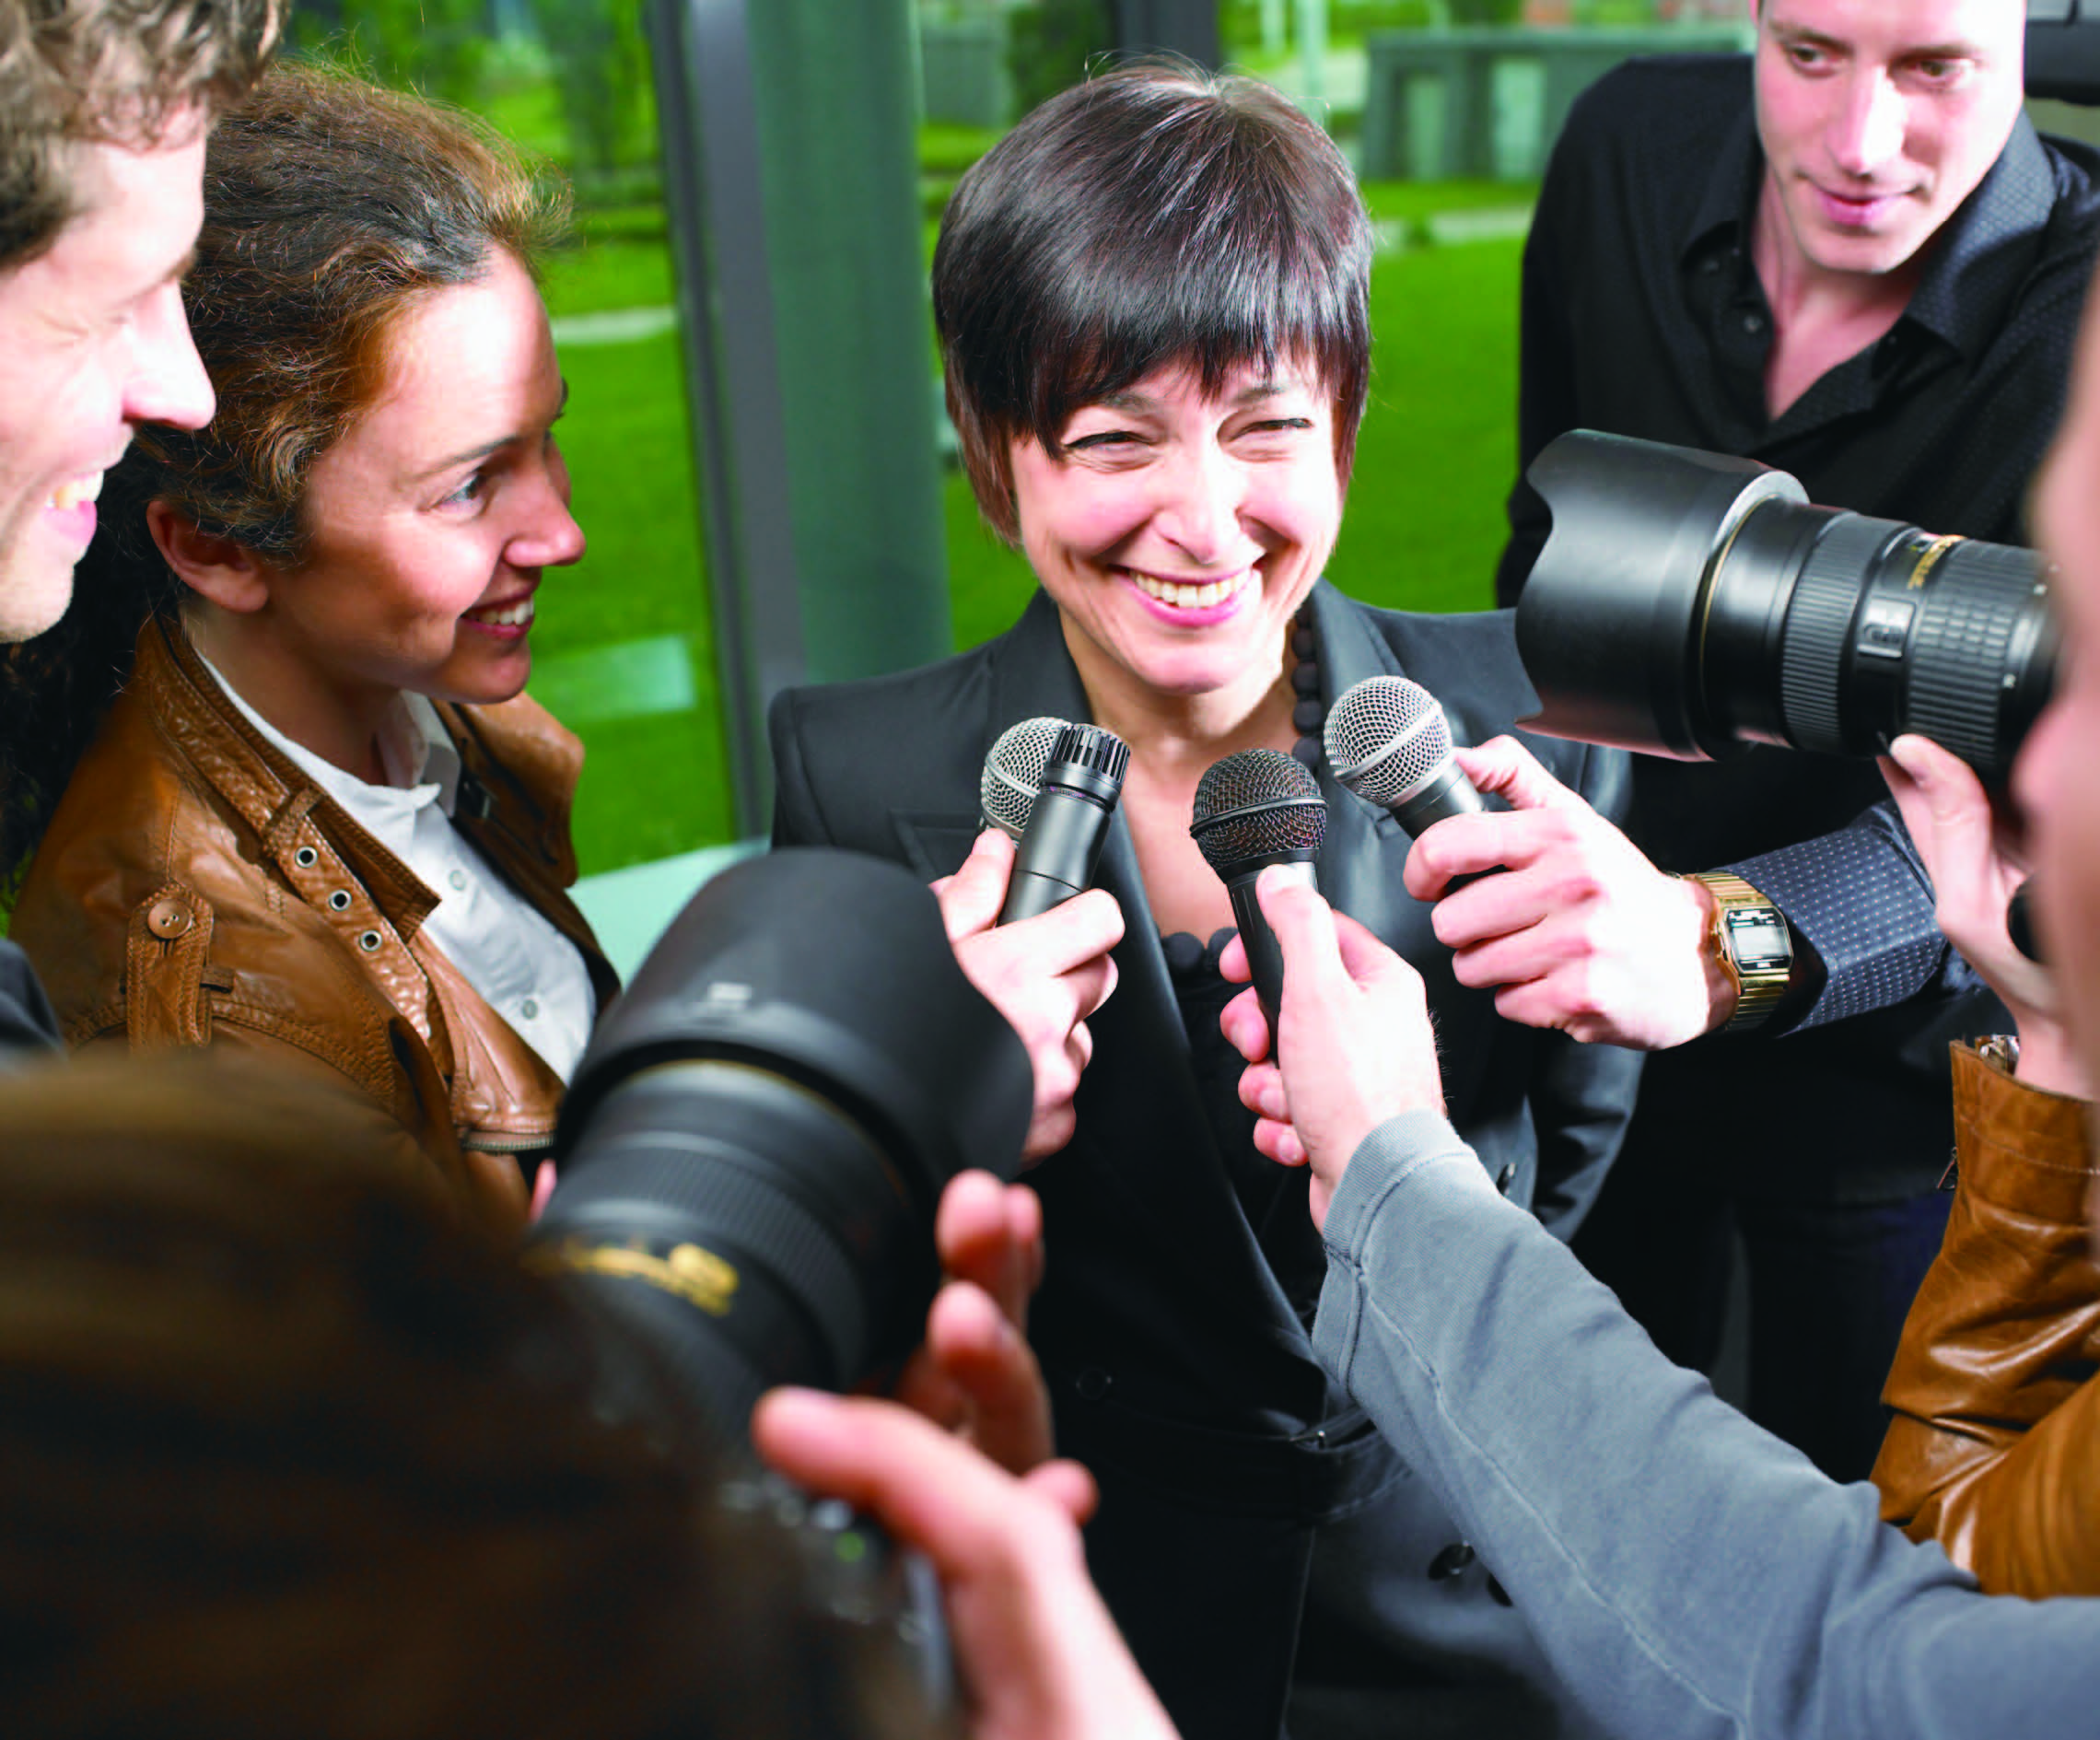
UNIT 4
Life under the spotlight

Slide 2
Unit 4 Life under the spotlight
Learning objectives
Opening up
Listening to the world
Speaking for communication
Further practice in listening
Wrapping up
Fun time

Slide 3

Learning objectives
1
talk about fame and celebrities
2
understand cause and effect
3
make requests and offers
4
debate on whether we should hold on to our dreams

Slide 4
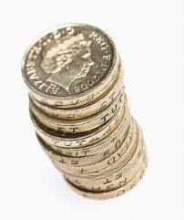
Opening up
1
Work in pairs and discuss the questions
1 What are the positive and negative things about being famous?
Positive 1: Fortune
One of the greatest advantages of being famous is that fame generally brings with it lots of fortune. So celebrities usually live a comfortable and even luxurious life.

Slide 5
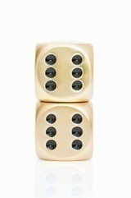
Opening up
1
Work in pairs and discuss the questions
1 What are the positive and negative things about being famous?
Positive 2: Opportunity
Being famous opens up many opportunities in life. Many celebrities embark upon the entrepreneurship path as soon as they achieve stardom.

Slide 6
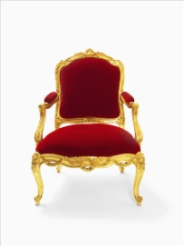
Opening up
1
Work in pairs and discuss the questions
1 What are the positive and negative things about being famous?
Positive 3: Privilege
Celebrities get special treatment wherever they go, for example, special seats at theaters or special tables at restaurants.

Slide 7
Opening up
1
Work in pairs and discuss the questions
1 What are the positive and negative things about being famous?
Negative 1: Lack of privacy
Lack of privacy is one of the biggest disadvantages of being a celebrity. Celebrities cannot lead lives of ordinary people because they are constantly watched and followed by paparazzi who have little or no respect for the privacy of celebrities or their family members.

Slide 8
Opening up
1
Work in pairs and discuss the questions
1 What are the positive and negative things about being famous?
Negative 2: Pressure
Celebrities experience great pressure owing to their fans’ expectations. Some fans may expect celebrities to be absolutely perfect in every aspect of their lives.
Negative 3: Harassment
Celebrities are often harassed by phone calls, emails or messages from fans or followers who cross the line and become obsessed.

Slide 9
Opening up
1
Work in pairs and discuss the questions
2 What would you do if you were famous?
• If I were famous, I would help my parents pay off the mortgage, and afford a lot of nice things for my family and my friends.
• If I were famous, I would buy myself a sports car and move my parents into their dream house.
• If I were famous, I would use my status to better the world and help people in need.

Slide 10
Opening up
1
Work in pairs and discuss the questions
3 What is the difference between becoming famous in the past and now?
It has become much easier for ordinary people to become famous nowadays. In the past, if you wanted to be famous, you might need to be outstanding in the field of entertainment or sports or politics. But now with the development of modern technology, there are a variety of ways to become famous. You can appear on a reality TV program, or you can make yourself a web celebrity overnight by filming yourself singing, dancing or giving a speech.

Slide 11
Listening to the world
Sharing
Listening
Viewing

Slide 12
Listening to the world
Sharing
1
Watch a podcast for its general idea.
The podcast is mainly about people’s attitudes toward being famous, what they’d like to be famous for, and which famous person they’d most like to meet.
2
Watch Part 1 and fill in the blanks.
finding out
a normal person
feel about fame

Slide 13
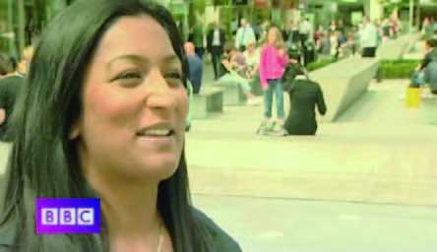
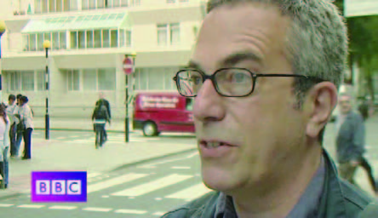
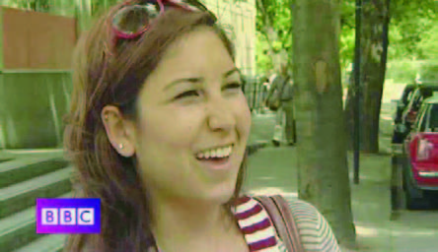
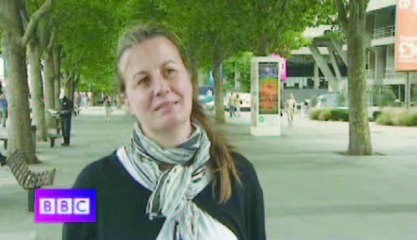
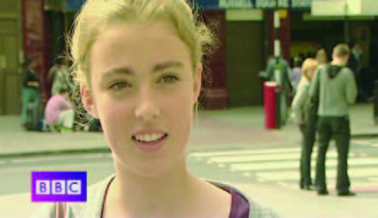
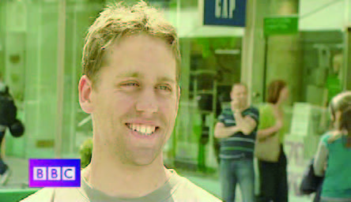
Listening to the world
Sharing
3
Watch Part 2 and check (√) the true statements.
1
2
√
A
B
4
3
√
√
C
D
5
6
E
F

Slide 14
Listening to the world
Sharing
4
Watch Part 3 and fill in the blanks.
exciting
worthwhile
a model
real fame
invention
in the street

Slide 15

Listening to the world
Sharing
4
Watch Part 2 and fill in the blanks.
Additional Notes
Mischa Barton: a movie, television, and stage actress, and occasional fashion model. She is best known for her role as Marissa Cooper in the television series The O.C. She also starred in movies Lawn Dogs, Notting Hill, The Sixth Sense, and Pups.

Slide 16
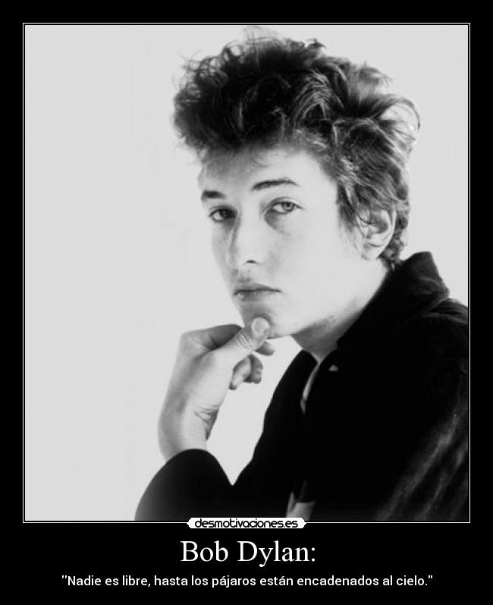
Listening to the world
Sharing
4
Watch Part 2 and fill in the blanks.
Additional Notes
Bob Dylan: He has been recording and performing since the 1960s, mixing many of the traditions in American song, from folk, blues, and country to gospel, rock and roll. Hailed as the Shakespeare of his generation, Dylan sold more than 58 million albums, wrote more than 500 songs recorded by more than 2,000 artists, performed all over the world, and set the standard for lyric writing. As a songwriter and musician, he has received 11 Grammy Awards, one Academy Award and one Golden Globe Award. In 2000, he was awarded the Polar Music Prize, and in 2012 the Presidential Medal of Freedom.

Slide 17
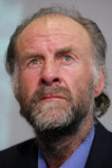
Listening to the world
Sharing
4
Watch Part 2 and fill in the blanks.
Additional Notes
Sir Ranulph Fiennes: a British adventurer and holder of several endurance records. He undertook numerous expeditions and was the first to visit both the North and South Poles by surface means and the first to cross Antarctica on foot. And he climbed to the summit of Mount Qomolangma at the age of 65.

Slide 18
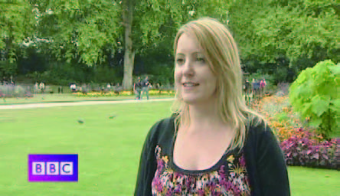
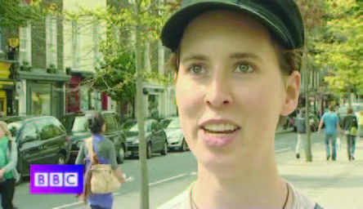
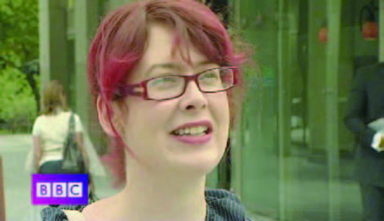
Listening to the world
Sharing
5
Watch Part 4 and match the statements.
1
2
E
F
3
4
A
D
5
6
B
C

Slide 19
Listening to the world
Sharing
6
Work in pairs and answer the questions.
1 Would you like to be famous?
• I wouldn’t like to be famous because if I were famous, I would have no privacy. I don’t like being watched all the time. I hate to have my every move recorded or photographed by paparazzi.
• I would like to be famous partly because I would enjoy being the focus of attention, and partly because I would have enough money to do whatever I want.

Slide 20
Listening to the world
Sharing
6
Work in pairs and answer the questions.
2 What would you like to be famous for?
• I would love to be a famous writer, like Shakespeare. I think it’s a wonderful thing to be able to write a book that people all around the world want to read.
• I’d like to be a famous politician. If I were a politician, I would try to change the world, to stop all these wars and do something to help poor countries. You know, I think it’s terrible that most politicians don’t seem to worry about things like that.

Slide 21
Listening to the world
Sharing
6
Work in pairs and answer the questions.
3 Which famous person would you most like to meet? Why?
I’d most like to meet Oprah Winfrey because she is kind and generous and willing to help people out during tough times. And more importantly because she has struggled with things we all have experienced and she has coped with them with dignity.

Slide 22
Listening to the world
Sharing
Listening
Viewing

Slide 23
Listening to the world
Viewing
BEFORE your view
1
Read the statements and the text and check the true statements.
1 If you are bored with doing the same thing every day, then you are stuck in a rut.
2 Many people think about changing their lives, but only a few of them take action.
3 Half of the holiday makers in the UK think about changing their jobs during the holidays.
√
√
Around holiday times a quarter of the people in the UK think about changing jobs.

Slide 24
Listening to the world
Listening
Listening skills
Additional Tips
Understanding cause and effect One strategy to figure out the cause-effect relationship is by asking questions. To figure out the effect: What events happened? Or what was the result? To figure out the cause or the reason: Why did it happen? What was the cause?

Slide 25
Listening to the world
Listening
Listening skills
Additional Tips
Understanding cause and effect Another strategy to figure out the cause-effect relationship is the use of visual representation. The single event: When there is only one cause and one effect The chain reaction: When a cause creates an effect and that effect turns into a cause and creates another effect The branching tree: When one cause creates multiple effects or multiple causes create one effect, and these multiple causes or effects can branch off into other cause and effect patterns.

Slide 26
Listening to the world
Listening
Listening skills
Additional Tips
Understanding cause and effect Another strategy to figure out the cause-effect relationship is the use of visual representation. The single event: When there is only one cause and one effect The chain reaction: When a cause creates an effect and that effect turns into a cause and creates another effect The branching tree: When one cause creates multiple effects or multiple causes create one effect, and these multiple causes or effects can branch off into other cause and effect patterns.

Slide 27
Listening to the world
Listening
Listening skills
Additional Tips
Understanding cause and effect The single event: A (cause) B (effect) The chain reaction: A (cause 1) B (effect 1/ cause 2) C (effect 2) The branching tree (cause 1) B (cause 2) C (cause 3) D ( effect)

Slide 28
Listening to the world
Listening
While you listen
2
Listen and complete the diagram.
1) advertising
2) enjoy the job
3) travel
4) chance
5) go traveling
6) a doctor
7) have time
8) play the piano
9) writing songs
10) wanted to do
11) make more time
12) playing her own music

Slide 29
Listening to the world
Listening
AFTER you listen
3
Discuss the questions.
1 Do you think it was a good idea for Anita and Jasmin to make these life changes? Why or why not?
• I think it is a good idea for them to make these life changes. The meaning of life is to make life meaningful. Anita and Jasmin obviously felt bored with what they did every day, and couldn’t find contentment, fulfillment and pleasure in their life, so it was the right time for them to make a change. They needed to try something different, something that can bring them new experience, give them a sense of achievement, and revive their passion for life. The pursuit of their dreams pushes them forward and inspires them to live life to the fullest.

Slide 30
Listening to the world
Listening
AFTER you listen
3
Discuss the questions.
1 Do you think it was a good idea for Anita and Jasmin to make these life changes? Why or why not?
• I think it is too risky for them to make these life changes at such an age, especially for Anita Jacobs who sold her house and gave up her job just to go traveling. I just doubt whether she will be able to make a living when she finishes traveling. It’s not unusual for many people to feel bored about doing the same job every day. But the point is that this job pays enough so that we can make a living, and we can have some money put away for retirement after paying the bills and putting food in our mouths. So when the going gets tough, just remember times when we have a peaceful life at home after an eight-hour day.

Slide 31
Listening to the world
Listening
AFTER you listen
4
Discuss the questions.
2 Can you think of a famous person who also has made a life-changing decision? Share the story with the class?
A typical example is Bill Gates. Bill Gates enrolled at Harvard University in the fall of 1973, originally thinking of a career in law. When the MITS Altair 8800 based on the Intel 8080 CPU was released in 1974, he and his friend Paul Allen saw this as a great opportunity to start their own computer software company. So Bill Gates dropped out of Harvard to start a business to write software for computers. It was a hard decision but it turned out to be the right choice.

Slide 32
Listening to the world
Sharing
Listening
Viewing

Slide 33
Listening to the world
Viewing
BEFORE you view
1
Read the program information below and answer the questions.
1 What qualities do you think a Formula One driver usually has?
I think the qualities a successful Formula One driver must have include physical strength and proficiency, mental alertness, quick reaction, endurance, consistency, courage, competitiveness, and appreciation for adventure and speed.

Slide 34
Listening to the world
Viewing
BEFORE you view
1
Read the program information below and answer the questions.
2 Why does Lewis Hamilton say his life now is a dream come true?
Lewis Hamilton is ambitious and he always wants to win. Now he has won many competitions and becomes a celebrity with fame and glory, so his life is a dream come true.

Slide 35
Listening to the world
Viewing
While you view
2
Watch the whole video clip and answer the questions.
1 Why do sponsors love Lewis Hamilton?
The sponsors love the face, the attitude, the style and the talent that Lewis Hamilton has.
2 Why did Lewis Hamilton want to be a Formula One driver?
Because it has got a lot of speed in it.

Slide 36
Listening to the world
Viewing
While you view
2
Watch the whole video clip and answer the questions.
3 What was Lewis Hamilton’s ambition when he was a teenager? Why?
His ambition as a teenager was to get to Formula One, because he enjoyed the speed, he liked to be with all the big guys, and he would like to be making lots of money.
4 What do we know from the video clip about Formula Three?
Formula Three is fast, dangerous, and full of young, ambitious drivers. The best of the drivers are seen by Formula One managers.

Slide 37

Listening to the world
Viewing
WHILE you view
3
Watch Part 2 and fill in the blanks.
speed
survive
October
richest
track
bank
glory
better
4
Watch Part 2 and complete the table.
seven
four
everything

Slide 38
Listening to the world
Viewing
AFTER you view
5
Discuss the questions.
1 Why do you think people say Lewis Hamilton is a “hero”? Do you think he is a hero?
People say Lewis Hamilton is a “hero”, because he is an incredibly talented driver who has made remarkable achievements in his career. In his first season in Formula One, he set numerous records, and was just one point behind the champion in the 2007 Formula One Championship. Then he won the World Championship the following season.
I think Lewis Hamilton is a sporting hero because of the excitement and joy that his courageous performances in 2007 and 2008 have brought to his countless fans. He showed us that in any case we should never give up, even if the conditions are not favorable.

Slide 39
Listening to the world
Viewing
AFTER you view
5
Discuss the questions.
2 Which sporting hero do you admire? Why?
The sporting hero I admire most is Lang Ping, a former player of Chinese Women’s Volleyball Team, nicknamed “Iron Hammer”. She is a beloved sporting hero and one of the most respected people in modern Chinese sports history mainly because of her central role in the success of the Chinese Women’s Volleyball Team in the 1980s, including the Gold Medal at the 1984 Olympics, World Championship crown in 1982 and World Cup titles in 1981 and 1985.

Slide 40
Listening to the world
Viewing
AFTER you view
5
Discuss the questions.
2 Would you make any different arrangements if you were the presenter?
If I were the presenter, perhaps I would get up earlier and have a walk in the streets because I would like to see how ordinary people in Barcelona work and live, not just go to those tourist attractions.

Slide 41
Speaking for communication
Role-play
1
Listen to four conversations and complete the notes.
1) White House
2) tomorrow afternoon
3) a space flight / a flight into space
4) next week
5) her husband
6) 80
7) three or four
8) organize
9) this weekend
10) restaurant service
11) French
12) Paris
13) directions
14) book

Slide 42

Speaking for communication
Role-play
2
Listen to the conversations again and write R for requests and O for offers.
1 R
2 R
3 O
4 R
5 O
6 O

Slide 43
Speaking for communication
Role-play
Speaking skills
Additional Tips
Making requests and offers The request Could you …? sounds more polite than Can you …? Second, if the response to the request Would you mind giving me your dictionary? is No, I don’t mind, it is a positive response, meaning that I will lend you my dictionary; if the response is Yes, it is a negative response, meaning that I don’t want to lend you my dictionary. Third, the structure Do you mind if …? is followed by the verb in the present tense, but Would you mind if …? is followed by the verb in the past tense.
Making a request:

Slide 44
Speaking for communication
Role-play
Speaking skills
Additional Tips
Making requests and offers
Offers and responses
Offers | Responses to offers
Can I help you? Can I help you? Shall I turn on the TV for you? Would you like another cup of tea? Would you like me to answer the phone? I’ll type the letter for you, if you like. | • Yes, please. I’d like to rent a car for four. • No, thanks. I’m just looking. • Yes, please. That would be very kind of you. • Yes, please. / No, thanks. • If you could. / If you wouldn’t mind. • It’s OK, I can do it. / Don’t worry, I’ll do it.

Slide 45
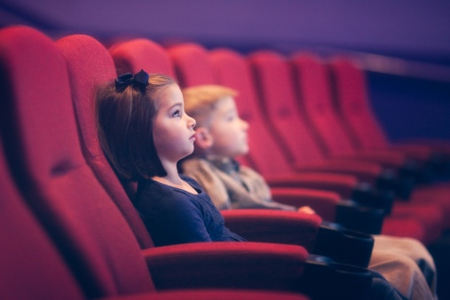
Speaking for communication
Role-play
5
Role-play the situations.
Situation 1
Booking tickets for the theater
B: Good afternoon, madam. What can I do for you? A: Good afternoon. May I have six tickets for the theater tonight? B: OK, madam. By the aisle or in the middle? A: In the middle, please.

Slide 46
Speaking for communication
Role-play
5
Role-play the situations.
Situation 2
Going to a restaurant
A: Excuse me. Could you please recommend the best restaurant in town? B: What kind of food do you want to eat? A: I think the local food is the best choice. B: OK. There is one on Madson Street, called Sweet Little Pepper. This restaurant is quite popular with the local people. A: Sounds great. B: Shall I book a table for you? A: Yes, please. That would be very kind of you.

Slide 47
Speaking for communication
Role-play
5
Role-play the situations.
Situation 3
Shopping for clothes
B: Good morning, madam. A: Good morning. Could you tell me where the shopping mall is? I want to buy a dress for a party tonight. B: Sure. There is one in downtown. You can take a taxi or take Bus No. 18 to get there. A: Thank you. Could you call a taxi for me? B: Yes, madam. I’m always at your service.

Slide 48
Speaking for communication
Role-play
5
Role-play the situations.
Situation 4
Visiting a film studio
B: What can I do for you, sir? A: I’d like to visit a movie studio and meet some stars in Hollywood. Could you make such an arrangement for me? B: Oh, I’m not sure about that. You know these big shots. But I will try and give you an answer as soon as possible.

Slide 49
Speaking for communication
Group discussion
Get ideas
1
Listen to a man talk about his dreams and answer the questions.
1 Where did he grow up?
He grew up in South Wales.
2 What was his dream when he was a child?
His dream was to become a rock star.
3 What inspired him to pursue his dream?
Many of his music idols died before they were 27, which inspired him to do something about his dream before it’s too late.

Slide 50
Speaking for communication
Group discussion
Get ideas
1
Listen to a man talk about his dreams and answer the questions.
4 What did he do to pursue his dream?
He bought himself a second-hand drum kit, joined bands, and played concerts. He also started to write songs. He played all the time.
5 When and why did his dream start to change?
At 28 he realized that apart from music he had his family and friends. He still played but only for fun.

Slide 51
Speaking for communication
Group discussion
Discuss and organize ideas
2
Discuss the meaning of the quotes about dreams.
You can dream, but do not make dreams your master.
—Anonymous
We all have dreams in our life. These dreams may be things we want to accomplish, places we want to go, or feats we must attempt. Whatever they are, dreams give us a purpose in life and a meaning to live, and allow us to fight for what we believe in. However, we should not let our dreams control our life and become a slave to them. In fact there are other things we should work for apart from our own dreams, such as our family and our friends. So don’t be afraid to let go our dreams if we have to.

Slide 52
Speaking for communication
Group discussion
Discuss and organize ideas
2
Discuss the meaning of the quotes about dreams.
Hold fast to dreams, for if dreams die, life is a broken-winged bird that cannot fly.
—Langston Hughes
This quote tells us that we should always strive to attain our dreams in life. Dreams push us to move forward, to struggle, to strive all the time. Without dreams, life is a life without hope; without dreams, we are as lost as a bird which has lost the gift of flight. So follow our dreams and let our ambition fuel us to surpass our limits. Never quit and always think of different ways to win.

Slide 53
Speaking for communication
Group discussion
Discuss and organize ideas
2
Classify the following information as pros and cons for the topic “ Should we hold on to our dreams?”.
Should we hold on to our dreams
Pros | Cons
1, 2, 5, 6, 9, 11, 13
3, 4, 7, 8, 10, 12

Slide 54
Speaking for communication
Group discussion
Present ideas
4
Please learn the following useful expressions in an English debate.
Expressions for Chairperson:
I’m quite honored to chair this debate
First, let me introduce … This is the affirmative side. This is the negative side …
The topic today is about …
The motion for debate today is …
The affirmative side holds that … while the negative side believes otherwise…
Now, I declare the debate begins …

Slide 55
Speaking for communication
Group discussion
Present ideas
4
Please learn the following useful expressions in an English debate.
Expressions for debaters:
We would like to introduce our stand by giving the following definition of dreams…
We hear what the opposition are saying. We would like to point out that …
At first sight, their argument seems to be true. But …
The other team has tried to make some good points; However…
I’m afraid we can’t agree that …

Slide 56

Speaking for communication
Group discussion
Present ideas
5
Have a debate on the topic “Should we hold on to our dreams?”.

Slide 57
Further practice in listening
Short conversations
1 Q: How did the woman react to the fact that she got pregnant?
B She was too happy to keep it a secrete.
2 Q: What do we learn from the conversation about Miley?
B She was no longer admired by teenagers.
3 Q: Why does the woman admire the couple?
C Because they have made great efforts to achieve success.
4 Q: What’s the man’s attitude toward these media?
D Critical.
5 Q: What does the woman imply about the American swimmer?
D He has more than once failed to meet public expectations.

Slide 58
Further practice in listening
Long conversation
1 Q: What did the man think of those famous actresses in Hollywood?
A They are foolish.
2 Q: Why did the woman want to be famous?
B She wanted to use her fame to help starving children in Africa.
3 Q: How did the man react to the woman’s reasons for wanting to be famous?
B He had doubt about her real intentions.
4 Q: What can be infer about the woman?
D She will stick to her original plan and prove it to the man.

Slide 59
Further practice in listening
Passage 1
1 Q: How did Bill Gates perform in school?
B He did quite well in mathematics and science.
2 Q: Why was studying in a private school a very important decision in Bill’s life?
D Because it was there he had his first contact with a computer.
3 Q: How did Bill like Harvard University?
A Harvard University made him feel bored.
4 Q: What did Bill Gates do at Harvard University?
C He spent many long nights in front of the school’s computer.

Slide 60
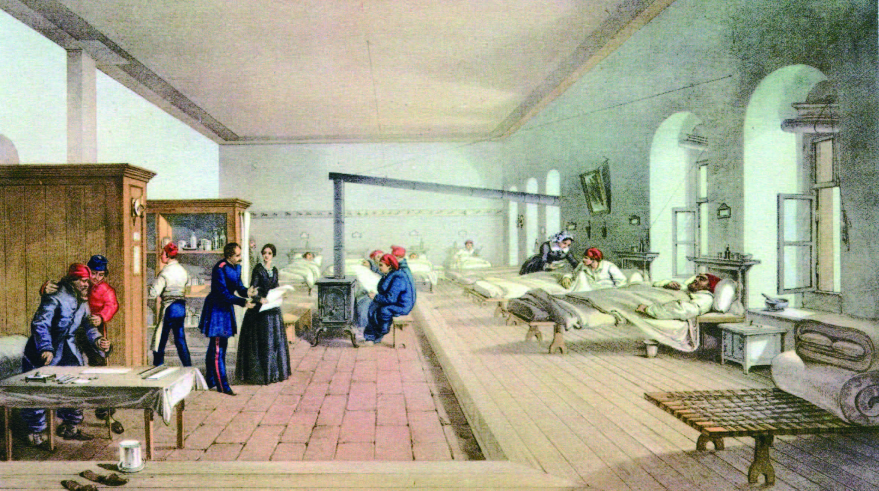
Further practice in listening
Passage 2
1) commentators
2) exaggerated
3) focus on
4) lead an active life
5) laid the foundation
6) annual
7) a series of
8) advocating
9) abolish
10) Influential

Slide 61
Wrapping up
Use the following self-assessment checklist to check what you have learned in this unit.
Skills | OK | Needs work
I can talk about my learning experiences.
I can listen for signal words for listing.
I can give and respond to advice.
I can discuss learning / teaching methods.

Slide 62
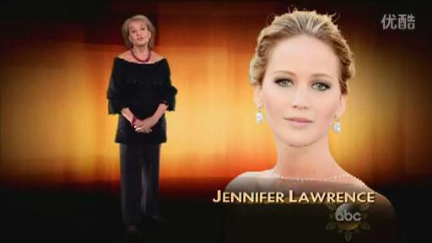
Fun time
Enjoy the video clip in which Jennifer Lawrence talks about tackling fame.

