Slide 1

UNIT 6
Climbing the career ladder

Slide 2
Unit 6 Climbing the career ladder
Learning objectives
Opening up
Listening to the world
Speaking for communication
Further practice in listening
Wrapping up
Fun time

Slide 3

Learning objectives
1
talk about jobs and working experiences
2
identify examples in speeches and conversations
3
express likes or dislikes
4
come up with a money-making idea

Slide 4
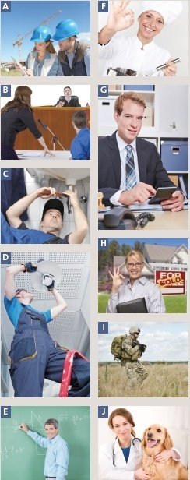
Opening up
Look at the pictures and match A-J to the jobs 1-10.
____ 1 chef (厨师)
____ 2 teacher
____ 3 soldier
____ 4 electrician
____ 5 accountant (会计师)
____ 6 vet (兽医)
____ 7 lawyer
____ 8 architect
____ 9 estate agent (房地产经纪人)
____10 plumber
F
E
I
D
G
J
B
A
H
C

Slide 5
Listening to the world
Sharing
Listening
Viewing

Slide 6
Listening to the world
Sharing
1
Watch a podcast for its general idea.
The podcast is mainly about different kinds of
jobs people do, their job locations, as well as the
best and worst things about these jobs.
2
Watch Part 1 and fill in the blanks.
1) a researcher
2) gets too busy
3) relax
4) flat

Slide 7
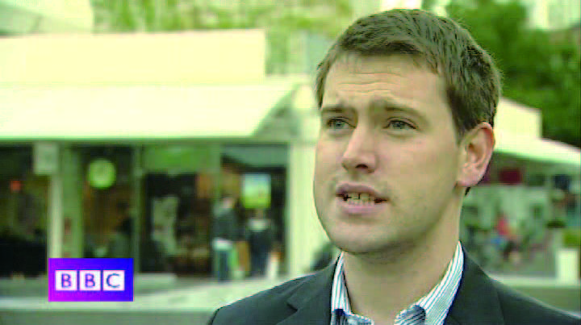
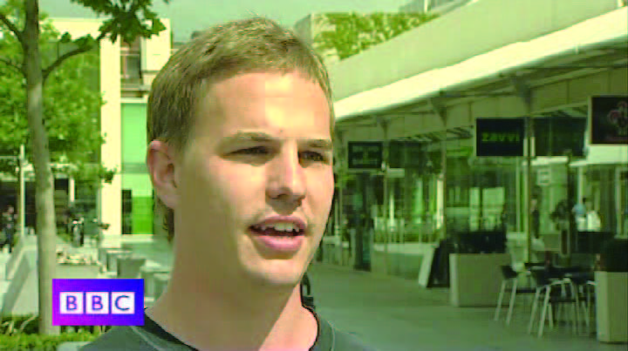
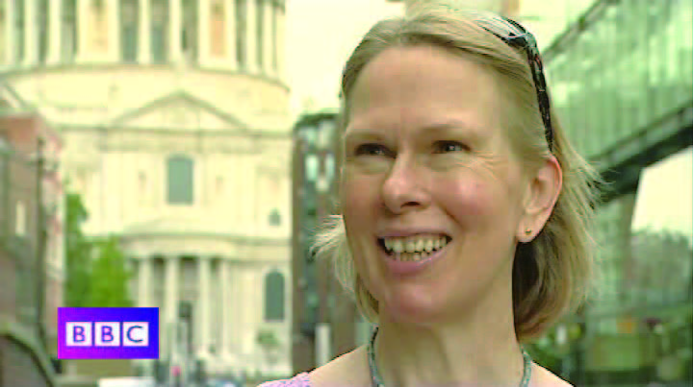
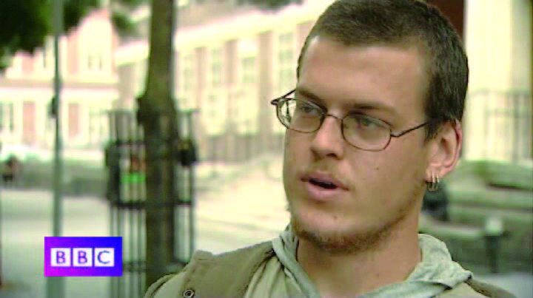
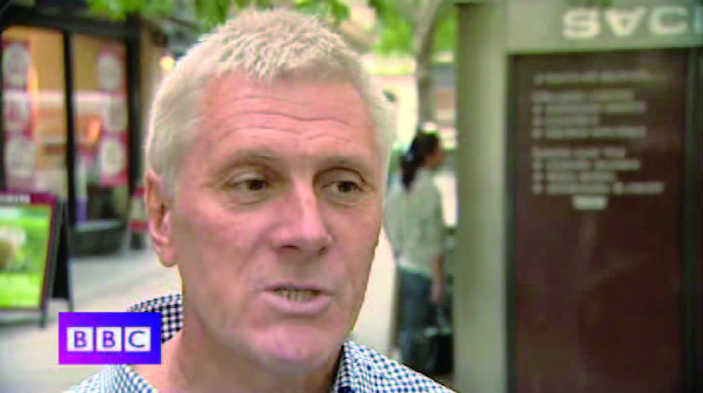
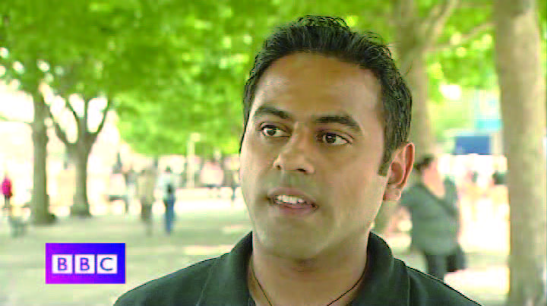
Listening to the world
Sharing
3
Watch Part 2 and check the true statements.
1
2
A
B
√
3
√
4
C
D
5
6
E
F

Slide 8
Listening to the world
Sharing
4
Watch Part 3 and match the statements.
1
2
C
E
3
4
A
D
5
6
B
F

Slide 9
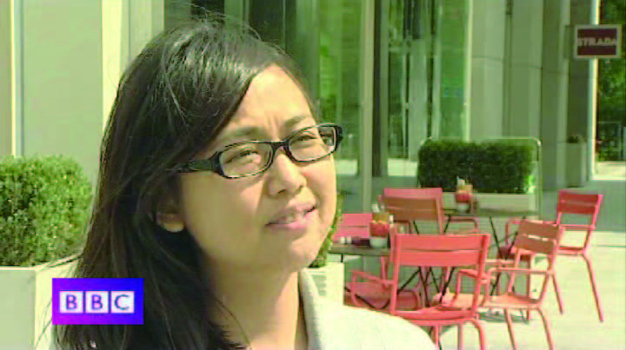
Listening to the world
Sharing
5
Watch Part 4 and fill in the blanks.
1
What’s the worst thing about her job?
Answer:
_______________________
________________________________
The worst thing about her job is that it can get very stressful.
A

Slide 10

Listening to the world
Sharing
5
Watch Part 4 and fill in the blanks.
2
What hurts him a lot?
Answer:
_________________________
___________________________________________________________________________________
Seeing that people who are very poor and very sad don’t have much opportunity and can do little about it hurts him a lot.
B

Slide 11

Listening to the world
Sharing
5
Watch Part 4 and fill in the blanks.
3
What’s the worst thing about his job?
Answer:
_________________________
_________________________
The worst thing about his job is the (long) hours he works.
C

Slide 12
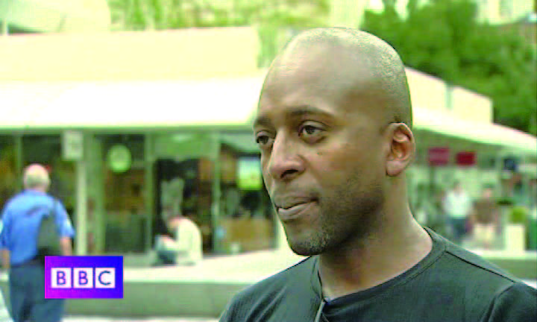
Listening to the world
Sharing
5
Watch Part 4 and fill in the blanks.
4
Why is it hard for him to make plans sometimes?
Answer:
_________________________
___________________________________________________________________
He never knows what he’s gonna be doing from one day to the next, so sometimes it’s
hard to make plans.
D

Slide 13
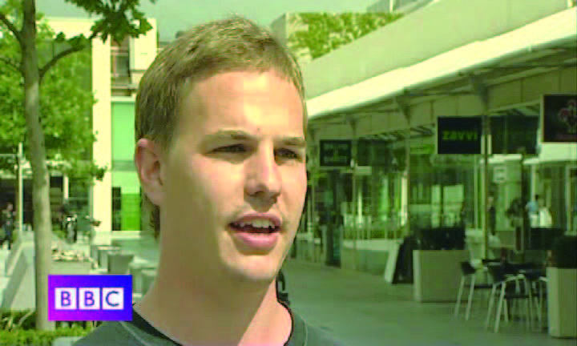
Listening to the world
Sharing
5
Watch Part 4 and fill in the blanks.
5
What does he dislike about his job?
Answer:
_________________________
_________________________
What he dislikes about his job is being away from his family.
E

Slide 14
Listening to the world
Sharing
5
Watch Part 4 and fill in the blanks.
6
What disadvantages does he think his job has?
Answer:
________________________
______________________________________
He thinks spending a lot of time outside of the UK has its disadvantages.
F

Slide 15

Listening to the world
Cultural Notes
University College London It is a public research university founded in 1826. It became one of the founding colleges of the University of London in 1836. It is a multidisciplinary (含有多种学科的) university with an international reputation for the quality of its teaching and research across the academic spectrum (范围). It is one of the two top universities in the UK for the number of professors and has one of the best academic (大学教师) to student ratios in the UK. It is regarded as one of the world’s most prestigious (有声望的) universities.

Slide 16
Listening to the world
Sharing
6
Work in pairs and discuss the question.
1 What are the pros and cons of the work of accountants?
The good thing of being an accountant is that the job offers a very good salary and benefits and excellent job security.
The bad thing is that it has a high potential for human error and the tasks involved are usually boring.

Slide 17
Listening to the world
Sharing
6
Work in pairs and discuss the question.
2 What are the pros and cons of the work of lawyers?
The benefits of being a lawyer are that lawyers are respected, and are usually paid a good salary. Besides, the work of lawyers is not repetitive, and they can meet different clients and different situations.
The downsides of being a lawyer are lawyers usually live a stressful life. They often have to work long hours and meet strict deadlines, and even worse they may sometimes be confronted with threats or actual violence.

Slide 18
Listening to the world
Sharing
6
Work in pairs and discuss the question.
3 What are the pros and cons of the work of salesperson?
The pros of being a salesperson include flexibility, potentially unlimited income and opportunities to meet many different people. While the cons include irregular income, unpredictable schedule, demanding expectations, and constant pressure.

Slide 19
Listening to the world
Sharing
6
Work in pairs and discuss the question.
4 What are the pros and cons of the work of doctors?
The good thing of being a doctor is that doctors are very respectable and usually have a decent salary.
The bad thing is that the job requires a long process to acquire a license, and doctors usually work long hours and have a great deal of responsibility.

Slide 20
Listening to the world
Sharing
Listening
Viewing

Slide 21
Listening to the world
Listening
BEFORE you listen
1
Work in groups and discuss.
1 flexible hours
I hate those nine-to-five jobs.
I want flexibility in working time so as to better meet my individual and business needs.
What I look for in a job is flexible working hours.

Slide 22
Listening to the world
Listening
BEFORE you listen
1
Work in groups and discuss.
2 stability
When I look for a job, what I expect most is job security.
I won’t worry about becoming unemployed.
A job with a low level of security may result in low morale and excessive stress, thus affecting my overall work performance.

Slide 23
Listening to the world
Listening
BEFORE you listen
1
Work in groups and discuss.
3 good work-life balance
I regard a good work-life balance as the most important thing.
It refers to the proper division of time and energy between work and the other important aspects of life.
It will make me feel I am paying attention to all the important factors in my life, and thus gives me a sense of achievement and satisfaction.
But if not, I will feel stressed and unhappy.

Slide 24
Listening to the world
Listening
BEFORE you listen
1
Work in groups and discuss.
4 chances of promotion
I have strong ambition about my career and I want to achieve professional success.
It can give me a chance to develop my skills, and have potential room for me to advance in my career.
I expect the company or organization I work for to offer necessary training and chances.

Slide 25
Listening to the world
Listening
BEFORE you listen
1
Work in groups and discuss.
5 a good salary and benefits
The salary and benefits are the most important factors that I will take into consideration.
They are the biggest motivation for me to work hard and also the best way to prove that my good work is recognized and rewarded.
At least I expect I am paid enough to meet my needs, and paid fairly in comparison to others.

Slide 26
Listening to the world
Listening
BEFORE you listen
1
Work in groups and discuss.
6 interesting job tasks
When I look for a job, I will consider what job tasks I am supposed to complete.
I prefer tasks that are interesting and challenging.
Repetitive and boring tasks will only make me lose interest or motivation in my job.

Slide 27
Listening to the world
Listening
BEFORE you listen
1
Work in groups and discuss.
7 a good boss
When I look for a job, a good boss is a very important factor that will affect my decision.
A good boss is honest, compassionate, fair, hard-working, and understanding.
A good boss always keeps an open door, lends an ear to employees, and never let good work go unnoticed.
A good boss will make employees feel appreciated, recognized and valued.

Slide 28
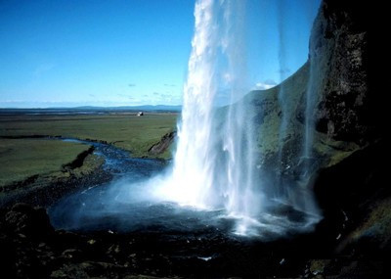
Listening to the world
Culture Notes
Iceland It is an island country located in the North Atlantic Ocean. With sparkling glaciers (冰川) lying across its beautiful mountain ranges and abundant hot geysers (间歇喷泉) providing heat for many of the country’s homes and buildings, it is a land of vivid contrasts of climate, geography, and culture.

Slide 29
Listening to the world
Listening
Listening skills
Additional Tips
Listening for examples Examples are often used to help explain unfamiliar or difficult concepts, making them easier for the listener to understand and remember.
Expressions for giving examples
I have been to many countries. For example, I have been to Russia, Canada, Mexico, and Spain. He’s a greedy boy. Yesterday, for instance, he ate all our biscuits! Many people, like my family, call me Jim. I like sports, such as football, basketball, and swimming including … by way of illustration, ... A classic / well-known example of this is ...

Slide 30
Listening to the world
Listening
Listening skills
Additional Tips
• X is a good example / illustration of ... • X illustrates this point / shows this point clearly. • This can be illustrated briefly by ... • The evidence of X can be clearly seen in the case Hyponyms (下义词 ) Furniture: table, chair Europe: the United Kingdom Animal: cat , dog Fruit: banana, pear

Slide 31
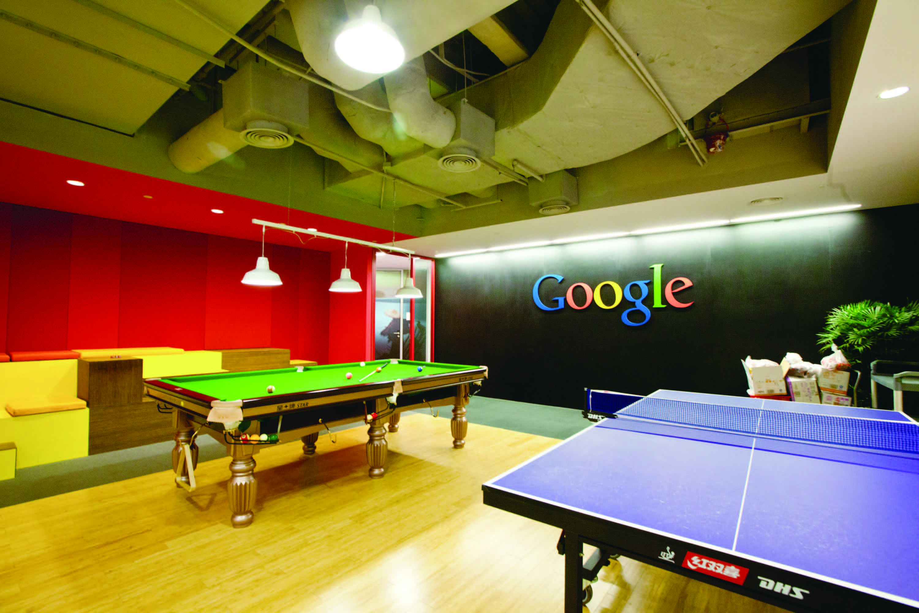
Listening to the world
Listening
WHILE you listen
2
Listen to the conversation and complete the table.
1) a free bus ride
2) a dentist
3) watch films
4) Lunch
5) a cheap
6) take your dog
7) a surprise holiday
8) free coffee
9) bring their children
10) a party
11) free drinks
12) go fishing
13) all the fish

Slide 32
Listening to the world
Listening
AFTER you listen
3
Work in pairs and discuss the questions.
1 Which way of motivating staff do you like most? Why?
I like the methods adopted by Google most. Because one of the benefits Google offers is a cheap massage, which is my favorite form of relaxation.

Slide 33
Listening to the world
Listening
AFTER you listen
3
Work in pairs and discuss the questions.
2 If you were a boss, what would you do to motivate your staff?
If I were the boss, I would offer free daycare for children, in addition to benefits such as free lunches, free drinks and paid holidays. But most importantly, I would create a healthy company culture to motivate the staff.

Slide 34
Listening to the world
Sharing
Listening
Viewing

Slide 35

Listening to the world
Viewing
BEFORE you view
1
Read the program information below and answer the questions.
1 Why did the man get fed up with his life?
Every day there was a lot of traffic on the roads and the commute to work took a long time. He wasn’t happy with his work-life balance.

Slide 36
Listening to the world
Viewing
BEFORE you view
1
Read the program information below and answer the questions.
2 In what ways do you think the man’s life has been “transformed”?
His life has been transformed by living in another country and commuting to work by taking cheap flights. Now he doesn’t have to get stuck in traffic jams anymore. He has a completely different lifestyle.

Slide 37
Listening to the world
Viewing
BEFORE you view
2
Work in pairs and discuss the questions.
1 How do people usually commute to work or school in your city?
People usually commute to work or school by
walking on foot
riding a bike
taking the bus
taking the subway
taking a taxi
driving a car.

Slide 38
Listening to the world
Viewing
BEFORE you view
2
Work in pairs and discuss the questions.
2 What problems do most commuters have?
The biggest problem is the rush hour traffic.
Commuters who take a taxi or drive a car often find themselves sitting in endless traffic jams.
Commuters who take the bus or take the subway often have to squeeze themselves into already overcrowded buses or trains.
So commuting has become a big headache and a source of stress for many commuters.

Slide 39
Listening to the world
Viewing
WHILE you view
3
Read the paragraphs. Then watch the video clip and fill in the blanks.
More and more British people are fed up of 1) __________________ on packed commuter trains or tired of being sat in endless traffic queues. Some of them choose to 2) ____________ and commute to their jobs in Britain. They are Britain’s dream commuters. It’s 3) _____________ in Europe and budget flights that are changing the way they live.
traveling to work
live abroad
cheap houses

Slide 40
Listening to the world
Viewing
WHILE you view
3
Read the paragraphs. Then watch the video clip and fill in the blanks.
Justin Saunders is part of Britain’s dream commuters. He runs 4) ______________________ near Reading. At the end of the working week, he flies from Gatwick to his house in a village in southwest France, an hour’s drive from Toulouse Airport and over 700 miles from his Hampshire office. When he books the flights early enough, he pays something like 5) _________ for a return ticket. He and his family decided to move to France for the better 6) ____________. They were fed up with the commuting and 7) ___________.
an online map company
38 pounds
quality of life
the traffic

Slide 41
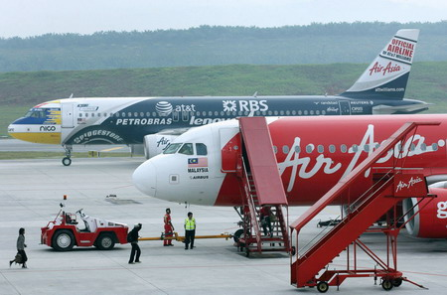
Listening to the world
Cultural Notes
Budget flight It is a flight that seeks to provide flight service at low cost, sometimes undercutting traditional airlines by more than 50 percent. It seeks to cut costs by providing “meal options”, which means extra charge for food rather than an included meal service, and using “first come, first served” seating, which means that seats go to whomever takes them first.

Slide 42
Listening to the world
Viewing
AFTER you view
4
Work in pairs and discuss the questions
1 What do you think of Britain’s dream commuters?
I think Britain’s dream commuters have made a wise decision.
They have the worst deal in all of Europe and spend longer in cars and trains than anyone else.
So more and more people are moving to mainland Europe but still keeping their jobs in the UK. It’s all being made possible thanks to cheap air travel, the growth of flexible working hours and an increase in communication technology.

Slide 43
Listening to the world
Viewing
AFTER you view
4
Work in pairs and discuss the questions
2 Do you think this lifestyle is possible in China?
Why or why not?
I don’t think Chinese commuters will live in a foreign country and commute to work in China.
Chinese citizens may not have the freedom to travel between countries and air travel in China is not that cheap.
But it is very likely that Chinese commuters will live in a small city and commute to work in a big city.
Because the house prices in big cities are skyrocketing, and the fast development of inter-city railway systems has greatly reduced the time needed to travel between cities.

Slide 44
Speaking for communication
Role-play
1
Read the statements. Then listen to a talk and check the true statements.
1 The speaker is a biologist.
2 He mainly travels in South Africa and Australia.
3 He enjoys working alone.
4 He doesn’t like getting his hands dirty.
5 He doesn’t mind working under pressure.
√
√

Slide 45
Speaking for communication
Role-play
2
Read the statements and fill in the blanks.
1 I _____________ working outside.
2 I _____________sitting at a desk all day.
3 I ______________ traveling.
4 I _____________ working in a team. I _______ working alone.
5 I ____________ getting my hands dirty.
6 I’m ___________ learning new things.
7 I couldn’t do an office job because I _______ working under pressure.
8 I’m ________________ working for a company. I _____________ my own boss.
like
can’t stand
absolutely love
don’t like
prefer
don’t mind
keen on
hate
not very keen on
want to be

Slide 46
Speaking for communication
Role-play
Speaking skills
Additional Tips
Expressing likes or dislikes
Degrees of likes or dislikes | Expressions
love | • I love eating chocolate. • I adore hanging out with my friends. • He’s mad / crazy about basketball.
like a lot | • She’s fond of / likes / really likes ice cream.
like | • He (quite) likes playing computer games.
neither like nor dislike | • I don’t mind / don’t really care doing the laundry. • It’s all the same to me. • It makes no difference to me.

Slide 47
Speaking for communication
Role-play
Speaking skills
Additional Tips
Expressing likes or dislikes
Degrees of likes or dislikes | Expressions
dislike | • She doesn’t like/ dislike cooking very much. • He’s not very fond of Italian food. • He’s not a great fan of basketball. • Skiing isn’t really his thing.
really dislike | • I don’t like sports at all. • He can’t stand his nagging wife. • She can’t bear cooking in a dirty kitchen.
hate | • I hate / detest crowded buses. • She loathes garlic.

Slide 48
Speaking for communication
Role-play
3
Role-play the situations.
Situation 1
Talking about hobbies
A: Do you like dancing?
B: I’m mad about disco, and you?
A: No, I don’t. I’m sick of dancing.
B: What about sports?
A: I love doing sports. I like skiing. How about you?
B: I hate skiing.
A: Do you like swimming?
B: No, I’m fed up with it.
A: So am I.

Slide 49
Speaking for communication
Role-play
3
Role-play the situations.
Situation 2
Talking about movies
A: Hey, Kathy. I’m thinking about renting a movie for tonight’s party, and I want to know what kind of movies you like.
B: OK. What kind of movies do you have in mind?
A: Well, what about action movies?
B: Ah, I’m sick of action movies. Too much violence.
(To be continued)

Slide 50
Speaking for communication
Role-play
3
Role-play the situations.
Situation 2
Talking about movies
A: OK, do you like comedies?
B: Yeah, I’m keen on comedies.
A: Fine. Well, what do you think of horror movies or love stories?
B: Uh ... I’m not really crazy about horror movies or love stories. But I’m really mad about Hollywood movies.
A: OK. I’ll go to the video store and see what I can find.

Slide 51
Speaking for communication
Group discussion
Get ideas
1
Listen and complete the following sentences.
1 We want to make interesting cakes 1)________ like animals or trains or 2) ________.
2 We’ll also make the cake 3)________, by writing your name or a 4)_______________ on it.
3 We don’t need very much to start our business, because we can make the cakes 5)_________.
4 We need to advertise in schools and have a 6)_________________ with lots of colorful photos.
shaped
faces
personal
special message
at home
beautiful website

Slide 52
Speaking for communication
Group discussion
Get ideas
2
Listen to the talk again and use the key phrases a-e to complete the statements 1-5
1 ____________ The Very Special Cake Company.
2 ____________ make delicious birthday cakes for children.
3 ____________ selling the cakes at local markets, in shops
and on the Internet.
4 ____________ advertise.
5 ____________ go to markets and give people a free taste.
c
d
a
e
b

Slide 53
Speaking for communication
Group discussion
Discuss and organize ideas
3
Discuss the following questions and decide on the best money-making idea.
1 What is the name of your business?
Smart Travel.
2 What is the product / idea?
To offer college students holiday bookings at reduced student rates;
To promote, develop and facilitate travel among college students.

Slide 54
Speaking for communication
Group discussion
Discuss and organize ideas
3
Discuss the following questions and decide on the best money-making idea.
3 How will the business make money?
By providing best fares as well as top quality customer services.
4 Who will you sell your product / service to?
To college students.

Slide 55
Speaking for communication
Group discussion
Discuss and organize ideas
3
Discuss the following questions and decide on the best money-making idea.
5 What will you need to start / be successful?
Advertising on campus;
Having a beautiful website;
Cooperating with the Student Union and other associations or clubs.

Slide 56
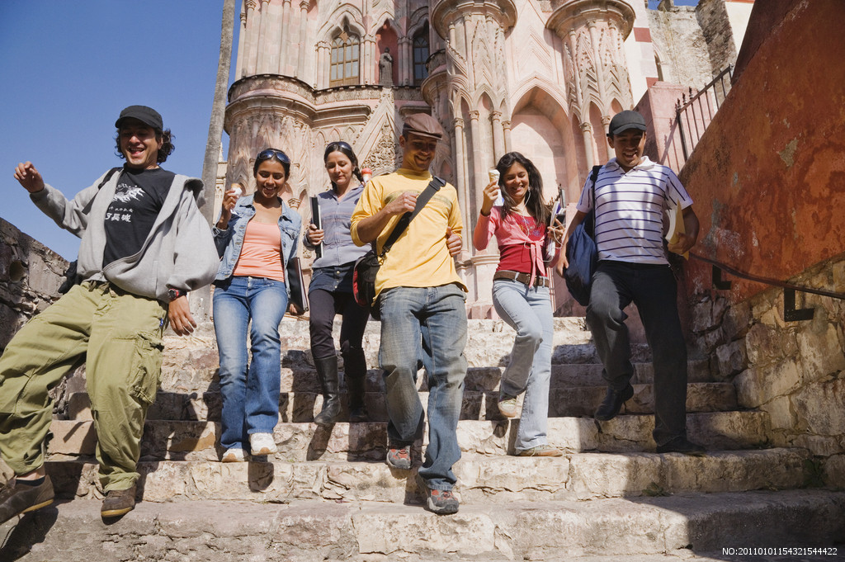
Speaking for communication
Group discussion
Present ideas
4
Present your ideas to the class.

Slide 57
Further practice in listening
Short conversations
1 Q: What do we know from the conversation about Addison?
B He changes jobs quite frequently.
2 Q: What does the man say about his job?
D He works to support his family.
3 Q: What does the woman think about her future?
A She has no idea about her future plan.
4 Q: What does the man say about his job?
C His well-paid job requires a lot of hard work.
5 Q: Why doesn’t the woman take the position?
C Because it will take her along the wrong career path.

Slide 58
Further practice in listening
Long conversation
1 Q: How does the woman prepare for the working world?
A She does not know where to start for her jobs.
2 Q: How did the man find his internship?
D He got information from the Internet.
3 Q: What advice does the man give to the woman?
B Seek help from the Career Center.
4 Q: What does the man think the woman needs most right now?
B A good plan.

Slide 59
Further practice in listening
Passage 1
1 Q: How has the number of working women with college degrees in the United States changed?
B It has increased 200 percent since 1970.
2 Q: What is the current situation of working women in the United States?
B Most women are engaged in lower-end jobs.
3 Q: What is the best-paying job for women?
A A physician or a surgeon.
4 Q: What does the speaker think of the job prospects for women in the United States?
D It is promising.

Slide 60

Further practice in listening
Passage 2
1) evaluate
2) compensation
3) negotiating
4) confirm
5) schedule
6) circumstances
7) turn down
8) start over
9) work out
10) informed

Slide 61
Wrapping up
Use the following self-assessment checklist to check what you have learned in this unit.
Skills | OK | Needs work
I can talk about different jobs and working experiences.
I can identify examples in speeches and conversations.
I can use different expressions to express likes or dislikes.
I can discuss money-making ideas.

Slide 62
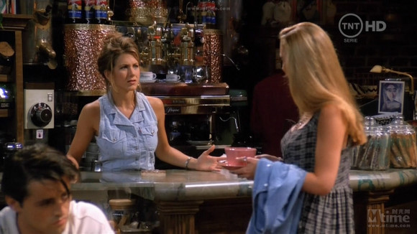
Fun time
Enjoy the video clip from Friends.

