Slide 1
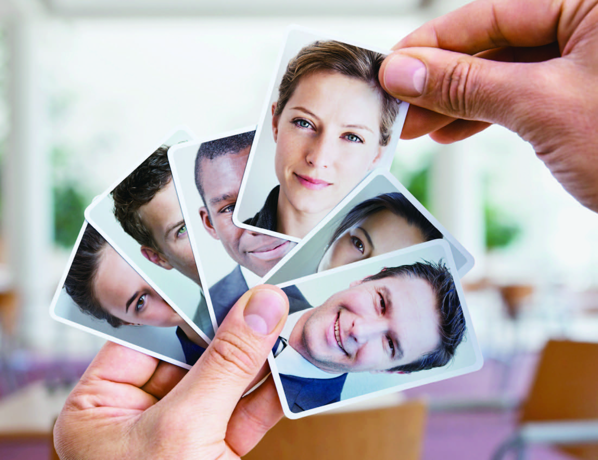
UNIT 8
Discovering your true identity

Slide 2
Unit 8 Discovering your true identity
Learning objectives
Opening up
Listening to the world
Speaking for communication
Further practice in listening
Wrapping up
Fun time

Slide 3

Learning objectives
1
talk about your family
2
take notes in a T-chart
3
introduce an opinion
4
create a new identity in a
computer game

Slide 4

Opening up
Look at the words in the box and answer the questions.
1 Which pair works together?
boss and employee
2 Which pair promises to help guide a child through life?
godfather and godmother
3 Which pair is going to get married?
fiancée and fiancé
4 Which pair involves one person learning from the other?
mentor and pupil

Slide 5
Opening up
Look at the words in the box and answer the questions.
5 Which pair involves one person renting a room from the other?
landlord and tenant
6 Which word describes people who play in the same sports team?
teammates
7 Which word describes people who go to the same class?
classmates

Slide 6
Opening up
Look at the words in the box and answer the questions.
8 Which word describes a person who is part of a club?
member
9 Which word is a general word for “someone who you do something with”?
partner
10 Which word refers to the members of your husband’s or wife’s family?
in-laws

Slide 7
Listening to the world
Sharing
Listening
Viewing

Slide 8
Listening to the world
Sharing
1
Watch a podcast for its general idea.
The podcast is mainly about what people know about their family, their similarities with parents or siblings, and what they know about their family history.
2
Watch Part 1 and fill in the blanks.
1) come from
2) most of my family
3) talking to people

Slide 9

Listening to the world
Cultural Notes
Brighton:
a town, historic county of Sussex, England, which makes up the major part of the city of Brighton and Hove. It is a seaside resort on the English Channel, 51 miles south of central London. It has been a popular place for holidays since the 18th century.

Slide 10

Listening to the world
Cultural Notes
Toronto:
the provincial capital of Ontario, located on the northern shore of Lake Ontario. It has the most populous (人口稠密的) metropolitan (大城市的) area in Canada and, as the most important city in Canada's most prosperous province, is the country's financial and commercial center.

Slide 11
Listening to the world
Sharing
3
Watch Part 2 and match the questions 1-6 to the people A-F.
____1 Who lives near his parents?
___ 2 Whose parents have lived in England for 25 years?
___ 3 Who has six younger brothers and sisters?
___ 4 Whose father passed away about 20 years ago?
___ 5 Who has a very good relationship with her sister?
___ 6 Who gets on very well with her brothers?
C
E
A
F
B
D

Slide 12

Listening to the world
Cultural Notes
Belfast:
A city, district, and capital of Northern Ireland. It became a city by royal charter in 1888. After the passing of the Government of Ireland Act, 1920, it became the seat of the government of Northern Ireland.

Slide 13
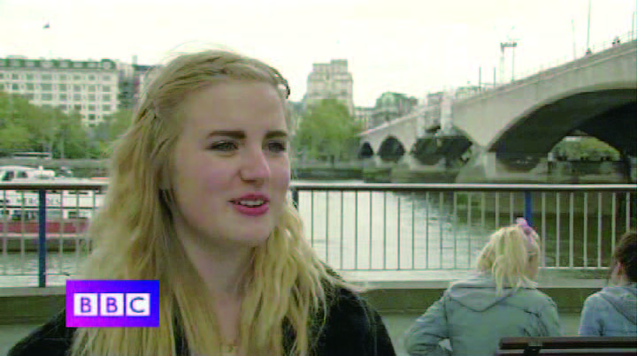
Listening to the world
Sharing
4
Watch Part 3 of the podcast and fill in the blanks.
A
I look a lot like my mom. We have, like, the same 1)___________ and build and face structure. And, I guess I have the 2)____________ as her. We, sort of, have a very similar personality in the way we 3)___________________, (and) the way we express ourselves.
height
same traits
think about things

Slide 14
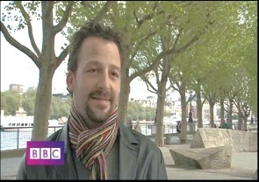
Listening to the world
Sharing
4
Watch Part 3 of the podcast and fill in the blanks.
4
B
I don’t think I’m very much like 4)____________ I think she’s very different from me. I think I’m 5)____________ my father: We both have a, 6)_______________ “science type” mind, um ... and I like to think I’m conscientious like my mother.
my sister
similar to
mathematical

Slide 15
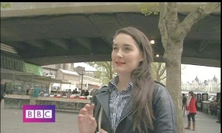
Listening to the world
Sharing
4
Watch Part 3 of the podcast and fill in the blanks.
C
I look quite a lot like my sister. But she’s like 7)_________________ of me. And she’s thinner. And then, my mom, she’s a bit more er, reserved, so she’s very 8)_____________ and my dad is a lot 9)____________ , a lot more enthusiastic.
a younger version
organized
louder

Slide 16
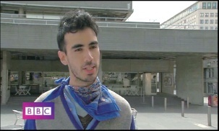
Listening to the world
Sharing
4
Watch Part 3 of the podcast and fill in the blanks.
D
Um, I’m 10)_____________like my dad, and, but can get quite, um, I think, maybe passionate like my mom.
quite calm

Slide 17
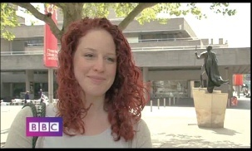
Listening to the world
Sharing
4
Watch Part 3 of the podcast and fill in the blanks.
E
I’m not very like 11)______________. Um, they are very similar to each other, but I’m 12)________________ I’m ... they’re more like my mom. I’m more like my dad.
my brothers
quite different

Slide 18
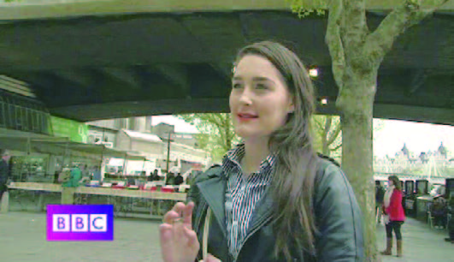
Listening to the world
Sharing
5
Watch Part 4 and check (✔) the true statements.
A
1 She found her name was of Scottish origin.
(Her name is supposed to be Scottish or Irish, but she has no idea where it’s really from.)

Slide 19
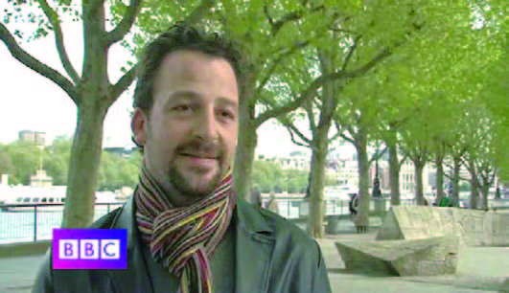
Listening to the world
Sharing
5
Watch Part 4 and check (✔) the true statements..
B
√
2 His family has a history of about four or five
hundred years on his father’s side.
3 His mother and her twin sister were adopted
from southwest Scotland.
(His mother and her sister were adopted from the northwest of England.)

Slide 20
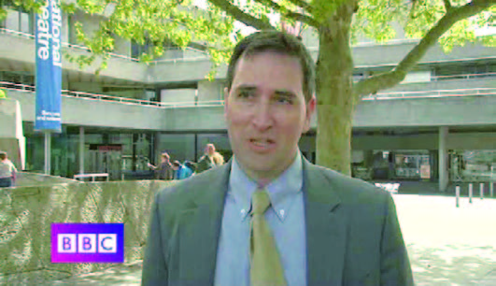
Listening to the world
Sharing
5
Watch Part 4 and check (✔) the true statements.
C
4 He started to retrace his family roots three years ago.
5 He went to Belfast and found the house where his
great-grandfather was born.
(He started to retrace his family roots last year.)
(He went to Belfast and found the house that his great-grandfather built.)

Slide 21
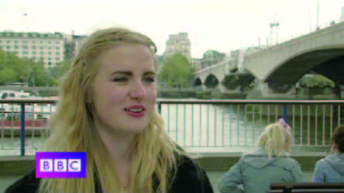
Listening to the world
Sharing
5
Watch Part 4 and check (✔) the true statements..
D
√
6 She would like to look into her family history in the
future.

Slide 22
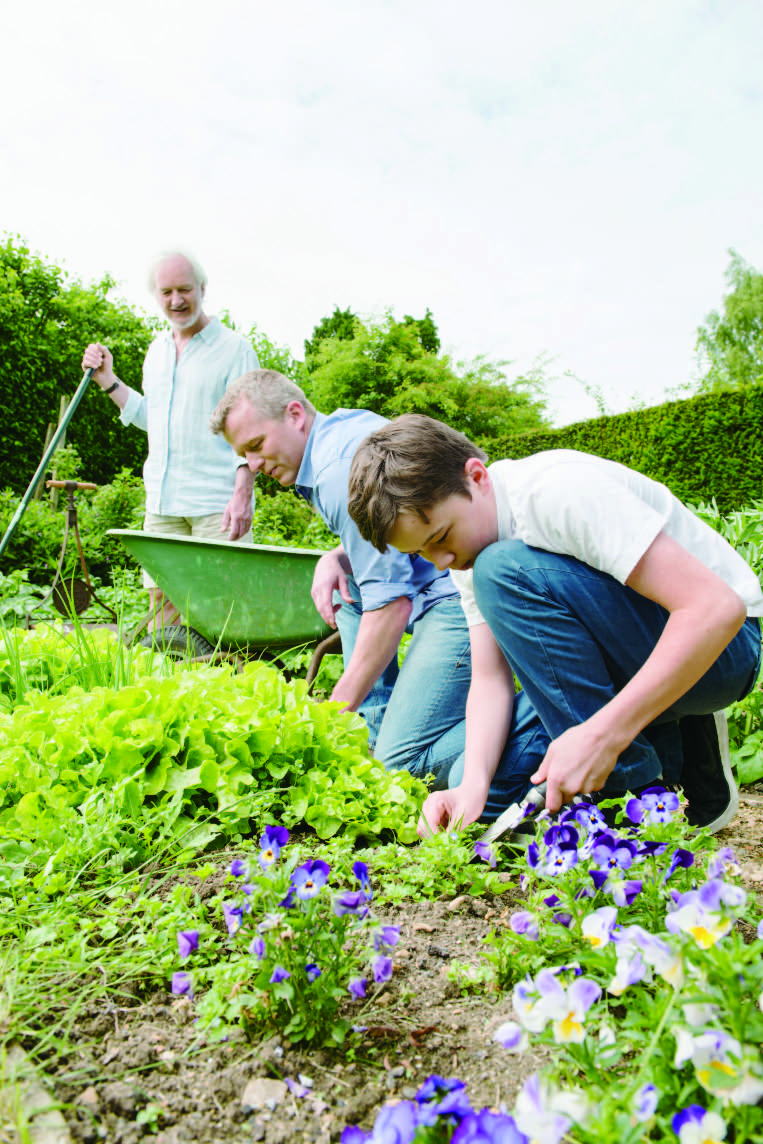
Listening to the world
Sharing
6
Work in pairs and answer the questions.
1 Where did your ancestors come from?
My ancestors came from the northeast of China. They moved to Zhejiang Province about 200 years ago.

Slide 23
Listening to the world
Sharing
6
Work in pairs and discuss the question.
2 Are you related to anyone famous? If yes, who is
he / she?
• No, I’m not related to anyone famous.
• Yes, I may have some connections with Confucius.
3 Which members of your family do you feel close to?
My grandmother, because I was brought up by her.

Slide 24
Listening to the world
Sharing
6
Work in pairs and discuss the question.
4 Have you ever met your great-grandparents? What do you know about them?
• No. Unfortunately, they died before I was born.
I know they were farmers.
• Yes, I’ve met my great-grandmother on my mother’s
side. She thought girls should receive more education
than boys, so she sent my grandfather’s younger
sister to university, while let my grandfather work to
support the whole family.

Slide 25
Listening to the world
Sharing
6
Work in pairs and discuss the question.
5 What family characteristics have you inherited?
I’m a bit shy and reserved, just like my father
and my older brothers.
6 Who in your family do you take after?
My mother. We look alike and we have similar characters.

Slide 26
Listening to the world
Sharing
Listening
Viewing

Slide 27
Listening to the world
Listening
BEFORE you listen
1
Work in pairs and answer the questions.
1 Which do you know better: your mother’s or
your father’s side of the family?
I know my father’s side of the family better. My grandparents have three children. Even after they all got married, they still live near my grandparents. Every weekend and every traditional Chinese festival, we all get together in my grandparents’ house.

Slide 28
Listening to the world
Listening
BEFORE you listen
1
Work in pairs and answer the questions.
2 What types of job do most of your relatives do?
My grandparents were doctors before they
retired. Their three children and their spouses
are all doing medicine-related work.
3 How many people are there in your immediate family?
I have a small family. There are three people in my family, my parents and I. It’s a typical nuclear family.

Slide 29
Listening to the world
Listening
Listening skills
Additional Tips
Taking notes in a T-chart
A T-chart is a T-shaped graphic organizer in which information is divided into two columns, each with an appropriate heading, thus allowing its users to conveniently list or examine two ideas or two facets of a topic.
take notes selectively take accurate notes use abbreviations use a skeleton outline and show importance by indenting special care should be taken not to write down the information in the wrong column

Slide 30
Listening to the world
Listening
WHILE you listen
2
Read the T-chart. Then listen to the interview and complete the T-chart.
 | His mother’s side | His father’s side
Origin | They all came from Yorkshire. | They came from Holland with William of Orange in 1) __________. His ancestors was William of Orange’s closest 2) _________for the Glorious Revolution.
Occupation | Most of his ancestors were either 3) _________, or in the church, or 4)______________.
1689
advisor
soldiers
sailors

Slide 31
Listening to the world
Listening
WHILE you listen
2
Read the T-chart. Then listen to the interview and complete the T-chart.
 | His mother’s side | His father’s side
Personality | They were very 5) _________ apparently. | His ancestors were 6) _________dull, until his grandfather married a woman whose 7) __________was Knowle. They’re all eccentrics, lovely and 8) ____________.
incredibly
dull
surname
great fun

Slide 32
Listening to the world
Listening
After you listen
3
Recall memorable events about your family.
My grandma is very kind to me and she teaches me a lot. On a birthday party for me at a restaurant, a doorman came to help me. I didn’t say anything to him. But, my grandma told me that every man deserves respect. From then on I began to say “Thank you!” to anyone who helped me.

Slide 33
Listening to the world
Sharing
Listening
Viewing

Slide 34
Listening to the world
Viewing
BEFORE you view
1
Read the program information below and answer the questions.
1 Have you ever experienced Second Life? If not, would
you like to spend time there? Why or why not?
No, I haven’t. But I would like to go there. I have heard about it and some of my friends have even been there. They strongly recommend this virtual community to me. I have a lot of interest in it.

Slide 35
Listening to the world
Viewing
BEFORE you view
1
Read the program information below and answer the questions.
2 In addition to what has been mentioned in the
program information, what else do you expect to be
able to do in a virtual community like Second Life?
• I can buy an island, build a farm and live a self-reliant life there.
• I can have magic power or some special talents which will empower me to do what I am not able to do reality.

Slide 36
Listening to the world
Viewing
WHILE you view
2
Watch the video clip and fill in the blanks.
I Second Life (general introduction)
• It’s a virtual world full of strange 1) ____________ and towns and buildings created by people who live here.
• The rules in Second Life are: 2) ____________________.
islands
There are no rules

Slide 37
Listening to the world
Viewing
WHILE your view
2
Watch the video clip and fill in the blanks.
II Reinventing yourself
an account
• Once you have created 3) ____________, you create an avatar, which is basically 4) ____________ version of yourself.
• You can choose your new body. You can be female, 5) ____________, or even something called a “Furry” – 6) ____________________, half human.
• You can 7) ____________ your appearance. You can look tall or 8) ____________ or fat or skinny.
• You can alter your 9) ____________ and get a hairdo.
• You can tweak your 10) ____________.
• Finally you 11) ____________ an outfit.
a digital
male
half animal
edit
short
face
features
pick

Slide 38
Listening to the world
Viewing
WHILE your view
2
Read the notes. Then watch the video clip and fill in the blanks.
III Socializing
• Second Life is all about creating your own online 12) ____________ and socializing: It’s going to online concerts, going into 13)____________________ and trying on shoes; it’s dressing up.
• Second Life claims to have 14) ___________
individual residents from all over the world living there. You can go up to anyone and 15) ____________.
personality
online stores
over three million
chat

Slide 39
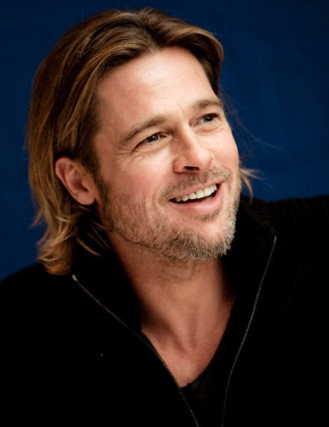
Listening to the world
Cultural Notes
Brad Pitt:
An American actor and film producer known as much for his versatility ( 多才多艺) as he is for his handsome face. By 2012, he has received four Academy Award nominations ( 提名) and five Golden Globe Award nominations, winning one Golden Globe.

Slide 40
Listening to the world
Viewing
AFTER you view
3
Work in pairs and discuss the questions.
1 What might you enjoy about Second Life? What would you not like about it?
• I can reinvent myself, a totally different me from the one in reality.
• I don’t like the way of socializing with other people. I still prefer communicating with real people to communicating with avatars.

Slide 41
Listening to the world
Viewing
AFTER you view
3
Work in pairs and discuss the questions.
2 Do you think that people could become addicted to Second Life? Why?
• Yes, I think people could become addicted to
Second Life. Although Second Life is a virtual
community, it gives its users a life-like experience.
• What makes users addicted to it, I think, is the
sense of achievement and satisfaction that they
cannot obtain from the real life.

Slide 42
Listening to the world
Viewing
AFTER you view
3
Work in pairs and discuss the questions.
3 What do you think are the positive and negative effects of Second Life on its users’ real life?
The positive effects | The negative effects
give people the chance to meet people worldwide allow interaction in a very realistic way offer creative outlet users can make real money | communication can be difficult a likely place for identity theft and fraud some users get addicted to it

Slide 43
Speaking for communication
Role-play
1
Read the questions. Then listen to three conversations and answer the questions.
Conversation 1
1 What does the man want to practice?
The man wants to practice English speaking and
listening.
2 What types of classes are there in the afternoon?
There are special classes with a special focus like
English idioms, conversation and pronunciation in the
afternoon.

Slide 44
Speaking for communication
Role-play
1
Read the questions. Then listen to three conversations and answer the questions.
Conversation 2
1 What did the girl organize at the summer camp?
The girl organized games for children at the summer
camp.
2 What “can be difficult” according to the interviewer?
Different ages together can be difficult according to the interviewer.

Slide 45
Speaking for communication
Role-play
1
Read the questions. Then listen to three conversations and answer the questions.
Conversation 3
1 What does the man want to know?
He wants to get information about online classes.
2 Why are online courses more difficult than face-to- face courses, according to the interviewer?
According to the interviewer, the reading and writing for online courses are really quite demanding.

Slide 46
Speaking for communication
Role-play
2
Listen to the three conversations again and write down the expressions that are used to introduce an opinion.
Conversation 1: 1) _____________________________
____________
Conversation 2: 2) _____________________________
3) _____________________________
Conversation 3: 4) _____________________________
So for me the most important thing
is to...
I suppose I’d have to say …
In my opinion,…
One thing I’d like to say is that …

Slide 47
Speaking for communication
Role-play
Speaking skills
Additional Tips
Expressions of introducing an opinion
Expressions | Usage
I’m afraid (that) | It is used to introduce apologetic refusals and bad news.
I mean | It is used to correct or soften something the speaker has just said.
I think, I guess, I reckon, and in my view / opinion | They are used to make opinions sound less dogmatic.

Slide 48
Speaking for communication
Role-play
Speaking skills
Additional Tips
Expressions of introducing an opinion
Expressions | Usage
As / So far as I’m concerned | It is used when you are giving your opinion about something, especially when this may be different from other people’s opinions.
If you want my advice / opinion | It is used for emphasizing that you are giving someone your honest advice / opinion, perhaps without being asked for it
So to speak, more or less, and sort / kind of | They are used to soften something which might upset other people

Slide 49
Speaking for communication
Role-play
3
Work in pairs and role-play the following situations. Use the skills for introducing an opinion.
Situation 1: An interview at a business school
A: Hello, can I help you?
B: Yes, I am quite interested in the marketing course you offer.
A: Well, marketing is one of the required courses for students in our school. Why do you want to take this course?
B: I’m going to graduate from university next year, and I would like to try to get a job as a salesman. As I see it, some knowledge about marketing is essential for a salesman.
A: Yes, you’re right. And I believe that this course will provide exactly what a salesman needs. Have you got any working experience in this field?
(To be continued)

Slide 50
Speaking for communication
Role-play
3
Work in pairs and role-play the following situations. Use the skills for introducing an opinion.
B: Well, I worked as a part-time salesman during this summer holiday.
A: I see. What do you expect to learn from this course?
B: I’m not quite sure. Personally, I think I need to learn how to control such elements as product policy, channels of distribution, communication and pricing to satisfy the needs of customers in a profitable way.
A: I see. Then I’m sure this course will offer what you need. In addition, this course will demonstrate the role of marketing in the company, and explore the relationship of marketing to other functions.
B: I’m convinced that this course is exactly what I need. Could I ask some questions about the course?
(To be continued)

Slide 51
Speaking for communication
Role-play
3
Work in pairs and role-play the following situations. Use the skills for introducing an opinion.
A: Go ahead, please.
B: How often do we meet for classes?
A: Once a week.
B: Do I have any other opportunities to meet my tutor apart from during class?
A: Yes. That’s every Thursday afternoon, three to four.
B: I see. Thank you!

Slide 52
Speaking for communication
Role-play
3
Work in pairs and role-play the following situations. Use the skills for introducing an opinion.
Situation 2: Shall we get an air conditioner?
A: It is getting increasingly hot. I’m thinking of installing an air conditioner in the dorm. What do you think?
B: If you ask me, it is not necessary to install one. When it is getting really hot, we will be at home to spend the summer holidays.
A: But there is still one month before we go home. And more importantly, when we are having the final exams, it will be over 30°C .
B: But I think that it is unnecessary to spend so much money to buy an air conditioner just for two or three weeks, not to mention the electricity bill.
(To be continued)

Slide 53
Speaking for communication
Role-play
3
Work in pairs and role-play the following situations. Use the skills for introducing an opinion.
A: For me the most important thing is not money, but to have a good rest during the examination time. I couldn’t sleep well without an air conditioner in hot weather.
B: Anyhow, it’s perfectly OK for me to go without an air conditioner. And I’m afraid that the other two roommates don’t need an air conditioner either.
A: I will talk to them later. One thing I’d like to say is that it is still very hot in September and October in this city. I believe that you’ll find that an air conditioner is essential at the beginning of next semester.

Slide 54
Speaking for communication
Group discussion
Get ideas
1
Read the questions. Then listen to a woman talking about her avatar and answer the questions.
1 Where did she hear about Second Life?
2 What did she change about her appearance?
She didn’t change her appearance very much except her hair color.
3 What job did she decide to do in Second Life?
She decided to be a businesswoman in Second Life.
She heard about Second Life on BBC breakfast TV.

Slide 55
Speaking for communication
Group discussion
Get ideas
1
Read the questions. Then listen to a woman talking about her avatar and answer the questions.
4 What is the “one thing that hasn’t changed” for her in
Second Life?
Her personality is the one thing that hasn’t changed.
5 What type of buildings does she talk about?
It’s a shop. You can set up and pay for the building.
Then you can work in it as a businesswoman.

Slide 56
Speaking for communication
Group discussion
Get ideas
2
Read the expressions. Then listen to the talk again and check (✔) the expressions you hear.
☐ 1 (You can) create a different version of yourself.
☐ 2 I reinvented myself as ...
☐ 3 I created a new image of myself.
☐ 4 I didn’t change my appearance that much.
☐ 5 One thing I decided to alter was ...
☐ 6 One thing that hasn’t changed is ...
☐ 7 My avatar is based on …
√
√
√
√
√

Slide 57
Speaking for communication
Group discussion
Discuss and organize ideas
3
Work in pairs. Think of the following questions and create a different version of yourself in Second Life.
What would your appearance be like?
What kind of personality would you have?
What job would you like to do?
What is your dream?
What kind of people would you like to meet?
What kind of places would you like to visit? …

Slide 58
Speaking for communication
Group discussion
Discuss and organize ideas
4
Use the following table to organize information about the new identity you create.
name
age
height
weight
hair color
eye color
personality
job
dream
people I’d like to meet
favorite places to hang out
motto or personal philosophy

Slide 59
Speaking for communication
Group discussion
Present ideas
5
Describe your new identity to your group members.
I’m a 22-year-old girl studying in a Chinese university. I want to create a new image of myself. One thing I decide to alter is my appearance. I hope I can be 175 cm tall, and my weight is about 50 kg. I want to make my eyes blue and my hair blonde. I want to become a fashionable and attractive girl so that I can become a good actress and a charming cover girl. I want to be famous. I won’t change my personality much. I will still be a positive, easy-going and honest girl as I am now.

Slide 60
Speaking for communication
Group discussion
Present ideas
5
Describe your new identity to your group members.
But I hope I can be more outgoing. The things that haven’t changed are my perception of perfect happiness and my dream. For me, perfect happiness means perfect health, lots of money in my wallet and lots of love in my heart. Traveling around the world has long been my dream. I want to have enough money and time to go traveling, and I want to go to different places in the world and meet a lot of humorous and knowledgeable people. And when I come back home, I want to hang out with my friends at coffee bars and shopping malls. I long for that exciting and fun life, and I bet I’ll enjoy it.

Slide 61
Further practice in listening
Short conversations
1 Q: What does the man mean?
B He hopes that the woman can stay at this job for a
long time.
2 Q: What’s the relationship between Robert and Rose?
C Half-brother and half-sister.
3 Q: How will identity thieves use the stolen personal information?
C They will use the credit cards in your name without
paying the bills.
4 Q: What does the woman think of her female boss?
D She is considerate.
5 Q: Why didn’t the woman see Barry yesterday?
A He has already changed his job.

Slide 62
Further practice in listening
Long conversation
1 Q: Why did Charlie feel stressed?
C Because he had to make a crucial decision.
2 Q: What does Ms. Parker say about changing majors?
D Most students change their major at least once.
3 Q: What kind of person is Charlie?
A He is a big picture kind of guy.
4 Q: What major does Ms. Parker suggest that Charlie
may choose?
B Marketing.

Slide 63

Further practice in listening
Passage 1
1 Q: How many differences between female and male
managers are mentioned in the passage?
C Four.
2 Q: How do the female bosses treat the individuals they
work with?
C Female bosses usually encourage them and
guide them.
3 Q: What is the possible reason that female managers
are more likely to get their work done on time?
A Because they are more likely to be dismissed for
poor work.
4 Q: What can we learn from the passage about women
managers?
B Women managers often face a double standard.

Slide 64

Further practice in listening
Passage 2
1) infancy
2) assumed
3) inherited
4) rooted
5) fairs
6) compensate for
7) cement
8) witness
9) exposed to
10) contributed to

Slide 65
Wrapping up
Use the following self-assessment checklist to check what you have learned in this unit.
Skills | OK | Needs work
I can talk about my family.
I can take notes in a T-chart.
I can introduce an opinion.
I can describe a new identity I created.

Slide 66
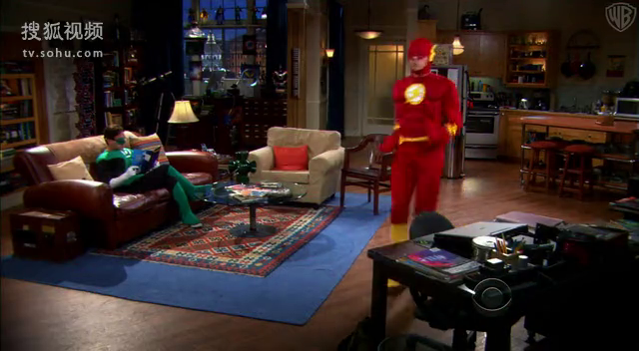
Fun time
Enjoy the video clip from The Big Bang Theory.

