Slide 1
INTERIM EVIDENCE · 10 OCT 2026
Noise-Calibrated
Silent Explanation Drift
20 / 140
registered Exp. 3 Phase-I runs
currently in the local interim slice
Architecture, intervention benchmark, and partial real-data evidence
NOT THE FINAL FOUR-DATASET RESULT
Current verdict
Operable measurement; saturated decision; no established innovation.
Locked target: prediction · forgetting · silent explanation drift · non-suppressive governance
Evidence scope: frozen Exp. 2 + interim Exp. 3 subset; full HPC comparison pending
1

Slide 2
Research architecture: questions before mechanisms
The research object is not NCD, OFRA, BARE, SHAP, or a learner swap.
Can a task-free class-incremental NIDS preserve useful predictions while its explanation basis changes silently?
RQ1 · MANDATORY
RQ2 · MATCHED
RQ3 · OPEN
Measure silent drift
Quantify trade-offs
Test governance
Frequency, magnitude, agreement, and threshold sensitivity across checkpoints.
Accuracy, class safety, forgetting, memory, runtime, and explanation cost.
Non-suppressive evidence logging with binary decision invariance. Not yet validated.
NCD is a candidate measurement mechanism. A detector gain, threshold, wrapper, or model swap alone cannot satisfy the substantive-innovation gate.
Source: RESEARCH_TARGET_LOCK.md and paper_ncd/paper.tex
2

Slide 3
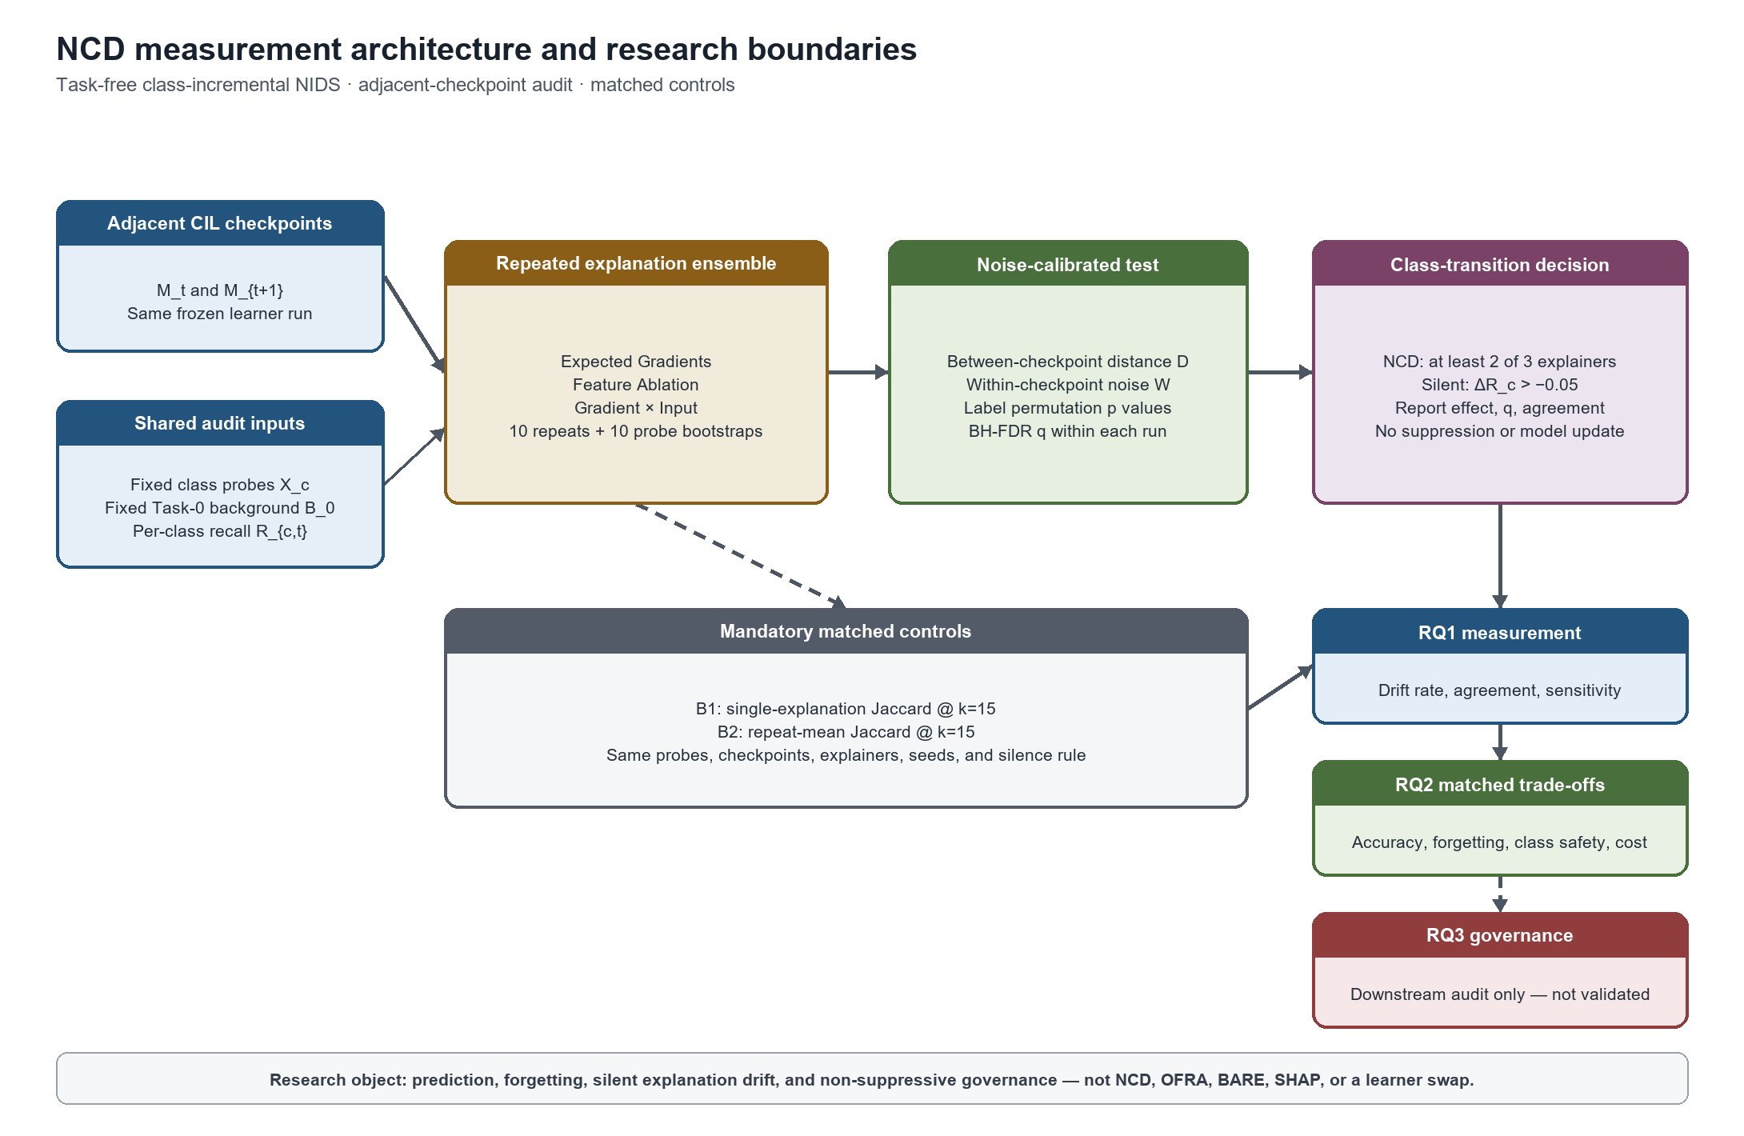
Frozen observations → repeated explanations → permutation/FDR → 2-of-3 consensus → non-suppressive audit
3

Slide 4
Exp. 2: intervention-grounded detector counts
Five seeds per cell; B2 is the repeat-mean Jaccard control.
Dataset
Learner
NCD FP
B2 FP
NCD P1
B2 P1
NCD P2
B2 P2
NSL-KDD
Replay
0/34
0/34
8/8
8/8
5/5
5/5
UNSW-NB15
Replay
0/30
0/30
5/5
5/5
4/4
4/4
NSL-KDD
iCaRL
0/20
0/20
9/9
9/9
—
—
UNSW-NB15
iCaRL
1/20
0/20
4/4
4/4
—
—
100%
1 vs 0
20–34
eligible P1/P2 cases detected by both NCD and B2
false positives: NCD versus B2 in UNSW iCaRL
negative controls per cell: too few for population FPR <5%
Decision: benchmark operability is supported; NCD superiority is not.
Source: frozen Exp. 2 five-seed intervention matrix
4

Slide 5
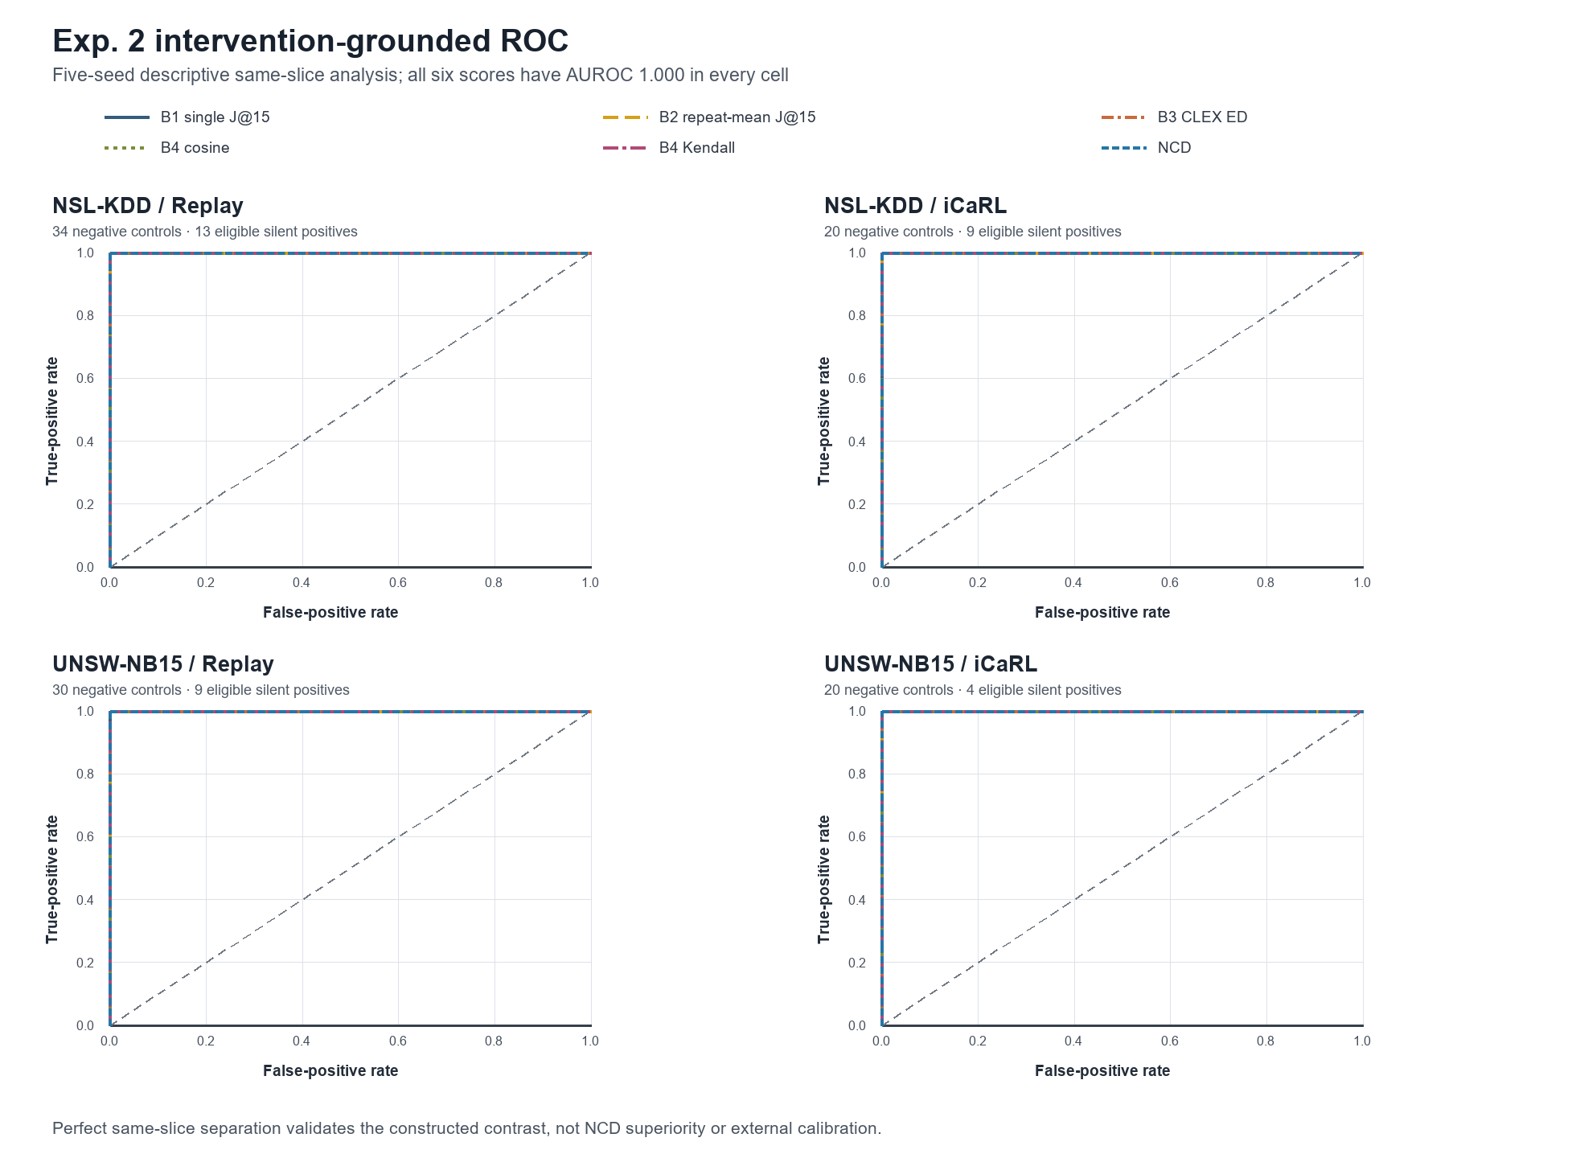
Exp. 2: same-slice separability is perfect—and non-identifying
All six continuous scores reach AUROC 1.000 in each frozen dataset–learner cell.
What the curves show
Constructed eligible positives are separable from negative controls.
What they do not show
External calibration, deployment discrimination, causal validity, or NCD superiority.
NO NOVELTY CLAIM
Source: paper_ncd/figures/exp2_four_cell_roc.png
5

Slide 6
Exp. 3 interim: performance and drift rates
20/140 Phase-I runs: two datasets × Replay/iCaRL × five seeds. Percentages are seed means or pooled eligible-unit rates.
Dataset
Learner
Acc.
BAcc.
Macro F1
Forget.
B1 drift
B2 drift
NCD drift
NSL-KDD
Replay
79.98
59.96
59.73
2.82
62.96
59.26
100.00
NSL-KDD
iCaRL
77.54
70.90
62.68
6.57
30.30
30.30
96.97
UNSW-NB15
Replay
63.30
42.13
34.00
33.44
31.67
30.00
98.33
UNSW-NB15
iCaRL
51.22
46.06
28.15
35.45
18.87
18.87
98.11
2.82–35.45%
96.97–100%
20 / 140
mean forgetting across cells
NCD drift rate: near saturation
registered runs represented
Interim only: excludes CIC-IDS2017, CIC-IDS2018, and five learner families
6

Slide 7
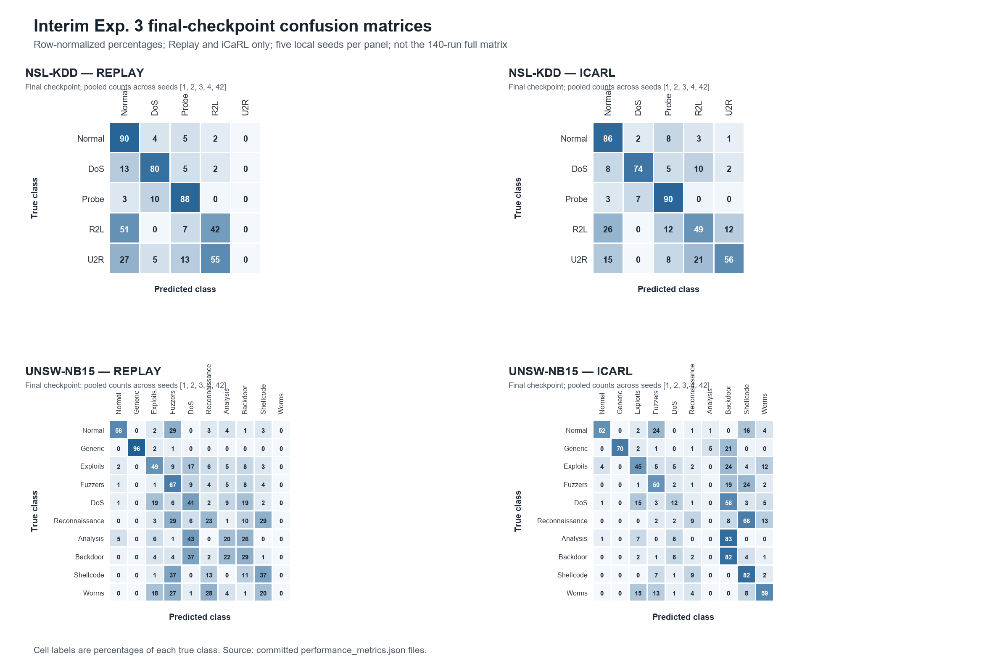
Final-checkpoint confusion matrices expose class-specific failure
Raw counts pooled over seeds 1, 2, 3, 4, and 42, then row-normalized within each true class.
Reading rule
Diagonal cells are per-class recall. Off-diagonal cells show which attacks collapse into another class or Normal.
Why it matters
Headline accuracy cannot certify class safety. The full result must retain per-class and Normal behaviour.
DESCRIPTIVE · 20 RUNS
Source: paper_ncd/figures/partial_exp3_confusion_matrices.png
7

Slide 8
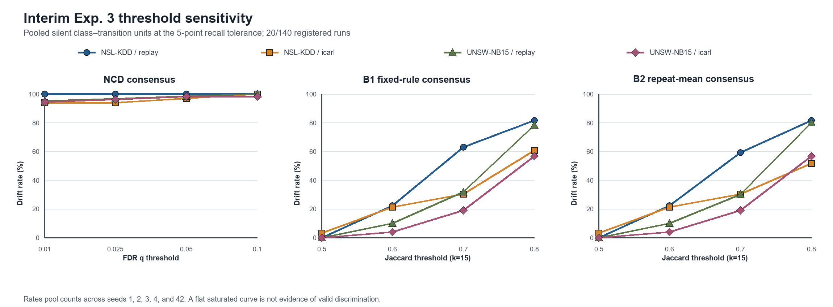
Threshold audit: calibration does not prevent saturation
Pooled silent units at the five-point recall tolerance.
93.94–100%
NCD drift across q = 0.01–0.10
Flatness here is an undesirable saturation result—not threshold robustness.
93.94–100%
46.99–106.86 s
3569–4057×
all-explainer agreement; invalidated by decision saturation
NCD permutation time per dataset–method cell over five seeds
fixed-rule decision time, despite only 3.29–3.65% of explanation time
Decision: the calibrated rule is currently less selective and more expensive than the matched fixed controls.
Source: q/Jaccard sensitivity and runtime aggregation for the 20-run subset
8

Slide 9
CURRENT EVIDENCE VERDICT
The measurement works.
The innovation claim does not—yet.
HPC completion path
12 registered owned jobs
4 primary training/explanation
4 performance aggregation
4 drift aggregation
No duplicate submission.
Final paper and deck update only after terminal, hash-verified evidence.
SUPPORTED
Repeated explanations and intervention constructions are auditable.
NEGATIVE
NCD ties B2 on eligible positives, adds one false positive, and saturates on the interim real-data slice.
OPEN
Full 4-dataset × 7-method × 5-seed comparison, cross-explainer validity, future-recall relation, and RQ3 governance.
No current result establishes substantive innovation, cross-domain generality, or validated governance.
Next: replace interim tables only after all registered jobs complete and protected artifacts pass audit
9

