Slide 1
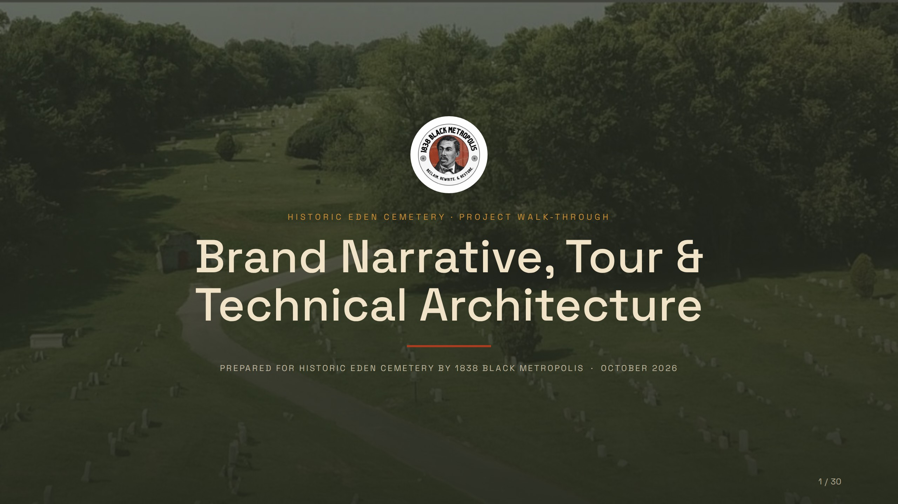
Notes:
HISTORIC EDEN CEMETERY · PROJECT WALK-THROUGH
Brand Narrative, Tour &
Technical Architecture
PREPARED FOR HISTORIC EDEN CEMETERY BY 1838 BLACK METROPOLIS · OCTOBER 2026

Slide 2
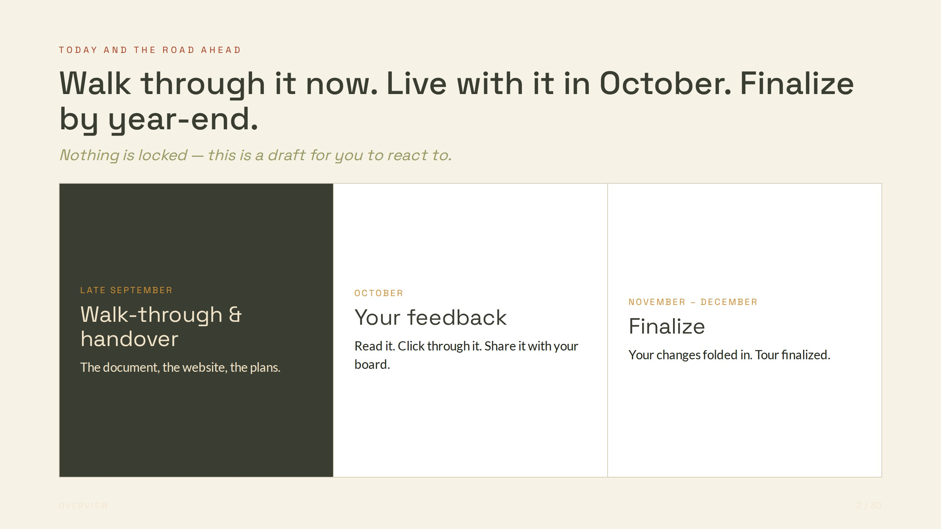
Notes:
TODAY AND THE ROAD AHEAD
Walk through it now. Live with it in October. Finalize by year-end.
Nothing is locked — this is a draft for you to react to.
LATE SEPTEMBER
Walk-through & handover
The document, the website, the plans.
OCTOBER
Your feedback
Read it. Click through it. Share it with your board.
NOVEMBER – DECEMBER
Finalize
Your changes folded in. Tour finalized.

Slide 3
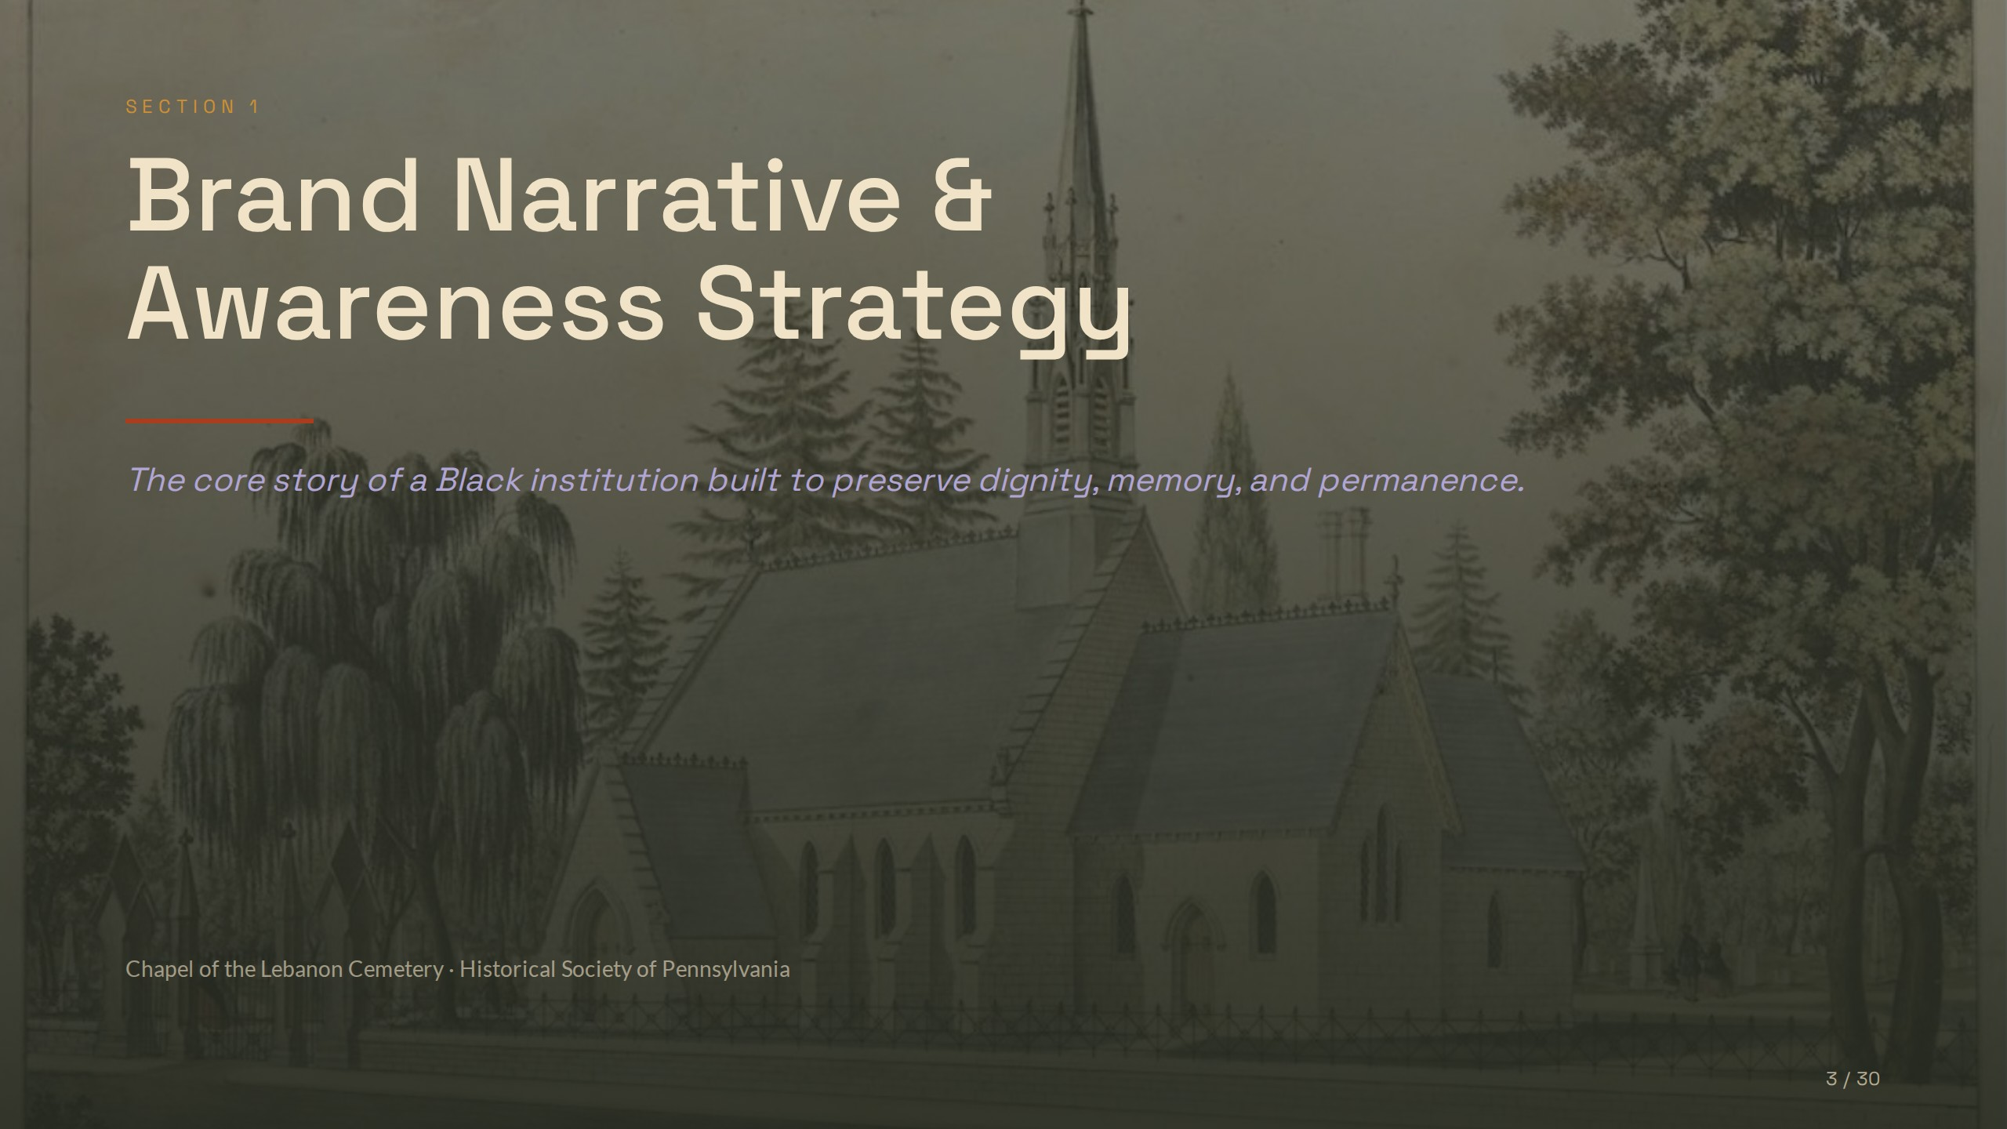
Notes:
SECTION 1
Brand Narrative &
Awareness Strategy
The core story of a Black institution built to preserve dignity, memory, and permanence.
Chapel of the Lebanon Cemetery · Historical Society of Pennsylvania

Slide 4
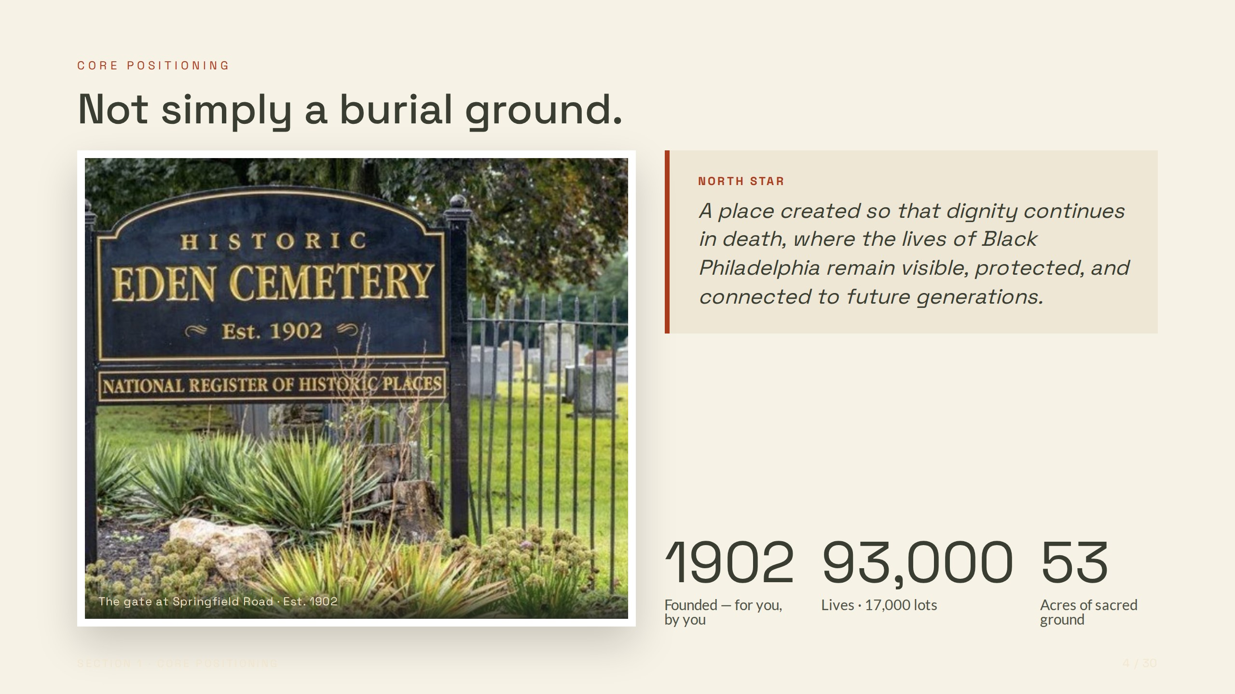
Notes:
CORE POSITIONING
Not simply a burial ground.
The gate at Springfield Road · Est. 1902
NORTH STAR
A place created so that dignity continues in death, where the lives of Black Philadelphia remain visible, protected, and connected to future generations.
1902
Founded — for you, by you
93,000
Lives · 17,000 lots
53
Acres of sacred ground

Slide 5
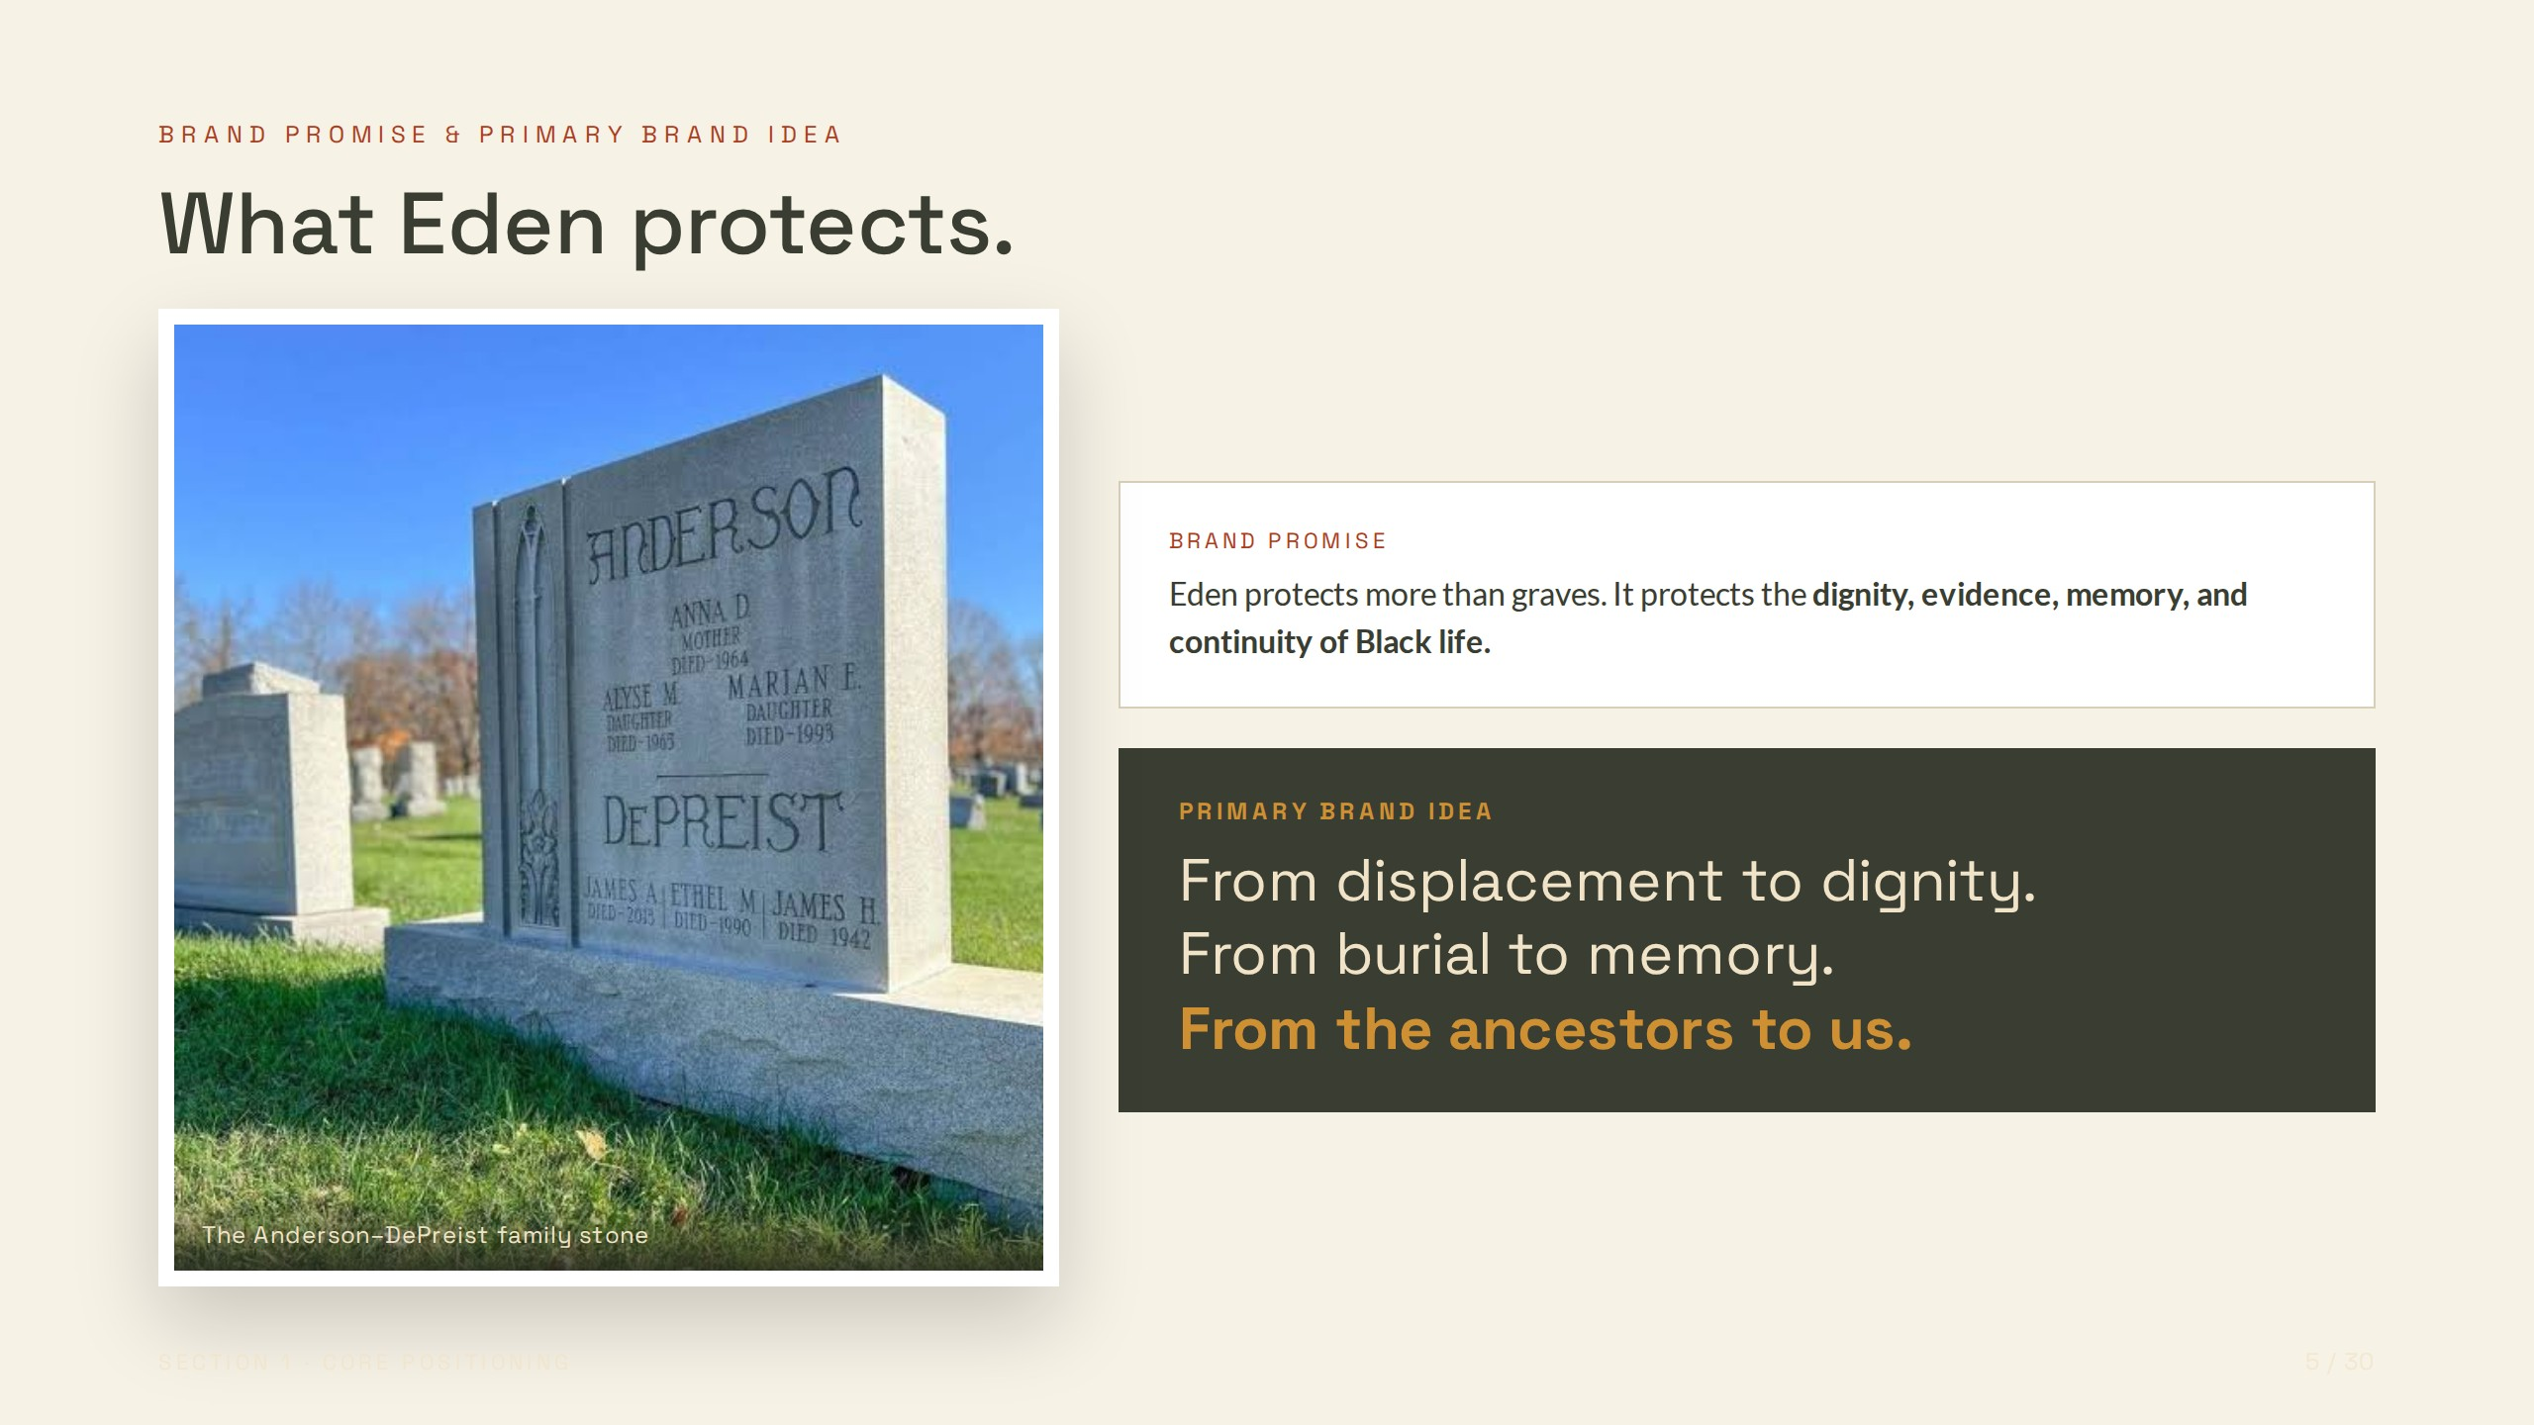
Notes:
BRAND PROMISE & PRIMARY BRAND IDEA
What Eden protects.
The Anderson–DePreist family stone
BRAND PROMISE
Eden protects more than graves. It protects the dignity, evidence, memory, and continuity of Black life.
PRIMARY BRAND IDEA
From displacement to dignity.
From burial to memory.
From the ancestors to us.

Slide 6
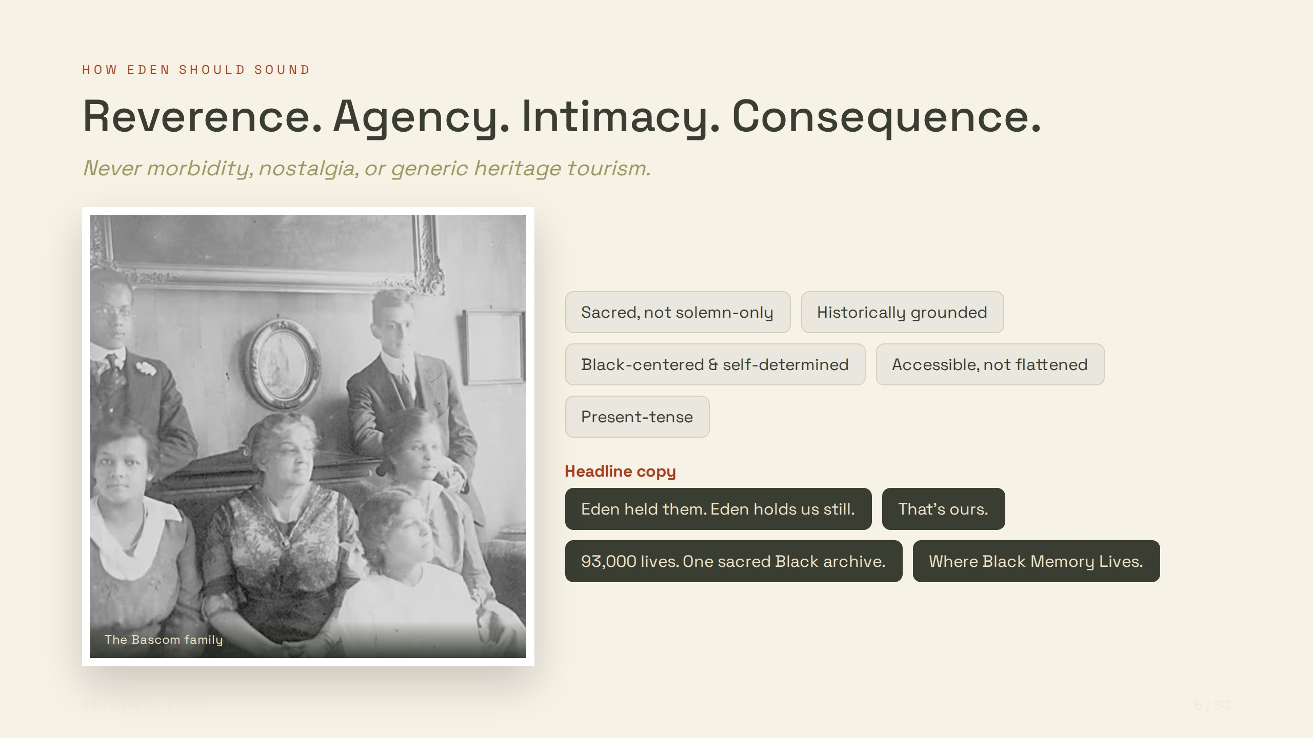
Notes:
HOW EDEN SHOULD SOUND
Reverence. Agency. Intimacy. Consequence.
Never morbidity, nostalgia, or generic heritage tourism.
The Bascom family
Sacred, not solemn-only
Historically grounded
Black-centered & self-determined
Accessible, not flattened
Present-tense
Headline copy
Eden held them. Eden holds us still.
That's ours.
93,000 lives. One sacred Black archive.
Where Black Memory Lives.

Slide 7
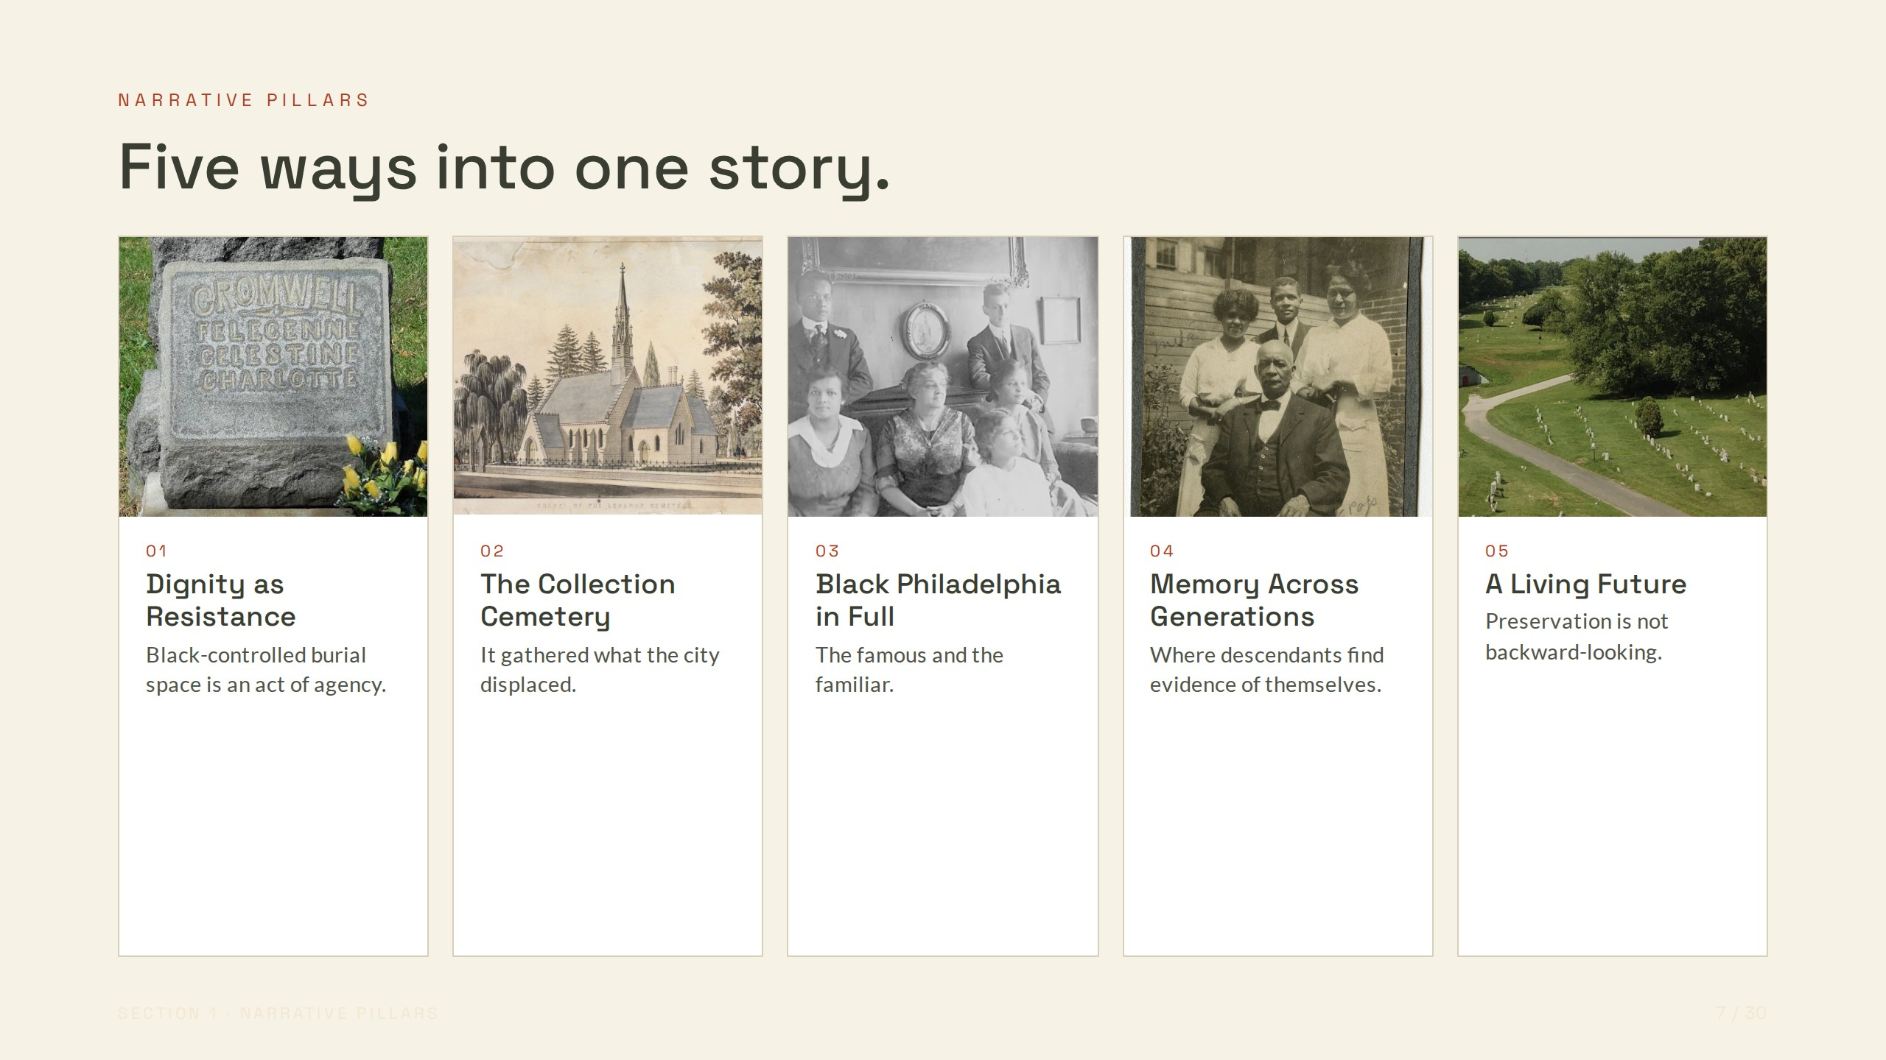
Notes:
NARRATIVE PILLARS
Five ways into one story.
01
Dignity as Resistance
Black-controlled burial space is an act of agency.
02
The Collection Cemetery
It gathered what the city displaced.
03
Black Philadelphia in Full
The famous and the familiar.
04
Memory Across Generations
Where descendants find evidence of themselves.
05
A Living Future
Preservation is not backward-looking.

Slide 8
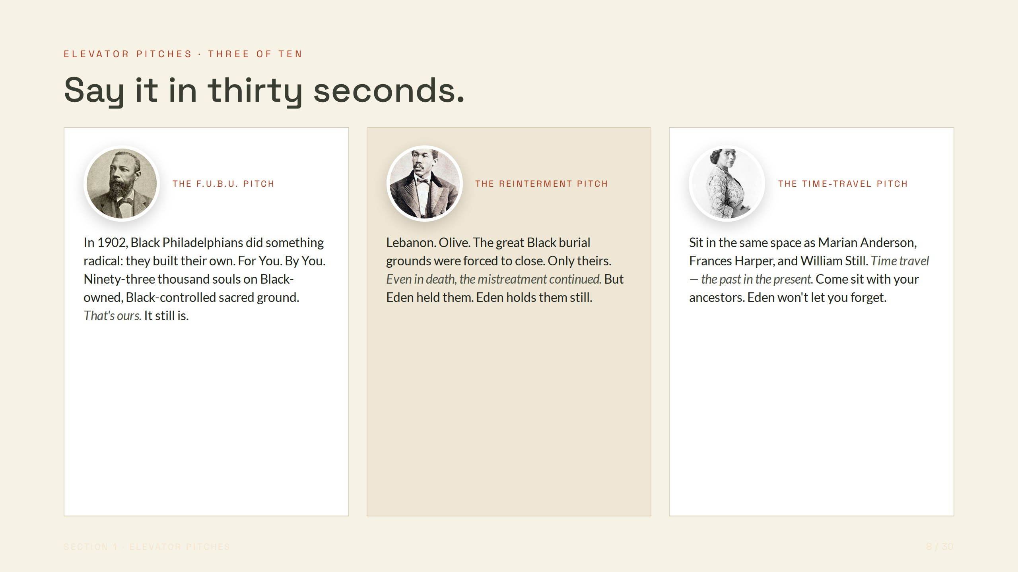
Notes:
ELEVATOR PITCHES · THREE OF TEN
Say it in thirty seconds.
THE F.U.B.U. PITCH
In 1902, Black Philadelphians did something radical: they built their own. For You. By You. Ninety-three thousand souls on Black-owned, Black-controlled sacred ground. That's ours. It still is.
THE REINTERMENT PITCH
Lebanon. Olive. The great Black burial grounds were forced to close. Only theirs. Even in death, the mistreatment continued. But Eden held them. Eden holds them still.
THE TIME-TRAVEL PITCH
Sit in the same space as Marian Anderson, Frances Harper, and William Still. Time travel — the past in the present. Come sit with your ancestors. Eden won't let you forget.

Slide 9
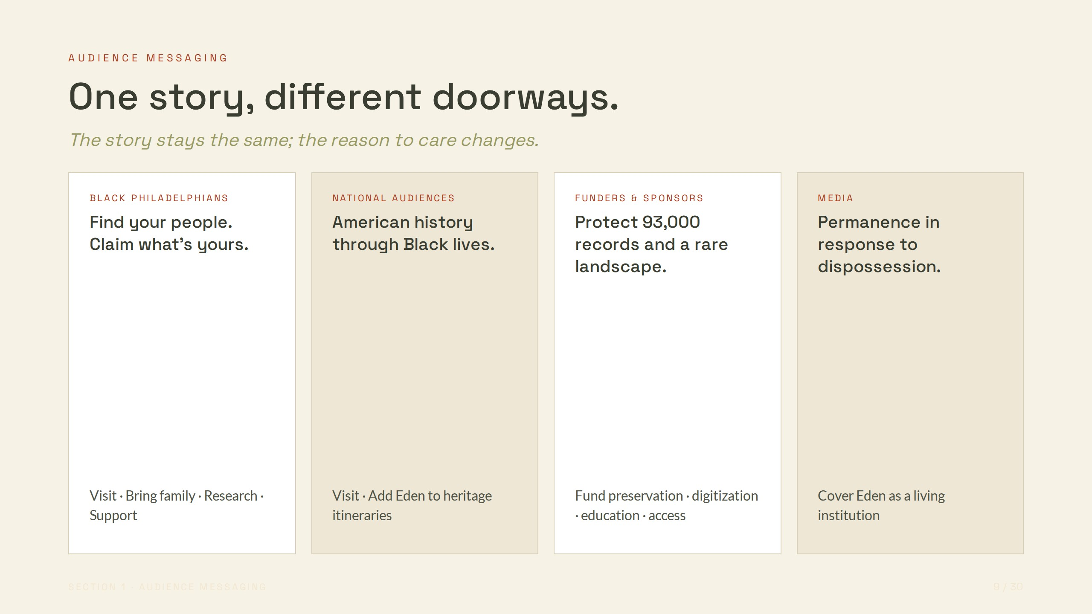
Notes:
AUDIENCE MESSAGING
One story, different doorways.
The story stays the same; the reason to care changes.
BLACK PHILADELPHIANS
Find your people. Claim what's yours.
Visit · Bring family · Research · Support
NATIONAL AUDIENCES
American history through Black lives.
Visit · Add Eden to heritage itineraries
FUNDERS & SPONSORS
Protect 93,000 records and a rare landscape.
Fund preservation · digitization · education · access
MEDIA
Permanence in response to dispossession.
Cover Eden as a living institution

Slide 10
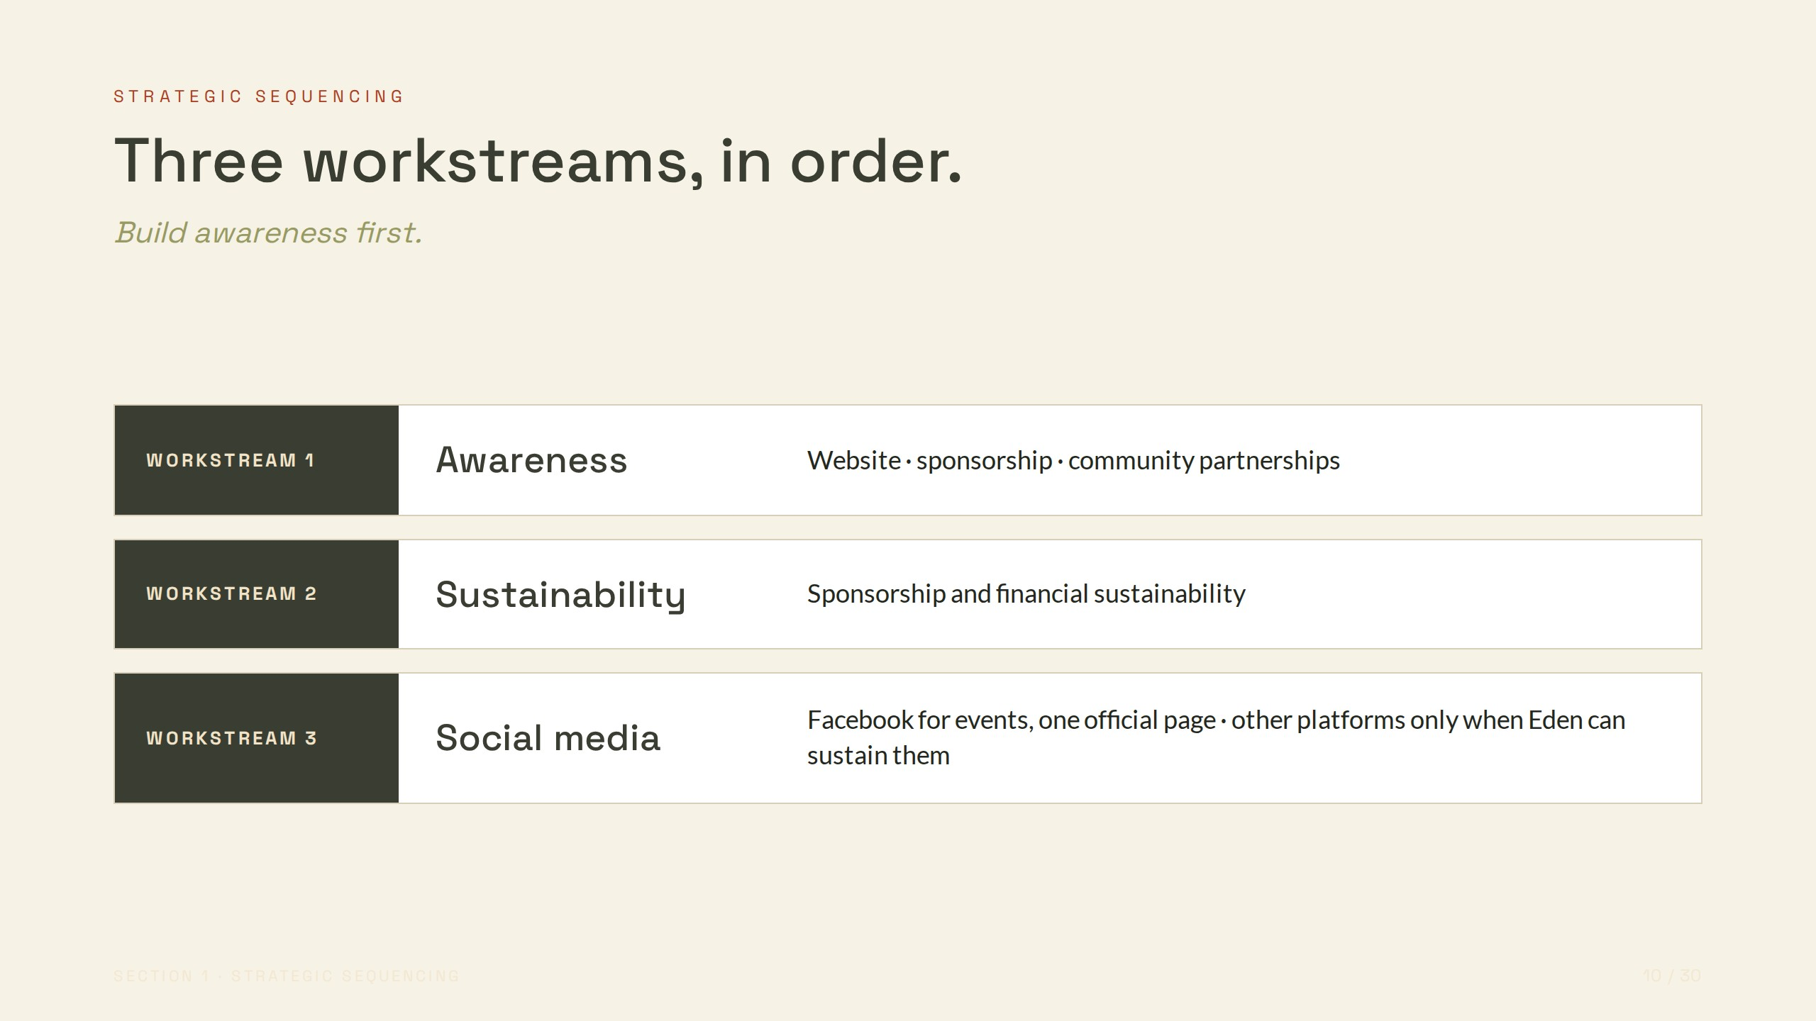
Notes:
STRATEGIC SEQUENCING
Three workstreams, in order.
Build awareness first.
WORKSTREAM 1
Awareness
Website · sponsorship · community partnerships
WORKSTREAM 2
Sustainability
Sponsorship and financial sustainability
WORKSTREAM 3
Social media
Facebook for events, one official page · other platforms only when Eden can sustain them

Slide 11
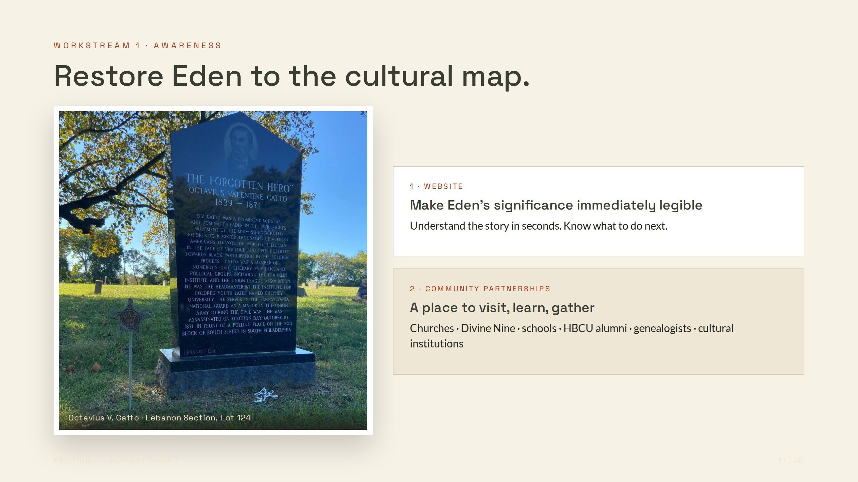
Notes:
WORKSTREAM 1 · AWARENESS
Restore Eden to the cultural map.
Octavius V. Catto · Lebanon Section, Lot 124
1 · WEBSITE
Make Eden's significance immediately legible
Understand the story in seconds. Know what to do next.
2 · COMMUNITY PARTNERSHIPS
A place to visit, learn, gather
Churches · Divine Nine · schools · HBCU alumni · genealogists · cultural institutions

Slide 12
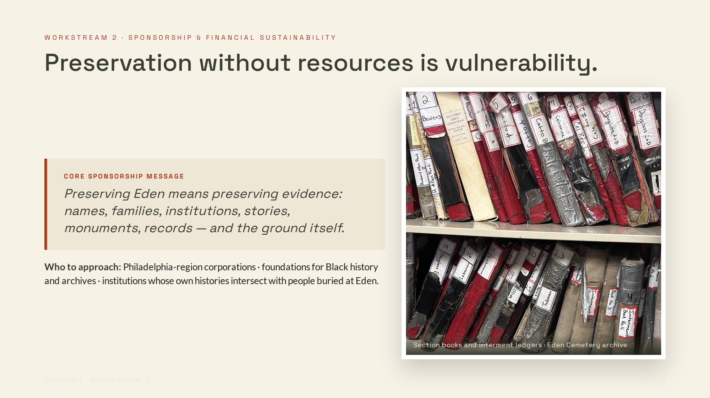
Notes:
WORKSTREAM 2 · SPONSORSHIP & FINANCIAL SUSTAINABILITY
Preservation without resources is vulnerability.
CORE SPONSORSHIP MESSAGE
Preserving Eden means preserving evidence: names, families, institutions, stories, monuments, records — and the ground itself.
Who to approach: Philadelphia-region corporations · foundations for Black history and archives · institutions whose own histories intersect with people buried at Eden.
Section books and interment ledgers · Eden Cemetery archive

Slide 13
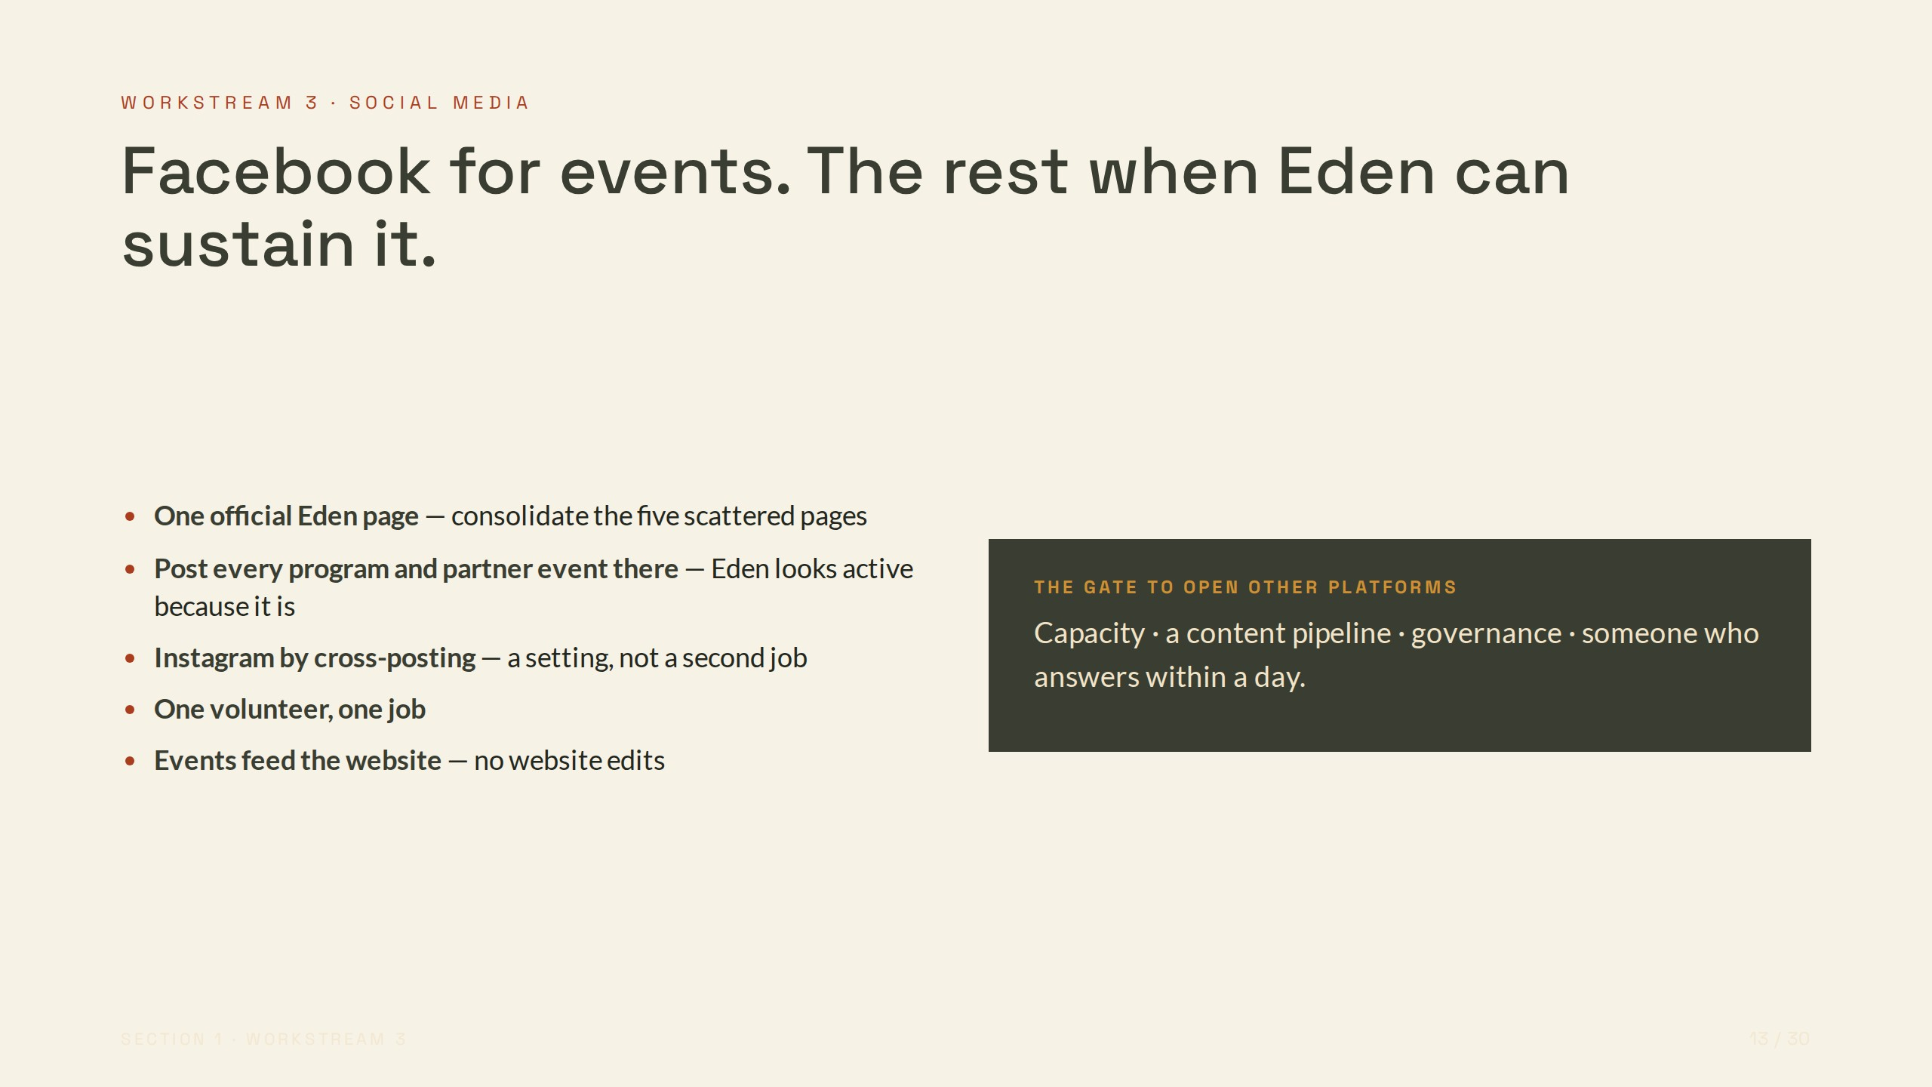
Notes:
WORKSTREAM 3 · SOCIAL MEDIA
Facebook for events. The rest when Eden can sustain it.
One official Eden page — consolidate the five scattered pages
Post every program and partner event there — Eden looks active because it is
Instagram by cross-posting — a setting, not a second job
One volunteer, one job
Events feed the website — no website edits
THE GATE TO OPEN OTHER PLATFORMS
Capacity · a content pipeline · governance · someone who answers within a day.

Slide 14
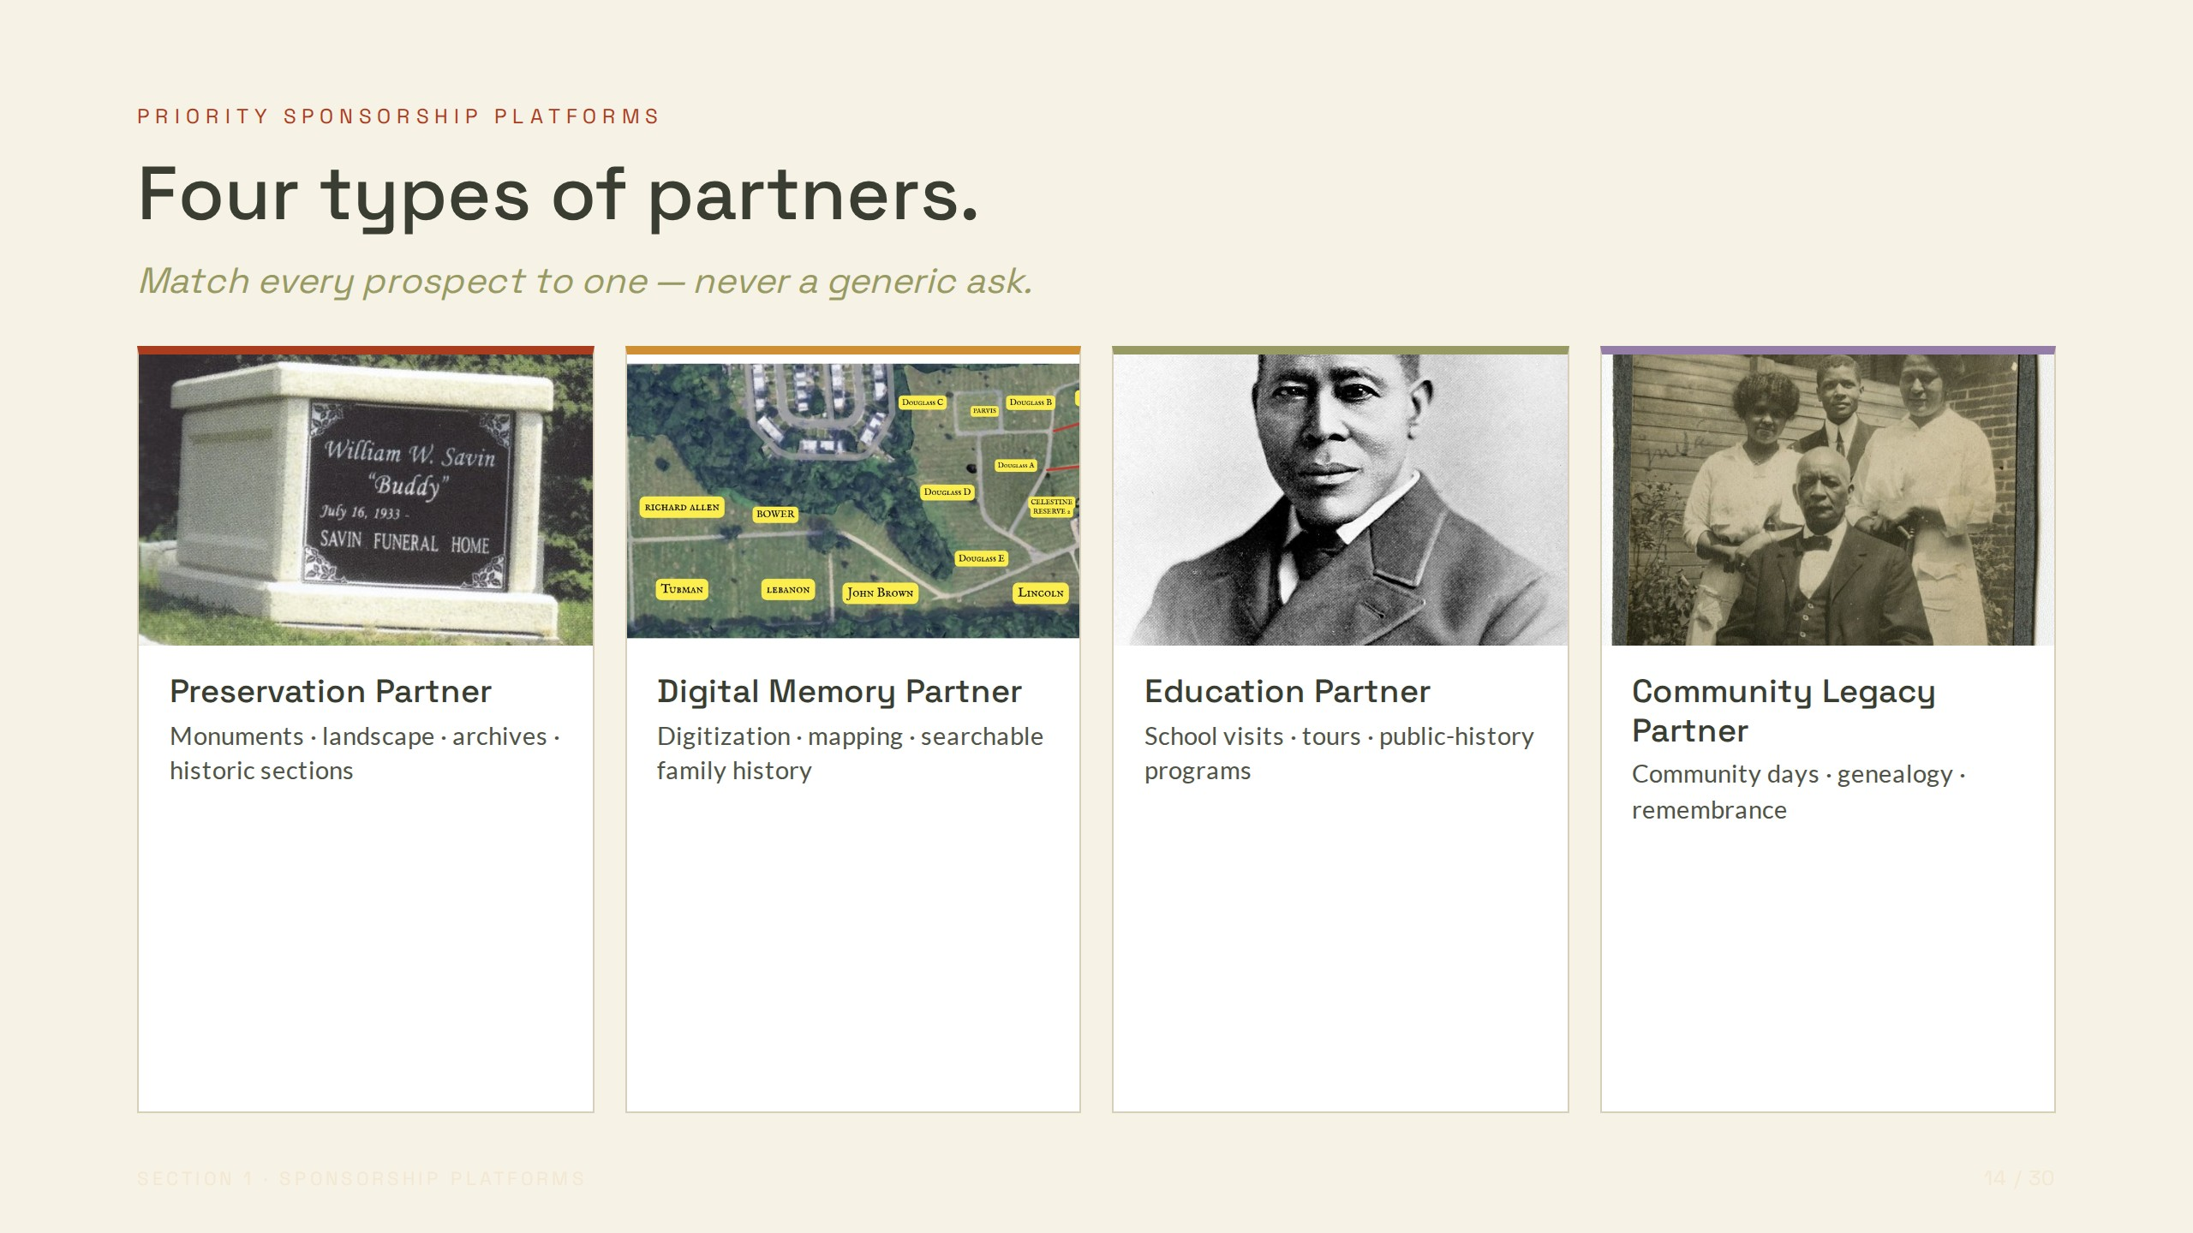
Notes:
PRIORITY SPONSORSHIP PLATFORMS
Four types of partners.
Match every prospect to one — never a generic ask.
Preservation Partner
Monuments · landscape · archives · historic sections
Digital Memory Partner
Digitization · mapping · searchable family history
Education Partner
School visits · tours · public-history programs
Community Legacy Partner
Community days · genealogy · remembrance

Slide 15
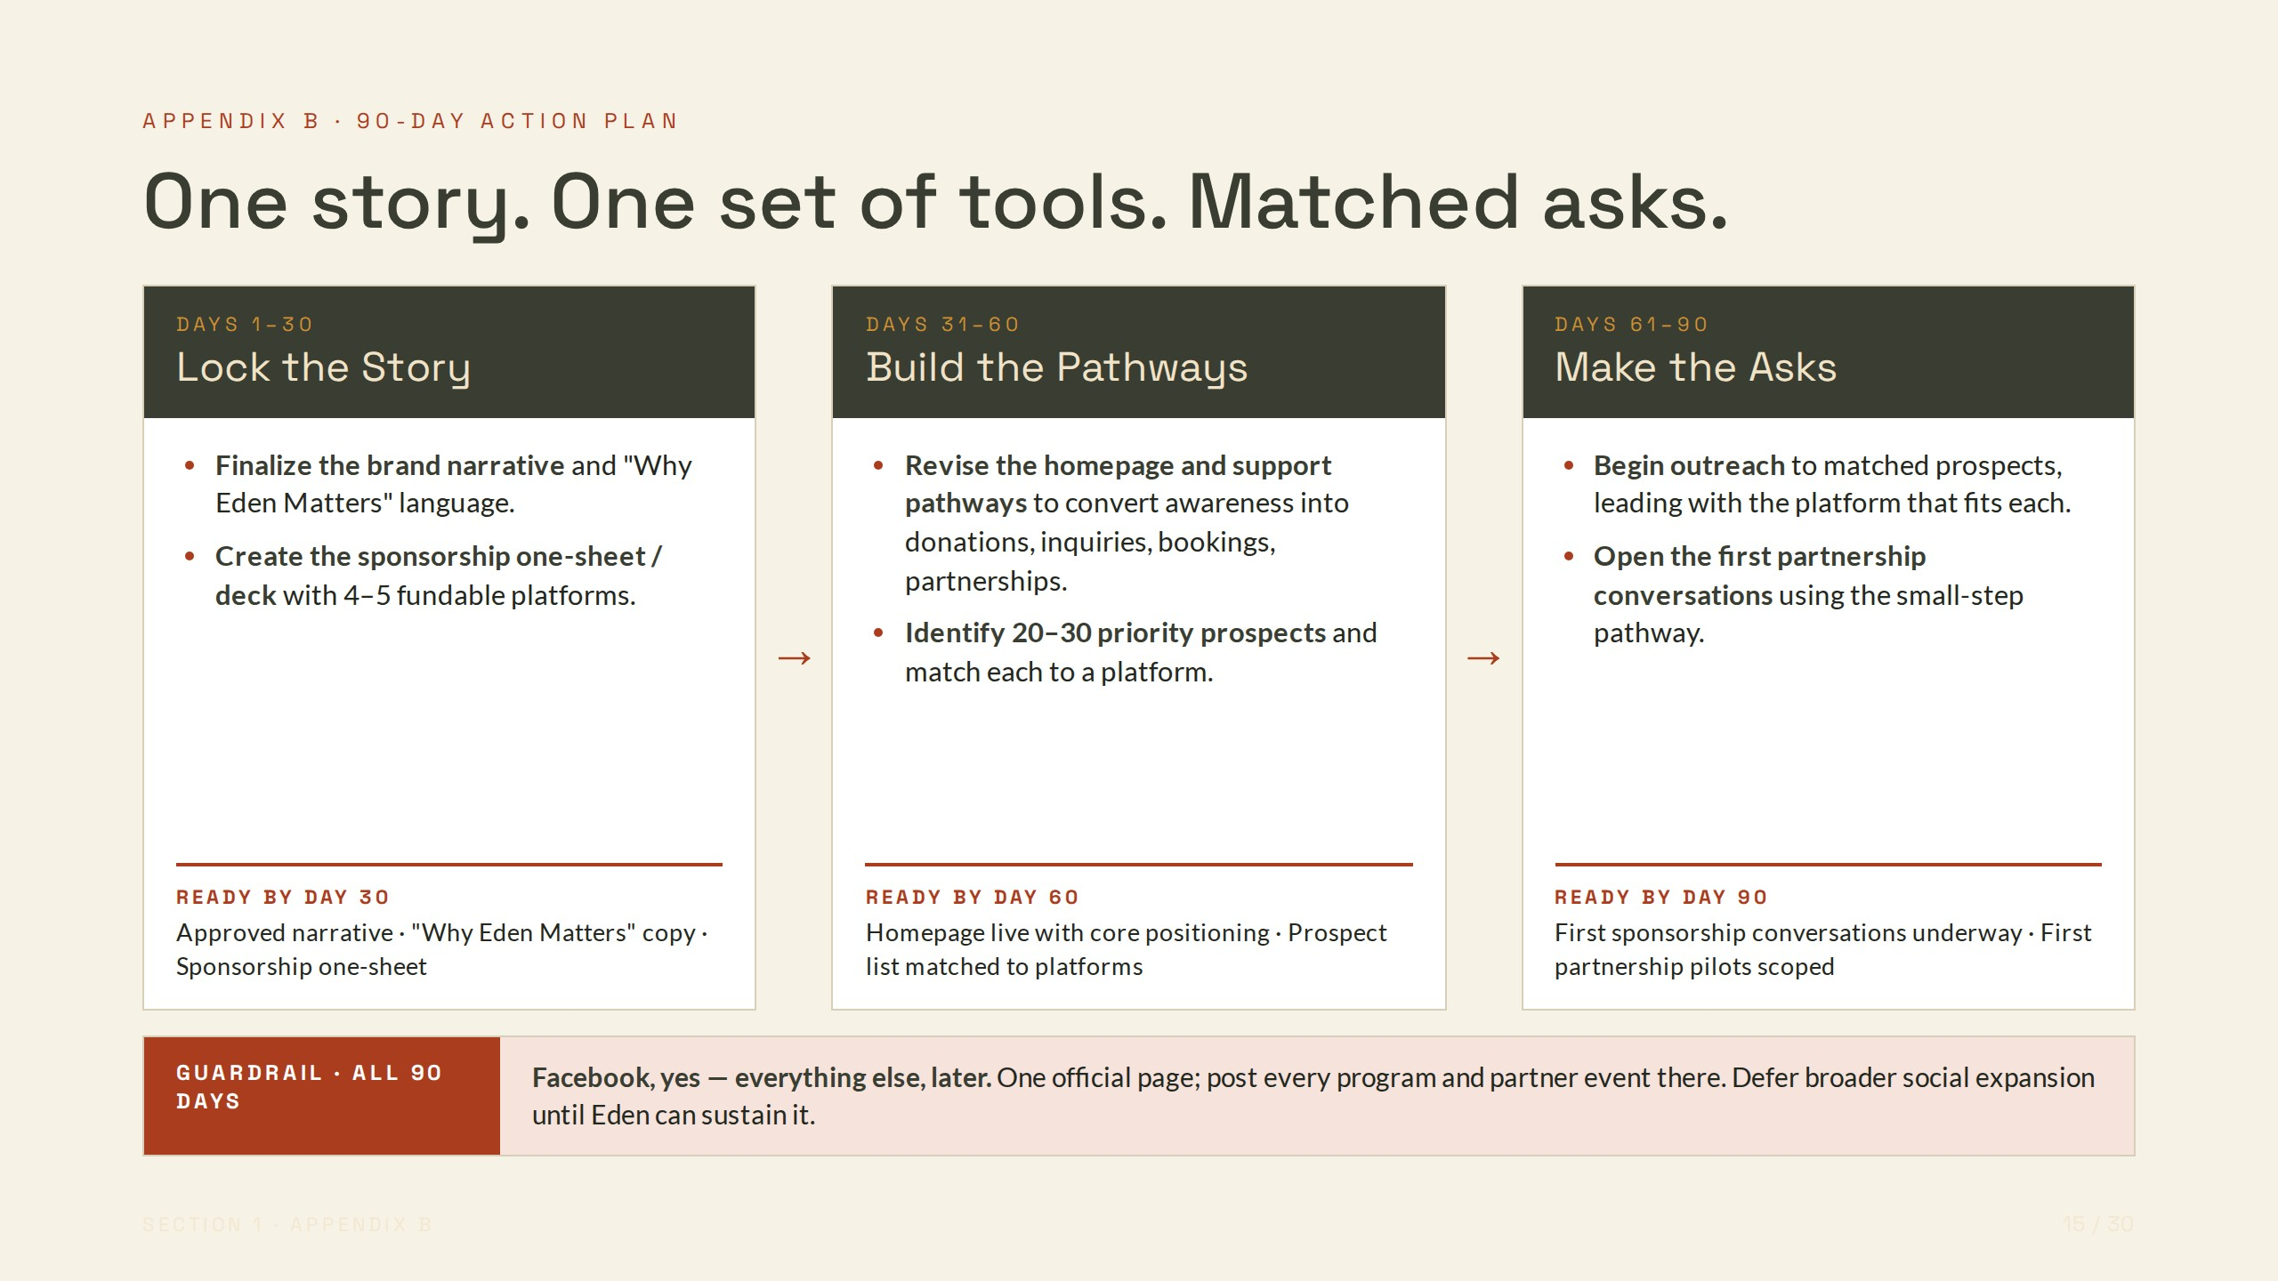
Notes:
APPENDIX B · 90-DAY ACTION PLAN
One story. One set of tools. Matched asks.
DAYS 1–30
Lock the Story
Finalize the brand narrative and "Why Eden Matters" language.
Create the sponsorship one-sheet / deck with 4–5 fundable platforms.
READY BY DAY 30
Approved narrative · "Why Eden Matters" copy · Sponsorship one-sheet
→
DAYS 31–60
Build the Pathways
Revise the homepage and support pathways to convert awareness into donations, inquiries, bookings, partnerships.
Identify 20–30 priority prospects and match each to a platform.
READY BY DAY 60
Homepage live with core positioning · Prospect list matched to platforms
→
DAYS 61–90
Make the Asks
Begin outreach to matched prospects, leading with the platform that fits each.
Open the first partnership conversations using the small-step pathway.
READY BY DAY 90
First sponsorship conversations underway · First partnership pilots scoped
GUARDRAIL · ALL 90 DAYS
Facebook, yes — everything else, later. One official page; post every program and partner event there. Defer broader social expansion until Eden can sustain it.

Slide 16
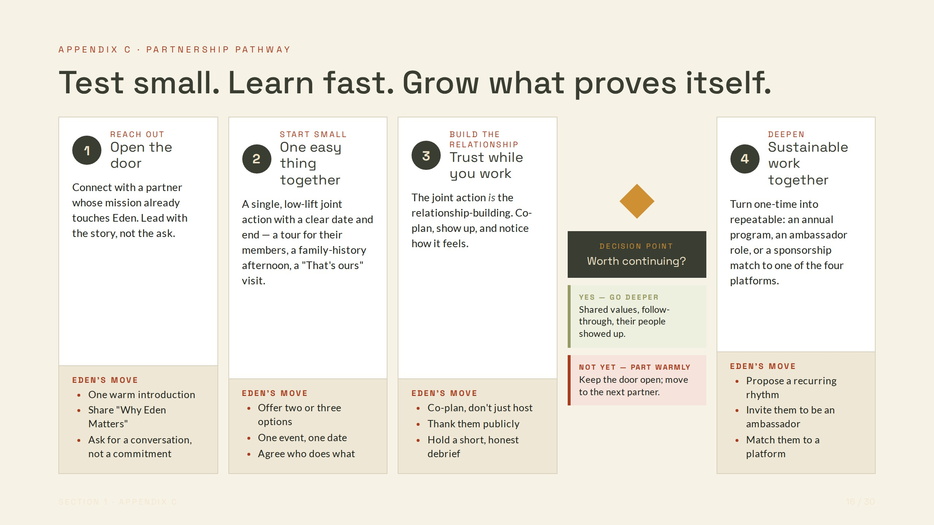
Notes:
APPENDIX C · PARTNERSHIP PATHWAY
Test small. Learn fast. Grow what proves itself.
1
REACH OUT
Open the door
Connect with a partner whose mission already touches Eden. Lead with the story, not the ask.
EDEN'S MOVE
One warm introduction
Share "Why Eden Matters"
Ask for a conversation, not a commitment
2
START SMALL
One easy thing together
A single, low-lift joint action with a clear date and end — a tour for their members, a family-history afternoon, a "That's ours" visit.
EDEN'S MOVE
Offer two or three options
One event, one date
Agree who does what
3
BUILD THE RELATIONSHIP
Trust while you work
The joint action is the relationship-building. Co-plan, show up, and notice how it feels.
EDEN'S MOVE
Co-plan, don't just host
Thank them publicly
Hold a short, honest debrief
DECISION POINT
Worth continuing?
YES — GO DEEPER
Shared values, follow-through, their people showed up.
NOT YET — PART WARMLY
Keep the door open; move to the next partner.
4
DEEPEN
Sustainable work together
Turn one-time into repeatable: an annual program, an ambassador role, or a sponsorship match to one of the four platforms.
EDEN'S MOVE
Propose a recurring rhythm
Invite them to be an ambassador
Match them to a platform

Slide 17
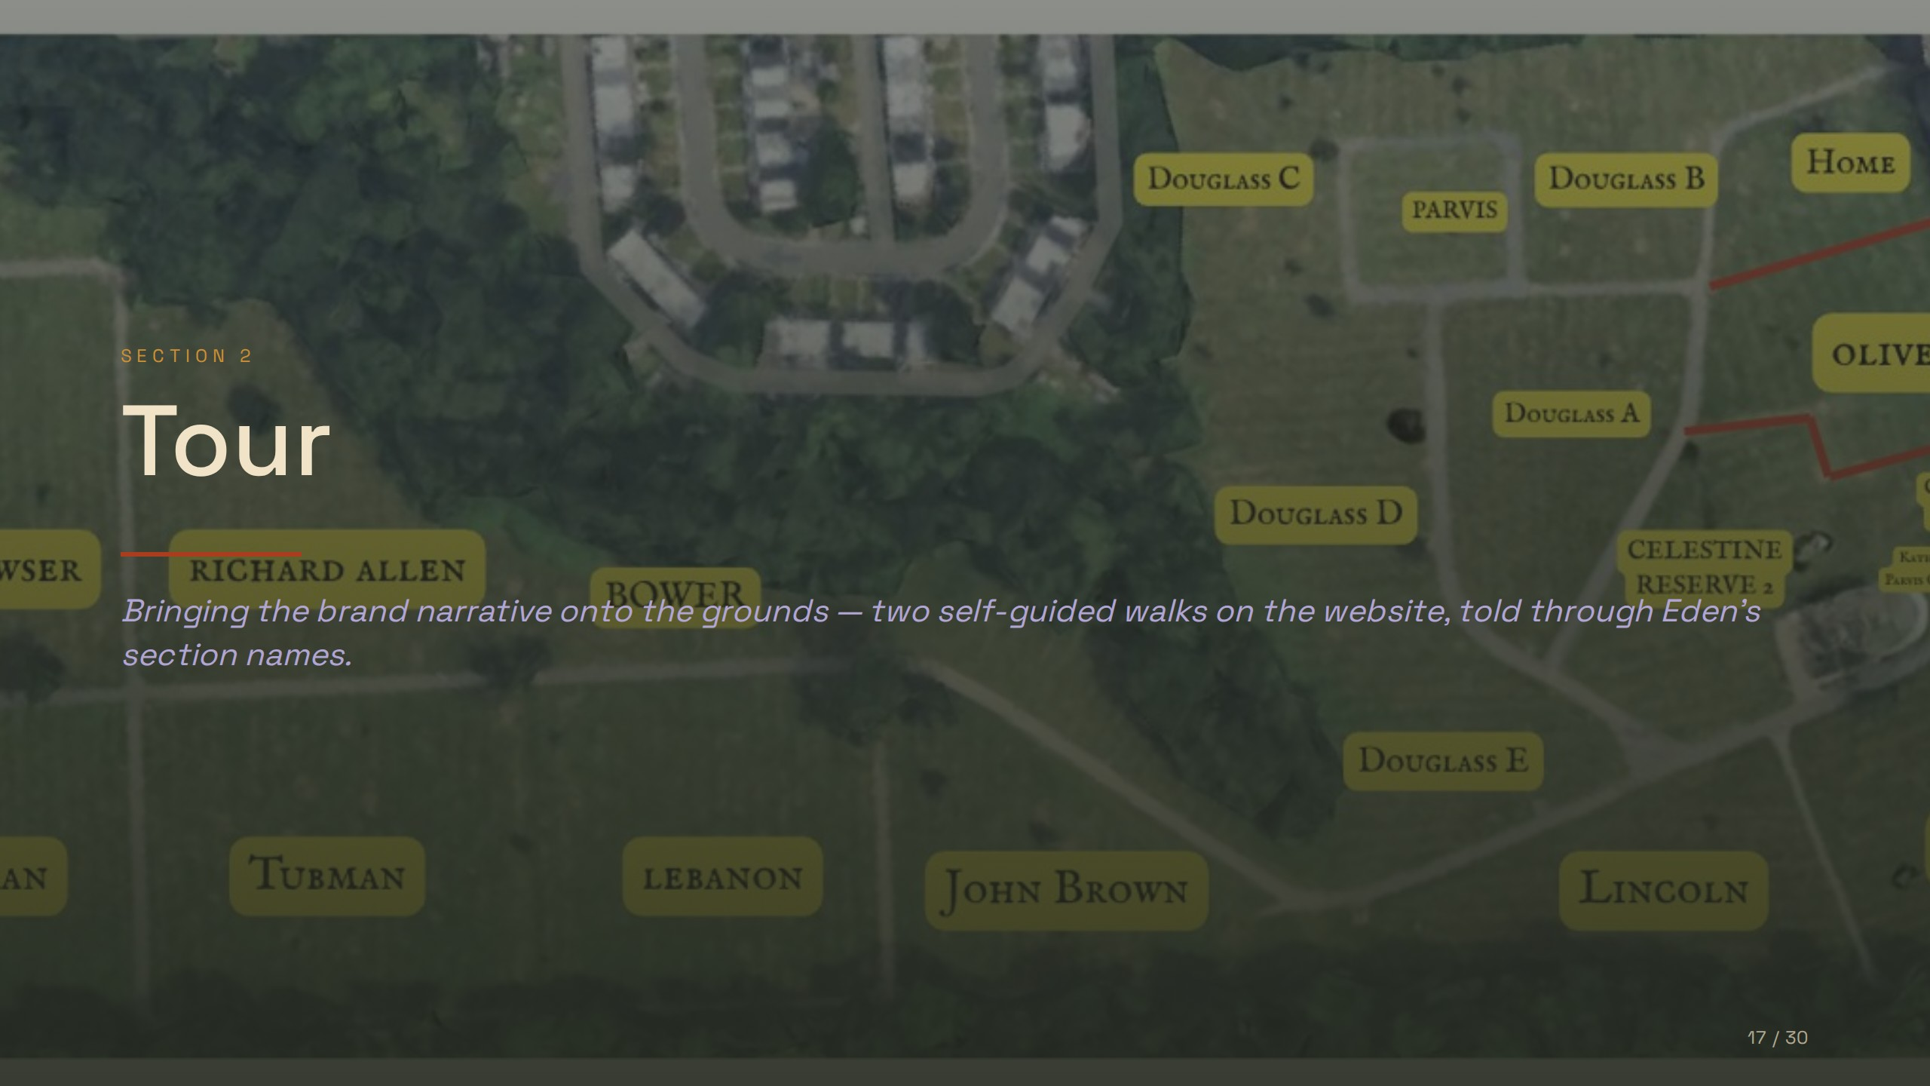
Notes:
SECTION 2
Tour
Bringing the brand narrative onto the grounds — two self-guided walks on the website, told through Eden's section names.

Slide 18
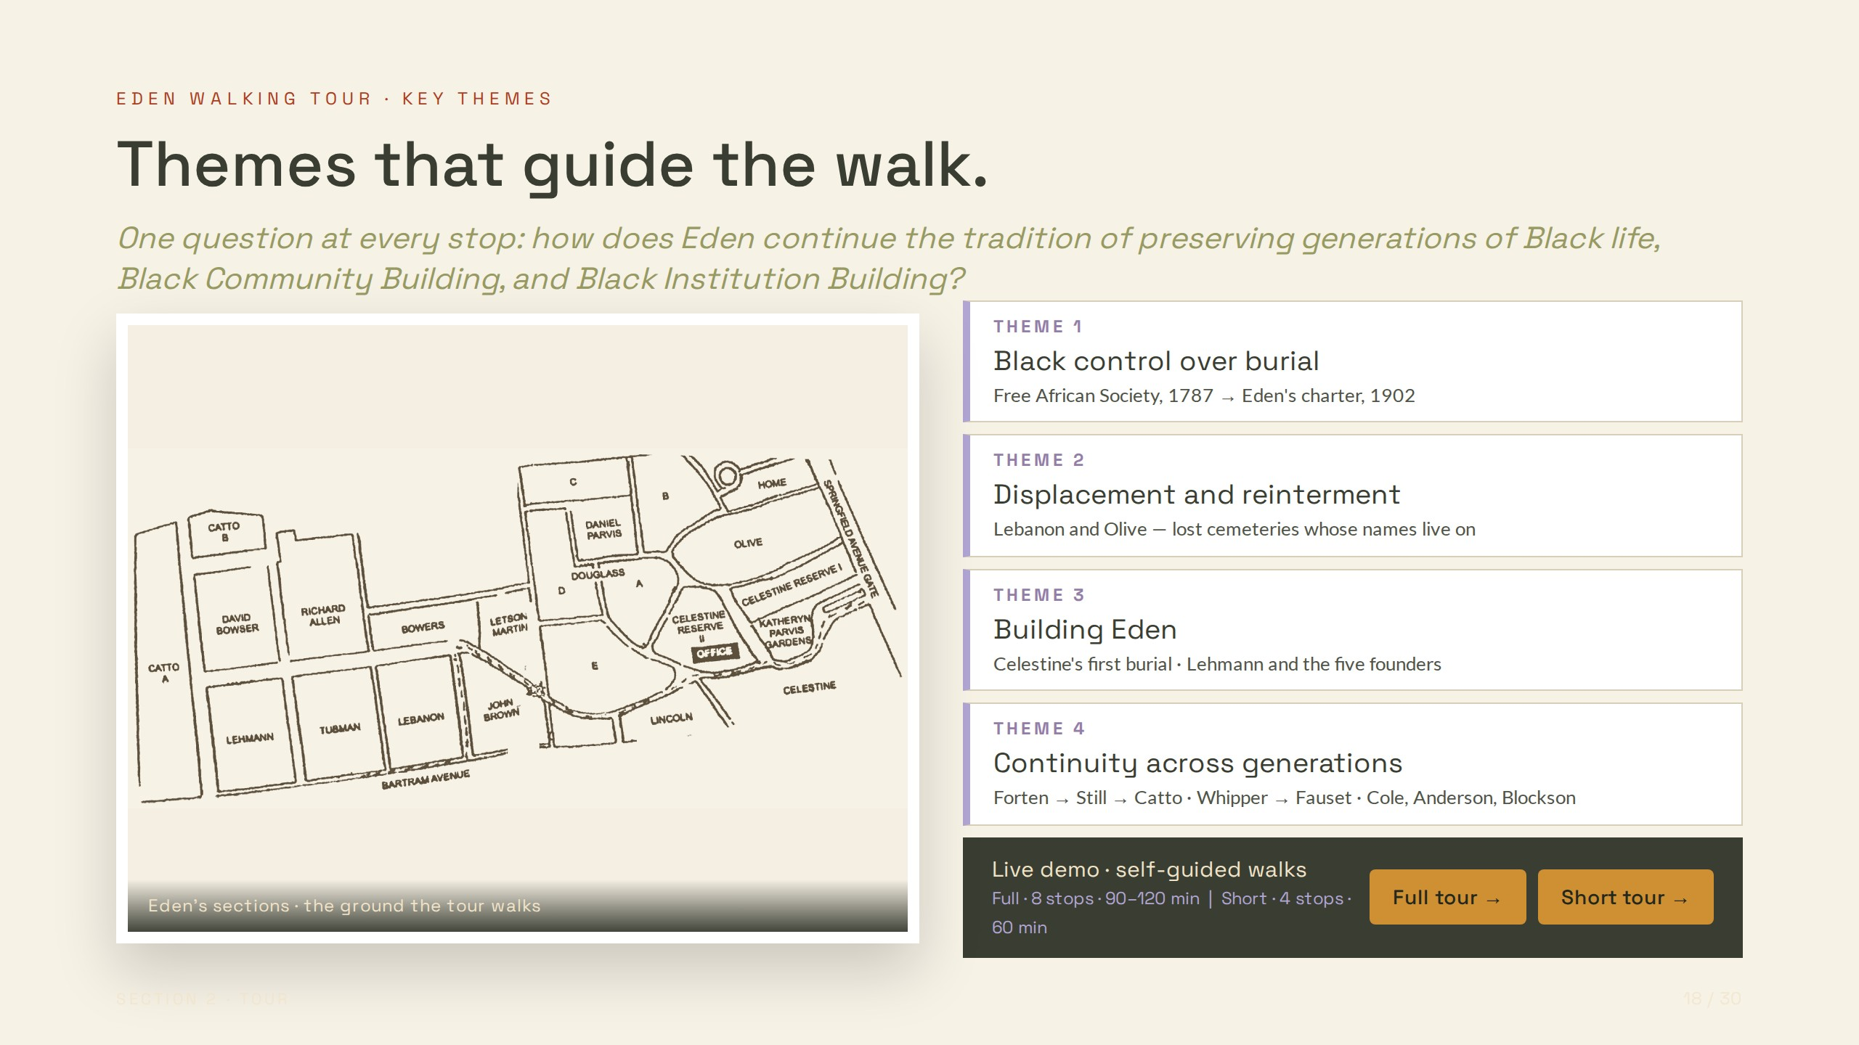
Notes:
EDEN WALKING TOUR · KEY THEMES
Themes that guide the walk.
One question at every stop: how does Eden continue the tradition of preserving generations of Black life, Black Community Building, and Black Institution Building?
Eden's sections · the ground the tour walks
THEME 1
Black control over burial
Free African Society, 1787 → Eden's charter, 1902
THEME 2
Displacement and reinterment
Lebanon and Olive — lost cemeteries whose names live on
THEME 3
Building Eden
Celestine's first burial · Lehmann and the five founders
THEME 4
Continuity across generations
Forten → Still → Catto · Whipper → Fauset · Cole, Anderson, Blockson
Live demo · self-guided walks
Full · 8 stops · 90–120 min | Short · 4 stops · 60 min
Full tour →
Short tour →

Slide 19
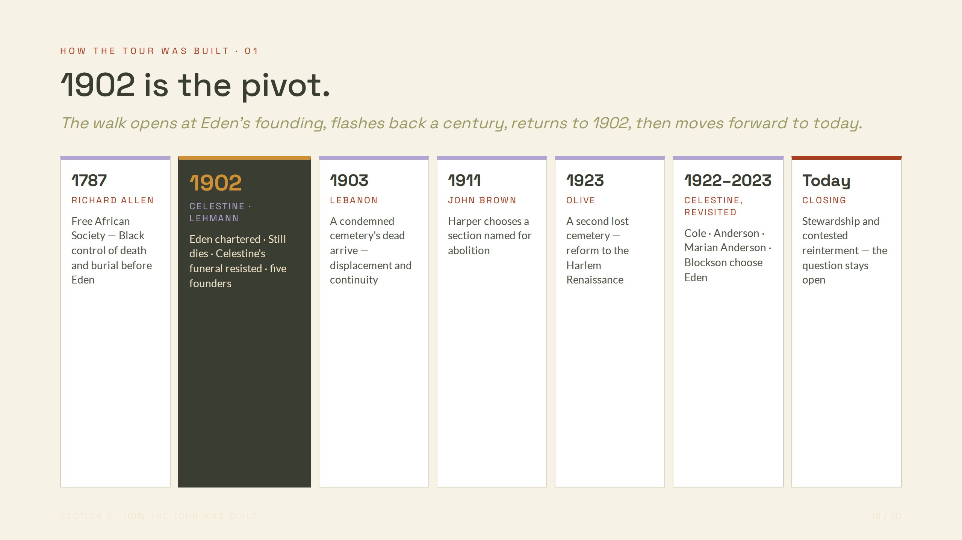
Notes:
HOW THE TOUR WAS BUILT · 01
1902 is the pivot.
The walk opens at Eden's founding, flashes back a century, returns to 1902, then moves forward to today.
1787
RICHARD ALLEN
Free African Society — Black control of death and burial before Eden
1902
CELESTINE · LEHMANN
Eden chartered · Still dies · Celestine's funeral resisted · five founders
1903
LEBANON
A condemned cemetery's dead arrive — displacement and continuity
1911
JOHN BROWN
Harper chooses a section named for abolition
1923
OLIVE
A second lost cemetery — reform to the Harlem Renaissance
1922–2023
CELESTINE, REVISITED
Cole · Anderson · Marian Anderson · Blockson choose Eden
Today
CLOSING
Stewardship and contested reinterment — the question stays open

Slide 20
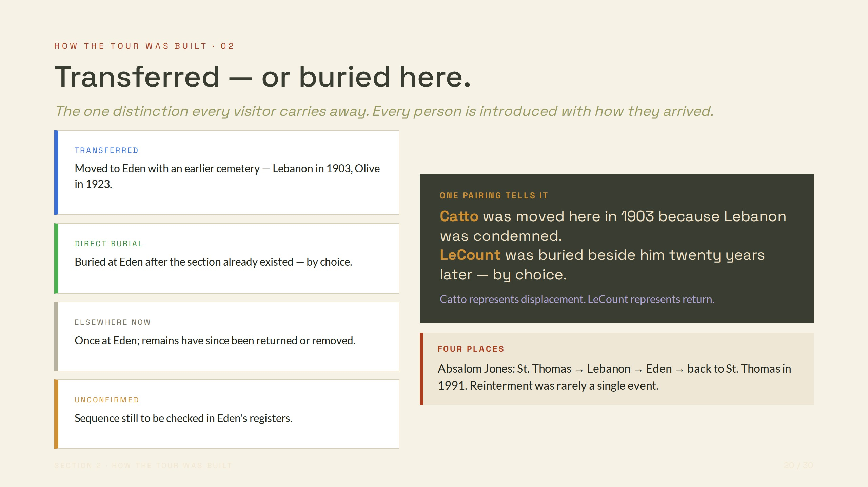
Notes:
HOW THE TOUR WAS BUILT · 02
Transferred — or buried here.
The one distinction every visitor carries away. Every person is introduced with how they arrived.
TRANSFERRED
Moved to Eden with an earlier cemetery — Lebanon in 1903, Olive in 1923.
DIRECT BURIAL
Buried at Eden after the section already existed — by choice.
ELSEWHERE NOW
Once at Eden; remains have since been returned or removed.
UNCONFIRMED
Sequence still to be checked in Eden's registers.
ONE PAIRING TELLS IT
Catto was moved here in 1903 because Lebanon was condemned.
LeCount was buried beside him twenty years later — by choice.
Catto represents displacement. LeCount represents return.
FOUR PLACES
Absalom Jones: St. Thomas → Lebanon → Eden → back to St. Thomas in 1991. Reinterment was rarely a single event.

Slide 21
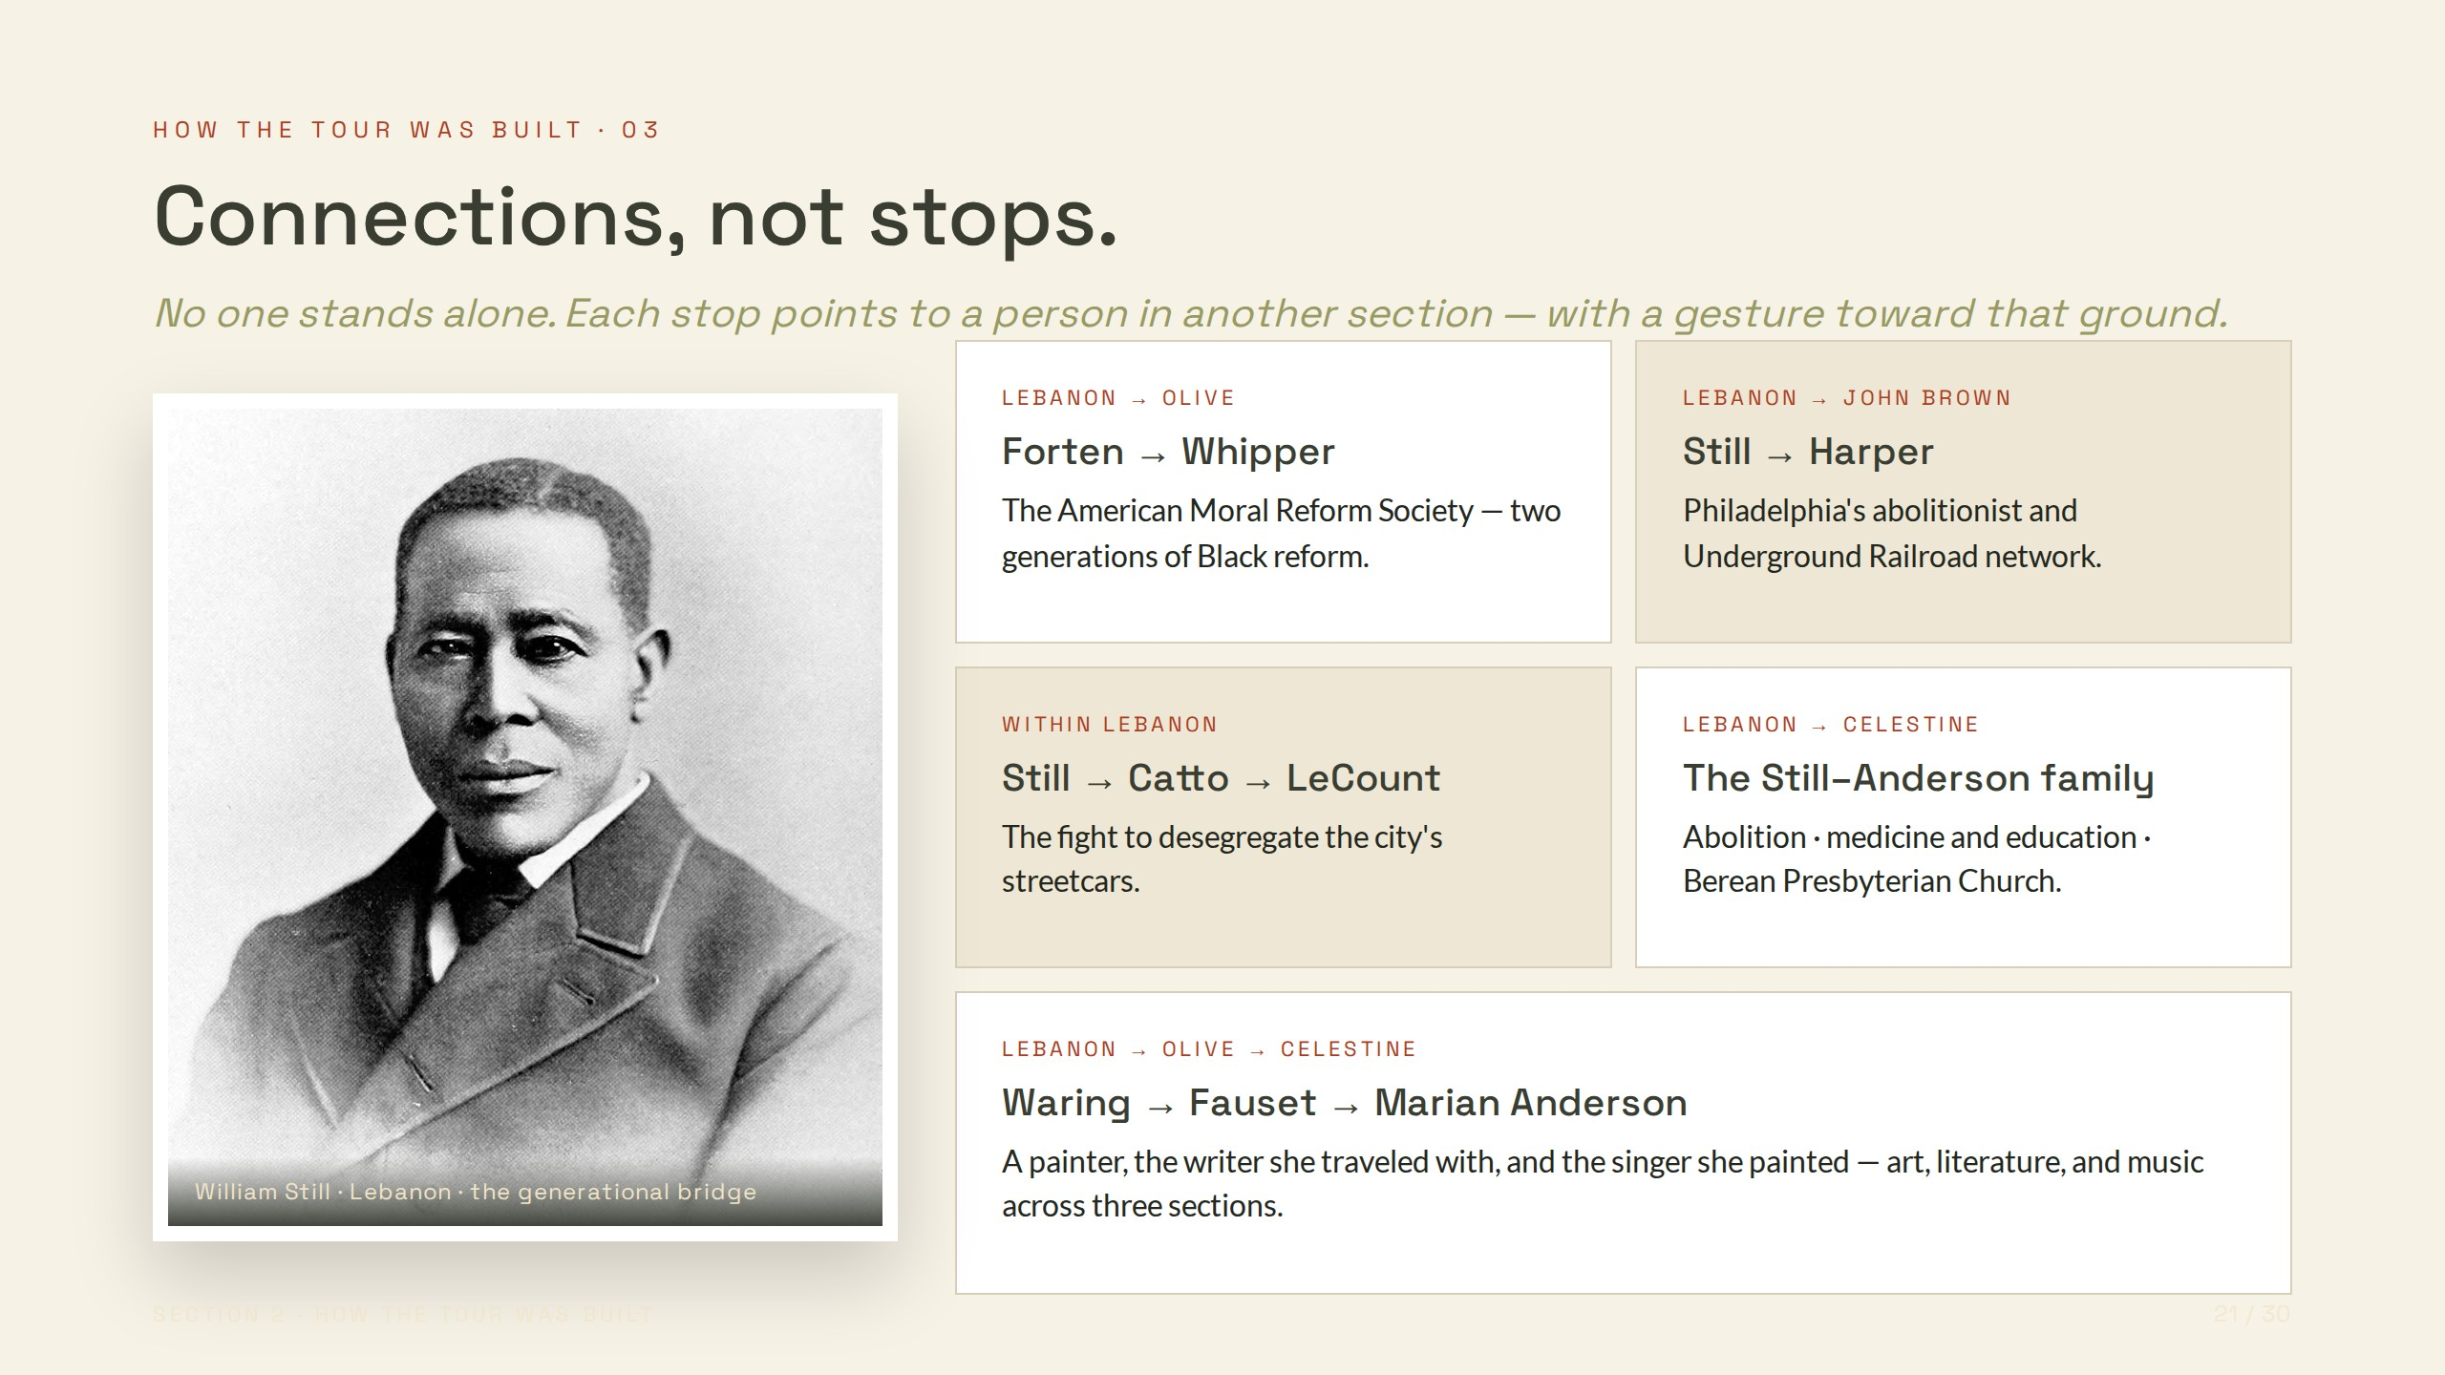
Notes:
HOW THE TOUR WAS BUILT · 03
Connections, not stops.
No one stands alone. Each stop points to a person in another section — with a gesture toward that ground.
William Still · Lebanon · the generational bridge
LEBANON → OLIVE
Forten → Whipper
The American Moral Reform Society — two generations of Black reform.
LEBANON → JOHN BROWN
Still → Harper
Philadelphia's abolitionist and Underground Railroad network.
WITHIN LEBANON
Still → Catto → LeCount
The fight to desegregate the city's streetcars.
LEBANON → CELESTINE
The Still–Anderson family
Abolition · medicine and education · Berean Presbyterian Church.
LEBANON → OLIVE → CELESTINE
Waring → Fauset → Marian Anderson
A painter, the writer she traveled with, and the singer she painted — art, literature, and music across three sections.

Slide 22
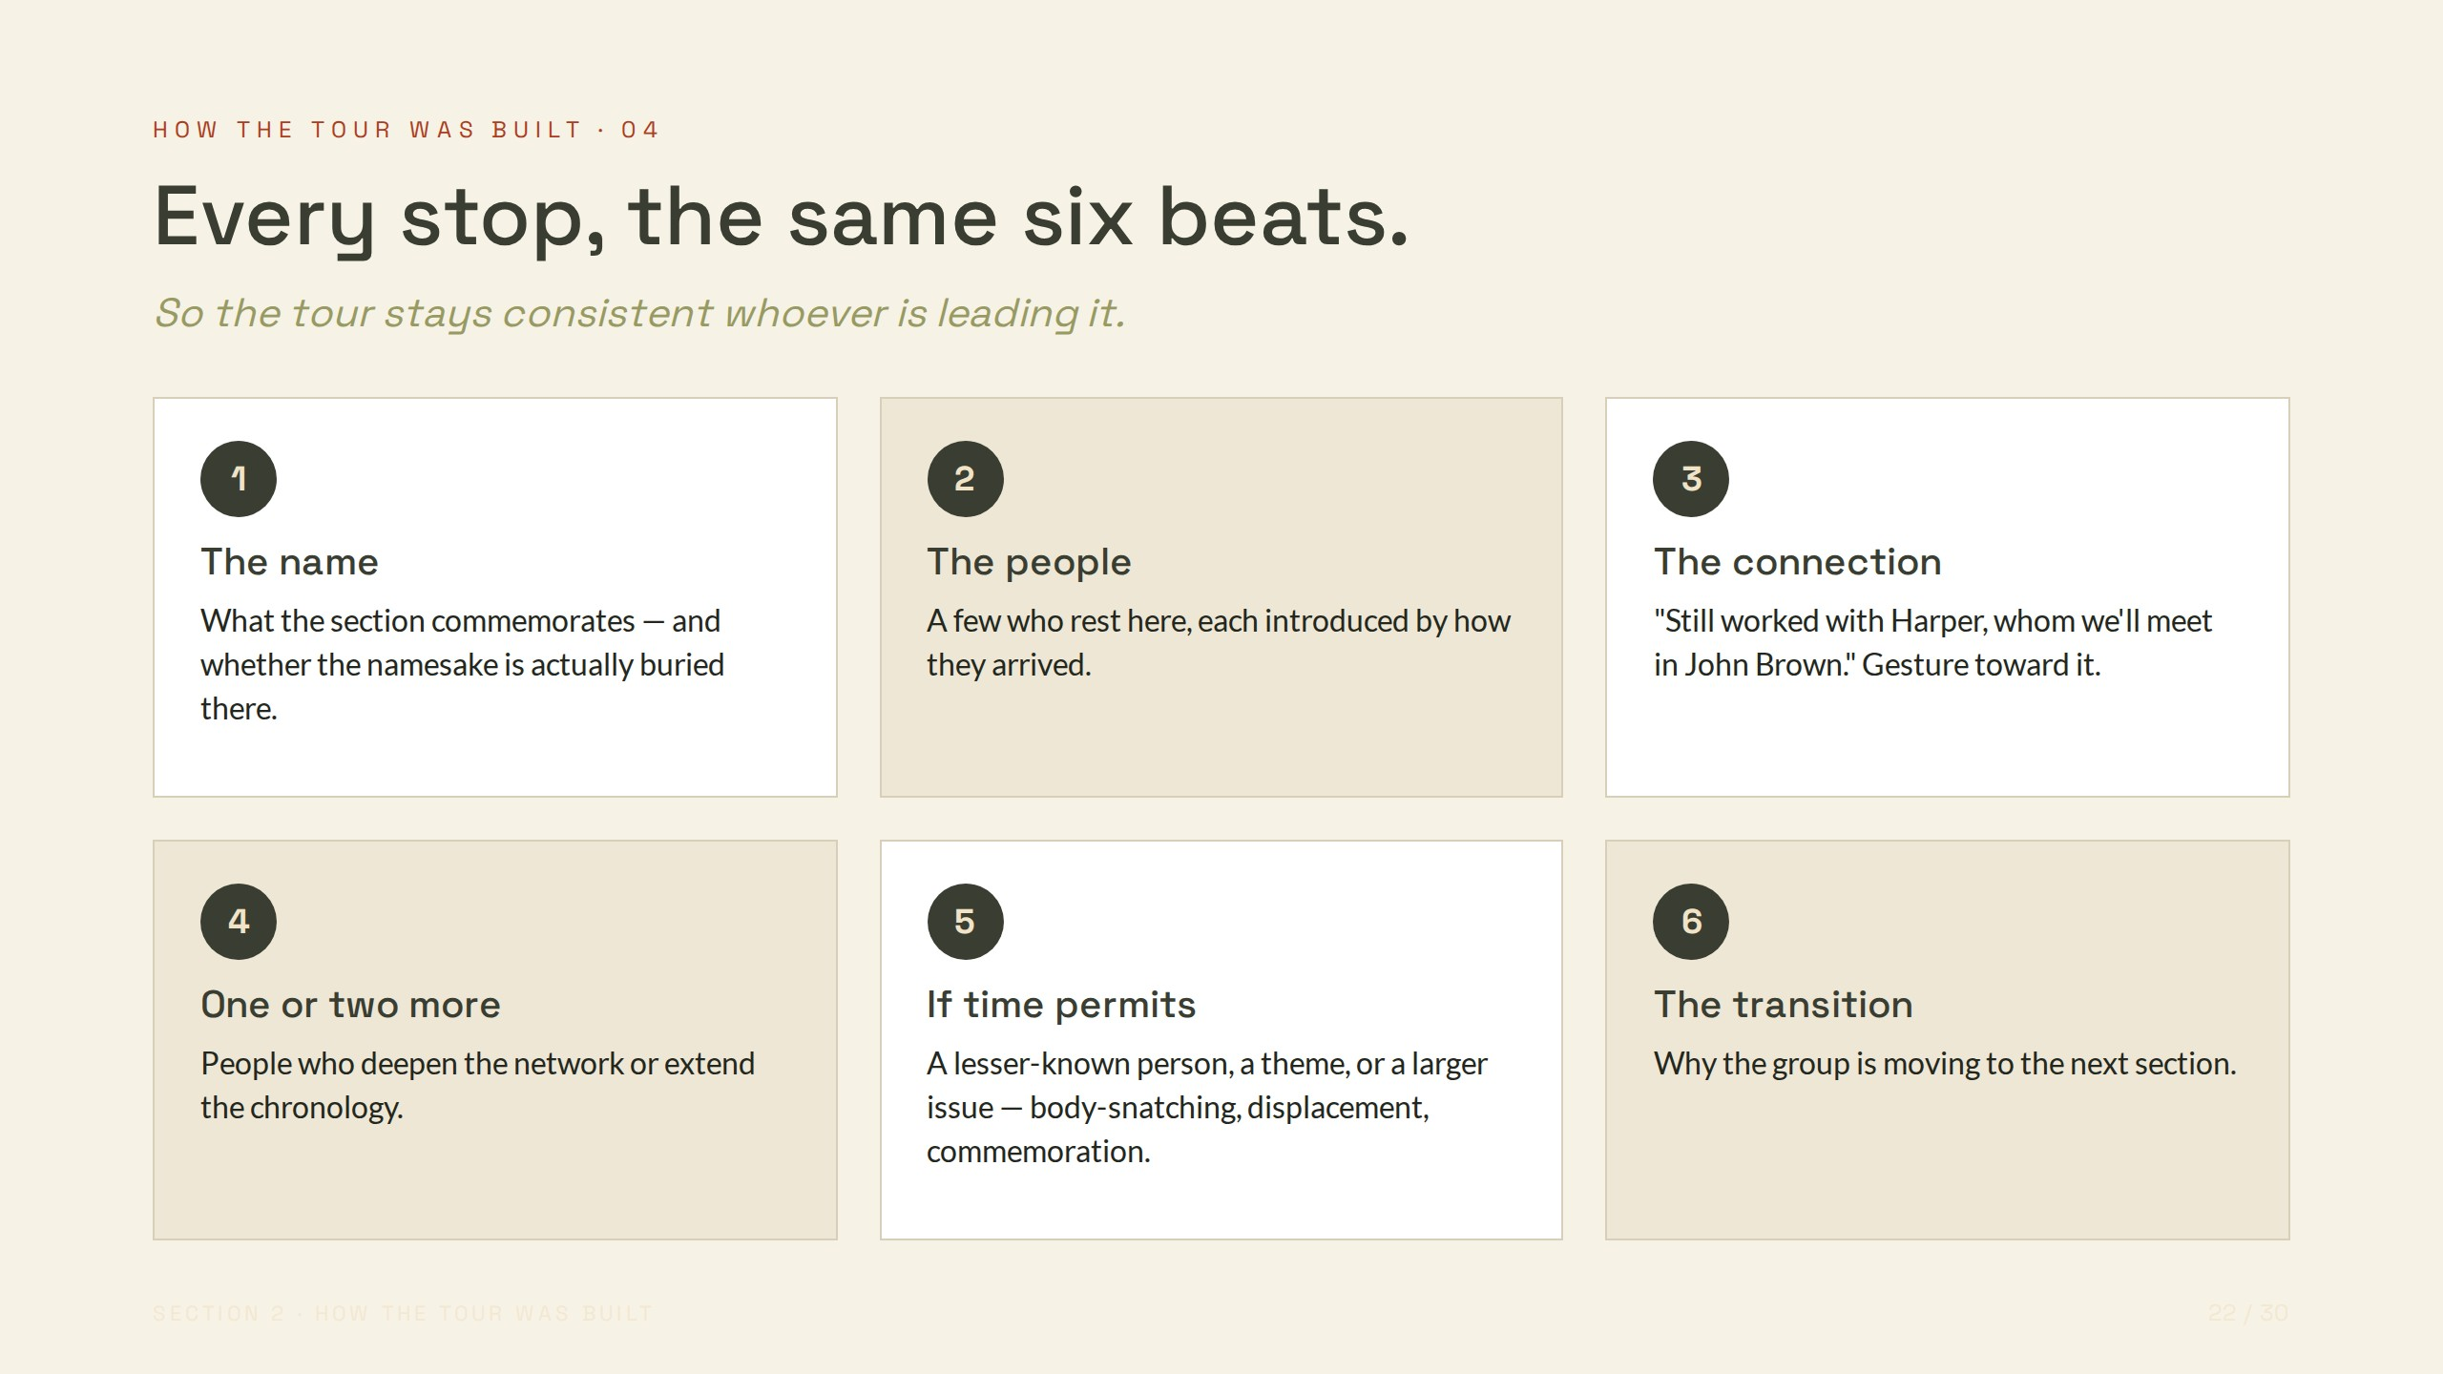
Notes:
HOW THE TOUR WAS BUILT · 04
Every stop, the same six beats.
So the tour stays consistent whoever is leading it.
1
The name
What the section commemorates — and whether the namesake is actually buried there.
2
The people
A few who rest here, each introduced by how they arrived.
3
The connection
"Still worked with Harper, whom we'll meet in John Brown." Gesture toward it.
4
One or two more
People who deepen the network or extend the chronology.
5
If time permits
A lesser-known person, a theme, or a larger issue — body-snatching, displacement, commemoration.
6
The transition
Why the group is moving to the next section.

Slide 23
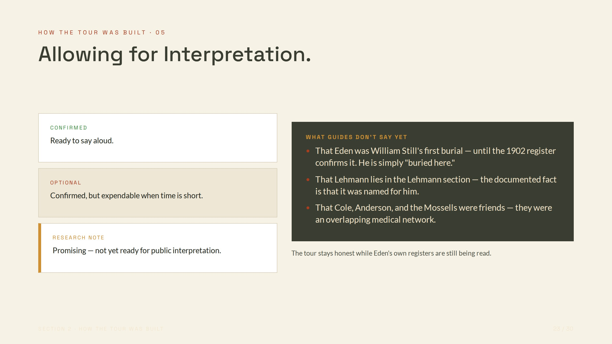
Notes:
HOW THE TOUR WAS BUILT · 05
Allowing for Interpretation.
CONFIRMED
Ready to say aloud.
OPTIONAL
Confirmed, but expendable when time is short.
RESEARCH NOTE
Promising — not yet ready for public interpretation.
WHAT GUIDES DON'T SAY YET
That Eden was William Still's first burial — until the 1902 register confirms it. He is simply "buried here."
That Lehmann lies in the Lehmann section — the documented fact is that it was named for him.
That Cole, Anderson, and the Mossells were friends — they were an overlapping medical network.
The tour stays honest while Eden's own registers are still being read.

Slide 24
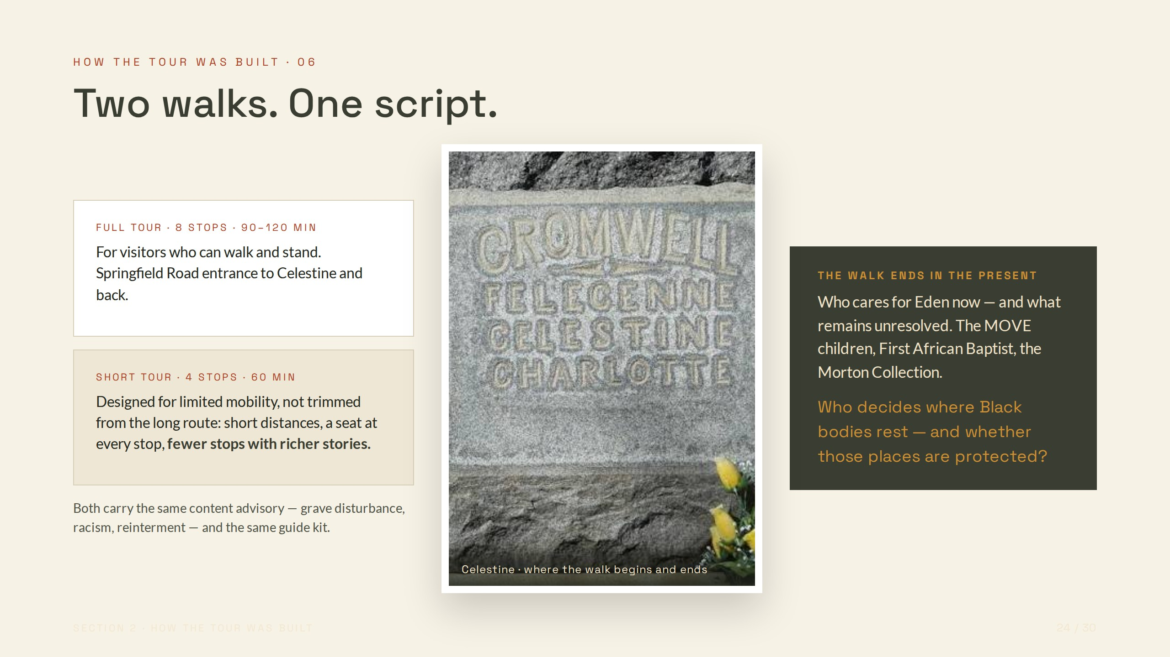
Notes:
HOW THE TOUR WAS BUILT · 06
Two walks. One script.
FULL TOUR · 8 STOPS · 90–120 MIN
For visitors who can walk and stand. Springfield Road entrance to Celestine and back.
SHORT TOUR · 4 STOPS · 60 MIN
Designed for limited mobility, not trimmed from the long route: short distances, a seat at every stop, fewer stops with richer stories.
Both carry the same content advisory — grave disturbance, racism, reinterment — and the same guide kit.
Celestine · where the walk begins and ends
THE WALK ENDS IN THE PRESENT
Who cares for Eden now — and what remains unresolved. The MOVE children, First African Baptist, the Morton Collection.
Who decides where Black bodies rest — and whether those places are protected?

Slide 25
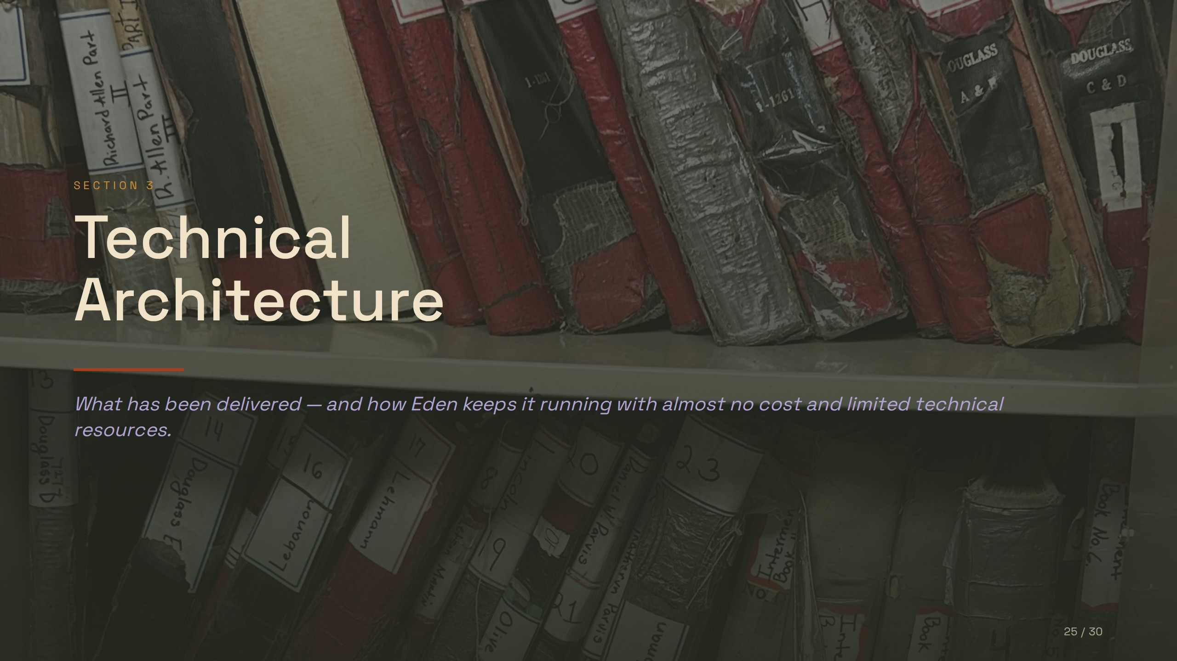
Notes:
SECTION 3
Technical
Architecture
What has been delivered — and how Eden keeps it running with almost no cost and limited technical resources.

Slide 26
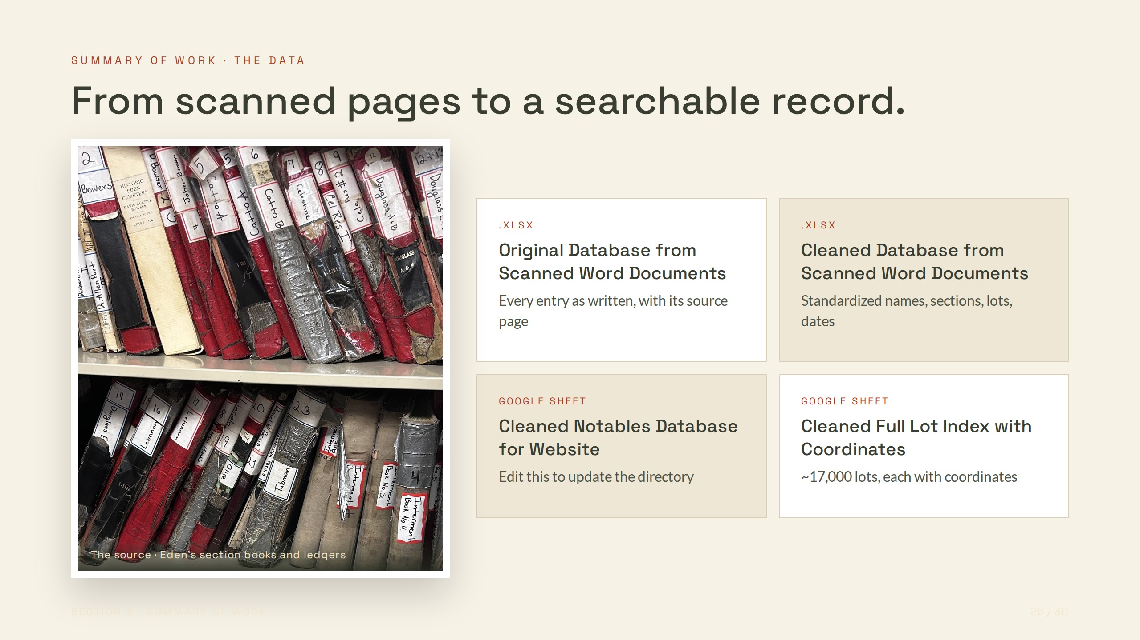
Notes:
SUMMARY OF WORK · THE DATA
From scanned pages to a searchable record.
The source · Eden's section books and ledgers
.XLSX
Original Database from Scanned Word Documents
Every entry as written, with its source page
.XLSX
Cleaned Database from Scanned Word Documents
Standardized names, sections, lots, dates
GOOGLE SHEET
Cleaned Notables Database for Website
Edit this to update the directory
GOOGLE SHEET
Cleaned Full Lot Index with Coordinates
~17,000 lots, each with coordinates

Slide 27
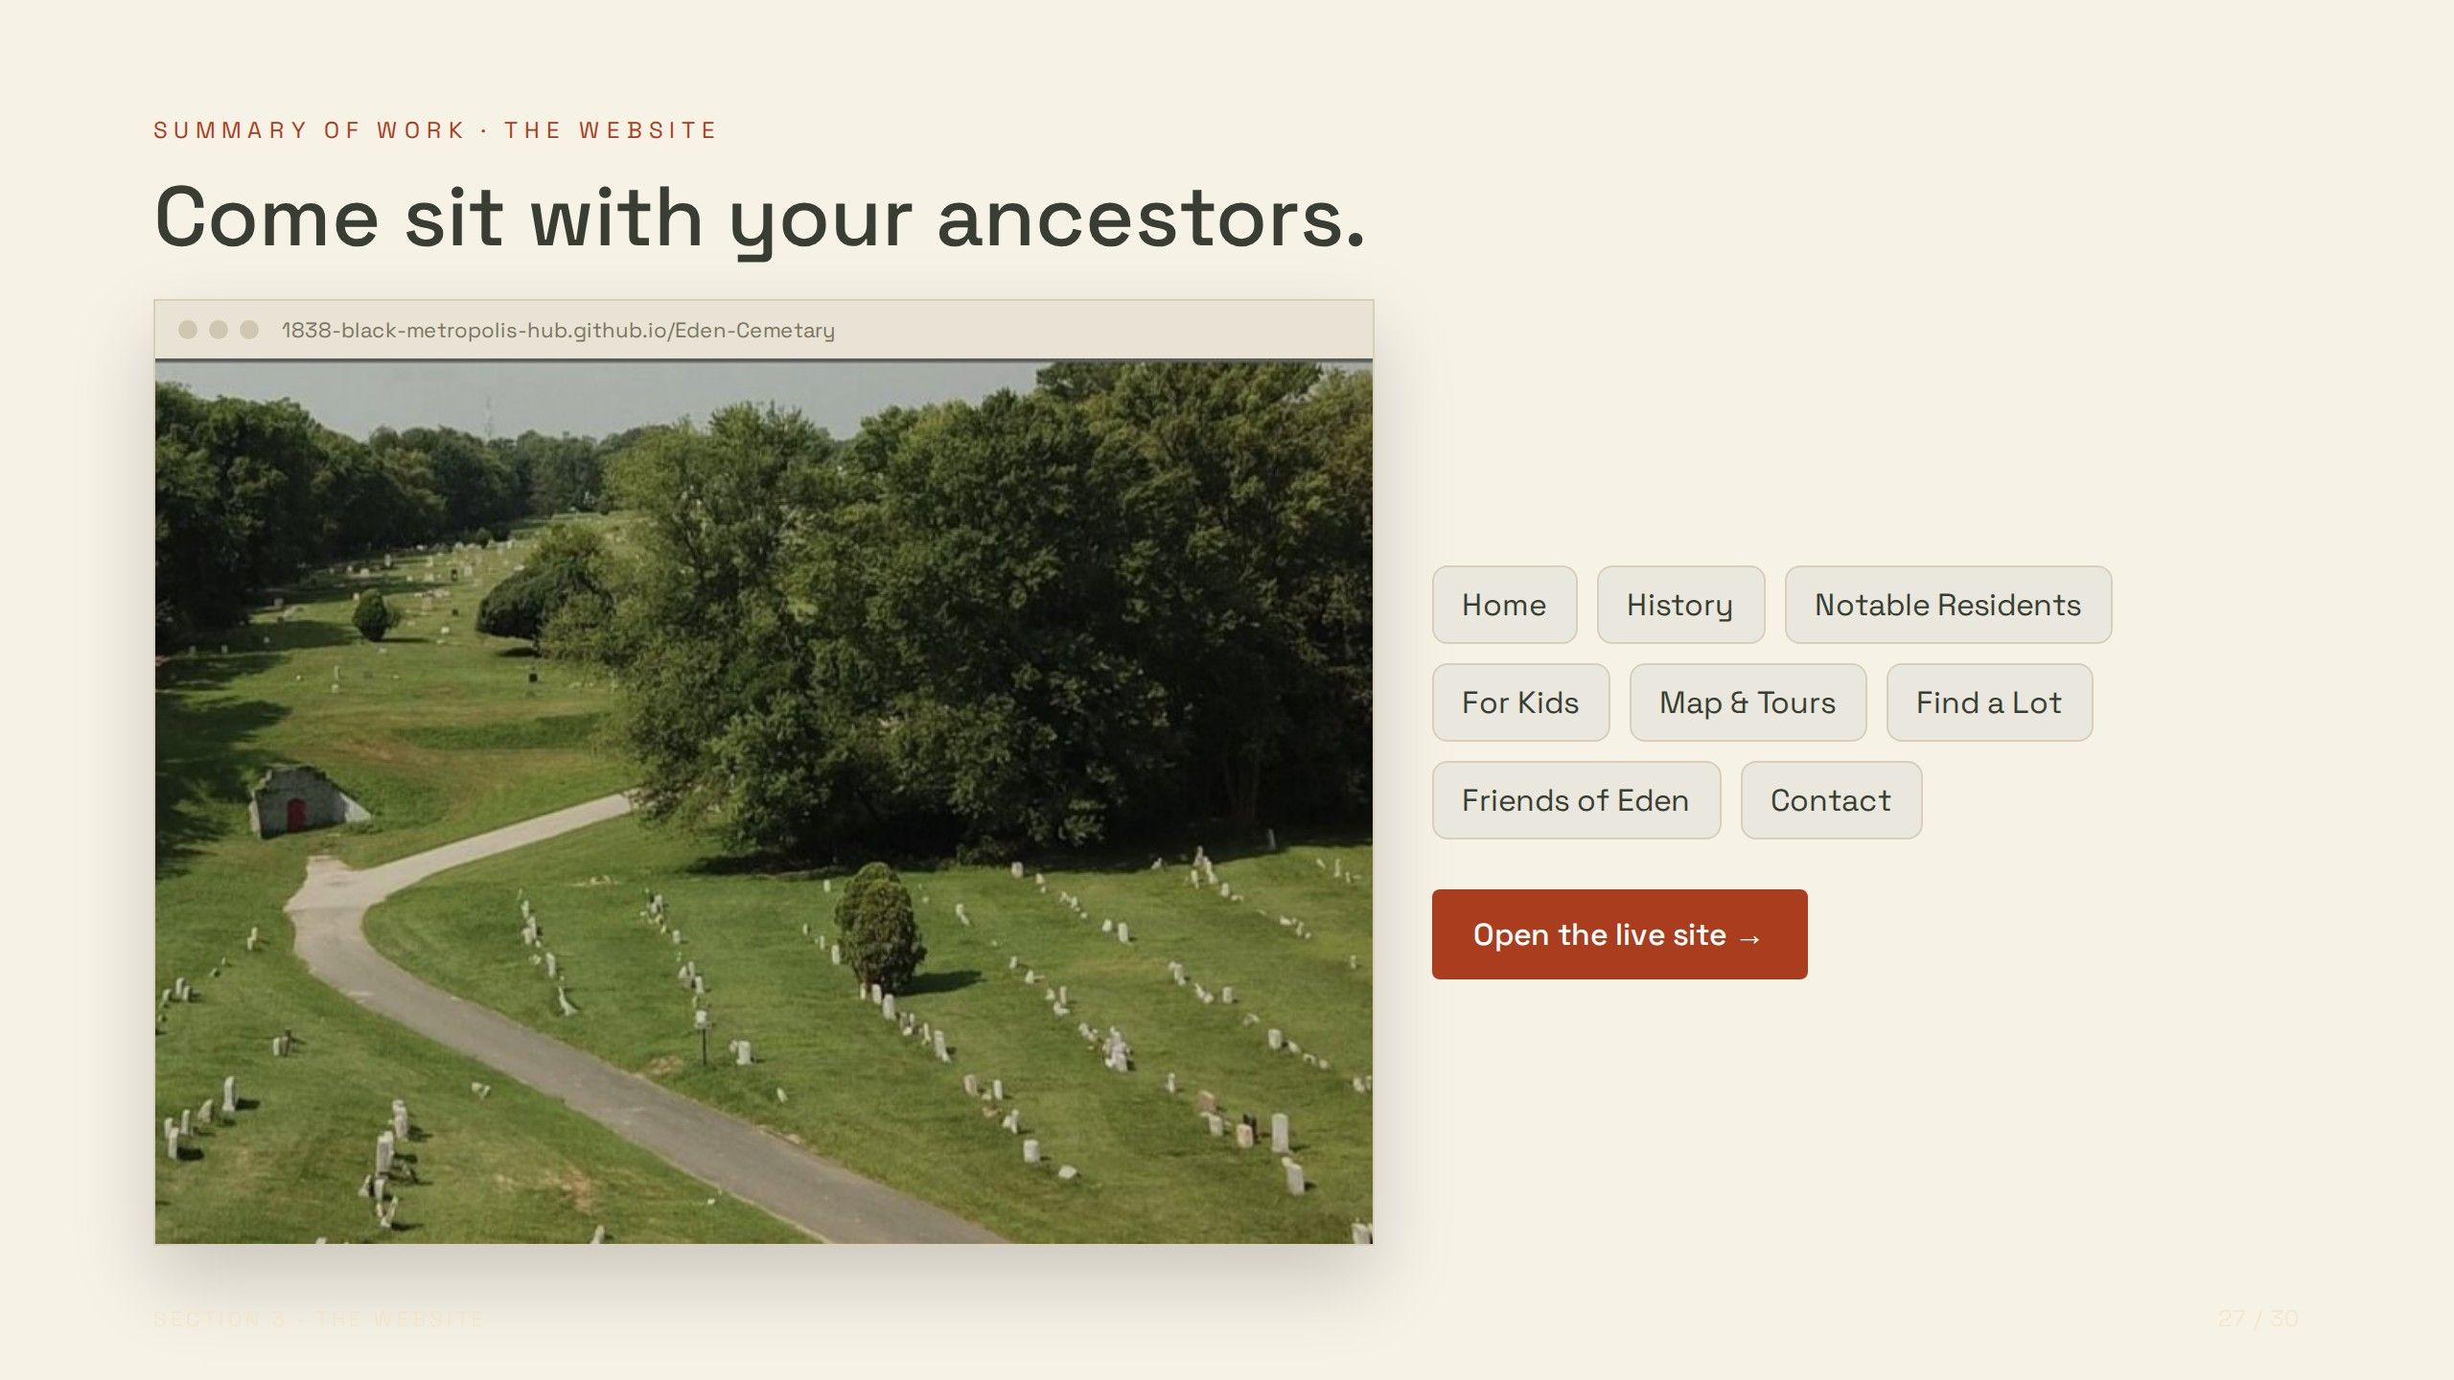
Notes:
SUMMARY OF WORK · THE WEBSITE
Come sit with your ancestors.
1838-black-metropolis-hub.github.io/Eden-Cemetary
Home
History
Notable Residents
For Kids
Map & Tours
Find a Lot
Friends of Eden
Contact
Open the live site →

Slide 28
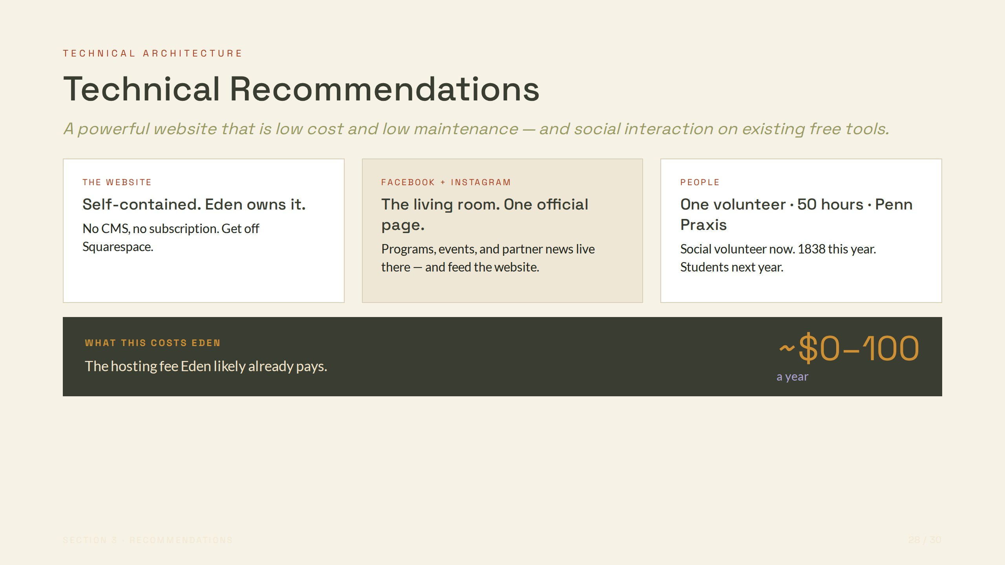
Notes:
TECHNICAL ARCHITECTURE
Technical Recommendations
A powerful website that is low cost and low maintenance — and social interaction on existing free tools.
THE WEBSITE
Self-contained. Eden owns it.
No CMS, no subscription. Get off Squarespace.
FACEBOOK + INSTAGRAM
The living room. One official page.
Programs, events, and partner news live there — and feed the website.
PEOPLE
One volunteer · 50 hours · Penn Praxis
Social volunteer now. 1838 this year. Students next year.
WHAT THIS COSTS EDEN
The hosting fee Eden likely already pays.
~$0–100
a year

Slide 29
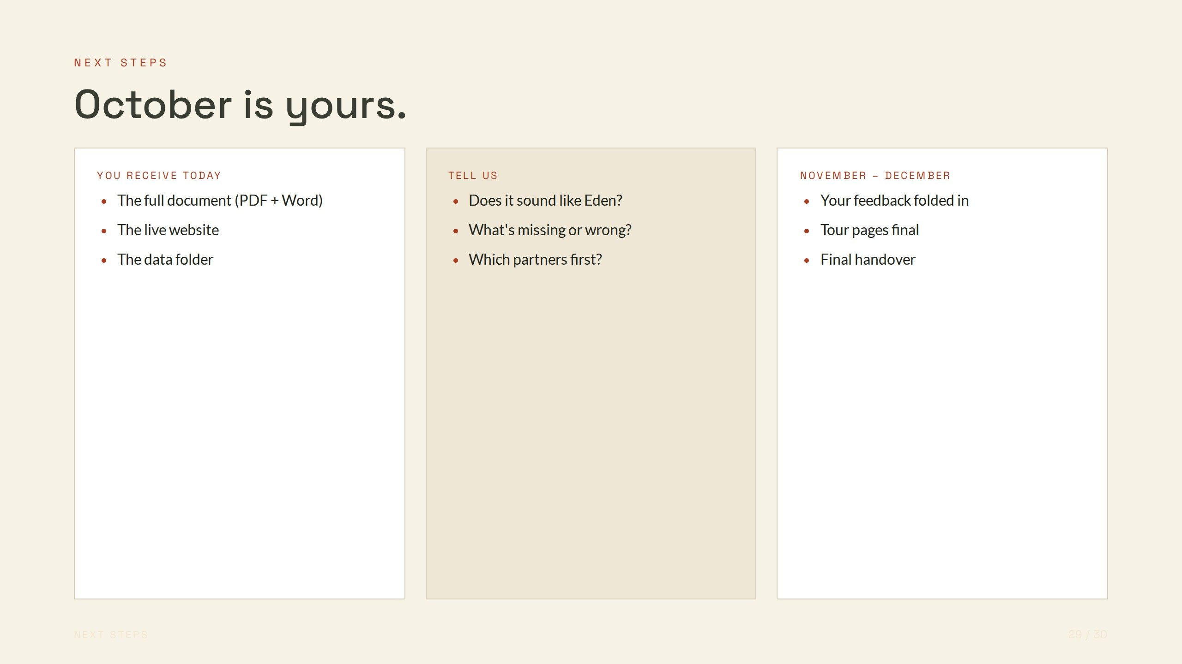
Notes:
NEXT STEPS
October is yours.
YOU RECEIVE TODAY
The full document (PDF + Word)
The live website
The data folder
TELL US
Does it sound like Eden?
What's missing or wrong?
Which partners first?
NOVEMBER – DECEMBER
Your feedback folded in
Tour pages final
Final handover

Slide 30
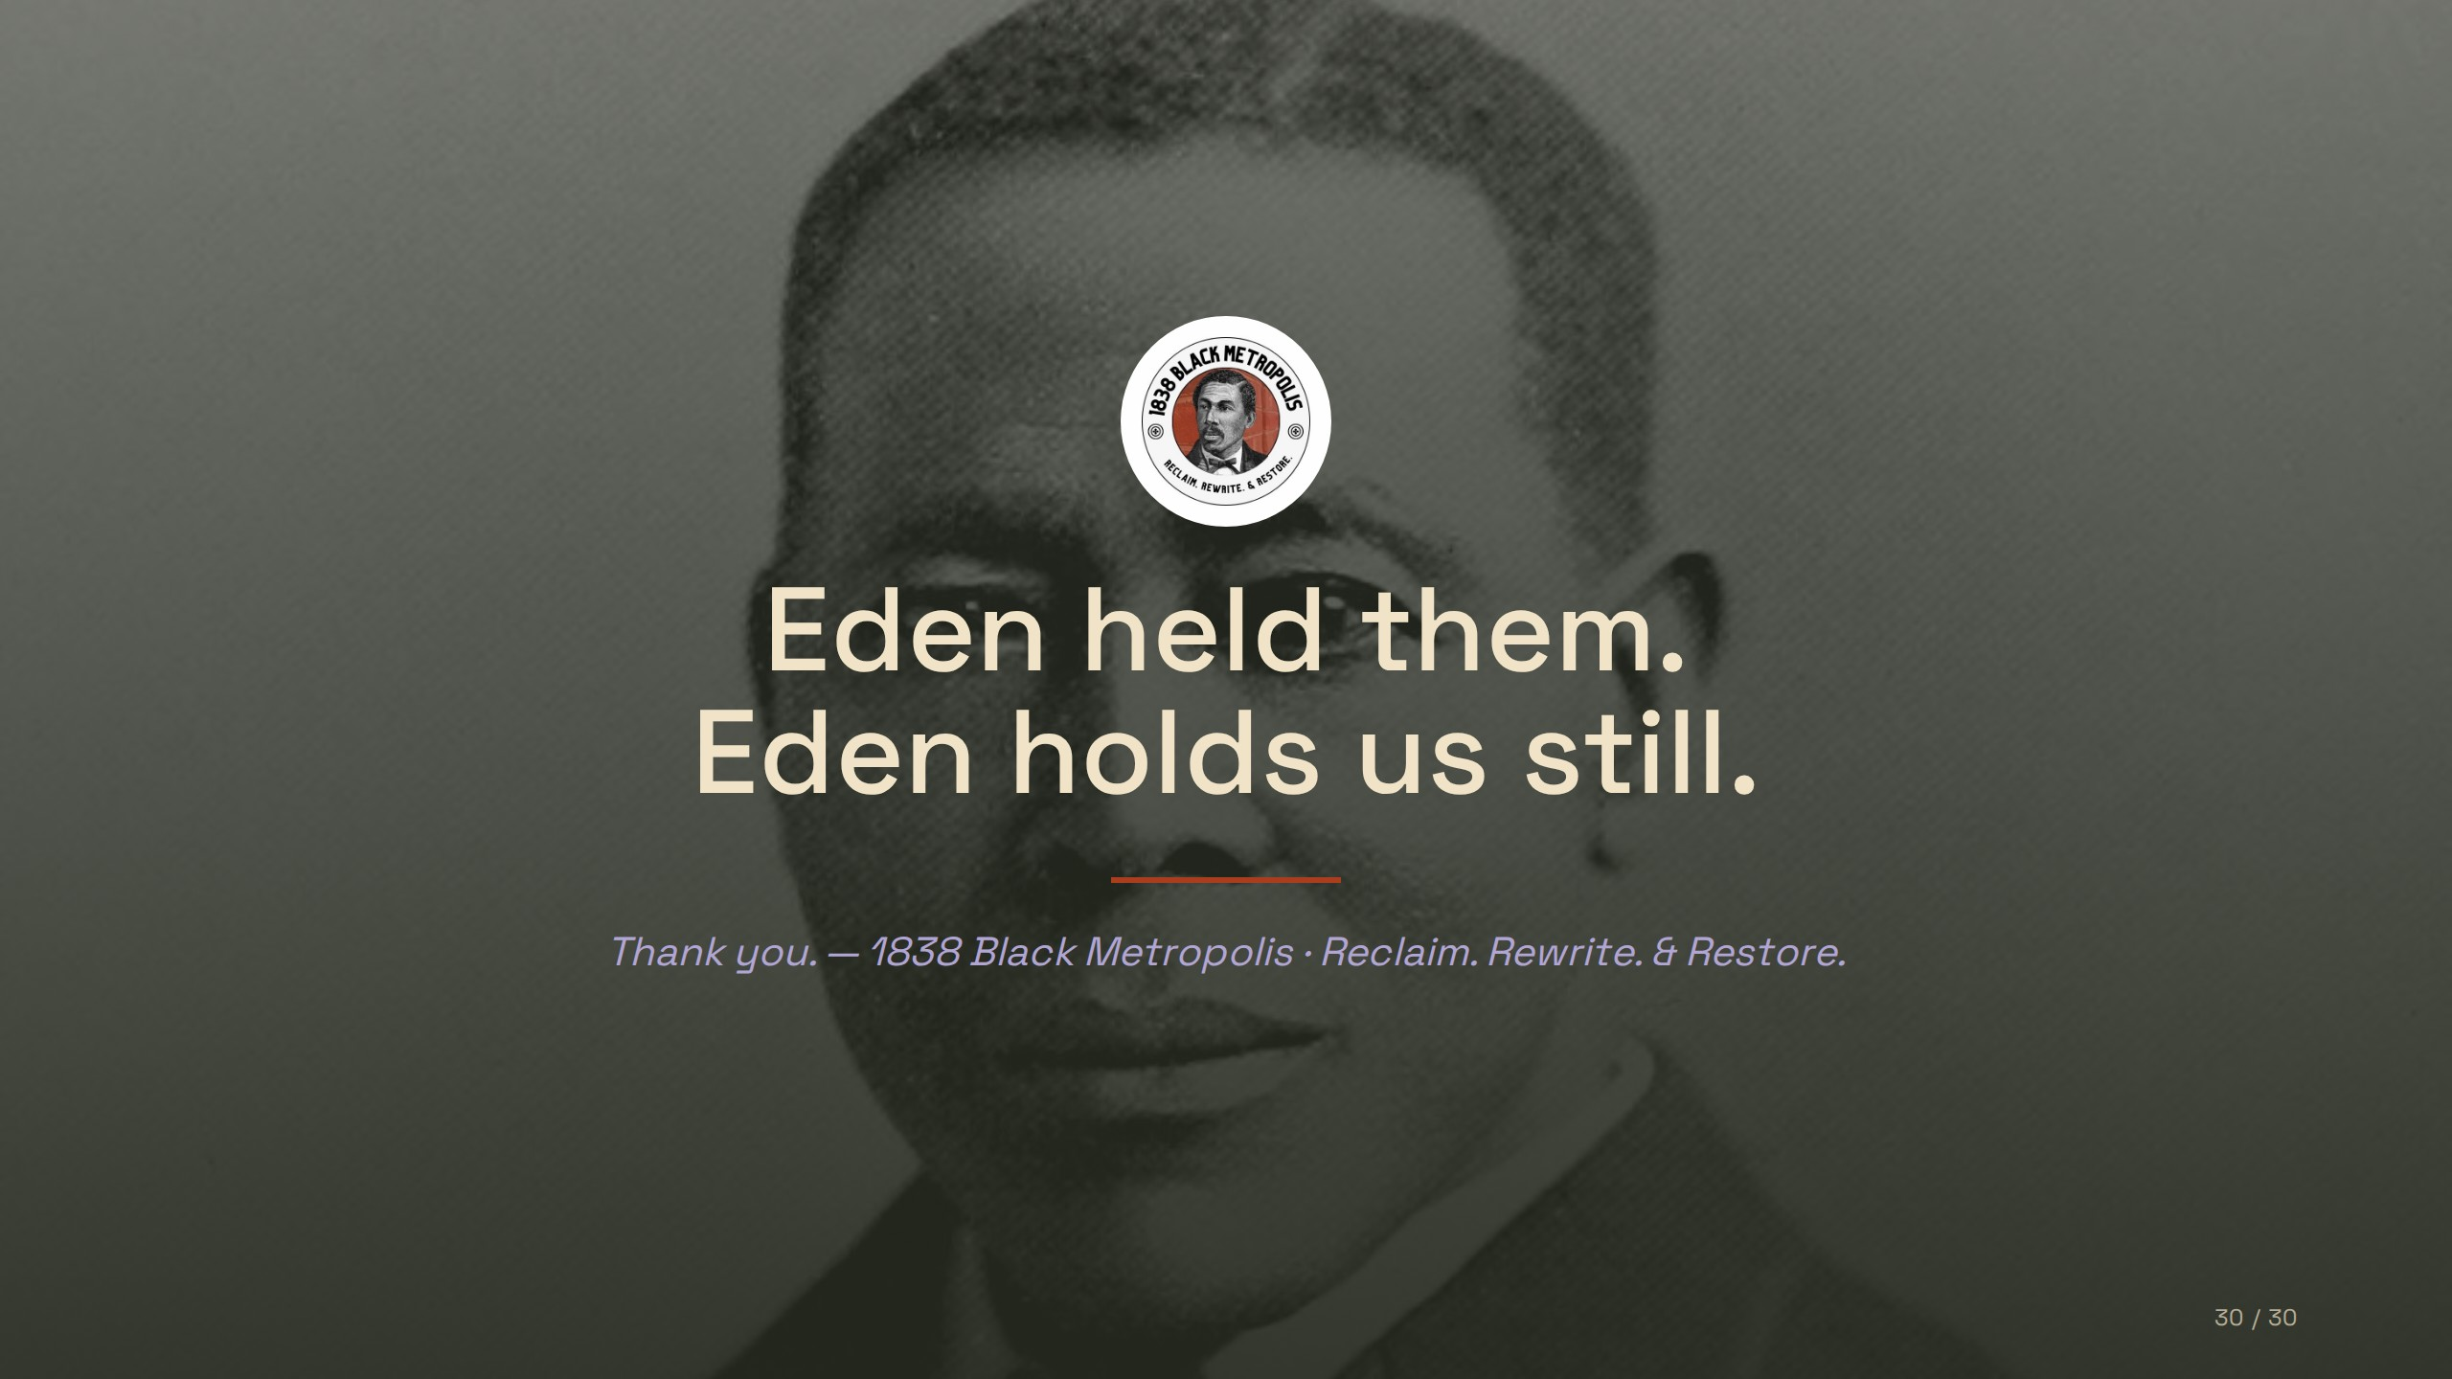
Notes:
Eden held them.
Eden holds us still.
Thank you. — 1838 Black Metropolis · Reclaim. Rewrite. & Restore.

