Slide 1


Applied Statistical Analysis II
POP77003
REPLICATION STUDY
Zhuo Zhang

Slide 2
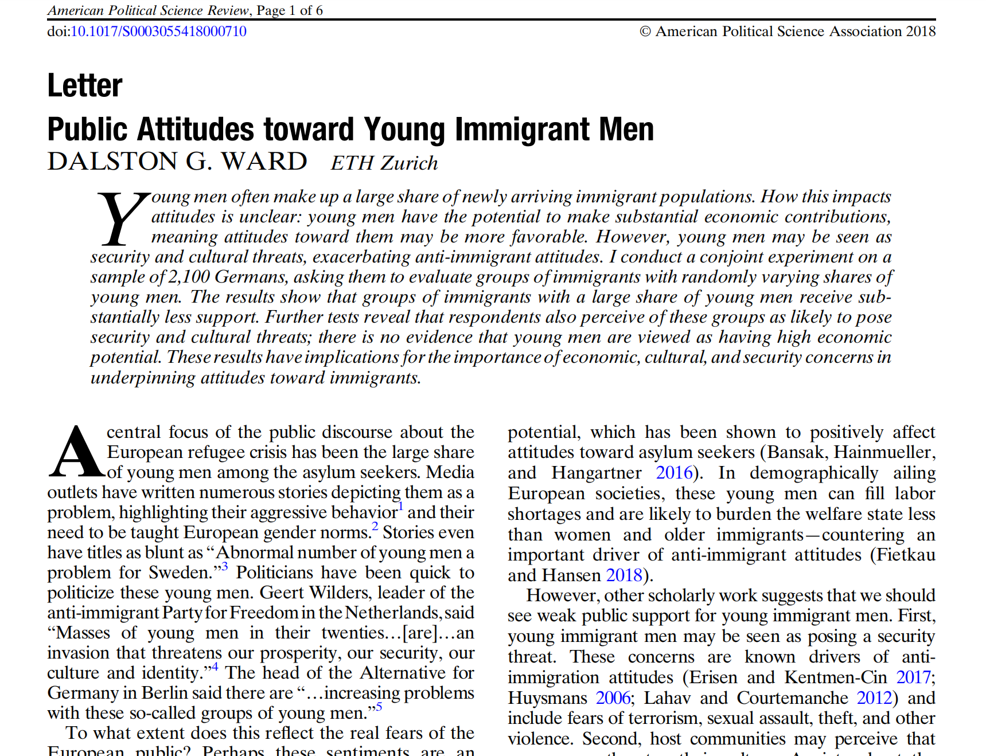
Replication study
Public Attitudes toward Young Immigrant Men
https://doi.org/10.7910/DVN/SQH6IF

Slide 3
Explaining The Original Study
Young men often make up a large share of newly arriving immigrant populations. How this impacts attitudes is unclear: young men have the potential to make substantial economic contributions, meaning attitudes toward them may be more favorable. However, young men may be seen as security and cultural threats, exacerbating anti-immigrant attitudes. The arictor conduct a conjoint experiment on a sample of 2,100 Germans, ...... The results show that groups of immigrants with a large share of young men receive sub stantially less support.
...... respondents also perceive of these groups as likely to pose security and cultural threats; there is no evidence that young men are viewed as having high economic potential.

Slide 4
Explaining The Original Study
Details of the original study
The experiment was conducted in Germany because it received the most asylum seekers in 2015 and 2016.
The survey was conducted in December 2016 with 2030 German participants.
The survey aimed to understand if the respondents were willing to have immigrant men in their community and whether they perceived immigrant men as having economic potential, posing security threats, or posing cultural threats.
Each question had a seven-point scale.

Slide 5
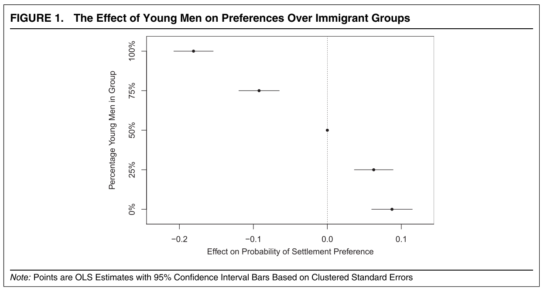
Explaining The Original Study
Example of outputs of the study
More young men a group has, the less likely they are to be chosen for settlement.
For example, a group with no young men has an estimated preference premium of 8.67 percentage points. But for a group with 25% young men, the premium is only 6.3 percentage points. On the other hand, groups with over 50% young men face a penalty in their likelihood of being selected. When young men make up three-fourths of the group, the penalty is 9.2 percentage points, and for a group entirely composed of young men, the penalty is 18.1 percentage points.

Slide 6
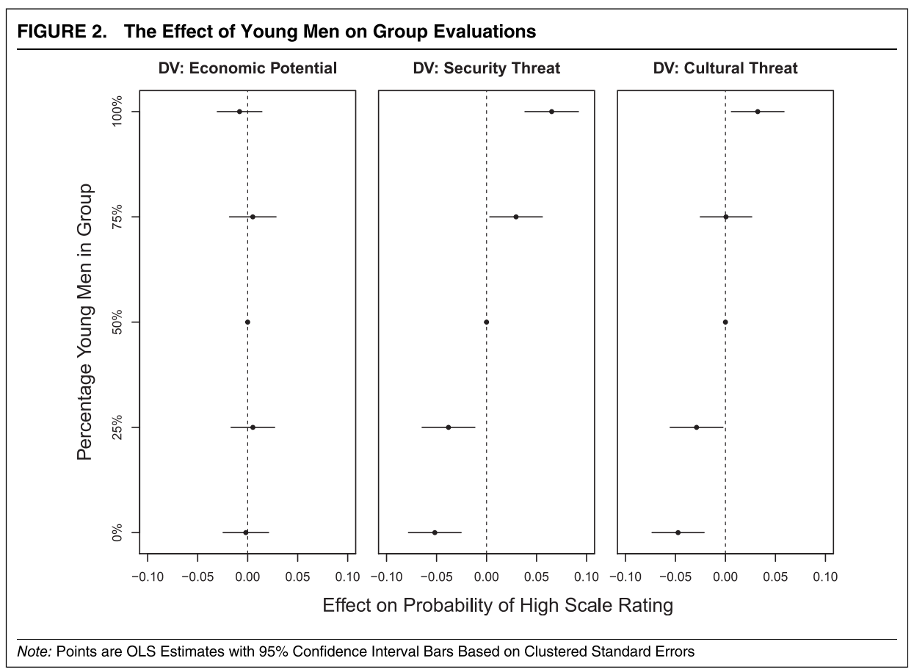
Explaining The Original Study
Details of the original study
The impact of young men on economic potential is not significant, but their impact on security and cultural threats shows a positive trend.
In this figure, the author used weighted OLS regression to explore three explanations for attitudes: Economic Potential, Security Threat, and Cultural Threat.
The impact of young men on Economic Potential was not significant, indicating that young immigrant men are not seen as having higher economic potential compared to other immigrants.
The effect of young men on Security Threat showed a positive trend, suggesting that as the proportion of young men in immigrant groups increases, the likelihood of the group being perceived as a high security threat also increases.
As the number of young men in a group increases, the perception of Cultural Threat also increases.
This indicates that non-economic factors play a crucial role in shaping respondent evaluations of immigrant groups.

Slide 7
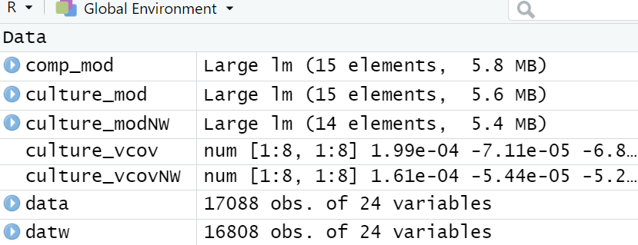
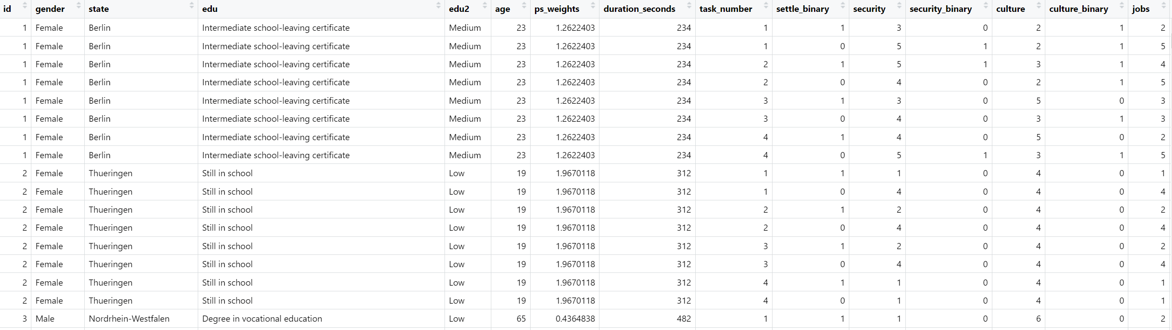
Explaining The Original Study
Data
This data has 17088 observations and 24 variables

Slide 8

My Contribution
For the paper, I conducted a re-analysis.
I wanted to kome any differences between female and male respondents regarding the perceived threats posed by younger immigrant males.
Upon analysis, I found that females were less willing to have young immigrant males living in their communities, and they were more likely to believe that young immigrant males posed threats to safety and culture.
Trinity College Dublin, The University of Dublin

Slide 9
My Contribution
I performed linear regression to fit the model, obtained coefficients and standard errors, and conducted a linear hypothesis test.

Slide 10
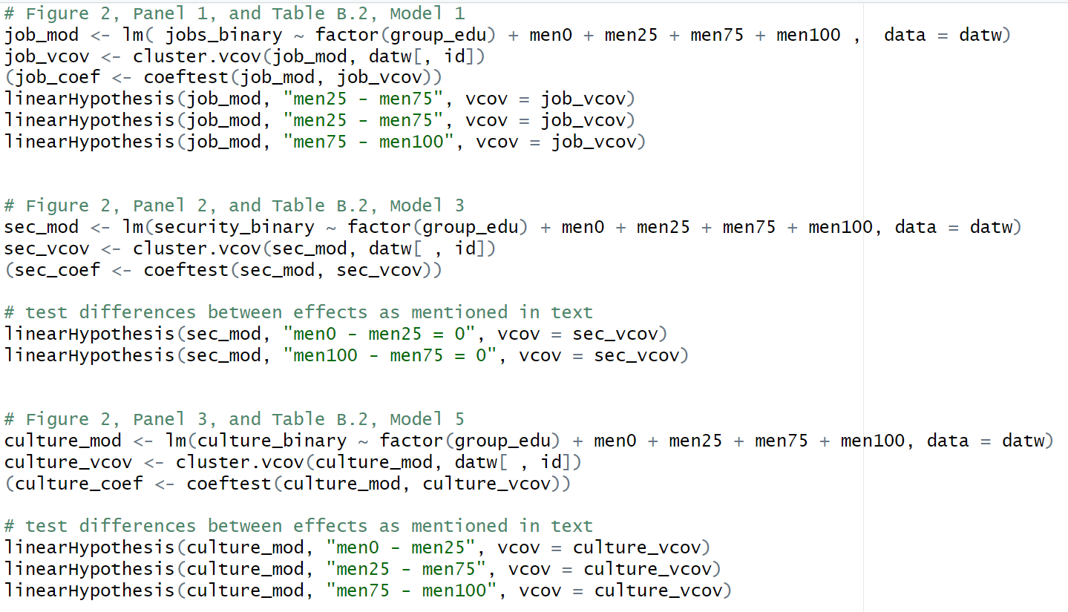
My Contribution
Fit a linear regression model to analyze the relationship between various predictive factors and results, estimate coefficients, calculate standard error, and perform hypothesis testing to compare the impact of different predictive factors on the results.

Slide 11
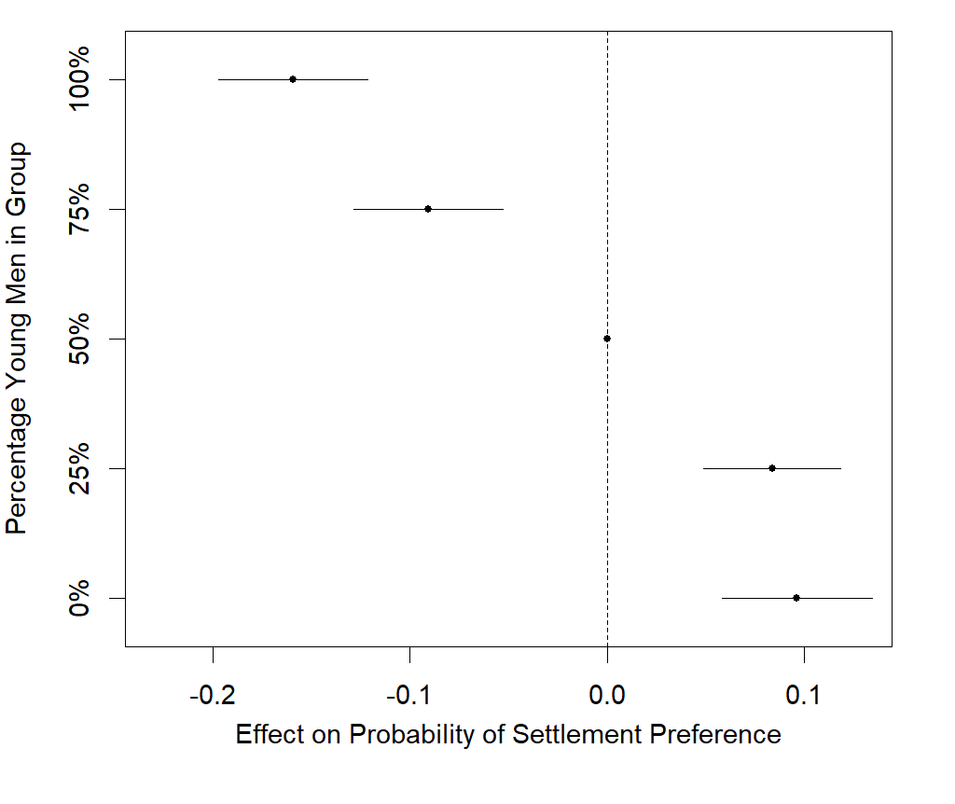
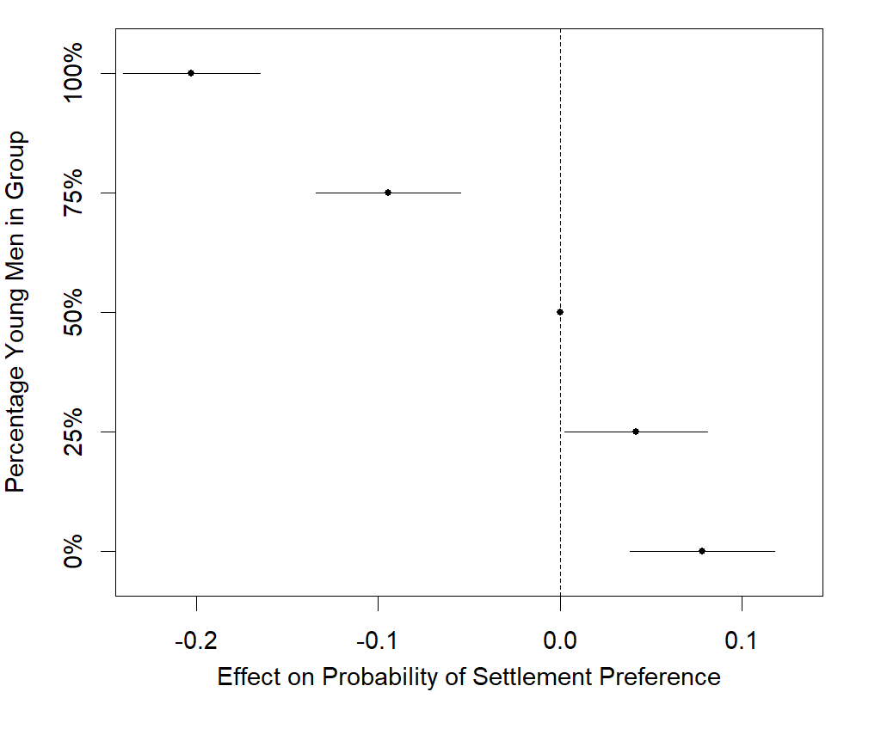
My Contribution
Male respondents
Famale respondents
Compared to men, women are less inclined to accept immigrant men settling in the community.
For instance, the preference gap for groups lacking young males is 7.8 percentage points for women and 9.6 percentage points for men. However, when considering 25% young men, the gap for women reduces to 4.2 percentage points, while for men, it remains at 8.4 percentage points. On the contrary, over 50% of young men living in the community also showed that female respondents were less willing to accept it than men

Slide 12
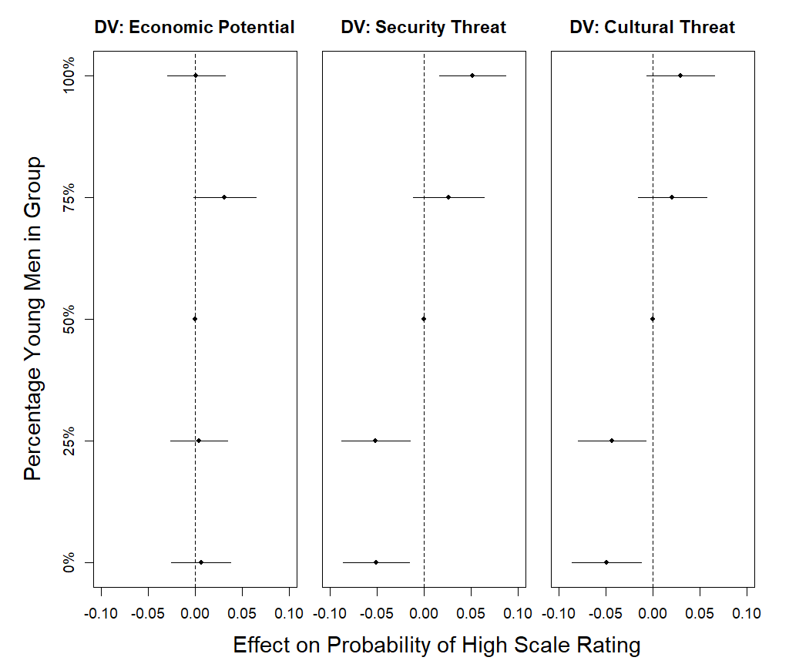
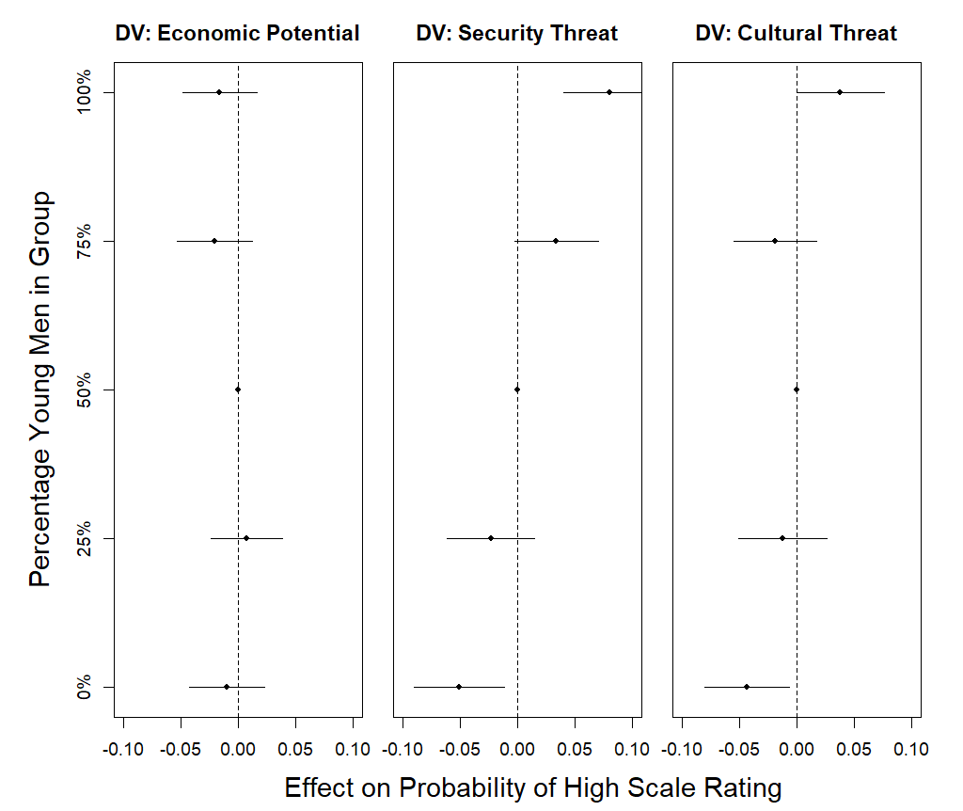
My Contribution
Male respondents
Famale respondents
Female respondents showed stronger feedback than male respondents regarding the potential security and cultural threats that young male immigrants may bring.

Slide 13
Quote Slide Option 2
Thank you

