Slide 1
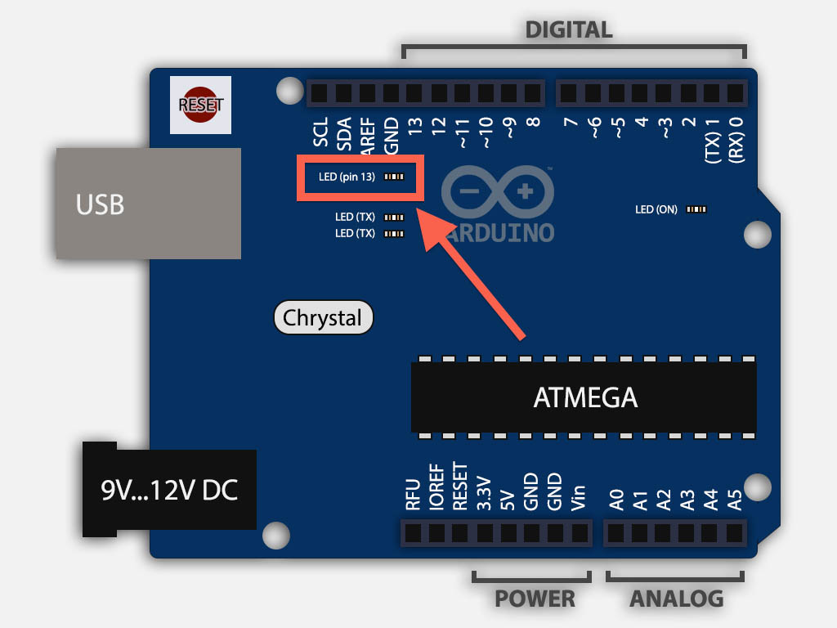
Encoder A – Yellow wire from encoder
Encoder B – Green wire from encoder
Motor PMW - R
Encoder Interrupt (A) - R
Encoder (B) - R
IMU Interrupt
Motor PMW - L
Encoder Interrupt (A) – Left
In4
In2
MOTOR 1 - Left
In3
In1
Serial
MOTOR 2 - Right
Power Supply +
IMU
Power Supply -
IMU - SCL
IMU - SDA
Current - R
Current - L
Encoder (B) - L

