Slide 1
High-Performance Implementation of the Fast Fourier Transform Using the
Cooley–Tukey Algorithm
Sharvari Satish Deshmukh
A59022896
ECE 277 - Fall 2024
Notes:
Hi, My name is Sharvari Deshmukh and my project is "High-Performance Implementation of the Fast Fourier Transform Using the Cooley–Tukey Algorithm"

Slide 2
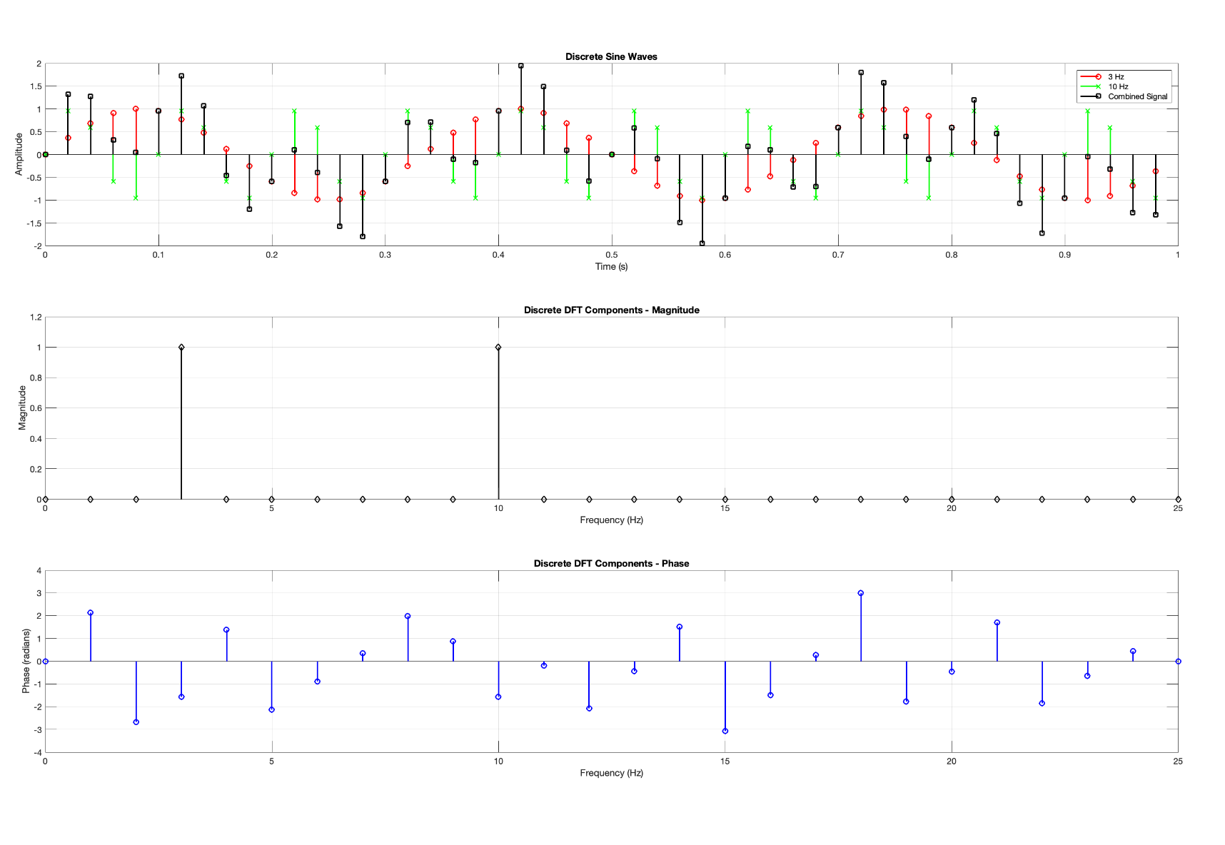
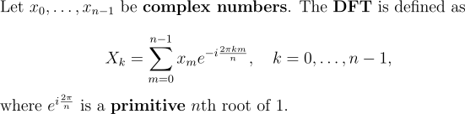
Discrete Fourier Transform & Fast Fourier Transform
DFT ----> FFT
O(n²) -----> O(nlog₂(n))
Notes:
Let's start with some fundamentals.
The Discrete Fourier Transform, or DFT, is a mathematical tool used to analyze frequency components in discrete signals.
It transforms a sequence of values into components of different frequencies.
It’s widely used in fields like signal & image processing, and machine learning.
You can see how the magnitude and phase of the DFT coefficients look like in the figure on the right
Here the input signal is combination of 2 different sine waves with different frequencies so you see 2 spikes in the magnitude plot
But DFT has a major drawback i.e. its computational complexity. It requires O(N^2)operations for N data points,
so it's really inefficient for large datasets or real time applications.
This is where the Fast Fourier Transform, or FFT, comes in.
It's an optimized algorithm for computing the DFT in O(Nlog⁡N) time.
It’s not a single algorithm but a family of algorithms, and Cooley–Tukey algorithm is the most popular one.
So In this project, I decided to explore the implementation of Cooley-Tukey for GPU and see if it can be optimized any further
starting from basic implementation using global memory and progressing to advanced optimizations like shared memory & cuda streams.

Slide 3
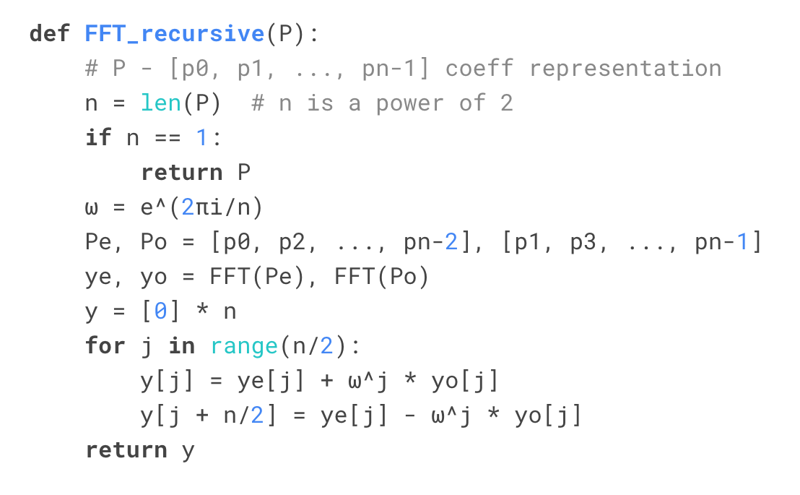
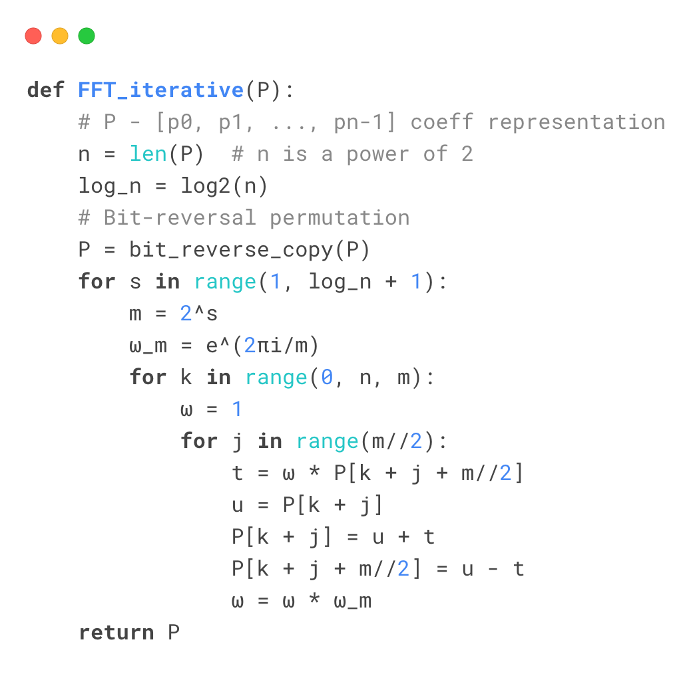
Cooley-Tukey: Recursive vs Iterative Algorithm
Notes:
There are 2 variations of Cooley Tukey algorithm - recursive and iterative.
Basically, it is a divide and conquer algorithm and it works by breaking down the DFT of a composite size N into smaller DFTs of sizes N1​ and N2.
which is what helps reduce the computational complexity from O(N^2) to O(Nlog⁡N).
In the recursive algorithm, DFT is broken down into 2 sets based on even and odd indices, recursively,
until the smallest possible size computed, i.e. N=2 for a radix-2 algorithm.
All of these computations are done in place, so there is no extra memory required.
This one easier to understand but it has function call overhead and so optimization opportunities are limited.
In the iterative version, same divide-and-conquer logic is there but it builds the DFT ground up, in a loop
So this is much more memory-efficient and cache-friendly and is better suited for parallelization with GPU
So in this project, I've implemented the GPU kernel based on this iterative version of the Cooley–Tukey algorithm.

Slide 4
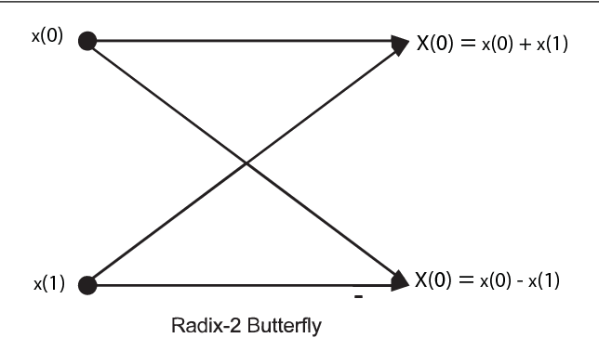
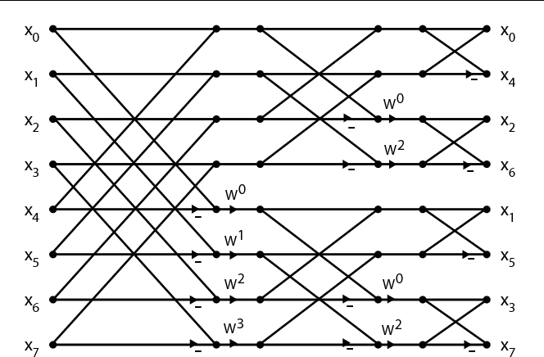
Cooley-Tukey: Iterative (Radix-2)
i=3 (011) --> (110) i=6 => swap(3,6)
twiddle factor
Figure 1: Length-8 Radix-2 FFT Flow Graph
Notes:
Let's understand the iterative cooley-tukey , specifically the radix-2 algorithm in detail.
This one is a specific case where the input size N is a power of 2. This simplifies the breakdown process
The first step in the iterative FFT is reordering the input data using bit-reversal permutation.
For example, if N=8, the index 3 (binary 011) would swap with index 6 (binary 110).
Bit reversal is necessary because the divide-and-conquer logic requires the data to be in this specific order to align the sub-problems correctly.
Once the input is reordered, we compute the FFT iteratively using a structure called the butterfly. The butterfly represents the core computation of the FFT
Each butterfly operates on a pair of input values, combining them to produce frequency components.
Mathematically, for two inputs a & b, the butterfly outputs are a+b⋅w^k & a-b.w^k where w^k =e−2πik/N is the twiddle factor.
This process is repeated in stages, doubling the size of the sub-problems at each stage until the entire FFT is computed.
The algorithm progresses through log⁡N stages.
On the slide, you can see a step-by-step diagram of the butterfly stages. The arrows represent the flow of data as it is combined and transformed.

Slide 5
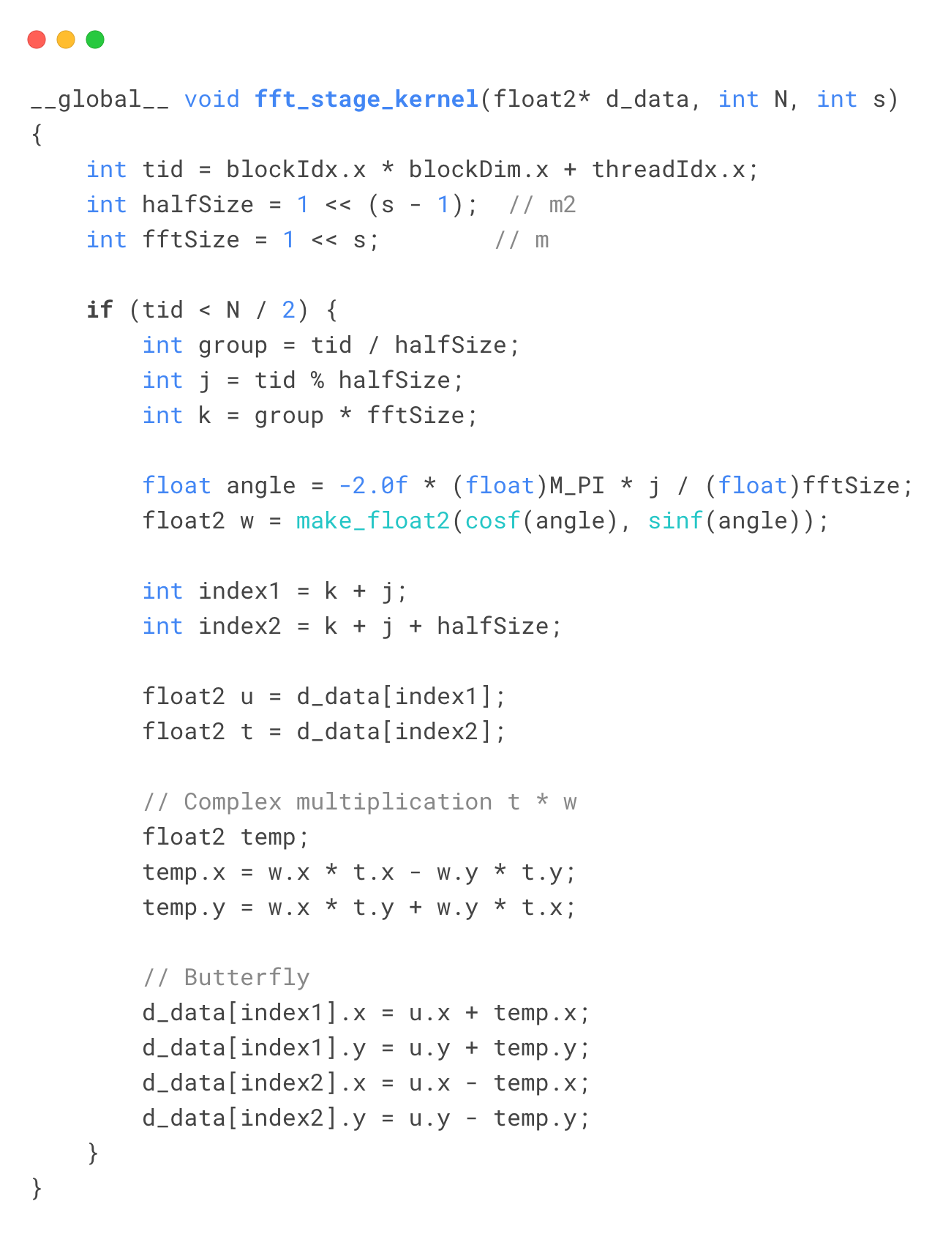
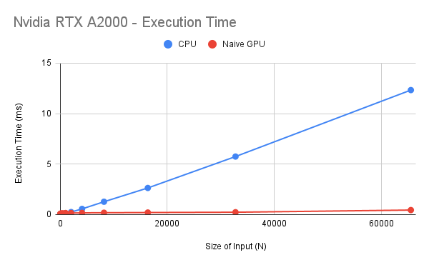
Simple GPU implementation
Notes:
I implemented this GPU kernel which computes one stage of the FFT algorithm.
So this kernel is sequentially called logN times from the host, since the output of one stage is used as the input for another.
This kernel performs the butterfly operations for the corresponding stage of the FFT.
Each thread calculates the indices the of the butterfly pair using the threadID and the stage of algorithm.
So each thread updates these two values in place.
Since we are doing pairwise operations, we only require N/2 threads in total per kernel call
And twiddle factor is calculated based on the threadID and stage.
I tested this implementation for input size N ranging from 32 to 65536 and as we can see that while the CPU execution time increases by N^LogN, GPU kernel execution time increases minimally

Slide 6
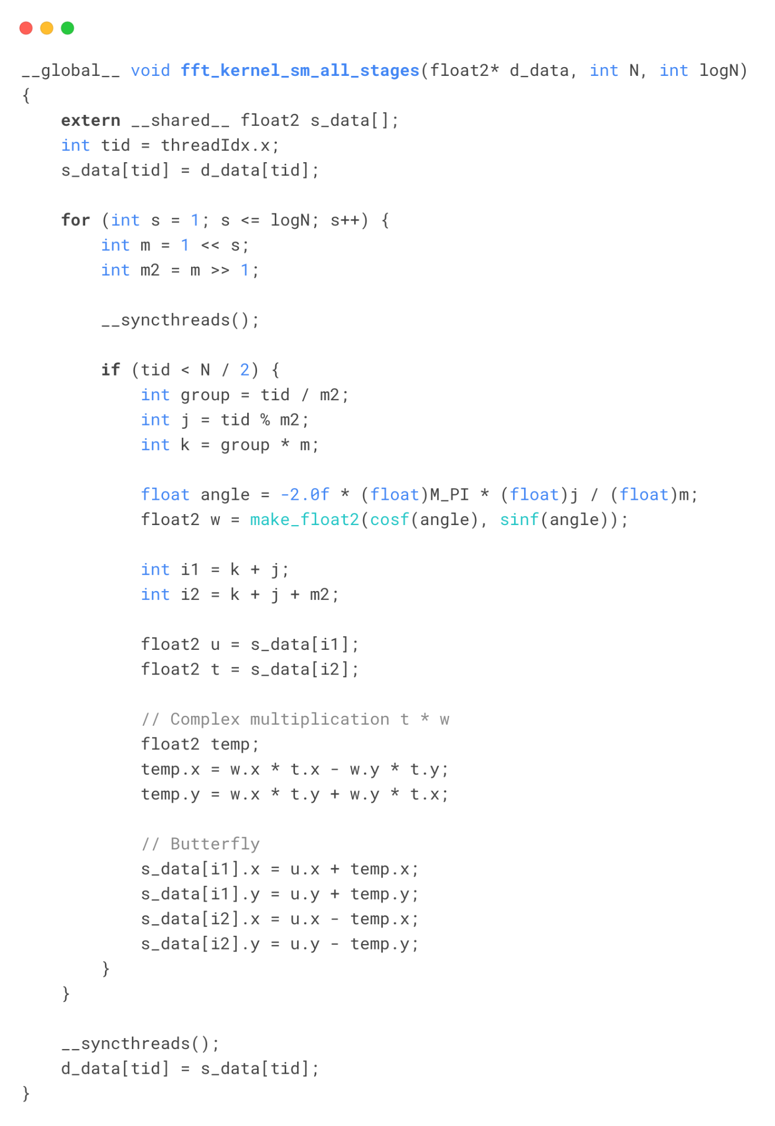
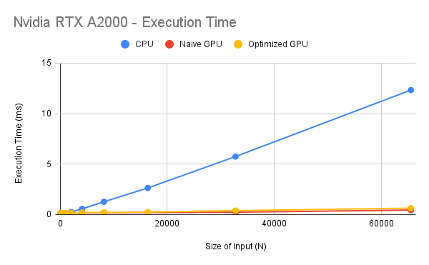
Optimized GPU: Streams
& Shared Memory
Notes:
Next, I tried some more optimization strategies as introduced in the lectures to see if I can reduce the execution time any further
In the simple GPU implementation, stages of of the algorithm are run sequentially
So I wanted to try if I could run some of these stages in parallel, and hence I came up with this hybrid approach
Where I divided the input into segments of 1024
(as the maximum number of threads in a block are limited to 1024 and I was planning to use shared memory of same size as of the block)
So in this kernel, I load all data for one segment from global memory to shared memory and perform all stages on it sequentially, updating the shared memory in place.
Once all stages are performed, the data is copied back to global memory
All these segments are are parallelized using cuda streams
So this way I can get DFT output of multiple segments of size 1024 and then need to combine them to calculate the complete.
To combine them, I run the same stage based kernel from previous simple GPU implementation after all the streams are executed, for all the remaining stages.

Slide 7
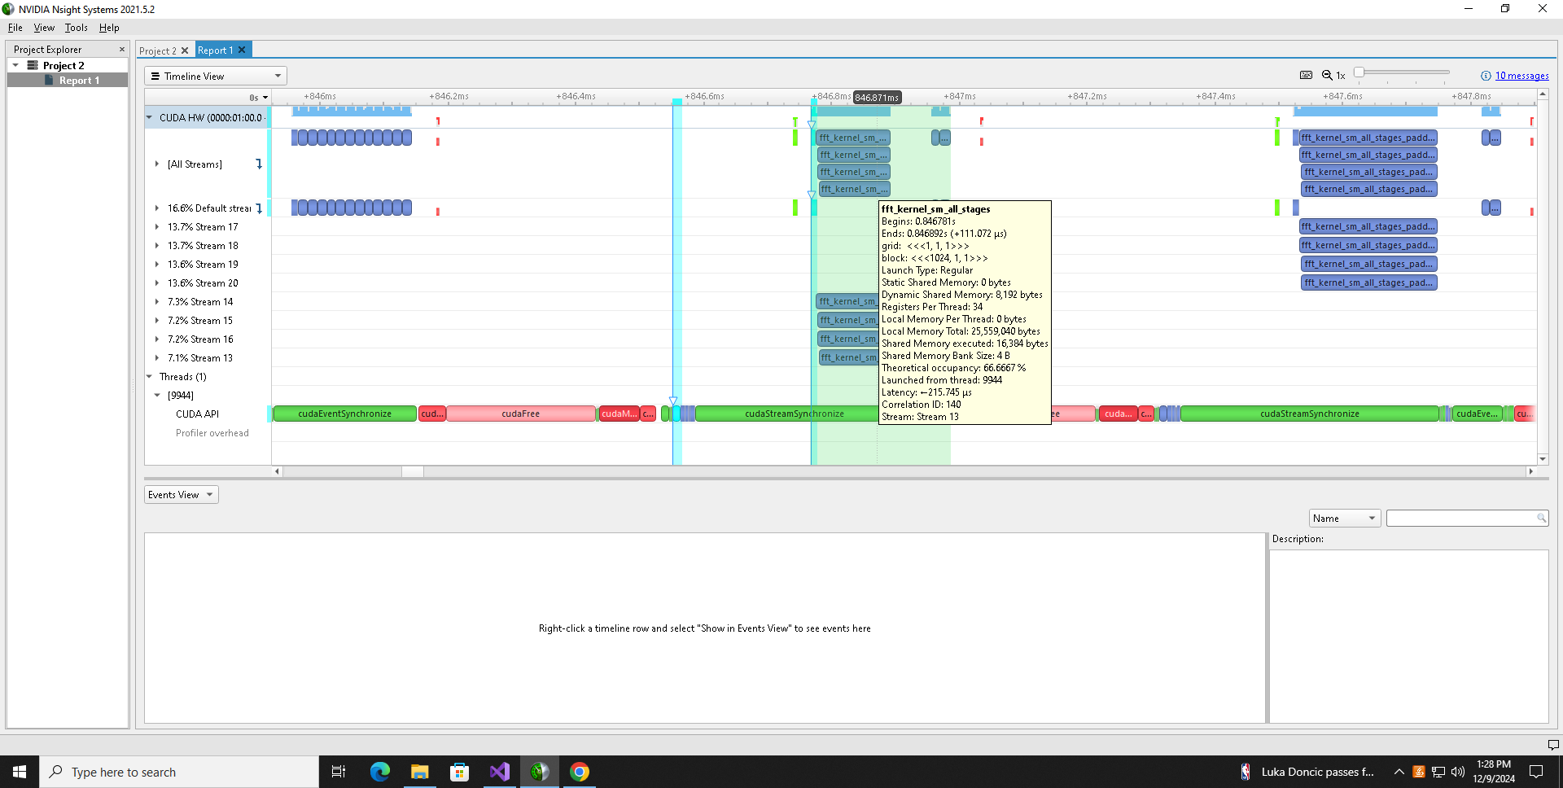
Optimized GPU: Streams & Shared Memory
N = 4096
Notes:
To explain the execution, here is how the trace of this approach looks like for N=4096
we can see 4 parallel streams carrying out DFT for 4 segments of size 1024
and then 2 simple GPU kernel combining and calculating rest of the stages in default stream after these 4 are done
I used cuda stream synchronize to make sure that the stage kernels are run only after all the segment kernels are completed
But this approach did not provide enough optimization over the simple GPU, because of multiple factors

Slide 8
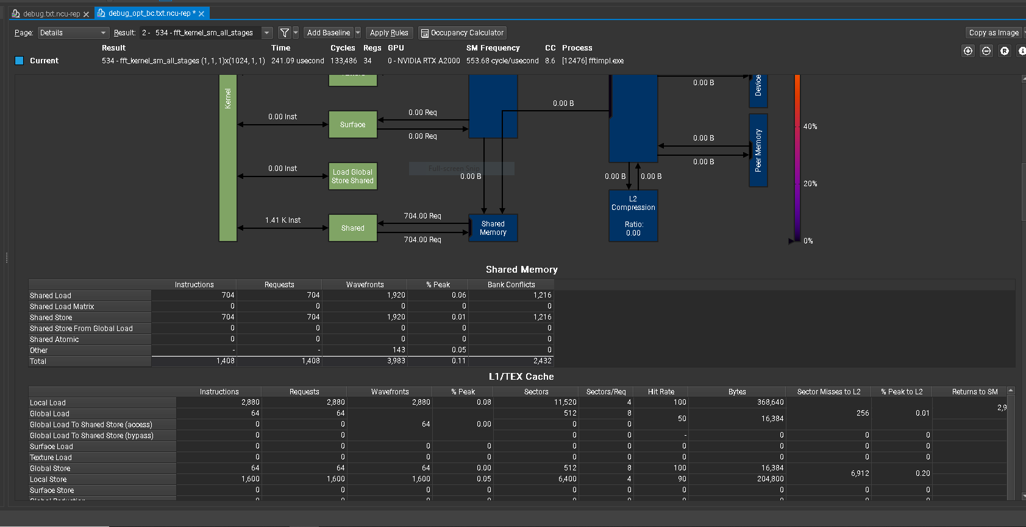
Optimized GPU: Bank Conflicts
Notes:
One of the factor was this, the bank conflicts in the shared memory were high, mainly due to the inherent algorithm structure
Since the butterfly structure operates on elements from indices that are not adjacent, each thread operates on different pair indices in each stage as well as runs multiple stages sequentially
this introduces multiple bank conflicts in one warp.

Slide 9
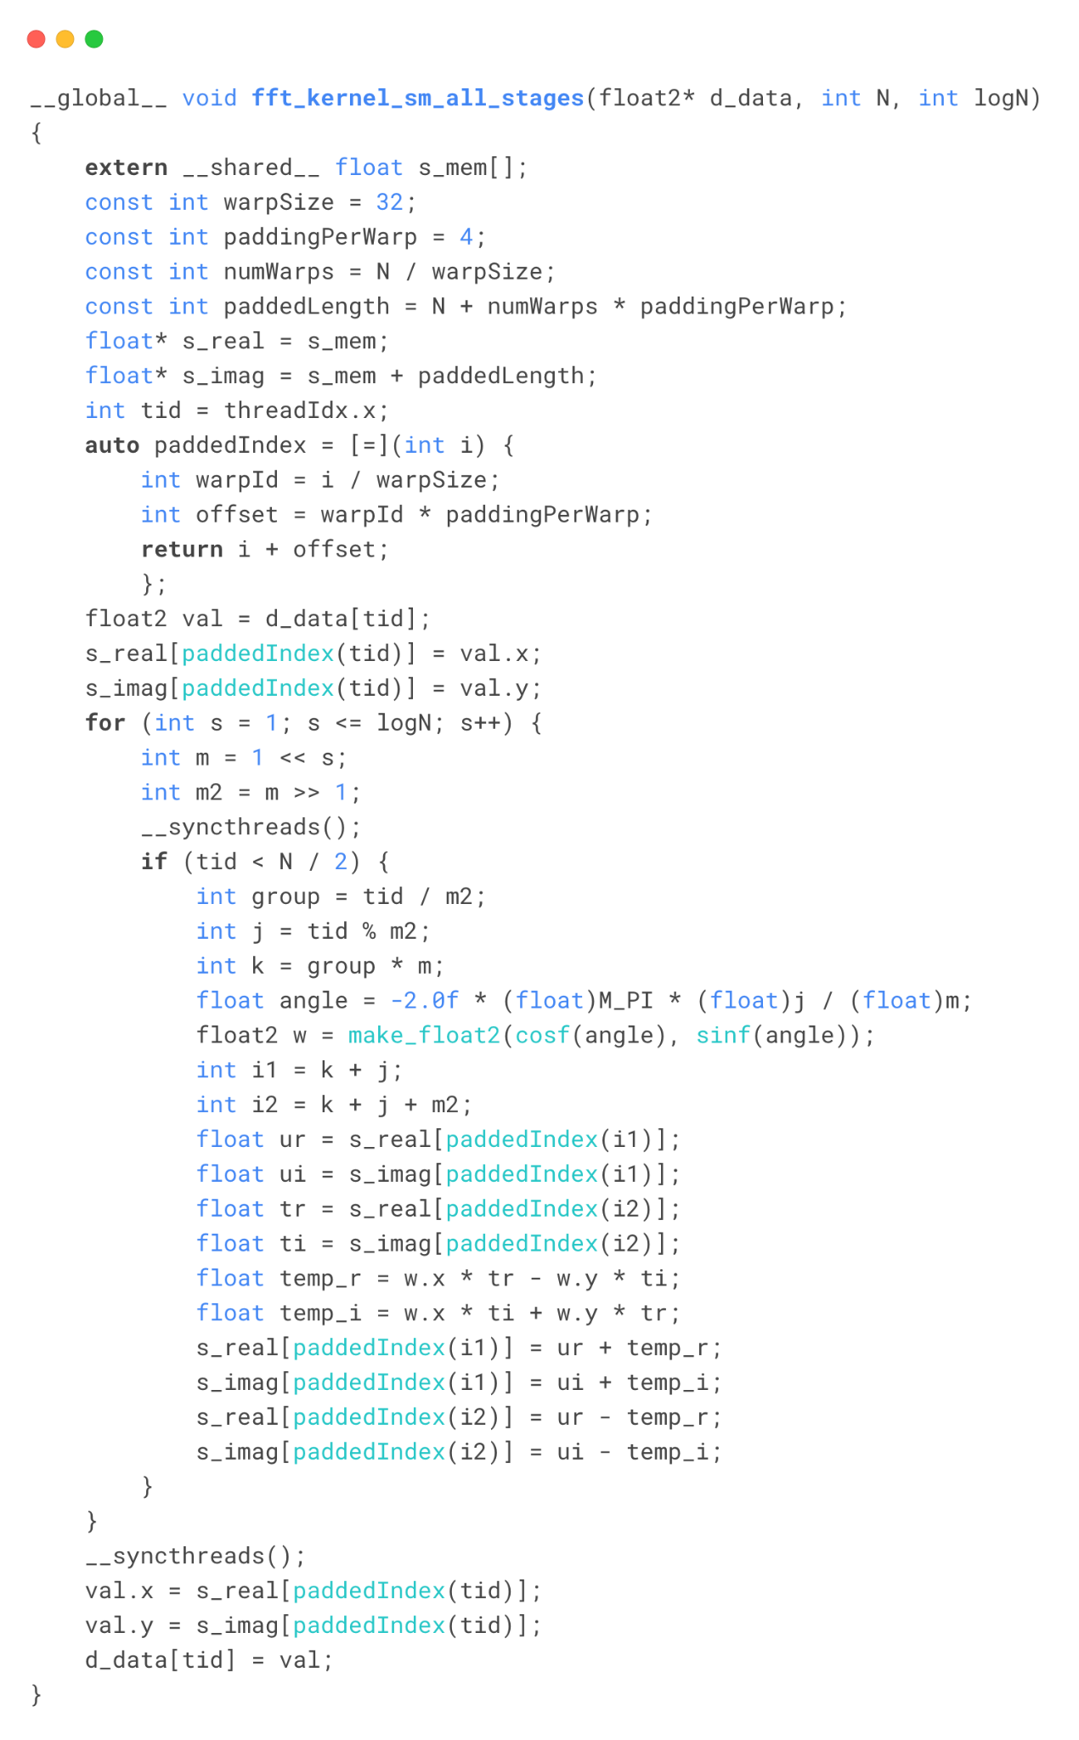
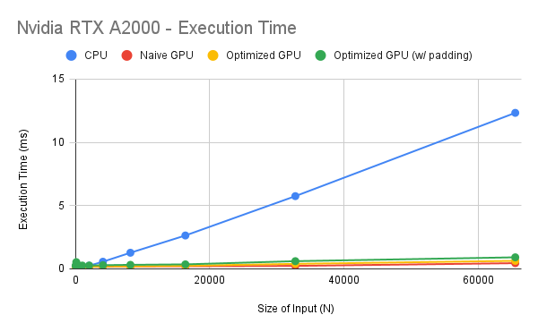
Optimized GPU: Padding
Notes:
So I tried to reduce these bank conflicts using multiple padding strategies. The one which reduced it to minimum was this -
Since we are dealing with DFT coefficients, the intermediate output values are complex and I've been handling them as a float2 type i.e a tuple of 2 floats each storing real and imaginary value of the number
So while writing in the shared memory, I first loaded all the real parts and then the imaginary parts and added padding of 4 after every 32 elements.
Idea was to spread out the 32 numbers i.e. total 64 floats per warp as much as possible to reduce the bank conflicts per warp

Slide 10

Optimized GPU: Padding
Notes:
This approach worked and the bank conflicts were reduced significantly as can be seen here, from 1216 to 256

Slide 11
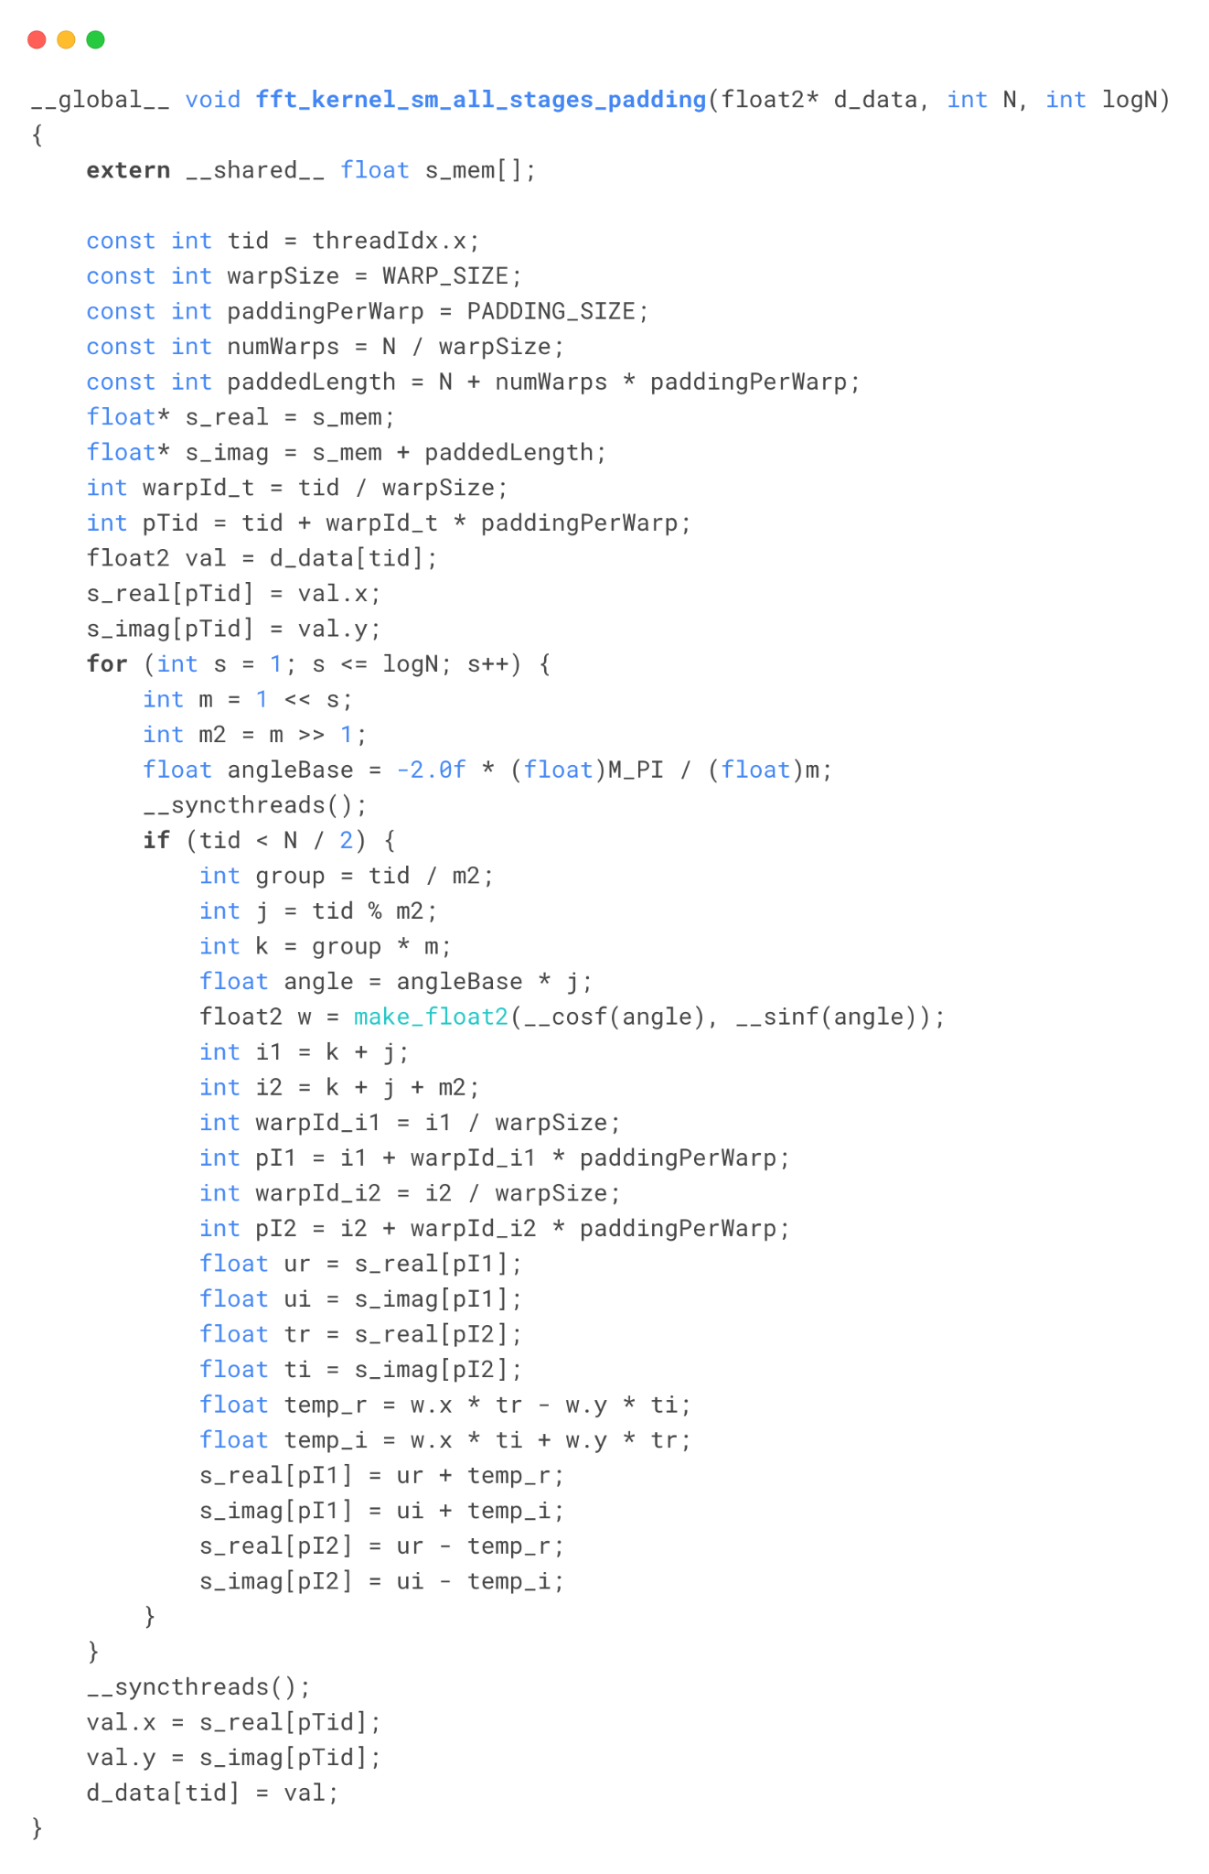
Optimized GPU: Instructions Overhead
Notes:
Another problem for this kernel was the instructions overload.
One was due the redundant calculation of padding index and another was caused due to multiple computations of sine and cosine within a kernel
So I changed this by precomputing the padding index and replacing the sine and cosine functions by their CUDA optimized versions
These have slightly lower precision than the previous ones but better performance

Slide 12
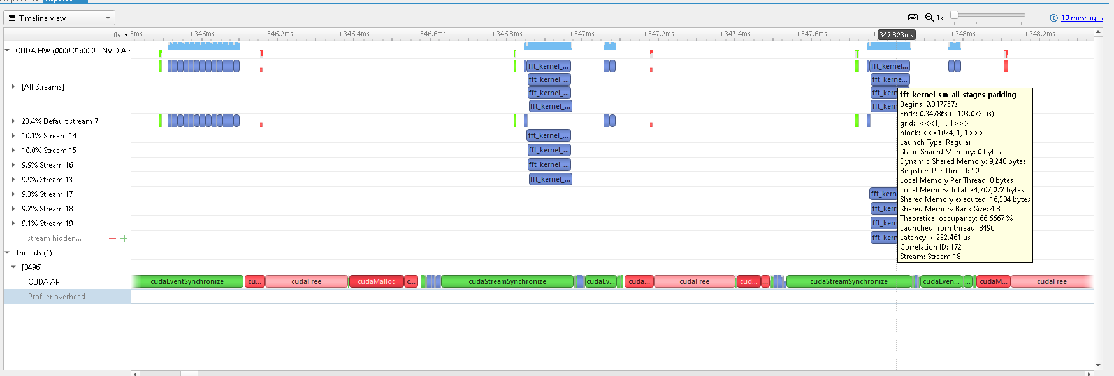
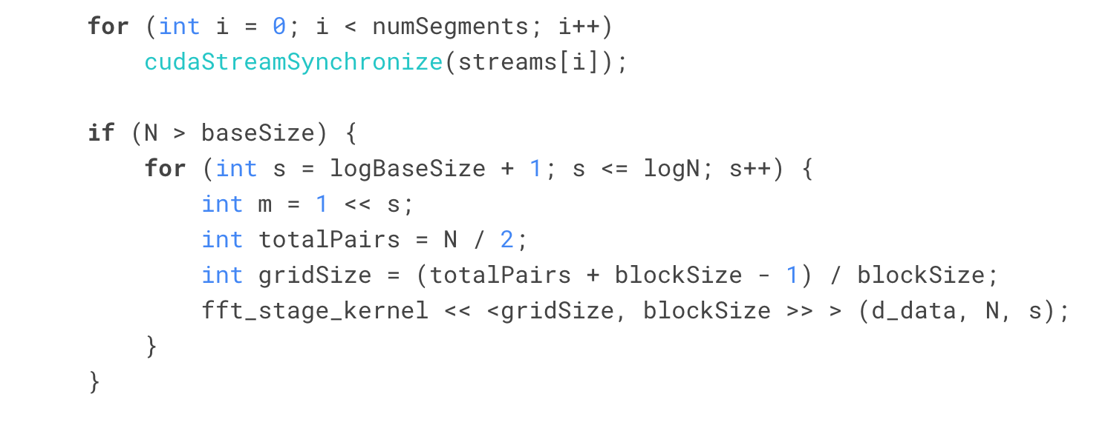
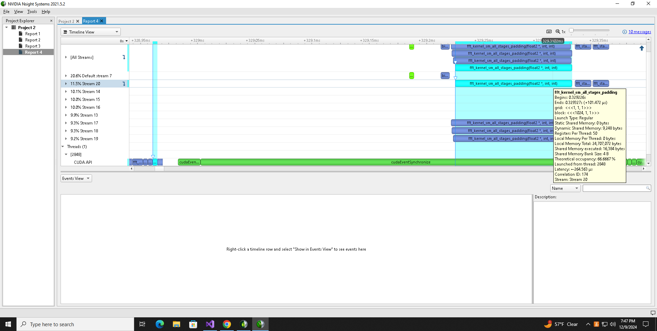
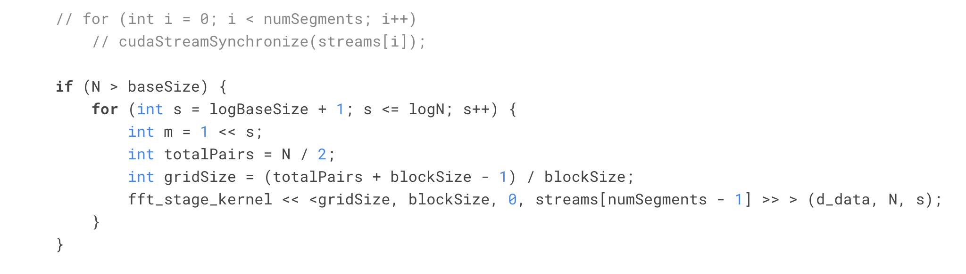
Optimized GPU: Synchronization Overhead
N = 4096
Notes:
The main bottleneck in this implementation was the streamSynchronization,
as you can see there is huge gap between the last segment stream and the default stage stream in the trace at the top
I experimented with multiple synchronisation methods like cudaDevicesynchronize and cudaEventSynchronize but they didn't have any better performance than this
Removing the synchronization and relying on the inherent queue-like ordering of the streams, helped decrease this gap and the overall execution time by a lot
but this approach didn't guarantee the correctness of output for large values of N, for me it was for N>16384

Slide 13
DEMO
Notes:
Now I'll give you a quick code walkthrough and show the output for some of these N values
bit reversal kernel - since it is a parallelizable process, I 've written a kernel that does the bit reversal in parallel
It is called before the GPU FFT kernel for all implementations
wrapper methods - data copy, trigger kernel, calculate execution time and clean up resources
opt - streams & shared memory size
ultra - padding size
main - allocate memory on host for all implementations separately, initialize values using sine function, call the implementations and calculate the difference between CPU and GPU outputs for sanity
Since we are dealing with floating points, there is some precision loss and error cascading because of which there's some diff in output from CPU and GPU
I've kept tolerance as this but for large N, it has to be increased
run for 4096, 8192

Slide 14
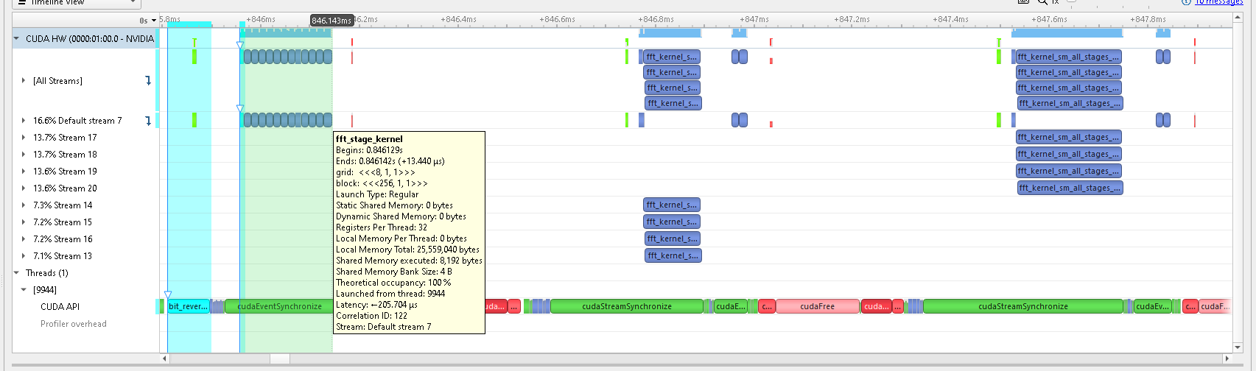
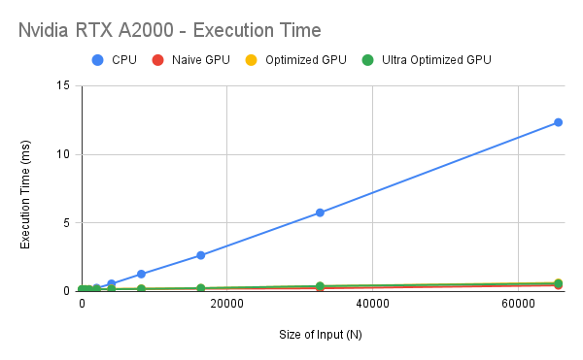
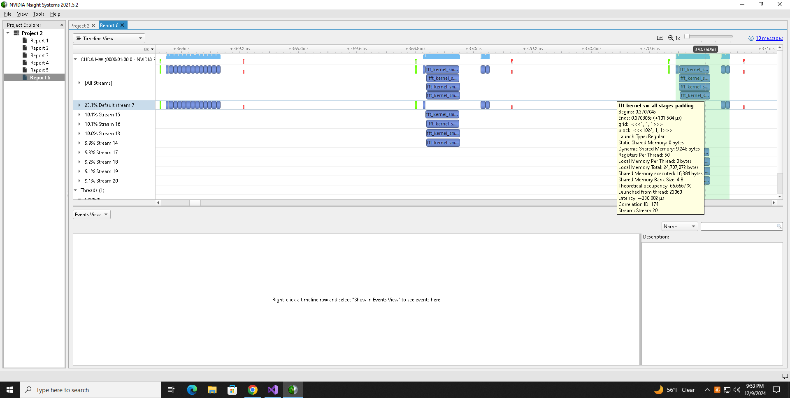
Results
N = 4096
Notes:
To summarize the results, Simple GPU implementation of the algorithm is already quite optimized due to the inherent parallel structure of the algorithm.
Some of the optimization techniques I tried semm to give some marginal improvements, especially for high values of N
You can see the relative execution times of the kernels for 3 different implementations in these traces for N = 4096

Slide 15
Limitations & Future Scope
Algorithmic limitations:
Dependence on Input size
Sequential dependency
Butterfly design
Shared memory size limitation
Synchronization overhead
Floating point data:
Precision vs Performance
Cascade of error
Hybrid algorithms, zero-padding (Radix-4/8, Stockham Algorithm)
Mixed precision (Tensor Cores), error-compensating algorithms
Batch Processing, Hardware-Aware Optimizations
State-of-the-art FFT Libraries
Notes:
That being said, there a multiple limitations to optimization of this algorithm, like input size needing to be power of 2, sequential dependencies between stages and the interthread sync required sue to butterfly design
Because of which shared memory size of the GPU and sync overhead become the real bottlemnecks
And the floating point operations add extra complexity causing precision loss & cascade of errors
So to further optimize the FFT, we need to choose some other algorithm with radix 4/8 or which has some hybrid approach to calculation of the coefficients
Mixed precision to reduce error cascade and maintain performance
And approaches like batch processing or Hw aware opt could be tried for large values of N
There are also state of the art libs like cuFFt available that implements the most optimized FFT in most efficient way
So overall this was a good project experience, understanding and experimenting using all the concepts and learnings from the class and
seeing the significant GPU optimization in terms of execution time vs the CPU time for Cooley Tukey algorithm

Slide 16
References
[1] Burrus, Sidney. “The Cooley-Tukey Fast Fourier Transform Algorithm ∗ C .” (2014).
[2] https://www.wikiwand.com/en/articles/Fast_Fourier_transform
[3] https://www.youtube.com/watch?v=h7apO7q16V0&t=1336s&ab_channel=Reducible
[4] https://github.com/KAdamek/SMFFT
[5] https://forums.developer.nvidia.com/t/does-cufft-show-much-higher-efficiency-than-cpu-fft-routines/17790/4
[6] https://github.com/roguh/cuda-fft/tree/main
[7] https://github.com/anair-eng/CUDA-MPI-pthreads-FFT
[8] https://cs.wmich.edu/gupta/teaching/cs5260/5260Sp15web/studentProjects/tiba&hussein/03278999.pdf
Notes:
These are some of the references and resources I used while building this project,
I've added the exact results from my experiments in the Appendix.

Slide 17
Thank You!
Notes:
Thank you!

Slide 18
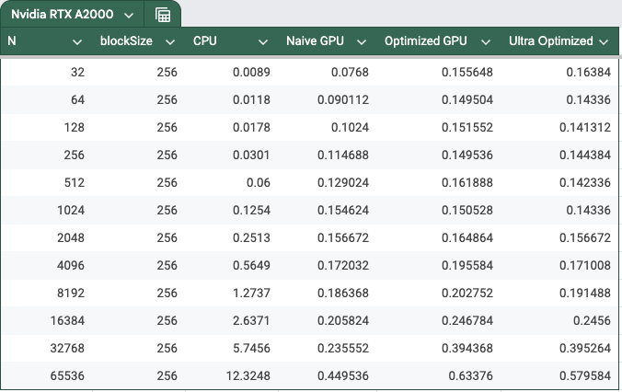
Appendix

