Slide 1


public
Horus –代码评审和团队画像构建平台
创建更好的工作环境，不断创新进步，成就更好的自己。
Date：2020.08.015
Author：曾冰清

Slide 2
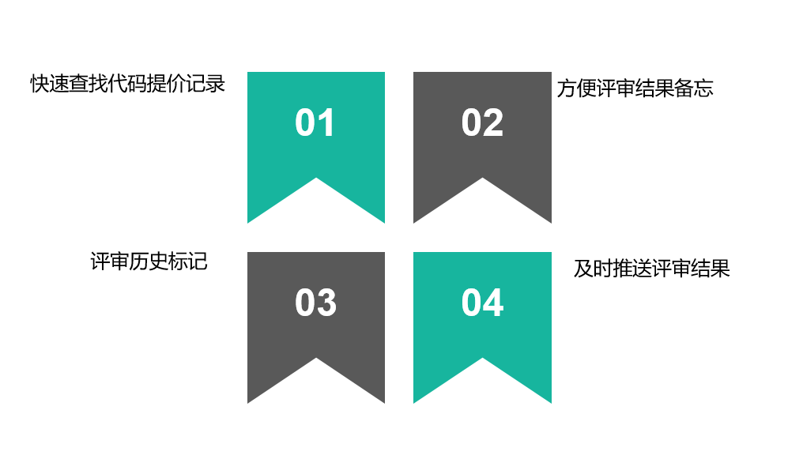
public
1
Horus能为我们做些什么?-代码评审
.

Slide 3
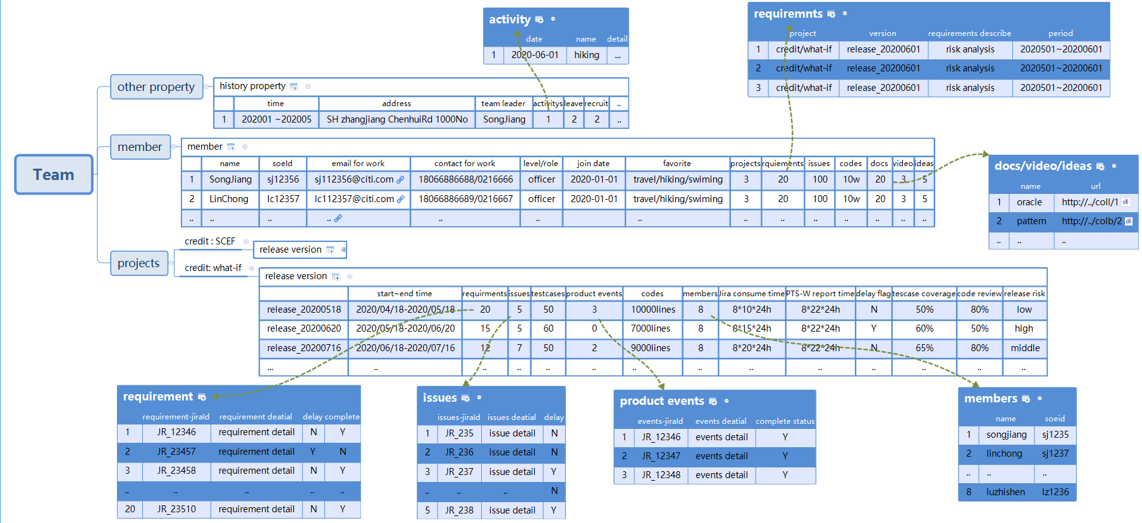
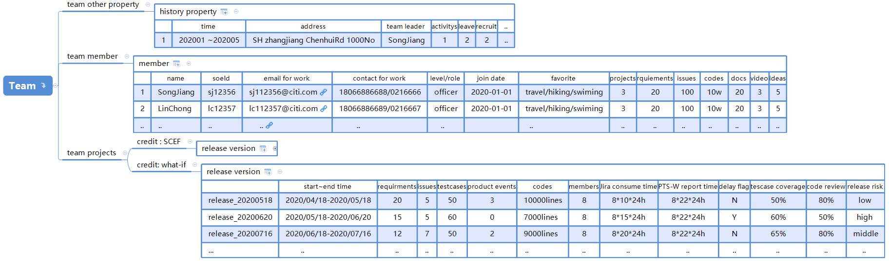

1
Horus能为我们做些什么?-团队画像构建
Inner public
刻画团队项目特征
01
刻画团队成员特征
02
刻画团队其它特征
03

Slide 4
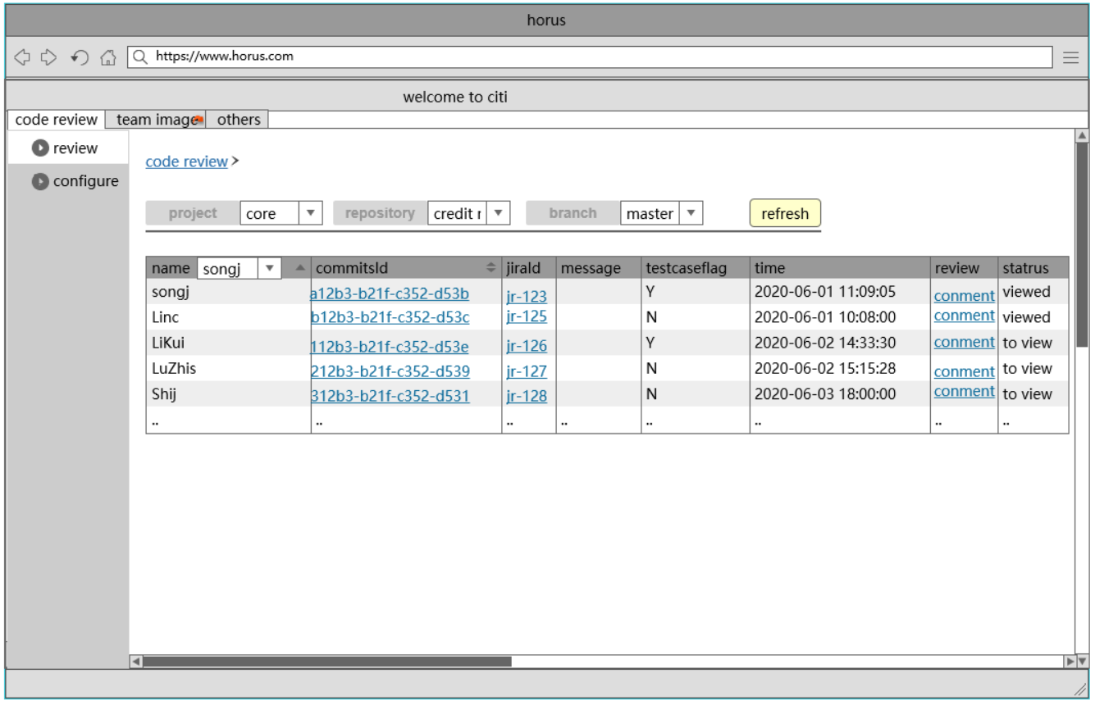
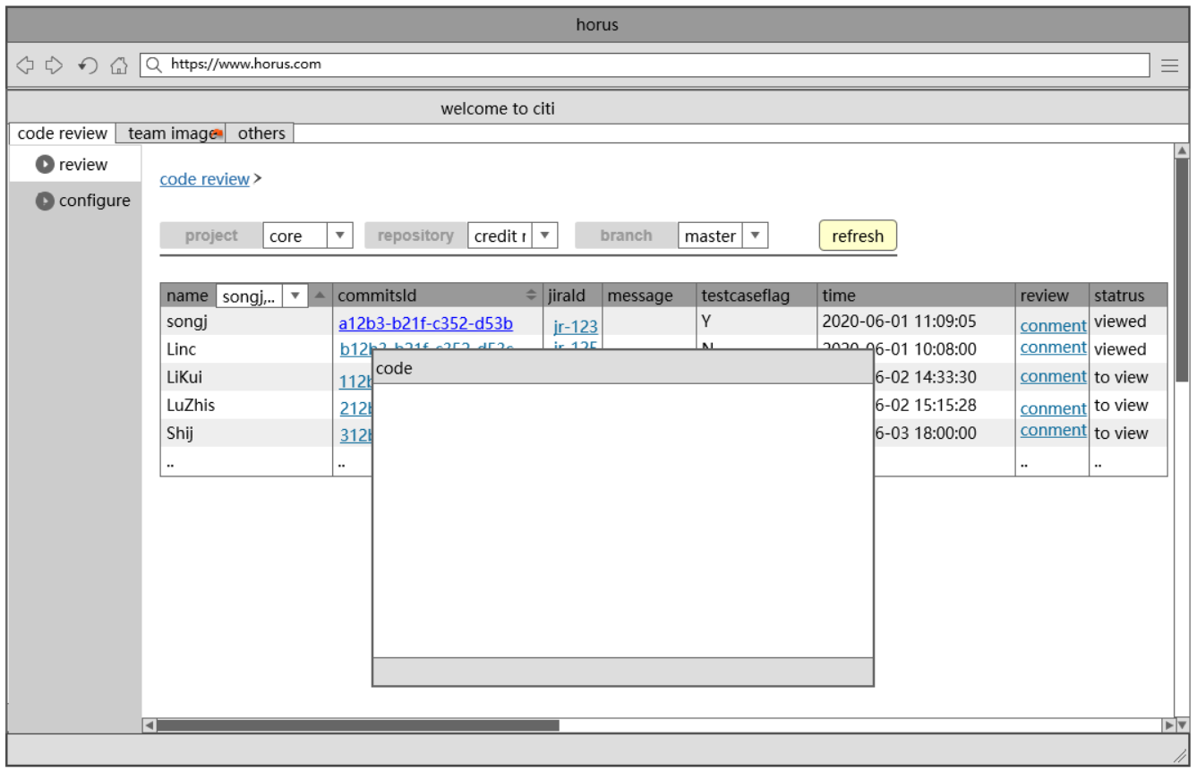
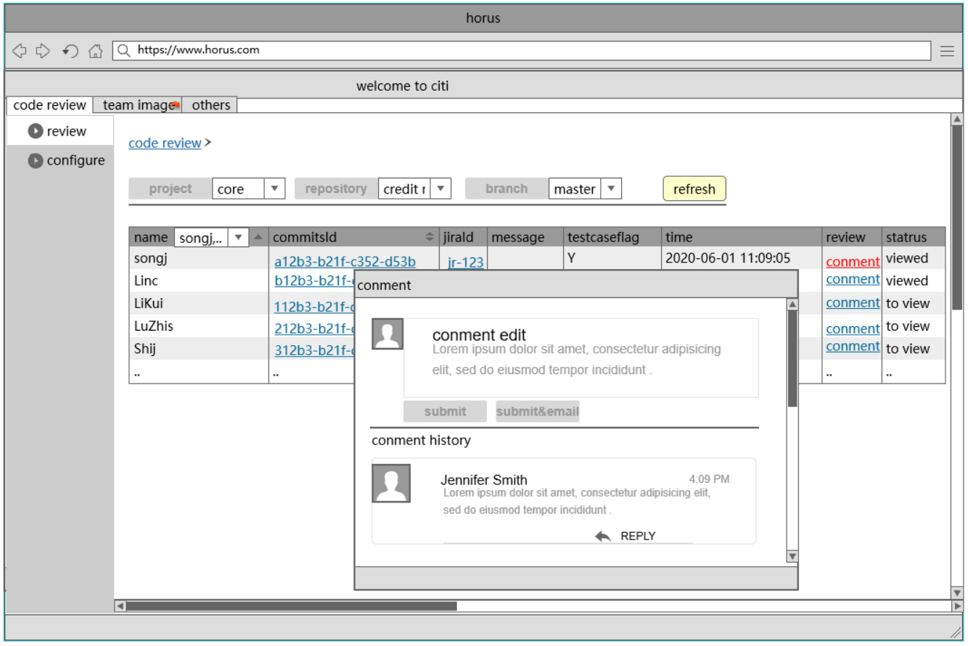
public
2
Horus设计原型-代码评审
代码评审
过滤->
查看代码->
评审结果备忘
Cannot to comment
Not able to show history
Reviewer can not comment after review and committer can not reply in BitBucket Commit Workstation ！
Reviewer and committer are not able to check history reviewed comments in BitBucket Commit Workstation ！
01
.

Slide 5
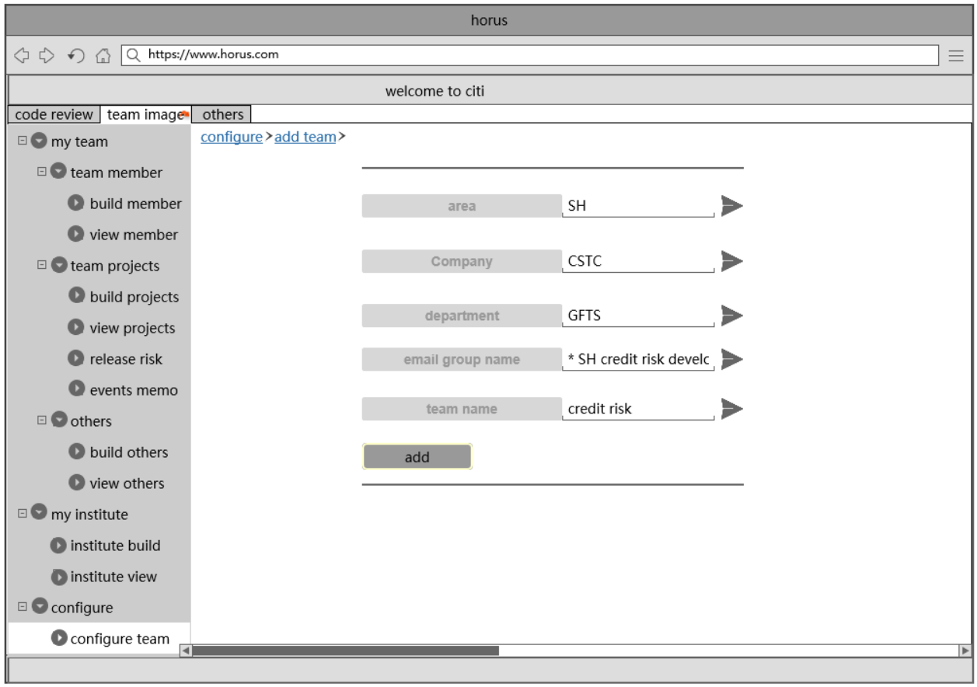
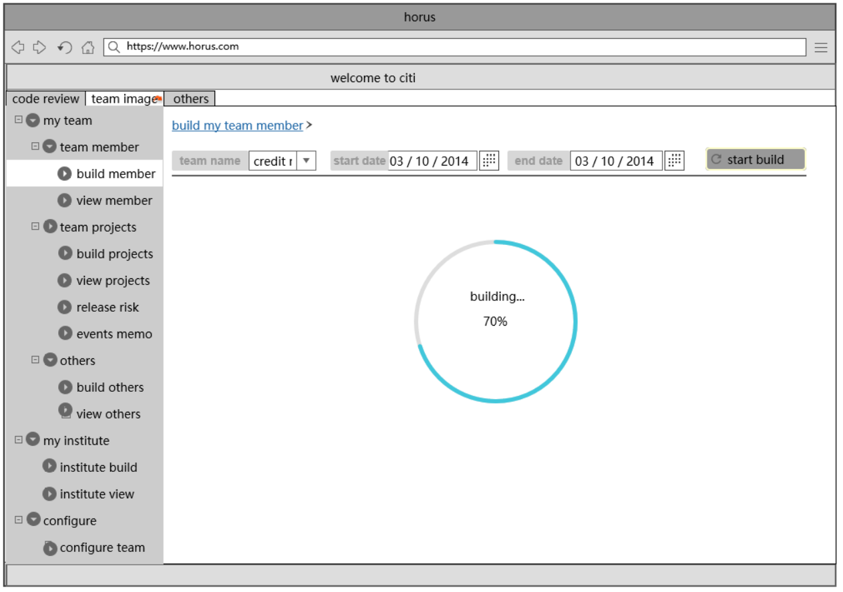
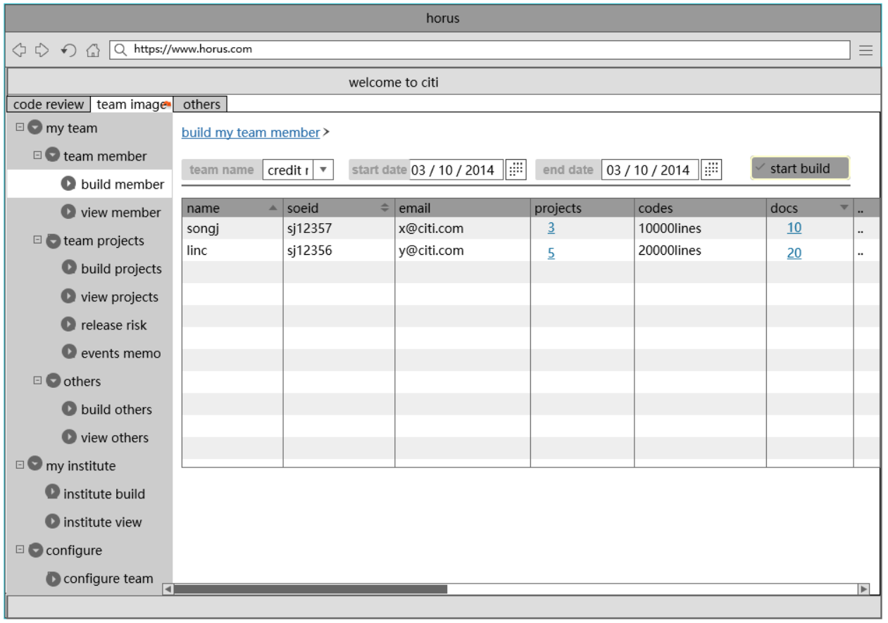
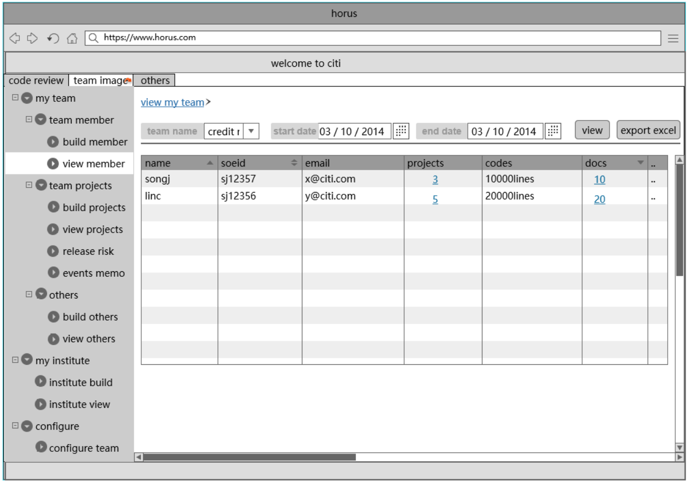
public
2
Horus设计原型–团队成员特征构建
团队成员画像
配置->
构建->
查看构建结果
Not able to show history
Not able to send message
Reviewer and committer are not able to check history reviewed comments in BitBucket Commit Workstation ！
It is not available to send email to committer after reviewer reviewed over in BitBucket Commit Workstation！
02

Slide 6
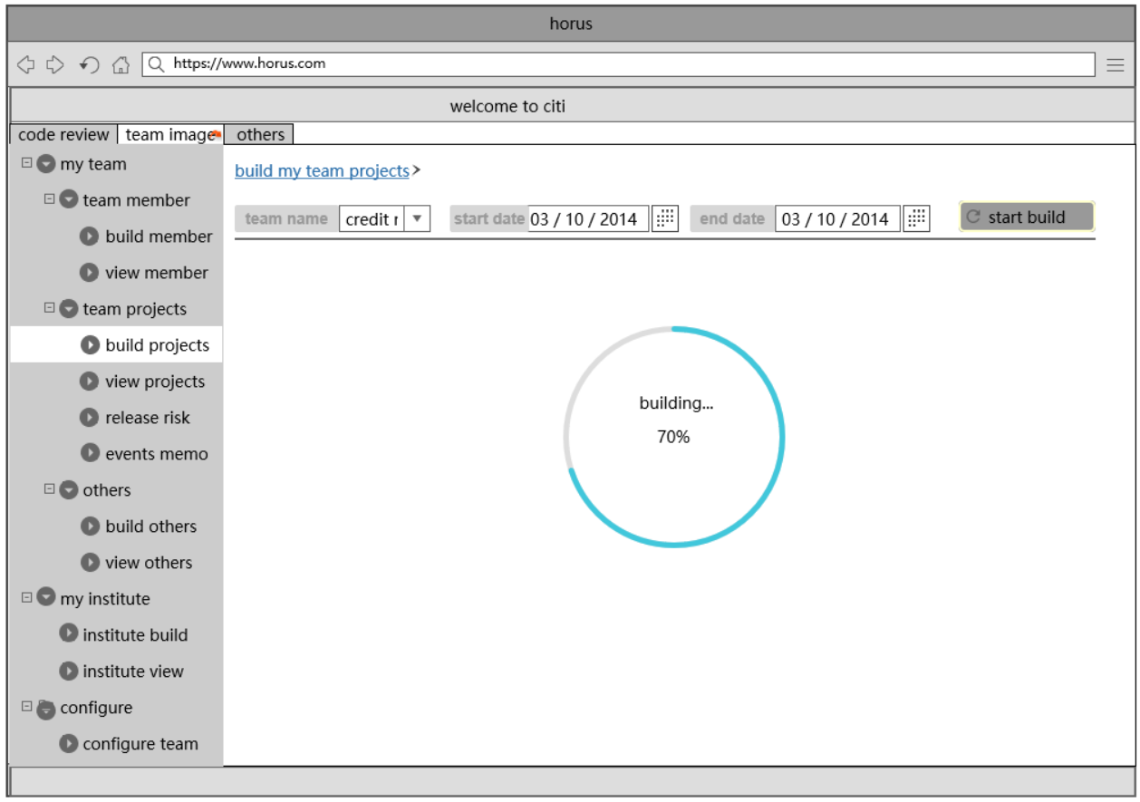
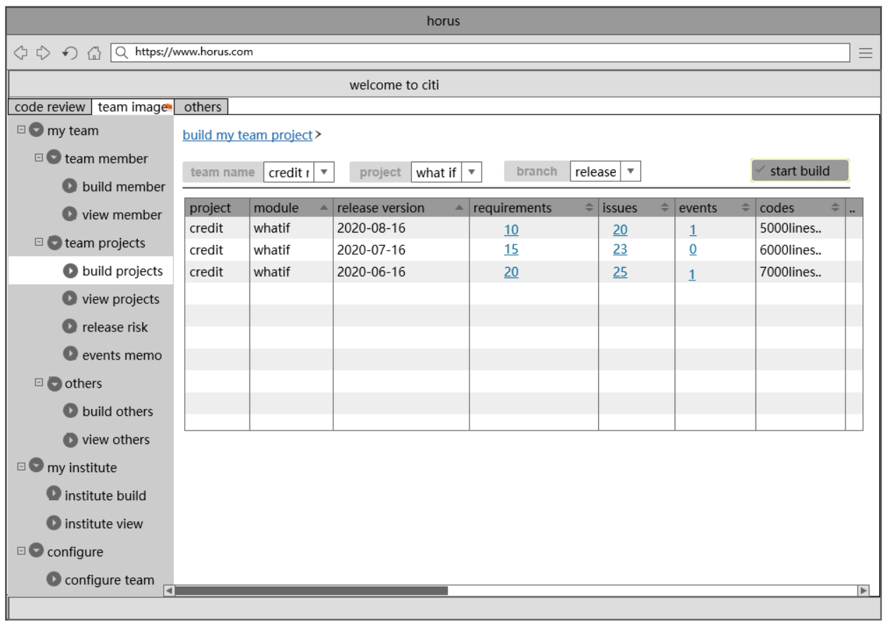
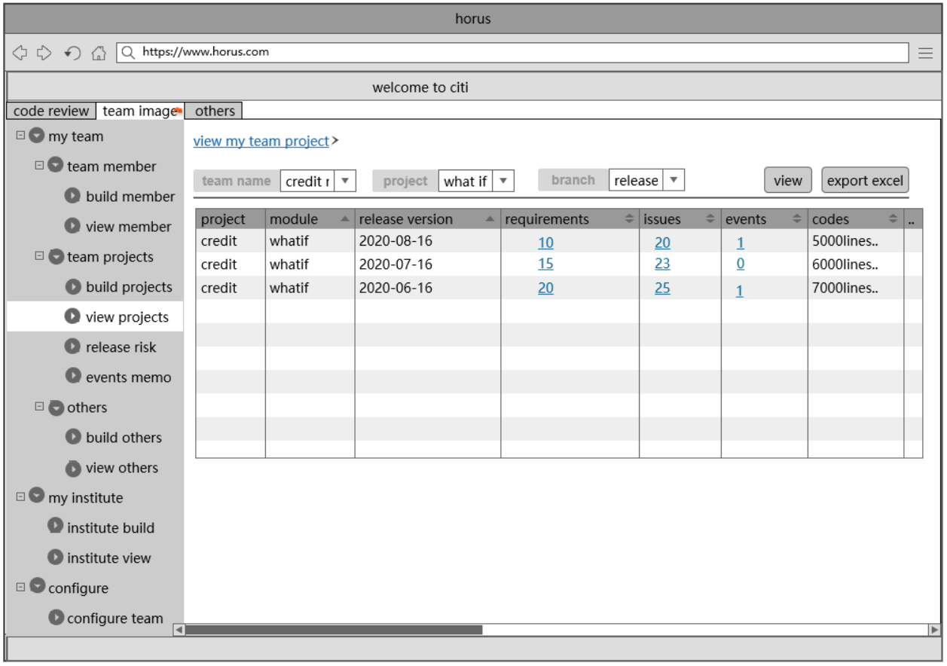
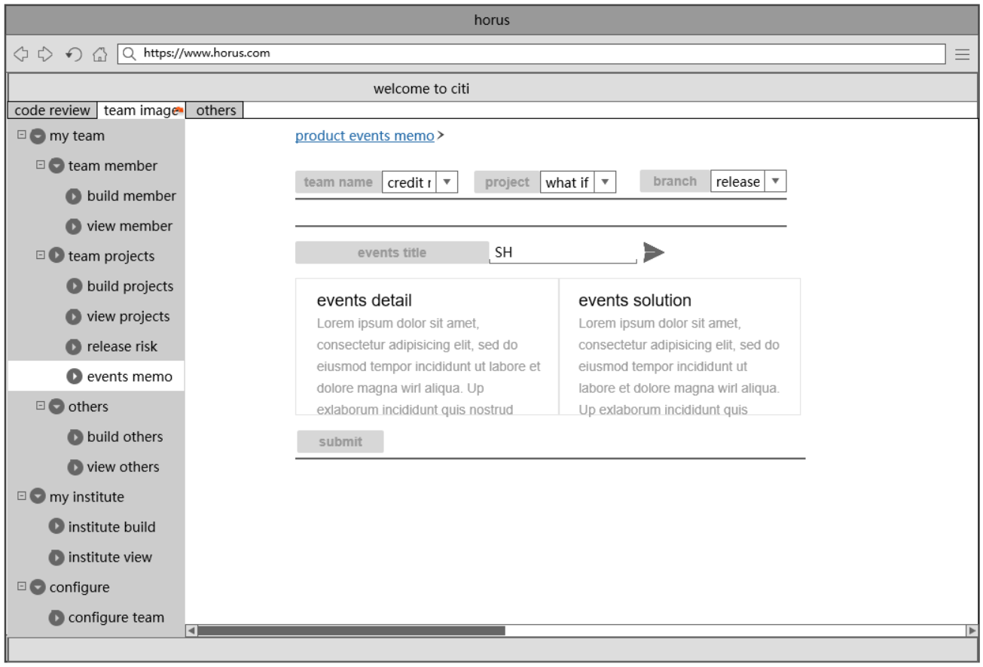
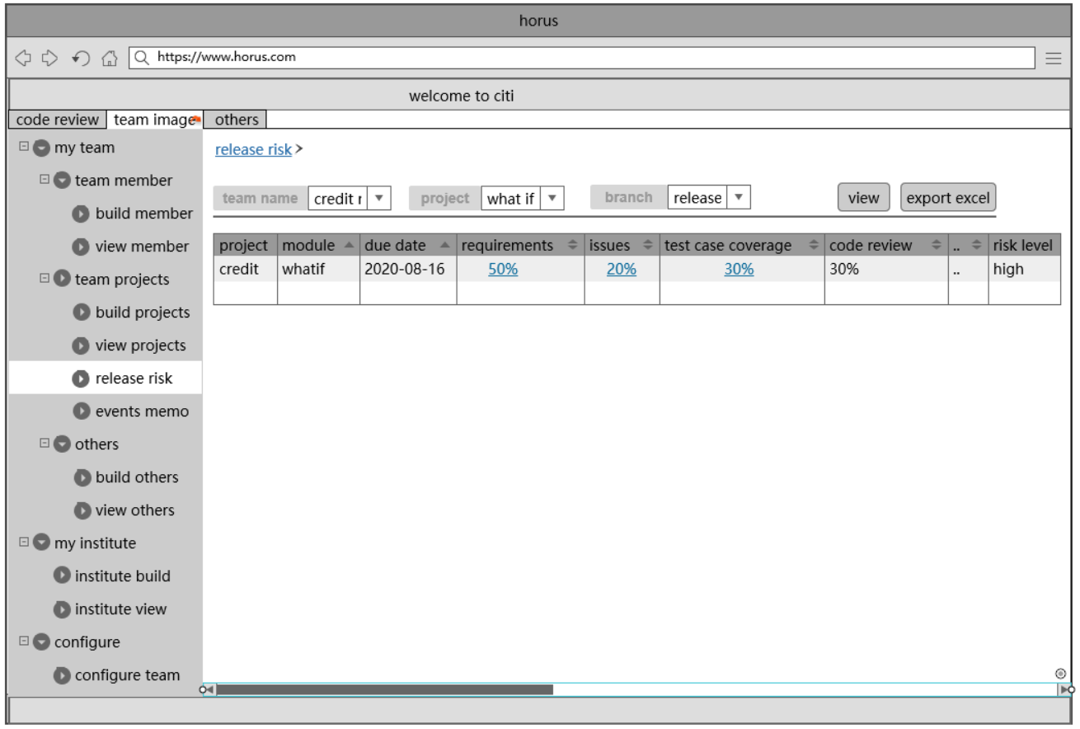
2
Horus设计原型-团队项目特征
public
团队项目特征
构建->
查看 ->
事件记录->
版本风险
Cannot to comment
Not able to show history
Not able to send message
It is not available to send email to committer after reviewer reviewed over in BitBucket Commit Workstation！
03

Slide 7
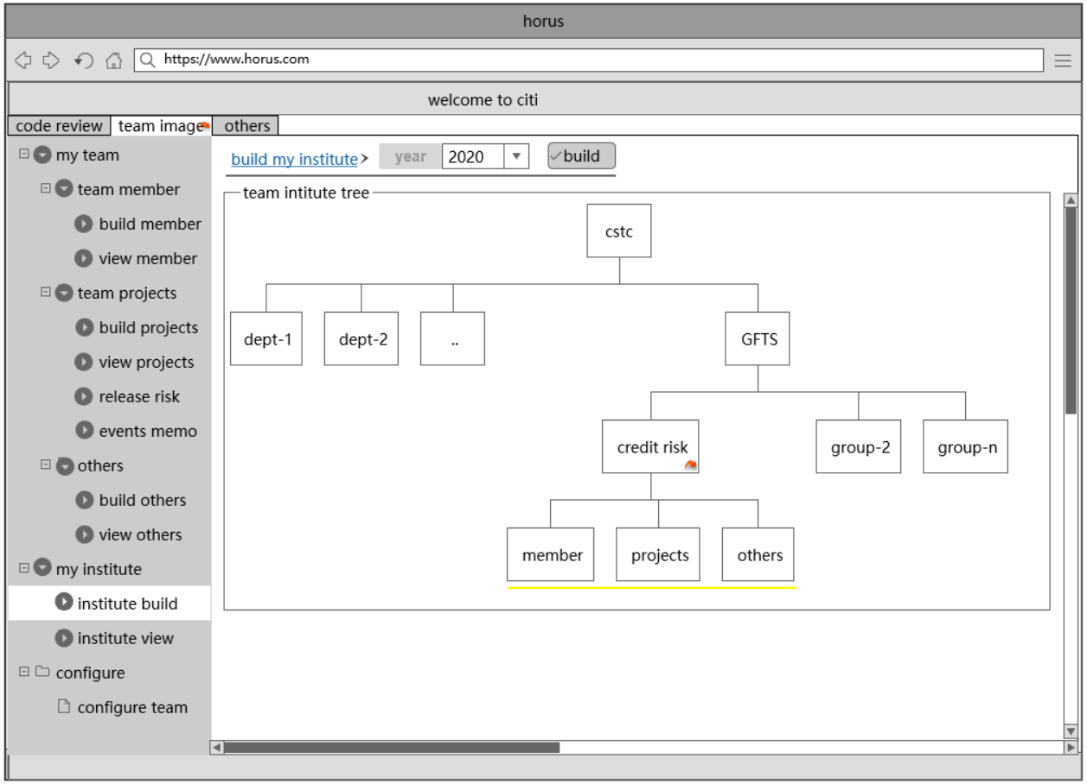
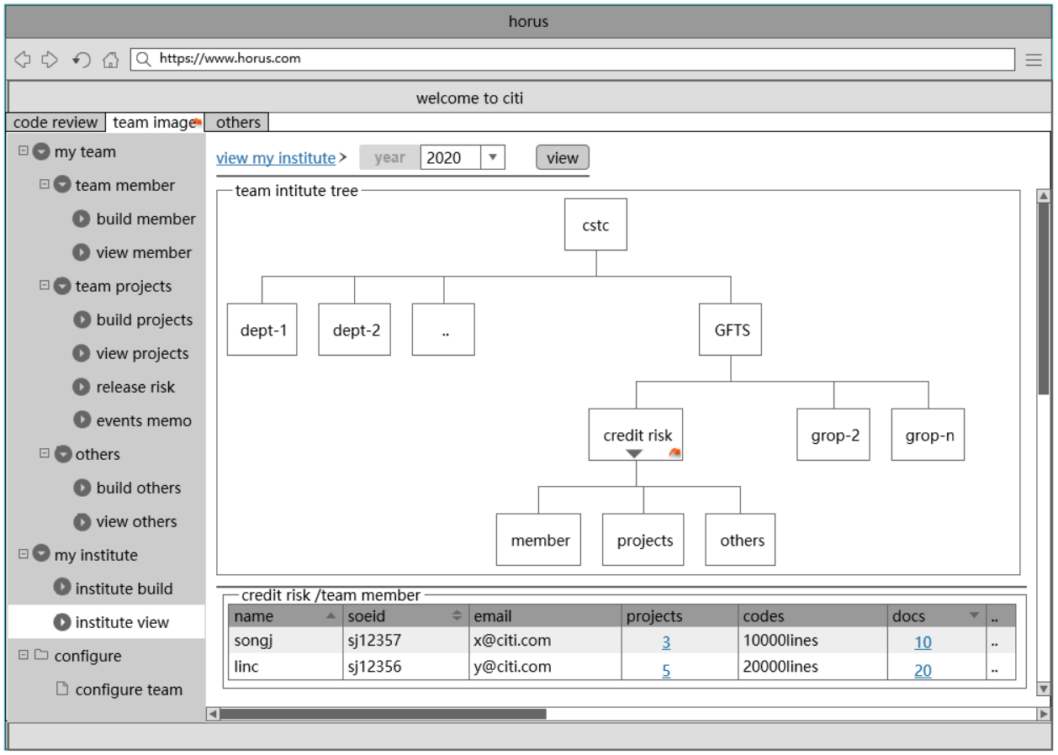
2
Horus设计原型–团队组织机构
public
团队组织
构建->
查看结果
Cannot to comment
Not able to show history
Not able to send message
It is not available to send email to committer after reviewer reviewed over in BitBucket Commit Workstation！
05

Slide 8
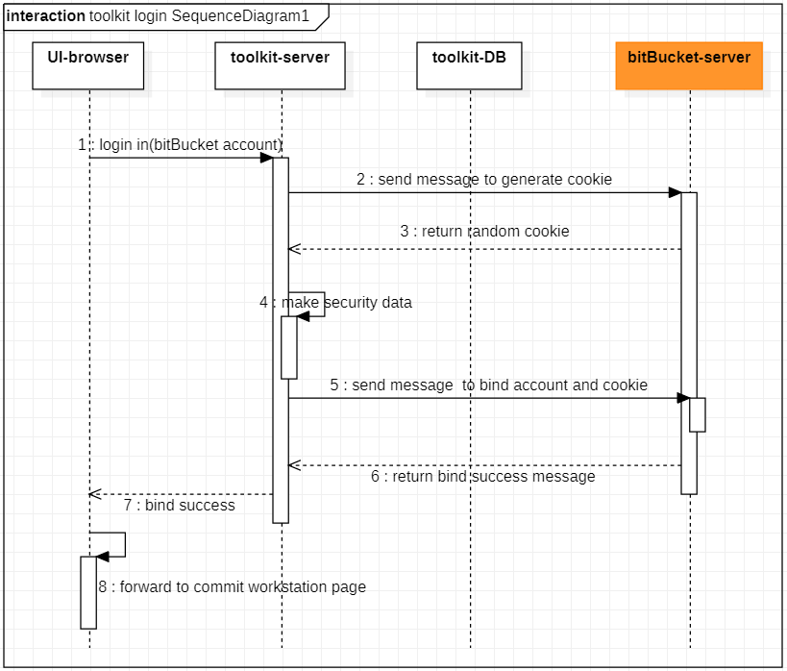
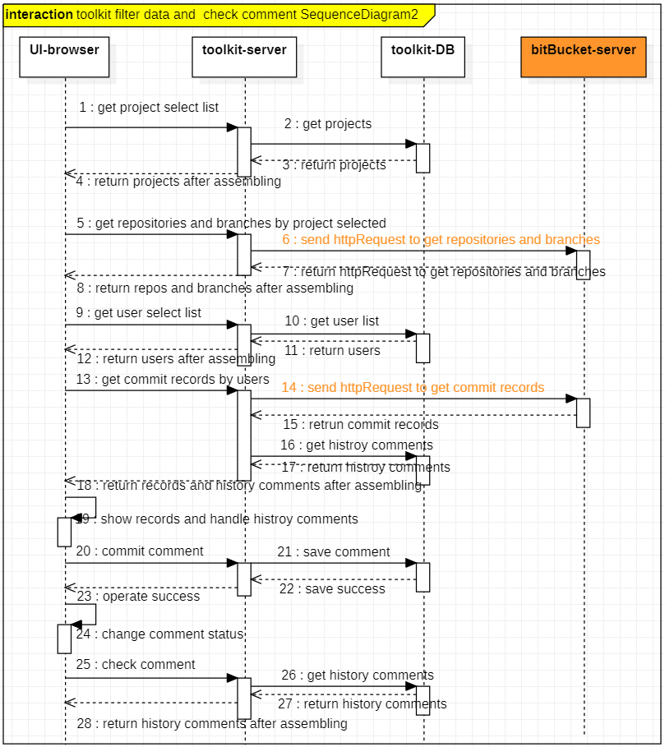
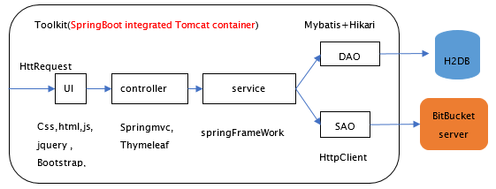
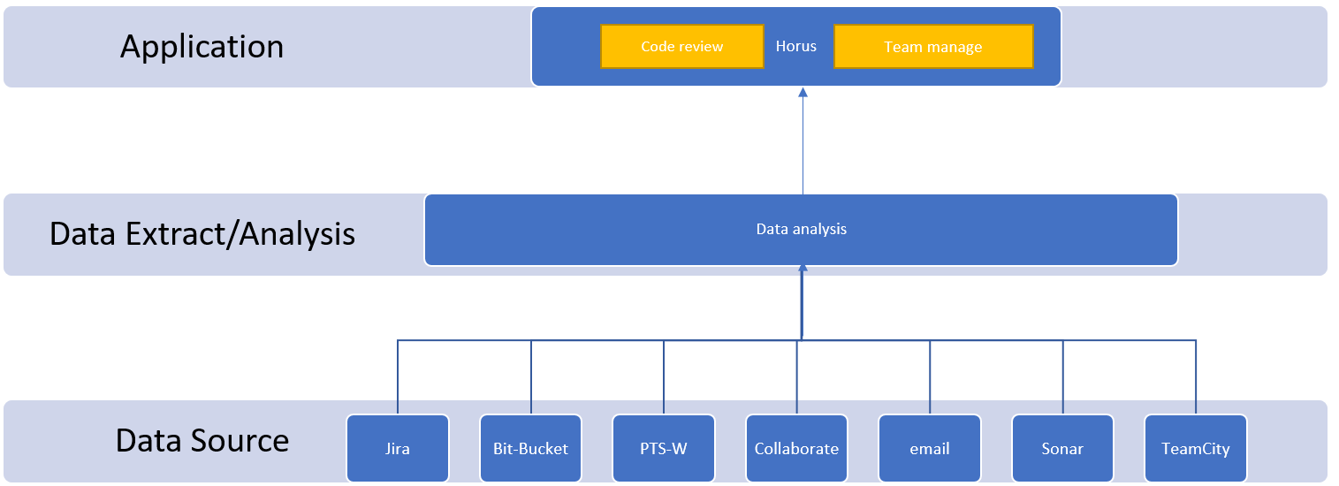
public
3
Horus系统设计-架构-流程-时序图
system design
System architecture diagram1
.

Slide 9
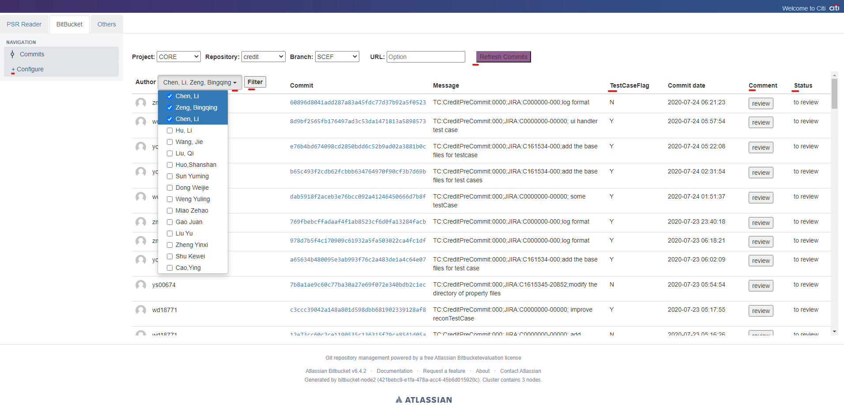
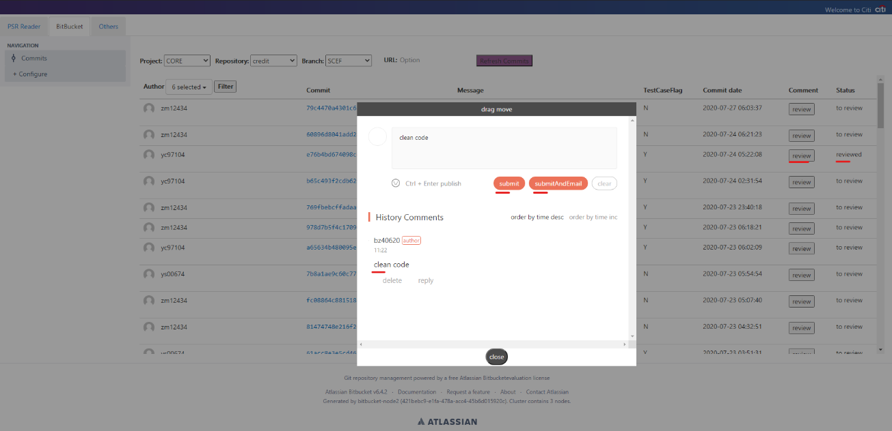
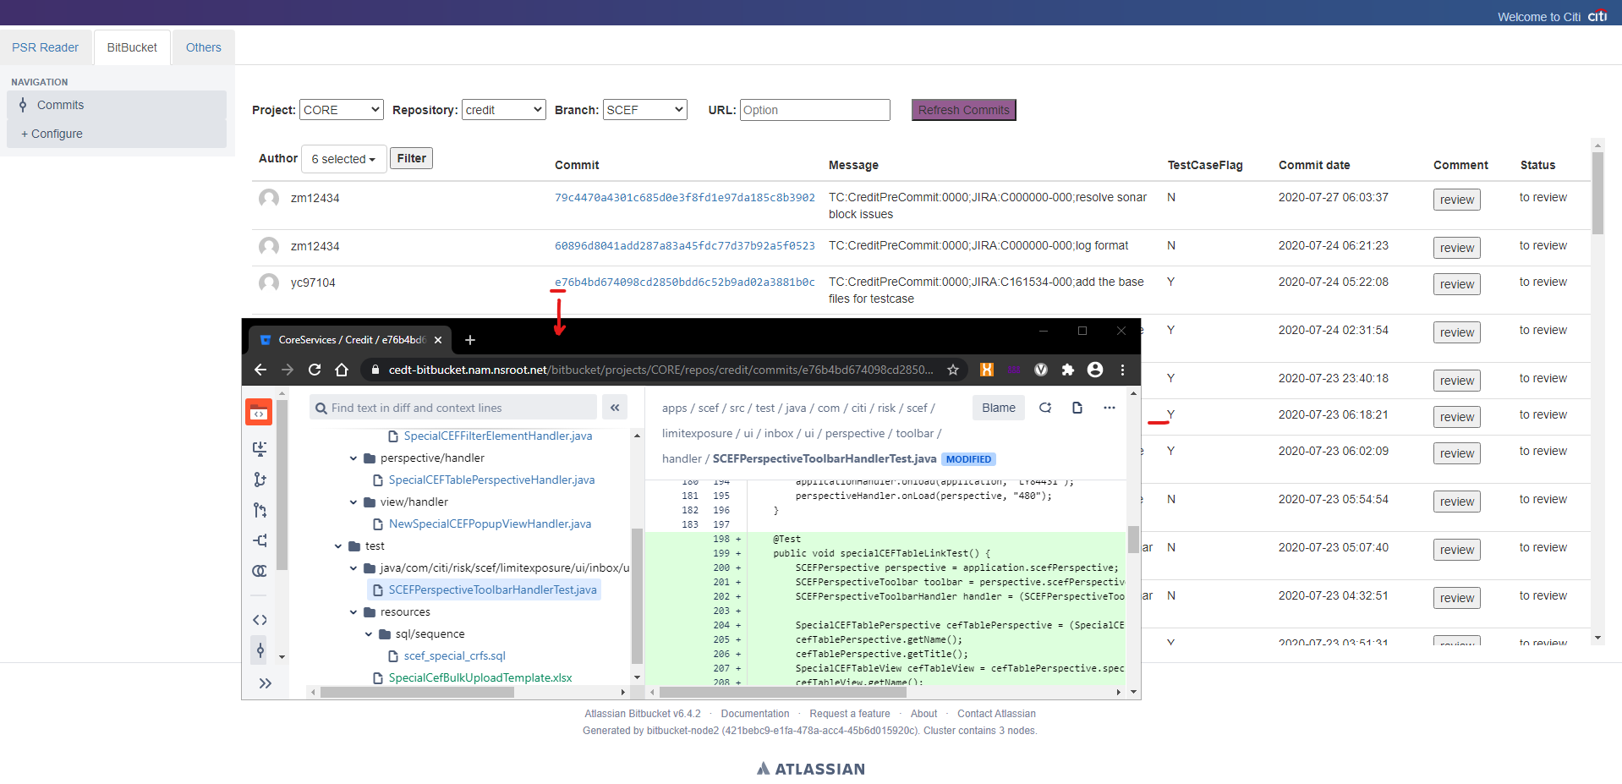
public
4
Horus 实现结果
登录
条件过滤
评审
评论&反馈
使用Bit-Bucket 账户登录
选择使用的过滤条件
审阅代码
备忘评审结果与回复
.

Slide 10
public
The End ,Thanks!
创建更好的工作环境，不断创新进步，成就更好的自己。
Date：2020.08.15
Author：曾冰清

