Slide 1
[Design and Implementation for customized mobile HTML5 template for end users]
Name: [Hong Yangkai]
QM Student No. [130800662]
BUPT Student No. [2013213085]

Slide 2
Content
· Introduction
· Background
· Design and Implementation
· Results and Discussion
· Conclusion and Further Work

Slide 3
Introduction
· This project developed a smart home app.
· The app mainly includes two templates.
· A template is a series of predefined operations on Several devices.
· The app is developed with Cordova framework.
· Cordova is a HTML5 Hybrid Mobile App Framework.

Slide 4
Background
HTML5
HTML5 is the latest version of HTML.
But HTML5 is often referred to as HTML, CSS and JavaScript, that is, front-end technology.
· HTML defines the content of a web page.
· CSS defines the style of a web page.
· JavaScript defines the action of a web page.
HTML5 can develop web app, which works across platforms.

Slide 5
Background
Cordova
Cordova is a HTML5 Hybrid Mobile App Framework.
The app developed only with HTML5 is pure web app.
It has some limitations. For instance, it cannot call android API.
This project chose Cordova framework. It enables the app to call android API, such as Bluetooth, with JavaScript.

Slide 6
Design (safety template)
App (client)
Raspberry pi (server)
server.py
Buzzer rings
get
Post request
Light on
start
index.html
safety.py
Send message
loop
infrared=True?
yes
Take photo
no
stop
Kill process

Slide 7
Design (wakeup template)
start
stop
Bluetooth open?
click
LocalNotification
no
yes
Open Bluetooth
setTimeout(playaudio, t)
Connect devices
setTimeout(opencurtain, t)
Set a time
Compute delay time t
setTimeout(opensocket, t)

Slide 8
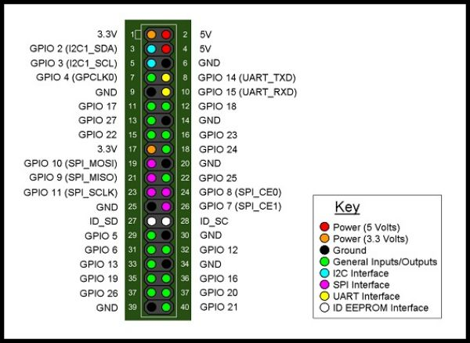
Implementation (safety)
Hardware part
Infrared module:
VCC – GPIO 1
OUT – GPIO 11
GND – GPIO 25
Buzzer module:
VCC – GPIO 2
I/O – GPIO 18
GND – GPIO 34
Light:
positive pole – GPIO 12
Negative pole – GPIO 14
Camera:
CLI interface
JRZJ. (2016, Jun). Raspberry pi operations. Retrieved March 1, 2017, from Web site: http://www.craftsmanotes.com/42/

Slide 9
Implementation (safety)
App part
1. Build environment (install Cordova).
Install Node.js, android SDK, Git first.
In DOS window: npm install –g cordova
2. Create Cordova app.
cordova create cp io.cordova.hellocordova Smart Home
cordova platform add android
cordova build android
3. Modify index.html in www directory.
cordova plugin add cordova-plugin-inappbrowser
$(“#bt").addEventListener("click", open);
function open(){var url = 'http://192.168.43.179:8086/';}

Slide 10
Implementation (safety)
Remote control
Router
Device
Dynamic public network IP:
124.127.207.175
122.122.122.122
……
Static Local Area Network IP:
192.168.137.180
DDNS
(Dynamic Domain Name Server)
Port mapping
Fixed domain name:
idhyk.top

Slide 11
Implementation (wakeup)
1. Install plugins.
cordova plugin add cordova-plugin-ble
cordova plugin add cordova-plugin-datepicker
2. Open Bluetooth and connect device.
evothings.ble.startScan()
3. Set wakeup time.
datePicker.show(options,onSuccess,onError)
4. Delay playing audio.
function onSuccess(date){
setTimeout(playAudio,t);
function playAudio(){…}
}

Slide 12
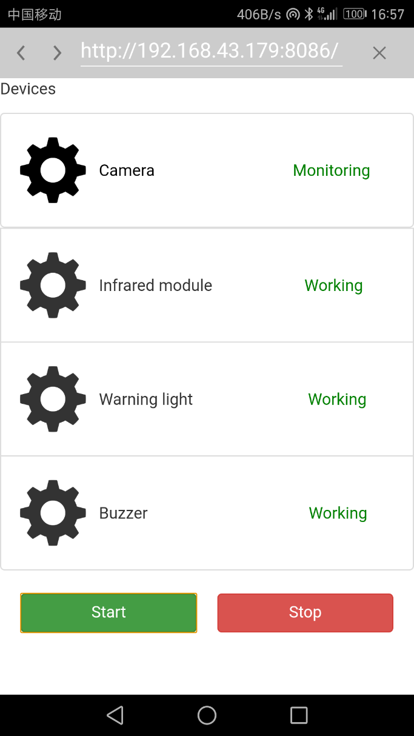
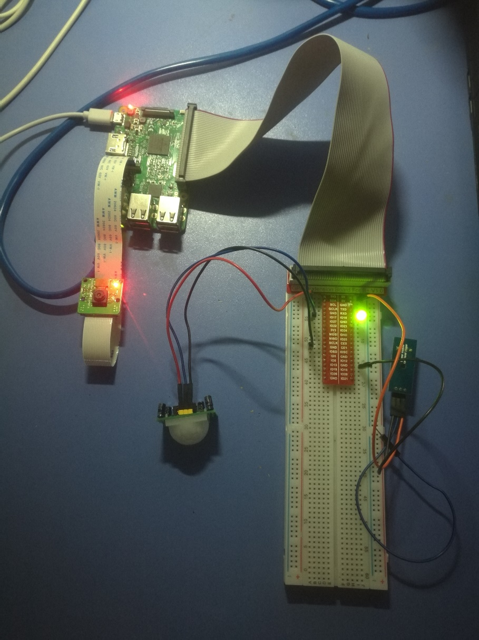
Result
Safety template start

Slide 13
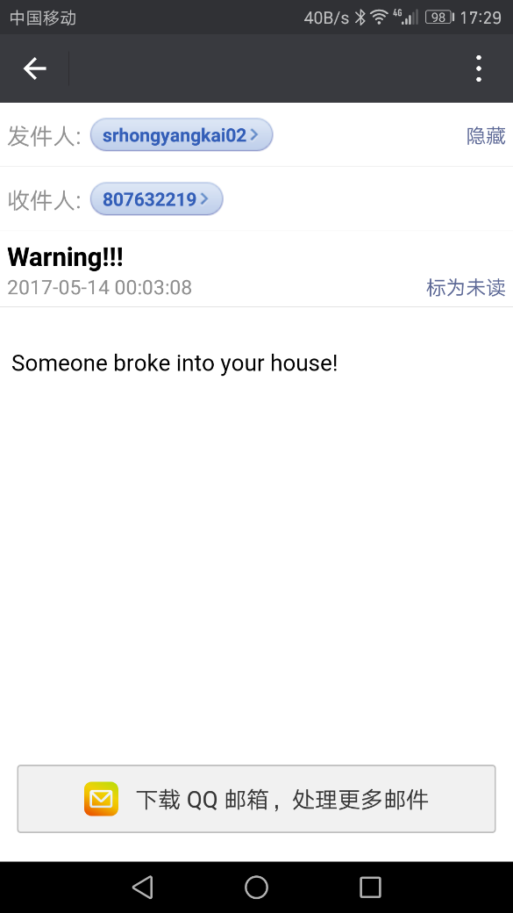
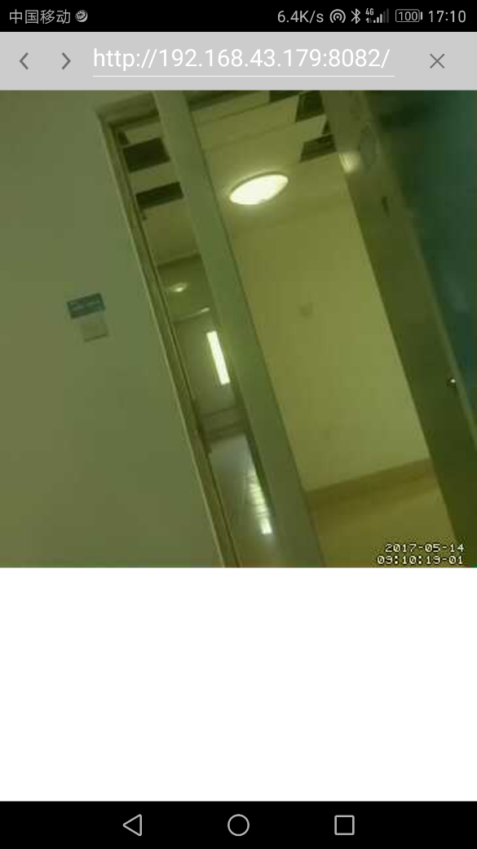
Result
Safety template start
Warning message
Monitor page

Slide 14
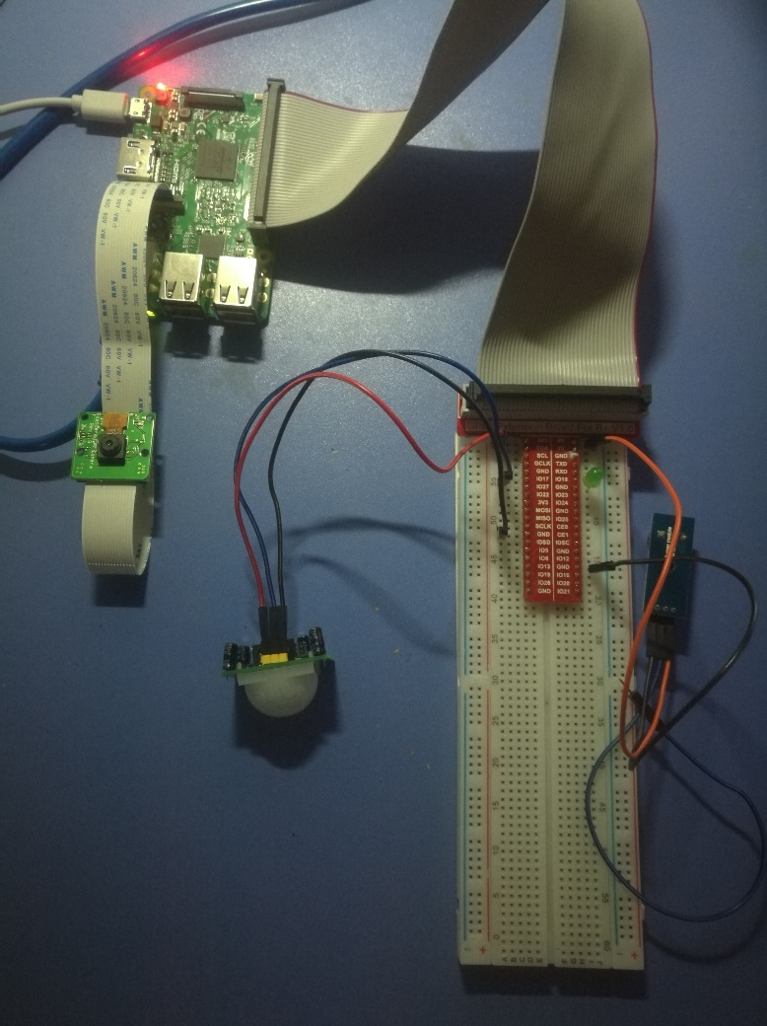
Result
Safety template stop
Safety template realizes the functions of remote monitoring and remote switching alarm device.
Device shutdown

Slide 15
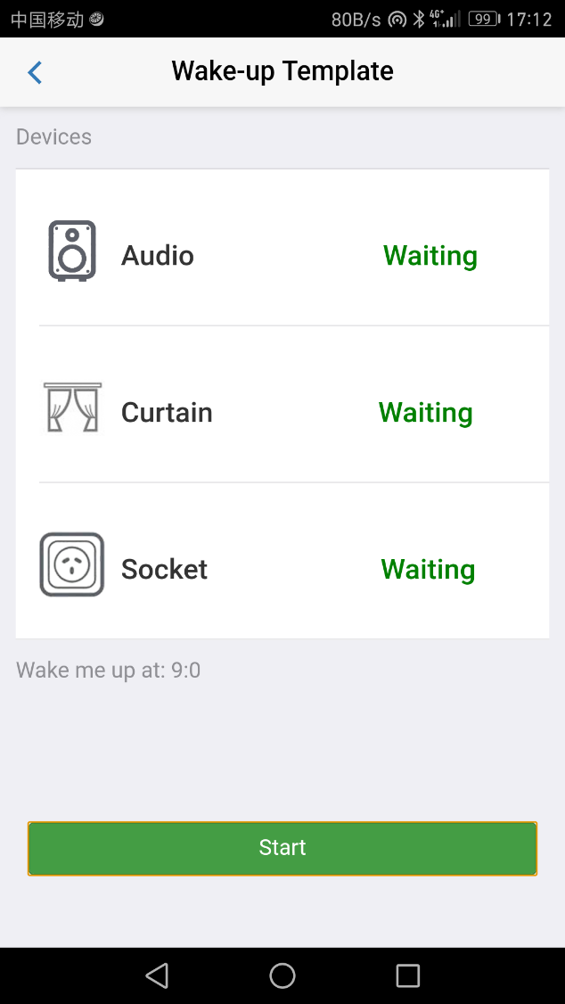
Result
Wakeup template
At nine o’clock, Bluetooth audio played music. The wakeup template realizes the function of controlling device via Bluetooth.
Template start

Slide 16
Conclusion
This project accomplished the main tasks and target in the specification.
1. Build a HTML5 template development environment.
· App: Cordova
· Hardware: Configure raspberry pi
2. Develop two kinds of HTML5 template.
· Safety template
· Wakeup template
3. A demo template and mobile app.

Slide 17
Further work
Although I completed the tasks, my method seems not advanced. Because I found my app looks different from the smart home app in the market. Obviously, my app immature.
I think it is because I have limited knowledge of smart home. After all, it involves too much knowledge, including hardware, software and networking.
I still have a lot to learn in this area.

