Slide 1
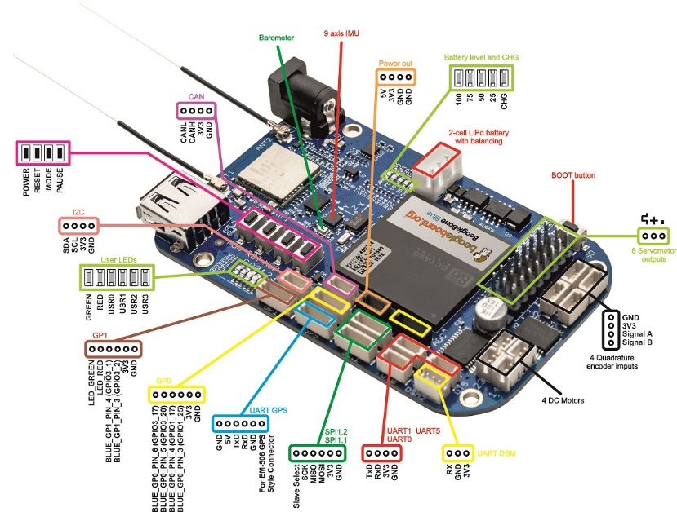
GPIO015=SI=UART1_TX
GPIO014=CLK = UART1_RX
TSL1401 line camera and BeagleBoneBlue Interface
Note AIN < 1.8 V!
wht
blk
AIN3
AIN2
AIN1
AIN0
1V8
GND
1K
1.5K
TSL1401
wht or yel?
AOUT
SI
CLK
3V3
GND
yel or wht?
SI
CLK
3V3
GND
red
blk

