Slide 1
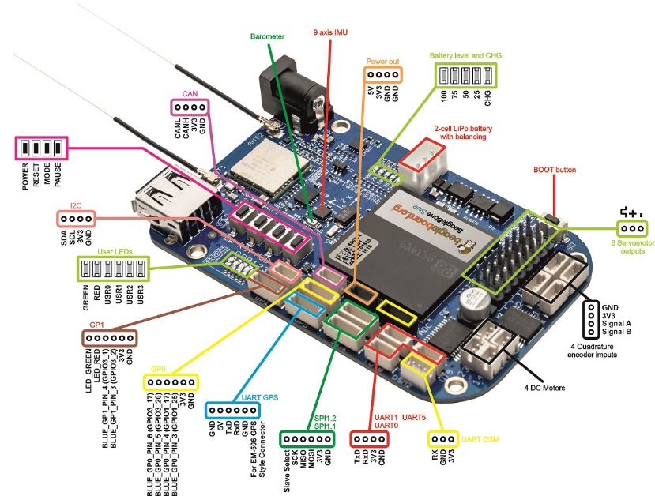
GPIO015=SI=UART1_TX
GPIO014=CLK = UART1_RX
TSL1401 line camera and BeagleBoneBlue Interface
Note AIN < 1.8 V!
AIN3
AIN2
AIN1
AIN0
1V8
GND
1K
1.5K
TSL1401
AOUT
SI
CLK
3V3
GND
SI
CLK
3V3
GND

Slide 2
i_{m}
0.1 ohm
L
v_{DS}
R_{m}
+ v_{L} -
10v
+-
SW

