Slide 1
Advanced Sequencing Technologies & Applications
http://meetings.cshl.edu/courses.html

Slide 2
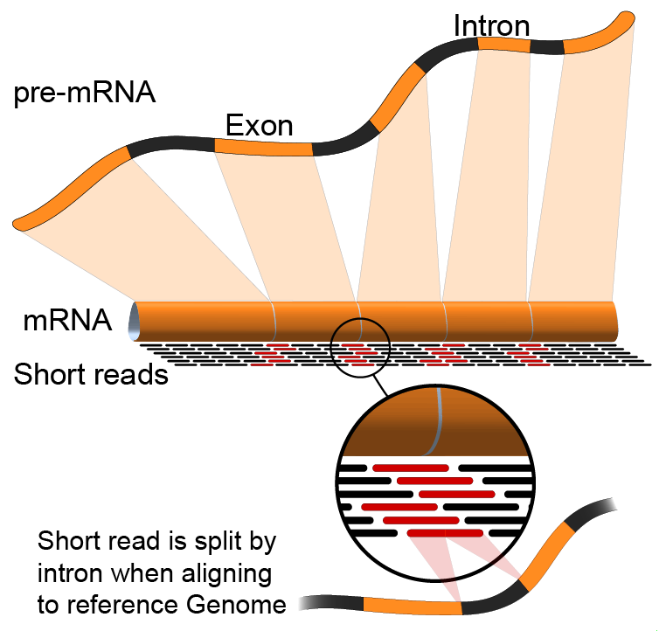

Module 3 Expression and Differential Expression (lecture)
Malachi Griffith, Obi Griffith, Jason Walker, Ben Ainscough
Advanced Sequencing Technologies & Applications
November 11-23, 2014

Slide 3
Learning objectives of the course
Module 0: Introduction to cloud computing
Module 1: Introduction to RNA sequencing
Module 2: RNA-seq alignment and visualization
Module 3: Expression and Differential Expression
Module 4: Isoform discovery and alternative expression
Tutorials
Provide a working example of an RNA-seq analysis pipeline
Run in a ‘reasonable’ amount of time with modest computer resources
Self contained, self explanatory, portable

Slide 4
Learning Objectives of Module
Expression estimation for known genes and transcripts
‘FPKM’ expression estimates vs. ‘raw’ counts
Differential expression methods
Downstream interpretation of expression and differential estimates
multiple testing, clustering, heatmaps, classification, pathway analysis, etc.

Slide 5
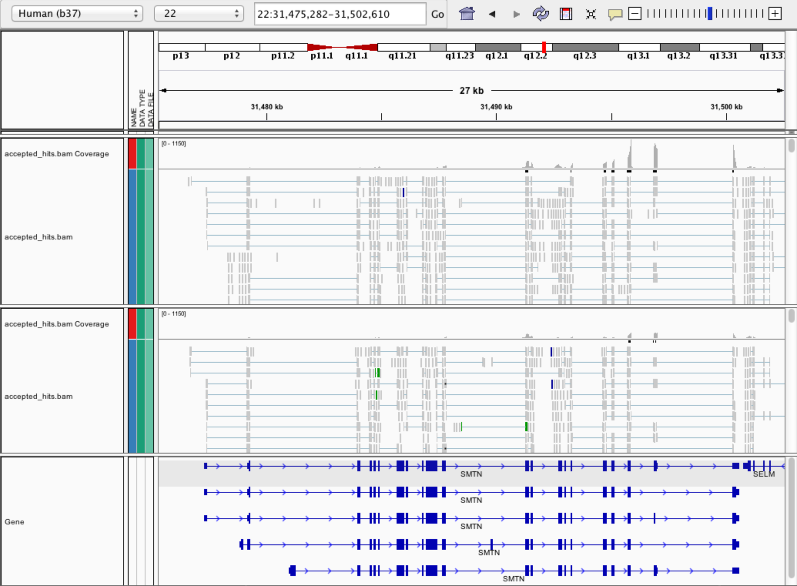
Expression estimation for known genes and transcripts
3’ bias
Down-regulated

Slide 6
What is FPKM (RPKM)
RPKM: Reads Per Kilobase of transcript per Million mapped reads.
FPKM: Fragments Per Kilobase of transcript per Million mapped reads.
In RNA-Seq, the relative expression of a transcript is proportional to the number of cDNA fragments that originate from it. However:
The number of fragments is also biased towards larger genes
The total number of fragments is related to total library depth
FPKM/RPKM attempt to normalize for gene size and library depth
RPKM/FPKM = (10^9 * C) / (N * L)
C = number of mappable reads/fragments for a gene/transcript/exon/etc
N = total number of mappable reads/fragments in the library
L = number of base pairs in the gene/transcript/exon/etc
http://www.biostars.org/p/11378/
http://www.biostars.org/p/68126/

Slide 7
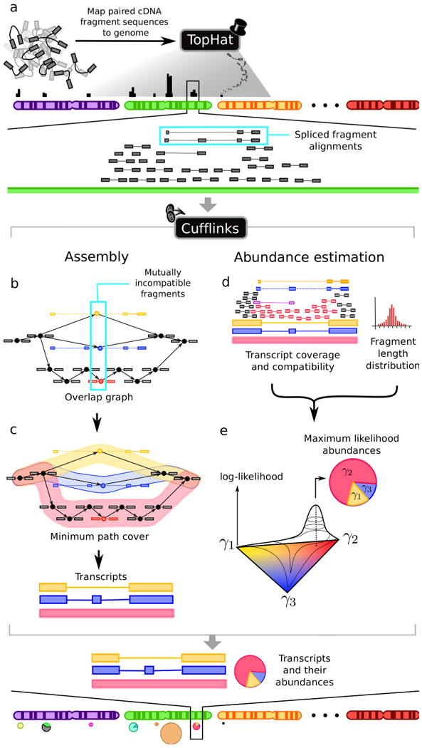
How does cufflinks work?
Overlapping 'bundles' of fragment alignments are assembled, fragments are connected in an overlap graph, transcript isoforms are inferred from the minimum paths required to cover the graph
Abundance of each isoform is estimated with a maximum likelihood probabilistic model
makes use of information such as fragment length distribution
http://cufflinks.cbcb.umd.edu/howitworks.html

Slide 8
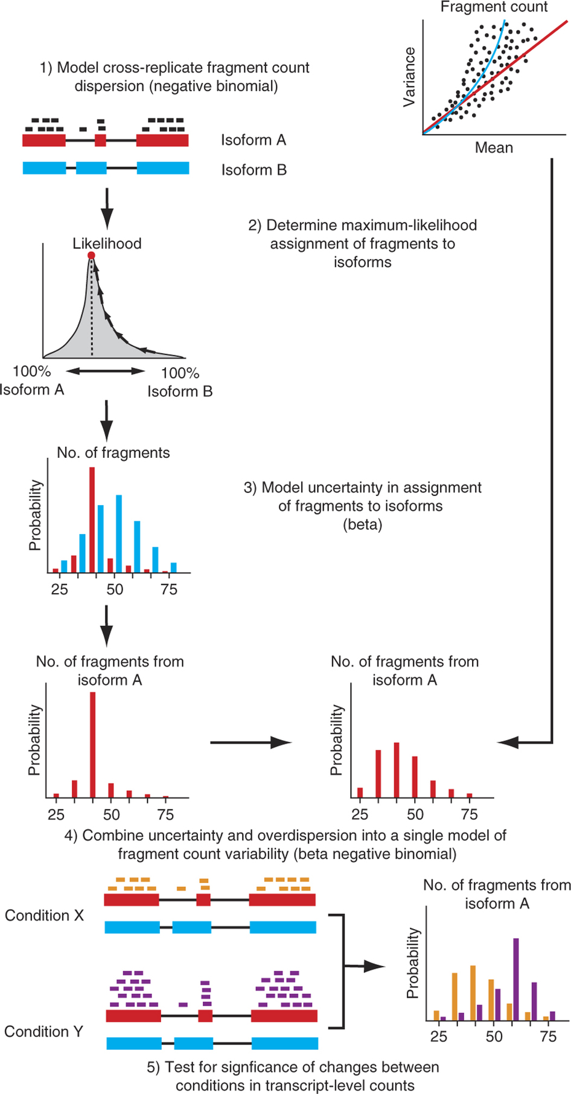
How does cuffdiff work?
The variability in fragment count for each gene across replicates is modeled.
The fragment count for each isoform is estimated in each replicate (as before), along with a measure of uncertainty in this estimate arising from ambiguously mapped reads
transcripts with more shared exons and few uniquely assigned fragments will have greater uncertainty
The algorithm combines estimates of uncertainty and cross-replicate variability under a beta negative binomial model of fragment count variability to estimate count variances for each transcript in each library
These variance estimates are used during statistical testing to report significantly differentially expressed genes and transcripts.

Slide 9
Why is cuffmerge necessary?
Cuffmerge
Allows merge of several Cufflinks assemblies together
Necessary because even with replicates cufflinks will not necessarily assemble the same numbers and structures of transcripts
Filters a number of transfrags that are probably artifacts.
Optional: provide reference GTF to merge novel isoforms and known isoforms and maximize overall assembly quality.
Make an assembly GTF file suitable for use with Cuffdiff
Compare apples to apples

Slide 10
What do we get from cummeRbund?
Automatically generates many of the commonly used data visualizations
Distribution plots
Overall correlations plots
MA plots
Volcano plots
Clustering, PCA and MDS plots to assess global relationships between conditions
Heatmaps
Gene/transcript-level plots showing transcript structures and expression levels

Slide 11
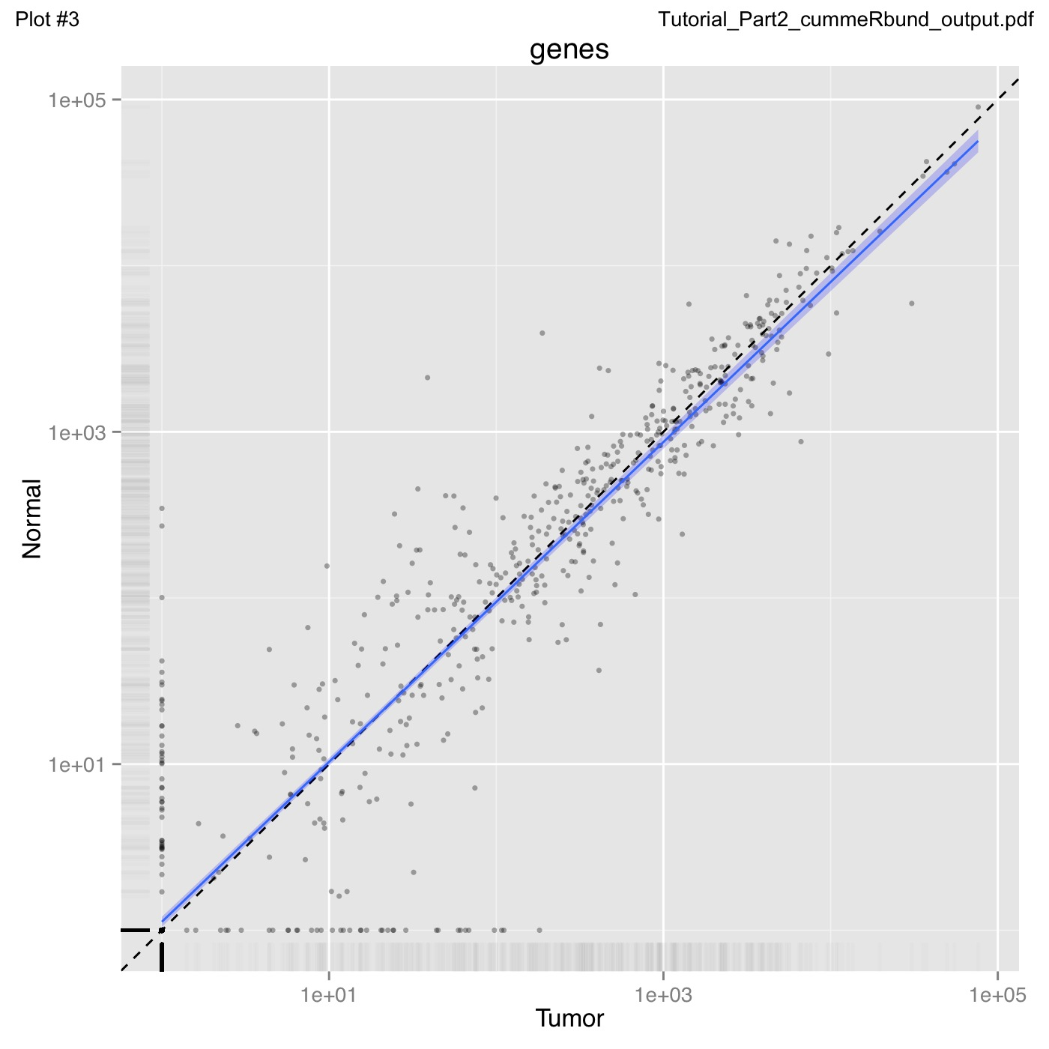
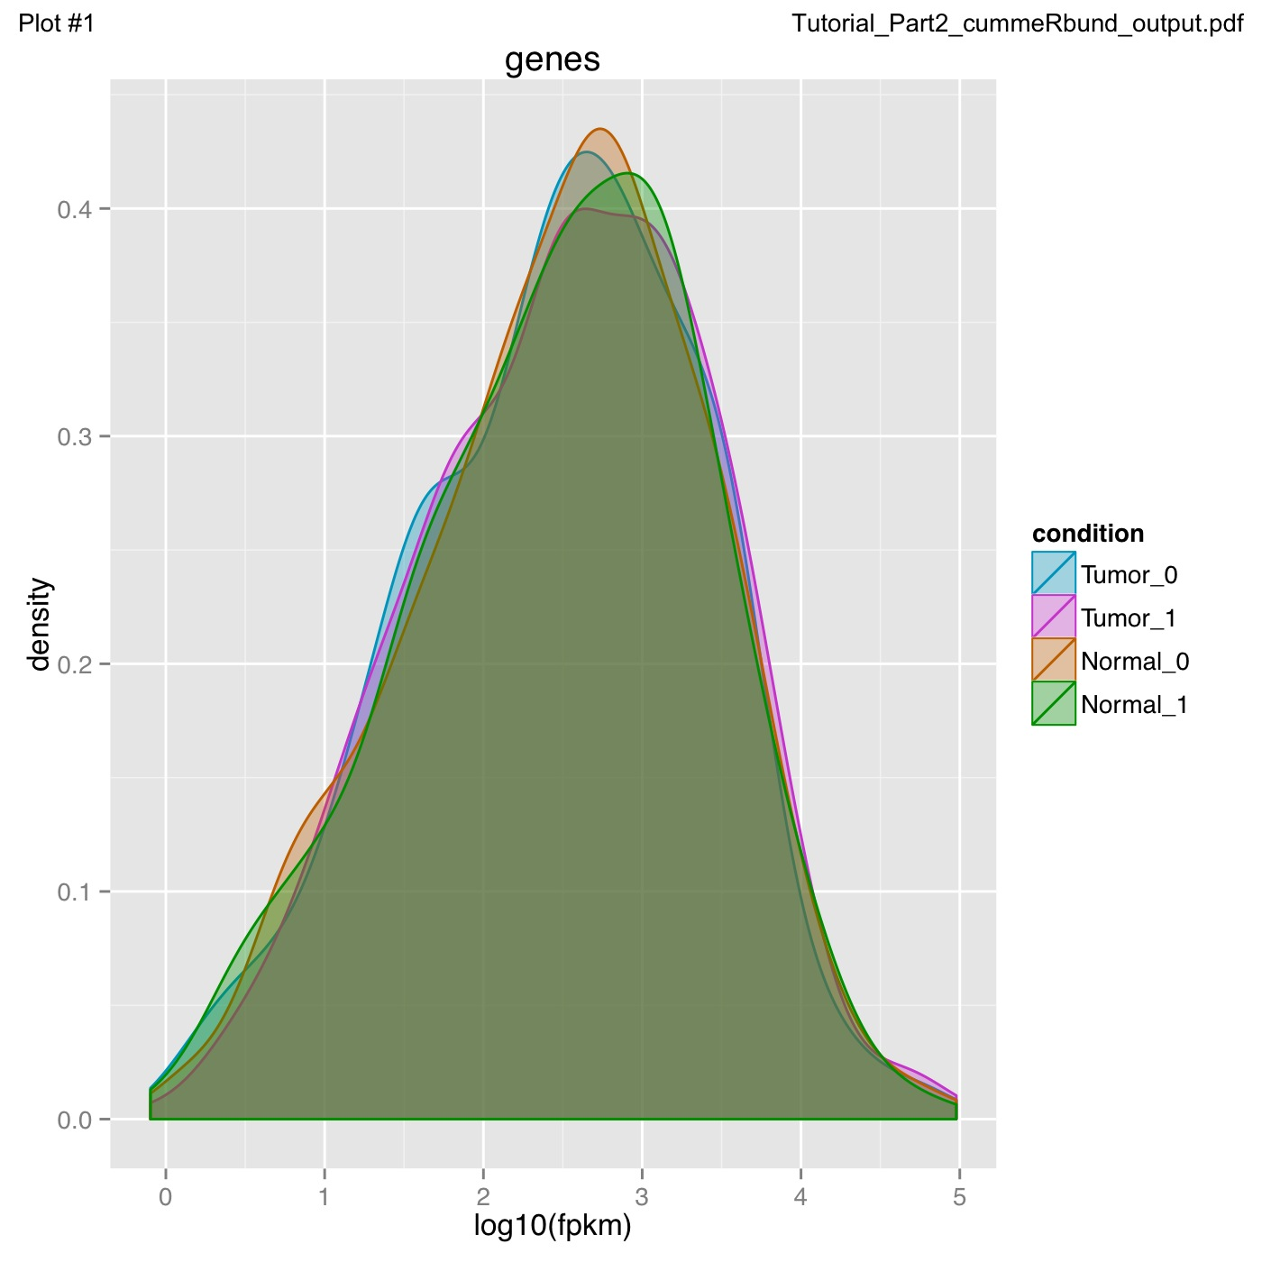
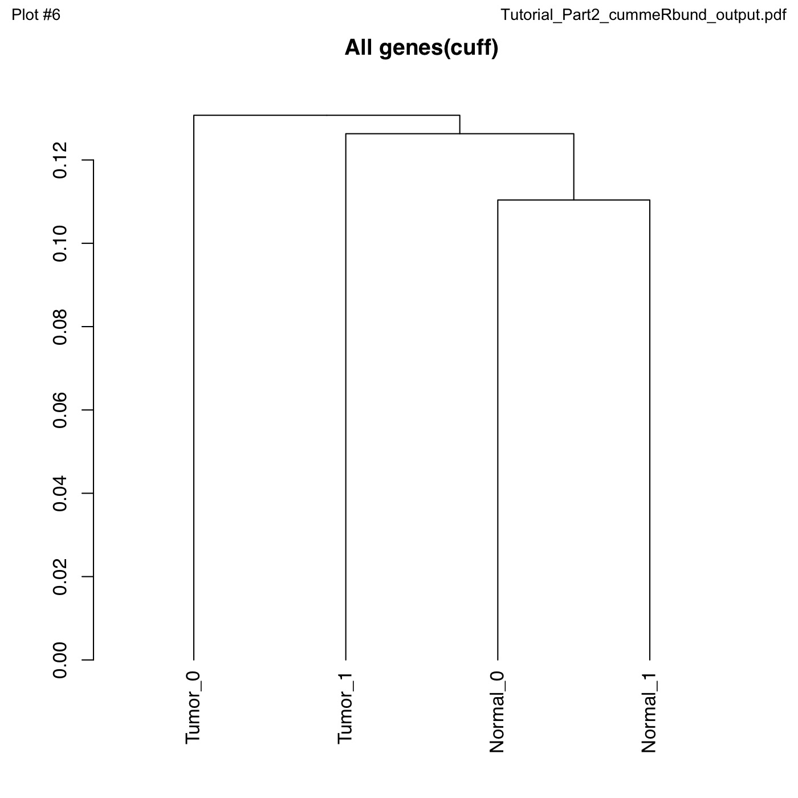
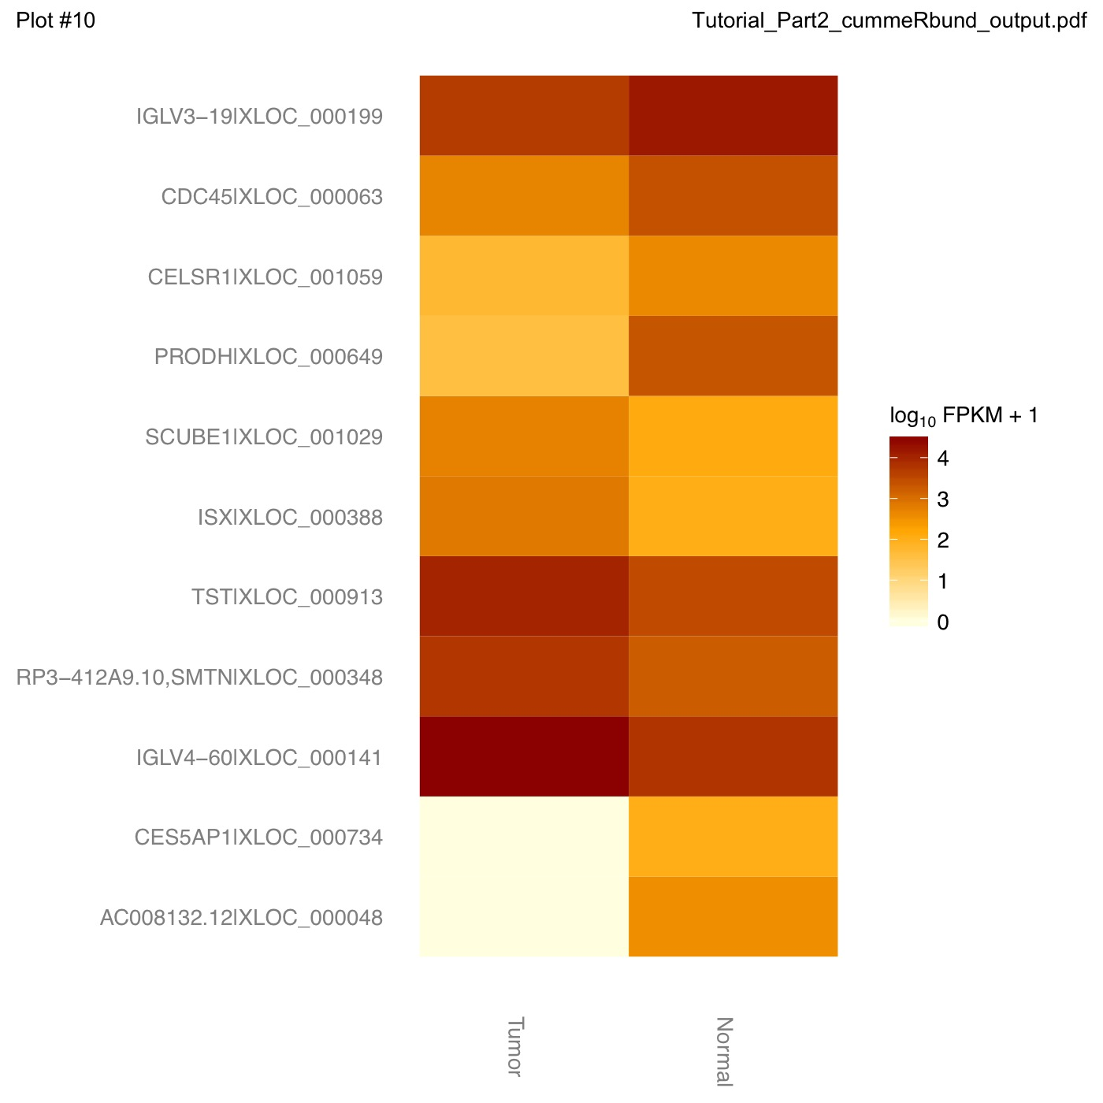
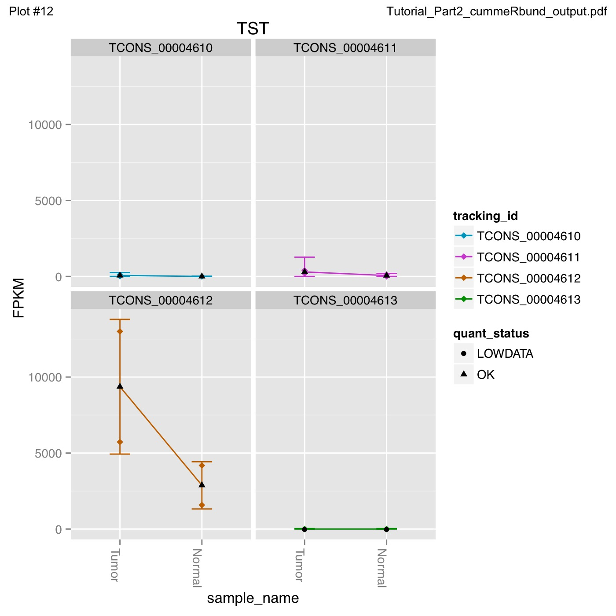
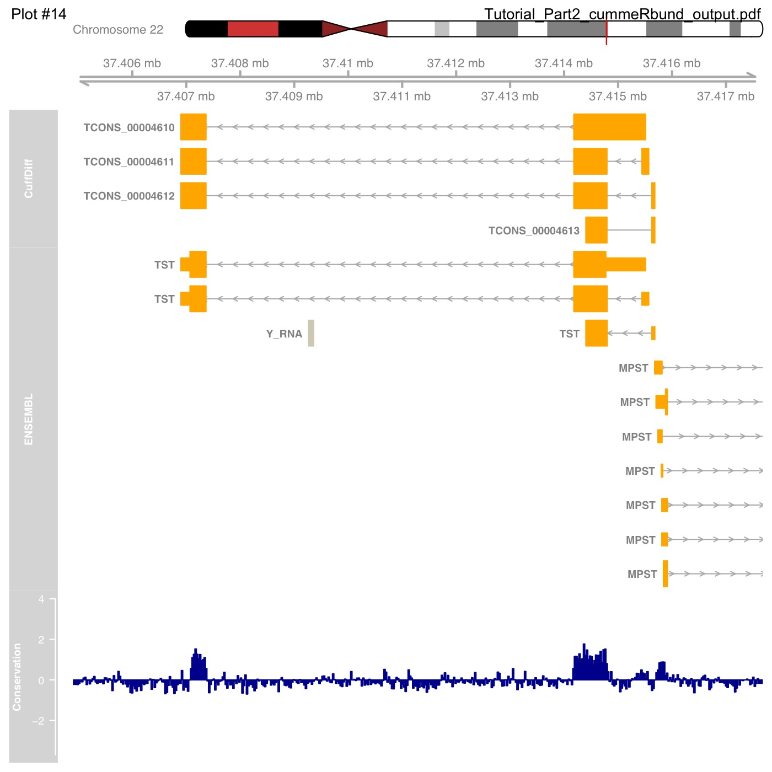
What do we get from cummeRbund?

Slide 12
Alternatives to FPKM
Raw read counts as an alternate for differential expression analysis
Instead of calculating FPKM, simply assign reads/fragments to a defined set of genes/transcripts and determine “raw counts”
Transcript structures could still be defined by something like cufflinks
HTSeq (htseq-count)
http://www-huber.embl.de/users/anders/HTSeq/doc/count.html
htseq-count --mode intersection-strict --stranded no --minaqual 1 --type exon --idattr transcript_id accepted_hits.sam chr22.gff > transcript_read_counts_table.tsv
Important caveat of ‘transcript’ analysis by htseq-count:
http://seqanswers.com/forums/showthread.php?t=18068

Slide 13
‘FPKM’ expression estimates vs. ‘raw’ counts
Which should I use?
FPKM
When you want to leverage benefits of tuxedo suite
Good for visualization (e.g., heatmaps)
Calculating fold changes, etc
Counts
More robust statistical methods for differential expression
Accommodates more sophisticated experimental designs with appropriate statistical tests

Slide 14
Alternative differential expression methods
Raw count approaches
DESeq - http://www-huber.embl.de/users/anders/DESeq/
edgeR - http://www.bioconductor.org/packages/release/bioc/html/edgeR.html
Others…

Slide 15
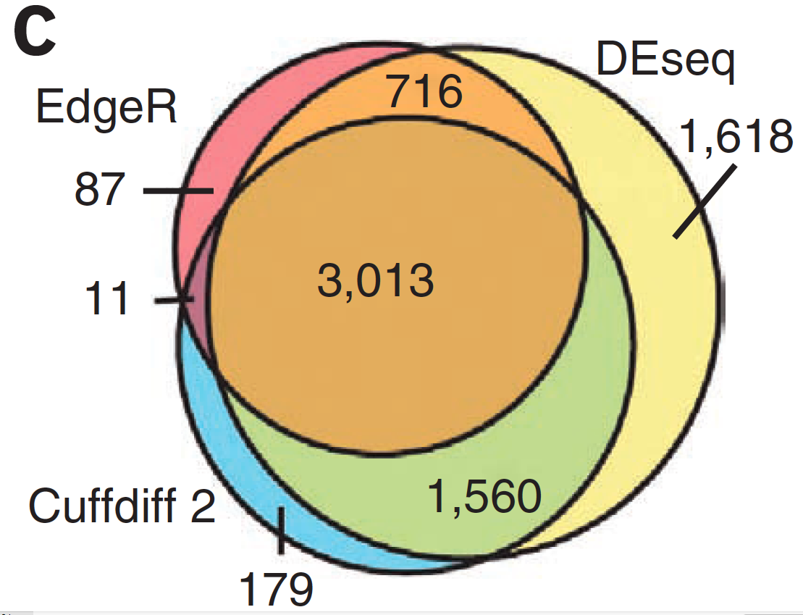
Multiple approaches advisable

Slide 16
Lessons learned from microarray days
Hansen et al. “Sequencing Technology Does Not Eliminate Biological Variability.” Nature Biotechnology 29, no. 7 (2011): 572–573.
Power analysis for RNA-seq experiments
http://euler.bc.edu/marthlab/scotty/scotty.php
RNA-seq need for biological replicates
http://www.biostars.org/p/1161/
RNA-seq study design
http://www.biostars.org/p/68885/

Slide 17
Multiple testing correction
As more attributes are compared, it becomes more likely that the treatment and control groups will appear to differ on at least one attribute by random chance alone.
Well known from array studies
10,000s genes/transcripts
100,000s exons
With RNA-seq, more of a problem than ever
All the complexity of the transcriptome
Almost infinite number of potential features
Genes, transcripts, exons, juntions, retained introns, microRNAs, lncRNAs, etc, etc
Bioconductor multtest
http://www.bioconductor.org/packages/release/bioc/html/multtest.html

Slide 18
Downstream interpretation of expression analysis
Topic for an entire course
Expression estimates and differential expression lists from cufflinks/cuffdiff (or alternative) can be fed into many analysis pipelines
See supplemental R tutorial for how to format cufflinks data and start manipulating in R
Clustering/Heatmaps
Provided by cummeRbund
For more customized analysis various R packages exist:
hclust, heatmap.2, plotrix, ggplot2, etc
Classification
For RNA-seq data we still rarely have sufficient sample size and clinical details but this is changing
Weka is a good learning tool
RandomForests R package (biostar tutorial being developed)
Pathway analysis
David
IPA
Cytoscape
Many R/BioConductor packages: http://www.bioconductor.org/help/search/index.html?q=pathway

Slide 19
Introduction to tutorial
(Module 3)

Slide 20
Bowtie/Tophat/Cufflinks/Cuffdiff RNA-seq Pipeline
Sequencing
Read alignment
Transcript compilation
Gene identification
Differential expression
RNA-seq reads (2 x 100 bp)
Bowtie/TopHat alignment (genome)
Cufflinks
Cufflinks (cuffmerge)
Cuffdiff
(A:B comparison)
Raw sequence data
(.fastq files)
Reference genome
(.fa file)
Gene annotation
(.gtf file)
CummRbund
Inputs
Visualization

Slide 21
Bowtie/Tophat/Cufflinks/Cuffdiff RNA-seq Pipeline
Sequencing
Read alignment
Transcript compilation
Gene identification
Differential expression
RNA-seq reads (2 x 100 bp)
Bowtie/TopHat alignment (genome)
Cufflinks
Cufflinks (cuffmerge)
Cuffdiff
(A:B comparison)
Raw sequence data
(.fastq files)
Reference genome
(.fa file)
Gene annotation
(.gtf file)
CummRbund
Inputs
Visualization
Module 3

Slide 22
Break

