Slide 1
Advanced Sequencing Technologies & Applications
http://meetings.cshl.edu/courses.html

Slide 2
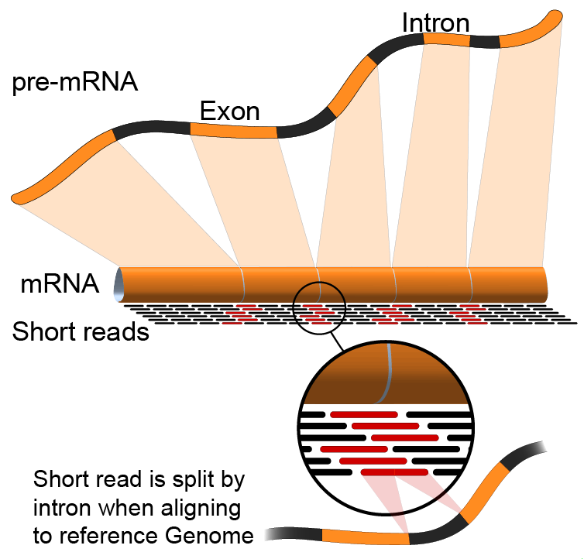

Module 4 Isoform discovery and alternative expression (lecture)
Malachi Griffith, Obi Griffith, Jason Walker, Ben Ainscough
Advanced Sequencing Technologies & Applications
November 11-23, 2014

Slide 3
Learning objectives of the course
Module 0: Introduction to cloud computing
Module 1: Introduction to RNA sequencing
Module 2: RNA-seq alignment and visualization
Module 3: Expression and Differential Expression
Module 4: Isoform discovery and alternative expression
Tutorials
Provide a working example of an RNA-seq analysis pipeline
Run in a ‘reasonable’ amount of time with modest computer resources
Self contained, self explanatory, portable

Slide 4
Learning Objectives of Module
Explore use of Cufflinks in reference annotation based transcript (RABT) assembly mode and ‘de novo’ assembly mode.
Both modes require a reference genome sequence...

Slide 5
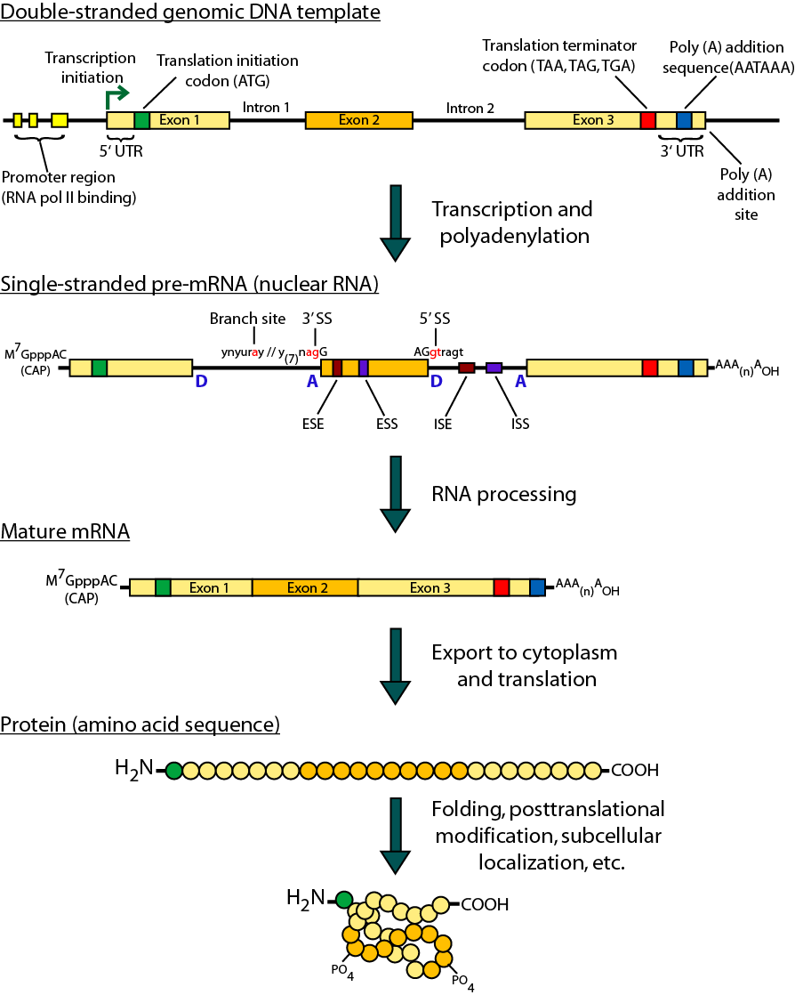
Review of gene expression

Slide 6
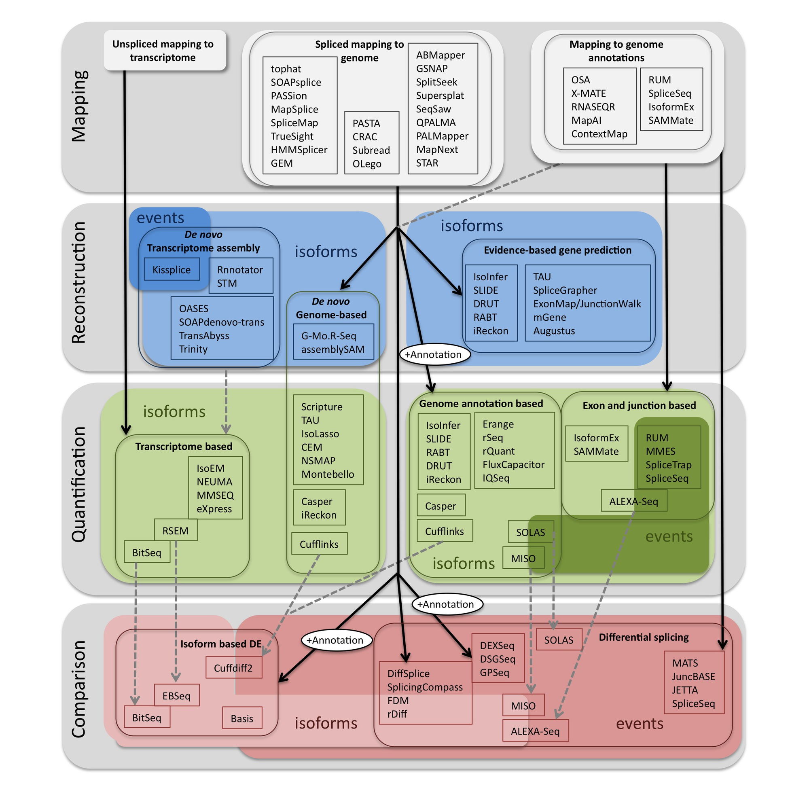
Methods to study splicing by RNA-seq
http://www.rna-seqblog.com/data-analysis/splicing-junction/methods-to-study-splicing-from-rna-seq/
http://arxiv.org/ftp/arxiv/papers/1304/1304.5952.pdf

Slide 7
Useful resources and discussion
Best approach to predict novel and alternative splicing events from RNA-seq data
http://www.biostars.org/p/68966/
http://www.biostars.org/p/62728/
Alternative splicing detection
http://www.biostars.org/p/65617/
http://www.biostars.org/p/11695/
Identifying genes that express different isoforms in cancer vs normal RNA-seq data
http://www.biostars.org/p/50365/
Cufflinks / Cuffdiff Output - How are tests different?
http://www.biostars.org/p/13525/
Visualisation of Alternative splicing events using RNA-seq data
http://www.biostars.org/p/8979/

Slide 8
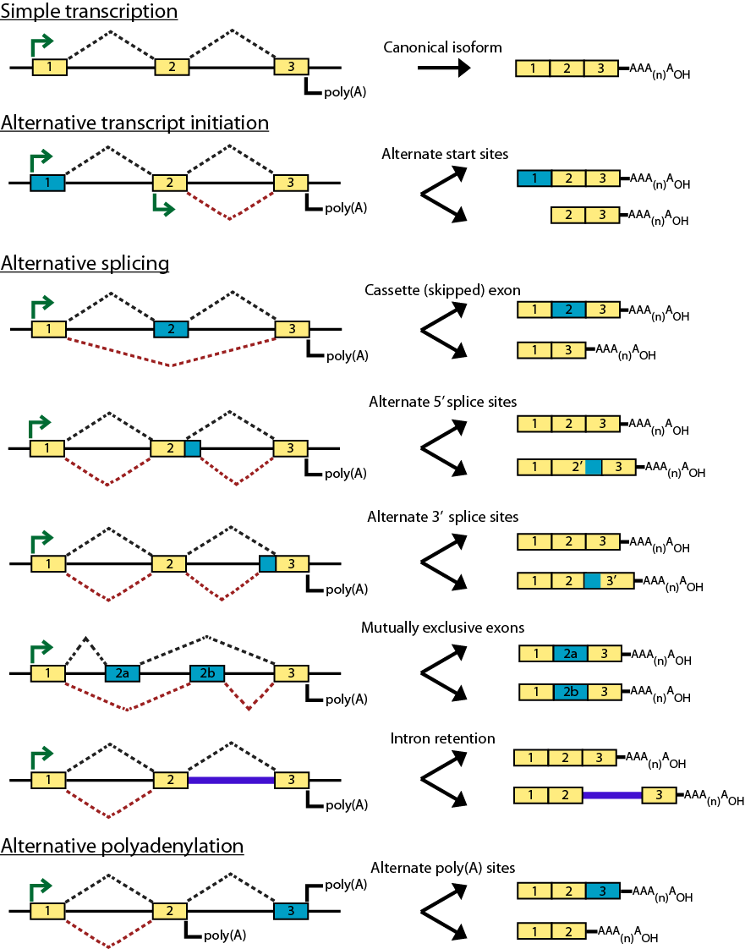
Types of alternative expression - part 1

Slide 9
Types of alternative expression – part 2

Slide 10
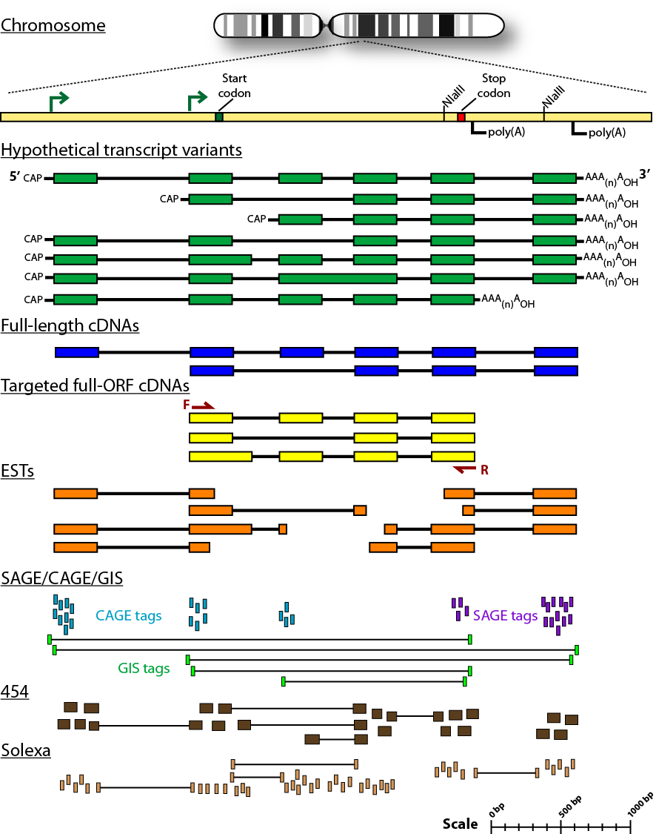
Sequencing methods for studying alternative isoforms

Slide 11
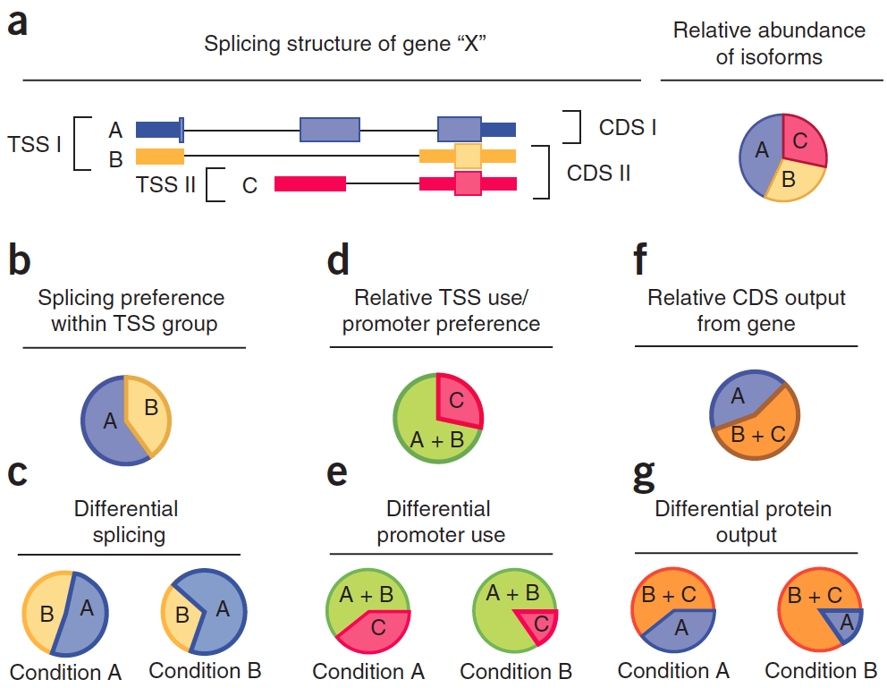
Cufflinks alternative splicing tests

Slide 12
Cufflinks alternative splicing tests
Relevant Cuffdiff output file
splicing.diff
promoters.diff
cds.diff

Slide 13
Introduction to tutorial
(Module 4)

Slide 14
Bowtie/Tophat/Cufflinks/Cuffdiff RNA-seq Pipeline
Sequencing
Read alignment
Transcript compilation
Gene identification
Differential expression
RNA-seq reads (2 x 100 bp)
Bowtie/TopHat alignment (genome)
Cufflinks
Cufflinks (cuffmerge)
Cuffdiff
(A:B comparison)
Raw sequence data
(.fastq files)
Reference genome
(.fa file)
Gene annotation
(.gtf file)
CummRbund
Inputs
Visualization

Slide 15
Bowtie/Tophat/Cufflinks/Cuffdiff RNA-seq Pipeline
Module 4 – Rerun Cufflinks in alternative ‘modes’
Sequencing
Read alignment
Transcript compilation
Gene identification
Alternative expression
RNA-seq reads (2 x 100 bp)
Bowtie/TopHat alignment (genome)
Cufflinks
Cufflinks (cuffmerge)
Cuffdiff
(A:B comparison)
Raw sequence data
(.fastq files)
Reference genome
(.fa file)
Gene annotation
(.gtf file)
CummRbund
Inputs

Slide 16
What if I don’t have a reference genome for my species?
Have you considered sequencing the genome of your species?
If that is not practical or you simply prefer a transcript discovery approach that does not rely on prior knowledge of the genome or transcriptome there are some tools available ...
Unfortunately de novo transcriptome assembly is beyond the scope of this workshop
The good news is that the skills you learn here will help you figure out how to install and run those tools yourself

Slide 17
Methods to study splicing by RNA-seq
http://www.rna-seqblog.com/data-analysis/splicing-junction/methods-to-study-splicing-from-rna-seq/
http://arxiv.org/ftp/arxiv/papers/1304/1304.5952.pdf

Slide 18
Break

