Slide 1
FINGERPRINT AND HANDPRINT RECOGNITION SYSTEM USING MATLAB GROUP 20
ANIRUDH KANNAN VP, MONICA GUDURU, LAISHA WADHWA, DHARANI AKURATHI.

Slide 2
PROBLEM DEFINITION
Finger Print Recognition and Handprint recognition system based on minutiae extraction.
Extraction is based on the orientation of the ridges and optimization is done by extracting correct minutiae points.
INPUT: 1. Scanned fingerprint images. 2. Scanned hand images.
OUTPUT: A grant message(with match percentage) or error message debarring entry to the place for which such biometric is used.

Slide 3
PROCESS
THREE STAGES: PREPROCESSING, MINUTIA EXTRACTION, POST PROCESSING
For the fingerprint image pre-processing stage, Histogram Equalization and Fourier Transform are used to do image enhancement.
Then the fingerprint image is binarized followed by image segmentation.
Binarization transforms the image from a 256-level image to a 2-level image that gives the same information.
In binarization, the image is divided into blocks (16x16), and the mean intensity value is calculated for each block, then each pixel is turned into 1 if its intensity value is larger than the mean intensity value of the current block to which the pixel belongs.
Then false minutia are removed which has two advantages: ridge type is used to distinguish minutia and second advantage is that the order of removal procedures reduce the computation complexity because it utilizes the relations among the false minutia types.
For hand print recognition minutia extraction is done only at corner ridges which are unique for everyone.

Slide 4
DATASET
Fingerprint Database consists of some images collected from online resources and a few images collected by us.
Handprint Database consists of some images collected by us.
For matching the fingerprints, it is matched with the pre processed files which contain the unique minutia marked points.
Images used are grayscaled.
For fingerprint database there are similar fingerprints of one person in different angles to test the system for accuracy.

Slide 5
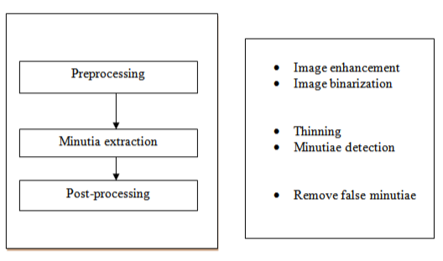
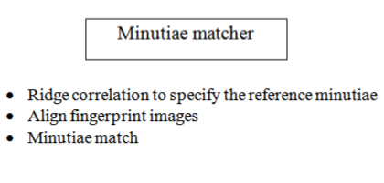
ALGORITHM LEVEL DESIGN
For the fingerprint identification, in the pre-processing stage, Histogram Equalization and Fourier Transform are used to do image enhancement.
Then the fingerprint image is binarized followed by image segmentation.
Image segmentation gives the extracted minutiae which are matched with the database images. Input for the system is set of images of fingerprints.
Input is followed by training of machine with the dataset.
After training the system is tested with a large dataset and the identification number is verified with match percentage.(<75% is not a match (The threshold value can be chosen depending on the level of accuracy needed)).
Fig 1.MINUTIA EXTRACTOR
Fig 2. MINUTIA MATCHER

Slide 6
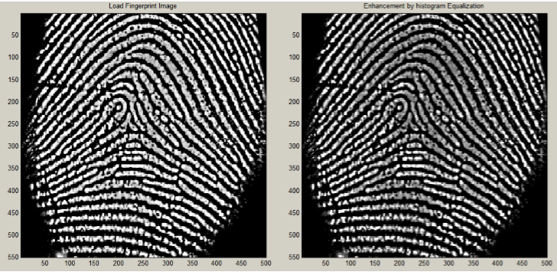
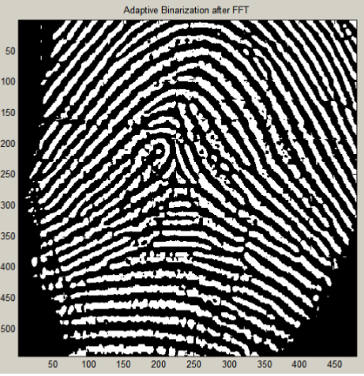
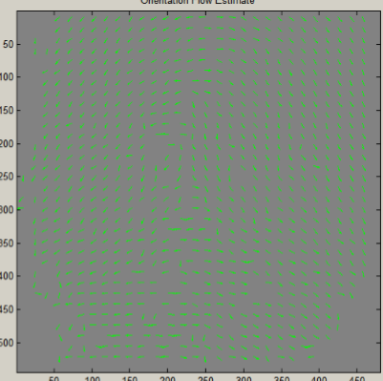
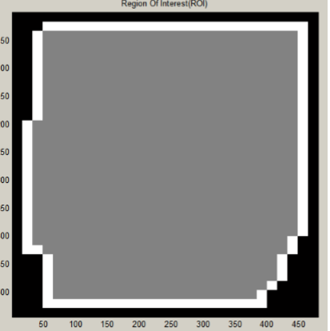
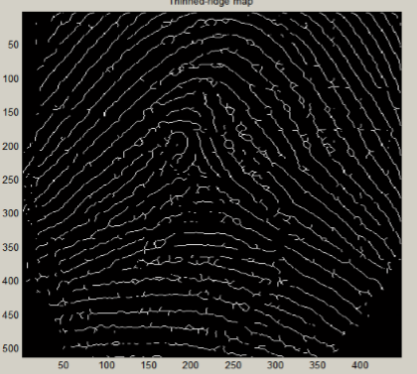
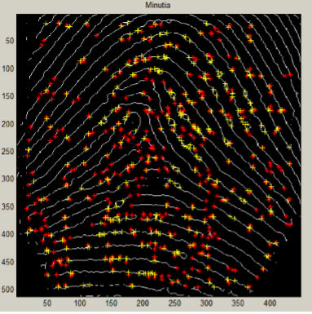
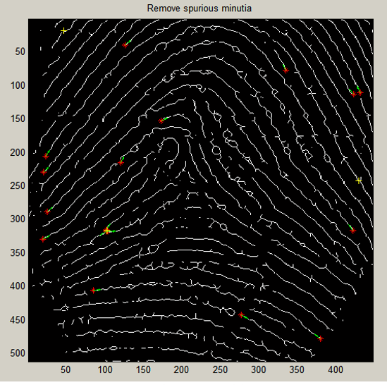
STAGES FOR FINGERPRINT RECOGNITION
1
2
3
4
LOADED IMAGE
HISTOGRAM EQUL.
AFTER FFT AND BINZ.
DIRECTION MAP
5
6
7
8
ROI
THINNING IMAGE MAP
MINUTIAE MARKS
REAL MINUTIAE

Slide 7
TESTING AND RESULT
SYSTEM INPUT : CHECK IF THE FINGERPRINT GIVEN DURING QUERY TIME MATCH WITH THOSE PRESENT IN DATABASE.
SYSTEM ALSO HAS THE FUNCTIONALITY OF FEATURE VISUALISATION TO SEE THE PROCESS OF EXTRACTION.
ACCURACY : FINGERPRINT (80%) HAND(78.95), CALCULATED USING THE SET THRESHOLD BY THE SYSTEM USER.

Slide 8
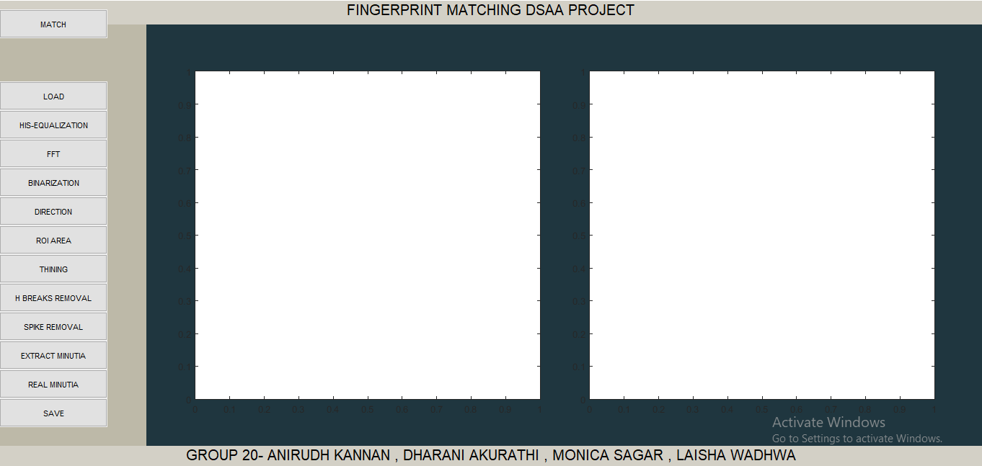
GRAPHICAL USER INTERFACE

Slide 9
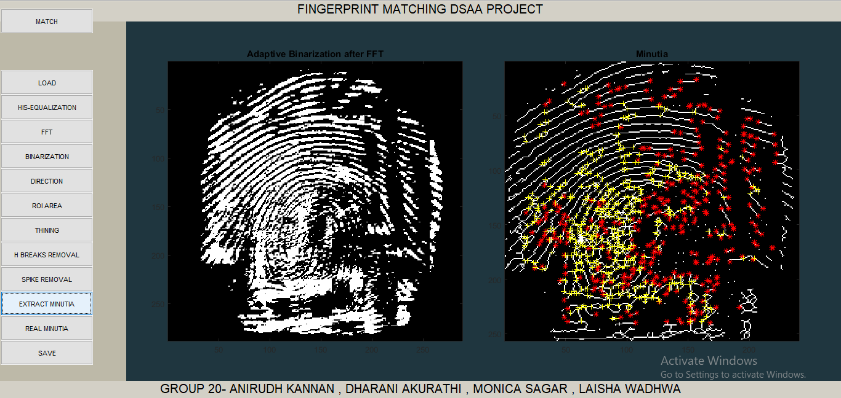
GRAPHICAL USER INTERFACE
MINUTIAE MARKING

