Slide 1


TriBranchNet: Multi-Region Adaptive Fusion for
Video-Based Respiratory Rate Estimation with
Semi-Supervised Training Support
Shuyi Zhou
Supervisor: Yue Sun
Notes:
Real-time Non-Contact Physiological Signal Monitoring and Emergency Resource Scheduling in Public Spaces

Slide 2

/ 01
Background

Slide 3
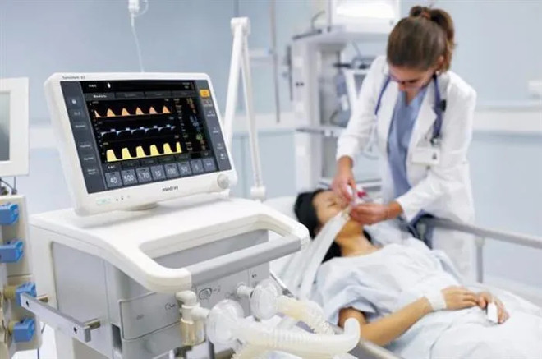
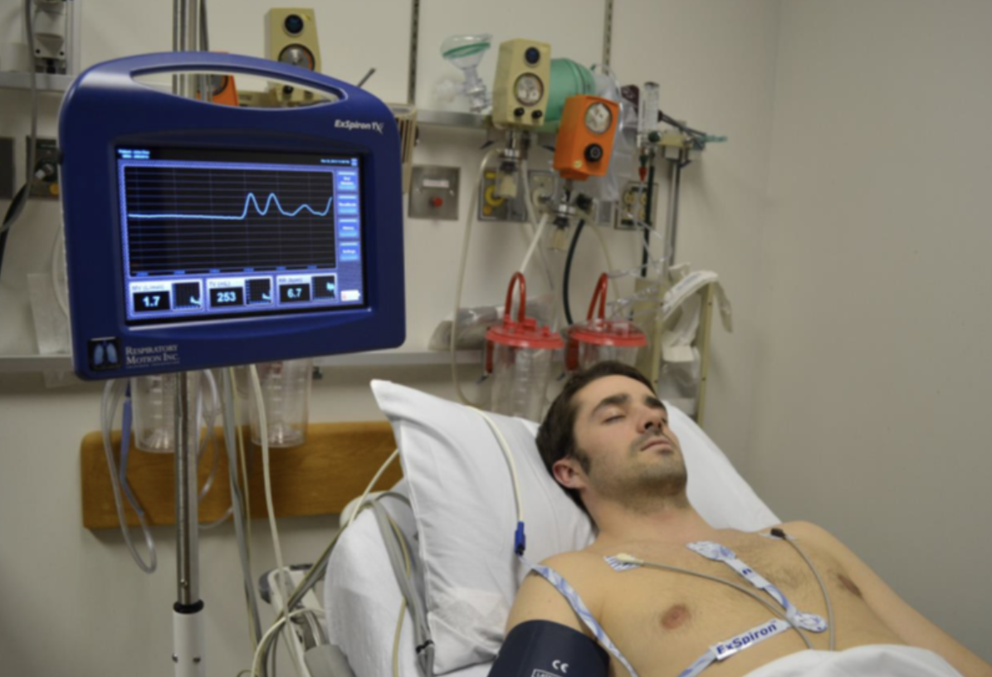
Background
Limitations of current monitoring technologies
Contact-based Devices: Skin irritation & discomfort.
Single-Region Visual Monitoring: Weak signals, easy to be disturbed.
Chest Optical Flow Methods: Clothing-dependent, easy to fail.
Core Motivation
Addressing the limitations of existing technologies, this study aims to:
• Fuse complementary physiological signals from the facial, neck, and chest regions.
• Achieve a more robust and accurate non-contact respiratory rate estimation.
Clinical Value of Respiratory Rate (RR)
• Respiratory rate (RR) is one of the four key vital signs. It helps warn early about serious illnesses such as sepsis and heart failure.
•Clinical Status Quo:RR measurement rate is significantly lower compared to heart rate and blood pressure. Traditional devices are difficult to apply to special groups like neonates and burn patients. There is a lack of datasets with real respiration labels..
Notes:
Today, the global market for remote health monitoring is rapidly growing, driven by advances in AI and an aging population. In the NICU environment, continuous monitoring of infant vital signs is essential, yet traditional contact-based methods such as electrodes and respiratory belts often lead to skin irritation, infection risks, and restrict natural movement.
Remote photoplethysmography, or rPPG, provides a promising alternative by extracting respiration from subtle skin color changes completely contact-free. This approach is non-invasive, low-cost, and suitable for real-time continuous monitoring. However, challenges remain, including low-light conditions, motion artifacts, and variations in skin tone, all of which can impact accuracy and stability.
当前，全球远程健康监测市场在人工智能发展和人口老龄化的推动下快速扩张。在新生儿重症监护室中，连续监测生命体征至关重要，但传统的接触式方法，如电极和呼吸带，容易引起皮肤损伤、感染风险，并限制婴儿的自然活动。
rPPG 技术通过捕捉皮肤微弱的颜色变化，实现完全无接触的呼吸信号提取。它具有非侵入、低成本、可实时连续监测等优势。然而，这一方法也面临低光环境、运动伪影以及肤色差异等挑战，会影响整体的准确性和稳定性。

Slide 4

Research Questions & Objective
02 Objective
01 Research Questions
Signal Complementarity & Advantage Integration
How to effectively fuse single-region signals and use the advantages of multi-source physiological signals.
01 / TriBranchNet Framework
A three-branch end-to-end deep learning architecture that unifies facial, neck rPPG, and chest optical flow information.
02 / Lightweight Cross-Attention
An adaptive signal weighting module with less than 50,000 parameters, enabling precise dynamic fusion with low computational power.
Dynamic Fusion & Adaptive Mechanism
How to design a dynamic mechanism that can perform weighted fusion of data from different sources based on signal quality.
03 / Frequency Domain Contrastive Learning
Applied to respiratory rate estimation for the first time, supporting semi-supervised training and saving up to 50% of manual annotation costs.
04 / Cross-Domain Generalization
Fully validated on 5 public datasets, demonstrating excellent cross-domain performance in both adult and infant populations.
Data Efficiency & Semi-Supervised Enhancement
When lack of labeled data , how to use semi-supervised learning to improve the model’s generalization ability.
Notes:
Our research addresses three main questions: how to integrate signals, how to dynamically fuse them, and how to use data efficiently. Our core contributions are the TriBranchNet framework, a lightweight cross-attention mechanism for adaptive fusion, the application of frequency domain contrastive learning for semi-supervised training, and extensive validation across multiple datasets showing strong generalization.

Slide 5
/ 02
Related Work

Slide 6
Literature review
2024 Contrast-Phys+ (Sun & Li)
Proved Neck ROI's value in spatial-temporal consistency for rPPG.
2025 Semi-rPPG (Wu et al.)
Semi-supervised rPPG with pseudo-labels.
2024 CliffPhys (Ghezzi et al.)
Clifford networks for chest motion sensing.
2024 BigSmall (Narayanswamy et al.)
Pioneered multi-region (Face+Neck) spatial branches for physiological tasks.
2023 AIRFlowNet (Manne et al.)
Chest optical flow for direct respiration.
2023 EfficientPhys (Liu et al.)
Lightweight real-time edge rPPG model.
2023 TS-CAN (Liu et al.)
Temporal attention for motion-robust rPPG.
2021 DeepPhys (Chen & McDuff)
Facial rPPG deep learning baseline.
2022 PhysFormer (Yu et al.)
Transformer for robust rPPG modeling.
Lack of adaptive multi-region fusion for face, neck, and chest signals in video-based respiratory rate estimation.

Slide 7
Complementary Analysis of Multi-Region Signals
Facial rPPG
Neck rPPG
Chest Optical Flow
▍ Signal Mechanism: Skin microcirculation modulation.
▍ Advantages: Covers a larger area and is less likely to be blocked.
▍ Disadvantages: Weak signal strength, easily affected by head movement.
▍ Signal Mechanism: Analyzes direct mechanical motion via pixel displacement.
▍ Advantages: Regular waveform contour with no baseline drift.
▍ Disadvantages: Dependent on clothing texture and easily blocked.
▍ Signal Mechanism: Responds strongly to large neck vessel pulsations.
▍ Advantages: High SNR and significant signal strength.
▍ Disadvantages: Easily affected by movement (like neck turning) and causes signal distortion.
Key Conclusion:A single physiological signal source cannot simultaneously guarantee "frequency accuracy", "morphological regularity", and "anti-interference ability". Therefore, to achieve high-precision monitoring, an adaptive weighted fusion algorithm of multi-region signals must be adopted.
Notes:
To justify our multi-region approach, we analyzed the complementarity of signals from the face, neck, and chest. Facial rPPG is less occluded but weak. Neck rPPG is strong but sensitive to motion. Chest optical flow provides a regular waveform but depends on clothing. Each has its own strengths and weaknesses. Our key conclusion is that no single region is sufficient, and a fusion approach is necessary for robust monitoring.

Slide 8
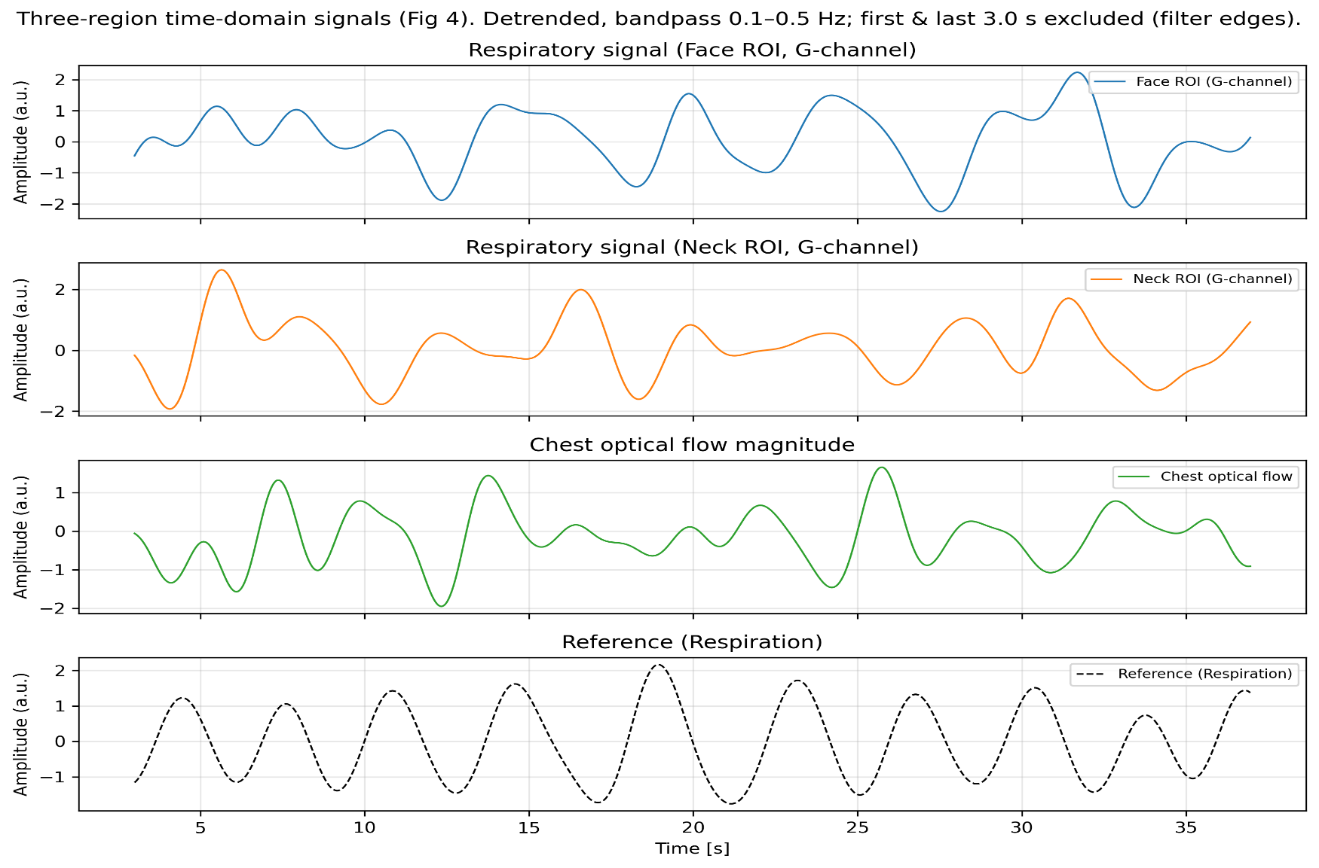
Analysis of Signal Complementarity in Three Regions: Comparison of Time Domain Waveforms
The neck signal has the clearest regular pattern. The face signal has more noise. The chest signal has a smaller range of movement.These differences demonstrate the complementarity of multi-region signals, supporting our multi-source fusion approach.
Notes:
为了更直观地展示三个区域信号的互补性，我们来看一下它们的时域波形和功率谱密度对比。从左侧的时域图可以看出，不同区域的信号波形存在差异。而右侧的频谱图则更清晰地显示了各个区域信号在频率域的特性，这为我们进
To clearly show the complementarity of signals from the three regions.行多区域融合提供了重要的数据支持。

Slide 9
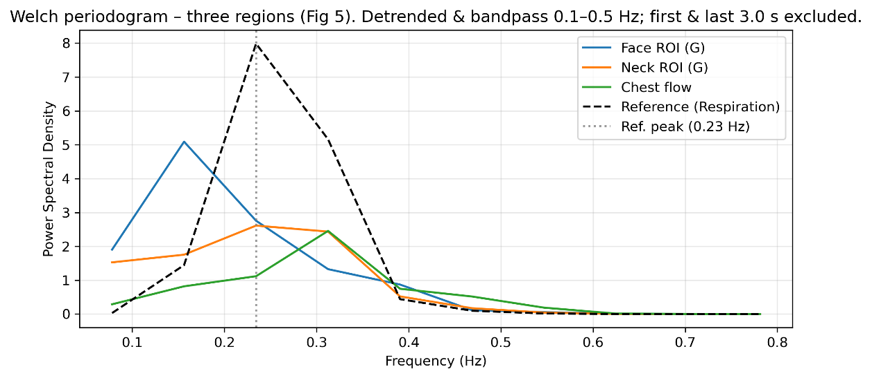
Three-region signal complementarity analysis: Comparison of PSD
This power spectral density figure shows the energy distribution of signals from different regions at various frequencies.
Near the respiratory frequency, the neck signal has the highest energy peak, while facial and chest signals have different features. This further proves the complementarity of different regional signals from a quantitative perspective, and it is also the key basis for our multi-region fusion method.
Notes:
接下来，我们将信号转换到频域进行分析。这张功率谱密度图显示了各个区域信号在不同频率上的能量分布。我们可以清晰地看到，在呼吸频率附近，颈部信号的能量峰值最高，而面部和胸部的能量分布则各有特点。这从量化的角度再次证明了不同区域信号的互补性，也正是我们提出多区域融合方法的核心依据。

Slide 10
/ 03
Methods

Slide 11
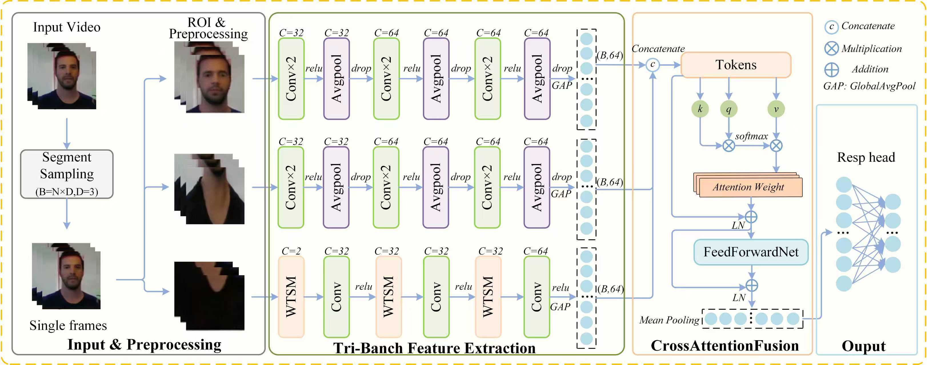
TriBranchNet Overview
01
Input & Preprocessing
02
Tri-Branch Feature Extraction
03
Cross-Attention Fusion & Output
Input video is segmented and sampled. ROIs (Face, Neck, Chest) are extracted, followed by color normalization and optical flow calculation.
Features are concatenated and tokenized. A Cross-Attention module dynamically learns attention weights, then fused features feed the Resp head for the final respiratory waveform.
Face/Neck branches use independent CNN stacks to extract appearance features. The Chest branch uses a WTSM CNN stack to extract temporal motion features from optical flow.
Notes:
This is the overall architecture of our proposed TriBranchNet. The workflow consists of three main stages. First, in the input and preprocessing stage, we extract the face, neck, and chest regions from the video. Second, in the feature extraction stage, three separate branches process these regions to extract complementary features. Finally, in the fusion stage, a cross-attention module adaptively combines these features to output the final respiratory waveform.

Slide 12
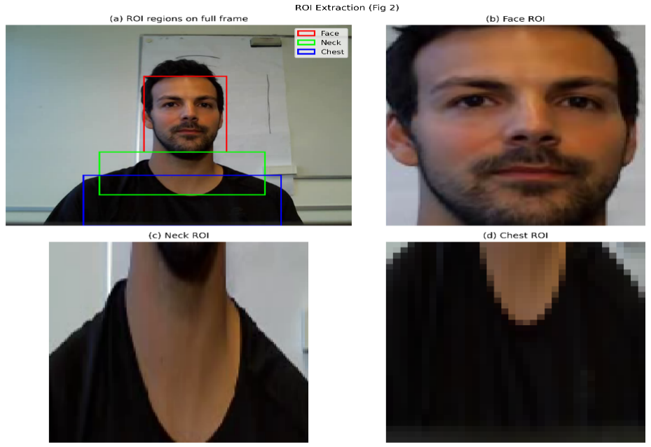
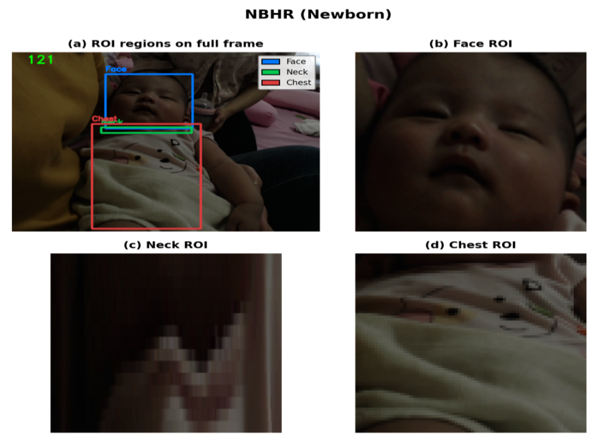
Key Module 1: Multi-Region ROI Extraction
01 Facial Region (Face)
▍ Region Definition : Main facial skin tone area, avoiding overlap with the neck.
▍ Preprocessing : Color normalization to eliminate illumination interference.
02 Neck Region (Neck)
▍ Region Definition : Exposed skin area from the chin to the shoulders.
▍ Preprocessing : Matches the face data to keep consistency.
03 Chest Region (Chest)
▍ Region Definition : The area above the clavicle with the maximum motion amplitude.
▍ Preprocessing : Extract Farneback dense optical flow.
Notes:
The first key module is the multi-region ROI extraction. We define the face, neck, and chest regions as shown. Each region undergoes specific preprocessing steps: color normalization for the face and neck to handle lighting variations, and dense optical flow extraction for the chest to capture subtle motion.

Slide 13

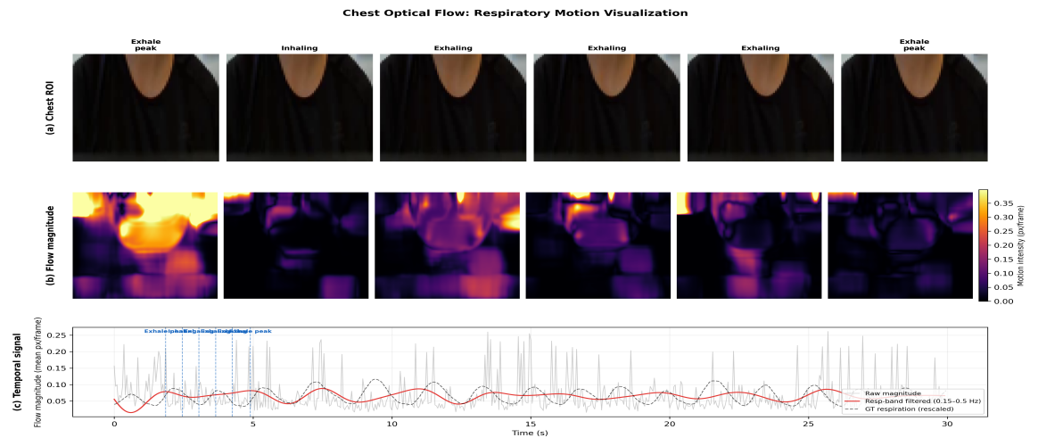

Key Module 2: Three-Branch Feature Encoding
Face / Neck Branches
Network: Stacked Convolutional Neural Networks (CNN).
Strategy: Independent parameter design for face/neck.
Chest Branch
Input: Dense optical flow field (captures subtle motion).
Modeling: Introduces the WTSM module for efficient correlation.
The chest respiration process:
(Original Frame) → (Dense Optical Flow Map) → (Flow Magnitude Time Series) → (Respiratory Waveform)
Core Significance:By capturing the subtle chest movements caused by respiration, the optical flow method provides crucial temporal dynamic information for respiratory rate estimation.
Output Alignment & Fusion
Alignment: Uniformly outputs 64-dimensional feature vectors.
Fusion: Normalized features support downstream aggregation.
Notes:
The second module is the three-branch feature encoding. The face and neck branches use CNNs to extract appearance-based features. The chest branch uses a WTSM module to encode temporal motion information from the optical flow field. The visualization on the left demonstrates how chest motion is converted into a respiratory waveform. All branches send out matched feature data to make the later fusion easier.

Slide 14
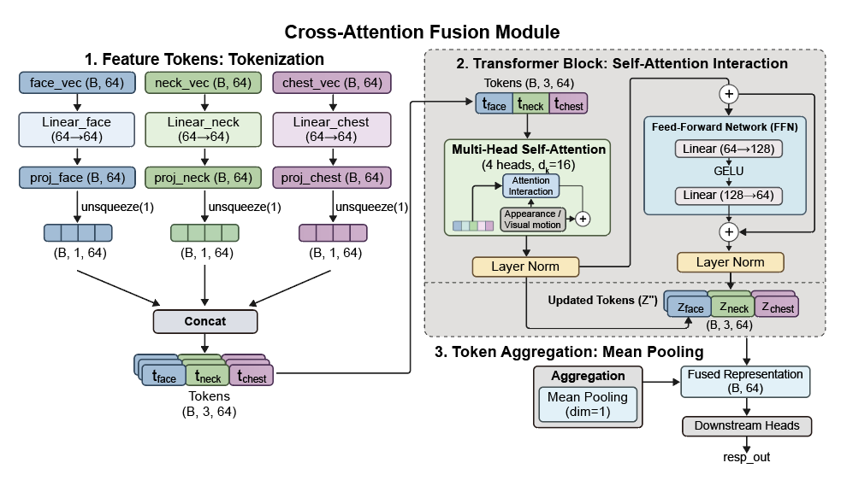
Key Module 3: Cross-Attention Fusion
▍ Core Process
1. Tokenization: Maps features to a unified dimension and converts them into regional Tokens.
2. Self-Attention Interaction: Feeds Tokens into a Transformer Block, enabling dynamic interaction and weighting of information between regions through a multi-head self-attention mechanism.
3. Token Aggregation: Aggregates regional information using global average pooling.
▍ Core Advantages
• Dynamic Feature Interaction: Adaptive interaction and weighting of regional information.
• Adaptive Anti-Interference: Suppresses adverse signals such as perturbations/illumination.
• Lightweight Design:< 50,000 parameters, suitable for edge deployment.
• End-to-End Optimization: Better performance with collaborative training.
Notes:
The third key module is the cross-attention fusion. This module takes the features from the three branches, converts them into tokens, and uses a Transformer block to model the dynamic interactions between them. This allows the model to automatically learn which region's signal is most reliable at any given moment. The advantages are dynamic feature interaction, adaptive anti-interference, a lightweight design with minimal parameters, and end-to-end optimization.

Slide 15
Loss Function and Semi-Supervised Training
Total Loss Function
L_total = λ_mse * L_MSE + λ_pear * L_NegPearson + λ_ctr * L_Contrast
L_MSE:Measures squared difference between prediction and ground truth.
L_NegPearson:Maximizes morphological correlation.
L_Contrast:Learns discriminative spectral features (semi-supervised).
Supervised Warm-up
Train using only MSE and Negative Pearson loss, leveraging high-quality labeled data to help the model converge quickly to a stable state.
Semi-supervised Training
Introduce frequency-domain contrastive loss, treating the same video segment as a positive sample pair to effectively exploit unlabeled data for better generalization.
Structure-Agnostic, Zero Inference Overhead
The strategy only takes effect during the training phase, with no additional computational burden during deployment.
Ultimate Data Efficiency
Retains over 90% of the original performance with only 50% of the labeled training data.
Notes:
For training, we designed a composite loss function that combines supervised losses (MSE and Pearson correlation) with a semi-supervised contrastive loss. We first perform a supervised warm-up to initialize the model, then introduce the contrastive loss to use unlabeled data efficiently. This semi-supervised strategy is structure-agnostic, meaning it adds no inference overhead, and achieves high data efficiency, retaining over 90% performance with just half of the labeled data.

Slide 16
/ 04
Datasets

Slide 17
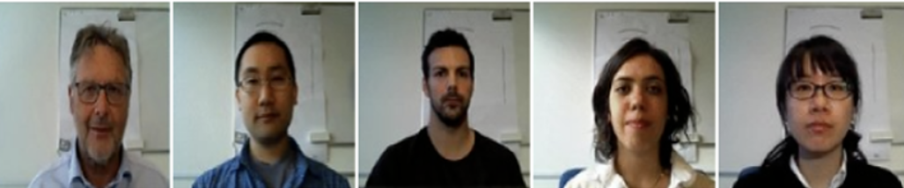

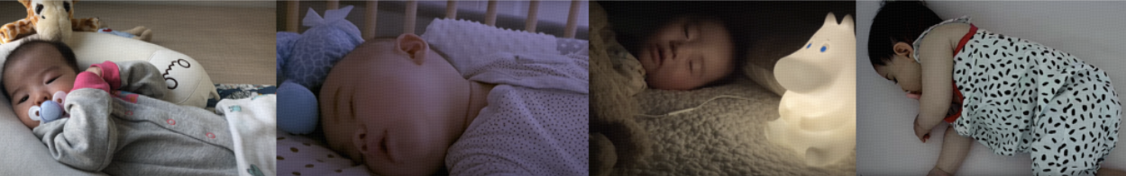
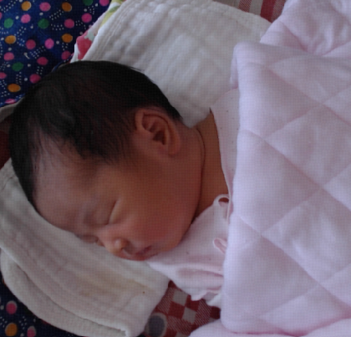
Dataset
COHFACE(40 subjects)
PURE(10 subjects) &UBFC-rPPG(42 subjects)
Population: Adults
Annotation Type: Chest Strap Respiratory Ground Truth
Useage: Primary Benchmark, Supervised Training
Population: Adults
Annotation Type: BVP proxy respiration
Usage: Cross-domain validation, semi-supervised training
AIR(5 subjects)
NBHR(25 subjects)
Population: Infants
Annotation Type: Respiratory Belt Ground Truth
Use: Pediatric Cross-Domain Validation
Population: Newborns
Annotation Type: PPG Proxy
Purpose: Newborn Generalization Validation
Notes:
为了全面验证我们的模型，我们使用了五个公开数据集。其中，COHFACE是我们的主要基准数据集。PURE和UBFC-rPPG用于成人跨域和半监督实验。而AIR和NBHR数据集则用于验证模型在婴儿和新生儿上的泛化能力。
To fully test our model, we use five public datasets.
Among them, COHFACE is our main benchmark dataset.
PURE and UBFC-rPPG are used for adult cross-domain and semi-supervised experiments.
AIR and NBHR are adopted to test the model’s generalization ability on infants and newborns.

Slide 18
/ 05
Results

Slide 19
Experimental Result 1: Main Benchmark COHFACE
State-of-the-art performance on COHFACE: MAE = 1.10 RPM, Pearson = 0.82, outperforming traditional rPPG and face-only deep learning baselines.
Multi-region advantage: Integrates complementary signals from the face, neck, and chest, improving both accuracy and robustness over single-source methods.
Core validation: Results confirm that multi-modal, multi-region fusion yields more reliable respiratory representations.
Method | Year | Signal Source | Supervision | MAE↓ (RPM) | RMSE↓ (RPM) | MAPE↓ (%) | Pearson↑
Traditional signal-processing methods (face rPPG)
CHROM [14] | 2013 | Face rPPG | Traditional | 4.5 | 6.2 | 22 | 0.45
POS [15] | 2017 | Face rPPG | Traditional | 4.8 | 6.8 | 24 | 0.45
Deep-learning face-only rPPG methods
DeepPhys | 2018 | Face rPPG | Supervised | 4.42 | 5.81 | 8.97 | 0.39
TS-CAN [42] | 2021 | Face rPPG | Supervised | 3.12 | 3.72 | 7.73 | 0.48
EfficientPhys | 2022 | Face rPPG | Supervised | 3.83 | 4.89 | 7.82 | 0.67
Camera-based chest motion methods
Guo et al.† | 2021 | Chest | Supervised | 1.04 | 2.45 | — | 0.82
AIRFlowNet† | 2023 | Chest | Supervised | 1.01 | 2.20 | — | 0.76
Multi-task
BigSmall† | 2024 | Face rPPG | Supervised | 2.12 | 3.23 | 6.55 | 0.79
Proposed method
TriBranchNet (Ours) | 2024 | Face+Neck rPPG + Chest OF | Supervised | 1.10 | 1.68 | 6.06 | 0.82
Key indicator highlights: MAE (minimum):1.10
Pearson (maximum):0.82
Notes:
On the COHFACE dataset, our model achieved an error (MAE) of only 1.10. This is better than many state-of-the-art methods. Our charts show that the predicted waveforms closely match the ground truth.

Slide 20
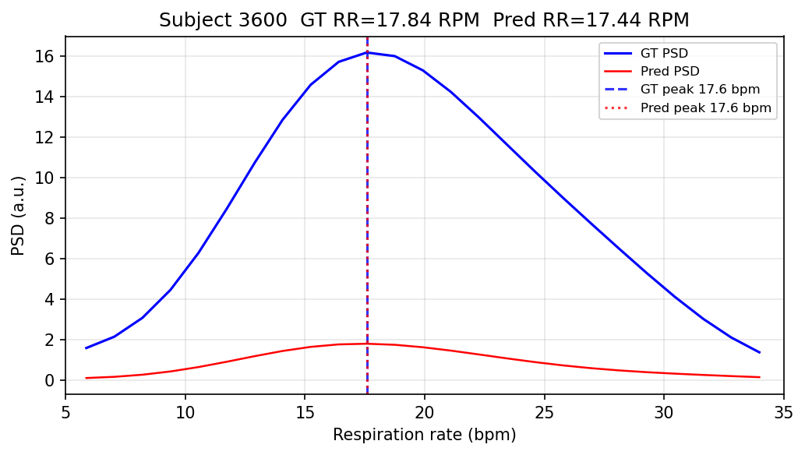
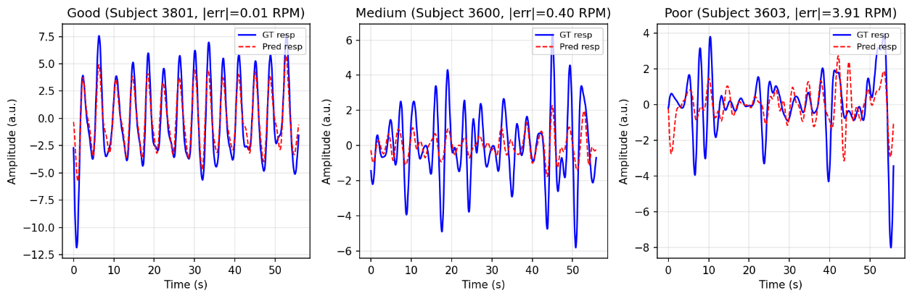
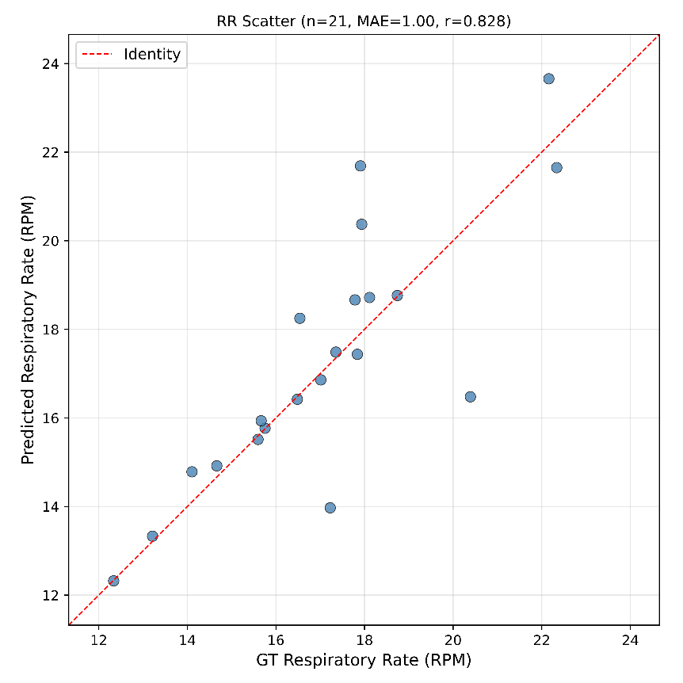
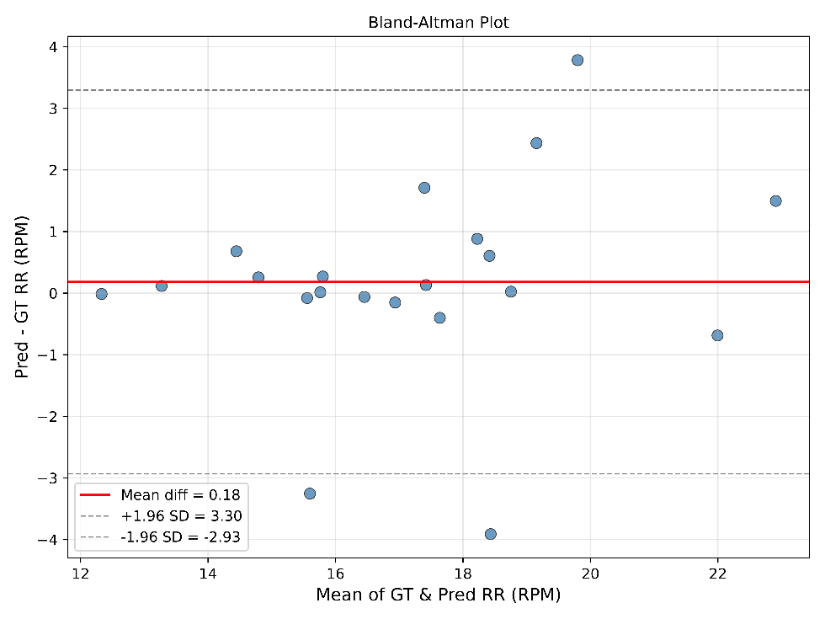
Experimental Result Visualization Analysis
Predicted vs. ground-truth respiratory waveforms for three representative COHFACE subjects
PSD comparison for Subject 3600
Waveform & PSD: Representative cases show that even with moderate waveform distortion, the respiratory rate peak remains accurately identified.
Scatter plot: Strong correlation between predictions and ground truth (r = 0.828), with samples tightly clustered around the identity line.
Bland–Altman plot: No systematic bias (mean diff = 0.18 RPM), with most samples within the ±1.96 limits of agreement.
TriBranchNet provides accurate and stable respiratory rate estimation across conditions.
Bland–Altman agreement plot
Scatter plot of predicted versus reference respiratory

Slide 21
Experimental Result 2: Ablation & Semi-Supervised Experiment
Configuration | MAE↓ (RPM) | RMSE↓ (RPM) | MAPE↓ (%) | Pearson↑
Exp. A: Face only | 3.09 | 4.08 | 20.01 | 0.111
Exp. B: Face + Neck | 2.82 | 3.77 | 17.11 | 0.302
Exp. C: Face + Chest | 1.81 | 2.85 | 9.86 | 0.543
Exp. D: Face+Neck+Chest, Concat fusion | 1.90 | 3.07 | 10.44 | 0.445
Exp. E: Face+Neck+Chest, Cross-Att. (Ours) | 1.10 | 1.68 | 6.06 | 0.825
Setting | Labeled COHFACE fraction | External unlabeled data | MAE ↓ (RPM) | RMSE ↓ (RPM) | MAPE ↓ (%) | Pearson ↑
Full supervision (baseline) | 100% | None | 1.10 | 1.68 | 6.06 | 0.825
Full supervision + CL | 100% | None | 1.09 | 1.67 | 6.02 | 0.829
Partial labels + CL | 50% | None | 1.61 | 2.28 | 9.12 | 0.721
Partial labels + CL | 30% | None | 1.98 | 2.71 | 11.38 | 0.648
Full labels + CL + external unlabeled | 100% | PURE + UBFC-rPPG | 2.51 | 3.50 | 14.37 | 0.717
Ablation Experiment
•Necessity of multi-region information: Using only the facial model results in the worst performance (MAE: 3.09), as signals from a single region are easily disturbed.
•Core contribution of the chest region: After including the chest, MAE drops to 1.81, demonstrating it as a more reliable signal source.
•Key to adaptive fusion: The Cross-Attention model (MAE: 1.10) performs best, with dynamic weighting enabling complementary information.
Semi-Supervised Experiment
• Fully supervised baseline: MAE=1.10, Pearson=0.825
• Contrastive learning (CL): slight improvement (MAE=1.09, Pearson=0.829)
• 50%/30% labelled CL: performance stable, no collapse
• Unlabelled out-of-domain data CL: performance declined due to domain shift
Semi-supervised contrastive learning can slightly boost model performance and maintain stable results even with only limited labeled data,
Notes:
为了验证模型各部分的有效性，我们进行了消融实验。结果非常清晰地表明：首先，融合三个分支的效果最好，证明了利用更多身体区域的价值。其次，我们设计的交叉注意力融合模块是性能提升的关键，它的效果远超简单的特征拼接，充分证明了该模块在提取有效特征上的优越性。

Slide 22
Experimental Result 3: Mixed Dataset Experiment
Training setting | AIR MAE ↓ | NBHR MAE ↓ | AIR Pearson ↑ | NBHR Pearson ↑
COHFACE + PURE + UBFC-rPPG | 4.92 | 5.31 | 0.338 | 0.307
All five datasets | 3.56 | 3.86 | 0.648 | 0.611
All five datasets + contrastive semi-supervision | 3.34 | 3.62 | 0.682 | 0.642
Training setting | COHFACE MAE ↓ | PURE MAE ↓ | UBFC‑rPPG MAE ↓ | COHFACEPearson ↑
COHFACE only | 1.10 | 3.08 | 3.26 | 0.825
COHFACE + PURE + UBFC-rPPG | 2.62 | 2.94 | 2.86 | 0.671
All five datasets | 3.13 | 3.51 | 3.45 | 0.588
All five datasets + contrastive semi-supervision | 2.57 | 2.76 | 2.92 | 0.652
1. Domain difference challenge: Different data sets do not match well. Training them together makes the model worse, and the error becomes larger. This shows there are clear differences between different data domains especially in whether rr labels are available or not.
2. Semi-supervised learning improvement: After we add contrastive semi-supervised learning, the model works better overall. The error on adult data sets drops a lot, for example COHFACE falls from 3.13 to 2.57.The error on baby data sets also gets better, for example AIR drops from 3.56 to 3.34.
3. Enhanced generalization: Semi-supervised learning makes good use of unlabeled data. It helps the model learn better features and work more stably. Thus the model can fit new different data sets better.

Slide 23
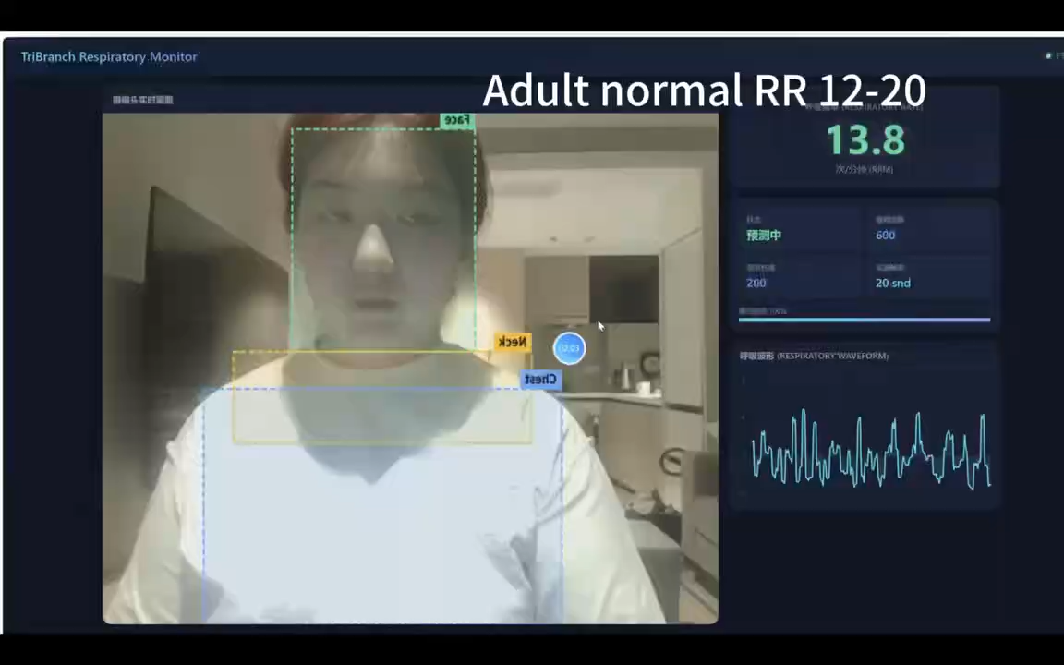
Demo Video

Slide 24
/ 06
Discussion

Slide 25



Summary & Outlook
Discussion
Conclusion
Future Work
Multi-Region Fusion: Boosts robustness and accuracy.
Adaptive Fusion: Dynamically adjusts signal weights for high performance.
Semi-Supervised Learning: Enhances generalization using unlabeled data.
Multi-Region Fusion:A unified framework for face, neck, and chest signals.
Adaptive Cross-Attention:Achieves superior dynamic weighted fusion.
Semi-Supervised Learning:Applies contrastive learning for efficient data use.
Moving forward, our focus is on enhancing TriBranchNet's practical impact. First, boost real-time performance for edge deployment and improve robustness against motion/defocus. Second, intensify neonatal applications via real-scenario validations to refine accuracy for this population.
Notes:
In summary, our discussion highlights that multi-region fusion, adaptive fusion via cross-attention, and semi-supervised learning are key to our success. We conclude that our TriBranchNet architecture, adaptive cross-attention mechanism, and semi-supervised strategy represent significant contributions to the field. For future work, we plan to optimize model efficiency, improve robustness in complex scenarios, explore self-supervised learning, incorporate multi-modal data, and conduct more extensive real-world validations.

Slide 26
That’s all for my presentation.
Your comments and guidance are appreciated.
Thank you!
Notes:
That's all for my presentation. Thank you for your attention. I would appreciate any comments or guidance you may have.

