Slide 1








I know nothing except the fact of my ignorance.

Slide 2


I know nothing except the fact of my ignorance.

Slide 3
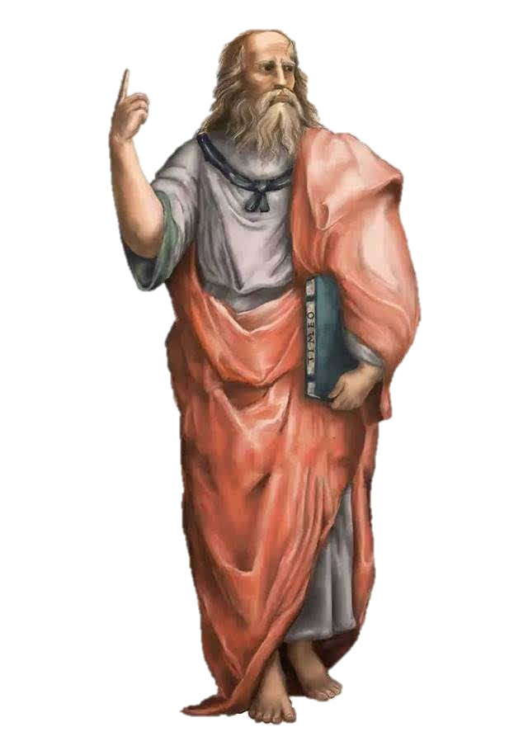

Slide 4
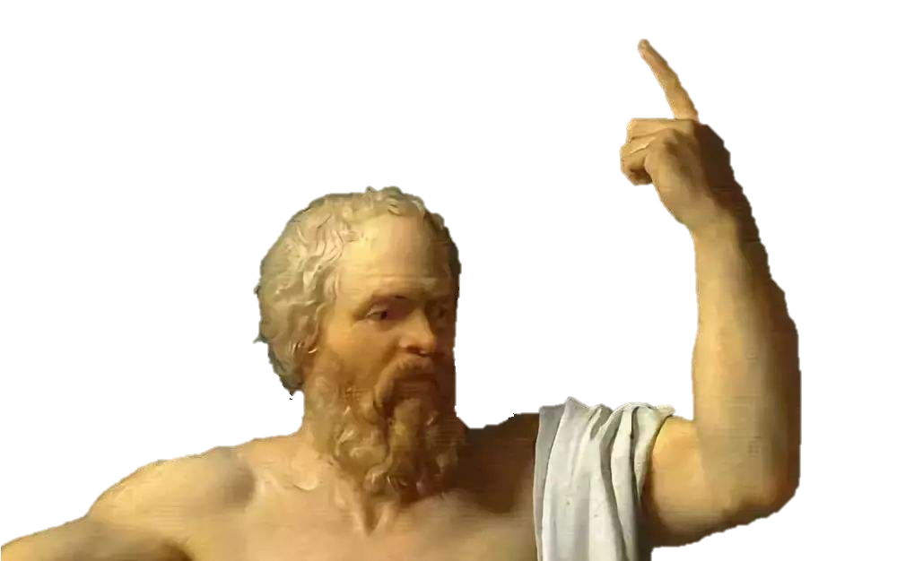
Know
thyself

Slide 5
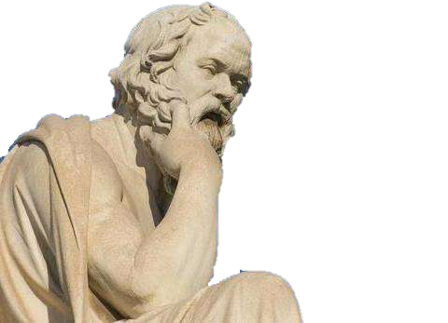
I know nothing except the fact of my ignorance.

Slide 6
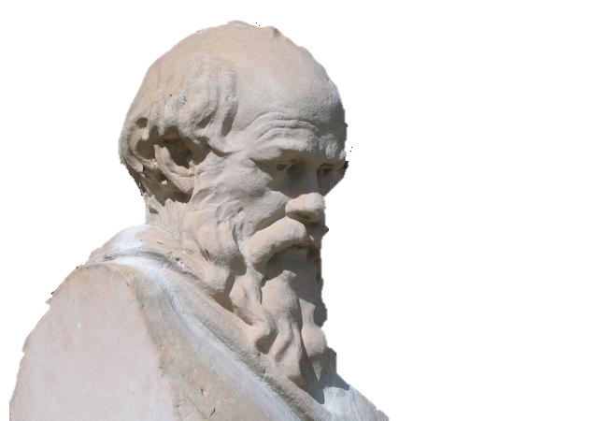
Education is the kindling of a flame, not the filling of a vessel.

