Slide 1
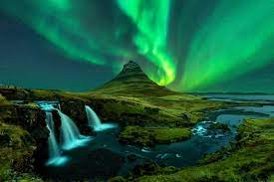
Iceland
Regional geography Project (2)

Slide 2
Prior knowledge about Iceland
Contrary to its name Iceland is actually home to less ice than Greenland
In Europe
In Europe
Northern lights
Mostly powered by geothermal power

Slide 3
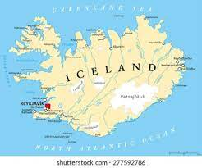
How Iceland was formed
The north American and Eurasian plates spread causing the magma to go through the gap created by the plates pulling apart

Slide 4
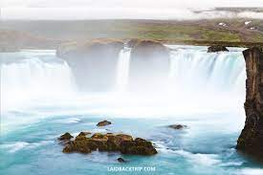
Down to earth with Zack Effron
100% of the energy in Iceland is made from renewable means
Iceland is split in two continents
There are four geothermal plants in Iceland
Co2 can be made into “fools gold”
Godafoss has 1,340,000 visitors in 2016

Slide 5
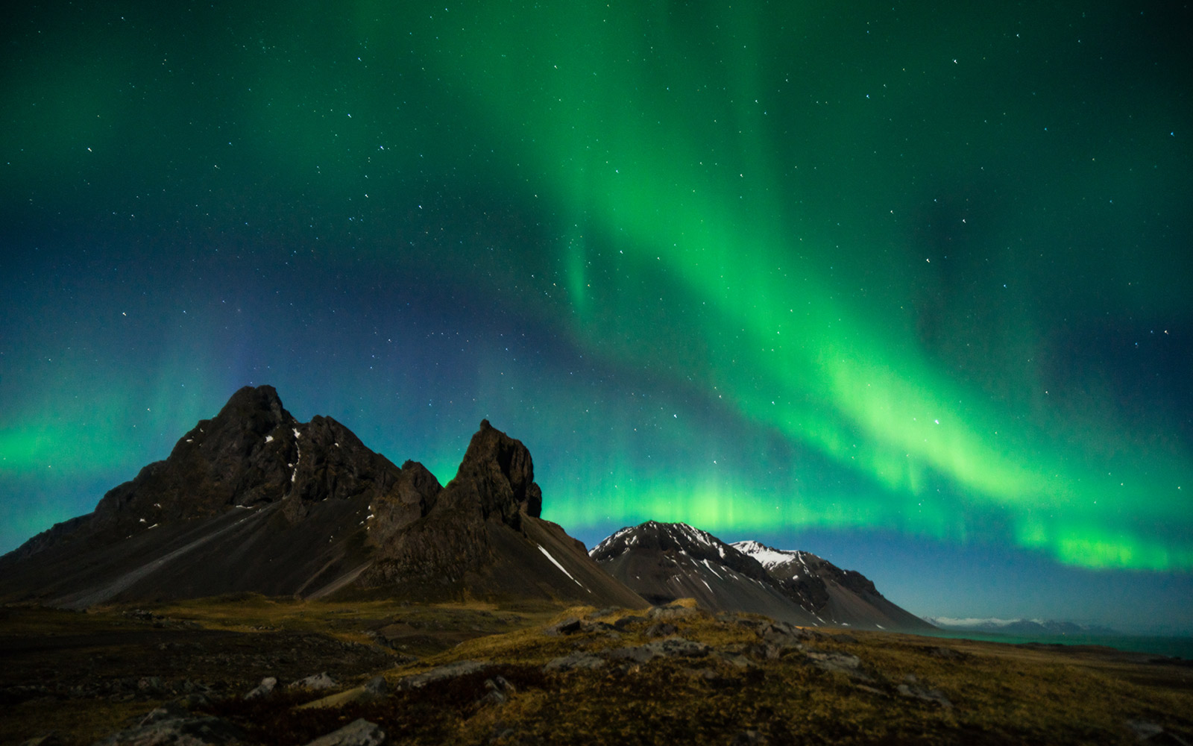
Iceland vacation travel guide
Bathe in the Blue Lagoon
Spot the northern lights
Go Whale Watching
Eat typical Icelandic cuisine
Bake Hot Spring Rye Bread in the earth
Drive the Golden Circle

Slide 6
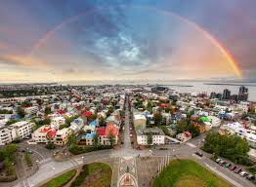
Population
As of 2020, the Icelandic population stands at a little over 364,000. 23.7%, a little over 86,000 are of foreign background. 99% of the nation's inhabitants live in urban areas (localities with populations greater than 200) and 60% live in the Capital Region.

Slide 7
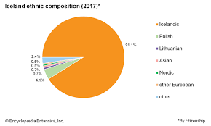
languages
Icelandic is the official language of Iceland. It is an Indo-European language, belonging to the sub-group of North Germanic languages. It is closely related to Norwegian and Faroese
English is taught as a second language in Iceland

