Slide 1

Agenda
Capability-Based Planning (CBP) for NFS Portfolio
Business Outcomes
Value
Road Mapping Incremental Change
DEMO
***Results are Preliminary***
USDA Forest Service – NFS RIM & CIO SPIMA
Notes:
History of USFS justifying efforts to broad strategic goals without clearly articulating the business value

Slide 2
What is a business capability?
A business capability
“A capability is a particular ability or capacity that a business may possess or exchange to achieve a specific purpose or outcome”
It’s WHAT we do to fulfill the mission of USDA/USFS
USDA Forest Service – NFS RIM & CIO SPIMA

Slide 3
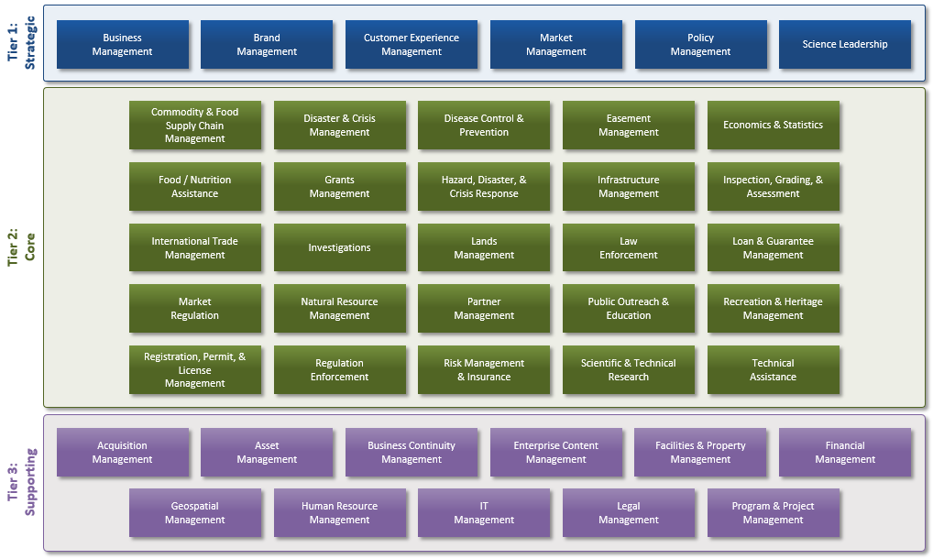
USDA Forest Service – NFS RIM & CIO SPIMA

Slide 4
Why plan around business capabilities?
CBP is a technique for planning investments in capabilities that contribute to realizing the Agency’s strategy
Bridge the gap b/w business strategy and project portfolio management
Focus on business outcomes and value (compliments traditional PPM)
CBP helps answer…
Are we doing the right things?
Are we doing them the right way?
Are we getting them done?
Are we getting the benefits?
Helps satisfy TBM requirements!
USDA Forest Service – NFS RIM & CIO SPIMA
Notes:
Focus on sequencing the delivery of business improvements in terms of value, as opposed to scheduling projects and the delivery of solutions (CBP compliments PPM).

Slide 5

CBP is like a game of chess Trying to make the most strategic incremental moves based on what is known of the current situation
Pivot from traditional approach to EA roadmaps!
Move forward from current state instead of “back-casting” from ideal future state.
Notes:
Chess players evaluate moves as to what they improve in the overall CURRENT situation. It’s impossible for us to know the intricate details of the entire landscape. SCENERIOS CHANGE! i.e. reorgs, technology, administration changes, etc.

Slide 6
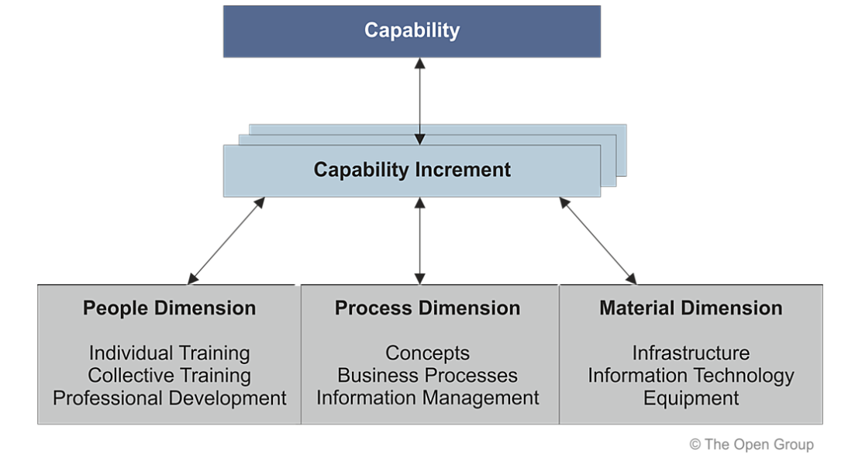
USFS Business Strategy
Manages and Creates
Consists of
Portfolio Backlog Items
To successfully plan around capabilities, they must be managed with respect to increments & dimensions
Notes:
Any change in strategic plans might yield a change in capabilities. Increments represent a change in maturity. Dimensions is an aspect of the capability that has to be analyzed, assessed, and actioned in order for the capability to be realized (Open Group 2017).

Slide 7

Aligning to Business Outcomes
USDA Forest Service – NFS RIM & CIO SPIMA

Slide 8
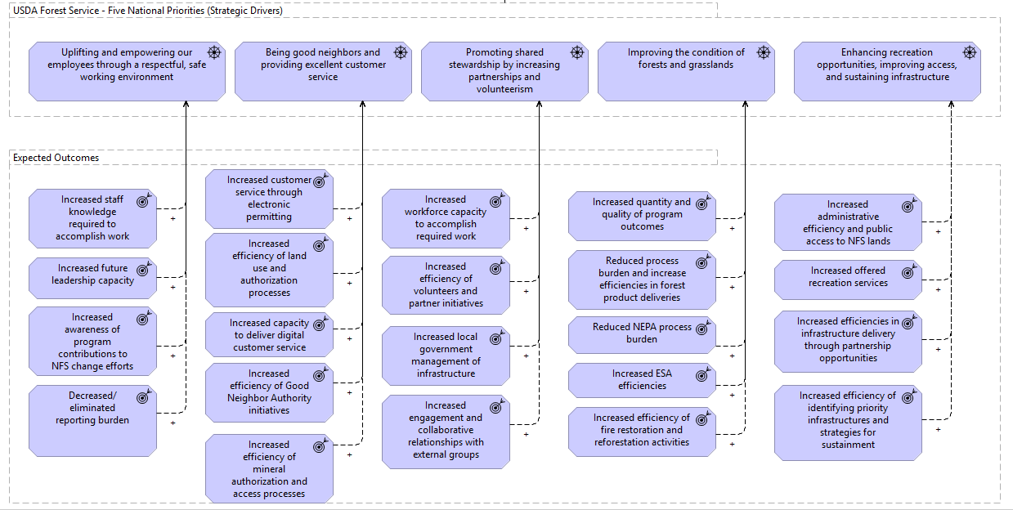
Are we doing the right things?

Slide 9
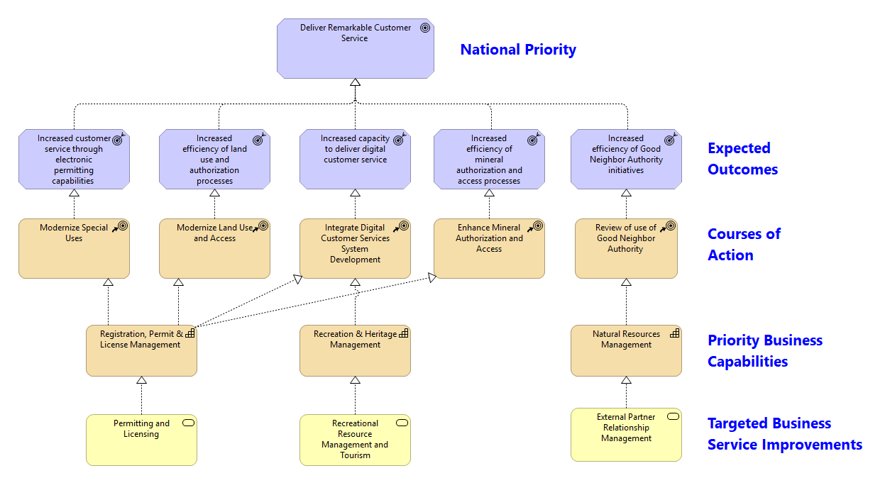
Are we doing them the right way?
Notes:
Strategic Input for CBP. Business Service = An explicitly defined exposed business behavior. A business service is associated with value.

Slide 10
Business Management
Brand Management
Customer Experience Management
Market Management
Policy Management
Science Leadership
Strategic
Commodity & Food Supply Chain Management
Disaster & Crisis Management
Disease Control & Prevention
Easement Management
Economics & Statistics
Food/Nutrition Assistance
Grants Management
Hazard, Disaster, & Crisis Response
Infrastructure Management
Inspection, Grading & Assessment
Core
International Trade Management
Investigations
Lands Management
Law Enforcement
Loan & Guarantee Management
Market Regulation
Natural Resource Management
Partner Management
Public Outreach & Education
Recreation & Heritage Management
Registration, Permit & License Management
Regulation Enforcement
Risk Management & Insurance
Scientific & Technical Research
Technical Assistance
Acquisition Management
Asset Management
Business Continuity Management
Enterprise Content Management
Facilities & Property Management
Financial Management
Supporting
Geospatial Management
Human Resource Management
IT Management
Legal Management
Program & Project Management
Notes:
These are capabilities that deliver the business strategy. Capabilities of Strategic Relevance based on 2018 Benefits to Segments mapping. Explain that these are L1 USDA capabilities. We own the L2-4.

Slide 11
Business Management
Brand Management
Customer Experience Management
Market Management
Policy Management
Science Leadership
Strategic
Commodity & Food Supply Chain Management
Disaster & Crisis Management
Disease Control & Prevention
Easement Management
Economics & Statistics
Food/Nutrition Assistance
Grants Management
Hazard, Disaster, & Crisis Response
Infrastructure Management
Inspection, Grading & Assessment
Core
International Trade Management
Investigations
Lands Management
Law Enforcement
Loan & Guarantee Management
Market Regulation
Natural Resource Management
Partner Management
Public Outreach & Education
Recreation & Heritage Management
Registration, Permit & License Management
Regulation Enforcement
Risk Management & Insurance
Scientific & Technical Research
Technical Assistance
Acquisition Management
Asset Management
Business Continuity Management
Enterprise Content Management
Facilities & Property Management
Financial Management
Supporting
Geospatial Management
Human Resource Management
IT Management
Legal Management
Program & Project Management
Notes:
Red = Capability targeted w/in current business strategy but not w/in IR Segments; Yellow, Capability targeted in current IR Portfolio, but not Business Strategy; Green = Capability targeted within strategy and portfolio. Green does not designate a close relationship. The current portfolio address different business services and outcomes than the business strategy. Only 25% of the NFS segments in the IR portfolio is directly aligned to current business strategy.

Slide 12


Value Delivery and Business Capability Planning Connecting Prioritized Outcomes, Business Capabilities, Services and Products
GOAL
Deliver Remarkable Customer Service
Value
Recipient
USDA Customers
(Public, Private Industry, Partners)
Value Items
Recreation Opportunities
Influences
Serves
Forest Products
Business Capability
Registration, Permit & License Management
Realizes
Business Process
Conduct Natural Resource Use Management
Realizes
Business Service
Permits & Licensing
Delivers
Forage
Operationalizes
Minerals
App
Rec.gov
App
Open Forest
App
NRM
App
Local Solutions
Technology Component
Data Component

Slide 13

Roadmaps for Incremental Change
USDA Forest Service – NFS RIM & CIO SPIMA
Notes:
Focus on sequencing the delivery of business improvements in terms of value, as opposed to scheduling projects and the delivery of solutions (CBP compliments PPM).

Slide 14




Registration, Permit & License Management
DRAFT
National Priorities (Goals)
Deliver Remarkable Customer Service
Business Outcomes (Value)
Increase customer service through electronic permitting
Increase efficiency of land use and authorization processes
Increase capacity to deliver customer service
Increase efficiency of mineral authorization and access processes
Customers
Public
Private Industry
USDA Partners
IMPLEMENTATION ROADMAP (Capability Increments)
Responsible Orgs
Deliverables
2019
2020
2021
National Forest System
Scale-up Open Forest app to include new Forests
Open Forest leveraged by additional field units
National Forest system
Open Forest to integrate new permitting capabilities
Open Forest can process many permit types for selected field units
National Forest system
Modernize Special Uses Data System (SUDS)
New SUDS app, Special Uses processes improved
National Forest system
Develop streamlined approach for handling expired permits
Standard processes, templates for decision making
National Forest system
Develop streamlined approach for mineral leasing analysis
Standard processes
Performance Measures
Number of Permits Issued via Open Forest vs current channels
Permit Administration Time Saved
Application Performance Metrics
Customer Feedback
IR Segment Dependencies
Enterprise ePermit
Natural Resource Manager
Status of Initiative
Risk Level
In Progress
Low
Committed
Medium
Forecast
High
Notes:
Planning around business capabilities. Direct bridge to agile development (epics & product roadmaps)

Slide 15
In Summary
CBP moves us in the direction of managing a portfolio of capabilities and value streams rather than IT projects from the bottom up.
Critical for agile development!
Agile and CBP bring significant benefits via a mixture of organizational agility and solid strategic decision making.
Use cases for CBP (i.e. new approach to EA)
Prioritization based on real business value
Documentation of non-functional requirements (standards, scalability, strategy, etc.)
Creation of portfolio epics and value streams that guide product management
On demand architecture for agile teams
USDA Forest Service – NFS RIM & CIO SPIMA
Notes:
Agile teams are concerned with functional requirements of single solutions. What about the nonfunctional requirements? Performance, scalability, use of standards, regulatory compliance, and most importantly strategic direction. Who’s taking care of that?

