Slide 1
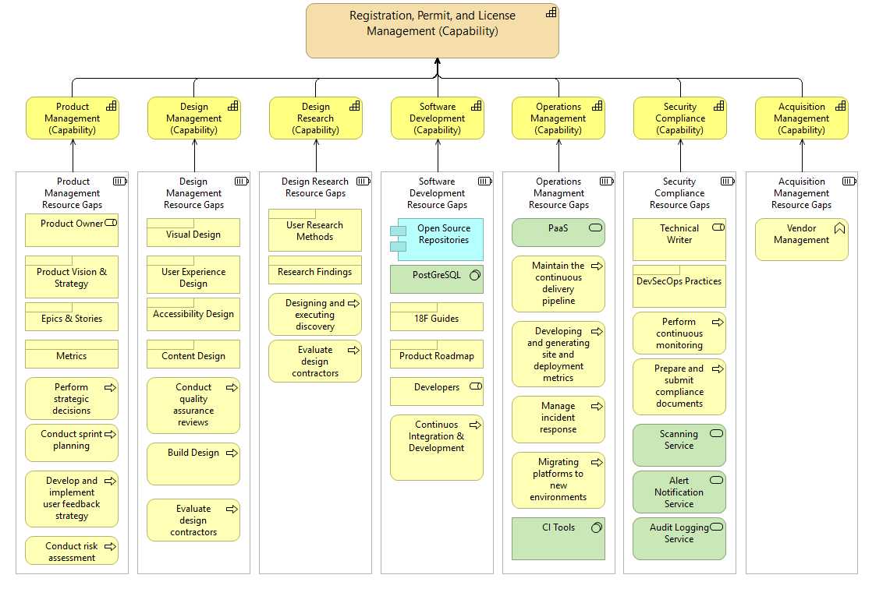




Product
Owner
Design Lead
Content Manager
Design Lead
Dev Team
Tech Leads
System Integrator
Lean-Agile Leader
Tech Leads
Technical Writer
Security Architect
Contracting Officer
Collaboration Tools
User research methods
DevSecOps Practices, Scanning Services, Audit Logging Services, Alert Notification Services
*Perform vendor management
*Pre- and Post-award management
*Develop and maintain acquisition strategy
Task Boards
Open Source Repository
Continuous Integration Tools
PaaS
*Manage product backlog
*Conduct sprint planning
*Develop & implement user feedback strategy
*Conduct risk assessment
*Conduct quality assurance reviews
*Build & validate design
*Evaluate design contractors
*Develop & implement user feedback strategy
*Designing and executing discovery
*Evaluate design contractors
*Continuous integration & development
*Conduct software testing
*Maintain the continuous delivery pipeline
*Developing and generating site and deployment metrics
*Manage incidents
*Migrate platforms
*Perform continuous monitoring
*Prepare and submit compliance documents
Research findings
Functioning Software, Functional & Tested Code, Capability Increments
Visual artifacts, user experience, accessibility, and content design
Vision, strategy, roadmap, epics, stories, and metrics
Release on demand
Reports, patches

